Slide 1
C.S.H. AND D.E.
Describe evaluation as an intervention rather than an observation.
Describe boundary setting as an ethical act.
Redefine performance and criterion when systems thinking is seen as a way of knowing.
Describe systems thinking as a mental model.
Tom Schwandt – at the Helps and Hinders Session
AEA 2014

Slide 2
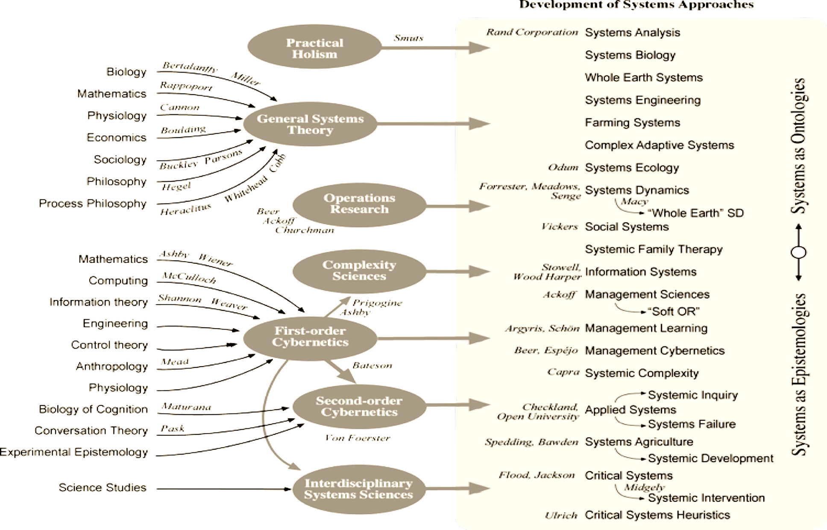
THE SYSTEMS FIELD?
Ison, R. (2010). Systems Practice: How to Act in a Climate Change World
Notes:
So I was a bit relieved when I came across this diagram. It was developed by Ray Ison – a leading figure in the systems field. There’s still a heck of a lot of information there, but you may recognise some systems methods or concepts that are familiar to you, especially in the third column from the right.
I also want you to look at the column on the far right. Ray ordered these methods along a continuum. At the top there are methods that help to identify and describe what we observe when we look at a situation. That’s ontology. At the bottom there are methods that focus on how we make sense of a situation …. you and I may ‘see’ the same thing, but we make sense of it in totally different ways depending on our beliefs, experience, status and motivations. Thus the top methods tend to be best when seeking to describe a situation and the bottom methods tend to be best when seeking to manage a response to a situations … finding ways to corral and prioritise all the different beliefs, experience, status and motivations we each bring to that response.
For many years the systems field argued about the relative merits of these two ends of the continuum. These days both are acknowledged as being a useful way of blending methodologies and methods to address different aspects of the problem.
[BES: this is excellent, and very important… and also how you speak about it, and explain it, as it’s a complex picture in its own right – took me a long time to understand when I first encountered it in the course, and still discover new things in it! – Don’t change anything, and esp the ‘ontology’ vs ‘epistemology’ bit is important to stress! (but who am I telling!]

Slide 3
CHURCHMAN & ETHICAL DECISION MAKING
“I suspect, and many agree, that the guiding ethical principle for a lot of human management is justice. Plato made justice central in his main management book, the Republic . So did Bentham in the Introduction to the Principles of Morals and Legislation , designed to help managers of the criminal justice system. So did Kant in the Foundations of the Metaphysics of Morals , which describes the interactive management of a human kingdom of ends. .....
Can we make "objective" ethical judgments?.... The designs [to establish ‘objectivity’] to date have not worked very well, even in the so-called exact sciences. .....
So the question whether ethical judgments are objective is still vague, but it is a managerial question. The question is important because ethical judgments are important. Hitler judged that one subspecies of humans was ethically superior to others, and inferred that the ethically inferiors should be killed off. Can we prove him wrong? Who is the "we" that is supposed to design the proof?”.

Slide 4
Critical Systems Heuristics
BOUNDARY CHOICES
WHAT’S IN/OUT
WHAT’S IS/ISN’T VALUED
PURPOSE
How do we know ?
V
A
L
U
E
S
CONTROL
How can we be held to account for resources ?
EXPERTISE
How can we avoid dogma/groupthink ?
LEGITIMACY
How can we claim the right to do what we do?

