Slide 1
Karen.Widmer@cgu.edu 123 E. 8th Street 707-815-2286 Claremont, CA 91711
Evaluation 2011: Values and Valuing Multisession 329
Valuing Knowledge Flow
in the Evaluation Process
Karen Widmer, M.S.
Claremont Graduate University
November 3, 2011
Notes:
Welcome.
Good morning
Thank you Joseph
I am K…3rd year…CGU…eval program ….[surprise]
Intro.
Topic: [read]
Tell you briefly about my interest in this topic
I came back to school because…keenly aware
…how little knowledge I possessed
[figure]…By pushing the frontiers [hand outward]…
….pushes my own [hand to sternum]!
c. Cool subject

Slide 2
Widmer’s Ode to Knowledge
The flow of knowledge is the chief necessary condition for evaluation capacity/building
It mediates or moderates all evaluative activities
and learning
It determines how well an organization can self- assess and how well it can use what it finds when it looks.
Notes:
Transition.
Allow me to start this presentation with three verses to my song.
Read (from screen)
Transition.
Today’s presentation is about the flow of knowledge. That is my term for what goes on with the data and information our collective heads send and receive.
I suggest that – as a platform - this flow…
Builds evaluative thought… which
Improves organizational performance, however broadly defined
Next few slides.
In the next slides, I will take knowledge parameters drawn from multiple disciplines and apply them to the evaluation process.

Slide 3
LEARNING ORGANIZATIONS Valuing Knowledge Flow in the Evaluation Process
Knowledge platform
Mediates
Moderates
Evaluative capacity
Organizational performance
My model suggests: By building the platform on which it stands, evaluation capacity grows and delivers a return on performance. A learning organization does this well.
Notes:
My model characterizes this flow.
Note the three key concepts: Evaluation Knowledge Performance
Notice also the Flow .
Depicted by arrows – but…
Pretend there’s an Activate button
Push it – carousel moves
My model suggests [read from screen]:
By building the platform on which it stands, evaluation capacity grows and delivers a return on performance.
A learning organization does this well.
Operationalize the boxes .
Evaluative capacity.
a. My model uses this simplified version of the “evaluation capacity definition”
Pro-offered in the 2002 New Directions on ECB… o Evaluative capacity is Evaluative thinking routinely applied to work activities
Knowledge platform.
a. The knowledge platform itself (sometimes referred to as a knowledge management system…)
a. Consists of tangible and intangible properties o Intangible being the dynamics… like leadership behavior, organizational values, incentives, rituals
o Tangible – the physical products such as a database – and all that surrounds using it
[Make clear] Platform is shared – things that go home with the individual don’t count
c. And remember –t he carousel is in motion
3. Organizational performance.
a. The organization performance concept is equally broad
o Like many kinds of use….there are many kinds of performance
Instrumental, process, conceptual, and symbolic
Whole-organization performance is underscored, especially when strategically relevant
Proposition.
Blue flags….note my proposition:
“Poorly managed knowledge flow moderates– even partially mediates – the quality of routine evaluation”
The title [And finally….]:
A Learning Organization.
All elements in model, done right, contribute to organization learning

Slide 4
Notes:
Now for a more interesting version of the model
The purpose of a Wordle is….
To convey a concept
Concept construction.
Purpose of model? [big green word]
Build
What are we building?
The evaluative capacity to make routine our evaluative thinking [ET], and thus
build an LO [learning organization].
What words accomplish this construction?
To move evaluative thinking beyond wishful thinking…
Requires attaching it….through knowledge platform…to performance
The complete loop locks evaluation capacity into real time
Rest is details.
Major influences behind successful knowledge flow? Items like culture and leadership
[Smallest words] How influences are measured - actions like grooming and rewards
SKIP
Wordle premise.
Every time, in the course of everyday work practices, that an organization…
Uses ET and LO behaviors
To engage in building evaluation capacity
Through which knowledge continually flows [for better or worse]
One can expect better org performance
…or organization needs to find a consultant on the AEA website self-organize

Slide 5
Knowledge Basics
Follow the flow = better evaluation
Polanyi (1966) “Tacit and explicit knowledge”
Argyris and Shon ( 1978) “Single- and double-loop learning”
Nonaka (1994) “Knowledge creation”
Becerra-Fernandez (2010) “Knowledge roles”
Davenport & Prusek (1988) “Data Information Knowledge”
Knowledge
Evaluation
Performance
Notes:
Five slides: Knowledge Basics.
Enough about model.
Now the knowledge parameters.
Why these five? [I chose the next five slides because…]
[They are…] Foundational concepts about knowledge – introduced by philosophy, information systems, instructional design, business management, communication theory…
Your job…. [Directions….show one slide from each expert].
1. Notice the flow in each.
2. Ask how flow could hamper/hamstring (aka moderate/mediate) the process.
FYI. Names are listed by birth order
Polanyi 1891-1976
Argyris 1923–present
Nonaka 1935–present
Davenport 1954

Slide 6
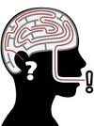
Polanyi
Tacit and Explicit Knowledge
1. Tacit: “Indwells” - understanding that resides in the mind
Ways to elicit tacit knowledge
on-the-job
Collaborative problem-solving, exit interview, focus group, network, job rotation, facilitate, mentor, apprentice, rounds, coach, cross-train, “master”, lessons learned, case-based reasoning
Cognitions
Technical know-how
~
Relationships
and trust
2. Explicit: “articulated” – written or recorded content
Apply
Did observed outcomes match the evaluand’s program theory?
Notes:
BASIC SLIDE #1: Michael Polanyi
Michael Polanyi is one of the earliest academics to deconstruct the KN platform.
1. [He suggested….] Two basic kinds of knowledge – tacit and explicit.
Of tacit it could be said…
“We…know more than we can tell”
Explicit knowledge, in contrast….
Appears in an understandable and transferable form
Within tacit, two kinds:
Cognitions – “mental models”
Technical know-how – a “knack” for making things happen
Pull-out box - expands on the many ways to elicit tacit knowledge
Imagine the many ways Dads have taught their children to ride a bike
a. He could climb on the bike and wobble down the street, use words to describe how…
2. [Similarly] Workplace – mentor or rounds
Both can be used to elicit tacit knowledge
So let’s apply this…
What happens if…an outcome doesn’t line up with what was “supposed” to happen?
Did you get the theory wrong? [tilt head]
[Or….] Maybe something tacit needed to be made explicit
As an example…
A formal After-Action Review might uncover why an innovation – like why adding a visit from the clown to the oncology ward activity program was such a bomb.

Slide 7
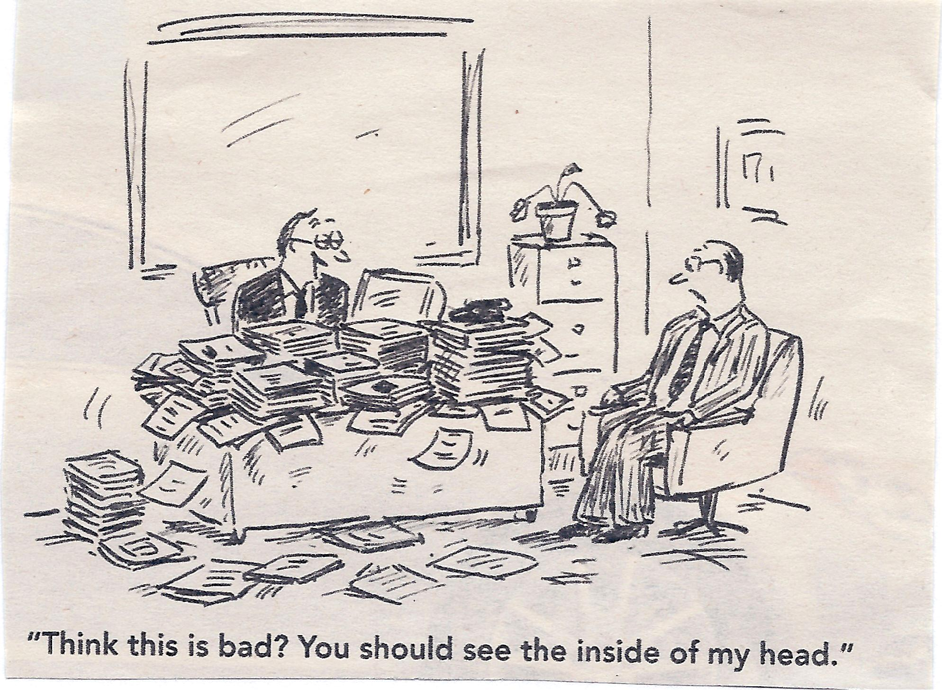
Notes:
Tacit or Explicit?
I’m the guy behind the desk.

Slide 8
Argyris
& Shon
Single- and double-loop learning
Single-Loop Learning – low-level evaluation
Underlying assumptions
What we do
Results
Double-Loop Learning - continuously create new knowledge by reconstructing the framework
Apply
Do you structure reframing into your evaluations?
Notes:
BASIC SLIDE #2: Chris Argyris and Donald Shon
Transition.
Another way flow of knowledge might be woven into the fabric of organizational learning is through single- and double-loop learning.
Single.
Single - loop learning...is doing something, saying I don’t like it, but doing it again - same way!
Einstein’s definition of insanity?
Double
An organization does Double-loop learning when it…
“Unlearns and reframes” its assumptions
An example?
[Are you…] Facing a seemingly unsolvable issue?
E.g. Those recalcitrant smokers who refuse to use the nice, convenient ash-cans outside the building?
How might you generate double-loop learning?
Carol Weiss suggests you bring in a critic of the program
On our Lean teams, we always had a set of Fresh Eyes
It was their job to see things differently!
Apply [read from bottom]. Do you structure reframing into your evaluations?
A double loop quadruples learning

Slide 9
Nonaka
Converting the forms of knowledge
 | Tacit knowledge | Explicit knowledge
Tacit knowledge | Socialization | Externalization
Explicit knowledge | Internalization | Combination
Apply
Are participants in synch and ready to action-ize the newly internalized?
Notes:
BASIC SLIDE #3: Ikujiro Nonaka
Transition.
1. Nonaka builds on Polanyi’s distinction between tacit and explicit knowledge.
He suggests four different activities that convert knowledge into different forms
Each quadrant involves a separate activity
Never done in logical order!
Model [read screen]
[Top left?] Socialize.
Two people– interact at water cooler
Having built acquaintance, we can more quickly pick up on each other’s nuances when working together
[Top right?]
It’s in your head…pull it out…make your document….that’s Externalize.
[Bottom right ].
You‘ve worked on your document; I’ve worked on mine
In this quadrant…we merge them. Combination.
Internalize [bottom left]
Have all your participants’ interests now been shared? Do they now sit on the flipchart?
Internalization moves the new learning from the flipchart…
Collectively inside [point – temple]
Apply
Conceptually, these conversions happen in a loop – Nonaka calls it a spiral [hand upward]
The spiral is of perhaps of greatest importance when you think about conceptual or symbolic use.
Policy [and Empowerment] Evaluation aims at Internalization
A shift in thinking, new understandings – on the collective inside.

Slide 10
Becerra-Fernandez
Four ways to use tacit explicit flow!
Discover o Socializationª o Combination^{b}
Share o Socializationª o Exchange^{b}
Apply o Direction^{a, b} o Routineª
Capture o Internalizationª o Externalization^{b}
ª =tacit knowledge; ^{b} = explicit knowledge
Apply
Awareness of the purposes that are served by knowledge aids evaluation design and choice of measures
Notes:
BASIC SLIDE #4 Isabelle Becerra-Fernandez
Transition
Nonaka gave us matrix
4 ways tacit and explicit knowledge convert back and forth among people.
Becerra-Fernandez now suggests 4 reasons to take advantage of all this conversion.
Model.
As the organization discovers, captures, and shares
New knowledge is created…and joins the flow
Two side-notes.
Capture - denotes the way the knowledge is housed
Apply - merely reuses existing knowledge
Old insights are just “applied”
How is this matrix useful?
Being aware of the functions of knowledge aids evaluation design and choice of measures
An example of an application?
1. Let’s say we are planning a sensitive evaluation.
Discovery is most likely to be achieved through socialization. No one will want to provide documentation for you to combine.
Sharing might be best achieved through stand-up meetings – another form of socialization.
Capture perhaps through stories.

Slide 11
Davenport
& Prusek
Distinguishing Data Information Knowledge
Data | Information | Knowledge
Discrete objective facts | Data with a message Categorized Condensed Corrected Calculated Contextualized | Actionable insights Experience Ground truths Complexity rules Involves judgment Values and beliefs *
Apply
What do you need to measure (data, information, or knowledge)?
And to what end?
Notes:
BASIC SLIDE #5: Thomas Davenport and Laurence Prusak
Transition
1. Sometimes when we said knowledge….we meant information - or maybe only data.
2. Davenport - developed knowledge nomenclature
The movement from data to knowledge involves a progression.
We start with Data.
Discrete objective facts.
We move to Information.
“in-form” = gives shape
Data becomes information when creator adds meaning
Knowledge is transformed information [“actionable insights”]
a. Bullets meaningful to me…
Experience – the condition achieved when one has internalized “minute” signals
Ground truths – Are lessons learned in the trenches
Nonaka suggests beliefs and commitments are more important than good information for arriving at actionable insight
How might this parameter be applied?
This slide points out the obvious - make sure you understand and evaluate the right thing.
[Let’s say...] Your evaluation involves a widget.
What category in the nomenclature is the number of widgets….
On a given day? Data.
In a given year relative to projected targets? Information.
Contrasted and compared at multiple sites or with entry into new markets? Knowledge

Slide 12
2nd Generation Concepts
More recent streams of knowledge flow
Oliver (2009) “Knowledge transfer”
Ashley (2009) “Innovation diffusion”
Davison (2009) “Knowledge translation”
Hawe (2009) “The complexity lens”
Apply
What other disciplines evaluate by following the knowledge flow?
Hint
Information systems, business management, instructional design, public policy, healthcare…other?
Notes:
2nd GENERATION SLIDE – more recent streams of knowledge flow
Final slide. How knowledge parameters have evolved
Transition
A special 2009 issue of New Directions spring-boarded these more contemporary KN parameters .
Disciplines outside evaluation certainly use these lenses.
Highlight four key words.
1. Transfer
KN arrives at new location with fidelity [party game - gossip]
2. Diffusion – similar to transfer
a. [In this case…] Knowledge “permeates” to recipients
“Perceived” as new [an innovation]
Translation –
Commonly used in healthcare research
It involves the exchange, synthesis, and application of knowledge…
To accelerate getting the benefits of research out to those that need it
4. Complex Adaptive System
Simply put: Nothing linear – everything’s interconnected
a. [Like we are…] All sitting on a giant inflated cushion- one shifts/all shifts
Great example
a. The way that birds fly in synch
Most applicable rules to me
Long leash - control function, not form
Respect people’s agency [trust that people are knowledgeable re. their ax]

Slide 13
Widmer’s Ode to Knowledge
The flow of knowledge is the chief necessary condition for evaluation capacity/building
It mediates or moderates all evaluative activities
and learning
It determines how well an organization can self- assess and how well it can use what it finds when it looks.
Notes:
BACK TO MY ODE
Conclusion.
Convince you – next time you are called to evaluate something
Put your knowledge flow glasses on
[yes] Read slide
4. Remember that…
[With flourish!] The flow of knowledge is woven into the fabric of organizational learning. It ties evaluative thinking to better performance. The most effective way for an organization to do better is to value that flow.”
SKIP. Remember that….
By building the knowledge platform on which it stands, evaluation capacity grows and delivers a return on performance. A learning organization does this well.
SKIP
Ask yourself:
[Are these packets…] Tacit or explicit
[Do they represent…] Single- and double-loops of learning
[How did they create that KN? By...] Socializing, externalizing, internalizing, and combining
[What platform need were they meeting…] Discovery, capture, sharing, just applying
[What kind of packet was that?] Data, information, or actionable insights [aka KN]
[Where’d that flow go? Did it…] Diffuse, get transferred, translated, or head some non- linear direction

Slide 14
(11:40 AM, today)
For more on knowledge and evaluation? Join Us!
Session 329: The Value of Knowledge Management in Evaluation: A Research Perspective
Knowledge Translation
Knowledge Management/Knowledge Exchange
Multi-paper Session 329; Laguna A
Thursday, Nov 3; 11:40 AM to 12:25 PM
Sponsored by the Research on Evaluation TIG
Notes:
Invite you to join another session
1. That begins shortly in Laguna A
Sponsored by the Research on Evaluation TIG
Exciting to see interest in the contribution that knowledge flow makes to evaluation.

Slide 15
References
Ashley, S. R. (2009). Innovation diffusion: Implications for evaluation. In J. Ottoson & P. Hawe (Eds.), New Directions for Evaluation, 124, 35-46. DOI: 10.1002/ev.310
Argyris, C., & Schön, D. (1978) Organizational learning: A theory of action perspective. Reading, MA: Addison Wesley.
Becerra-Fernandez, I., & Sabherwal, R. (2010). Knowledge management: Systems and processes. Armonk, N.Y.: M. E. Sharpe, Inc.
Davenport, T. H. & Prusak, L. (1998). Working knowledge. How organizations manage what they know. Boston, MA: Harvard Business School Press.
Davison, C. M. (2009). Knowledge translation: Implications for evaluation. In J. Ottoson & P. Hawe (Eds.), New Directions in Evaluation, 124, 75-88. DOI: 10.1002/ev.310
DeGroff, A. & Cargo, M. (2009). Policy implementation: Implications for evaluation. In J. Ottoson & P. Hawe (Eds.), New Directions in Evaluation, 124, 47-59. DOI: 10.1002/ev.310

Slide 16
References
Hawe, P., Bond, L., Butler, H. (2009). Knowledge theories can inform evaluation practice: What can a complexity lens add? In J. Ottoson & P. Hawe (Eds.), New Directions in Evaluation, 124, 89-100. DOI: 10.1002/ev.310
Nonaka, I. (1994). A dynamic theory of organizational knowledge creation. Organization Science, 5 (1), 14-37.
Oliver, M. L. (2009). The transfer process: Implications for evaluation. In J. Ottoson & P. Hawe (Eds.), New Directions in Evaluation, 124, 61-74. DOI: 10.1002/ev.310
Polanyi, M. (1966). The tacit dimension. London, England: Routledge and Kegan Paul.
Preskill, H. & Boyle, S. (2008). A multidisciplinary model of evaluation capacity building. American Journal of Evaluation, 29 (4), 443-459. Online. Retrieved September 11, 2008, from http:aje.sagepub.com; doi: 10.1177/1098214008324182

Slide 17
123 E. 8th Street karenwidmer@earthlink.net Claremont, CA 91711 (707) 815-2286
Evaluation 2011: Values and Valuing November 3, 2011 Multisession 329
Contact Information
Valuing Knowledge Flow in the
Evaluation Process
Karen Widmer, M.S.
Claremont Graduate University

