Slide 1
Demonstrating Tools for Supporting Programs Along Different Stages of the Evaluation Life Cycle
JBS International, Inc.
Nicole Vicinanza
Peter Lovegrove
Leith Lombas
Stacey Houston
Center for Creative Leadership
Valerie Ehrlich

Slide 2
Session Overview
Introduction
Session Rationale, Goals
Peter Lovegrove: Life cycle stages
Valerie Ehrlich: Beginning the conversation
Leith Lombas: Effective logic models
Stacey Houston: Questions, analysis for life cycle stages

Slide 3
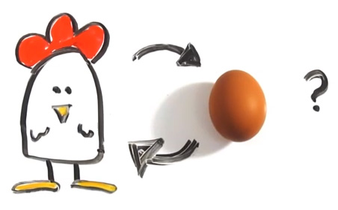
Introduction
What is the evaluation life cycle?
Varying evaluation capacity, needs/goals, responsiveness
Different definitions of program success
Is chasing the gold standard always best?
How to get started?

Slide 4
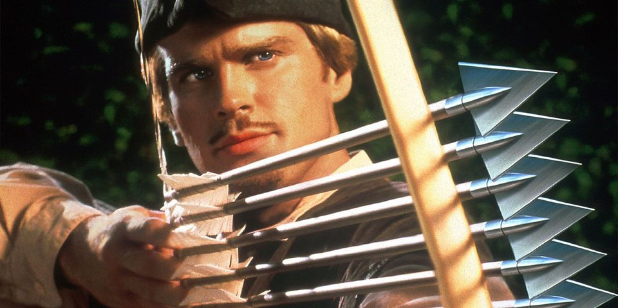
Goals of the Presentation
Explain the evaluation life cycle
Tools to spark conversations/ideas, mobilize evaluation
Begin a conversation
Formally outline program and its outcomes
Questions, analyses, for different stages of program development

Slide 5
Evaluation Life Cycle
Time
Concept
Presence of a need, buy-in
Design
Know context, task plan, logic model (TOC)
Pilot
Performance Measurement, Implementation
Early Implementation
Outcomes Study
Full Implementation
Impact Study, value added
Scaling Prep
Impact Study, replication, varying contexts
Early Scaling
Impact Study, varying contexts
Full Scaling
Impact Study, value added, contexts
Maintenance
Performance Measures, Outcomes

