Slide 2
The Role Of Consultancy Firms In Creating Pathways For Young & Emerging Evaluators (YEEs) And The Future Of Evaluation: –
Lessons from Lida Africa’s M&E Fellowship Program.
Victor Kiwujja
Cofounder & Executive Director, Lida Africa
Kampala, Uganda
victor@lidaafrica.org, www.lidaafrica.org

Slide 3
About Lida Africa

Slide 4
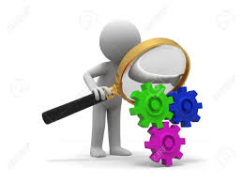
Background
The 17 SDGs draw significant attention to evaluation and youth
The future of evaluation depends on the critical role that young people play especially in production & use of high-quality evaluations especially in Africa where over 60% of the population is below 25 years.
Youth are under-represented in evaluation associations and are frequently absent from evaluations of policies and programs that impact them.
Many consultancies have not seen the need to involve young and emerging evaluators in their evaluations.
Lida Africa in a bid to contribute to the achievement of SDGs, designed the Global School of Experience to substantively engage youth in evaluations as critical thinkers, change makers, innovators, communicators, and leaders.

Slide 5
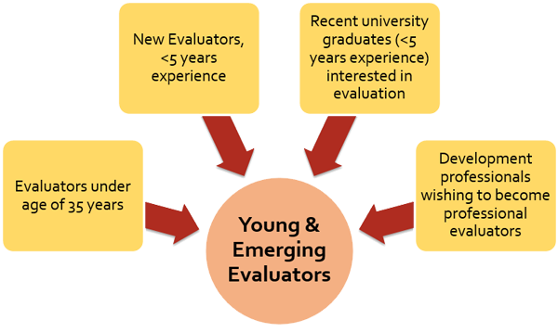
Our Approach
The Target Group
(Eval Youth)
“Fresh” university graduates with interest in the evaluation field
23-27 years
Unemployed youth
50% females
1-year M&E fellowship program.
Our Target Group

Slide 6
The Evaluator Empowerment Model (EEM)
Enabling Environment
Mentor
YEE
Evaluation Associations
Provision of platforms for YEEs to access strong mentors
Policy Environment & Culture
National M&E policy, and Development Agenda (NDPs)
YEE
National YEE Network
YEE program at the center of Associations
YEE Partnerships
Public, Private and Civil Society

Slide 7
Our Program
A tailored career guidance process (aligning personal qualifications, skills, & experiences with economic desires and career growth)
Life skills training (communication, public speaking, attitude change, interviewing etc)
Skills-based evaluation training (designing M&E systems, evaluation approaches, research, data management, analysis, and visualization)
Synergized by exposure to various evaluations conducted by Lida Africa.
Strong linkage to Uganda Evaluation Association and YEE Network

Slide 8
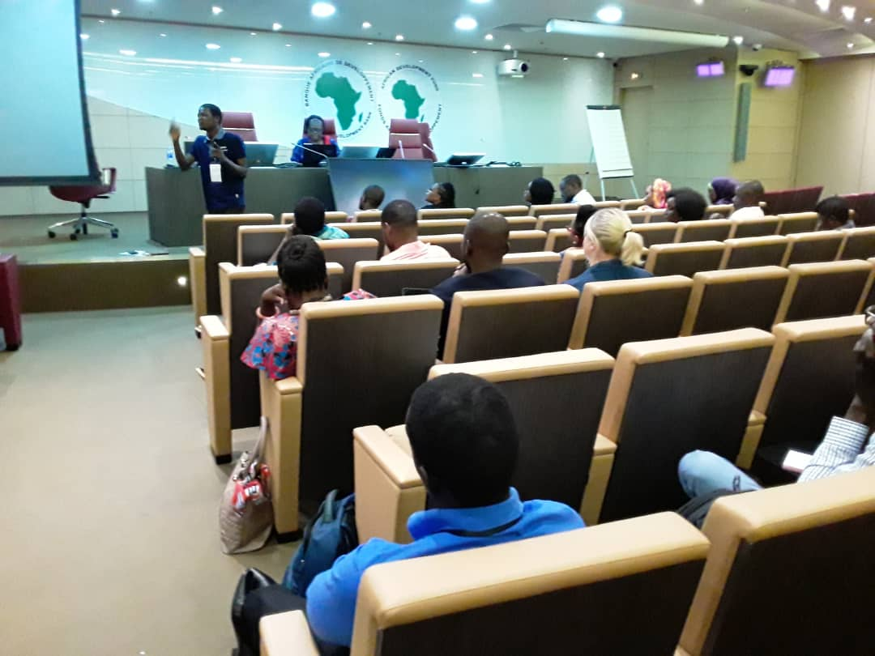
Results
75% have advanced evaluation careers
One manages evaluations of programs reaching 30,800 students with leadership & entrepreneurship skills
One leads evaluation training at 2 public universities
Another leads M&E strategies in least developed region (Karamoja)
Enhanced incomes and impact in human rights programmes
Mentors have become better evaluators
Joshua Kimera (one of the fellows) presenting a workshop at the recently held AfrEA conference in Ivory Coast

Slide 9
Lessons
1
2
YEEs INITIAL interest in evaluations is centered around “the practice” & “not management”
Soft skills matter in the evaluation field
3
4
Consultancies offer considerable synergy through exposure to evaluations “field work” (well designed package)
Strong partnerships between Evaluation Associations & consultancies yield

Slide 10
Call to Action: Involve Youth

Slide 11
Special Thanks
Lida Africa
Youth Power Learning
Eval Partners and Eval Youth
Uganda Evaluation Association
American Evaluation Association

