Slide 1
Helping Your Data Speak: A Workshop on Effective Communication of Statistical Results
α
β
μ
Antonio Olmos
Aurora Research Institute
Susan R. Hutchinson
University of Northern Colorado

Slide 2
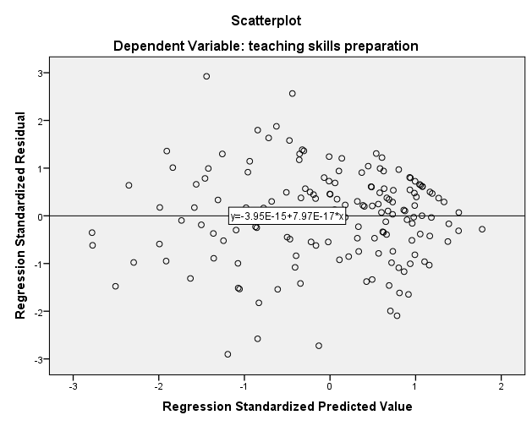
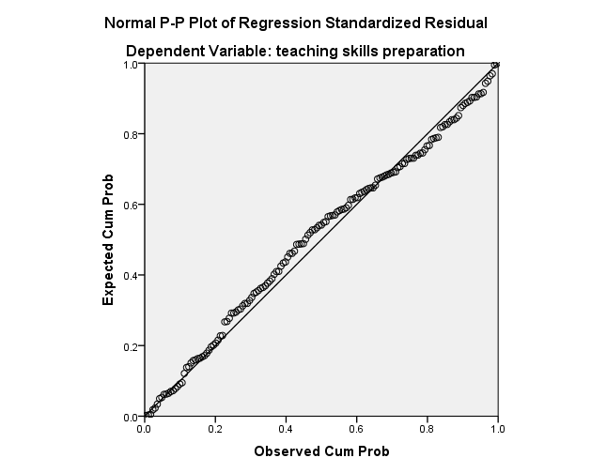
Evaluation Results

Slide 4
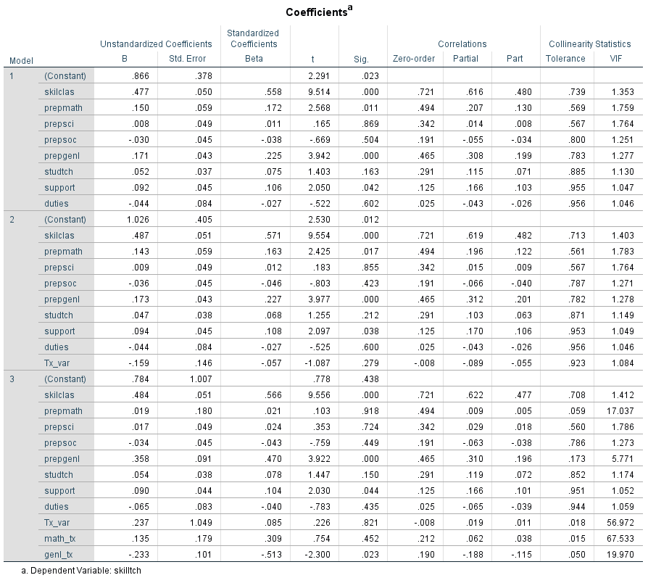

Slide 5
What was wrong with the preceding presentation? Why do evaluators sometimes do this ?

Slide 6
Statistics, …, is full of concepts and technical terms that may be difficult to interpret, let alone communicate, and this presents an important barrier to knowledge use (Bartlett & Gagnon, 2016, p. 12).

Slide 7
Factors to consider when communicating statistical findings
Stakeholders’ training and experience in statistics
Inferred meanings by stakeholders
Goal of the evaluation and stakeholders’ expectations
Salience of the information

Slide 8
If you were teaching someone to drive a car, would it be necessary (or even useful) to explain how the drivetrain, carburetor, spark plugs etc. work?

Slide 9
Suggestions for Reporting Statistical Information
Use visualization where appropriate and pair it with explanation
Keep it simple and avoid distracting details
Use analogies, conversational narrative, and stories

Slide 10
Words and phrases to avoid, among others
Coefficients
Parameter estimates
Odds ratios
Residuals
Random effects
Standard errors
Trajectory
P-values
Latent variable
Controlling for
Interaction

Slide 11
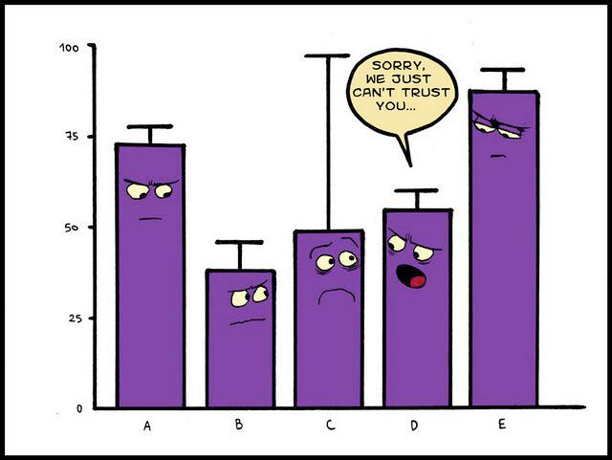
Sometimes humor helps
This Photo by Unknown Author is licensed under CC BY-SA

Slide 12
Examples

Slide 13
Using graphics to highlight key information
ARI, Jackman, 2018

Slide 14
Oneway ANOVA
A statistically significant oneway ANOVA indicated that the three groups of teachers differed in their perceptions of teaching skills preparation, F(2, 574) = 8.88, p < .001, η² = .03. Based on the Tukey pairwise comparison procedure only elementary and secondary teachers differed significantly with higher mean ratings for elementary teachers.
Overall, first year teachers rated their teaching skills preparation as generally favorable; however, elementary teachers reported somewhat better preparation than secondary teachers.

Slide 15
Visualizing Change across Time
High
No Intervention
Systolic Blood Pressure
130
Intervention
Low
Baseline
2 Months
4 Months

Slide 16
Visualizing Change across Time
154
No Intervention
Systolic Blood Pressure
130
Intervention
112
Baseline
2 Months
4 Months

Slide 17
Factorial ANOVA
Results of the factorial ANOVA indicated no statistically significant main effects for TEACHING or PROG on PREPGENL at alpha = .05; however, the interaction between these two variables was statistically significant, F(2, 140) = 4.04, p = .02,η² = .06, suggesting that TEACHING moderated the effect of PROG on PREPGENL. Tests of simple main effects indicated ….

Slide 18
Factorial ANOVA
Blah, blah, blah, DINNER, yada, yada, yada, PLAY, blah, blah, blah, NAP, …..
Results of the factorial ANOVA indicated no statistically significant main effects for TEACHING or PROG on PREPGENL at alpha = .05; however, the interaction between these two variables was statistically significant, F(2, 140) = 4.04, p = .02,η² = .06, suggesting that TEACHING moderated the effect of PROG on PREPGENL. Tests of simple main effects indicated ….

Slide 19
Another way to explain ANOVA results
Was the intervention effective?
Yes and no. For secondary and special education teachers, the intervention was effective. Those receiving the intervention rated their classroom management skills more positively than those not receiving the intervention.
For elementary teachers, the intervention did not appear to be effective.

Slide 20
Visualizing an Interaction
High
Intervention
Skills
No intervention
Low
Elementary
Secondary
Special Education

Slide 21
Other possible strategies
Describe findings for a hypothetical, single participant
Personalizes the results
Helps make the information more relatable
Present preliminary results for client feedback
Promotes client buy-in and insights about additional analyses
This Photo by Unknown Author is licensed under CC BY-SA

Slide 22
Hierarchical linear growth model
How might you describe the concepts of variation in slopes and intercepts?
Conditional versus unconditional?
Reading score
t1 t2 t3 t4

Slide 23
Moderator effect
Proposition 1b: The relationship between the amount of pizza consumed and the severity of heartburn experienced will be moderated by the time of day when the pizza is eaten. Specifically, when a large amount of pizza is eaten late at night heartburn will be the most severe.
Dependent (criterion) variable
Independent (predictor) variable
A
Amount of Pizza
Severity of Heartburn
Moderator variable
Time of Day

Slide 24
Mediator effect
Proposition 1c: The relationship between amount of pizza consumed and heartburn severity will be mediated by the amount of beer consumed with the pizza. Specifically, as more pizza is eaten, more beer is drunk thereby increasing the severity of heartburn.
Mediator
Amount of Beer Consumed
C
B
Amount of Pizza
Severity of Heartburn
A
Independent (predictor) variable
Dependent (criterion) variable

Slide 25
Vignettes and Group Activity
The handout provided includes 3 vignettes describing hypothetical evaluation scenarios.
You will form small groups, read one of the vignettes, examine the statistical information provided, and then your group will decide how you would present the results to the client.
Feel free to use the large sheets of paper and markers provided to draw graphs, highlight key narrative points, etc.
Be prepared to share your presentation with the whole group.

Slide 26
Other Challenging Concepts to Communicate
Effect size
Convert to a meaningful metric
Trivial versus meaningful differences
Confidence intervals around point estimates
Reliability
Bullseye analogy
Statistical power (and type 1 versus 2 error)
Guilt vs. innocence; drug testing

Slide 27
Comments or questions?

