Slide 1
Should Environmental and Social Sustainability be a Core Value for Evaluators?
Beverly Parsons, PhD
InSites
bparsons@insites.org
Veronica Thomas, PhD
Howard University
vthomas@howard.edu
Brian Yates, PhD
American University
brian.yates@mac.com
Notes:
Should Environmental and Social Sustainability be a Core Value for Evaluators?
12/29/11
AE.07.SOvsPSPrsntn.10-24.ppt
1

Slide 2
Session Focus
Rethinking evaluator values to address Triple Bottom Line = Planet, People, Profit
Planet = Environmental Sustainability
People = Social Justice
Profit = Economic Well-being
TIG-based discussion
Notes:
Evaluation from a Self-organizing Versus Predictive Systems Perspective: Examples from the Field
12/29/11
AE.07.SOvsPSPrsntn.10-24.ppt
2
.A. Background
1. A preliminary/exploratory AEA board task force composed of four board members—the three of us plus Leslie Cooksy—was established in January 2011 to determine if there are policy issues that need to be addressed and to start some member engagement around the issue to help sort that out.
2. We had a thought leaders forum on the topic in April and are now having this session to help understand members views on this topic. At the April forum we found that while we found people were interested, we also learned that there is a lack of knowledge about the nature and seriousness of the issue in general or how it might specifically affect evaluators and evaluation practices.
Another interesting coincidence is that AEA is in the midst of reviewing the evaluation guiding principles. There will be a session on that topic on Saturday. Hopefully some ideas from this session will help inform that process.
B Disclaimer
1. Veronica, Brian, and I do not claim to be experts on this topic of creating this type of sustainability. We are peer journeyors with you. We are seeking to learn together and figure out how to strategically position AEA and our own work and lives in this rapidly changing world.

Slide 3
Triple Bottom Line: Rethink Outcomes Holistically
Planet,
People &
Profit
Environmental Sustainability Social Justice Economic Well-being
Planet
People
(Program)
Profit
Notes:
C. Approach in this session
Although there are many ways we could approach this topic, we have chosen to do it around a concept that originally came from the business world and have been moving into the public and NGO worlds. It is the idea of the triple bottom line.
1. Businesses have focused their attention on making profit for their shareholders. The phrase “the triple bottom line” was first coined in 1994 by John Elkington, the founder of a British consultancy called SustainAbility. His argument was that companies should be preparing three different (and quite separate) bottom lines. One is the traditional measure of corporate profit—the “bottom line” of the profit and loss account. The second is the bottom line of a company’s “people account”—a measure in some shape or form of how socially responsible an organization has been throughout its operations. The third is the bottom line of the company’s “planet” account—a measure of how environmentally responsible it has been. The triple bottom line (TBL) thus consists of three Ps: profit, people and planet. It aims to measure the financial, social and environmental performance of the corporation over a period of time. Only a company that produces a TBL is taking account of the full cost involved in doing business.
Behind it lies the same fundamental principle: what you measure is what you get, because what you measure is what you are likely to pay attention to. Only when companies measure their social and environmental impact will we have socially and environmentally responsible organizations. (Taken from http://www.economist.com/node/14301663) Similarly, when evaluating a program, think of it as being positioned within these three domains of responsibility and resource use/contribution.
Although “Planet, People, and Profit” is an easily remembered way to describe the TBL, it is more accurate to use terms such as environmental sustainability, social justice, and economic well-being

Slide 4
Environmental Sustainability
Notes:
12/29/11
AE.07.SOvsPSPrsntn.10-24.ppt
4

Slide 5
Sustainability
Meeting the needs of the present generation without compromising the ability of the future generations to meet their own needs
Brundtland Commission 1987
Enough
For All
Forever
African Delegate Rio+10
The possibility that human and other forms of life on earth will flourish forever
John Ehrenfeld, MIT
Adapted from www.thenaturalstep.org
Notes:
A. Attention to the environment has ebbed and flowed
1. 1972 United Nations Conference on the Human Environment was held in Sweden.
2. The Brundtland Commission in 1987 established the millennium goal of “meeting the needs fo the present generatin without compromising the ability of the future generations to meet their own needs” in its report Our Common Future: Report of the World Commission on Environment and Development” . Let to millennium goal (on slide)
3. The United Nations Conference on Environment and Development, Rio de Janeiro, June 1992.
4. A conference, Rio +10 was held in Africa in 2002 (see a definition on slide from this event)
5. Another conference, Rio + 20 is to be held in Brazil in 2012.
B. With each event the statistics sound more and more alarms.

Slide 6
Funnel Metaphor
Increasing
demand for resources and ecosystem services
Unsustainability
Sustainable society
Declining
resources and
ecosystem services
Adapted from www.thenaturalstep.org
Notes:
C. The basic issues can be shown in this funnel metaphor. When the funnel was large, we didn’t realize we were getting close to the edges of the funnel. Now we know this is the case and must reduce demand and stop the decline of resources and our ecosystems.

Slide 7
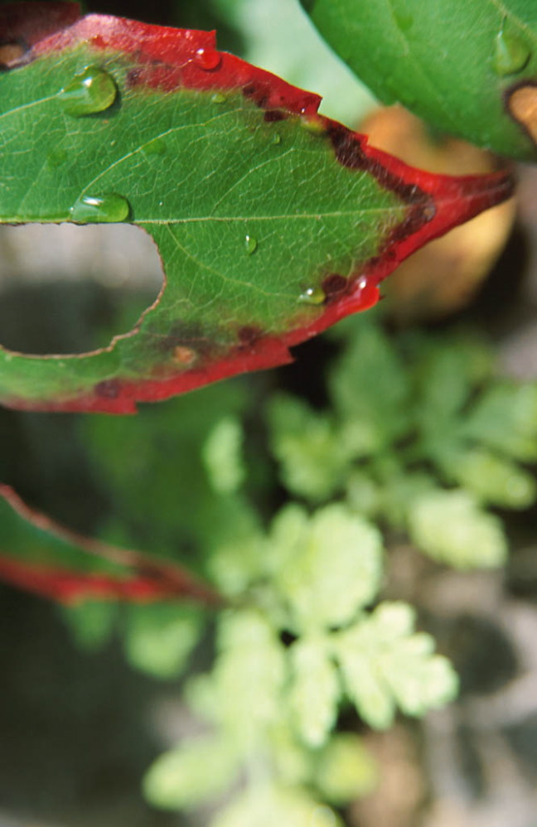
Conventional Thinking
Traditionally, we try to understand complex systems by reducing the whole and studying the individual parts.
This is called reductionist thinking.
Adapted from www.thenaturalstep.org
Notes:
D. What got us here—Our way of thinking.
Our conventional thinking is reductionist, seeing the parts and not the interconnections.

Slide 8
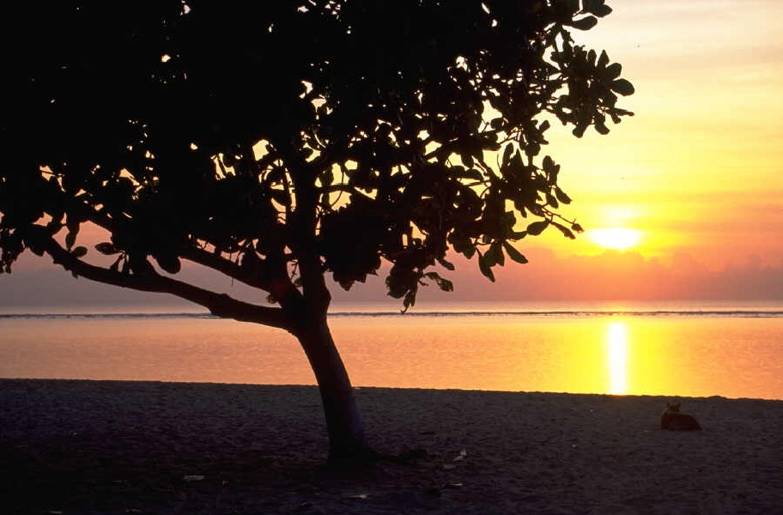
Systems Thinking
The properties of systems depend on the relationships between the parts as much as the parts themselves.
When you dissect the system, you destroy the pattern of relationships.
Adapted from www.thenaturalstep.org
Notes:
2. Systems thinking looks at the relationship among the parts as much as the parts themselves. When you dissect the system you destroy the pattern of relationships. Those relationships are essential. Thus our future approaches need to be tied to systems thinking.

Slide 9
Cycles of Nature
Open system with respect to energy
Closed system with respect to matter
1) Nothing disappears
2) Everything disperses
« Photosynthesis pays the bill »
Sustainability is about the ability of our own human society to continue indefinitely within these natural cycles
Slow geological cycles (volcano eruptions and weathering)
Slow geological cycles (sedimentation and mineralization)
From www.thenaturalstep.org
Notes:
12/29/11
AE.07.SOvsPSPrsntn.10-24.ppt
9
E. Nature’s cycles are about systems thinking. Here is the basic cycle you may have learned in a middle school science class.

Slide 10
How We Influence Cycles
Physically inhibit nature’s ability to run cycles
Barriers to people meeting their basic needs worldwide
Introduce persistent compounds foreign to nature
Relatively large flows of materials from the Earth’s crust
From www.thenaturalstep.org
Notes:
12/29/11
AE.07.SOvsPSPrsntn.10-24.ppt
10
F. We have disrupted this cycle through three major acts.
1. Creating a large flow of materials from the Earth’s crust.
2. Introducing persistent compounds foreign to nature.
3. Physically inhibiting nature’s ability to run cycles (largely through technological advances (removing top soil, deforestation, destruction of the oceans and the fish population are just a few examples. Do you know that 90% of the large ocean fish have been removed from the oceans through overfishing. Can you imagine how this affects small fishing villages in, say, Asia, that have for centuries relied on the ocean to provide its protein? )

Slide 11
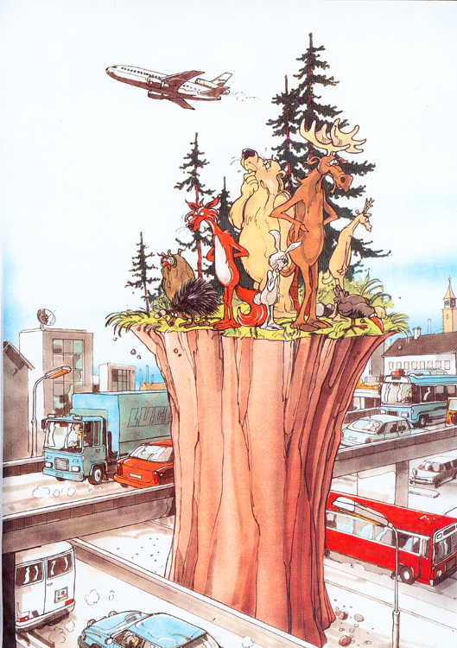
From www.thenaturalstep.org
Notes:
12/29/11
AE.07.SOvsPSPrsntn.10-24.ppt
11

Slide 12
Environmental Sustainability Principle 1: Shift FROM High Concentrations of Substances Extracted from the Earth’s Crust TO Abundant Renewable Substances
Scarce Fossil Fuels, Minerals
Abundant Renewables (e.g., sunlight)
Adapted from www.thenaturalstep.org
Notes:
B. The Natural Step organization, based on the original research by Swedish scientists, identified three principles that are at the core of environmental sustainability. They are framed as things we need to stop doing. These can also be framed in terms of what we need to start doing.
In a sustainable society, nature is not subject to systematically increasing concentrations of substances extracted from the Earth’s crust.
Shift from High Concentrations of Substances Extracted from the Earth’s Crust to Abundant Renewable Substances (not just fossil fuels but use of different metals/minerals that are sequestered in the earth. Green chemistry fits here.)

Slide 13
Environmental Sustainability Principle 2: Shift FROM Concentrations of Substances Produced by Society TO Sustainable Production
Take – Make – Waste
Borrow – Use – Return
Notes:
2. In a sustainable society, nature is not subject to systematically increasing concentrations of substances produced by society.
Reduce Concentrations of Substances Produced by Society by Shifting Production Orientation
a. One of my favorite ways of phrasing this is from a book called Cradle to Cradle: It talks about shifting from Take-Make-Waste to Borrow-Use-Return.

Slide 14
Environmental Sustainability Principle 3: Shift FROM Degradation of Nature by Physical Means TO Efficient use of Natural Resources and Well-managed Ecosystem Use
Inefficient use of resources and land; resources from poorly managed ecosystems
Efficient use of natural resources and well-managed ecosystem use
Notes:
In a sustainable society, nature is not subject to systematically increasing degradation by physical means.
Reduce Degradation of Nature by Physical Means by Efficient use of Natural Resources and Well-managed Ecosystem Use. Veronica will talk more about the connection of this degradation to social justice issues.

Slide 15
Implications for Evaluators: Our Own Environmental Practices
Consider your well-being holistically
Consider pollution, use of physical resources (e.g., travel)
Consider how to engage in practices that “Borrow – Use – Return” rather than “Take-Make-Waste”
Notes:
Evaluation from a Self-organizing Versus Predictive Systems Perspective: Examples from the Field
12/29/11
AE.07.SOvsPSPrsntn.10-24.ppt
15
D. Implications for Evaluators
1. Let’s look at the implications of these environmental sustainability issues to evaluators in two ways—what we can individually do in our evaluation work and what we can discuss with the leaders of the projects, products, and initiatives we are evaluating (the evaluands).
2. Implications for our own work (These are a few general starter ideas. This will be discussed more in small groups.)
a. Consider your well-being holistically
b. Consider pollution, use of physical resources (e.g., travel)
c. Consider how to engage in practices that “Borrow – Use – Return” rather than “Take-Make-Waste”

Slide 16
Implications for Evaluators: Encourage Projects/Initiatives to
Rethink their outcomes and activities holistically – planet, people, profit (move to well-being)
Consider their role within the broader communities of which they are a part
Notes:
12/29/11
AE.07.SOvsPSPrsntn.10-24.ppt
16
Implications for working with project/initiative leaders
Here are a couple of starting ideas. These will be discussed more in the small group discussions after Veronica and Brian’s presentations.
a. When working with leaders on their theory of change and/or logic models help them rethink their outcomes and activities holistically – planet, people, profit (move to well-being). Ask them questions. Raise issues that helps them connect their work better to a rapidly changing world —one changing on three of these fronts that need to be thought of systemically.
b. Consider their role within the broader communities of which they are a part

Slide 17
Resources
The Natural Step (www.thenaturalstep.org)
Northwest Earth Institute (discussion guides) (www.nwei.org
Biomimicry (www.biomimicryinstitute.org)
Hans Rosling (ww.Ted.com)
Notes:
12/29/11
AE.07.SOvsPSPrsntn.10-24.ppt
17
These are just a few of the many, many resources that address the environmental sustainability.. They contain ideas that can be very useful to evaluators (to discuss more in the TIG small groups).

Slide 18
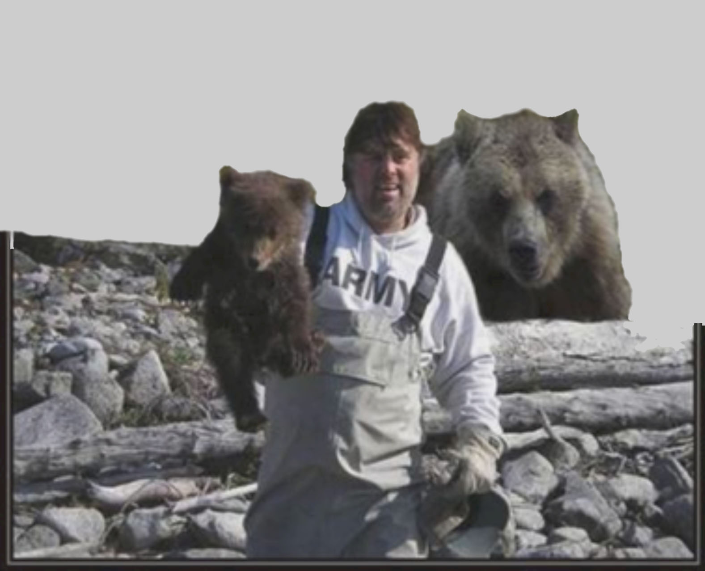
If we’re gonna be dumb enough to ignore nature’s laws, we’d better be tough.
Notes:
“If we are so dumb as to ignore nature’s laws, we’d better be tough!”

Slide 19
TIG Discussions
Notes:
12/29/11
AE.07.SOvsPSPrsntn.10-24.ppt
19
Following presentations by Veronica Thomas on social justice and Brian Yates on rethinking costs and economics, we used these slides to guide the small groups discussions. The groups were organized around the focus of a few TIGs.

Slide 20
Discussion Questions
What information/conversations do our TIG members need to determine the importance and implications of holding environmental, social, and economic sustainability as a core value?
What TWO TIG guidelines/actions would help our members better contribute to such sustainability through their evaluation work?
Notes:
12/29/11
AE.07.SOvsPSPrsntn.10-24.ppt
20

Slide 21
Discussion Groups and Facilitators
• Cost, Effectiveness, Benefits, and Economics TIG – Ron Visscher
• Multiethnic Issues in Evaluation TIG – Anna Madison
• Teaching of Evaluation TIG – Linda Schrader
• Systems in Evaluation TIG and Environmental Program Evaluation TIG – Mary McEathron
• PreK-12 Education Evaluation TIG – Manolya Tanyu
Notes:
12/29/11
AE.07.SOvsPSPrsntn.10-24.ppt
21
Here are notes from two of the groups: (inserted here following the session)
Teaching Evaluation TIG
• Awareness
• Consideration of how ideas of sustainability infused into evaluation pedagogy
• Understandings about content – holistically – with environmental considerations
• Evaluator behaviors/dispositions – reflexivity, voice, learner
Environmental Program Evaluation, Systems in Evaluation, and PreK-12 Education TIGS
What information do our TIG members need to help embrace sustainability
• Funders & what’s funded
• AEA – environmental sustainability as a value
• Clear definition and understanding of sustainability
• Do not reduce natruall capital and/or opportunity to access nature
• Do not abstract transparency
• Fair terms of cooperation
• Create and sustain _______
• Do not put people in vulnerable situations
TIG actions/guidelines
• Not just an add-on; holistic
• Language is important
– Move to adaptive balance
• Ethical responsibility to notice
• Sustainability audit for company
– Apply to own practice
• Look at PEER Associates

