Slide 1
Feeling the Presence of the Past: Teachers Engaging with Civil Rights History through Testimonial Narrative and Personal Experience
Ashlee Lewis
Office of Program Evaluation
University of South Carolina
Presentation at the American Evaluation Association in Minneapolis, MN

Slide 2
Presentation Purpose
The purpose of this presentation is to examine the ways in which narratives and personal experiences operated powerfully in the lives of teachers during a field study of historical sites related to the American Civil Rights Movement.

Slide 3
My Two Professional Lives
Researcher Life
Doctoral Candidate in Foundations of Education
Interest in Qualitative Inquiry
Interest in Researchers’ Active Engagement in the Research Process
Evaluator Life
Graduate Assistant in the Office of Program Evaluation for 6 years
Many large scale projects, lower levels of deep engagement with project staff and goals

Slide 4
Teaching American History Project
The Project
Federal Teaching American History grant program
The Setting
Large suburban district
The Content
Teachers take history courses accompanied by related “field studies”

Slide 5
Goals for Civil Rights Course
Identify major issues and questions regarding the Civil Rights Movement.
Demonstrate knowledge of interrelationships among places, times, and social mores relative to the Civil Rights Movement.
Construct meaning from primary documents.

Slide 6
Civil Rights Field Study Agenda
Site | City/Town
Martin Luther King, Jr. Historical Sites | Atlanta, GA
Atlanta Civil Rights Bus Tour | Atlanta, GA
Morehouse College | Atlanta, GA
APEX Museum | Atlanta, GA
Sixteenth Street Baptist Church | Birmingham, AL
Kelly Ingram Park | Birmingham, AL
Civil Rights Institute | Birmingham, AL
Alabama Jazz Hall of Fame | Birmingham, AL

Slide 7
Civil Rights Field Study Agenda
Site | City/Town
Brown Chapel AME Church | Selma, AL
Edmund Pettus Bridge | Selma, AL
Voting Rights Museum | Selma, AL
Lowndes Country Interpretive Center | Selma to Montgomery
Civil Rights Memorial Center (at the SPLC) | Montgomery, AL
Dexter Baptist Church | Montgomery, AL
Dexter Baptist Church Parsonage | Montgomery, AL

Slide 8
Data Sources
Evaluator field notes
2 Teacher focus groups
Teachers’ reflective journals.
Notes:
Because there was such a large amount of data, I will focus on a few encounters and themes that seemed to have the broadest influence on teachers.

Slide 9
Atlanta

Slide 10
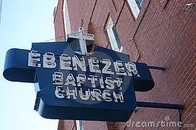
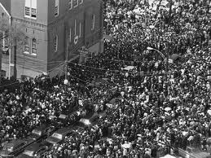
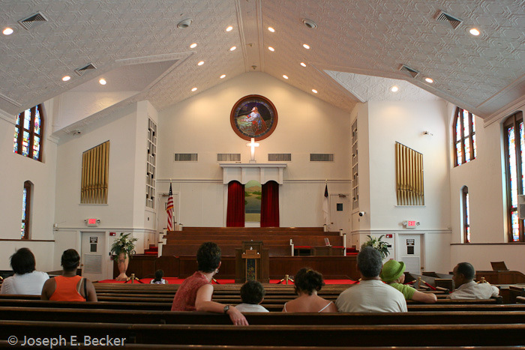
Ebenezer Baptist Church

Slide 11
Ebenezer Baptist Church
My experience inside Ebenezer Baptist Church was pretty overwhelming. It was 93 degrees in the building, however, it did not matter. It was very peaceful and just knowing all of the significant events that occurred in the church – from MLK’s baptism to his funeral – was an almost indescribable feeling.
~ Teacher Journal Entry

Slide 12
Birmingham

Slide 13
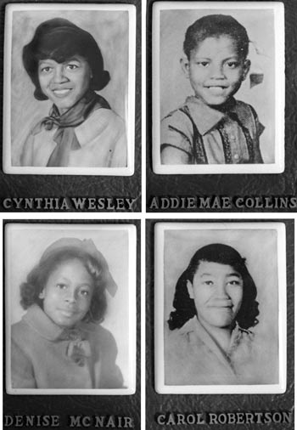
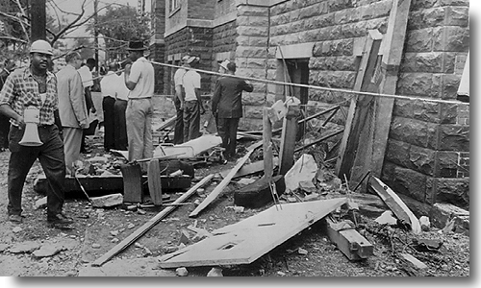
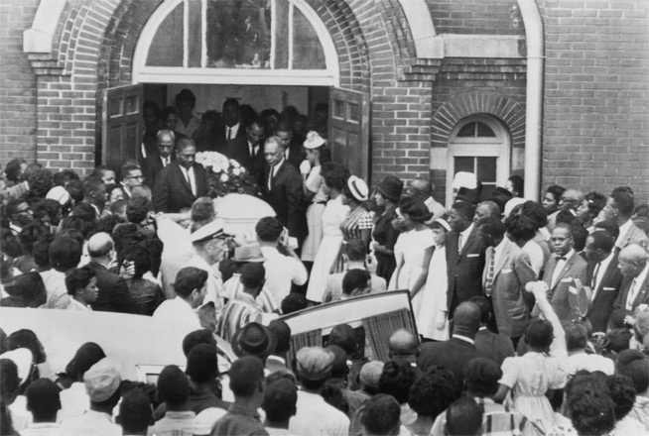
Sixteenth Street Baptist Church

Slide 14
Sixteenth Street Baptist Church
I felt the presence of the past as I stood in the exact place where a bomb exploded and killed four teenage girls.
~ Teacher Journal Entry
Felt like we were on sacred/hallowed ground. The pictures of the 4 girls brought tears. How could any human being do this?
~ Teacher Journal Entry

Slide 15
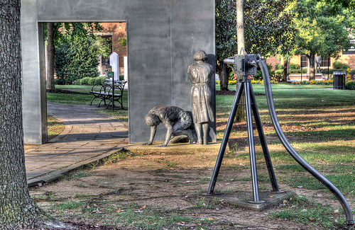
Kelly Ingram Park

Slide 16
Kelly Ingram Park
[The statues on the grounds] were moving, and they gave you a personal feel for what African Americans went through during the Birmingham demonstrations. I was amazed to hear that the water hoses in Birmingham could take the back off of a tree like a knife goes through butter. These non-violent protestors had true courage in the midst of such hatred and aggression.
~ Teacher Journal Entry

Slide 17
Selma

Slide 18
The Testimony of Joanne Bland
The ‘testimony’ of Joanne Bland has probably been the most captivating of my trip thus far. The rawness and truth and personality with which she spoke has left me with a desire to share her stories with my students. I am happy to have her stories in writing to actually do this.
~ Teacher Journal Entry

Slide 19
The Testimony of Joanne Bland
But I felt like definitely the testimony this morning with Ms. Bland was just, I mean it was just amazing. I mean just such a strong woman who had experience so much and was so – I mean she was tough and strong – but she was so open and kind of vulnerable at times. I felt like some of that bitterness had been, over the years, just taken away as she had let that story out. It was amazing to see…and you could see how it could be tough to get over something like that – it was powerful to hear her story.
~ Teacher in Focus Group 1

Slide 20
The Testimony of Joanne Bland
One of the things about the people aspect of this trip, some planned and some spontaneous is that they put a face to the events. Because it’s something that you may read in a history book or see on a documentary and yes those things happened, but especially this morning with Mrs. Bland, to hear her tell the story, it wasn’t just an event that happened in history, it was an event that involved real people. And you know, your head knows that, but until you actually have someone standing in front of you sharing that, sometimes it’s hard to wrap your mind around it. How much it affected people then. And the effects are still there.
~ Teacher in Focus Group 1

Slide 22
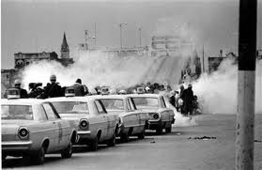
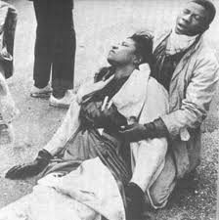
Walking the Edmund Pettus Bridge

Slide 23
Walking the Edmund Pettus Bridge
One of my words was “reviving” because even though I’ve seen a lot of this on television, today, especially coming across that bridge, it gave it life that it didn’t have before. I was just…that happening today, it was just different.
~ Teacher in Focus Group 1

Slide 24
Walking the Edmund Pettus Bridge
The bridge experience was very positive because I feel like we were able to take a part. Of course, we’re glad we weren’t a part of the actual movement, but, you know, just being able to walk across the bridge, the same bridge that those that went before us marched across to fight for those rights was very amazing.
~ Teacher in Focus Group 1

Slide 25
The Full Selma to Montgomery Narrative
I was so moved by the personal testimony of Ms. Joann Bland. It makes the moment personal and more real to me when I meet those who participated in the Civil Rights Movements. Her moving accounts and the honesty helped me see that she was just an eleven year old girl who was following behind her love-crazed sister. Then, walking on the [Edmund Pettus] bridge and visiting the museums helped pull it all together in the end so I could see how hard people struggled for my rights.
~ Teacher Journal Entry

Slide 26
Impact of Teachers’ Firsthand Narratives on Students

Slide 27
Sharing the Narratives with Students
There is a world of difference in saying [to your students] ‘We’re gonna learn today about…’ and ‘This is where…’ as opposed to saying, ‘Well, this summer I went to…I participated…I did this!’ You know? - Teacher in Focus Group 1
I like to teach with stories, reading stories, telling stories. I’ll have a lot of good stories to go back and tell them and just relay what I learned to them. – Teacher in Focus Group 1

Slide 28
Impact of the Involvement of Young People in the Movement
One of the things that keeps popping up to me is: Young people were involved. And those young people helped effect the change. Their perseverance. And I think with 6th grade… helping them realize that there were people at a young age, seeing a need and being determined enough to take a stand. And, I think that’s something that a lot of kids don’t think they can do. These were ordinary people who just happened to be caught up in extraordinary circumstances. And they were willing to step up to the plate because they were there.
~ Teacher in Focus Group 1

Slide 29
Sharing New Insights with Students
I don’t know what it was, it was just something about the way they described the struggle to gain the rights to vote today was really just, I don’t know, I think it just really made me think about how many – I mean I always go vote – but I’ve never, I don’t know it just gave me something today that…I will never ever take it [the ability to vote] for granted. And I never want my [students] to take voting for granted. I mean, how could you not, when somebody has gone through that much.
~ Teacher in Focus Group 1

Slide 30
Takeaways for Learners (Teachers and Students)
Incorporate testimonial narratives and storytelling:
In teacher professional development
In the classroom
Even with less obvious content (e.g., economic history, U.S. constitution)
Create experiences with narratives in the classroom if field study is not possible.

Slide 31
Case for Participant Evaluation
Programmatic understanding: First hand experience of program delivery
Data quality: Greater level of trust and rapport from stakeholders leads to richer data
Immediate feedback: In-the-moment communication with program staff about what is and is not working
Notes:
For example, I even roomed with one of the participants. Over the course of the trip, I attempted to spend time with all of the different teachers.

Slide 32
Thank You!
I welcome your questions, comments, and feedback!
Ashlee Lewis
University of South Carolina
lewisaa2@mailbox.sc.edu
ashleealewis@gmail.com

