Slide 1
Evaluating Campaign Spikes
Rebecca Perlmutter
October 2013
Notes:
I’m Rebecca Perlmutter from Oxfam America. I help campaign teams monitor, evaluate and learn from their work, which we call MEL. In this presentation I will take you through the four steps we go through to MEL our spikes.

Slide 2
WHAT IS A SPIKE?
Short Term
High Profile
Public Facing
Policy Win
Power Building
Notes:
Spikes are short term high-profile public facing work within a campaign targeting a particular policy. They last a few weeks to a few months. The primary goal is a policy win but they can also help Oxfam build its own power, profile and constituency.

Slide 3
THE ARMS TRADE TREATY (ATT)
Notes:
I’ll show how Oxfam evaluates spikes using our work on the Arms Trade Treaty. UN member states met in 2012 and 2013 to agree to the treaty, and we had spike activities leading up to and during these moments.

Slide 4
STEP 1: PLAN
Notes:
The first step is to develop a MEL plan. A MEL plan outlines the key framing questions or objectives, the outcomes and indicators and identifies how the data will be collected and by whom.

Slide 5
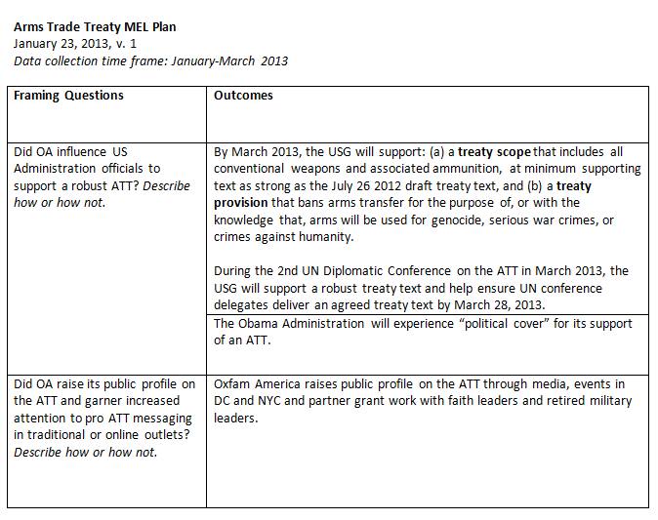
DECIDE WHAT TO EVALUATE
Notes:
The team decides what they are going to evaluate. For the ATT we had two key objectives – to influence the US Administration to support an ATT and to raise Oxfam’s public profile on the ATT.

Slide 6
MEL PLAN OUTLINE
Objectives/ Framing Questions | Outcomes | Indicators (with quant data & targets) | Lead Responsible | How & When Data Will Be Collected
Notes:
A MEL plan lists the key objectives with outcomes and indicators; who is responsible for providing the data; and how and when the data will be collected. We also include a timeline, team roles and types of evaluation products.

Slide 7
TEAM ROLES
Notes:
All members of the campaign team are responsible for contributing to the MEL for the spike. The MEL lead for the spike provides guidance on the MEL design, while different members of the team collect and analyze data.

Slide 8
STEP 1: PLAN STEP 2: MONITOR
Notes:
We collect data on a variety of indicators, including ads, media, work with other organizations and individuals and influence on policy and decision makers. Most spikes involve some if not all of these components.

Slide 9
ADS & CREATIVE PRODUCTS
Notes:
Teams will develop ads or visuals like infographics. For ATT, we had ads in DC publications and infographics to share online. We use Google analytics for online data, like page views, but we also get anecdotal feedback.

Slide 10
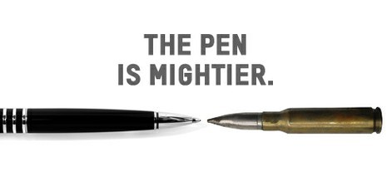
TRADITIONAL & SOCIAL MEDIA
Notes:
We track the number of Oxfam mentions in traditional media. Social media has so much data. We track petition signatures, number of new constituents and views of blogs and videos. This gives us a general picture of our online reach.

Slide 11
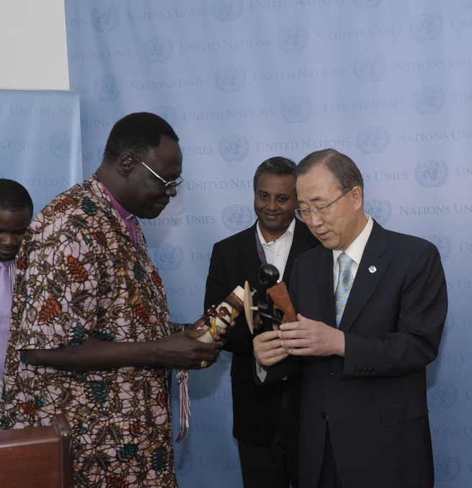
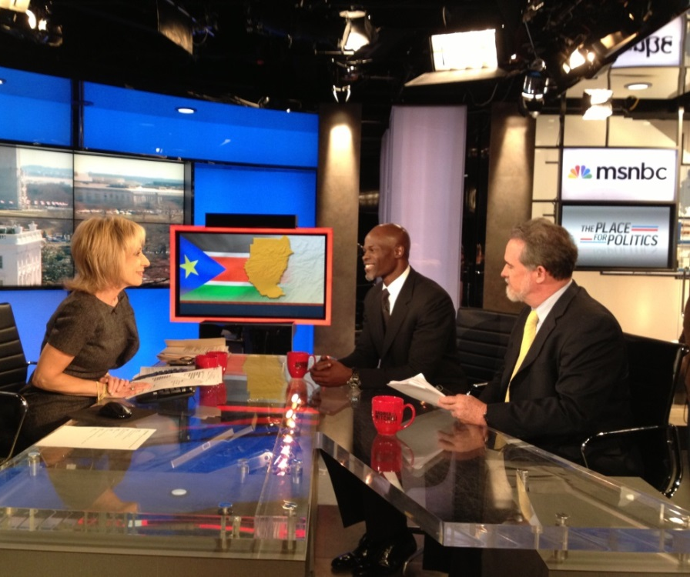
ALLIES & INFLUENTIALS
Notes:
We’ll work with organizations and influential individuals. We worked with American Values Network to bring a bishop from South Sudan and military and evangelical leaders to the UN for advocacy on the ATT. The results of their work go in our MEL.
Pictured: Bishop Elias Taban. Picture source: Control Arms, Flickr. http://www.flickr.com/photos/controlarms/7685160808/in/set-72157630840148552/

Slide 12
POLICY INFLUENCE
Notes:
All spikes have a desired policy outcome. We report on number of meetings and who was in them and we capture evidence of influence, like shifts in policymakers’ positions; their use of language we provide them; or any public or private statements.
Photo credit: Flickr user Cam in Van, http://www.flickr.com/photos/righthererightnow/2499653911/

Slide 13
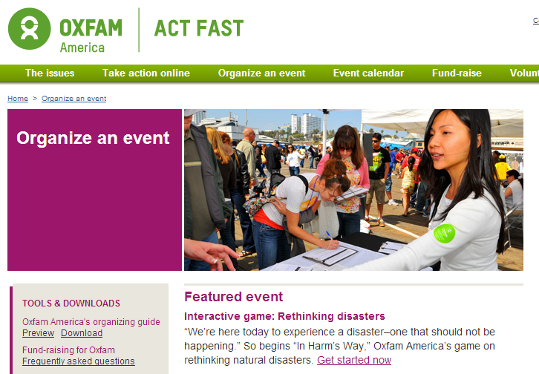
ENGAGING OXFAM SUPPORTERS
Notes:
All spikes have a desired policy outcome. We report on number of meetings and who was in them and we capture evidence of influence, like shifts in policymakers’ positions; their use of language we provide them; or any public or private statements.

Slide 14
STEP 1: PLAN STEP 2: MONITOR STEP 3: EVALUATE
Notes:
After the spike ends, it’s time to put the MEL plan to work and really dig into the learning. Teams usually have a few components to this process: the debrief, the final report, and any other products that may help share out the results.

Slide 15
DEBRIEF
Notes:
Oxfam uses debriefs to review what happened, look at data on tactics and activities, assess results against goals, and share out lessons. The essential questions are: “What happened?”, “So what?” and “What next”?

Slide 16
REPORT OUTLINE
Intro
Key Outcomes
Conclusions/Key Lessons
Next Steps
Notes:
Now it’s time to start writing! Team leads submit data for the indicators they are responsible for and provide brief write-ups for context. The MEL lead then assembles it all into a report, capturing the findings, evidence and recommendations.

Slide 17
PRODUCTS
Notes:
Reports often don’t get read. We’ve found it’s useful to have multiple formats, including a summary and PowerPoint. We’ve tried other items, like a trifold summary for tables in the office or an infographic. It’s a heavier lift, but it does promote use.

Slide 18
STEP 1: PLAN STEP 2: MONITOR STEP 3: EVALUATE STEP 4: SHARE LEARNINGS
Notes:
Now that you’ve created all these documents for different audiences, it’s time to share! Beyond presenting the report to the spike team, we share out toplines with other key groups. For this reason, it’s important that reports have lessons that are applicable across campaigns.

Slide 19
LEARNING & UTILIZATION
Notes:
We’ve struggled with utilizing findings. It’s hard to ensure teams read old reports before a new spike. Most spike reports are internal, although sometimes we’ll share with allies or donors. For the ATT, we shared our 2012 report with a donor, who then gave us funds for the next spike!

Slide 20
THANK YOU!
@RPCampaigner
RPerlmutter@
OxfamAmerica.org
Notes:
Thank you so much for taking the time to listen to me today. Remember the 4 steps: plan, monitor, evaluate and share learnings! If you’d like to connect with me more, feel free to reach out to me through email or Twitter.

