Slide 1
Linear Logic Modeling in the Non-Linear World of Translational Research Infrastructure
American Evaluation Association - Anaheim
November 5, 2011
Janice A. Hogle, PhD; D. Paul Moberg, PhD;
Christina J. Hower, MA; Bobbi Bradley, MPH
UW Institute for Clinical and Translational Research (ICTR)
ICTR Evaluation Office
School of Medicine and Public Health, University of Wisconsin-Madison
Marshfield Clinic, Marshfield, Wisconsin
JHOGLE@wisc.edu
Notes:
The 4 of us listed on this first slide constitute the 2.3 FTE of the Evaluation Office at our CTS Institute. Our job is to coordinate evaluation efforts across 8 cores or key functions comprising 30 discreet programmatic components providing integrated research resources to more than 1,000 scientists and their health sciences research teams at the U of Wisc and MC over the past 4 yrs. UW-ICTR is in the 2007 cohort, and thus in our 5th year of implementation.
I’m going to talk about how we use logic models as part of our evaluation approach at ICTR. And the reason I wanted to do that is because over the past 4 yrs I’ve seen the use of LMs mushroom among CTSA evaluators despite the fact that we’re in a very complex developmental situation with these CTSAs that theoretically works against the utility of logic modeling.
Abstract: At the UW Institute for Clinical and Translational Research, embedded evaluators use nested logic models to summarize complex layers of intent, assist with program improvement, encourage an evaluative perspective, communicate program achievements, and identify evaluation tasks and metrics. We think we have a handle on merit and worth, many processes and some outcomes, and formative and summative assessments. However, we continue to struggle with evaluating impacts within complex CTSA environments. CTSAs are interventions in research processes where fuzzy definitions and boundaries overlap with unpredictable emergent changes in program scope. We are not working in a simple environment of high certainty and high agreement about what to do, how to do it, and what impact to expect. Logic models, which work best in situations of static fixed cause and effect models, have become prevalent among CTSA evaluators. We address the utility of logic models within a developmental evaluation of CTSA implementation.

Slide 2
Theory of program change:
“…a static, fixed, and mechanical cause-effect model where inputs lead to outputs, which produce outcomes and impacts…
“Works well in simple situations of high certainty and high agreement about what to do. But such modeling has significant downsides and distorting effects in complex and dynamic situations where the [program] is emerging, evolving, and adapting.” MQP 2011
Notes:
The definition of logic modeling is that it represents a theory of program change, as we can read in many places including Dr Patton’s recent book on Developmental Evaluation. Logic models are commonly described as…. [read it]

Slide 3
In 12 minutes…
Why are logic models linear?
Why is CTSA-land nonlinear?
[do we have a problem?]
How does UW-ICTR use logic models?
What happens when they are “used”?
Notes:
Do we have a problem? The answer is “no” in advance.

Slide 4
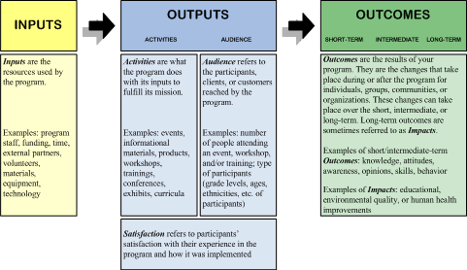
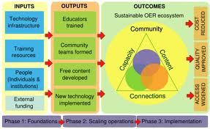
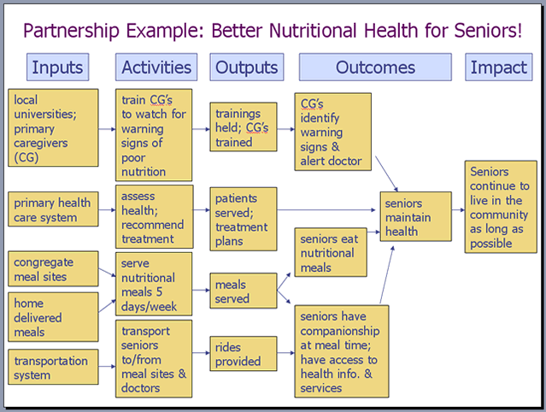
1. Why are logic models linear?
Notes:
We’ve observed that there are an infinite variety of formats with which to construct logic models. But they all have some similar characteristics and it’s very easy to misunderstand the features of logic models and to misuse them, but that’s not the topic of this ppt.

Slide 5
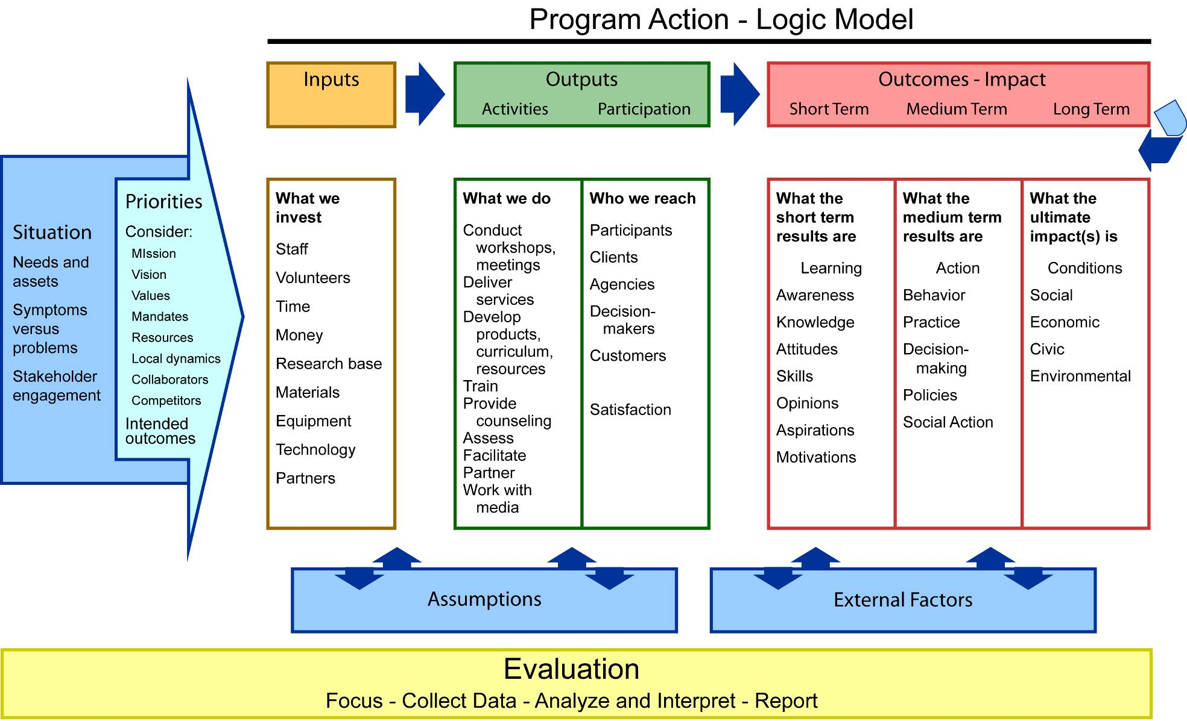
Logic model template update mm/dd/yy
Notes:
--Why are LMs linear when we know in advance that life is not linear?
--Maybe it’s a wish, that we’d like life to be more predictable and controllable.
--Maybe it’s because in English we read left to write and up to down.
--Maybe it’s just the way Western culture has evolved and LMs are a product of our culture.
--Maybe it’s because “logic” is supposed to be linear based on the “if” – “then” theory of change… IF you have a specified set of resources/inputs THEN you can do certain activities and IF you do those THEN there will be various types of results/outcomes/impacts over time.
--And maybe it’s because we’re trying to morph reality onto 2-dimensional space – a piece of paper.
--We talk about LMs as roadmaps and a road on a map is a line with dots along it and road signs – analogy for the unfolding of effort, the achievement of objectives, and milestones marking progress.
--BUT logic models incorporate feedback loops to suggest alternative realities;
--Classically, program evaluation determines if goals & objectives have been met – assuming a fixed program, a delimited time period, and a goal-attainment purpose -- none of which seems to apply in the CTSA world.
--It’s possible that some program managers feel that logic modeling is an attempt to “lock-in” a strict implementation plan with deliverables that may over time prove to be irrelevant, unnecessary or inappropriate. Some may even see LMs as an attempt by evaluators to annoy administrators.
It’s just a tool… a very useful one
This is the format we use at ICTR – it was designed years ago by the UW-Extension whose website provides an excellent tutorial for learning about applying logic models to evaluation – easily understandable to community-based collaborators and to academics. It comes up first when you Google “logic model.”

Slide 6
2. Why is CTSA-land non-linear?
Notes:
“Non-linear” to me implies complexity, unpredictability, an emergent situation – meaning that things are changing, morphing, evolving in ways that we had not foreseen. It means that as stuff happens over time, we have to come up with new directions, modifications, accommodations and different strategies for assessing achievement.
One example of the unknown was the realization that management of an Institute like ours takes so much more effort than the Administrative Core had imagined it would take.
Another example is that no one quite knew in advance how the partnership between UW Madison and the Marshfield Clinic, 3 hrs north, would actually happen. There was nothing in the proposal that explained how that partnership was going to develop, or even how it was intended to develop; the proposal just said it would develop. What’s happened in the past four years is an amazingly well-integrated mutually-beneficial situation of 2 large institutions combining their resources in forms of collaboration that had not happened in previous decades, and that likely would not have happened had the new CTSA infrastructure not been set in place.

Slide 7
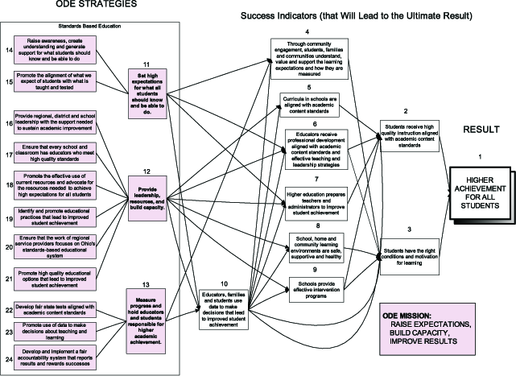
“Non-linearity”
“Real world”: budget, time, data, politics
Complexity and unpredictability
Lack of agreement on what to do and how to do it best
Fuzzy definitions; uncertain outcomes
Metric mania in the absence of clarity about what the evaluation questions really are
Emergent; “unexpectedness”
Notes:
I’m using the term “non-linearity” to mean that the real world intrudes on implementation – in terms of unexpected developments in the domains of budget, time, data and politics.
…that we are attempting to implement high quality evaluation adhering to our discipline’s standards, in a transforming environment of complexity where there’s a lack of agreement on what to do and how to do it best. We struggle with fuzzy definitions and poorly worded outcomes because we’re not really clear about what outcomes should really be.
Do we really know exactly what should be done to accelerate or advance the translation of health science knowledge into improved practices that impact human health?
Do we really know what it takes to connect the dots between better science and better human health?
Maybe not entirely, but we value these long term objectives, and the 100+ evaluators working at 60 CTSAs continue to collaborate to increase clarity. Thus, our evaluation strategies are emergent and deal constantly with “unexpectedness”.

Slide 8
“unexpectedness” -- characteristic of large-scale interventions
…50-60% of what we’re working on are things that we didn’t know about…
Notes:
We are all engaged in “Transforming the research process” but we don’t know in advance exactly what’s going to happen as this process unfolds.
Yet we’re faced with demands for accountability, metrics, predictability and even simplicity.
One of the dominant themes that’s emerged in our key informant interviews is that of “unexpectedness” as illustrated in this one quote from a senior staff member, underscoring the complexity and non-linearity of the transformation of the clinical and translational research process…
Here’s the full quote:
“…we did a gap analysis and that’s how we built our system. What I didn’t appreciate – like digging a hole and not realizing that there’s a clay pipe in the way -- that you come across things that you didn’t expect. We’re discovering that 50-60% of what we’re working on are things that we didn’t know about – gaps that were unknown in the beginning when we wrote the grant... I feel somehow that we’ve gone back some steps, but we’ve discovered that things are more complex than we thought… maybe we haven’t seen more progress for the amount of effort, but a lot of effort has gone into things we didn’t foresee. We’ve done other things that we didn’t expect to have to do.”
~ 2010 in-depth interview with senior staff member

Slide 9
“unexpectedness” -- characteristic of large-scale interventions
…50-60% of what we’re working on are things that we didn’t know about…
…things are more complex…
Notes:
[reading full quote from notes]

Slide 10
“unexpectedness” -- characteristic of large-scale interventions
…50-60% of what we’re working on are things that we didn’t know about..
…things are more complex…
…a lot of effort has gone into things we didn’t foresee…
Notes:
[reading full quote from notes]

Slide 11
3. How we use logic models in ICTR
Summarize complexity
Interpretation and clarification
“Did we understand your program accurately?”
Encourage an evaluative perspective
Added 2nd page w/indicators, data sources
Update regularly on a schedule
Print latest update on logic model
Link ICTR global objectives to key function level intent – “nested” outcomes
Notes:
We use LMs diagnostically – in the sense of needing to understanding the complexity of the various components of our Institute. The 18 LMs currently in existence help to interpret and clarify an integrated change process for clinical and translation research in our state. In our evaluation office we create logic models based on existing documentation and then ask stakeholders if the logic model accurately reflects what they’re doing, why, and how they’ll know they accomplished their objectives.
In a subtle way, the LM process encourages an evaluative perspective among our scientists and academic administrators most of whom have little understanding of program evaluation. They tolerate us, but we’ve put much effort into relationship & rapport building via participant observation as embedded evaluators. We use the UW Extension format, but we added a second page on which we include quantitative metrics and qualitative assessment strategies along with data sources in columns that correspond to the objective statements on the first page. Each logic model has a date on it [not described as “draft” but rather as “update”.] That tells us when was the last time changes were made to the LM. No logic model is ever really finished. And we do consider our component level LMs to nest within the ICTR global logic model. But we didn’t actually demonstrate on paper what that nesting concept looked like. It was our PI who operationalized that idea.

Slide 12
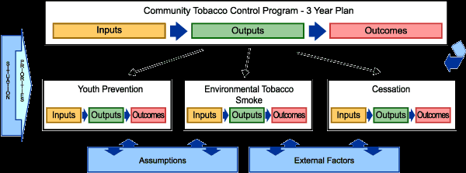
“Nested” logic models
View from space – overall roadmap [ICTR global]
View from mountaintops – more detail by core, component, program
View from ground level – “you are here” – workshop, training initiative, event
How is the concept operationalized?
Notes:
Nesting logic models help staff to understand how the outcomes they achieve fit into the larger organization.
The nested LMs are embedded in the organization’s macro theory of change summarized in the Institute-level LM.

Slide 13
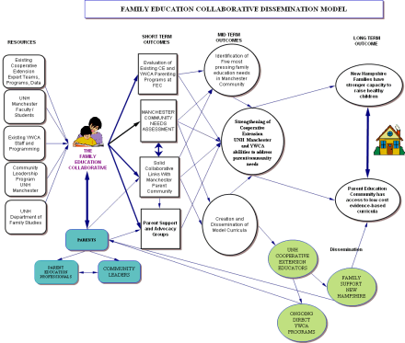
4. What happens when logic models are used?
A molecular biologist discovers program evaluation
One piece of paper can summarize 750 pages
Evaluators have an excuse to meet with key function directors and talk about objectives and means of verification
Groups of scientists talk about outputs, outcomes, metrics, goals & objectives, milestones
Logic model matrices become the structure for presentations
Matches between objectives and data
Notes:
Our PI is a molecular biologist with an international reputation for scientific work in bone and mineral metabolism.

Slide 14
Program manager comment:
“Our use of the Logic Model framework was an important catalyst for our Advisory Committee engaging in a very candid discussion about our goals, objectives and associated metrics, and in particular, our need to maintain efficiency and quality while establishing priorities for expansion -- a critical topic for our growing network. ”
Notes:
We’ve collected some stakeholder feedback in the process of in-depth, key informant interviews with key staff over the past 4 years, on a variety of topics, including their perspectives on evaluation. The program manager of one of our large research networks had this to say about the process of working on a logic model with the Advisory Committee for the research network.

Slide 15
Program manager comment:
“Our use of the Logic Model framework was an important catalyst for our Advisory Committee engaging in a very candid discussion about our goals, objectives and associated metrics, and in particular, our need to maintain efficiency and quality while establishing priorities for expansion -- a critical topic for our growing network.
“While creating our Logic Model, we experienced a spirit of collaboration and trust, engaged in healthy debate, acknowledged resources and success to date, addressed areas in need of improvement, and ultimately came to a consensus on our vision for the future.

Slide 16
Program manager comment:
“Our use of the Logic Model framework was an important catalyst for our Advisory Committee engaging in a very candid discussion about our goals, objectives and associated metrics, and in particular, our need to maintain efficiency and quality while establishing priorities for expansion -- a critical topic for our growing network.
“While creating our Logic Model, we experienced a spirit of collaboration and trust, engaged in healthy debate, acknowledged resources and success to date, addressed areas in need of improvement, and ultimately came to a consensus on our vision for the future.
“Upon completion of our first Logic Model, our Advisory Committee members expressed a renewed sense of ownership, camaraderie, and excitement for the future of the network.”
Notes:
She did tell me in addition, that at the beginning of the discussion, the committee members were not enthusiastic about being asked to comment on the logic model, but that as the discussion proceeded, people became more and more engaged. After the meeting, several members called her to say that they were amazed at how a discussion about boxes on a single sheet of paper, let to communication about a number of serious issues that had not actually come before the group before – issues that had been lurking in the background and needed to be discussed, but somehow the opportunity for those discussions had not emerged until objectives and metrics had been summarized in the logic model.

Slide 17
OUTCOMES Results -- Impacts
SHORT Learning Changes in: Awareness Knowledge Attitudes Skills Opinion Aspirations Motivation Behavioral intent | INTERMEDIATE Action Changes in: Behavior Decision-making Policies Social action | LONG-TERM Conditions Changes in: Conditions Social (well-being) Health Economic Civic Environmental
C H A I N OF O U T C O M E S
Notes:
Much of our time is now spent in the domain of outcomes – the results of activities.
As you see in this piece of the LM, the columns for short, medium/intermediate and long term outcomes are equal in size which may imply equivalent time periods, which in practice is not at all the case.

Slide 18
RESULTS/OUTCOMES → IMPACT (from ICTR logic model)
SHORT Learning | INTERMEDIATE Changes in action 5. Create an integrated home for clinical and translational science 6. Transform the research enterprise 7. Broaden the research process to encompass and integrate a wide variety of research communities beyond our academic boundaries | LONG-TERM Conditions
C H A I N OF O U T C O M E S
Notes:
At the global level of our institute, these are the 3 intermediate outcomes/results that have guided our activities. I’m going to use #6 to illustrate how our PI used the concept of nested logic models to illustrate accomplishments in a presentation to our EAC, and then to describe achievements using evaluation data.

Slide 19
IMPACT ANALYSIS
Impact CTSA had on quality and extent of clinical/translational research and success with which CTSA integrated with pre-existing research
ICTR | INTERMEDIATE OUTCOME
 | Transform the research enterprise by modifying and expanding existing resources, and creating new resources to produce better scientists, more effective research partnerships, and high quality clinical and translational research
CORES | NESTED INTERMEDIATE OUTCOMES
Education | Expand and enrich the clinical and translational training, education and career development environment
Regulatory | Reduce the regulatory barriers to high quality clinical and translational research
Informatics | Improve tools to organize patient related data for more efficient clinical and translational science Develop new methods applicable to analysis of biomedical images, next generation sequencing data, and proteomic profiles, and apply these methods in collaborative projects
Clinical Research | Sustain a classical CTRC (née GCRC) while extending research services to a broader community of researchers
Notes:
3 images from our PI’s presentation to our EAC
Our intermediate outcome #6 is in red [read it]. 4 of the cores are listed on the left, with their own intermediate outcomes that link to the global one. This slide was part of our PI’s presentation to our EAC earlier this year. [Comment on some of the details.]

Slide 20
IMPACT ANALYSIS
Impact CTSA had on quality and extent of clinical/translational research and success CTSA integrated with pre-existing research
ICTR | INTERMEDIATE OUTCOME
 | Transform the research enterprise by modifying and expanding existing resources, and creating new resources to produce better scientists, more effective research partnerships, and high quality clinical and translational research
CORES | NESTED INTERMEDIATE OUTCOMES
Biostats | Improve the availability of biostats resources, and strengthen and expand the quality and capacity for clinical and translational research
Community Academic Partnerships | Enhance educational innovations for Type 2 Translational Research Establish a diversified array of resources to support Type 2 Translational Research Support collaborative research partnerships with community based organizations Create or expand membership in and use of practice based research networks
Notes:
This same global outcome statement is in red. Then 2 additional cores have intermediate outcomes that link to the global statement.

Slide 21
IMPACT ANALYSIS
Impact CTSA had on quality and extent of clinical/translational research and success CTSA integrated with pre-existing research
ICTR | INTERMEDIATE OUTCOME
 | Transform the research enterprise by modifying and expanding existing resources, and creating new resources to produce better scientists, more effective research partnerships, and high quality clinical and translational research
CORES | NESTED INTERMEDIATE OUTCOMES
Collaborative Center for Health Equity | Expand the academic-community infrastructure to assist investigators with health equity research Obtain independent (NIH) funding to support a Center of Excellence for Community Health Equity Research Enhance interaction with UW cancer center to reduce cancer health disparities in rural communities
Lab resources | Increase awareness about and utilization of core laboratories for clinical and translational research Improve collaboration between ICTR and other supported Centers/Institutes
Pilot Grants | Improve the research infrastructure for young investigators, affording them the opportunity to initiate research projects
Notes:
One of the results of demonstrating how each of the key functions’ outcomes nested within the global outcome was to underscore the Institute’s efforts to break down silos and to better integrate the variety of types of services available to investigators.
But… he didn’t stop there…

Slide 22
Impact CTSA had on quality and extent of clinical/translational research and success with which CTSA integrated with pre-existing research
ICTR
Transform the research enterprise by modifying/expanding resources and creating new resources to produce better scientists, more effective research partnerships, and high quality clinical and translational research
Research Education Core
Expand and enrich the clinical and translational training, education
and career development environment
Established successful KL2 program for 43 trainees, 20 of whom have graduated
$28,738,284
$24,462,917
Amount Funded
Number
$2,607,467
$1,325,531
Total
Federal
Foundations
Intramural
Notes:
For each core-level intermediate outcome, he presented data demonstrating achievement.

Slide 23
Impact CTSA had on quality and extent of clinical/translational research and success with which CTSA integrated with pre-existing research
ICTR
Transform the research enterprise by modifying/expanding resources and creating new resources to produce better scientists, more effective research partnerships, and high quality clinical and translational research
Research Education Core
Expand and enrich the clinical and translational training, education and career development environment
Established successful MS degree program in clinical investigation
Number
Awarded
Federal Funding
2
4
5
$3,238,201
Notes:
[This structure was also used in our competitive renewal application.]

Slide 24
Take home messages…
Embedded evaluators working in complex research infrastructures might find logic modeling to be an extremely useful tool for participatory program evaluation

Slide 25
Take home messages…
Embedded evaluators working in complex research infrastructures might find logic modeling to be an extremely useful tool for participatory program evaluation
“Did I understand your program accurately?”

Slide 26
Take home messages…
Embedded evaluators working in complex research infrastructures might find logic modeling to be an extremely useful tool for participatory program evaluation
“Did I understand your program accurately?”
The process of using them is likely more beneficial that the actual matrix

Slide 27
Take home messages…
Embedded evaluators working in complex research infrastructures might find logic modeling to be an extremely useful tool for participatory program evaluation
“Did I understand your program accurately?”
The process of using them is likely more beneficial than the actual matrix
Logic models evolve just like programs do – put a date on them and check back regularly
Notes:
Embedded evaluators working in complex research infrastructures might find logic modeling to be an extremely useful tool for participatory program evaluation because it’s possible that LMs do not have to be static, fixed, cause & effect models that lock programs into delivering on SMART metrics.
“Did I understand your program accurately?” -- When they’re used diagnostically and updated regularly to reflect program evolution, then…
The process of using them is likely more beneficial that the actual matrix.
Participatory evaluation happens more easily with program managers and evaluators engaging in discussions about objectives and assessment strategies, as summarized in LMs.
And finally, to underscore the organic nature of programs and logic models – put a date on them and revisit them regularly.

Slide 28
Questions? jhogle@wisc.edu
Notes:
Go BADGERS!!

