Slide 1
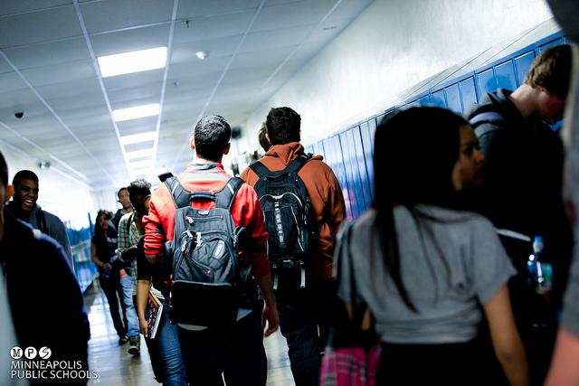
What Happens When Youth Speak their Truth(s)?
Youth Participatory Evaluation
November 2018
Notes:
Session Title:
What Happens When Youth Are Empowered To Speak Their Truth(s)? Youth Participatory Evaluation in a Public School System
Session Abstract:
Minneapolis Public Schools is the first district in the country to systematically implement a Youth Participatory Evaluation (YPE) program across all middle and high schools. Since 2015, youth teams have collected data from peers and adults in their school, analyzed this information, and presented recommendations to school administration and district leadership. This session will briefly present our process to empower youth as evaluators. Then, we will share what we have learned from youth who speak their truth(s), as captured by a meta-analysis of YPE projects over three years and youth-led focus groups about their YPE experience. Finally, we will present the results of our ripple effect mapping efforts, which models the impact of participating in YPE and that youth evaluators can have on their schools and the district.

Slide 2
Program Overview

Slide 3
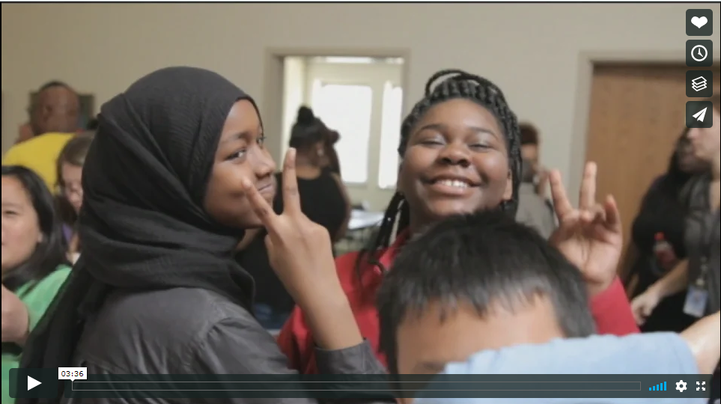
Youth Participatory Evaluation in MPS
https://vimeo.com/283058317
Notes:
https://vimeo.com/283058317

Slide 4
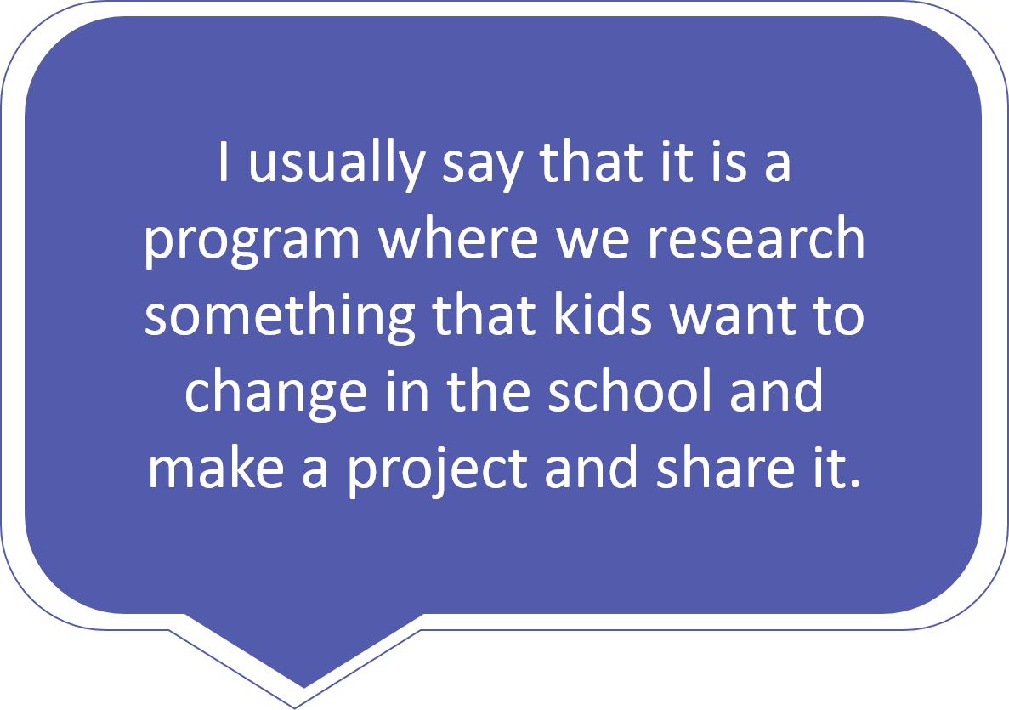
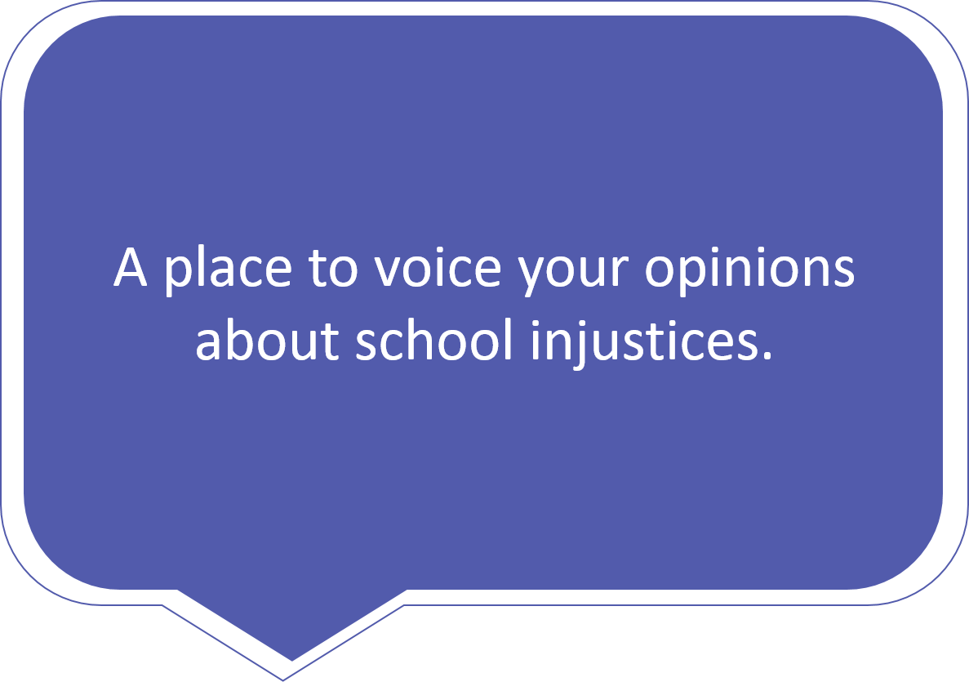
YPE Students Say...

Slide 5
Compliance to Transformation
Office of
Civil Rights Agreement
Youth Participatory Evaluation
• Youth develop evaluation skills to address school issues that matter to them
• Team collects data to represent student body voice
• Student voice influences district decisions and accountability
• Racial disproportionality in school discipline
• Student committees give input on behavior policy
• School and district administrators respond to student suggestions

Slide 6
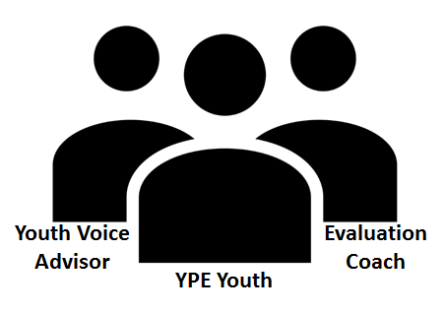
Adult Support
Advocate for Youth Voice throughout school
Connect YPE Team with E&E Team
Support YPE Team

Slide 7
Theory of Change
Empower & Institutionalize Youth Voice
Create Positive School Climate and Increase Student Engagement
Build Infrastructure &
Buy In
Impact Participants,
Policies, & Practices
Develop program model
Pilot program
Increase support and communication
Advocate for youth voice among system
Mapping change
Documenting what’s happening.
Shifting focus on adults
Address racial disproportionality
1
2
3
+

Slide 8
Program Calendar
Fall Summit
Data Collection
Analysis
Action
Spring Summit
Identify research question
Create annual research agenda
Learn data collection methods
Existing data review
Surveys
Focus Groups
Interviews
Participatory Methods (posters in lunch room, Kahoot survey at assembly)
PhotoVoice
Coding
Graphing
Breakdown by demographics
Need for more information
Potential Bias
Student PSAs
Staff Meeting Presentations
Policy Changes (i.e. hat/hood policy)
Present project to peers and district leadership
Identify shared findings and prioritize recommendations
Reflect on process

Slide 9
YPE Website
https://sites.google.com/mpls.k12.mn.us/mpsype
Notes:
https://sites.google.com/mpls.k12.mn.us/mpsype/home

Slide 10
What Are Youth Saying?

Slide 11
Research Agenda
What is getting in the way of you and your classmates having the school experience you want to have?
Curriculum
#WeDeserveBetter #TeachMe
Student Relationships
#IncreaseThePeace
School Policies
#RespectGoesBothWays
Student-Teacher Relationships
#KnowMe
School Distractions
#StayFocused
Student Voice
#YouthNeedVoiceandChoice
Resource Distribution
#WrongPriorities
Motivation for the Future
#PrepareMe
Notes:
Improved teacher and student relationships
Student-centered learning
Active
Culturally relevant
Project-based or collaborative
More time to understand content and ask questions

Slide 12
Specific Research Questions
At our school, does identity impact how people get treated? If so, how can we make a change in order to make Andersen a safe environment for all identities and races?
At our school, does the relationships between teachers and students impact the way students learn? If so, how can we come together as a student body to evaluate and give feedback to create a better learning culture for Northeast Middle Schoolers?
At our school there are a lot of negative student interactions/relationships. How does that impact a student's ability to learn and their well being?

Slide 13
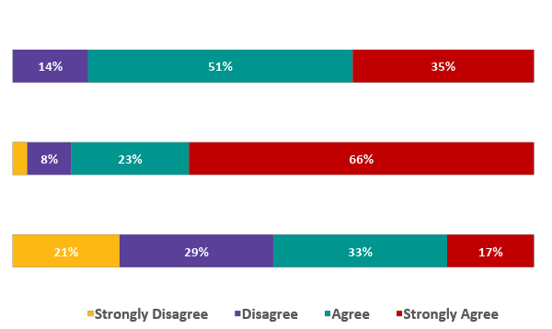
Program Impact - 2017
I feel like our research was important for impacting my school.
I feel like I am a leader in my school.
Adults at our school are open to hearing our ideas.
Notes:
Transition into challenges with adults -- dangers of asking youth to speak their truth if adults aren’t supported in hearing their truth

Slide 14
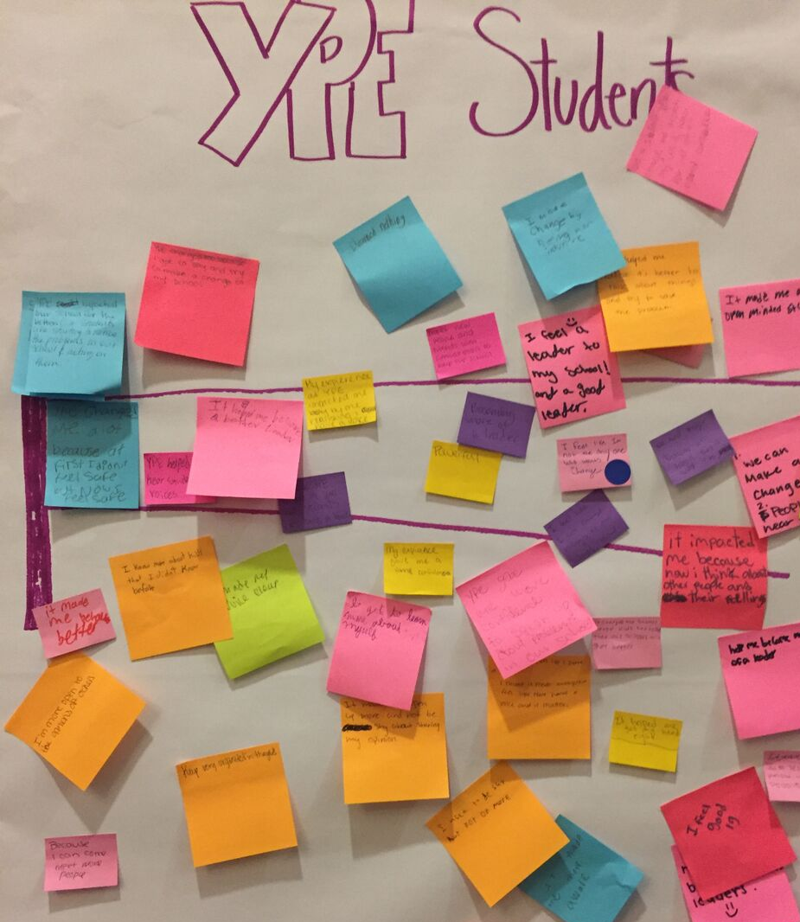
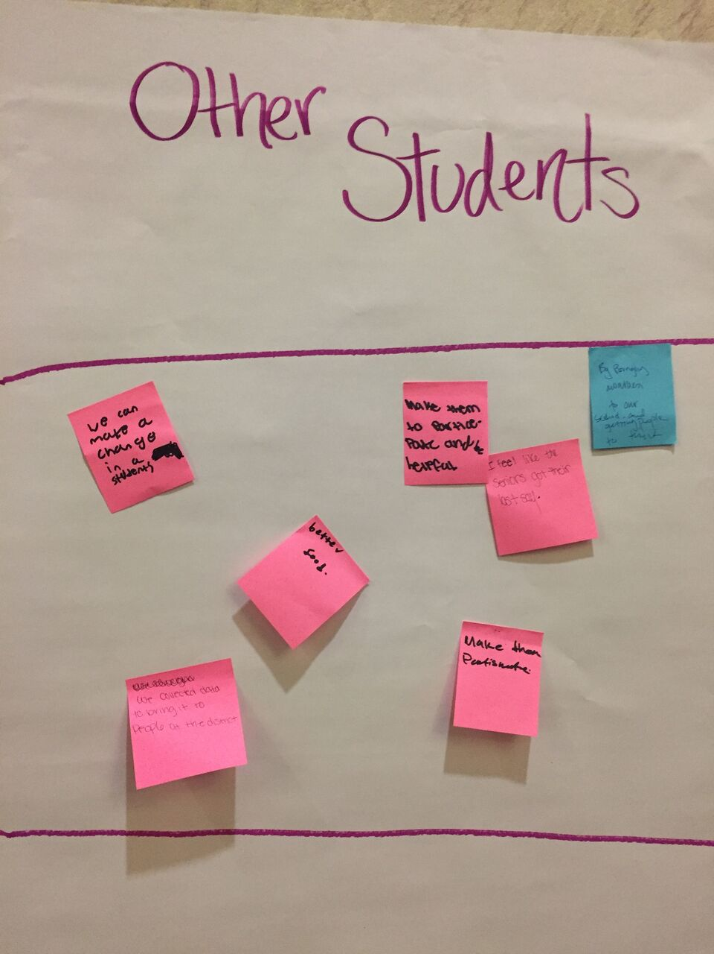
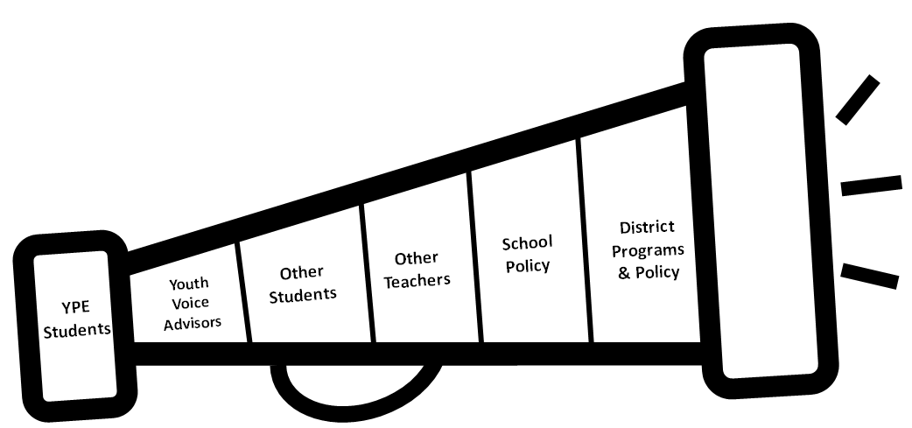
Program Impact - 2018

Slide 15
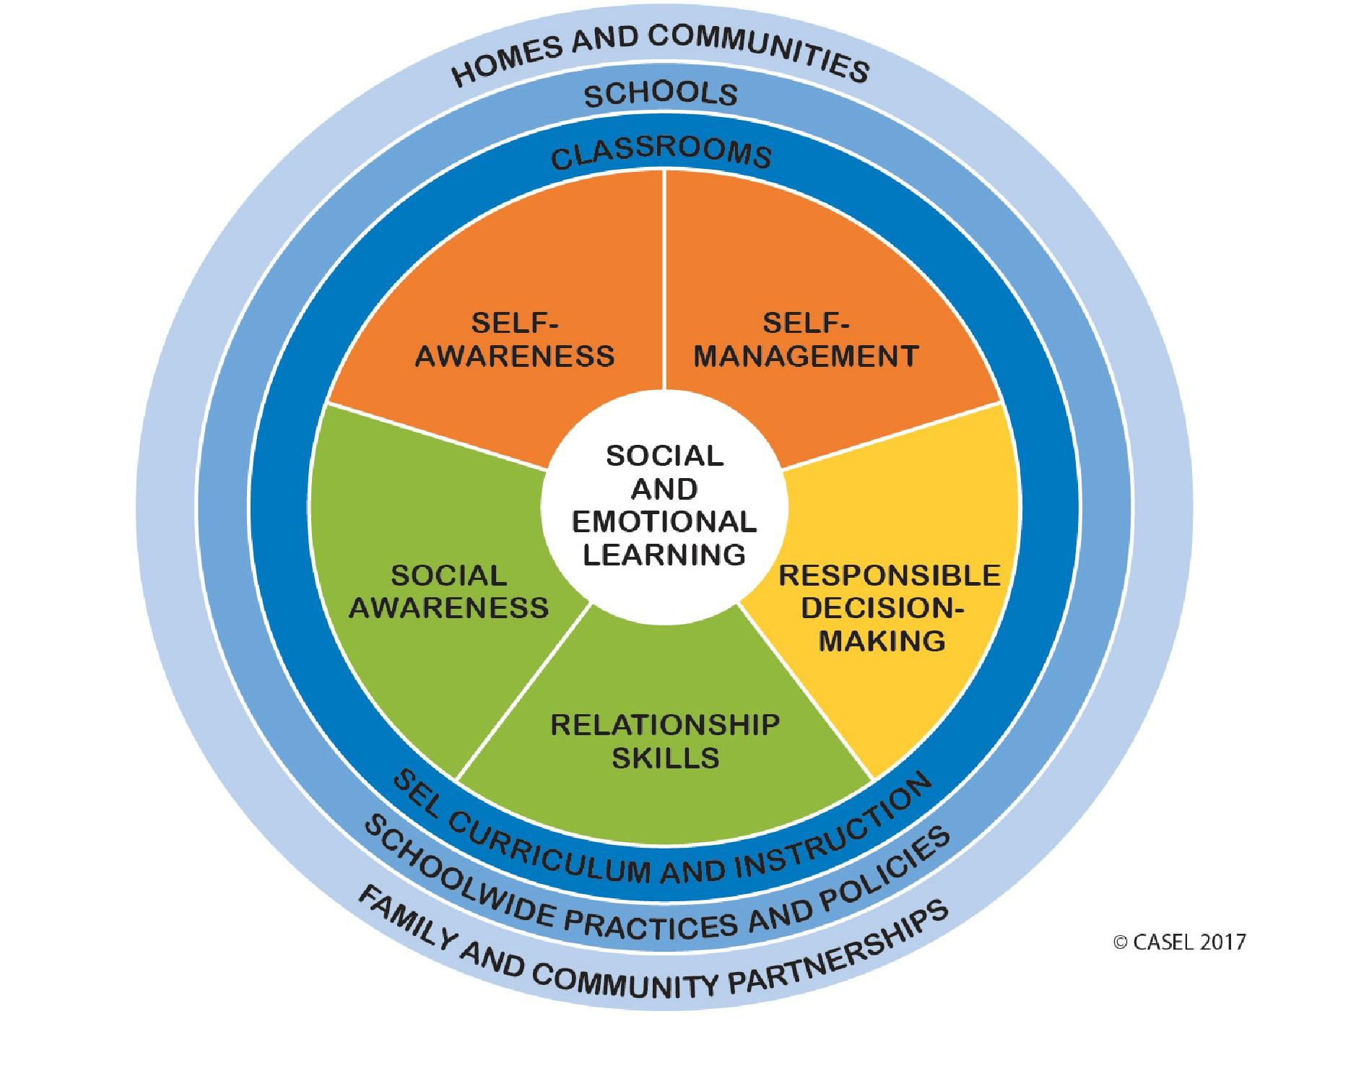
YPE as Social Emotional Learning
How do YPE Participants report program impact on themselves?
Self-Awareness/Self-Management
Reflection “It made me a more open minded student”
Confidence “YPE gave me more confidence to speak up about problems in our school”
Social Awareness/Relationship Skills
Empathy “It impacted me because now I think about other people and their feelings”
Collaboration “Meet new people and friends with similar goals to help our school”
Responsible Decision Making - Taking Action!
Leadership “YPE has helped us become better leaders”

Slide 16
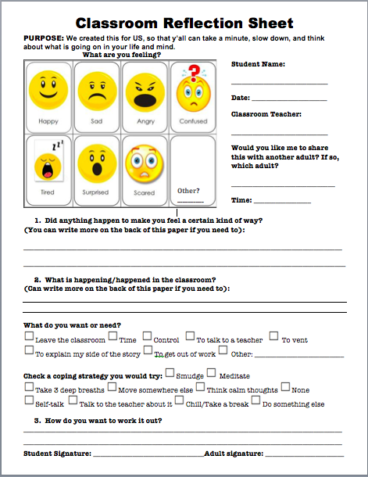
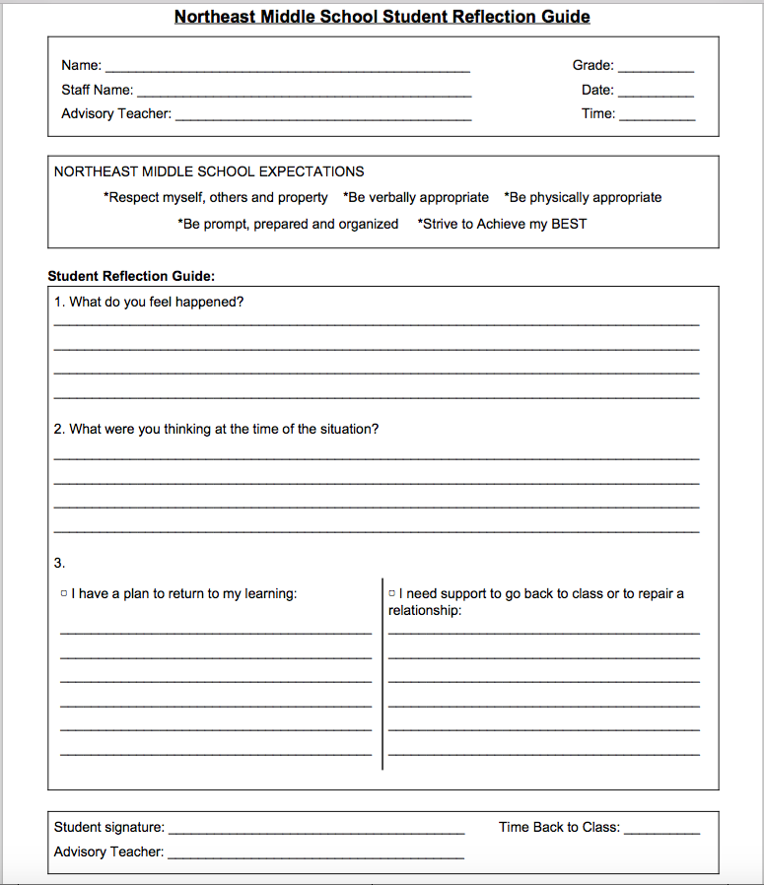
Current Buddy Room Sheet
YPE-Lit!’s Reflection Sheet
Example of School Practice Change -
Northeast MS Buddy Room Sheet

Slide 17
Issues with current policy:
Example of School Policy Change -
Roosevelt Hat & Hood Policy
Hats and Hoods are not a valid issue with gangs in our school.
Policy isn’t enforced equitably.
Current policy is used to support microaggressions against minorities.
Supports breakdown of relationships between students and staff.
Current policy is more of a distraction than a benefit.
Promotes student removal from class.

Slide 18
Next Steps
Documenting monthly progress via Evaluation Coaches to study implementation factors
Advisor commitment
School culture and leadership
Project theme
Comparing YPE participants with similar non-participating peers
Climate & SEL Survey
School Day Outcomes (attendance, referrals, GPA)
Gathering qualitative feedback from Youth Voice Advisors

Slide 19
Thank You!
Maren.Henderson
@mpls.k12.mn.us

