Slide 1
Learning for Adapting
Findings and implications of a Peer Education Assessment in the Philippines
Molly Chen, RTI International
Presenting on behalf of USAID LuzonHealth Project

Slide 2
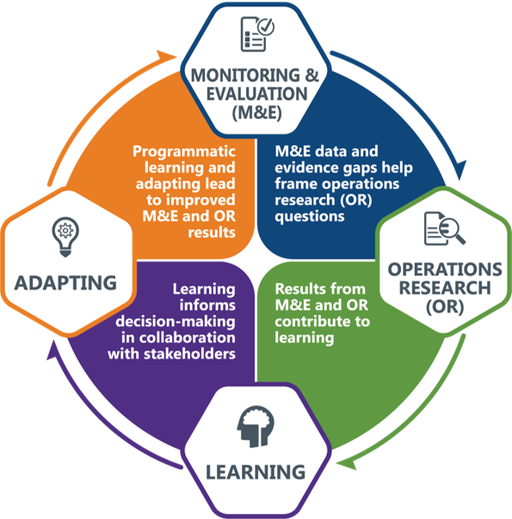
Monitoring & Evaluation, Research, Learning, and Adapting
Notes:
RTI International’s unique MERLA approach goes beyond traditional monitoring and evaluation and integrates M&E with operations research findings to contribute to an intentional learning plan/agenda/framework, which we have grounded using the USAID Learning Lab’s Collaborating, Learning, and Adapting (CLA) guidance. We encourage continuous learning from data from M&E data collection and OR finding to use for adaptive management, course correction, and policy decisions.

Slide 3
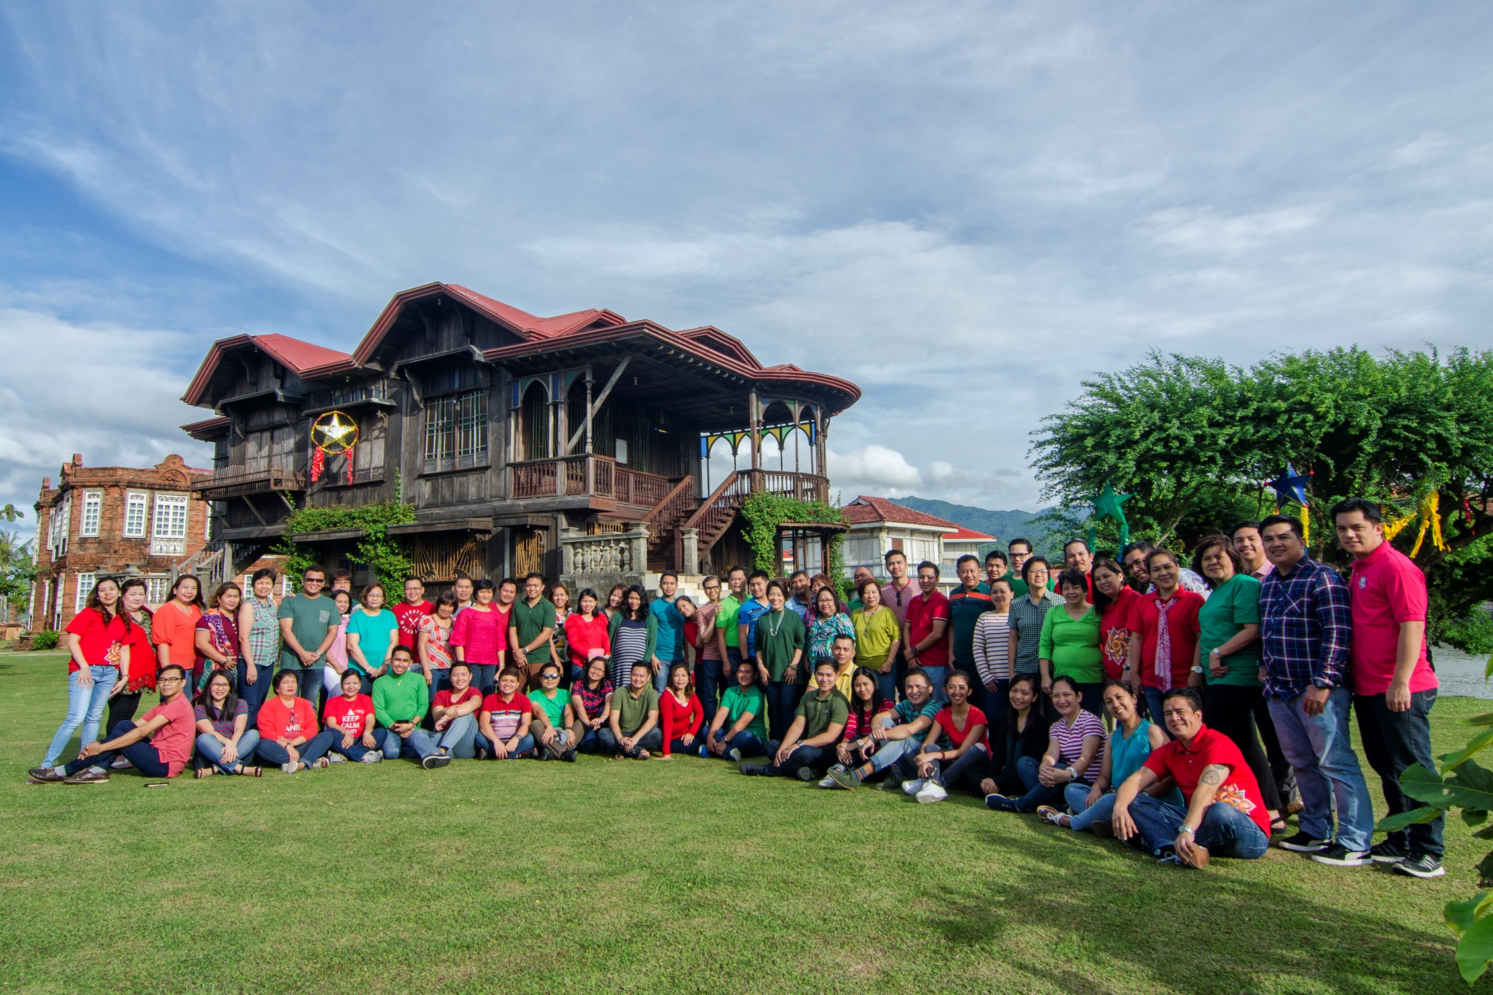
USAID Philippines LuzonHealth Project
Notes:
LuzonHealth is a five-year (2013-2018) health service strengthening project of USAID/Philippines implemented in partnership with RTI International. The project supports the Department of Health-led scale-up of high-impact services and client-centered information to reduce maternal and infant deaths, improve child health and nutrition, and meet the demand for modern family planning services.

Slide 4
Peer Education for adolescent health
Adolescent development
Sex, gender and development
Teen pregnancy
HIV and AIDs
Responsible parenthood and family planning
Notes:
In 2014, LuzonHealth designed and implemented a school-based peer education program to address high teen pregnancy rates in support of the government led Adolescent Health and Development Program.
The peer education program provides a venue for open, interactive and non-judgmental discussions among students on five standard topics, namely, Adolescent Development; Sex, Gender and Development; Teen Pregnancy; HIV and AIDS; and Responsible Parenthood and Family Planning.

Slide 5
Peer Education for adolescent health
Notes:
These discussions are initiated during peer education sessions facilitated by trained students and supervised by faculty members trained as advisers. The peer education program was established in 11 national high schools in Cavite and seven public and private high schools in Batangas City, Lipa City and Tanauan City in the Luzon Region.

Slide 6
Operations Research
Evaluate:
effectiveness of peer education on adolescent sexual and reproductive health knowledge and awareness and behavior intentions
Learn:
Identify improvements to incorporate back into the peer education model
Notes:
we aimed to assess the extent to which peer education contributes to the desired intermediate results of increased health knowledge and awareness and improved behavior intentions with specific focus on pregnancy prevention.
We implemented a mixed-methods approach that first compared knowledge and awareness outputs from a sample of schools who adhere to the standard teacher led curriculum and compared the same outputs with a sample of schools who implement peer education in addition to the standard curriculum.

Slide 7
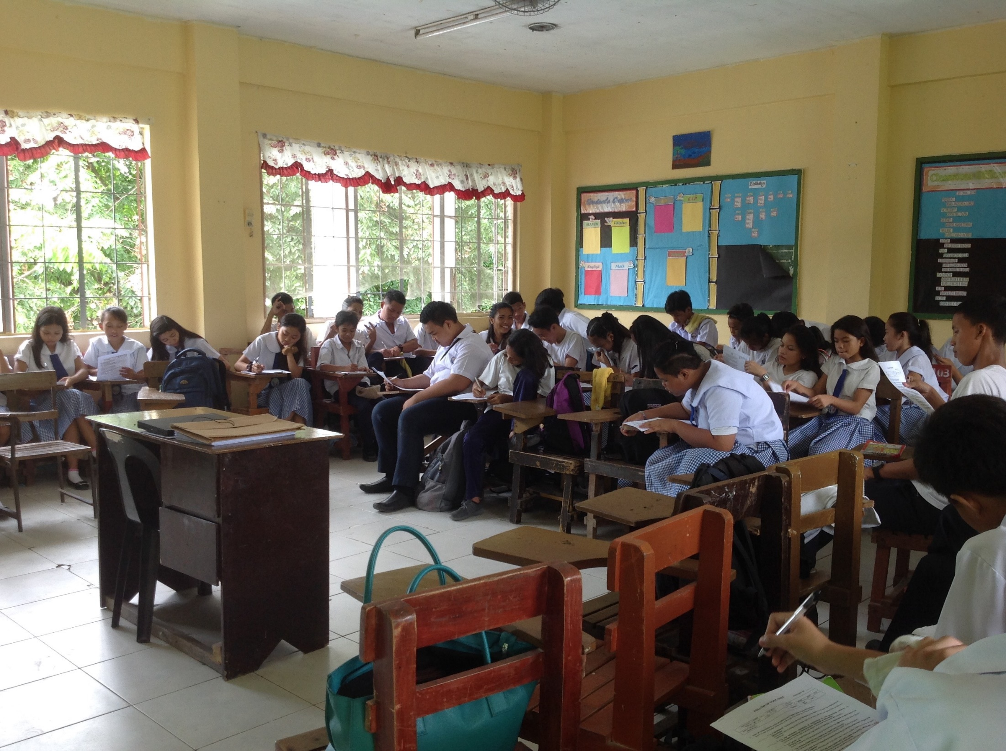
Operations research: quantitative methods
Notes:
Knowledge and awareness were measured through a quasi-experimental design.
The intervention and comparison groups each completed pre- and post-tests to measure knowledge of pregnancy prevention and sexual health. The test also included a behavior intention section, aiming to provide additional evidence around knowledge or awareness and behavior choices.

Slide 8
Operations research: quantitative methods
Notes:
Pre-tests were conducted on the first day of the first peer education module, prior to any teaching. Post-tests, were conducted on the last day of the fifth peer education module, following completion of teaching. The comparison group administered the tests at the same time intervals as the intervention group. All tests were conducted November through December 2017.

Slide 9
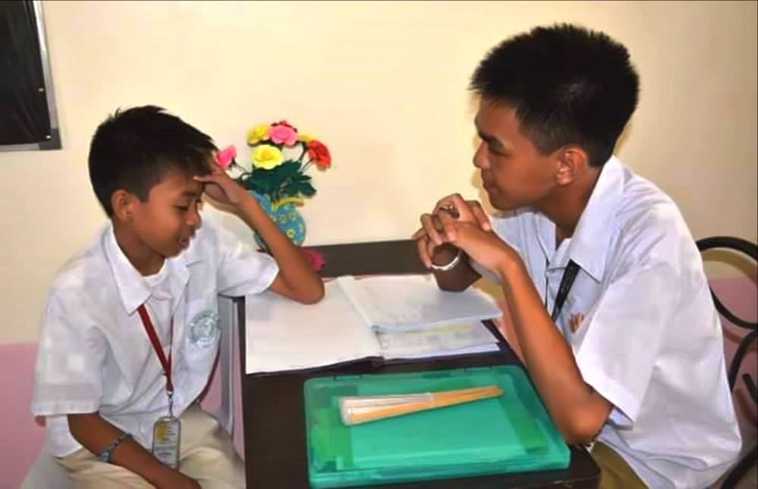
Operations research: qualitative methods
Notes:
To provide context for the pre and post test results and evaluate the strengths and limitations of peer education, key informant interviews (KIIs) were conducted among students, peer educators, advisors and school administrators.

Slide 10
Operations research: sample
Quantitative
Qualitative
Group | Location | Schools | Classes
Intervention | Batangas | 7 | 18
 | Cavite | 8 | 29
Comparison | Batangas | 5 | 15
 | Cavite | 8 | 27
Total |  | 28 | 89
Group | Interview Population | Count
Intervention | Administrators | 8
 | THK advisors | 8
 | Peer educators | 24
 | Students | 24
Comparison | Administrators or guidance counselors | 8
Total |  | 72
Notes:
For the comparison group, 13 schools were identified, sharing similar demographics with the schools in the intervention group. Forty-Two Grade 7 classes were then stratified and randomly selected from these 13 schools.
A total of 72 KIIs were carried out, 64 of whom were stratified across intervention school population groups.

Slide 11
Quantitative results
Test Section | Comparison group |  |  | Intervention group |  |  | Post-test score difference between intervention and comparison group
 | Baseline | Post-test | p-value | Baseline | Post-test | p-value | p-value
Pregnancy (Knowledge) | 67% | 68% | 0.679 | 66% | 72% | <0.001* | 0.003*
Sexual health (Knowledge) | 60% | 60% | 0.799 | 62% | 72% | <0.001* | <0.001*
Pregnancy* (Behavior intention) | 83% | 86% | 0.024* | 82% | 88% | 0.012* | 0.070
Sexual health* (Behavior intention) | 76% | 80% | 0.017* | 76% | 83% | 0.005* | 0.052
Full test | 68% | 69% | 0.514 | 68% | 74% | <0.001* | <0.001*
*p-values indicate a significance difference in values at the 95% level **likert scale scores were calculated where the preferred response received the highest value
Notes:
The pre-test scores for both the intervention and comparison group were not significantly different. Therefore, it can be assumed that the baseline knowledge, awareness and reported intended behavior within the two groups was not different.
On average, the post-test results demonstrated a significant improvement among the intervention group. The post-test results among the comparison group did not show a significant improvement. Additionally, the difference in post-test scores between the two groups were, on average, statistically significant.

Slide 12
Quantitative results
Test Section | Comparison group |  |  | Intervention group |  |  | Post-test score difference between intervention and comparison group
 | Baseline | Post-test | p-value | Baseline | Post-test | p-value | p-value
Pregnancy (Knowledge) | 67% | 68% | 0.679 | 66% | 72% | <0.001* | 0.003*
Sexual health (Knowledge) | 60% | 60% | 0.799 | 62% | 72% | <0.001* | <0.001*
Pregnancy* (Behavior intention) | 83% | 86% | 0.024* | 82% | 88% | 0.012* | 0.070
Sexual health* (Behavior intention) | 76% | 80% | 0.017* | 76% | 83% | 0.005* | 0.052
Full test | 68% | 69% | 0.514 | 68% | 74% | <0.001* | <0.001*
*p-values indicate a significance difference in values at the 95% level **likert scale scores were calculated where the preferred response received the highest value
Notes:
From this initial analysis, we can generalize that the students who received peer education increased in their knowledge and awareness and that this increase was significantly more than those who did not receive peer education.
When evaluating the test by topic, the intervention group had a significantly higher score in the pregnancy and sexual health knowledge sections compared to the comparison group.

Slide 13
Quantitative results
Students who attended peer education sessions were significantly more likely to respond that they:
are not ready to become parents
do not intend to engage in sex in the next one to two years
are not embarrassed to ask for or buy condoms, pills or other FP methods
Notes:
The results show that knowledge and awareness improve with peer education. However, reported behavior intention is less generalizable. However, students who attended peer education sessions were significantly more likely to respond that they:
are not ready to become parents
do not intend to engage in sex in the next one to two years
are not embarrassed to ask for or buy condoms, pills or other FP methods

Slide 14
Qualitative highlights
“Students can better relate to people of the same age …Usually they turn to their peers if they have questions about sex. At least, if we conduct talks about those things, we can assure that we deliver the right information.”
– THK advisor
“Because we are the same age they are more open to give ideas because they are not shy with someone their own age. For the discussion it feels like we are just talking casually, bonding. They don’t feel like I am a teacher who is lecturing.”
– Peer educator
Notes:
Students showed comfort in approaching peer educators with questions and demonstrated a preference in approaching peer educators over adults. 88% of students mentioned that they feel more comfortable discussing topics on sex and pregnancy after the peer education sessions and 96% of students prefer engaging in these topics with peers rather than teachers. This finding aligns with the outcomes of the quantitative analysis.

Slide 15
Qualitative highlights
“The subjects [standard curriculum] only provide information on what happens to the body during adolescence like puberty and development. These subjects do not teach the cause of pregnancy and how to take action.”
– Student
Notes:
When asked if there was any benefit to receiving the peer education curriculum in addition to the standard curriculum, 80% of those interviewed from intervention schools stated that even though components of the peer education curriculum are covered briefly in the standard curriculum, there is an additional benefit to reinforcing the curriculum through peer education.
It was also often mentioned that the peer education sessions provided additional information not covered in the standard curriculum. When the peer education sessions covered information that was also mentioned in the standard curriculum, they went beyond just providing facts but also provided practical information.

Slide 16
Qualitative highlights
“I thought this illness [HIV] was transmitted from mosquitoes and it isn’t.”
– Student
Notes:
Of the students interviewed, 75% said that the peer education sessions cleared up prior misconceptions.
Also, an additional benefit was that peer educators like conducting the sessions; noting that being a peer educator has improved their public speaking skills, knowledge and confidence. This unintentional outcome suggests that not only are the peer education sessions beneficial to the students attending them, but also to the students conducting them. Through training these students, the project has created advocates within the student population who are armed with correct knowledge and have developed skills to effectively articulate this information to their peers. These students have developed leadership skills which will serve them and their community in the future.

Slide 17
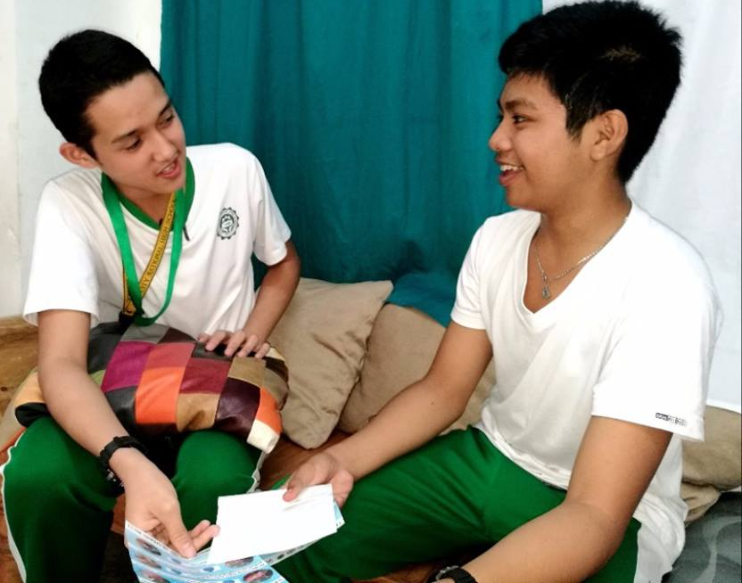
Summary of Learnings
“Just reading science gives biological and scientific explanation, not how will it (pregnancy) be avoided and how to deal with it if it happens to you.” – Student
Notes:
The peer education sessions provide information on contraceptive use in the context of HIV, responsible parenthood and family planning; rather than in the explicit context of teen pregnancy prevention
Compared with students not exposed to peer education, those exposed demonstrate greater knowledge and awareness of pregnancy and sexual health, and more intention for safe behaviors
The improvement in knowledge and behavior interventions in intervention group was statistically significant, but not necessarily of high/sufficient magnitude

Slide 18
Moving from learning to adapting
Peer education likely creates an avenue or entry point to engage in open, engaging, interactive dialog with students
This evidence opens a channel for policy engagement with Department of Education in collaboration with Department of Health, USAID and other stakeholders
Notes:
Peer education likely creates an avenue or entry point to engage in open, engaging, interactive dialog with students
This evidence opens a channel for policy engagement with Department of Education in collaboration with Department of Health, USAID and other stakeholders

Slide 19
Moving from learning to adapting
These findings could now be used to revisit the content of sessions, refine peer educator training and recruitment, expand outreach to adults, and inform other improvements.
Notes:
These findings could now be used to revisit the content of sessions, refine peer educator training and recruitment, expand outreach to adults, and inform other improvements.

Slide 20
This work was supported by the U.S. Agency for International Development. We thank our colleagues from USAID’s LuzonHealth Project who provided insight and expertise in this work.

