Slide 1
Incorporating innovative data collection and presentation methods into state- and community-level evaluation
April Hendrickson, MA
ahendrickson@omni.org
Alex Clay
aclay@omni.org

Slide 2
Overview & Objectives
Incorporating Technology
Background
Collaboration assessment
Process data
Data dashboard

Slide 3
Please Share!

Slide 4
Project background
Incorporating Technology

Slide 5
Project history
2004: Strategic Prevention Framework State Incentive Grant (SPF-SIG)
2009: Partnerships for Success (PFS): State & Community Performance Grant
(CPPS)

Slide 6
Past 30-day binge alcohol use

Slide 7
Project background

Slide 8
Target goals and timeline
Reduce binge drinking for Latino high school youth
Measured by the Health Kids Colorado survey
Baseline: 30.75%
3 year goal: 25.75%
5 year goal: 22.75%
2009 2010 2011 2012 2013
State baseline
County baselines
State & county sample
County samples
State & county sample

Slide 9
Incorporating technology
“The success of program evaluations will depend on evaluator’s abilities to leverage future technologies to produce and disseminate knowledge in an accessible and actionable form.”
Galen, M., & Grodzicki, D. (2011). Utilizing emerging technology in program evaluation. In S. Mathison (Ed.), Really new directions in evaluation: Young evaluators’ perspectives. New Directions for Evaluation, 131, 123–128.

Slide 10
Collaboration assessment
Incorporating Technology

Slide 11
Quality Process Survey

Slide 12
Benefits of online administration
No need to train how to administer
Take it whenever & where ever
No need to use valuable meeting time
Members who did not attend a meeting could still take it
Provides complete anonymity
Efficient analysis and reporting

Slide 13
Lessons learned
Less opportunity to create buy-in
Loss of a captive audience
Non-consistent members could respond
Reminders and extending deadline helped increase response rate

Slide 14
Incorporating Technology
Process
data

Slide 15
Process data

Slide 16
Benefits of online data collection
Complete it whenever and where ever
Program implementers can also access and enter data

Slide 17
Benefits of online data collection

Slide 18
Lessons learned
Buy-in is essential
In-depth technical assistance important
Interactive reports have not been well utilized
Required reporting is a great motivator

Slide 19
Incorporating Technology
Data dashboard

Slide 20
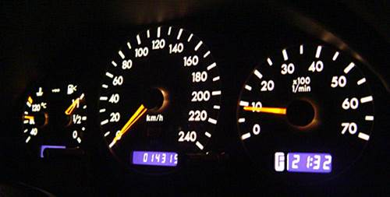
What is a data dashboard?
"An easy to read, often single page, real-time user interface, showing a graphical presentation of the current status (snapshot) and historical trends of an organization’s key performance indicators (KPIs) to enable instantaneous and informed decisions to be made at a glance.”
Peter McFadden CEO of ExcelDashboardWidgets "What is Dashboard Reporting".

Slide 21
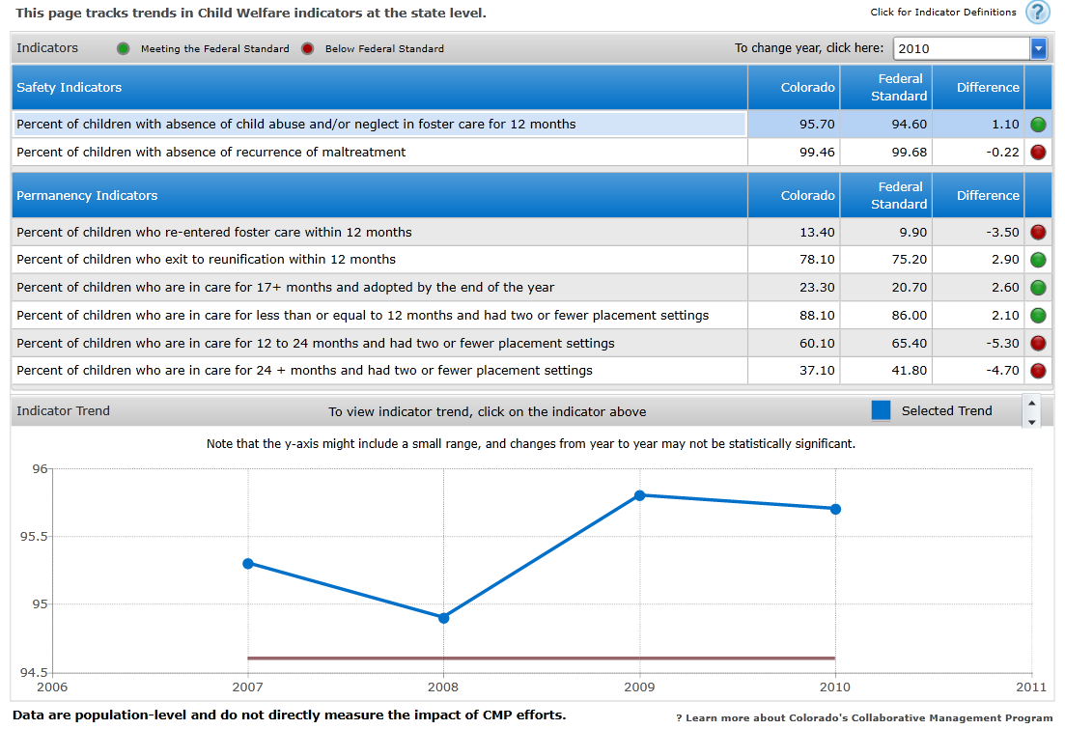
Provides a snapshot

Slide 22
Interactive

Slide 23
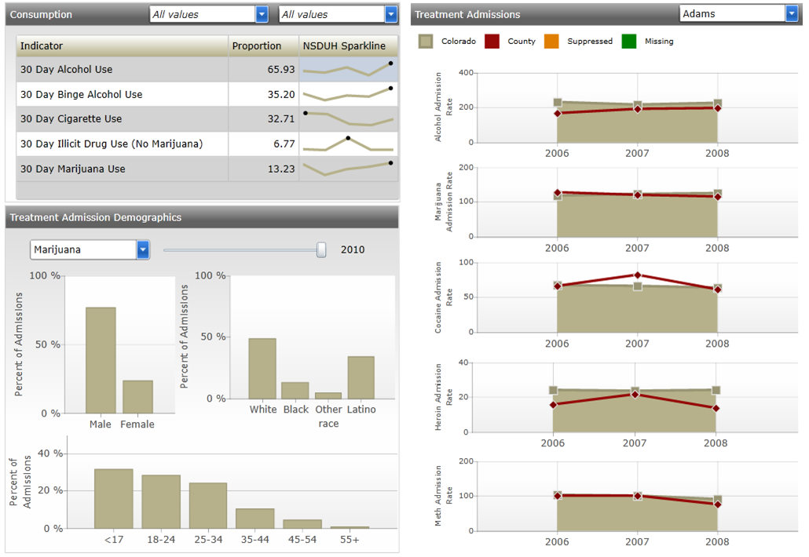
Combine data from different sources

Slide 24
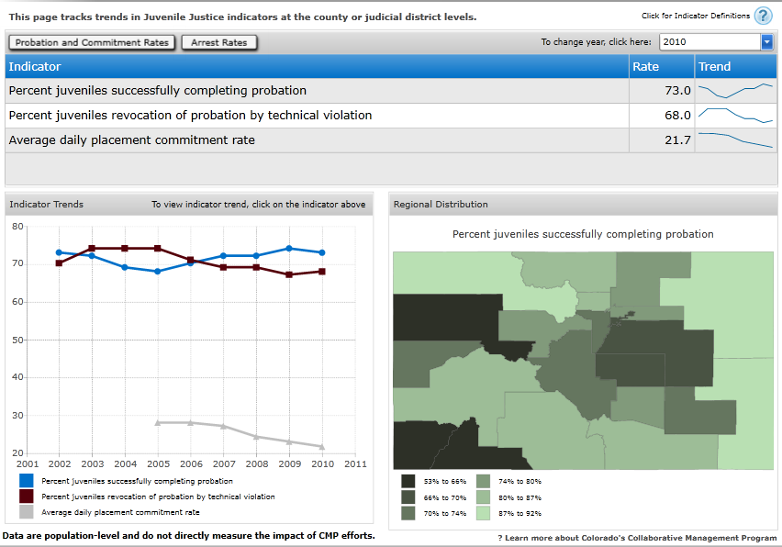
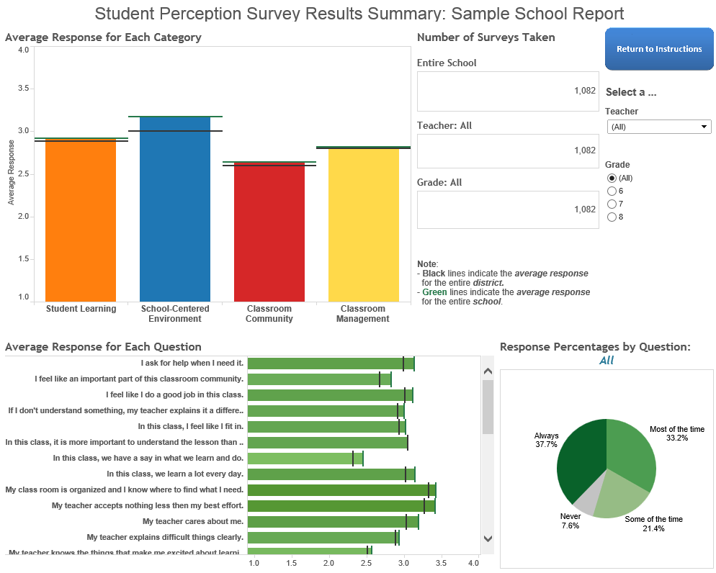
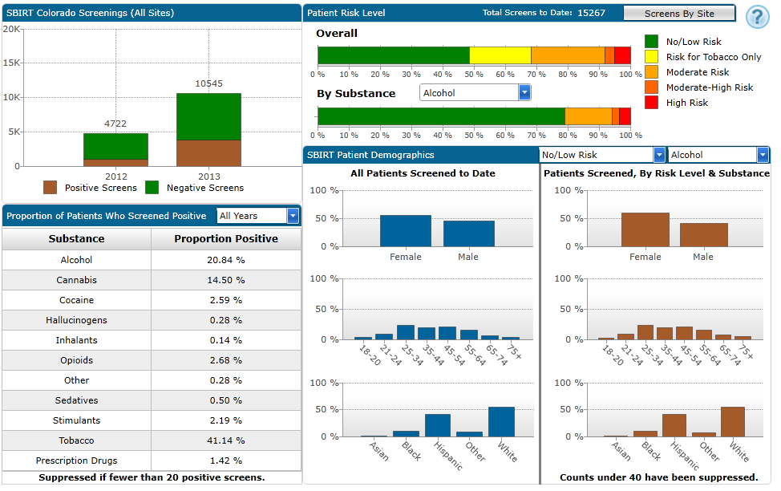
Customizable

Slide 25
Benefits
Provides a snapshot of key indicators
Interactive
Combine data from different sources
Customizable
However…

Slide 26
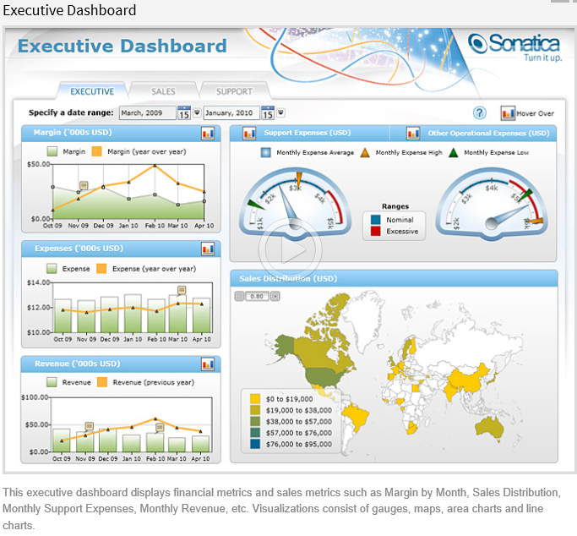
Lessons learned

Slide 27
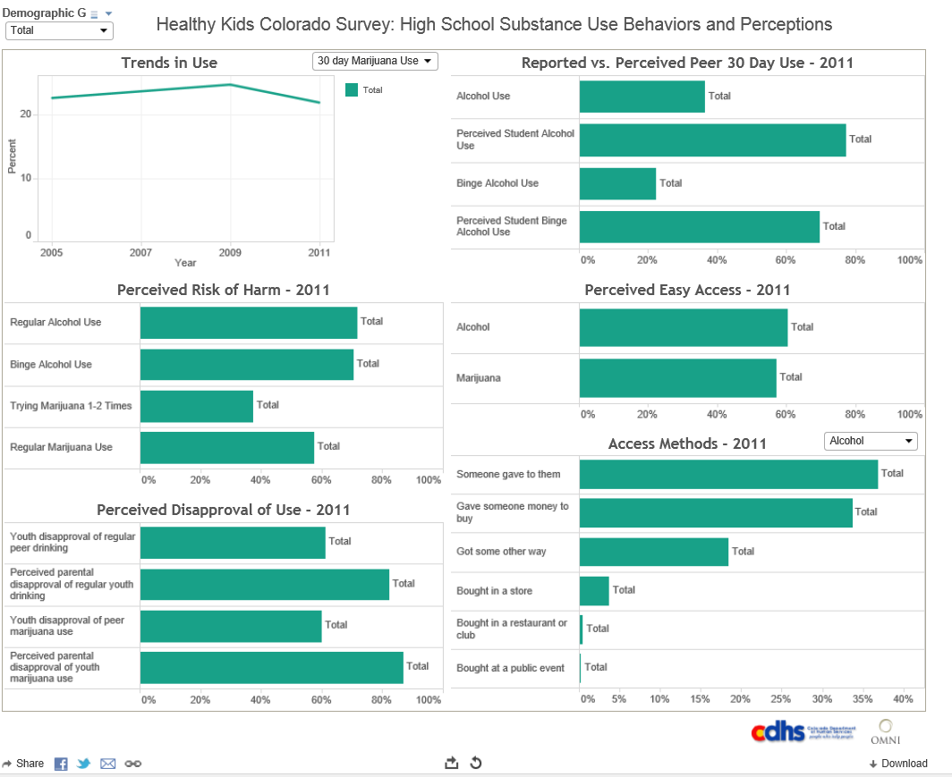
Lessons learned

Slide 28
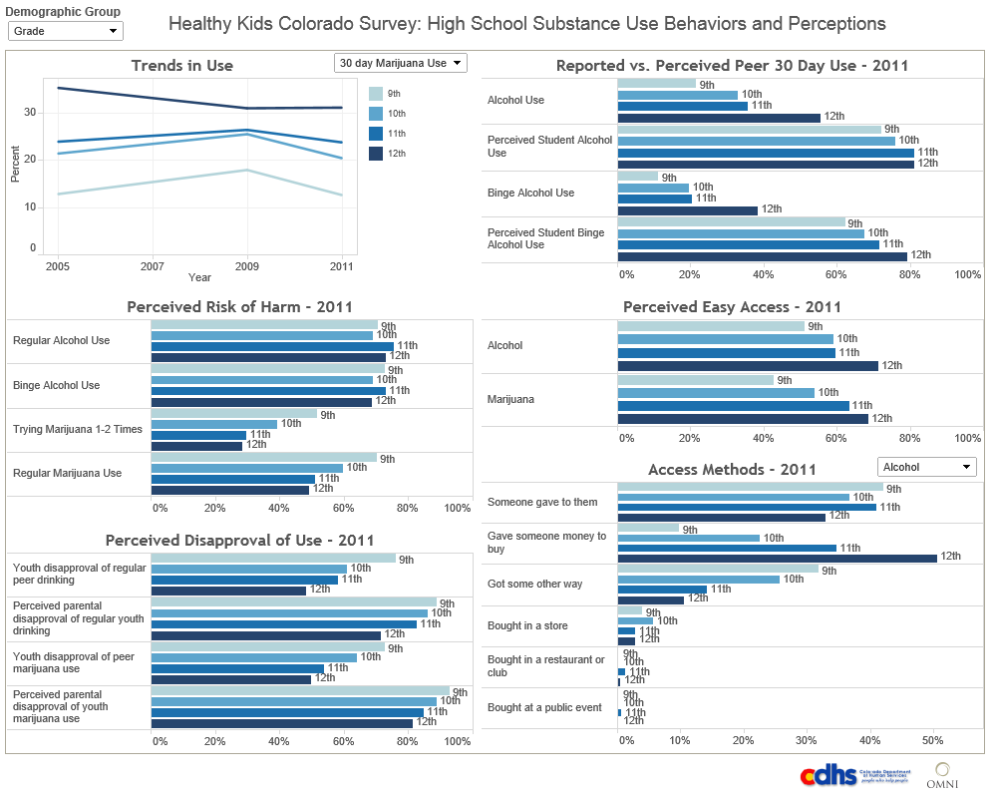
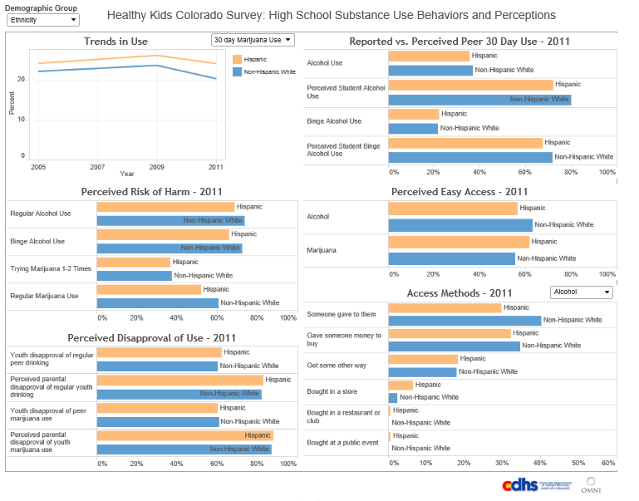
Lessons learned

Slide 29
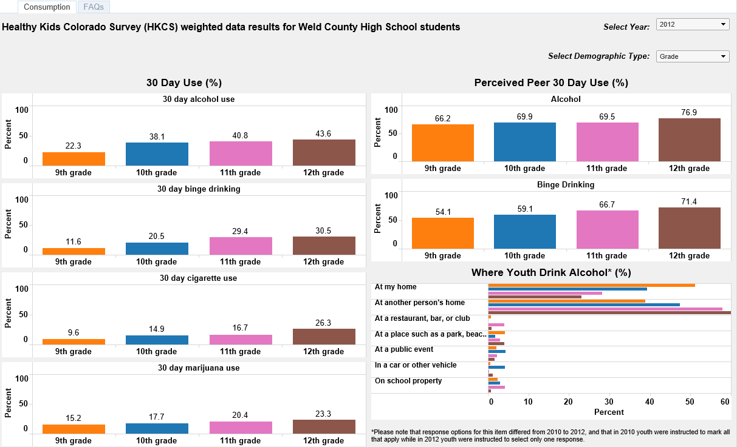
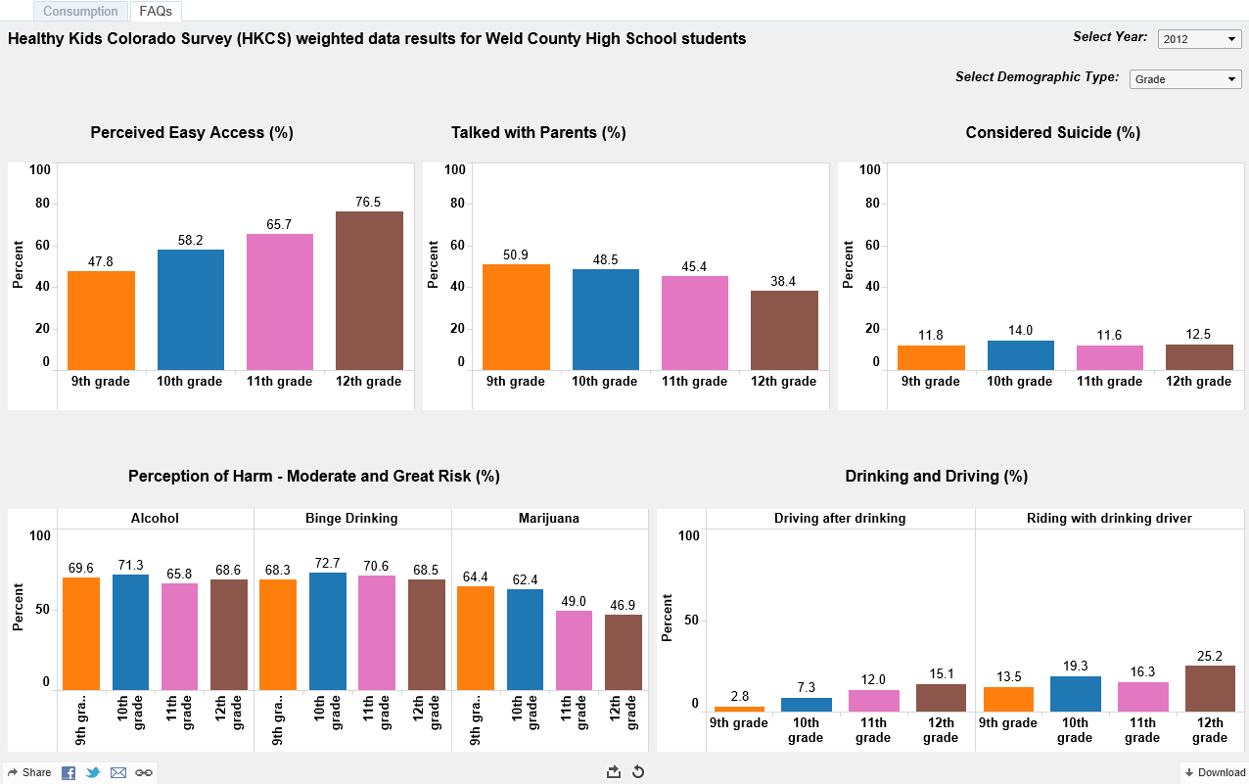
Lessons learned

Slide 30
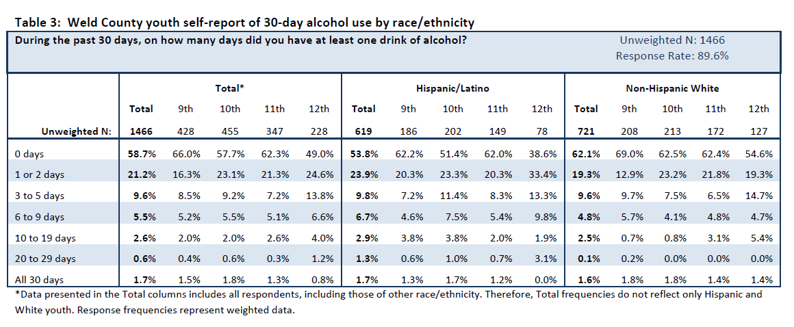
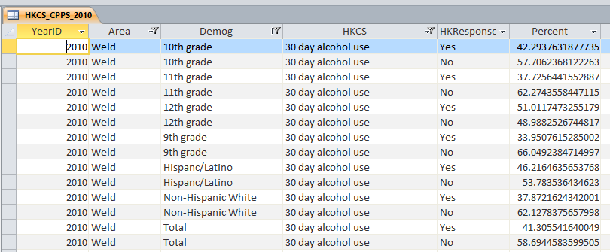
Lessons learned

Slide 31
Conclusion
“Evaluators must constantly scan for emerging technologies, consider their utility, and selectively deploy them into practice.”
Galen, M., & Grodzicki, D. (2011). Utilizing emerging technology in program evaluation. In S. Mathison (Ed.), Really new directions in evaluation: Young evaluators’ perspectives. New Directions for Evaluation, 131, 123–128.

Slide 32
Thank you!
April Hendrickson, MA
ahendrickson@omni.com
Alex Clay
aclay@omni.org

