Slide 1
Valuing Voices: Sustainable Solutions for Excellent Impact
Jindra Cekan, PhD
Valuing Voices at CEKAN CONSULTING LLC
www.ValuingVoices.com
and Siobhan Green of Sonjara (partner org)
AEA, Denver – Oct 2014

Slide 2
Why do we fund – and evaluate- international development projects?
We may want to:
1) Fulfill a mandate:
Make the world a better place by providing much-needed funding and expertise to the needy
Prove we spent taxpayer funds well
2) Prove we did a great job…
we were successful in using our inputs and outputs for sustained outcomes and impacts – or not
3) … or learn from where we haven’t?
4) Why else? ___________________
How could we make aid more sustainable?

Slide 3
Why We Value Voices
‘They’ should evaluate our assistance for effectiveness, not the other way around ☺
‘They’ are ‘Us’
Designing for sustained exit should be our first priority
We ALL deserve self-sustaining projects: Communities/ countries, we development workers, taxpayers… it’s true respect.
The business model works – do more of what’s excellent/ profitable and less of what’s not. Currently in international development we don’t know much about sustained impact. Let’s change that and fund future projects accordingly
Notes:
Briefly Aminata (Mali) and ___ (Sio’s Mali story)
We believe:
We ALL (Africans, Asians, Latin Americans, Europeans/ Americans and others) deserve self-sustaining projects
Communities living with projects should co-design them, use their own ICT systems and have strong capacity manage projects themselves and to evaluate how effective our assistance has been
Much international development assistance is needed; we must jointly learn from the past for future resource efficiency, time-use, credibility and sustained impact
Countries and communities must self-govern – how can we help them get there fastest with the best technology, know-how and respect

Slide 4
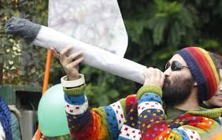
What’s Great?
Huge funding! US Government $20.4 billion 2014 USG funding and EU’s $80 billion in 2014 alone
Over 300 international non-profits in the US alone… helping 150+ countries over the last 50+ years!
Funding to local organizations by USAID is nearly 20% (goal 30%)

Slide 5
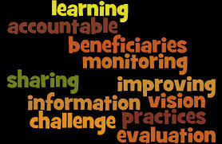
Great M & E work is being done…
Our industry is helping millions of ‘beneficiaries’ every year through multi-sectoral, global projects
We desire real impact: USAID and EU have invested millions in M&E as have Gates, Rockefeller…e.g. 3ie but are we evaluating impact?
IOCE supports over 100 national VOPEs (national evaluator associations) in 93 countries
Donors have invested further millions in learning ventures such as USAID’s/ Gates Foundation Grand (Health) Challenges, Making All Voices Count and IATI etc …

Slide 6
Global Commitment to Aid Effectiveness
US Government signed onto these goals in 2011:
Paris Declaration (2005), Accra Agenda for Action (2008)
and the Busan Partnership (Nov 2011) created shared
principles to achieve common goals:
Ownership of development priorities by developing counties: Countries should define the development model that they want to implement.
A focus on results: Having a sustainable impact should be the driving force behind investments and efforts in development policy making
Partnerships for development: Development depends on the participation of all actors, and recognizes the diversity and complementarity of their functions.
Transparency and shared responsibility: Development co-
operation must be transparent and accountable to all citizens

Slide 7
Development is becoming ripe for change…
Local Accountability has been proposed as a core feature of the new post-2015 development agenda, according to UNICEF.
MDGs are becoming Sustainable Development Goals post-2015
Donors talk about Country-led Development, M&E Capacity (OECD), Local Systems (USAID), as do non-profits like Local First- wonderful. Let’s support community-owned and driven ones!

Slide 8
Locating Valuing Voices in the sustainability evaluation landscape
Int’l non-profit does it all…………+Country/NGO does it………………..+Community does it all
EVALUATION- Done to/ with
Done by
Baseline, midterm and End of project evaluation
Impact evaluation (projected), Outcome Harvesting
Systems: Empowerment Eval, IOCE’s VOPEs
Ex-post evaluation (actual)
Self-sustainability evaluation…
ICT4D Knowledge Retention/ Learning
Done by
Paper documents
Databases, e.g. DEC, AidTracker and VOPE national databases
Mobiles/ tablets for crowd-sourcing
Self-generation Open-data database…

Slide 9
What could be improved?

Slide 10
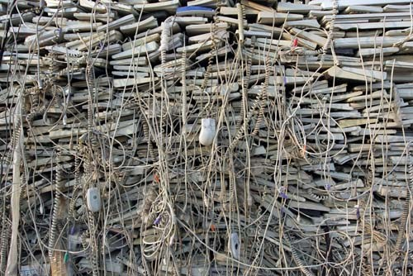
“Real” Sustainable Development?
Standard Operating Procedure
post close out:
Billions of $$ invested
Ex-post evaluations not performed, only few w/projected impact
Work ‘transferred’ to weak NGOs
without any continuing funds
National evaluations nonexistent
Minimal knowledge of projects by national governments
Data + tracking systems discarded
We don’t know what worked after we leave because we don’t ask
Or we don’t remember!
Notes:
Millions of dollars of development projects come and go from people’s lives after 2, 5, even 10+ years, usually without gaining the benefit of learning how sustainable their work has been.
Excellent monitoring and evaluation (M&E) are done during the project, examining how well project design and implementation worked to meet objectives, goals, impact.
Yet development implementers, donors and partners stop great M&E/ learning and hope for the best as they withdraw resources at project funding’s end.

Slide 11
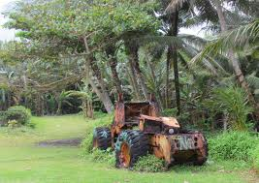
Scant design for self-sustainability
Communities’ voices are also rarely
elicited to design or to improve
activities they will make last…
RFPs not designed in communities…
To not evaluate sustainability
short-changes the communities which have entrusted us to improve their lives
Notes:
Sustainability is something left to community based organizations, often without staff or financial resources to go on anywhere nearly as robustly. Communities are routinely abandoned to their own (hopefully strengthened) devices.
We must support communities to evaluate these impacts themselves and teach us what they need. This returns development to their hands and empowers them to challenge future programs to be different.

Slide 12
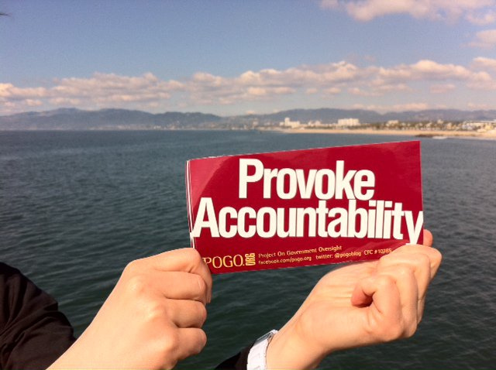
Leadership needed: ours! Unless we Value Participants’ Voices… to evaluate projects, make them their own:
Will we continue with narrowly focused, relatively-solvable projects aimed at the symptoms of underdevelopment as we have now?
… or look to learn from (un) expected impacts 2, 3, 5 after projects end? Ask participants what they feel projects yielded?
What if we:
© 2014 Valuing Voices, Cekan Consulting LLC

Slide 13
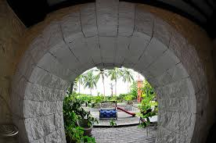
What are our real clients’ ROI?
We need to explore the long-term Return on Investment (ROI) of projects to communities
Focusing on ROI to just donors’ taxpayers misses the goal of development which is to Exit Sustainably
Ignoring community constituent voice is:
a symptom of a system focused on short-term success
a missed opportunity to learn from what was most self-sustaining (and why!)
A doorway to improve ways to
co-design for self- sustainability as
that is the real point in most
development projects (with the
exception of the needs for short-
term humanitarian aid)
* US$20.4 billion USG funding and EU’s $80 billion budget in 2014 alone is unevaluated for sustainability. The deserve more (www.ValuingVoices.com/blogs)

Slide 14
What Exists Now re: sustainability
There is a gaping hole in development and accountability: no longitudinal post-project evaluation of expected impacts and what has emerged after projects end, much less community-determined parameters of desired impact;
Sustainability is now narrowly defined as continued orgazinat’l financing;
Projects come and go, barely consult and withdraw resources in fixed times
Hardly ever are unintended impacts documented and learned from… + or -
Learning is often limited to within the projects, rarely across projects or later
Data and systems end at close-out, rarely open data (siloed/hidden)
STOP?
? ? ? ? ?
Development
Project, 2-5 year duration, typically
Feedback loops?
Earlier or concurrent
Development
projects
? ? ? ? ?
Follow -ons
baseline
midterm
final
? ? ? ? ?
E V A L U A T I O N S
Feedback loops?!
…The continuity of people’s lives in communities…

Slide 15
Views from outside on our DIME*
"You cannot set your own examination, take the examination and mark it. Then you cry out success or failure. The community will just 'look at you' and wonder what is the issue.
... It will be sustainable development if the people at community level are involved in designing and delivering their own dreams of development”
Peter Kimeu, Catholic Relief Services’ Senior Technical Advisor for Partnership/ Solidarity, East Africa (30 years expertise)
* Design, Implementation, M&E

Slide 16
Views from outside on our DIME*
“We push new ideas, rather than building on what communities have already created…. we must be able to look back and see what they've learned and can sustain themselves.… to show what they've done themselves, and where they think they're taking themselves. [Sustainability] is an ignored area. Challenge is, it's just been gathering numbers for 5 years, 10 years….
We don't have the right feedback system from communities to the NGO world. It’s the tyranny of deadlines so they "just get their concerns" when go out [to the field]…
Budgets and timing don't accommodate communities' ability to have time gathering together for distilled learning.”
R.K. Kenyan Independent Evaluation Professional
(20 yrs)
* Design, Implementation, M&E

Slide 17
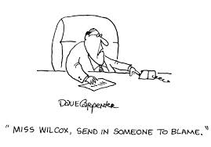
Feedback: how right are we?
Sustainability Evaluation:
What’s so Right you have to celebrate?
What’s so Wrong you want to scream?
Where is data capture, project learning and knowledge retention and sharing being done Well?
Where is it Worse than we think?

Slide 18
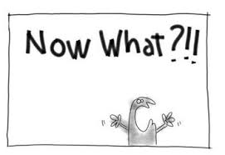
What Can Be Done?

Slide 19
Rarely is there a problem for which there is such a clear solution:
Shockingly, 99% of development projects are not evaluated for sustainability after close-out. (We’ve researched AEA, World Bank, USAID, EU databases…)
Ask Communities what has worked best in international development, what they want more of, and can sustain themselves
Do that everywhere.
That’s SUSTAINABILITY
Tell Others, Learn, Repeat.

Slide 20
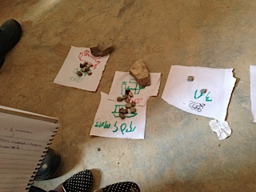
Self-Sustainability Impact
CURRENTLY NO ONE SYSTEMATICALLY, REPEATEDLY RETURNS TO EVALUATE POST-PROJECT SUSTAINABILITY…. But communities know what works
VALUING VOICES evaluated self-sustainability of ERCS food security project through Community Participatory M&E

Slide 21
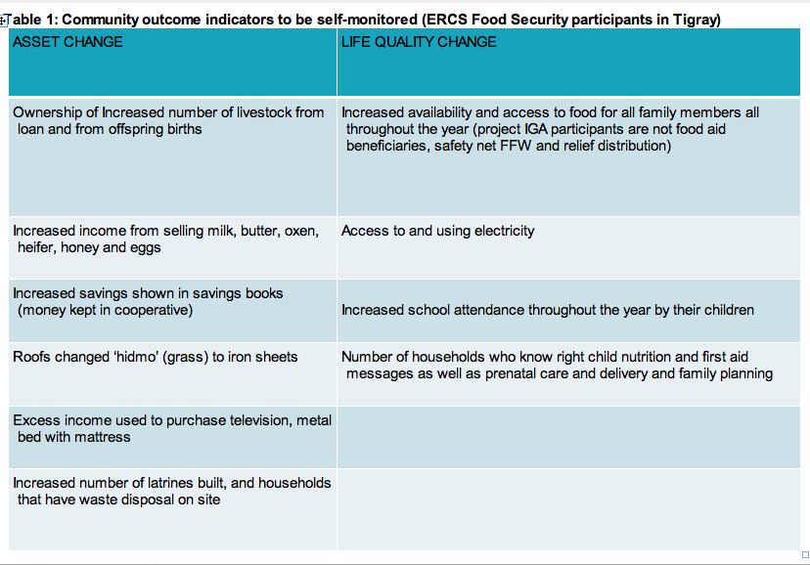
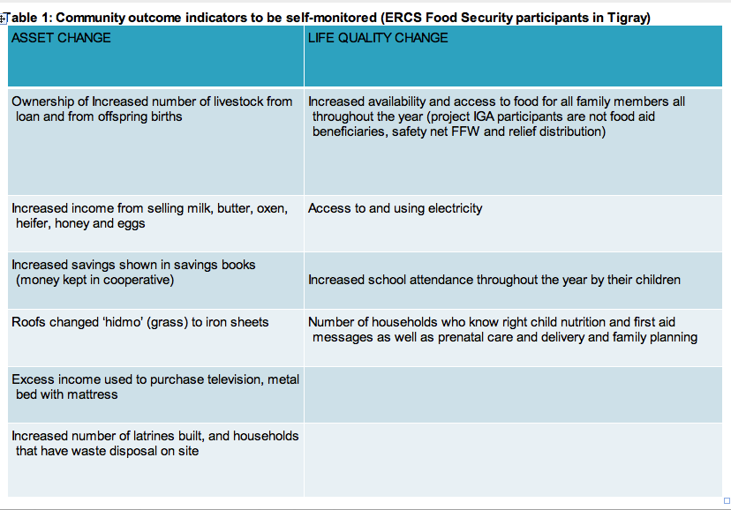
Accountability to our True Clients
This is what communities will measure themselves in Ethiopian Red Cross’ Tigray food security project:

Slide 22
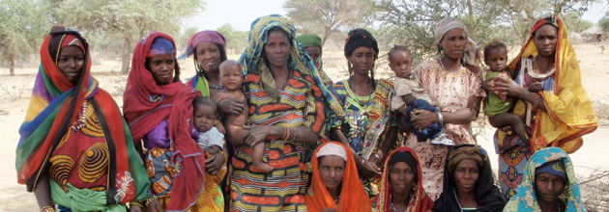
LWR Niger post-project unexpected impacts
Food security/ Livelihood/ Resilience project: sheep distribution, fodder, wells, peaceful transhumance for 500 women post-drought
Expected findings:
Variable impacts on women’s economic benefits
Great impact on time gain from wells for income generation.
Shocker:
Decreased domestic
violence from wells
(“our husbands don’t beat us
anymore”)

Slide 23
Great ex-post Catalysts
Organization | Project(s)
US Mercy Corps | MILK Program in Niger; Community Recovery in Central Asia
US Plan International | Kenyan Livelihood Project
Argentina's GVC OLNUS' | Support to generation and consolidation of cooperatives of Argentine Puna
Japan's JICA | Agricultural Development Project in Kambia District (Zambia)
PACT US/ Nepal | Micro-credit (Nepal)
CARE US/ | Food security (possible)
WHO ELSE?!

Slide 24
VV ex-post self-sustainability approach
Participatory Research by Activity and Objectives with Communities, NGOs, local stakeholders, on:
Background data:
1. Closed project data:
Activities
Objectives
M&E results (outcomes and projected impacts)
+
Participant lists for sampling
2. Project-expected sustainability and impacts
4. Intervening Factors during gap between close-out and ex-post:
Natural/crises
Govt policies
New projects
+
3. Community, NGO, stakeholder- expected impacts
Qualitiative
+
Quantitiative
Qualitiative
Analysis:
Classification, ranking including positive or negative
Country-specific Systems
Donor-specific Systems
Implementer-specific Systems
International System
(roll-up to)

Slide 25
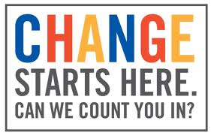
VV Research approach
Selection:
Past final evaluation/ financials on-hand, at minimum project design data
Ex-post project sites: projects closed within the last 2-3 years
Sector could be food security/ livelihoods, will select across age/gender/income
National databases in web-saavy countries to handle data/ analysis/ curation/ storage
Curation by: country vs donor vs
Implementing partner vs sector

Slide 26
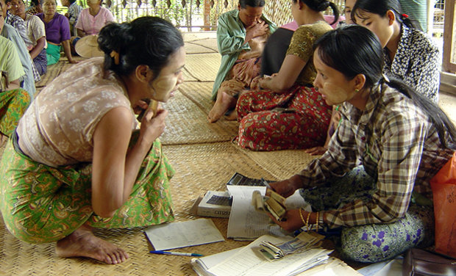
VV Research approach
Methodologies:
Participatory/ Qualitative approaches
(10 main questions of impact)
Appreciative Inquiry focus on what has worked best
Empowerment Evaluation principles, community-led
Outcome Harvesting looking for probable
Contribution of inputs to impacts
Feedback gathered from communities, by country national evaluators (pre-trained)
Possibly have a random-control site, e.g. one w/o further assistance vs. one with further assistance, or comparable village without same aid
ICT crowd-sourcing feedback through social media

Slide 27
VV Data Sustainability Approach
Open Data:
Design data captured using open data international standards (such as IATI)
Aggregate with other data sets (project, demographic, maps)
Sharable beyond project staff/activities
Available after project period of performance
Allows for public accountability /transparency
Historical marker of “what happened back then”
Mapping malnutrition in Uganda

Slide 28
VV Data sustainability approach:
Local data ownership:
Partner with local ICT firms to design app with local sustainable financing /business model
Local ICT firm focused on local users – responsive to local needs
Data gatherers and curators pulled from local communities (by universities, national evaluators)
Business model designed to cover both maintenance but also future upgrades post-initial donor funding
Pay per service can build usability expectations and empowerment by making beneficiaries also clients

Slide 29
PILOT YEAR BUDGET: VALUING VOICES Research and Ugandan Fieldwork Year
1. Research and writing:
Staff time, travel: $130,000
2. 1-country Fieldwork
Staff (US, Ug, Ky): $60,000
Travel (US, Ky to Ug) $16,500
Consultations $33,500
Local ICT firm $10,000
TOTAL: $250,000…
Can the Development Industry
afford not to trial and adopt this
methodology, especially given missed
learning to date?
Any funders in the house ☺?

Slide 30
Barriers to this work of Valuing Voices?
Donor inability to question inflexible budget and
funding cycles
Lack of commitment to national learning, infrastructure,
knowledge retention
Difficulty devolving power/ authority to countries,
focusing aid on demand, not supply
Commitment to listen to qualitative, local wisdom in
addition to parallel post-project quantitative evaluations is low
This is more than local NGO capacity building, its system-change
Weakness in processes of some local government and ministries to absorb lessons…dearth of available excellent national evaluators
Slow internet connections and prohibitive costs of mobile ICT communications especially rural
WHAT ELSE? What do we need for this to succeed?

Slide 31
Near-term projected Benefits of Valuing Voices?
Learning from post-project self-sustainability
Evaluations results in:
Learning what enabled sustainability or
prevented it… for other projects to do/ or not
A global database of post-project evaluation lessons by sector, country, implementer on sustained activities + ROI by project investment- how sustainably $$ was spent by open data formats
A cadre of trained national evaluators/ students and ICT database managers exists in each country
Inspiring better local solutions via better information on what works best and how to do more of it…
Fostering more sustainable, cheaper and resilient development through national Development Consumer Reports, AIDMaps…
Others you can see?

Slide 32
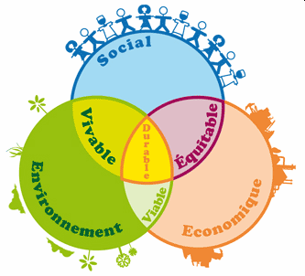
Feedback: Learning from what lasts?
What do we have right?
What would you change?
What else haven’t we considered?
Notes:
What can we improve?
Qualitative data systematized/ retained for analysis – tools?
Incentives to communities to participate in new feedback loops (possible issues of anonymity)?
Best ways to capture in databases at national + for global analysis?
How do we best advocate for:
Funding for Valuing Voices and willingness for community to learn from this approach? Larger/ later $$ ask: Global self-sustainability research, data repositories, capacity building and analysis/ sharing for joint programming with countries
How to address the ‘threat’ to donor autonomy and PVO $$ vs handing programming to national governments to take the reins and exert project design control, led by their national experts in partnership

Slide 33
What can we do now?
Monitoring: Work with communities to co-create their own self- monitoring system: IIED PLA Notes referenced in ValuingVoices blog, build this into baselines, midterm, final and beyond.
Ongoing evaluation via Feedback Loops: Support local evaluators to evaluate prospects for sustaining project impacts at design, midterm and end; use feedback to/from participants on project outcomes;
Publish your findings in open data formats using int’l standards such as IATI (US Gov’t is starting to require it!)
4) Advocate to donors for community-led ex-post
self-sustainability evaluation of actual impacts
2-5 years after projects close (community-felt
intended and unintended) impacts, knowledge
retention and sharing via ICT, global databases,
build capacity
… or fund your own!
Don’t we want to be at the forefront of development?
© 2014 Valuing Voices, Cekan Consulting LLC

Slide 34
Let’s go!
Let’s change how international development works… together.
Jindra@ValuingVoices.com and Sio@Sonjara.com
Thank you!

