Slide 1
An Evaluation of Teach For America (TFA) in Texas Schools: Findings, Issues and Challenges
Lauren Decker, Herb Turner, David Goodman, Jessica Brite, & Eishi Adachi
Presented to American Evaluation Association
October 16, 2013

Slide 2
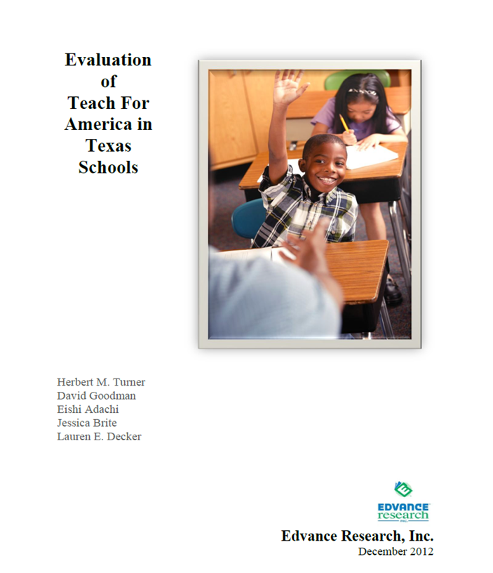
Report released March 2013
Turner, H., Goodman, D., Adachi, E., Brite, J., and Decker, L. (2013). Evaluation of Teach For America in Texas schools. San Antonio, TX: Edvance Research, Inc.
Available at www.edvanceresearch.com

Slide 3
TFA Overview
Teach For America (TFA)
Alternative means to teaching profession
2 year commitment with training and support (TFA corps member)
Program’s Primary Goal
provide teachers to high-need schools otherwise not staffed with comparable quality teachers
Four TFA regions in Texas
more than 1,600 corps members
working in 32 districts during the 2010-11 school year
Notes:
recruits recent college graduates, from the top colleges and universities in the United States, as well as experienced professionals from the U.S. workforce to commit to two years of teaching in low-income urban and rural public schools across the United States
Corps members work to obtain alternative certification during time as corps member
After the 2 year commitment, corps member who continue in the teaching profession are considered TFA alumni
Rio Grande Valley, San Antonio, Houston, Dallas
Previous research has been conducted on TFA in Texas but no studies had investigated all four Texas TFA regions and most did not utilize a statistically matched comparison group. One RCT previously conducted did include a Texas region but was not focused on understanding the impact of TFA in Texas

Slide 4
Evaluation Context

Slide 5
Independent
Evaluation
TFA receives funding from Texas Legislature
Short-time frame to complete study prior to next legislative session
TFA commissions study to support TFA’s request for more funding

Slide 6
Evaluation Process
Teach For America Funded independent impact evaluation
Edvance Research designed and conducted the impact evaluation
Edvance Research conducted the evaluation in consultation with a Technical Working Group (TWG):
Eric Hanushek
Thomas Dee
Ildi Laczko-Kerr
Final report reviewed and approved by TWG

Slide 7
Primary Research Questions
What is the effect of TFA corps members on 2010/11 TAKS mathematics and reading scores?
What is the effect of TFA alumni on 2010/11 TAKS mathematics and reading scores?
Target Population: Upper elementary (Grades 4 & 5) and middle school (Grades 6-8) across 4 TFA Texas regions
Notes:
TAKS was the Texas state assessment for the school year 2010/11 and stands for the Texas Assessment of Knowledge and Skills

Slide 8
Primary Contrasts & Outcomes
Grades
Contrasts
Outcomes
TFA corps members
Novice comparison teachers
Reading
Elementary
(4 & 5)
vs.
Math
TFA corps members
Novice comparison teachers
Reading
vs.
Math
Middle
(6 – 8)
TFA alumni
Experienced comparison teachers
Reading
vs.
Math
Notes:
Questions that had the adequate statistical power for policy relevancy
Results discussed in this presentation will focus on the primary research questions addressed in the report.
The missing comparison of elementary students of TFA alumni and elementary students of experienced comparison teachers was conducted; however, due to concerns about statistical power due to sample size as well as multiple comparison concerns, this question was addressed as an exploratory question.

Slide 9
Evaluation plan and data challenges

Slide 10
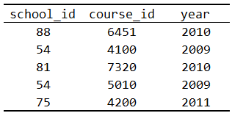
Structure of Administrative Data
Requested
School level
Teacher level
Student level
Notes:
Plan
Obtain data on schools, teachers and students including a teacher-student link available in Texas state data
Data challenges
Concerns about confidentiality led the state to deny access to teacher-student link
State agreed to provide two pieces of teacher information at the student-level
Teacher status (non-TFA teacher, TFA corps member, or TFA alumni)
Teacher years of experience

Slide 11
Structure of Administrative Data Received
Two teacher characteristics at the student level

Slide 12
Two-stage matching

Slide 13
Texas Schools
TFA
Schools
Stage 1
School Matching
Comparison
Schools
Stage 2
Student Matching
Grade level | TFA schools |  |  | Matched Comparison schools
 | Corps member (0-1 yr experience) | Alumni (> 1 yr experience) |  | Novice (0-1 yr experience) | Experienced (> 1 yr experience)
4
5
6
7
8
Notes:
First compute propensity scores then conduct matching
Matched schools with at least one TFA corps member or alumni (TFA school) to similar schools without a TFA corps member or alumni (comparison schools); matching variables used = previous year school-level student achievement (percent met proficiency on TAKS mathematics and reading) and current year school-level demographic characteristics (percentages of students by ethnicity, economically disadvantaged status, special education status, limited English proficiency, and mobility; size of the campus, the percentage of 1st year teachers and full time equivalents were also included)
Optimal matching method in MatchIt then used
Eligible students in comparison campuses were stratified by grade level then matching on prior achievement in reading and mathematics and demographic variables including student gender, ethnicity, economically disadvantaged status, special education status, limited English proficiency, and mobility
Greedy matching then used – matching at the student level was conducted within the sample stratified by teacher years of experience and grade level. What does that mean?

Slide 14
Largest matched comparison study conducted on TFA in Texas (To Date)
 | Reading (analytic sample) |  | Mathematics (analytic sample)
 | TFA | Comparison | TFA | Comparison
Schools | 108 | 375 | 94 | 399
Students | 7,177 | 7,177 | 5,894 | 5,894

Slide 15
Did the matching process work?

Slide 16
Summary of school-level baseline equivalence testing
 | Elementary TFA vs. comparison schools | Middle grade TFA vs. comparison schools
Gender | = | =
Race/ethnicity | = | covariate
Economically disadvantaged | = | covariate
LEP | = | covariate
Reading | = | =
Mathematics | = | =
Note: Results of all baseline equivalence testing is evaluated based on the WWC standards
Notes:
Prior to the matching process, substantial differences were found for seven of the eight campus characteristics between both elementary TFA and elementary non-TFA campuses as well as middle grade TFA and non-TFA campuses
These equivalences differed for each analytic sample; therefore, school-level covariates differed in each model. The report contains more information on which school-level covariates were included in the various analytic models.

Slide 17
Summary of student-level baseline equivalence testing (reading analytic sample)
 | Elementary TFA corps member vs. Novice | Middle grade TFA corps member vs. Novice | Middle grade TFA alumni vs. Experienced
Gender | = | = | =
Race/ethnicity | = | = | covariate
Economically disadvantaged | = | = | =
LEP | = | = | covariate
Reading | = | = | covariate
Mathematics | covariate | = | =
Notes:
Groups were statistically equivalent for most demographic and academic variables. Four variables were found to differ between .05 - .25 and warranted inclusion as covariates. No differences too substantial (above .25)

Slide 18
Summary of student-level baseline equivalence testing (mathematics analytic sample)
 | Elementary TFA corps member vs. Novice | Middle grade TFA corps member vs. Novice | Middle grade TFA alumni vs. Experienced
Gender | = | = | =
Race/ethnicity | = | = | =
Economically disadvantaged | = | = | =
LEP | = | = | covariate
Reading | covariate | = | =
Mathematics | = | = | covariate
Notes:
Groups were statistically equivalent for most demographic and academic variables. Three variables were found to differ between .05 - .25 and warranted inclusion as covariates. No differences too substantial (above .25)

Slide 19
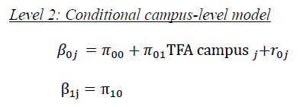
Two-level Regression Model

Slide 20
Findings
Notes:
No significant difference was found between elementary students of TFA corps members and novice comparison teachers for reading or mathematics achievement
No significant difference was found between middle grade students of TFA corps members and novice teachers for reading. A significant difference was found between middle grade students of TFA corps members and novice teachers for mathematics

Slide 21
Findings
Note. Elementary grade sample sizes were insufficient to conduct the analysis.
Notes:
A significant difference was found between middle grade students of TFA alumni and experienced teachers for reading and mathematics

Slide 22
Main Limitations
Only one teacher characteristic was controlled through matching
Matching only equated groups on measured school and student characteristics
The level of TFA fidelity of implementation associated with impact estimates is unknown
The TFA teacher indicator were embedded in the student record so the exact number of TFA teachers in the study is unknown

Slide 23
Thank you
Lauren Decker
ldecker@edvanceresearch.com
Herb Turner
herb@analytica-inc.com

