Slide 1
American Evaluation Association Conference Washington, D.C. November, 2017
Using Narratives and Pivotal Stories to Facilitate Learning
Leanne Kallemeyn, Loyola University Chicago
Jay Wade, Loyola University Chicago
Linda Gilkerson, Erikson Institute

Slide 2
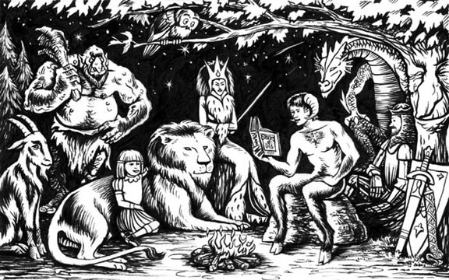
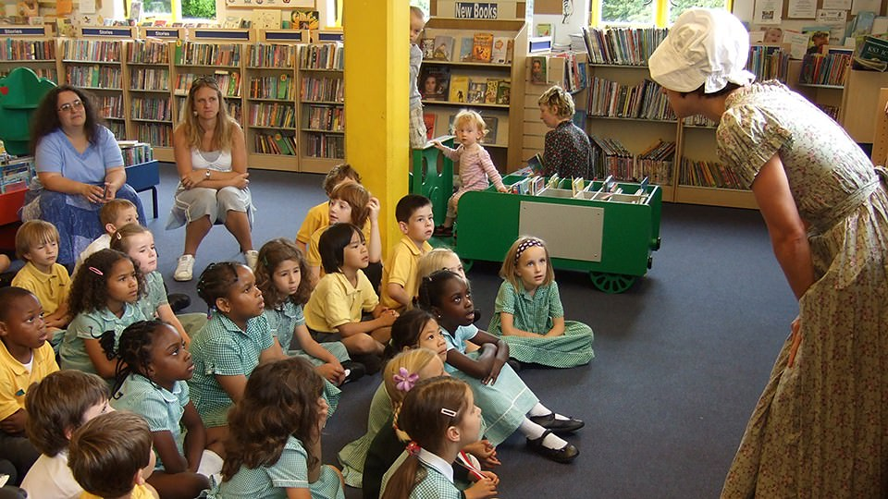
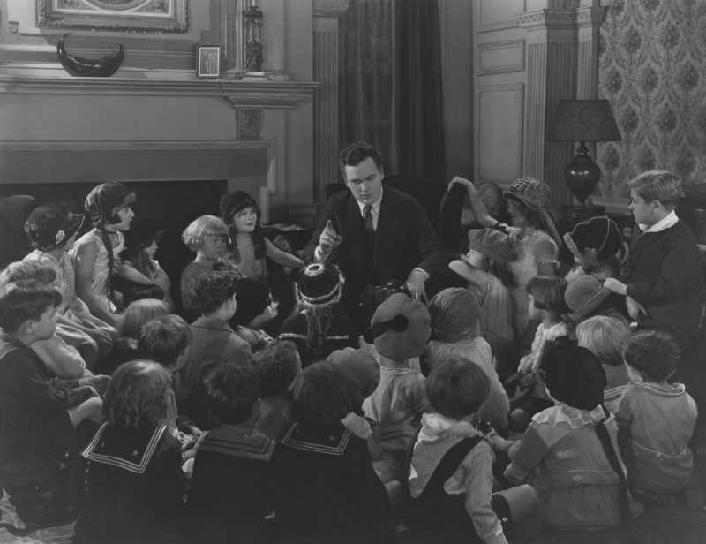
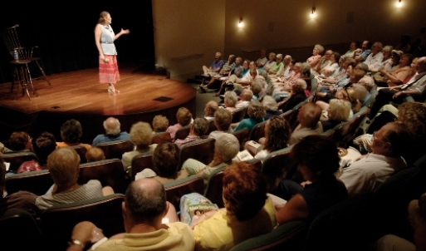
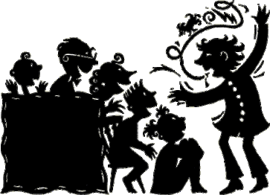
Notes:
Images have a storyteller in positions of authority and they have engaged listeners
Images represent a sense of community, wholeness
Images sometimes include unlikely stakeholders coming together (e.g., lion and child)

Slide 4
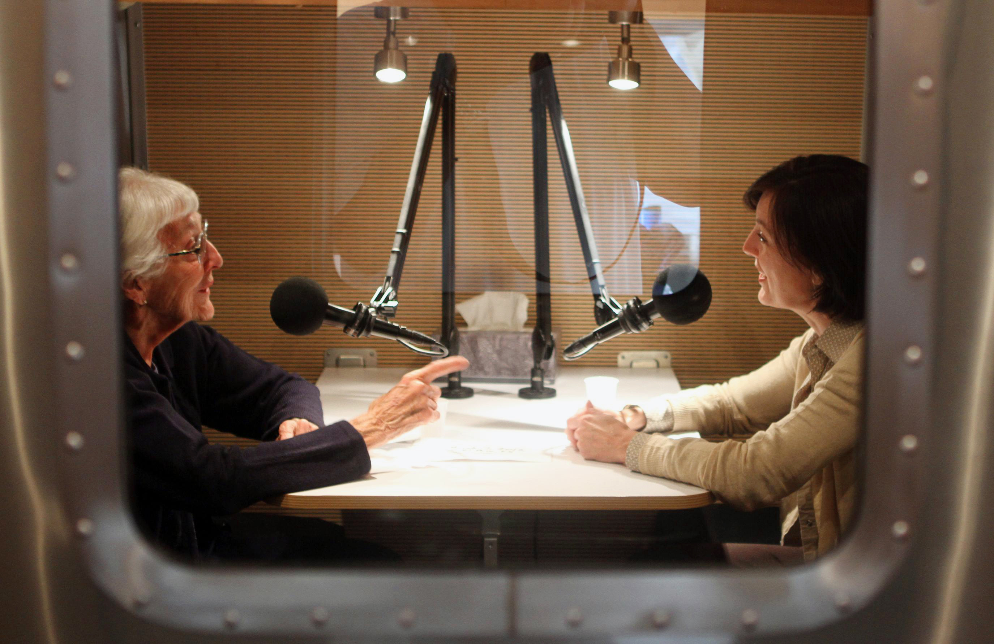

Slide 6
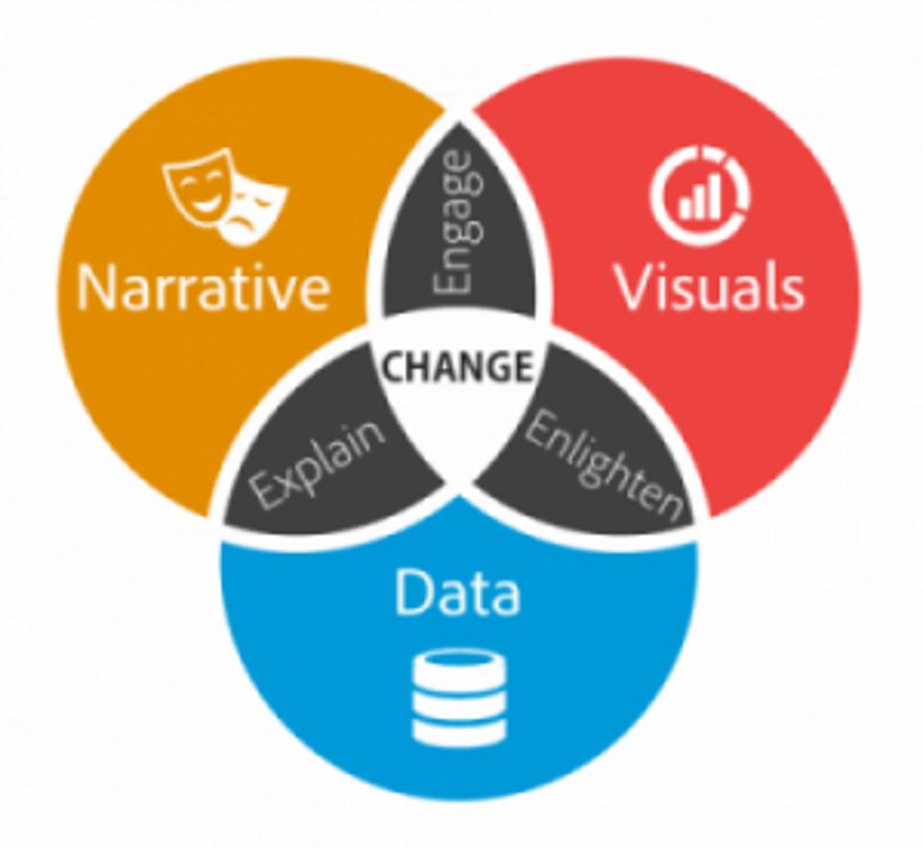
Notes:
http://www.bethkanter.org/data-viz-2/

Slide 7
Purpose
Revitalize an interest and value in narratives, particularly given their accessibility and ability to facilitate learning

Slide 8
Narratives in Evaluation
Tineka Abma’s (1998, 2003) work on Responsive Evaluation and Storytelling
Dart and Davies (2003) story-based method Most Significant Change
Brinkhoff’s (2003) Success Case Method
Narrative analysis in qualitative inquiry (e.g., Riessman, 2008)

Slide 10
Pivotal Stories
Accounts of turning points in the learning process for program participants
Demonstrate participants’ thinking, integration into practice, and deep learning

Slide 12
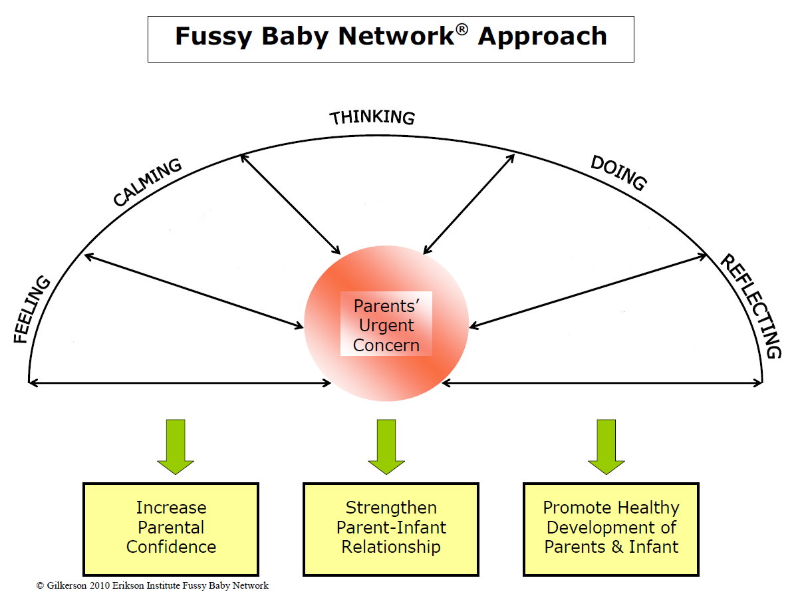
Evaluation Approach
Plan
Reflexivity
Do & Act
Trainers’ Urgent Concern
Study
Fear & Anxiety
Increase Trainers’ Confidence
Strengthen Trainers’ Evaluative Thinking
Promote FAN Learning through Training

Slide 13
Tools
Chapin Hall Impact Evaluation Results
Post-Training Participant Feedback Forms
Training and Supervision Reflection Logs
What went well and what didn’t go well
Levels of engagement
Pivotal stories
Training Observation Tool
Facilitated Attuned Interactions (FAN) Learning Tool
Notes:
What “ah-ha” moments did you have today in training?
Based on what you learned today, what might you do differently in your next home visit?
What more would you like to learn about the FAN?
Content focus
Active learning
Collective participation
Coherence

Slide 14
Evaluation In Practice
Monthly meetings for 1 hour 20 minutes with trainers
Evaluator Role
Facilitators
Critical friends
Format
Used arc questions
Beginning: How have trainings been going for you since the last time we met?
Middle: Have we gotten to what is most important to you?
End: What would you like to hold on to from our discussion today?
Provided one or two activities related to evaluation
Content
Acknowledged fears and anxieties related to evaluation
Developed evaluation tools and troubleshoot implementation of tools
Shared what we have observed based on evidence generated from tools
Interpreted findings collaboratively and discuss implications for program implementation
Notes:
Leanne– talk about mirroring FAN training within CQI meetings here

Slide 15
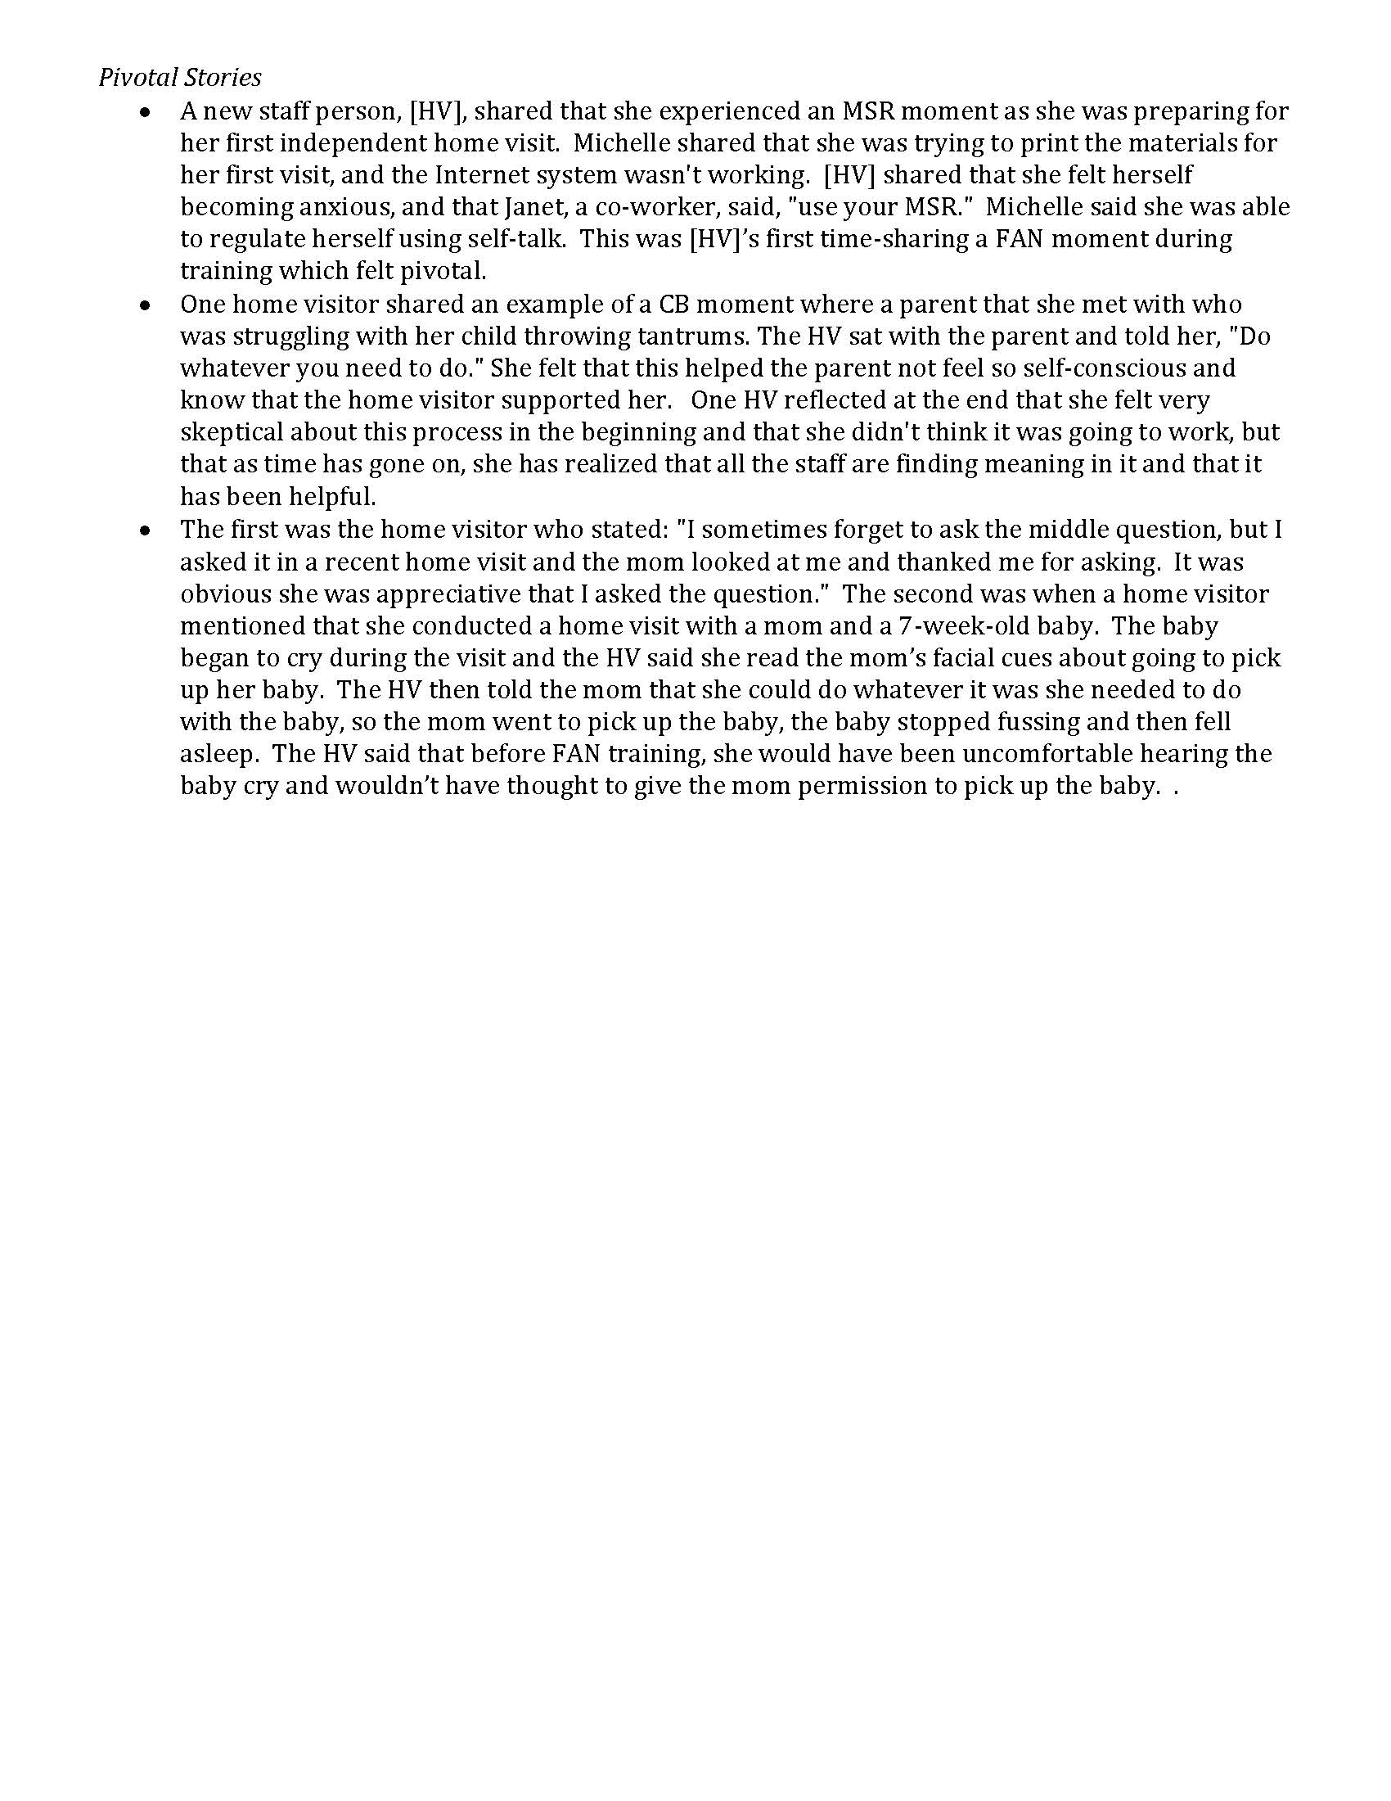

Slide 16
Analysis
150 pivotal stories over 2 years
73 (46%) excluded because only focused on experiences with training
77 pivotal stories included that focused on home visitor’s practices

Slide 17
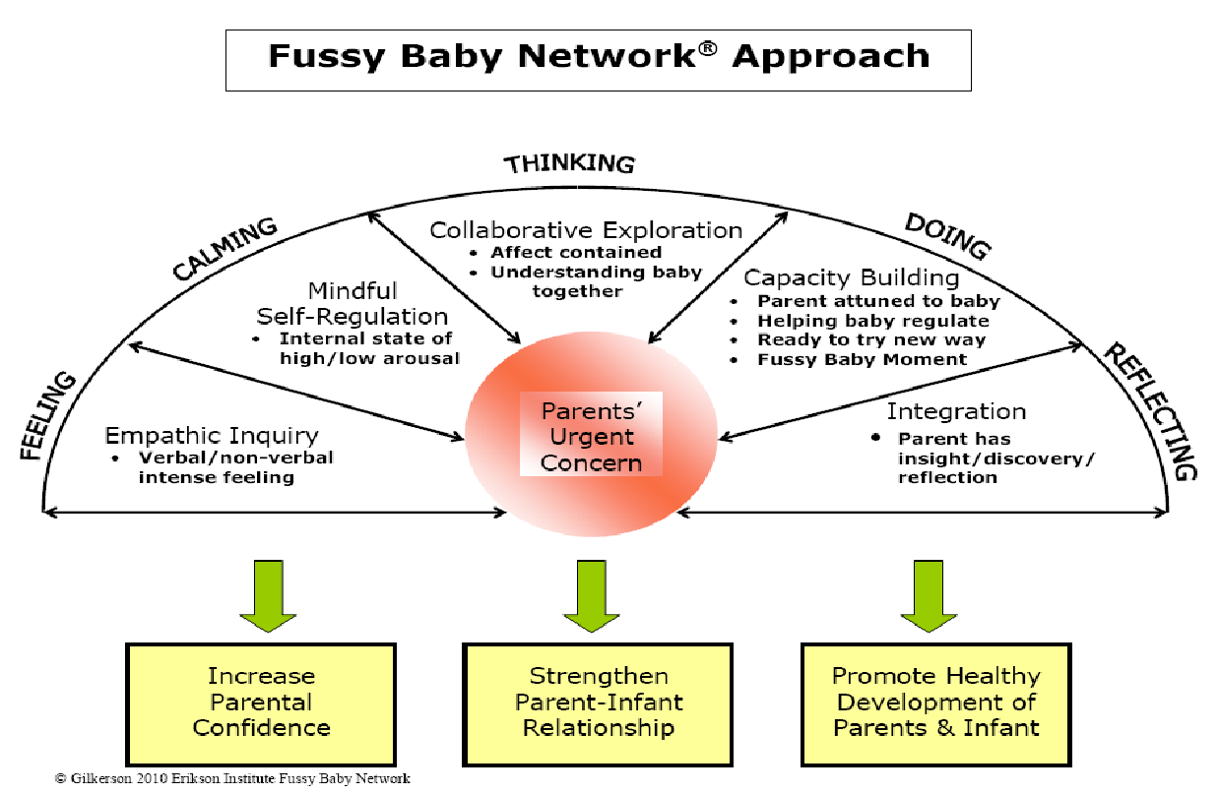
Findings
Majority of the stories reflected two of five elements, which was also consistent with other data sources
Empathic Inquiry (26, 34%)
Mindful Self-Regulation (24, 31%)
This finding identified as areas to improve in the training
Collaborative exploration (15, 19%)
Capacity building (15, 19%)
Integration (3, 4%)
Notes:
General (26, 34%)
ARC (11, 14%)
*Note bleed-over and adds to over 100% due to multiple processes per story

Slide 18
Findings: Stories demonstrated shifts in perspectives and shifts in practice

Slide 19
Findings: Structure of the stories involved attunement and engagement
“Karen (pseudonym) shared a story in which she had been working with a young mom for 9 months. The baby experienced crying and sleep challenges. Mom would regularly share with Karen, "Why won't she sleep? I just need a break." Karen stayed with this mother in feelings over the course of months. Karen shared that one day, the mom said, "I really need help figuring out how I can take a break." This cued Karen that mom was probably ready to do - or at least think about an action. Karen and the mom talked about how getting out of the house, for even 15 minutes, can feel like a meaningful break. The next week, Karen went to the house for a visit. The mom had gotten dressed and was taking baby for a walk. Karen and mom decided to rescheduled their home visit so that the parent could have this meaningful moment with her baby. At the next home visit, the mom told Karen that she was taking baby to a baseball game in which baby and mom could sit on a blanket and baby could explore while being out of the house. Karen shared that she thought, at one point, that mom would never get any relief. Karen shared that she stuck with mom, met her where she was, and ultimately mom experienced some relief. ”

Slide 20
Findings: engagement can be used to articulate program outcomes
Behaviors | Emotions
Participates regularly in visits | Maintains active involvement through being fully absorbed or enthusiastic about an activity or interaction
Provides critical information in response to HV questions | Being interested, motivated, enjoying home visits
Tries activities with HV | Sharing an emotional experience due to feeling safe/brave in relationship/interaction
Tries activities independent of HV
Articulates a reflection, insight; understands a new perspective and/or shifts perspective

Slide 21
Notes:
Images have a storyteller in positions of authority and they have engaged listeners
Images represent a sense of community, wholeness
Images sometimes include unlikely stakeholders coming together (e.g., lion and child)

Slide 22
Reference
Abma, T. A. (1998). Storytelling as inquiry in a mental hospital. Qualitative Health Research, 8(6), 821-838.
Abma, T. A. (2003). Learning by telling: Storytelling workshops as an organizational learning intervention. Management Learning, 34(2), 221-240.
Brinkerhoff, R. (2003). The success case method: Find out quickly what's working and what's not. Berrett-Koehler Publishers.
Costantino, T. E., & Greene, J. C. (2003). Reflections on the use of narrative in evaluation. American Journal of Evaluation, 24(1), 35-49.
Dart, J., & Davies, R. (2003). A dialogical, story-based evaluation tool: The most significant change technique. American Journal of Evaluation, 24(2), 137-155.
Riessman, C. K. (2008). Narrative methods for the human sciences. Sage.

