Slide 1
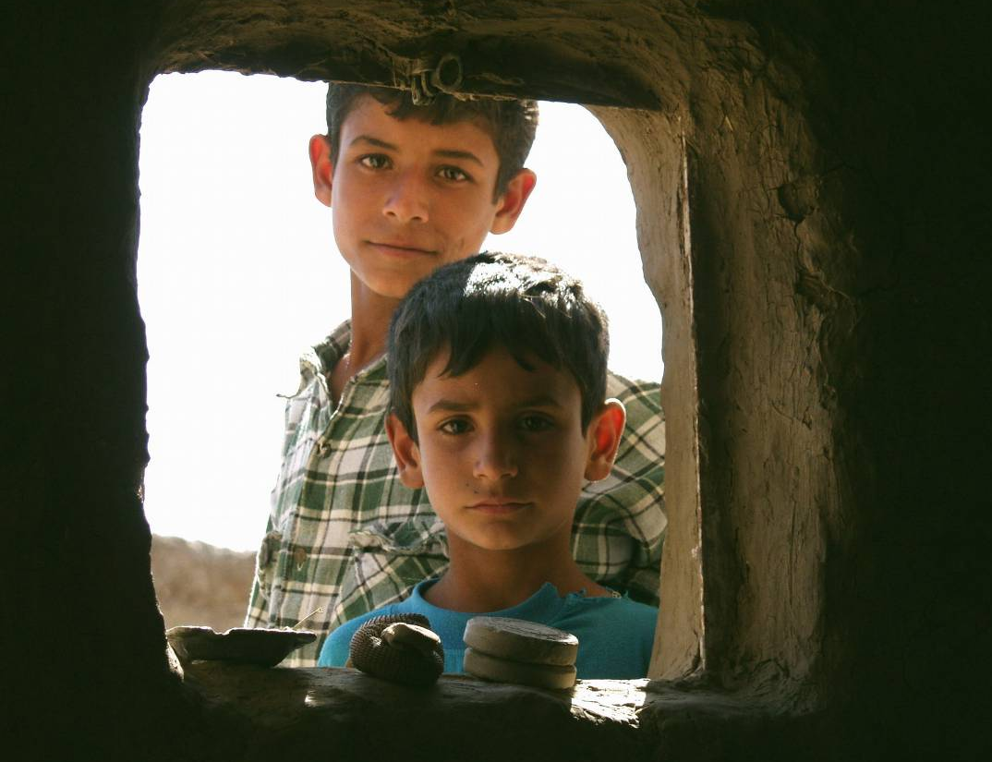
Mission Metrics: One Agency's Effort to Capture Mission Level Results
35
Barbara Willett, Senior Technical Advisor – DM&E

Slide 2
Program Overview
What does it all mean?
Iraq Conflict Management & Governance
Nationwide network of 87 Iraqi leaders at the provincial level.
Highly diverse membership that crossed major ethnic, sectarian, regional, and political lines of division.
Interest-based negotiation training.
Network members resolved over 130 complex disputes
Notes:
Whatever you call it, it’s something like this. What does it all mean, why am I here, why are we here?
How many of you have asked this question about your work? How many of you have been asked to answer that question!

Slide 3
How did we start?
Mission Metrics: Capturing Mission-Level Results
Organizational Learning and Strategy (DM&E)
Set up a Working Group
Mapped a rough plan - incremental
Consultant
Learned from partners/colleagues
Source - Mission
Notes:
So this is how we started…
But most importantly we did what many have done which is to go back to the source - the Mission.

Slide 4
Mission Statement
Mission Metrics: Capturing Mission-Level Results
Mission Statement
Mercy Corps exists to alleviate suffering, poverty and oppression by helping people build secure, productive and just communities.
Notes:
From the mission it was clear we neneded to do some defining and clarifying and unifying of those words and that mission - before we could talk about measurement.

Slide 5
The Challenges!
Mission Metrics: Capturing Mission-Level Results
42 countries - more than 300 active programs
Average length of grant – 24 months
Field driven
Wide, ever-changing program scope
Notes:
So before I get to our next steps, I have to address our challenges.

Slide 6
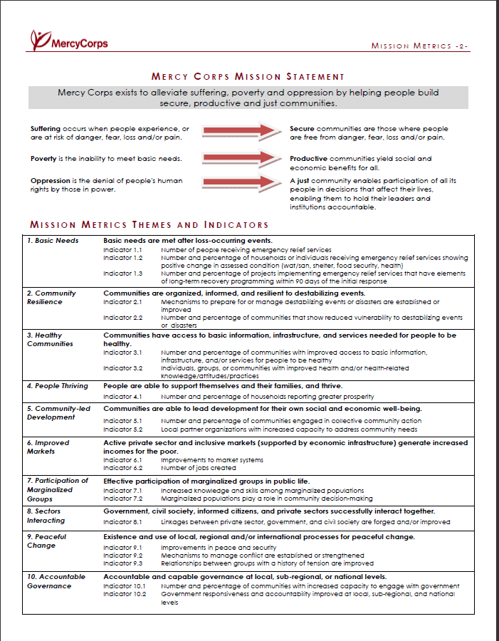
Mission Metrics: Capturing Mission-Level Results
Definitions
Themes
Indicators
Notes:
This is the framework of our initiative. See our accompanying handout, Mission Metrics Overview.
You don’t have to read the narrative part, but if you look at page 2, you will see our mission statement., you will see we started first with definitions of the Mission’s key terms (just look at secure, productive and just for now – the other three came later).
Then we developed what we call Themes (facets of each term) – the first three themes relate to Secure, the next three to Productive, and the last 4 to Just. So for example, in further defining the facets of a secure community (one free from danger, fear loss or pain), we keyed in on meeting basic needs in emergency situatoins, building community reslilience to disasters, and what communities need to be healthy. Beyond that, Productive communities need to prosper at a household level, commuities need the tools and understanding to lead development responsibility and sustainably, and markets need to improve and function to benefit the poor. Just communities are about participation, conflict, governance, and relationships between public, private and civil society sectors.
Then we needed indicators to measure them. Now, these are not indicators that are measured directly – in addition to oprogram indicators and measurements, but are more like buckets, baskets, categories, headings of indnicators against. Program indicators are then aligned with one or more of these, and reported against them..
A few other points about these indicators: We don’t align every program indicator – only the ones that relate to these Mission Indicator categories, and that speak meaningfully to the intended outcomes. There is a mix of outputs and outcomes. There is room for qualitative as well as quantitative data. We encourage the use of standard indicators (and provide a list to select from in the data system), but these are not required – people can use the Standard Indicators, create a Custom Program Indicator, or use the language of the Mission Indicator as a vague reference or placeholder for something they expect to report later. Consequently, there is room for (and encouragement for the consideration of…) unintended outcomes.

Slide 7
How does it work?
Mission Metrics: Capturing Mission-Level Results
Extension workers improve skills
Government health facilities improved
Malnutrition Decreased
Hygiene Improved
Mission Indicator 10.2 Improved Governance
Mission Indicator 3.2 (Improved Health)
Councils that provide regular op-portunities for formal public inputs
Notes:
How does it work? So here I have a Mission Indicator 3.2 – Improved Health. So that’s not what I measure directly, I have program indicators that fall into this category. They are ‘aligned’ with this MI, and then reported against it. They may be from the same program/grant, or from different grants and different countries. In our 2010 dataset, we had as many as 82 different program indicators for a single Mission Indicator.
Now some program indicators might align with more than one Mission Indicator. For example, ‘government health facilities improving’ is about improved health, as well as improved governance – helping improve government staff or institutions. So this is also linked to the MI, which also has other program indicators.

Slide 8
What do results look like?
Mission Metrics: Capturing Mission-Level Results
26,355 out of 48,805 (54%) households showing evidence of increased prosperity…
14 out of 32 countries (44%) reported against this Mission Indicator
22 out of 269 programs (8%) reported against this Mission Indicator
MI 4.1 Number and percentage of households reporting greater prosperity
Types of improvement…
19,642 households participated in loan or savings programs - average loan amount $552.50
Average increase of paddy production 3.3 MT per hectare
Among 6570 farmers in Helmand, surveys (sample size 363) showed there was a 33% increase in total sales among HASIL farmers
Notes:
So what do we do with all these results? We can aggregate to a certain level. See the language of the Mission Indicator? Number and percentage of households. The number for this is 26,355. The percentage is 54% - that’s out of programs aligning with this indicator – not out of everyone served. So we get a top level analysis of results and success.
We can also get some organizational descriptive analysis – how many countries and how many programs were reporting against this mission indicator – the distribution and usage of these indicators across the agency has been of particular interest and utility to us – where are we focusing our measurement (if not the programming – sometimes there is a difference).
Beyond the number and percentage of households, now to know what that really looks like, we have to drill down into the specific program results. Here I’ve done another subaggregation of households participating in loan and savings programs, and the average loan amount, plus a couple of program specific results – increased production, increased sales. But we also have a couple of specific program results, which is where the the real truth of measurement results lies, and where we can look for what’s working and what’s not.

Slide 9
Review of the 2010 Process
Mission Metrics: Capturing Mission-Level Results
Data Quality Initiative
Renewed agency focus on measurement and reporting Practices
Agency and Country Action Plans for Improvement
Notes:
As a result of the 2010 data collection process, we focused on a couple of main areas. First, this served as an agency-wide Data Quality Audit for us and gave us a level of understanding about measurement and results we would never otherwise have been able to have.

Slide 10
Review of the 2010 Process
Mission Metrics: Capturing Mission-Level Results
Key Points for Investigation
- Emergencies (numbers, types, services)
- Missing results (partnerships, community, etc.)
- Program Indicators (best practices, more standards?)
- Mission – does this framework fully represent it?
Notes:
Additionally, though incomplete, the results we had and used still told us a lot. Some gave us important data to contribute to decision points and strategic decisions, some pointed to the need for more information about measurement and evidence (why didn’t we have more to show for areas we know are critical?). We are also able to look at massive numbers of program indicators and figure out how we can improve here. Maybe not a small set of standard/common indicators, but certainly plenty of room for improvement. Finally, we could really examine again our Mission Statement, and discuss whether this is all still fully representative of it.

Slide 11
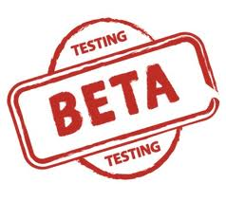
Timeline
Mission Metrics: Capturing Mission-Level Results
Senior Leadership Decides to Take on Macro Level Measurement
Developing Themes
Field Testing
Agency Rollout
2010 analysis
Revisions/Re-training
2007
2008
2009
2010
2011
2012
Mission Metrics’
Defining Terms
Full-time Facilitator
Beta Test
MIS System
Finished Framework
2011 analysis
Global interface
First complete review
Notes:
Here’s our general timeline. Note that the inclusion of 2007 here is just a decision point, late in the year. And 2012 hasn’t happened! So this has really been four good years in the making…

Slide 12
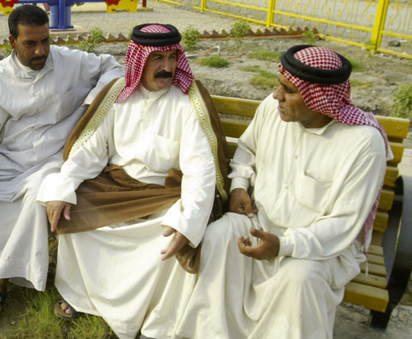
Recommendations
Mission Metrics: Capturing Mission-Level Results
Start with a genuine interest in internal learning
Get wide involvement – take the time - incremental
Focus on use – but consider different stakeholders (HQ vs field vs external)
Use ‘mandate’ to compel, but only in the short-tem – connect to real use as soon as you can
Be prepared to be uncomfortable!
Notes:
How we did this is less important, because each agency will chart its own path, BUT these are a few things we maybe didn’t plan to begin with but that looking back, we think made a difference.
Focus early on what you’re taking on – there are so many different things we might be in need of measuring – so many aspects of quality or operations or impact. We decided early to stick to the mission, and to stick to programmatic results and impact – not operational questions about efficiency or adherence to standards or financial merit or do no harm frameworks. We said ‘let’s do this first,’ and then see what’s to come. And other things are coming about – development of a dashboard of key operational indicators, new program management standards, etc. But we’ve avoided getting entangled in too many other questions.
The other focus was on using this as a performance improvement tool – not PR. It’s not just about showing how great we are, but knowing how great we are, if we are, and where we can improve. People didn’t believe this at first and thougt it was really a ploy for senior leaders to have more stats to throw around capitol hill, or for the web developers to have more material – or for us to write better proposals. That’s all very possibly an outcome. But it’s not the goal.
Start with a genuine interest in learning – responding to internal questions – but let the process evolve and take you in unexpected directions
Focus on use – but consider different stakeholders (HQ vs field vs external) – we understood senior leaders’ desire for information, but had to convince others it wasn’t just for show – not for PR, but for real learning
Use ‘mandate’ to compel, but only in the short-tem – connect to real use as soon as you can – that’s where it will take root. I could show you more and more slides of the different uses that have been identified by the field and by other agency leaders for the process and for the results, but that would take too much time.
Be prepared to be uncomfortable – figuratively (lots of tough questions and challenges – we opted to accept them openly and admit that we shared those same doubts and concerns – but were hopeful that we could overcome them) and literally. Being in Portland, we have some terrible time zone conversions and middle of the night conference calls and trainings, but we must stay focused on the field and what works for them.

Slide 13
Notes:
So, as we started with those universal questions, it got me thinking and realizing that even organizations can have an existential crisis and want to know ‘what does it all mean – why am I here?’.
And when you have that crisis moment, my recommendation is to welcome and embrace it. And try to answer the questions you think you’re asking. You may not find the answers you thought you were looking for, but, in the words of the Rolling Stones, you just might find, you get what you need.

Slide 14
Contact Information
Mission Metrics: Capturing Mission-Level Results
Barbara Willett
bwillett@mercycorps.org
Gretchen Shanks
gshanks@mercycorps.org

