Slide 1
Reframing: The Fifth Value of Evaluators’ Communities of Practice
Patricia Jessup, chair
InSites
Beverly Parsons
Incites
Veronica Thomas
Howard University
Karen Peterman
Karen Peterman Consulting
Ginger Fitzhugh
Evaluation & Research Associates
Leslie Goodyear, discussant
EDC
Marah Moore, discussant
I2i Institute

Slide 2
Reframing a Community of Practice: The ECLIPS Experience
Beverly Parsons, Ph.D.
InSites
Notes:
I’m going to talk about the experience that 15 of us evaluators had through an NSF grant where we worked as a community of practice to learn more about the application of systems concepts and thinking to evaluation. The project was called ECLIPS – Evaluation Communities of Learning, Inquiry, and Practice about Systems. We worked together over 18 months through two all day meetings – one at the beginning and one a year later – and monthly webinars. Five of the members (including Karen and Ginger) were working on specific STEM evaluations to which they were applying the systems concepts. Four were advisors with various areas of expertise, one of whom—Veronica—you’ll meet t in this session, two were leaders of evaluation resource centers, and three of us were facilitators of the ECLIPS work. This project was a pilot effort to see if the CoP structure worked well for learning and applying systems concepts.
I’m going to give an overview of a framework that one of our ECLIPS members introduced to the group that guided our thinking about understanding the value of the ECLIPS work.

Slide 3
Key Message
Value Created through Communities of Practice:
From Immediate Value to Reframing Value
Notes:
My key message today is about the value created through CoP. We found that our CoP moved participants from the immediate value of participation to considerable reframing of their work based on systems concepts. This notion of reframing was our overall goal although we hadn’t described it in quite that way initially.
Let me begin by explaining the framework. It was developed by Etienne Wenger and colleagues (pioneers in developing CoPs in the business world) and describes five types of value that are created in CoPs.

Slide 4
Value Creation
immediate value
Immediate: the value of the activities and interactions in the community of practice
Notes:
The first type of value is the immediate value of the activities and interactions in the CoP. We definitely experienced this as a group. The excitement of just coming together, meeting one another,……

Slide 5
Value Creation
potential value
Immediate value
Potential: knowledge capital that is produced but not necessarily used in the immediate situation
Notes:
Potential value was a big part of where we started the ECLIPS. We as facilitators of the ECLIPS had gained considerable knowledge of systems concepts and ideas but weren’t always clear how they would be useful in evaluation.

Slide 6
Value Creation
potential value
applied value
immediate value
Applied: adapting and applying knowledge in different contexts
Notes:
Applied value was what we were aiming for when we started the ECLIPS. We wanted to see if the concepts could be applied to ongoing STEM education evaluations by STEM evaluators. The five STEM evaluators indeed applied the concepts to their work (you’ll hear more about this shortly from Ginger and Karen).
Likewise, our advisory panel who were advising us on our work were also applying the concepts in their own work. Veronica will talk shortly about how she was doing that. And Marah, Pat, and I as ECLIPS facilitators were applying what we were learning to the way we guided the ECLIPS overall as well as in other evaluations we were doing.

Slide 7
Value Creation
potential value
applied value
immediate value
realized value
Realized: application that leads to improvement in performance
Notes:
Realized value was what we were hoping would happen for each of the leaders of the STEM education programs being evaluated. That is, once the evaluators had applied the system concepts to their evaluation did it result in value for the leaders of the STEM education programs they were evaluating?
Over the first few months, we weren’t sure that we could reach this stage. Would the PIs of the project actually benefit from the changes in the evaluations given that the evaluations were already underway and only a limited amount of change could be made?
We were pleasantly surprised at the extent to which this did happen. We interviewed the PIs at the end of the 18 months to see what they had to say. The benefits were substantial. For example, some developed a new way of seeing their project from a systems perspective, some saw new roles for evaluation and new ways to interact with their evaluators.
Had we not been introduced to the Wenger Values Creation Framework, we would most likely have stopped our investigation of the value of the ECLIPS with these four values.
However, the framework highlighted another value that we hadn’t named before but in actuality was our real goal.

Slide 8
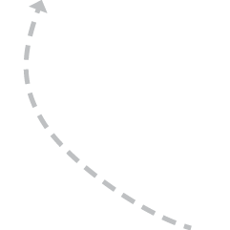
Value Creation
potential value
reframing value
applied value
immediate value
realized value
Reframing: reconsideration/redefining of perspectives, processes and/or structures
Notes:
That was Reframing value. When it all was said and done, this was for us the most important value of the work. Yet, each of the other types of value was important to lead us to this point. Reframing value is the reconsideration, redefining of perspectives, processes, and/or structures. It was what we were actually seeking for the evaluators and the leaders of their STEM education projects. It is at the heart of systems change; it is the change in our own mental models. It is at the heart of the benefit for all of us and represents a process we want to be able to continually recognize and engage in in our evaluation work. Naming it as reframing value was very helpful for us.

Slide 9
Reframing Value Creation
potential value
reframing value
applied value
immediate value
Reframing: reconsideration/ redefining of perspectives, processes and/or structures
realized value
Notes:
Also, it was apparent that the process of reframing is not a linear one. We found many connections among the various types of value that were created in the ECLIPS.
.

Slide 10
Placeholder ZOOM 1
From ZOOM by Istvan Banyai, © 1995 by Istvan Banyai. Used by permission of Viking Penguin, a division of Penguin Group (USA) LLC.
Notes:
TRANSITION
Example
Pat, Marah, and I as facilitators of the ECLIPS project went through many reframings of our work. These mini-reframings led us to a major reframing of how to proceed with the ECLIPS work. Let me take a couple minutes to describe the process we went through.
I’ll illustrate it with some slides.
We started by looking at three system concepts that we thought would be important for the ECLIPS members to learn—a definition of systems, system dynamics, and finding leverage points for system change.
(Show ZOOM 1)
Those concepts were rather abstract. We weren’t sure how they fit with the STEM education evaluations the evaluators were doing. It’s like this picture. We looked at these concepts and said what is this? How do we use it in evaluation? We wrote the NSF proposal identifying where to start.
Once we got into the work, however, we began to see it differently. It tied to a lot more
(Show ZOOM 2)

Slide 11
Placeholder ZOOM 2
From ZOOM by Istvan Banyai, © 1995 by Istvan Banyai. Used by permission of Viking Penguin, a division of Penguin Group (USA) LLC.
Notes:
The use of systems concepts get clear again as the evaluators started to apply the system concepts. We regained our confidence again that system concepts was of value in evaluation. However, we weren’t quite sure if it was making a difference for the PIs of the STEM education project.
(Show ZOOM 3)

Slide 12
Placeholder ZOOM 3
From ZOOM by Istvan Banyai, © 1995 by Istvan Banyai. Used by permission of Viking Penguin, a division of Penguin Group (USA) LLC.
Notes:
Then we found out that it did matter for them. That was a relief.
However, about that time, we began to get uncomfortable that maybe just changing individual STEM education project evaluations using a systems perspective was not enough.
It was at that point that we had our major reframing experience.
(Show ZOOM 4)

Slide 13
Placeholder ZOOM 4
From ZOOM by Istvan Banyai, © 1995 by Istvan Banyai. Used by permission of Viking Penguin, a division of Penguin Group (USA) LLC.
Notes:
10/24/13
We realized we needed to be engaged in a different way of thinking about the whole approach to STEM education project evaluation. We had been looking at the individual STEM education evaluations. If we wanted to truly influence the three intractable challenges in STEM education that were present in much of the work that our ECLIPS members were engaged in and/or familiar with we needed to rethink our approach. The three challenges were. (a) bringing underrepresented populations into STEM education; (b) supporting continual adaptive STEM curriculum and faculty renewal; and (c) enhancing the STEM workforce. These challenges are deeply rooted in system conditions.
(Show ZOOM 5)

Slide 14
Placeholder ZOOM 5
From ZOOM by Istvan Banyai, © 1995 by Istvan Banyai. Used by permission of Viking Penguin, a division of Penguin Group (USA) LLC.
Notes:
10/24/13
We realized that the systems application to evaluation would be even more powerful if it were used in STEM education projects that had partnerships that reached across multiple levels of the education system – both formal and informal.
It would also be more powerful if the PIs were learning the system concepts along with the evaluators and there was more interaction among them as they each came to understand the nature of the systems in which they were working.
That was a major step forward for us. However, we don’t see it as the end of the journey of our reframing. We are continuing to rethink what are the multiple ways that we can bring system concepts into our evaluation work.
(Show ZOOM 6)

Slide 15
Placeholder ZOOM 6
From ZOOM by Istvan Banyai, © 1995 by Istvan Banyai. Used by permission of Viking Penguin, a division of Penguin Group (USA) LLC.
Notes:
10/24/13
If you are familiar with this book ZOOM, you’ll know that these pictures continue on. The pics go on to a ship to a city street to a desert island. But if you think you know where you are, guess again. In Istvan Banyai’s mysterious landscape of pictures within pictures, nothing is ever as it seems.
It’s a great reminder for those of us engaged with evaluation. There are more angles on the situation that we might not yet have thought of. Learning to frame and reframe and yet know when to stop and hold steady with one approach is one of the big challenges of evaluation and systems thinking.

Slide 16
Key Message
Value Created through Communities of Practice:
From Immediate Value to Reframing Value
Notes:
To recap before moving on to our next presenters who show specific examples of their reframing, let me say that we found that the ECLIPS approach created a wide range of types of value. The one we have been especially excited about is the reframing value that builds on the other types and reshapes our thinking long term. As Oliver Wendell Holmes said: “Every now and then a man’s mind is stretched by a new idea or sensation, and never shrinks back to its former dimensions.

Slide 17
Reframing Culturally Responsive Evaluation From a Systems Perspective
Veronica G. Thomas, Ph.D.
Howard University
Panel presentation at the Annual Meeting of the American Evaluation Association, Washington, DC, October 16, 2013.

Slide 18
Culturally Responsive Evaluation Meets Systems-Thinking Through ECLIPS

Slide 19
Educator/trainer
Culturally responsive evaluator
Change agent (social justice stance)

Slide 20
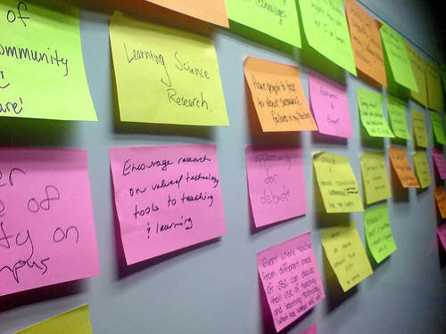
Reframing External Reviewer Role in ECLIPS

Slide 21
Seeing the intersection of culturally responsive and systems-oriented evaluation

Slide 22
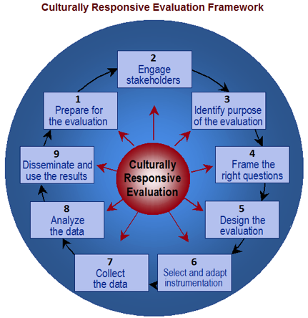
Source: Rodney . Hopson, AEA 365 blog

Slide 23
Culturally Responsive Evaluation (CRE)
Holistic way of thinking about and engaging in evaluation practice
Recognizes that project design, implementation, and evaluation takes place within broader (e.g., historical, social, political) context
Attends to spectrum of stakeholder variability and perspectives
Recognizes diversity as source of value and resources
Considers culture/context throughout entire evaluation process

Slide 24
Systems-Oriented Evaluation
Balances focus between the whole (system) and its parts (e.g., project)
Helps evaluator see where working against (or in support) of one another to undermine or strengthen program capacity and connected systems to achieve outcomes
Soft and critical systems theory most aligned with CRE

Slide 25
Systems-oriented evaluation
Design Evaluation
Shape Practice
Collect Data
Make Meaning from Data
Source: Beverly Parsons, InSites, Inc.

Slide 26
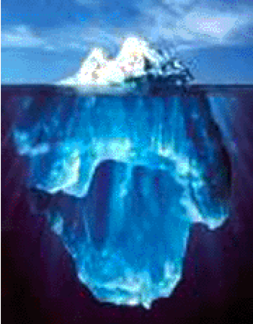
Where CRE and System-Oriented Evaluation Meet
Activities & Results
Patterns
Norms, Infrastructures & Policies
what is
what could be
Principles
Paradigms
Source: Beverly Parsons, InSites, Inc

Slide 27
Balancing CRE, systems-orientation with social justice stance

Slide 28
Challenges hegemonic ontological, theoretical epistemological, and methodological practices that diminish groups at the margins of society and normalize injustice
Espouses evaluators as “stewards of the public good” (Greene, 2005)

Slide 30
Reframing CRE
Reframing CRE at Multiple Levels
Evaluation’s Purpose
Evaluator’s Role
Planning and working differently

Slide 31
Reframing CRE Purpose from Systems-Perspective
Expand CRE beyond boundaries of specific project inputs, outputs, and outcomes
Represent both the “forest and the trees”

Slide 32
Reframing Culturally Responsive Evaluator’s Role
Illuminate dynamics of complex systems and processes
Identify leverage points for influencing whole system
Focus on outcomes that are systemic in nature
Educate and shape practices

Slide 33
Thinking, Planning, and Working Differently –Zooming in/out
Beyond seeing evaluand as simply treatment to potential system change intervention
Engage stakeholders in different ways
Consider both linear and nonlinear perspectives
Seek out patterns (boundaries, relationships, and perspectives)
Focus of how institutions, structures (e.g., system archetypes) differentially take (or give) opportunities from (to) particular groups within communities and ultimately impact these individuals’ relationships with and outcomes from projects
Adapt methodologies

Slide 34
Reframing –Incorporating systems concepts in CRE questions (few examples)
Boundaries
Who is involved in addressing the problem for diverse groups?
How are parts of the evaluand connected? What is the strength of this connection?
Who/what has influence on the problem for diverse groups?
Who has access to the project? Who is left out?
Relationships
What relationships (formal, informal) exist within the project’s structure? Among stakeholders? Which seem to contribute to meaningful results or conditions for different (sub)groups?
Are relationships fixed? Dynamic? Constrained?
What power dynamics exist between project and larger context?
How might your group membership , personal power, and privilege influence effectives as the evaluator?
Perspectives
Do different (sub)groups have varying perspectives on the nature of the problem? Strategies for addressing the problem?
Are certain (sub)groups missing or avoiding an important perspective?

Slide 35
In sum, systems-orientation help me to….
view my role more expansively
refocus from parts to whole
focus on assumptions, and practices that sustain or impede change for various (sub)groups of individuals
seek out patterns and structures (system archetypes) that give or take opportunities from particular (sub) groups of people
analyze the situation more deeply in order to better explain program effects (or non-effects) and understand how systems are arranged and to what results

Slide 36
However, not without real challenges
Making paradigm shift is difficult
PD opportunities are limited
Time and resource constraints
Getting project staff and funders buy-in

Slide 37
vthomas@howard.edu

Slide 38
If You Aren’t Part of the Solution…Reframing the Role of the Evaluator
Annual Meeting of the
American Evaluation Association
October 16, 2013
Karen Peterman, Ph.D.
Notes:
Hello. My name is Karen Peterman and I participated in the ECLIPS as a participant, focusing on an NSF ITEST project that I was evaluating.

Slide 39
Oh my gosh,
what if I am the lever!?!
Notes:
I am somebody who does some of my best thinking in the shower. And something that I have found myself puzzling about over again and again in the last year is one of our final ECLIPS sessions after AEA last year. We were asked to choose the one word that summarized our feelings about our excursion into systems ideas and my immediate reaction was “empowered.” But I had no idea why I felt that way. And then one day I was in the shower and I had this thought – what if I am the lever? What if I have started viewing myself and my role as the evaluator as the small change that can result in big impact? And so I’m going to spend my time today sharing examples of how systems views have empowered my work and why I think this idea of the evaluator as lever has some merit.

Slide 40
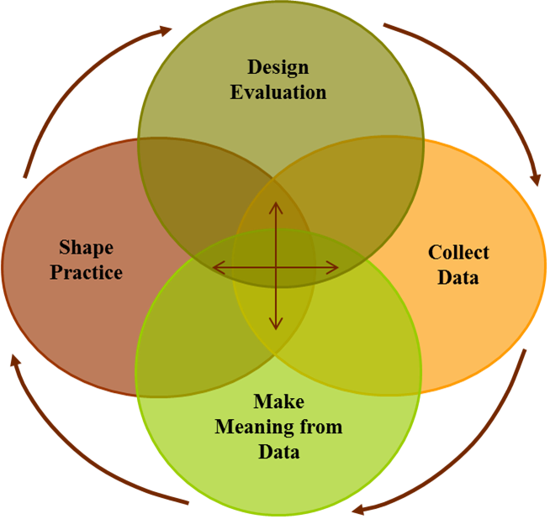
Courtesy of Beverly Parsons
InSites
Notes:
One thing that has helped me envision the shift in my evaluation practice is this graphic that Beverly created and generously shared. This is the systems view of the evaluation cycle in which all of the components interact with and inform each other. And for me the most interesting part of this idea is the intersection, and thinking about what that really looks like in practice. And so I wanted to open it up to the group - what kinds of evaluation practices or activities live at this intersection – where do you see it in your work?

Slide 41
Collaborative inquiry might be key
Cousins & Whitmore, 1998; Cousins, Whitmore & Shula, 2013
Notes:
So for me, one thing that lives in the intersection is collaborative inquiry. The idea of participatory evaluation has been around for a long time, but I only started trying to incorporate participatory methods into my work a couple of years ago. I had always been collaborative with clients but I had not spent as much time thinking about the larger group of stakeholders and I had not worked collaboratively with clients or stakeholders to explore evaluation results and think about how those results should shape practice. But when I think about the intersection in Beverly’s graphic, I think that evaluators have to invite others to the table if we are going to navigate that intersection most effectively. Though there is still much debate about the terminology and practice of participatory or collaborative evaluation methods, I do think that collaborative inquiry and/or participatory methods might be key.

Slide 42
Experiences with
collaborative inquiry
have been mixed
Notes:
I have used some form of collaborative inquiry with stakeholders on three projects thus far, and this slide sums my experiences nicely. In some cases we all have our hands up enjoying the ride. In others, we have a mix of smiles, one or two people covering their eyes, and others holding on for dear life.

Slide 43
System archetypes
explain
program dynamics
Notes:
Interestingly my most and least successful participatory experiences thus far have come from two projects that I evaluate with the same client - the difference in our success across these programs has resulted in some interesting conversation about the underlying patterns that might result in success with one project and continued challenges with another. Another way that I have reframed my practice a bit is by taking of my evaluator hat once in a while and putting on a consultant hat instead. Early on in ECLIPS I slid in to the consultant role for a bit and led a staff meeting with the client to talk about system archetypes – these are common patterns of problematic behavior in systems, and the staff meeting was organized to help the client think about which patterns to look our for in relation to their work. For me, this conversation was a way to do some preventative troubleshooting with the client and that choice paid off because we have found ourselves revisiting this archetype language as a way to explain the successes and failures of our participatory evaluation approach.

Slide 44
Courtesy of Beverly Parsons
InSites
Notes:
I see both the participatory approach and playing the role of consultant as two ways that I have reframed my evaluation practice to be more consistent with this systems diagram. The participatory approach lives at the very center of the diagram, where all of the circles overlap. The consulting example I gave seems to fall in the shared space between Making Meaning and Shaping Practice. The next examples I wanted to focus on have to do with a reframing in how I think about the Shape Practice sphere. My initial ideas about shaping practice focused almost exclusively on ways to use evaluation data to shape the practice of either the program I’m evaluating or the evaluation itself.

Slide 45
Zoom in and zoom out to shape practice
Notes:
There is another systems concept that we learned early on in ECLIPS that reminds you to zoom in and zoom out when you are adopting a systems view so that you drill down with your data to try to really understanding the nuance of what is going on but then you also remember to zoom out to reflect on what is happening on a broader scale. I have found myself zooming in and out in unexpected ways.

Slide 46
Zoom in: Client’s literature
Zoom out: Filling the gaps
Notes:
This first example is sort of an odd consulting role that feel out of my evaluation work on an NSF DRK12 project. Evaluation of DRK12s is sort of odd because they are research grants and so you are expected to evaluate the research and the research process. One of my first tasks was to read the literature cited in the proposal to describe the methods and instruments being used so that I would be prepared to monitor and track the research team’s implementation of those instruments. That has created an interesting opportunity to help guide the way that the client shapes practice rather than actually doing the work myself. I have been able to point out opportunities that the client was not taking advantage of that would be a benefit to the project’s research and to broad field of engineering education and the client has picked up that baton and run with it.

Slide 47
Zoom in: “Local” language
Zoom out: Talk the talk
Notes:
This next example focuses on zooming in on the local language around a project to figure out how to get the most traction, and then creating an evaluation plan that would allow us to talk the talk. In this case the client wanted to have data that resonated with district leaders and potential new funders and so shifted gears to find a way to analyze the evaluation data we already had in relation to existing test score data. We also developed this plan, from the beginning, with the hope of publishing it in an education journal because we knew that would be valuable currency for the project.

Slide 48
Zoom in: Methods
Zoom out: Policy change
Notes:
We also had publication in mind when we developed these performance-based assessments. This is a performance-based assessment that focuses on kids’ ability to talk about and interpret data and the development of these evolved by zooming in on the kinds of methods I like to use most, the need for an authentic assessment of kids’ skills, and an interest in leveraging these results to contribute to the broader conversation about assessment in relation to the NGSS. We have just started collecting data with these but we are already looking forward to contributing to the literature and hopefully helping to push the needle toward more meaningful assessment.

Slide 49
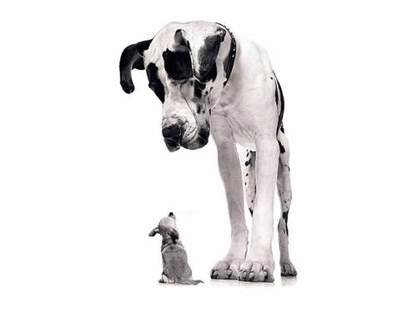
Notes:
And so what does all of this mean? Why do I feel empowered? How could one evaluator or even the field of evaluation be a lever in the face of the huge systems we operate within? I think we have probably all been to meetings with fellow evaluators that devolve into sessions where everybody is complaining about all that is wrong with the system and how those problems prevent programs and/or evaluators from being able to do our work the way we think it should be done. And while I agree that there is something naïve about the idea of evaluators as a lever, there is also an entire literature that supports the power and impact of leverage points. I find it refreshing and empowering to reframe my role from this perspective.

Slide 50
Policy changes
open opportunity
Notes:
I think this perspective is especially interesting for STEM evaluators because we are in the middle of a huge policy shift with the adoption of the NGSS. There are certain things about the NGSS that are naïve as well – focusing on practice and thinking how to think, going deep into a topic and series of practices rather than going wide – but it could be a really exciting time. As STEM evaluators we have a huge range of methodological approaches in our back pockets and by zooming in and zooming out across our evaluation practice, the methods we know and love and the shifts that will have to happen in science education and testing, we have a golden opportunity to help shape practice by sharing what we already know and do well. I expect that there are other examples in other fields as well that can also benefit from our talents and approaches as evaluators.

Slide 51
The role of evaluator could use some reframing too
The Future of Evaluation: 5 Predictions (building on 10 others!) http://aea365.org/blog/?p=5794
Notes:
In February of 2012 Susan Kistler posted a fascinating post of AEA365 that expanded on 10 ideas from John Gargani about the future of evaluation. These were really interesting and in some cases a bit terrifying because they confronted us with changes to our own system and the way that we do our work. The examples I shared today are beyond the traditional scope of how I have done my work in the past – shifting into the role of consultant, taking the time to involve stakeholder groups, providing guidance to clients about publication opportunities, and making decisions about evaluation plans based on gaps in the literature – these are things that I had rarely if every done before. But I like the idea of diversifying my range of services, and my experience thus far is that clients see the value in it and are willing to pay for it. I think the field as a whole would benefit from some systems-based shifts in how we do our work and the ripple effect that it could have on our reputation as professionals and our ability to weather whatever changes are coming next.

Slide 52
Reflect
Find a friend
Meadows, D.H. (2008). Thinking in Systems: A Primer.
Designing Initiative Evaluation: A Systems-oriented Framework for Evaluating Social Change Efforts. http://bit.ly/129zZRu
Notes:
One of the greatest gifts were given as members of the ECLIPS was time to learn about systems ideas and then reflect on those ideas in relation to our practice. I think that reflection is key. And so if you have found any of these ideas compelling, I’d like to suggest that you find your own way to reflect. The simplest way might be to think about your professional elevator speech – isolate the key components of that speech and those are your systems, your potential leverage points. Once you have that list, it is easy to think about the intersection of a systems evaluation and how you might zoom in and zoom out to reframe your own role as evaluator in the way that is the best fit for you and your context. Also, find a friend. Systems ideas are messy - they make your head hurt. It helps to have someone to talk to and bounce ideas off of. No matter how you end up reframing your role, my experinece has been there is wonderful clarity on the other side.

Slide 53
(919) 627-2676 2706 Stuart Drive, Durham NC 27707 www.consultkp.com
Notes:
This is me – if you have questions, comments, or stories to share about your own reframing please let me know.

Slide 54
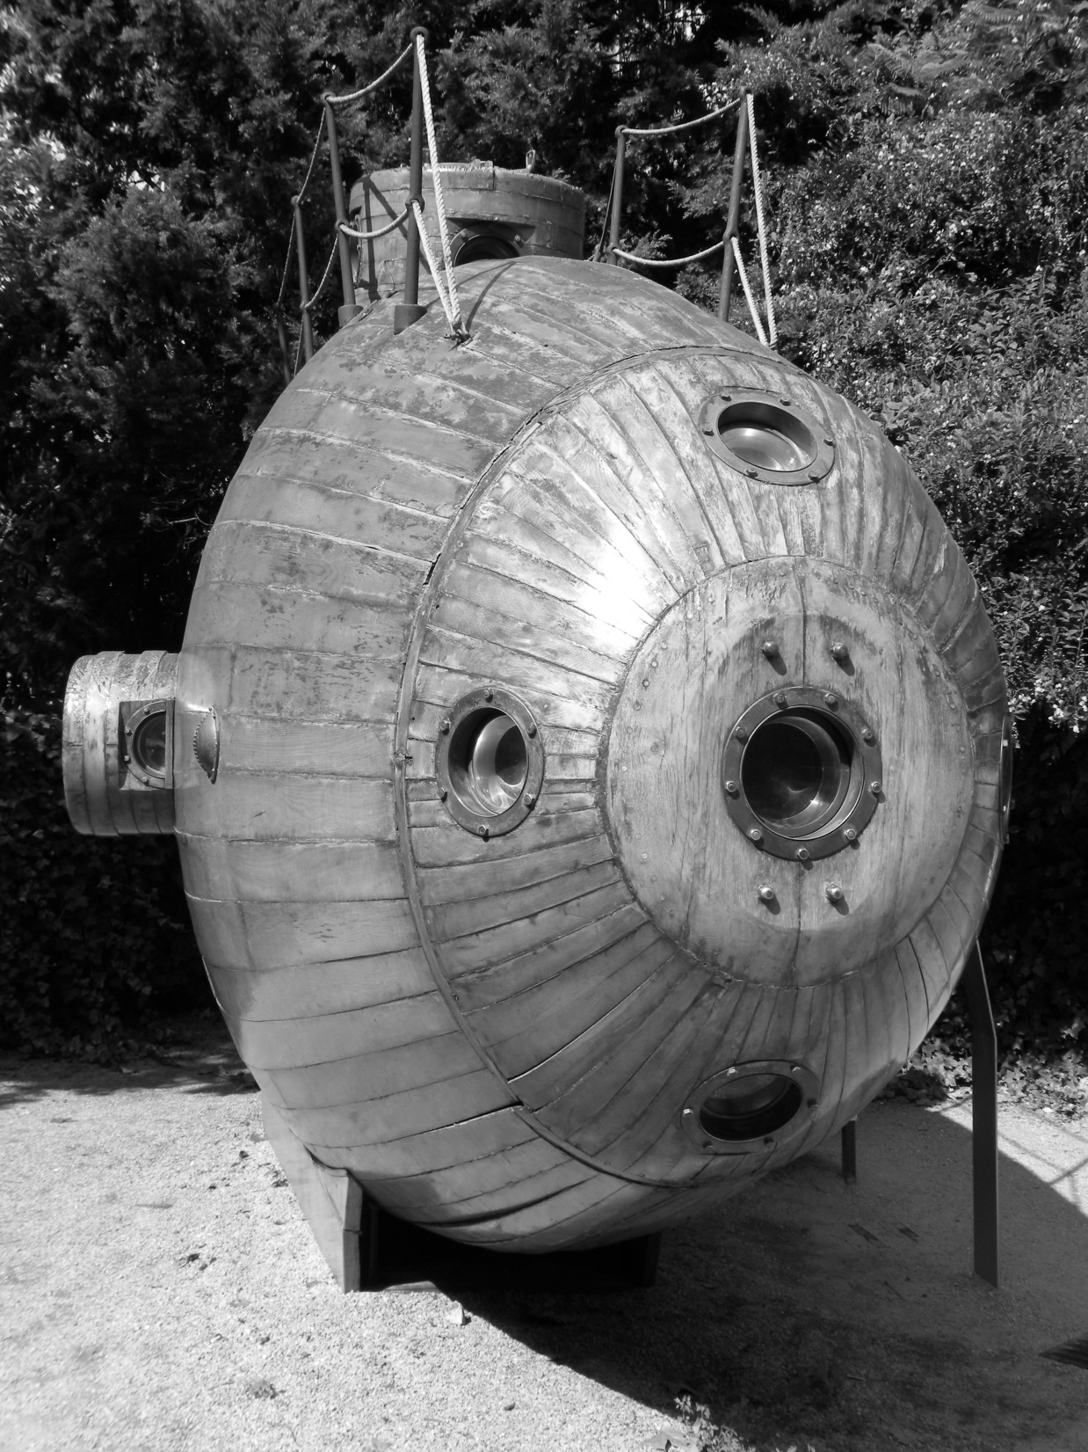
Taking the Long View: Reframing Scale-up and Sustainability Evaluations (or How Evaluation Is Like Conducting Research in a Submarine)
Ginger Fitzhugh
American Evaluation Association
October 16, 2013
Notes:
Hi, I’m Ginger Fitzhugh. I’m going to share how reframing an evaluation I’ve been working on for past four years as a complex adaptive system made me realize…

Slide 55
Evaluation : submarine
Notes:
…that conducting evaluations can be like doing research using a submarine. Although there are some definite challenges with doing research from inside a metal tube in an alien environment, submarines also you give you access to depths that you would not otherwise have.

Slide 56
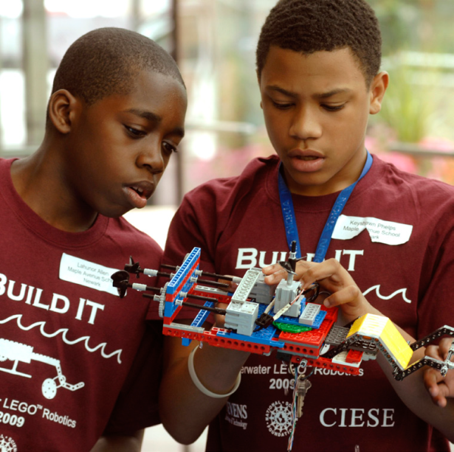
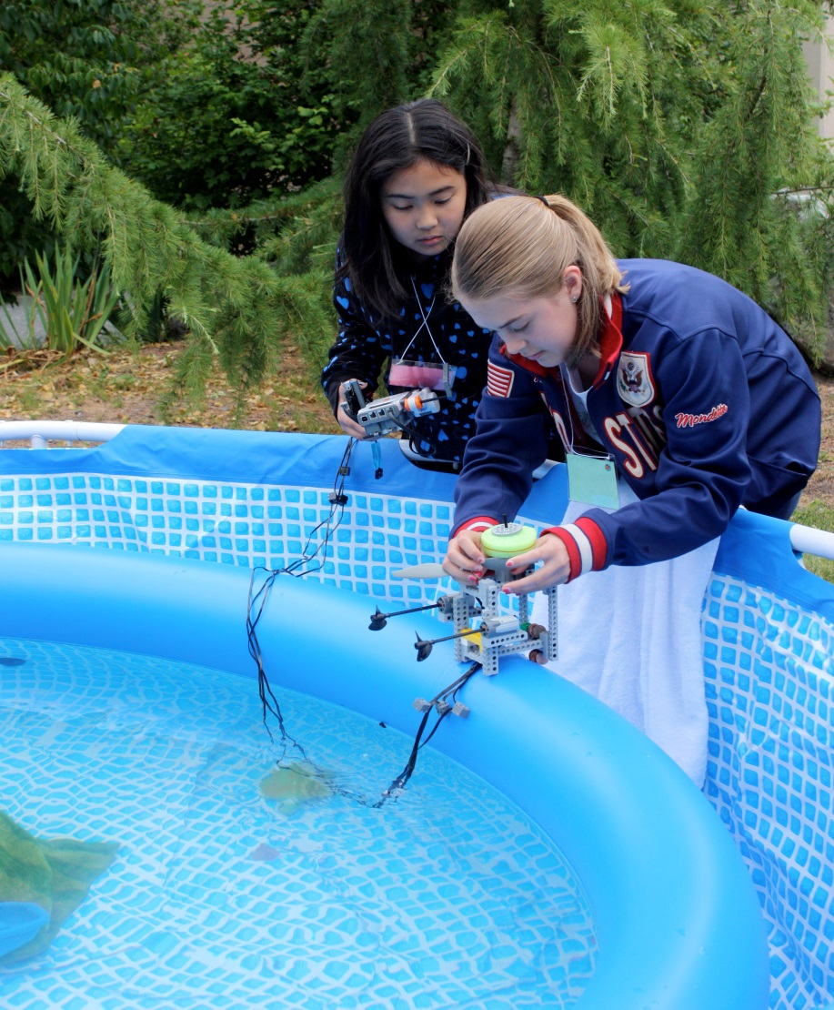
WaterBotics
Students design and build robots
Program ’bots to do engineering tasks underwater
Notes:
First, let me briefly explain the evaluation project. The project we have been evaluating for the past four years is called WaterBotics. WaterBotics is an underwater robotics curriculum for middle and high school youth. Kids learn about science and engineering concepts and careers by building submersible robots made of LEGO® components, which they program to complete various kinds of tasks underwater.

Slide 57
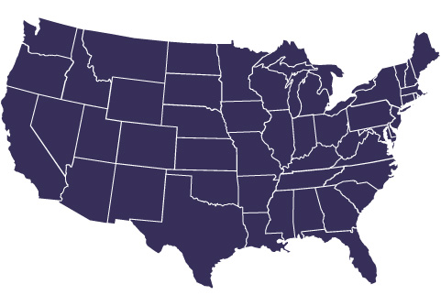
WaterBotics Expanded
Stevens Institute of Technology
Notes:
WaterBotics started at the Stevens Institute for Technology in New Jersey about 8 years ago. After successfully testing the model <click next>…

Slide 58
WaterBotics Expanded
Pacific Northwest Girls Collaborative Project
Stevens Institute of Technology
Triton College
Sinclair Community College
Kentucky Girls STEM Collaborative
Texas Girls Collaborative Project
Notes:
WaterBotics started at the Stevens Institute for Technology in New Jersey about 8 years ago. After successfully testing the model <click next>…

Slide 59
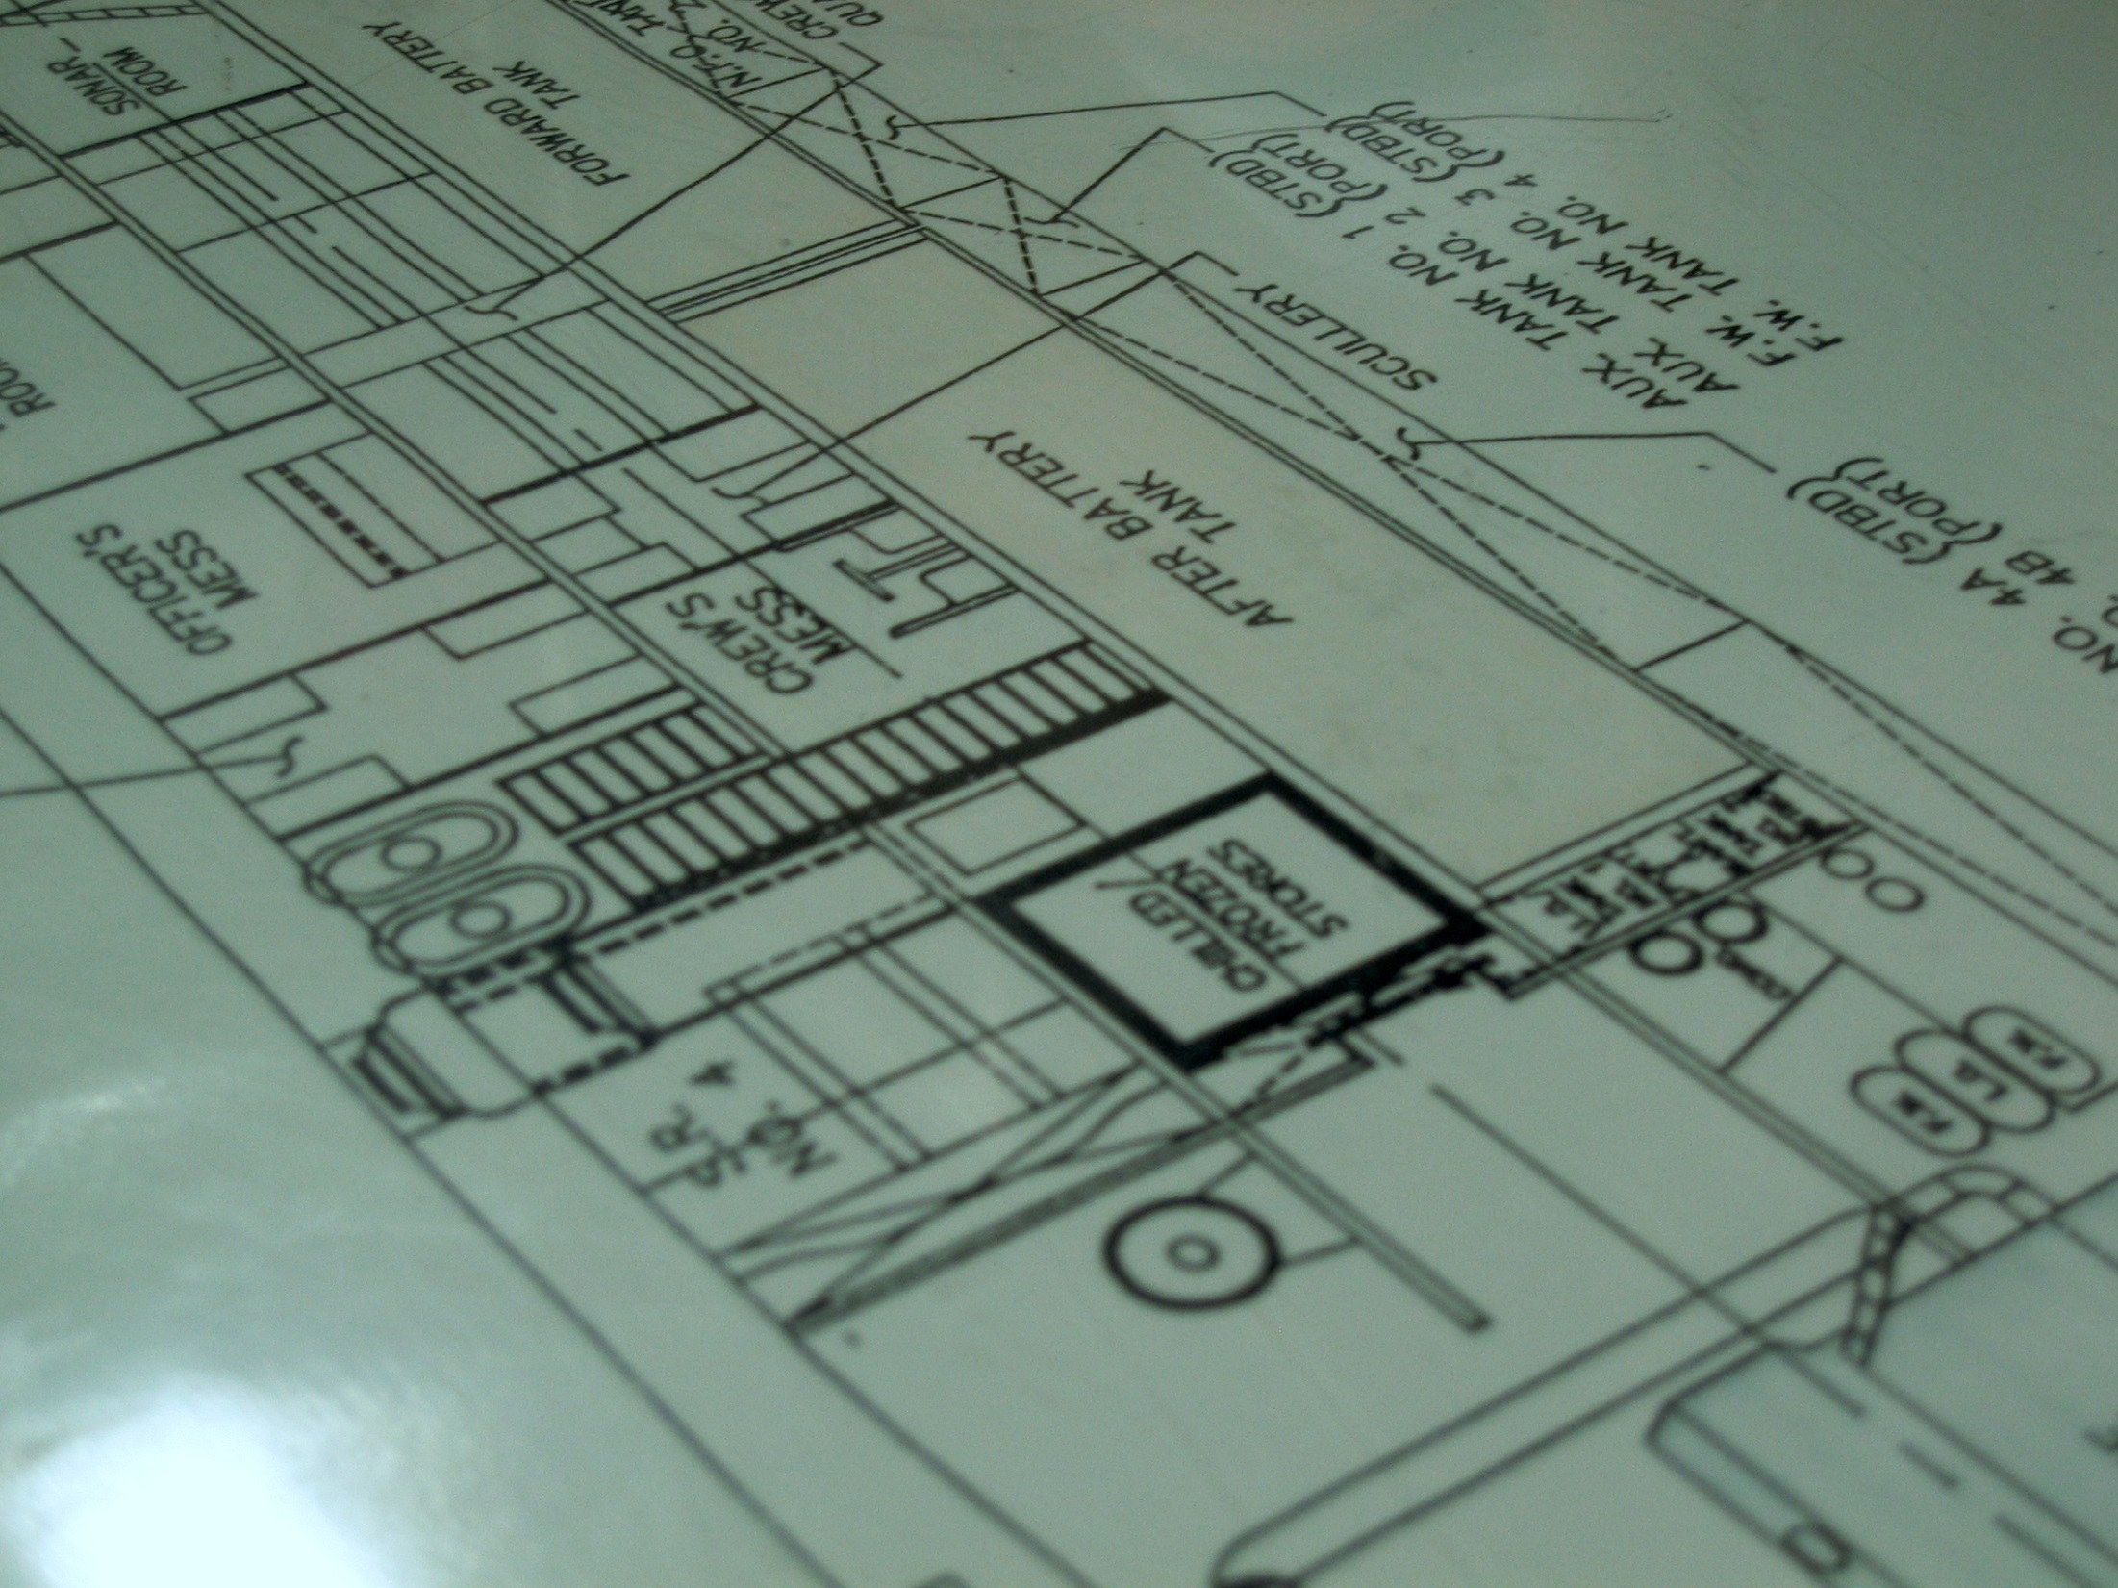
The best-laid evaluation plans…
Notes:
My colleagues and I at Evaluation & Research Associates were hired to evaluate part of this national expansion effort. We have focused on evaluating the overall effectiveness of the WaterBotics scale-up while another evaluation team has focused on collecting data re: the curriculum’s impact on educators and students. We developed a blueprint for our evaluation.

Slide 60
The view is different from up here
Notes:
As you know, I’ve been part of the ECLIPS project where I learned about applying systems thinking to evaluation. So what happens when you pull back and reframe the project you are evaluating (and the evaluation itself) as a complex adaptive system?

Slide 61
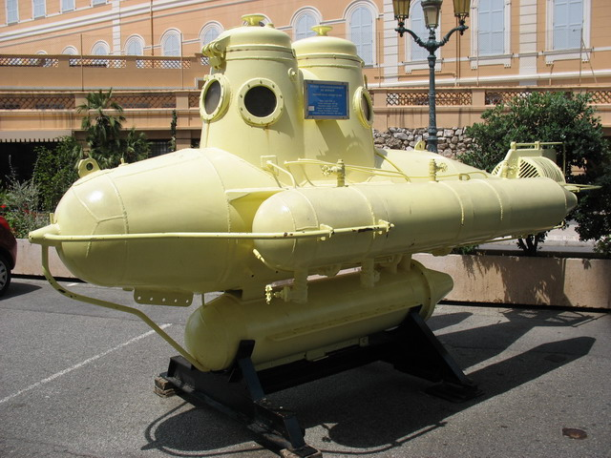
We all live in a yellow submarine
Notes:
I had an “aha.” Conducting evaluations from a systems perspective (or any perspective really!) can be like doing research using a submarine.

Slide 62
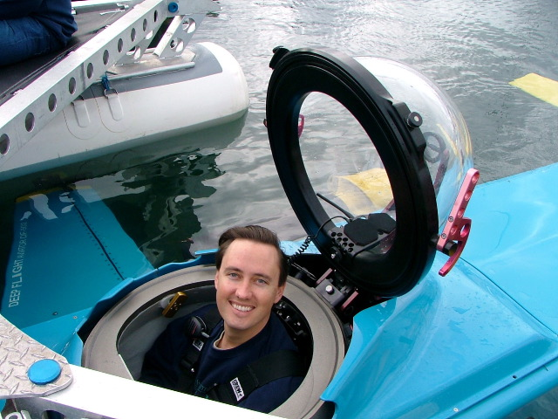
We bravely go…
Notes:
We gamely get our evaluation tools ready…

Slide 63
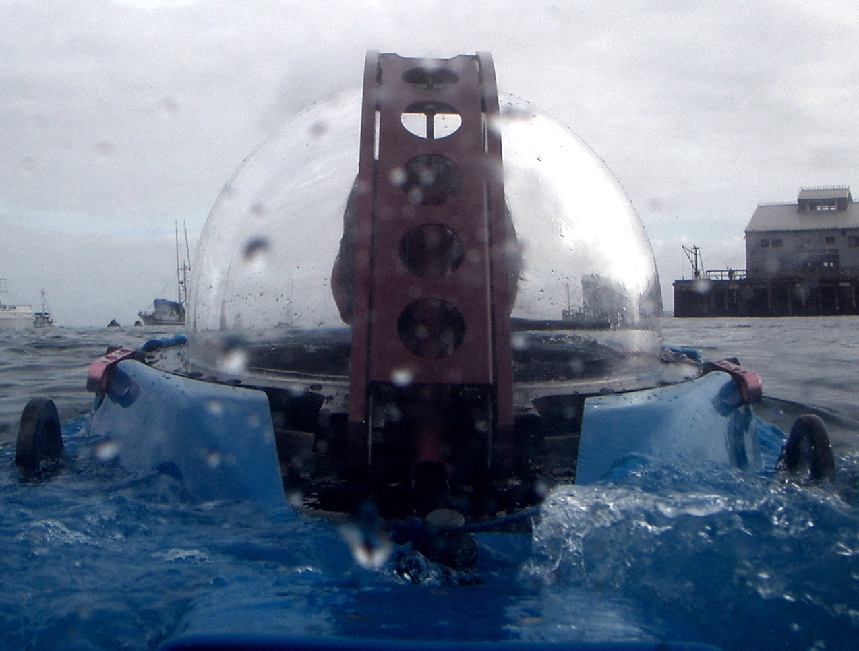
…down…
Notes:
…and we enter the project system…

Slide 64
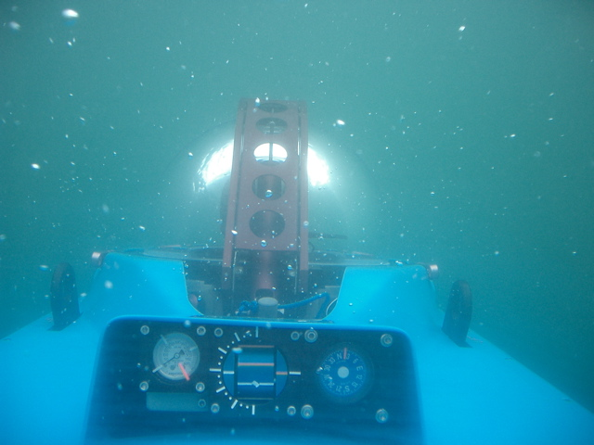
…into the depths
Notes:
…As we descend…

Slide 65
Where it can be murky
Notes:
We learn that it can be hard to see what is really going on.

Slide 66
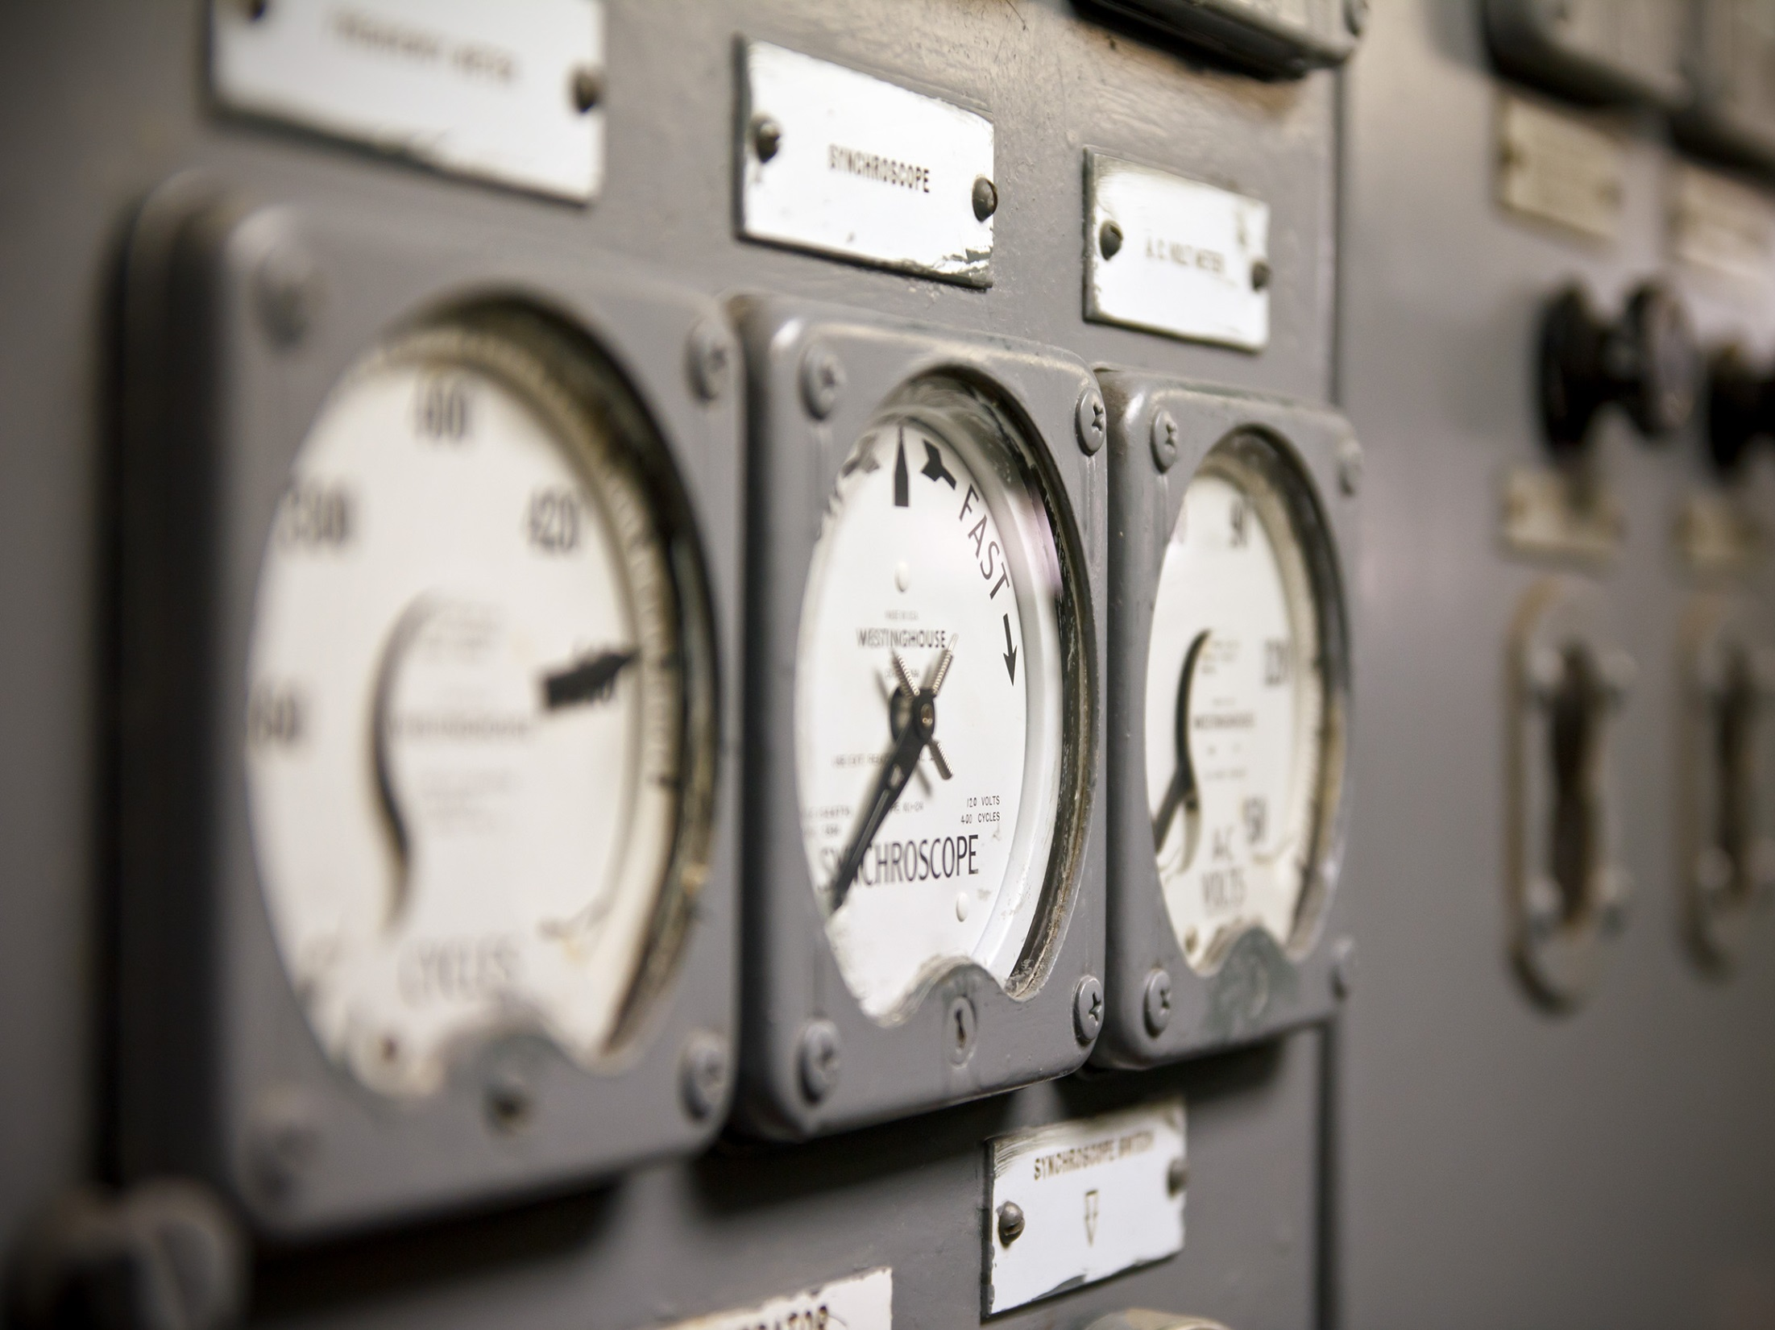
We depend on the quality of our gauges
Notes:
…and so we rely on the gauges that we’ve designed, hoping that they are accurate and tell us what’s really going on out there.

Slide 67
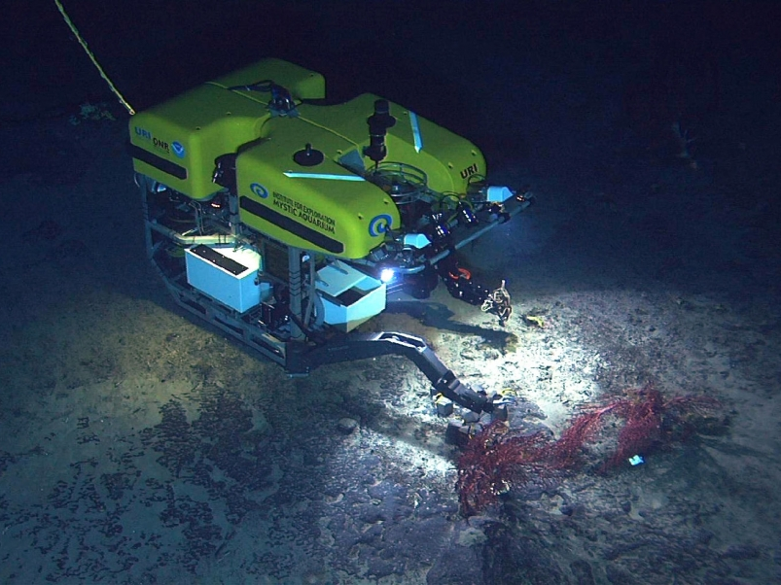
We may have to operate remotely
Notes:
We often end up relying on various indirect means for collecting information, like online surveys or relying on others to collect and share the data with us.

Slide 68
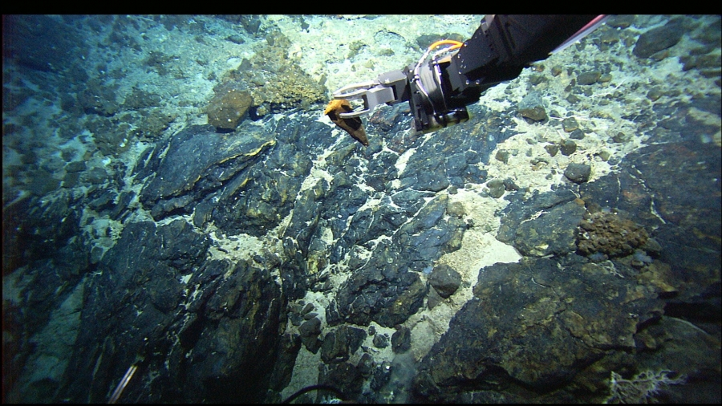
Collecting data can be awkward
Notes:
And these data collection methods can be awkward and tricky to control.

Slide 69
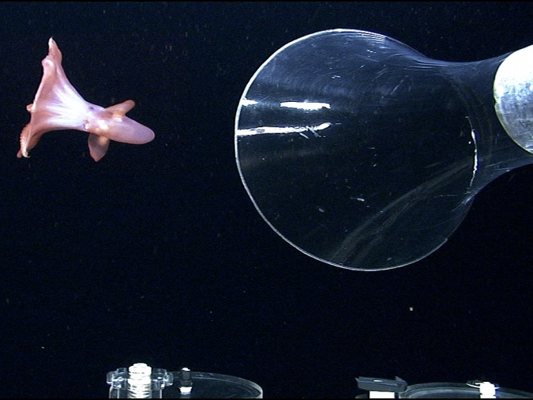
Who knows what we’ll find?
Notes:
We also may be limited to a few data collecting expeditions where we collect what happens to be around then, which may or may not be representative of the environment.
(Ask audience: Does any of that sound familiar or ring true for you?)

Slide 70
BUT…

Slide 71
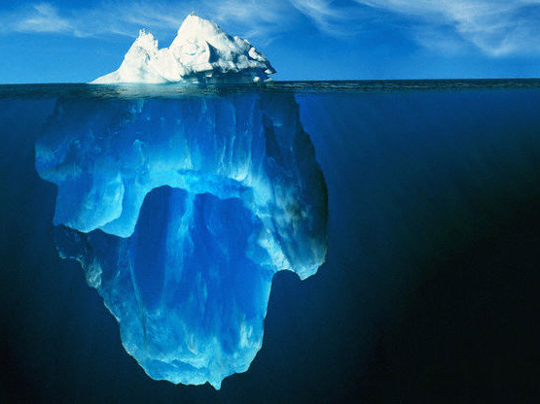
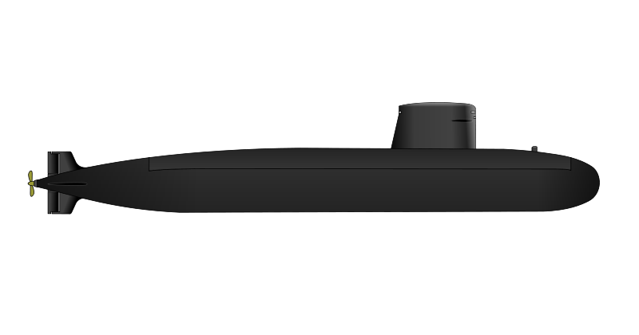
See 20,000 leagues under the sea
Notes:
BUT…there is at least one great advantage to descending to the depths in a submarine: we get to see things below the tip of the iceberg.

Slide 72
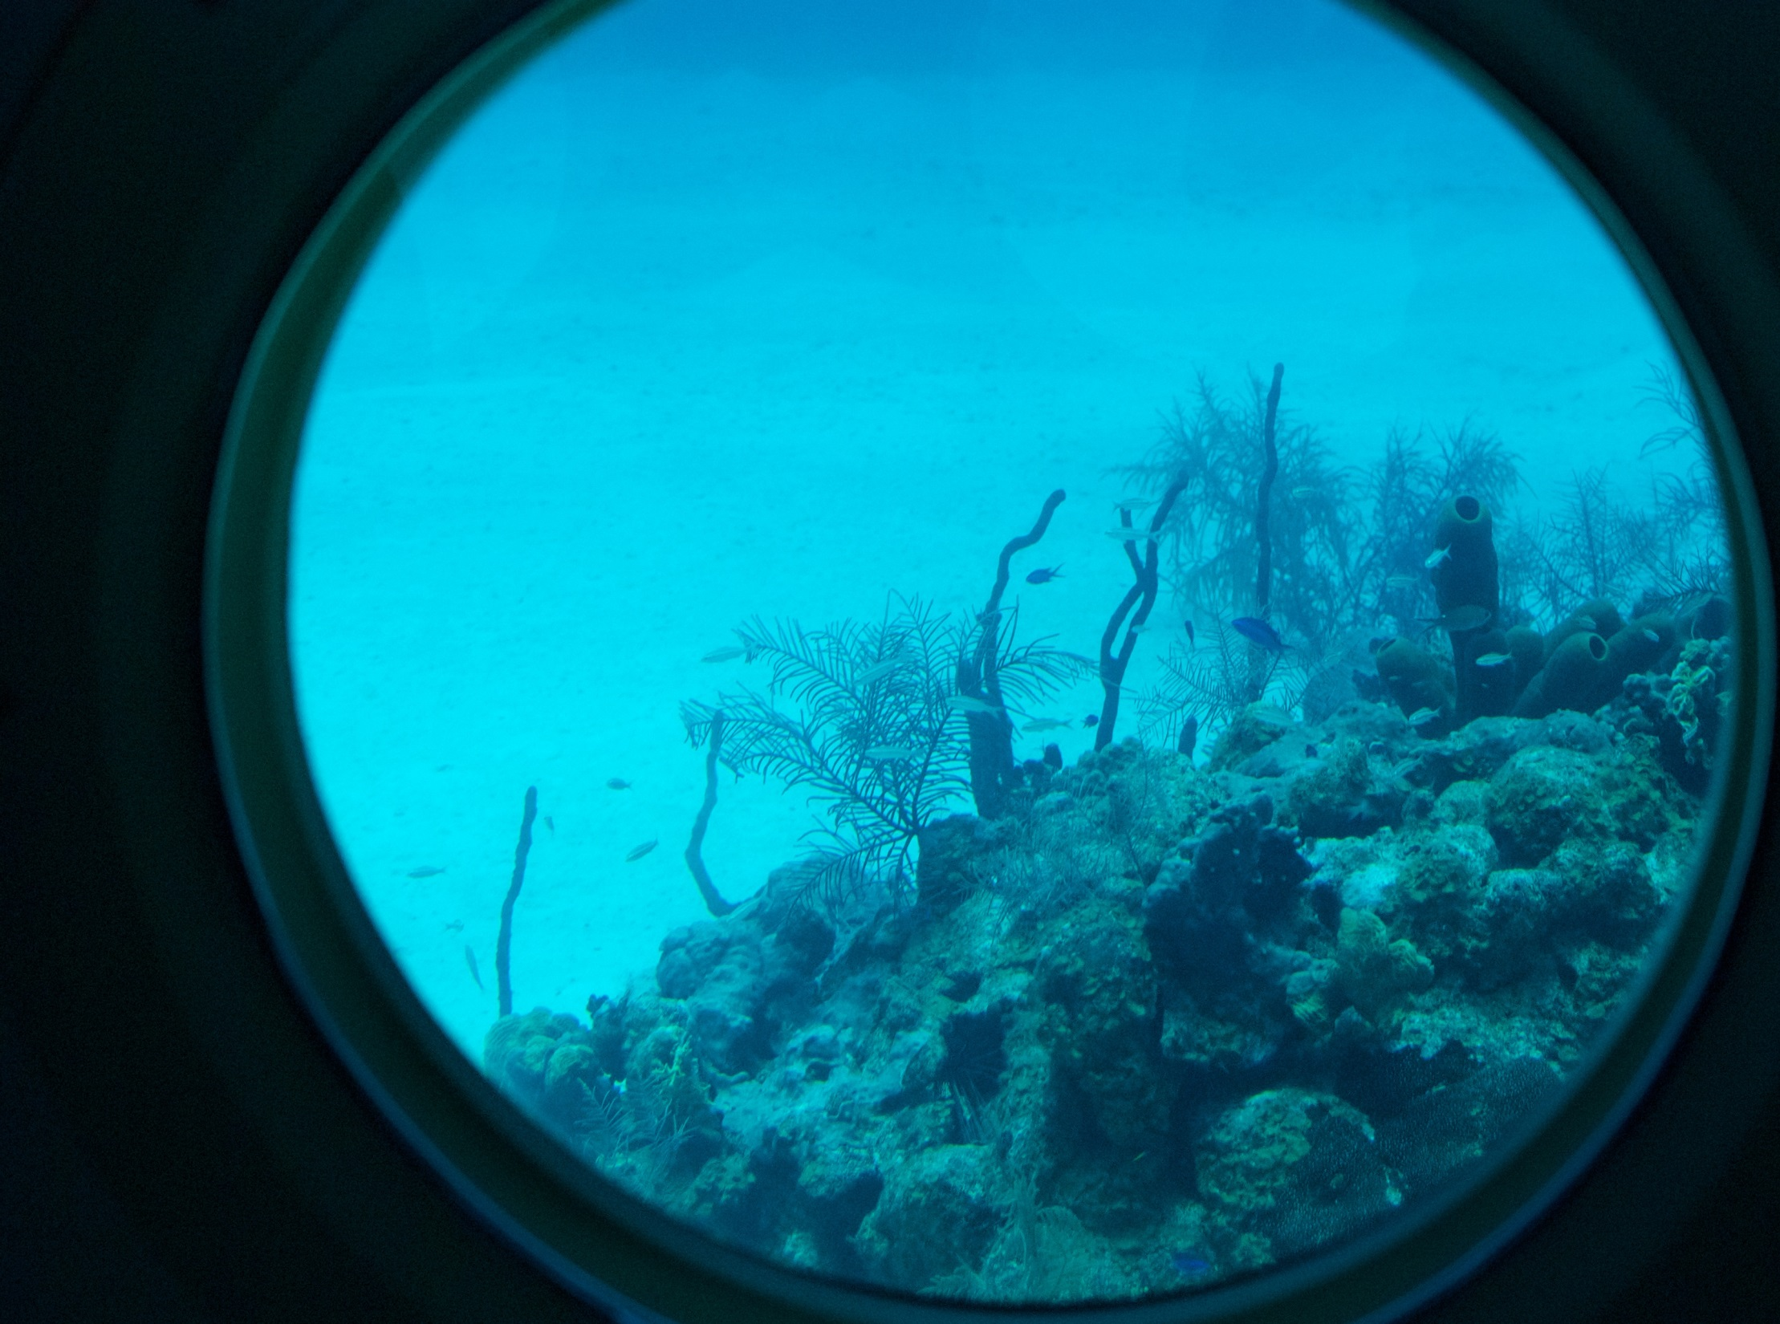
3 things
we learned from reframing
Notes:
And what are those great depths that we can see below the surface? I’m going to share three things I learned by looking at a project more deeply which helped to change both the project and our evaluation.

Slide 73
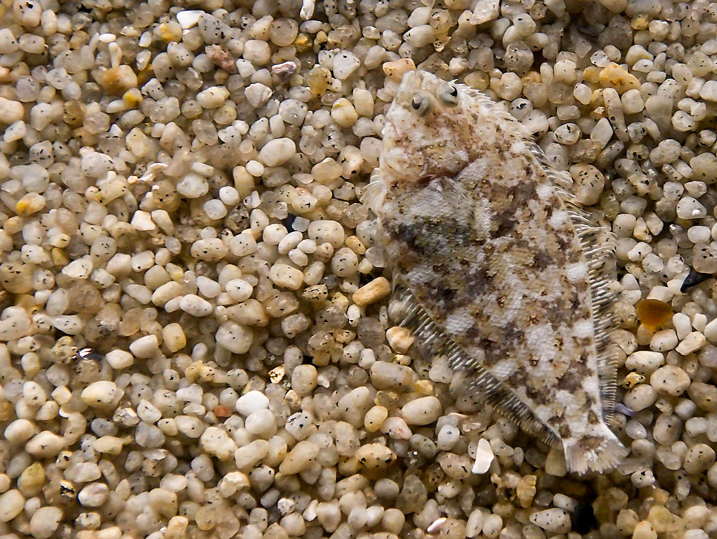
1. Adapt
Notes:
First, when you reframe the project and your evaluation as a system, you pay much more attention to the local context. You realize that both the project and the evaluation need to adapt to fit the needs of the changing environment.

Slide 74
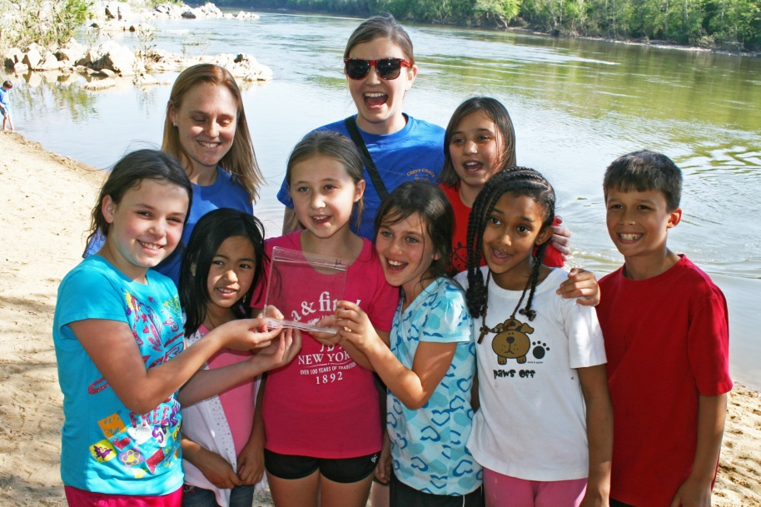
School classroom
Summer camp or afterschool program
Notes:
The WaterBotics curriculum was originally designed to be implemented in classrooms. As part of the scale up, the curriculum was implemented for the first time in informal educational settings, including summer camps and afterschool programs. But a science classroom looks very different than a week-long summer camp. They have different purposes, different needs, and different policies.

Slide 75
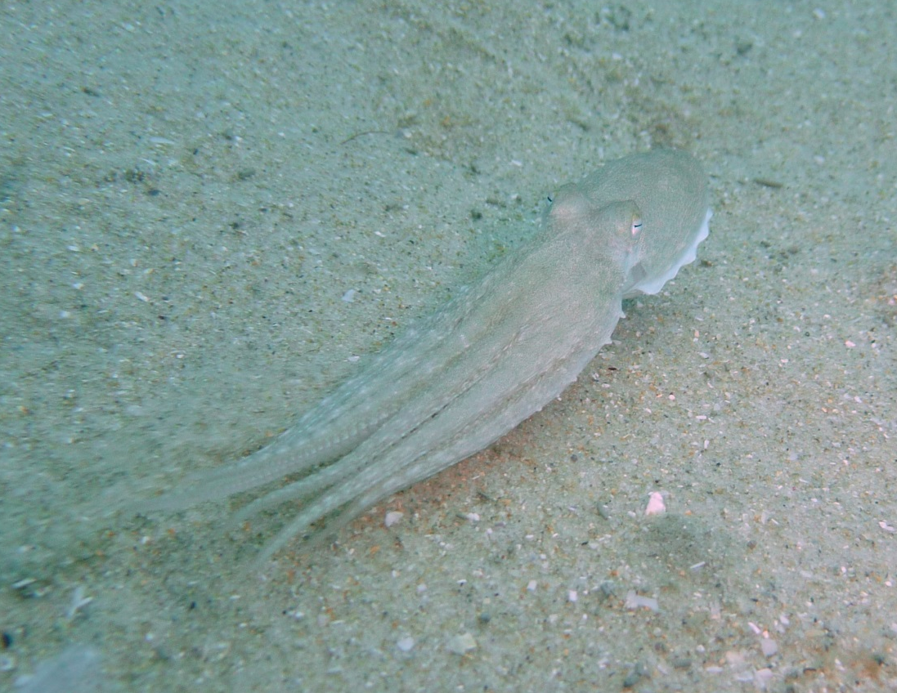
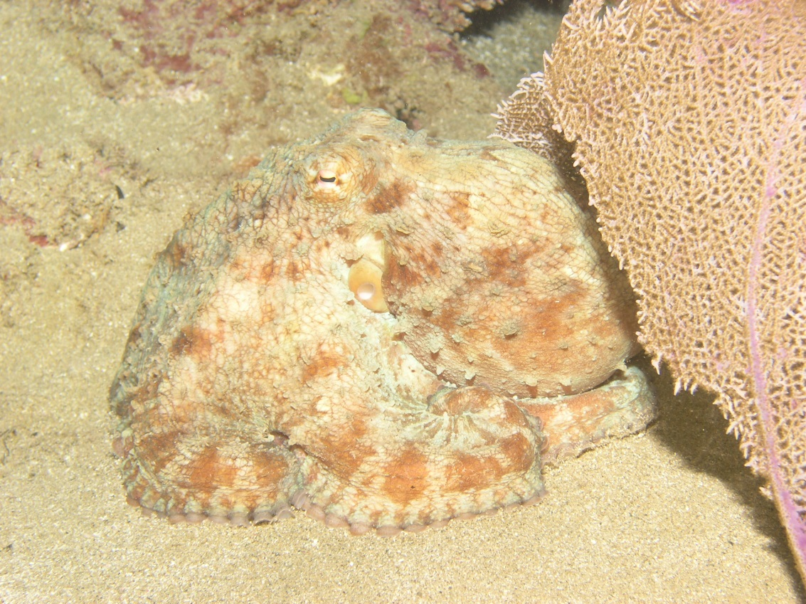
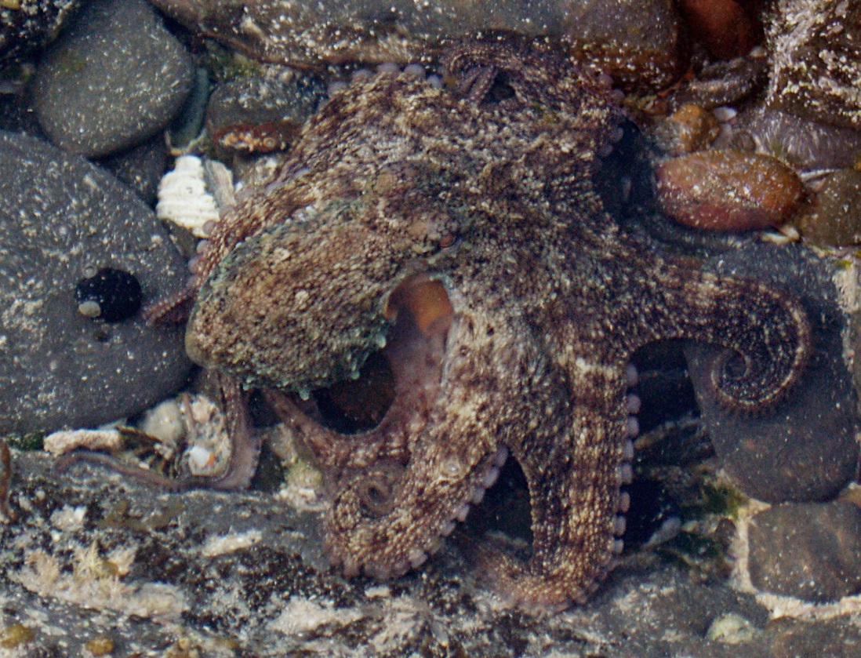
The project adapted
Notes:
The WaterBotics project team originally expected that they would simply implement the same curriculum that had already worked so well in New Jersey everywhere else. They quickly learned that wouldn’t work. So the team modified the curriculum for out-of-school-time contexts. For example, they added fun activities to break up the lessons about physics principles and how to program the robots, and to help keep kids engaged. Some of the girl-serving out-of-school time organizations were uncomfortable with the original curriculum in which students had competitions to demonstrate how their robots worked. These competitions were renamed and reconceptualized as “missions” in the new informal version of the curriculum.
The project has continued to evolve. Now there are four versions of the curriculum for different educational settings and different age groups.

Slide 76
?
We changed our questions
Notes:
What did the changing context mean for the evaluation? Our annual evaluation budget and scope were small, but we knew we could make some changes. By participating in the ECLIPS community of practice, I learned that understanding a project’s changing boundaries, perspectives, and relationships can help you understand that project more deeply. So we modified our interview protocols to include questions to collect information about the needs of the different contexts where the project was now being implemented, and we shared what we learned with the project team to help them with planning. We were also able to document an unanticipated outcome: the infusion of informal educational practices into some of the formal classrooms.

Slide 77
2.
Open
wide
Notes:
Here’s the second thing I learned. When you reframe a project and your evaluation as a system, you realize that you need to open wider. You may need to expand the boundaries and look beyond the project itself.

Slide 78
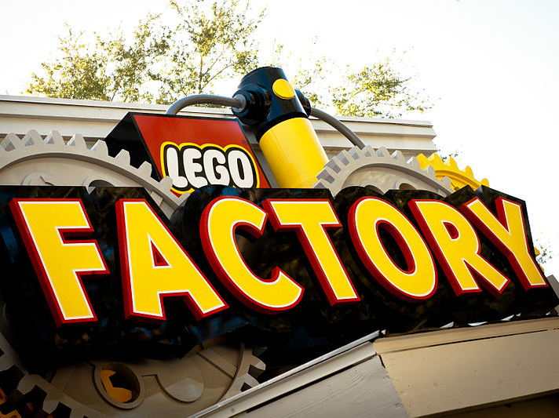
The equipment changed
Notes:
Here’s one way external forces affected WaterBotics. The project team purchases kits from LEGO which include the bricks, electronic components, and motors needed to build a submersible robot. Two years into the project, LEGO stopped manufacturing a key component of these kits. This external change—which the project team had no control over—forced the team to modify the equipment kits. They also had to revise the curriculum and retrain some educators who had been trained using the old kits. The project team thinks the new equipment will actually make the curriculum easier to implement.

Slide 79
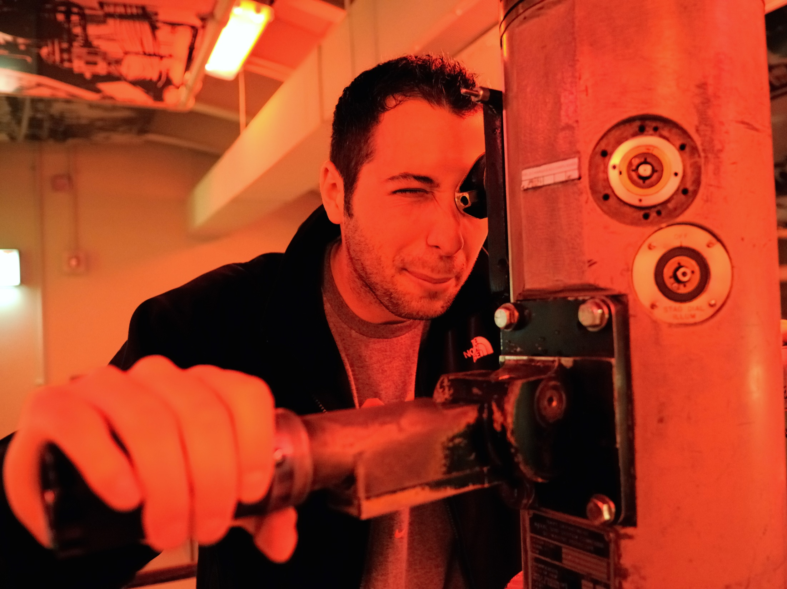
We kept our periscope up
Notes:
What did “opening wider”—expanding our boundaries—mean for the evaluation? More than anything, it meant being a position to collect data about external factors that might affect or were affecting the project. We tried to do our best with this, although our limited evaluation resources meant that our field of view (or “periscope” ☺) was also limited. We modified our evaluation protocols to include a few questions asking interviewees what external factors had impacted the project, such as school policies and competition with other teacher professional development opportunities or educational programs. Ideally, we could help the team anticipate external issues so that they could plan for them before they happen. We did learn that LEGO recently announced that they will stop making another important component of the kits in about two years. We’ve encouraged the team to think about how this upcoming change will affect the project—but it’s a tough issue for the team because the equipment change will occur after the WaterBotics grant ends.

Slide 80
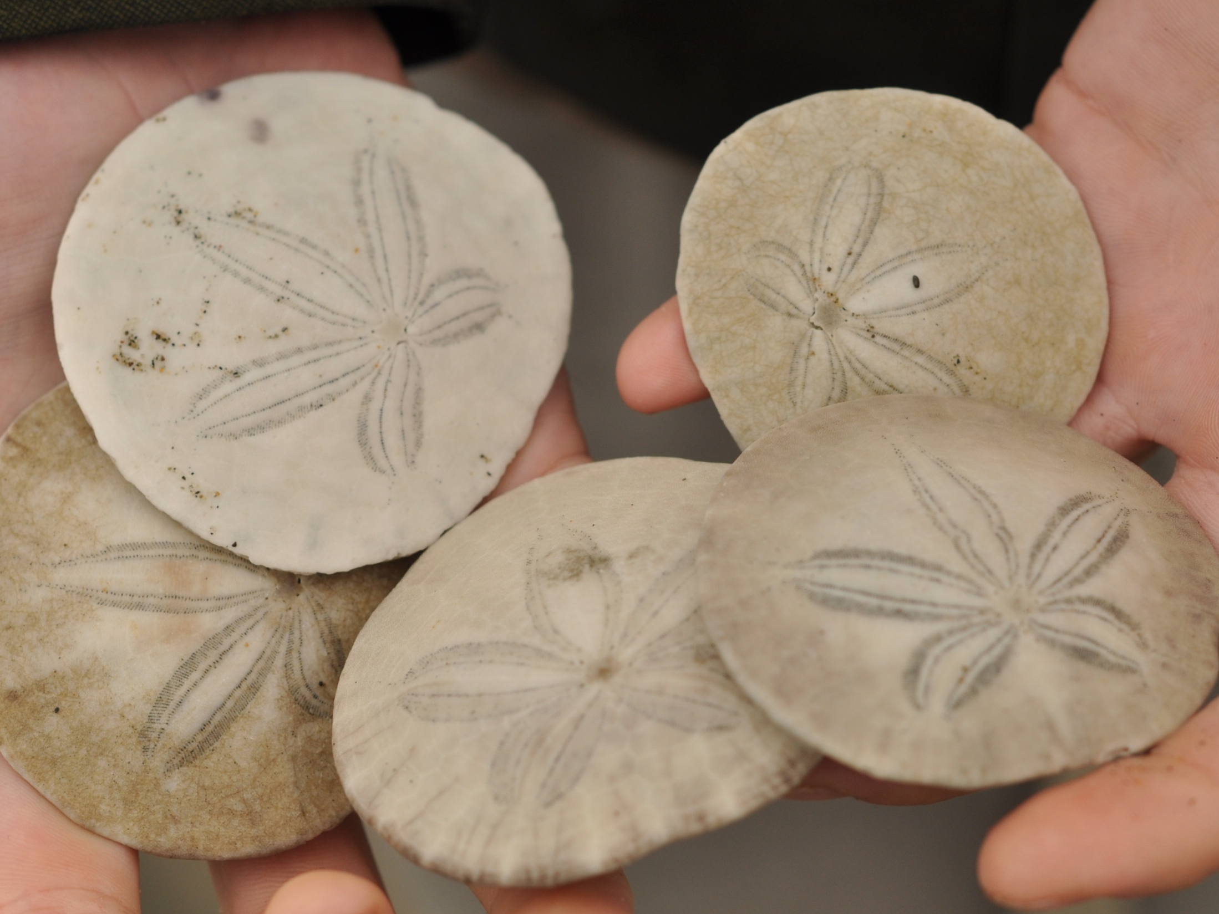
3. Plan for sustainability
Notes:
And here’s the third thing I learned: When you reframe a project or an evaluation as a system, you take the long view regarding project sustainability. By sustainability, I mean the ability of a project to continue to operate into the future.

Slide 81
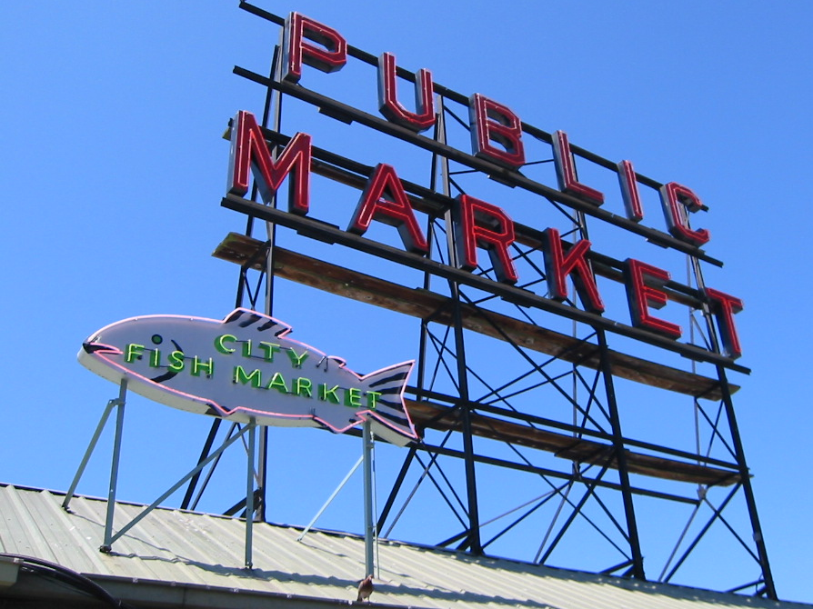
The project evaluated the market
Notes:
WaterBotics is nearing the end of its five-year grant. The project team’s goal is that the curriculum will continue to be implemented in the current five expansion sites, as well as in a growing number of schools and organizations around the country. How will that happen? The team has worked hard to try to identify alternative funding sources. As is true for many non-profit educational ventures, the team realized that they did not have the entrepreneurial or business expertise to know how to market the curriculum and raise revenue commercially. They are currently leveraging internal resources—by partnering with their university’s business school—to help evaluate the market and develop a business plan.

Slide 82
We encouraged them to plan for
the future
Notes:
What did reframing the evaluation to look at sustainability mean for us? We tried to highlight the importance of resources and the need to plan for sustainability early and often—actually starting in the very first year of the project. We encouraged the team to identify which elements of WaterBotics were essential (“it wouldn’t be WaterBotics without X”) and which elements could be adapted or changed to fit the needs of the local context and to help foster local ownership. Of course, there are many issues that impact sustainability, but we thought the fewer and clearer the essential elements were, the more likely the project was to be adopted and sustained. We also documented whether and how the national team and each of the local expansion sites had taken steps toward achieving sustainability, such as by securing additional funds or institutionalizing the project into the organization. Finally, we encouraged the national team to decide what centrally-provided project resources and supports will continue to be available to the new sites after the grant ends, and communicate that clearly to the expansion sites.

Slide 83
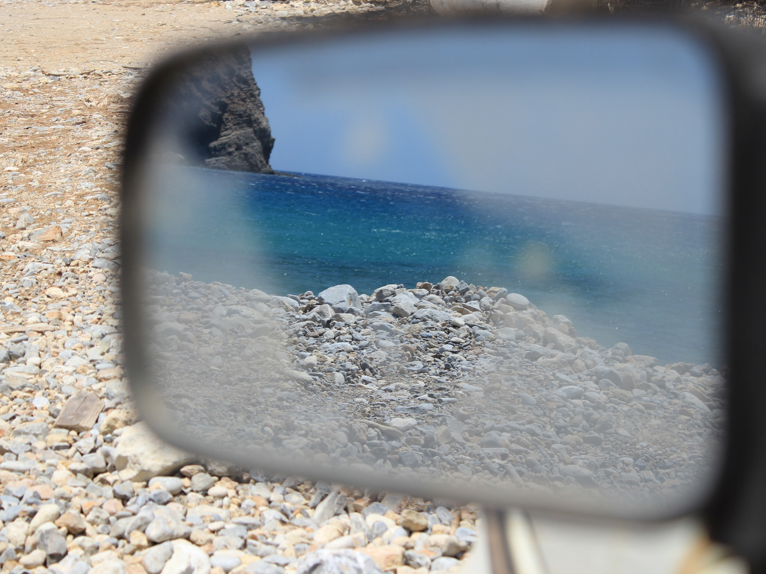
Hindsight is 20/20
OBJECTS IN MIRROR ARE CLOSER
THAN THEY APPEAR
Notes:
OK. I’ve shared three things that we did and the project did that were helpful. But as we near the end of the five-year evaluation, there are a few things that I wish we could have done differently that might have helped the project even more. I’m going to share three of those wishes with you.

Slide 84
Wish #1: Collect data from
non-implementers
Notes:
First, I wish we could have collected data from educators who did not implement WaterBotics. We have some indirect data about why some educators have chosen not to implement the curriculum, but it would have been great if we had allocated resources to track down and interview non-implementing teachers themselves about what the barriers to implementation were.

Slide 85
Wish #2: Collect data from
outside sources
Notes:
I also wish we could have collected data from sources that were not directly connected to the project—put on our scuba gear and gone outside the sub, so to speak. As I mentioned, we had a small evaluation budget which permitted us to collect and analyze a limited amount of data. We focused our resources on collecting interview data from the project team and leaders at the five new sites around the country, along with some limited survey data from educators. It would have been great if we could have expanded the evaluation’s boundaries and interviewed representatives from other organizations that have scaled up robotics curriculum for kids (like FIRST Robotics) or talked with LEGO Foundation staff about their interests in supporting the project.

Slide 86
Wish #3: Collect data after
the project ends
Notes:
Finally, my third wish is that we could send out a fleet of bottles with messages in them and collect data after the project’s funding formally ends in one year’s time. The only real way to answer the question about whether the project is sustainable is to collect data after it ends—maybe in 2 to 3 years’ time—to see whether and how the curriculum is being implemented, how it has been adapted, and how it is being supported.

Slide 87
How can you use this?
Notes:
So here’s a quick review of what I learned about reframing, and how you might be able to use this information in your own work.

Slide 88
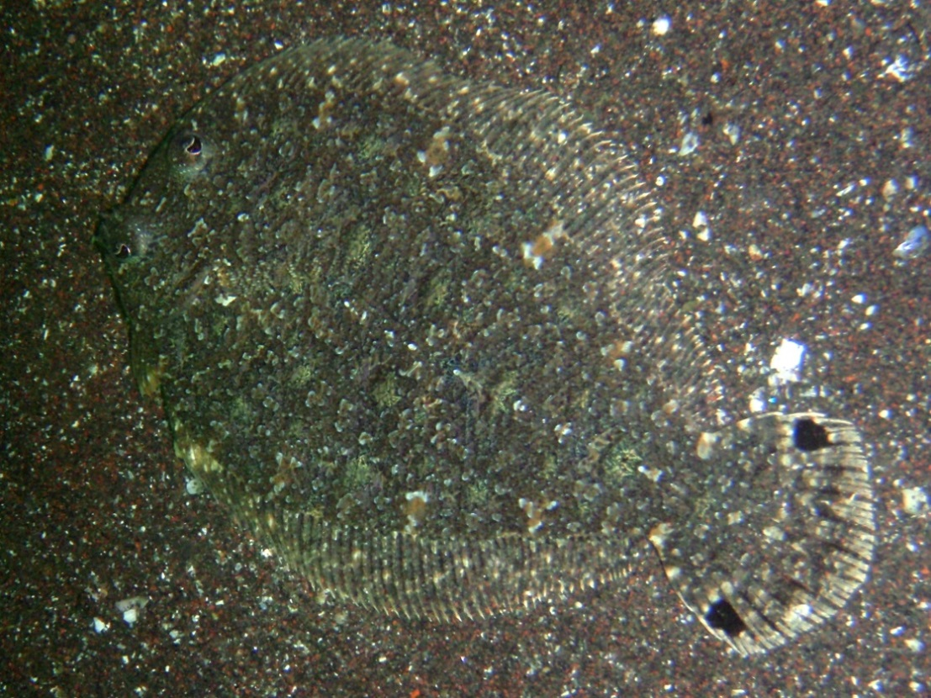
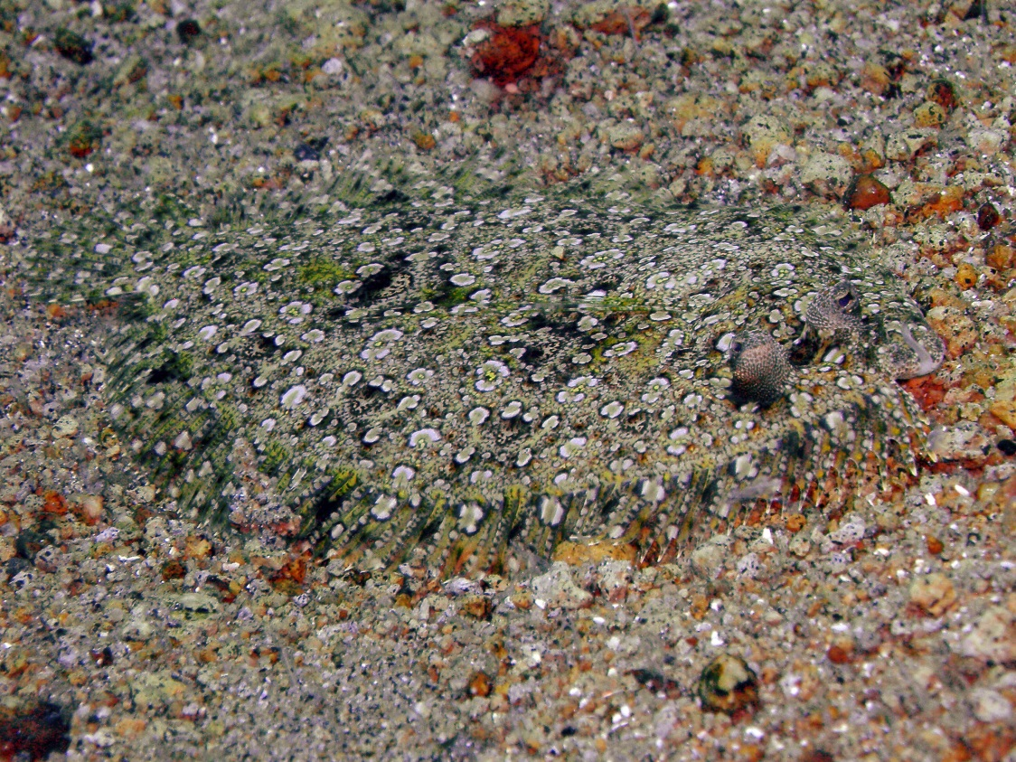
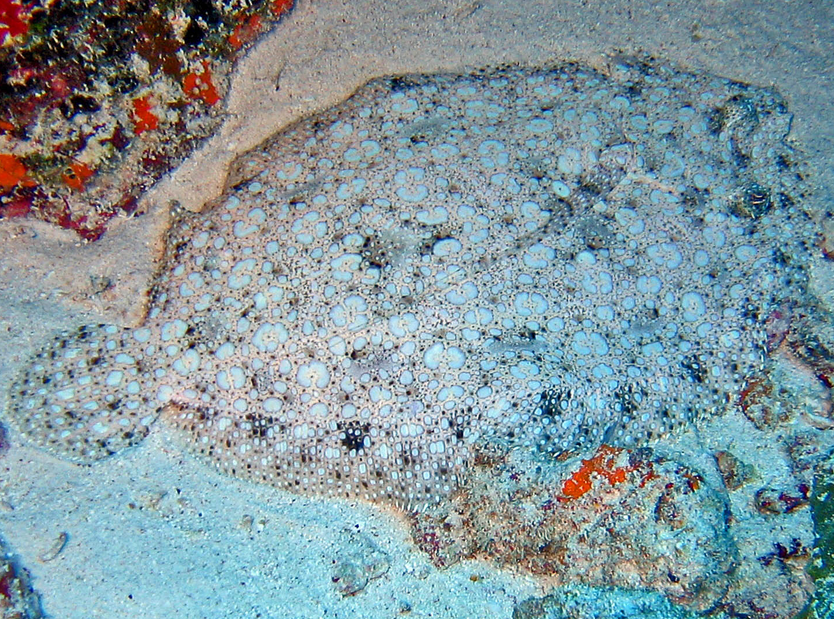
1. Adapt, adapt, adapt!
Notes:
First, be willing to modify your evaluation methodology to adapt to changes in the project system. For example, modify your survey or interview questions, or even modify who you collect data from. Although you may sacrifice the ability to make some direct comparisons over time, you gain the ability to collect more relevant and useful information.

Slide 89
2. Open wider
Notes:
Second, open wider. Help your clients think about the larger context—look beyond the project’s boundaries and encourage them to consider the impact of other factors that could impact their efforts.

Slide 90
3. Plan for sustainability
Notes:
Third, help projects think about what they need to become sustainable. What additional resources do they need, and how might they acquire them? What resources do they already have in-house that they can leverage?

Slide 91
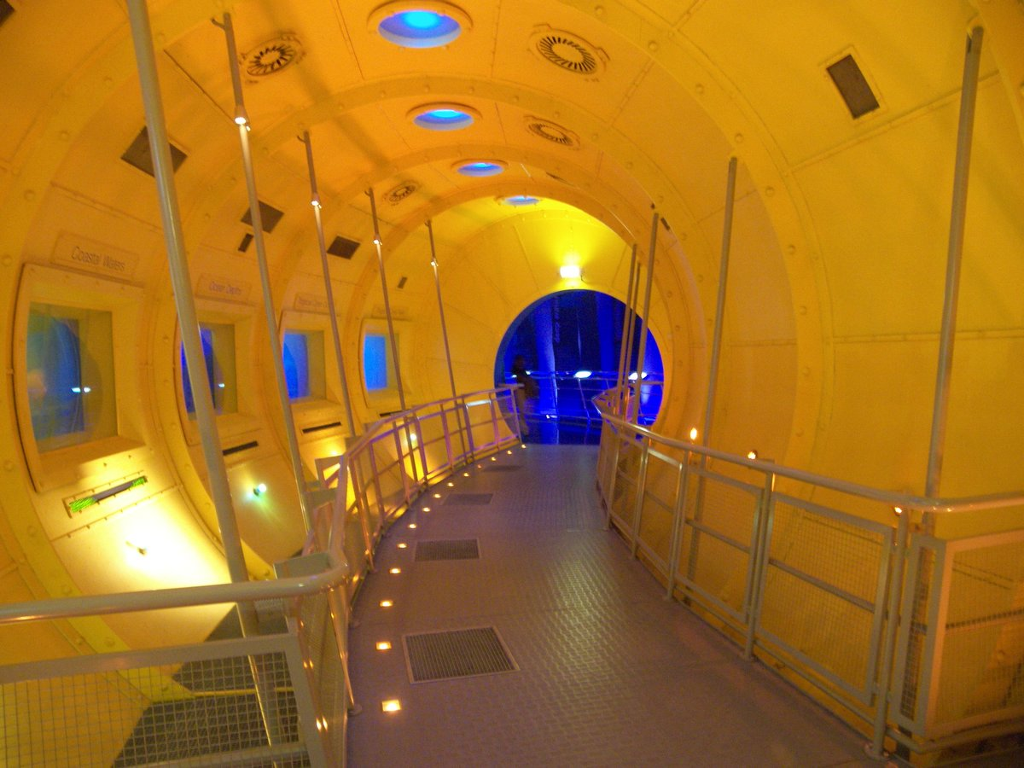
What do you see from your
evaluation submarine?
Notes:
I want to end by circling back to the idea of evaluation being like doing research from a sub. Yes, it can be murky, we sometimes have to collect data using awkward tools, and we never know what we’re going to find on our evaluation expeditions. But I’ve found that it allows me to go below the surface and go deeper than I otherwise would, especially when I’m willing to adapt, open wide, and think about the long-term.

Slide 92
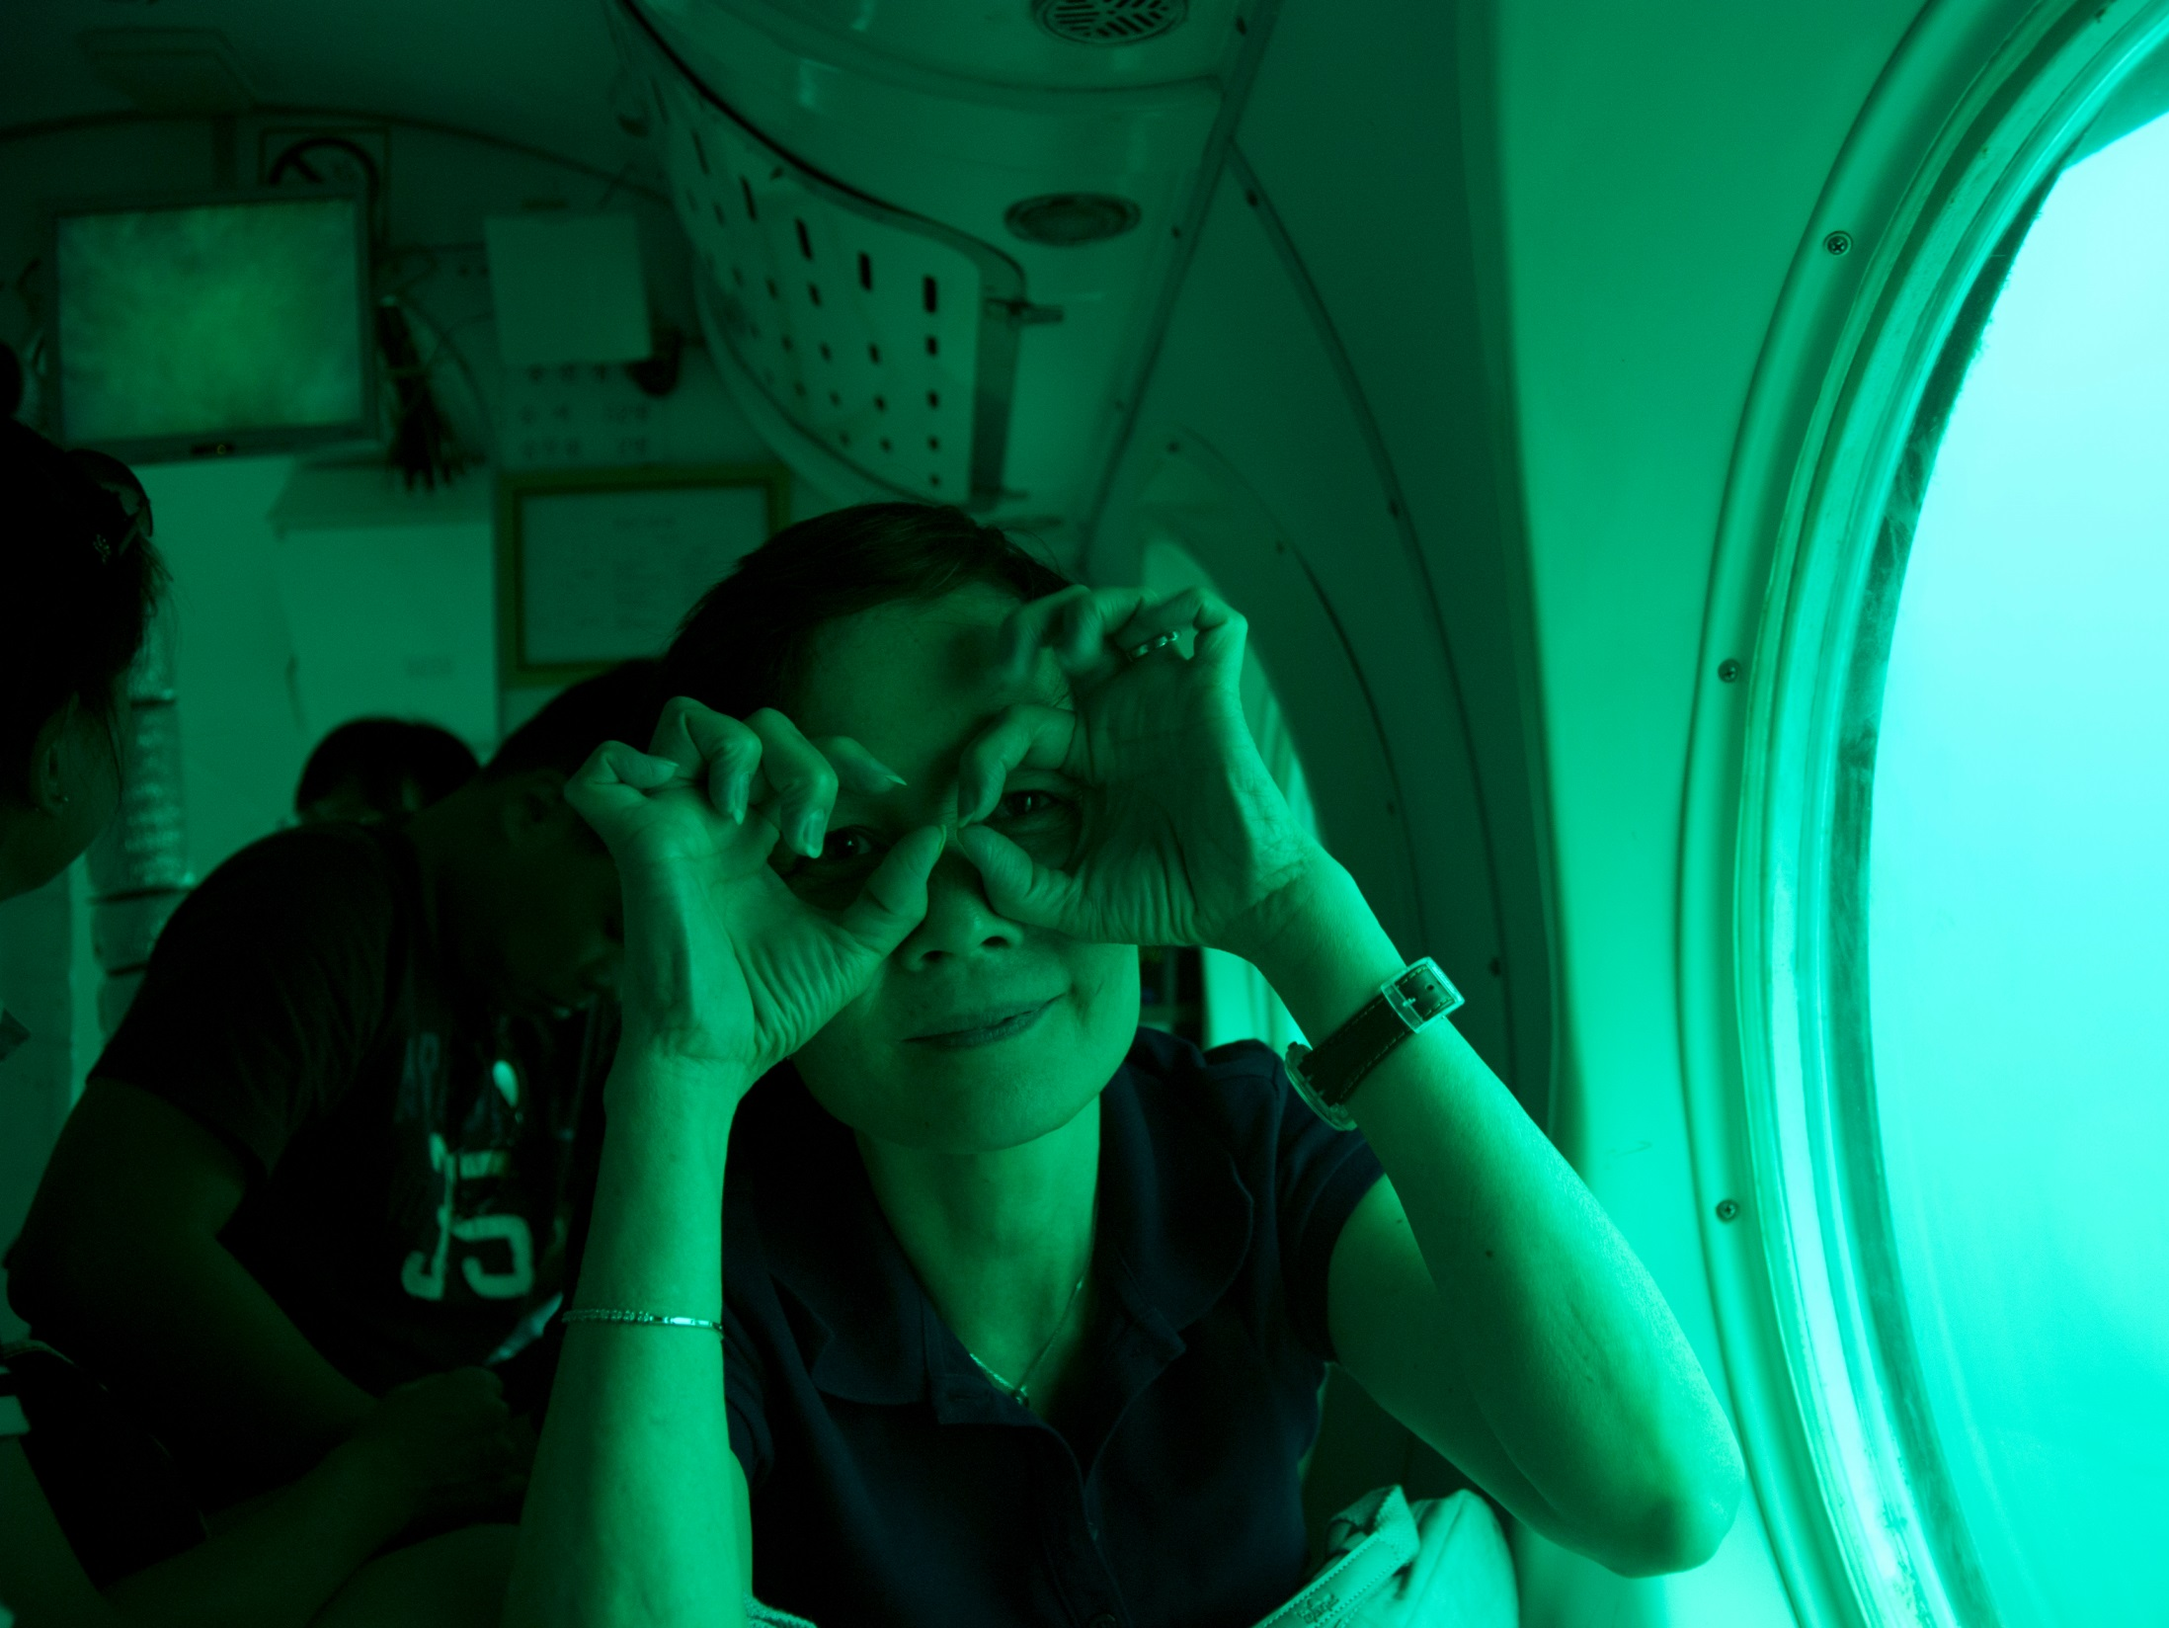
How could you reframe?
http://www.insites.org/evaluations-and-resources/systems-thinking-in-evaluation
Notes:
So the most important advice I can give you—especially if you are engaging in a multi-year evaluation—is to pause. Take time to sit and think. Periodically re-assess your evaluation by looking back, forward, and all around you. Consider how the project may have changed and reframe the evaluation as needed.
I also invite you to check out the resources on the Insites.org website (link on bottom of this slide), which includes the ZIPPER mnemonic for applying systems thinking to evaluations and examples of interview questions that can help you understand complex situations.

Slide 93
Image Credits (via Flickr and Pixabay)
Piper 60 (antique sub)
David Mark (sub through porthole, basking shark, photographer)
Stevens Institute for Technology (WaterBotics)
Marcin Wichary (sub blueprint)
NASA Goddard Photo and Video (Gulf Stream world view)
Alberto Perdomo (yellow sub)
Steve Jurvetson (blue sub descending)
Find (underwater scene)
NOAA (ROV collecting samples)
Nataraj Metz (sub instrument panel)
Pere (iceberg) and Rubis (submarine next to iceberg)
Public Domain Pictures (bench, underwater sand background)
Moondigger (flounder)
Merrimack College (teacher and students)
Woodley Wonderworks (afterschool trip)
Saspotato, BBM Explorer, Ryan Wick (octupi)
Hyku (LEGO factory)
Steve Hanna (periscope)
Rachel Hathaway (sand dollars)
Mykl Roventine (Seattle Public Market)
Markus De Nitto (sun glass)
Paul Kam (rearview mirror)
Alan Wolf (sea otter)
Sigmund (leopard shark)
Kraftwerck (bottle)
JRL5 (seal)
Boogies with Fish, Dachlan, Hectonichus, and Nemo’s Great Uncle (flounder)
David Cook (seal)
Jessica Lucia (sand dollar)
Bittlelit (inside yellow sub)
Cactusbeetroot (woman with hands on face)
Florian Berger (red-knobbed starfish)
Notes:
Thanks to all the wonderful photographers who made their work freely available.

Slide 94
Ginger Fitzhugh
gfitzhugh@eraeval.org
Notes:
Please feel free to contact with me with questions or ideas. Thank you.

