Slide 1
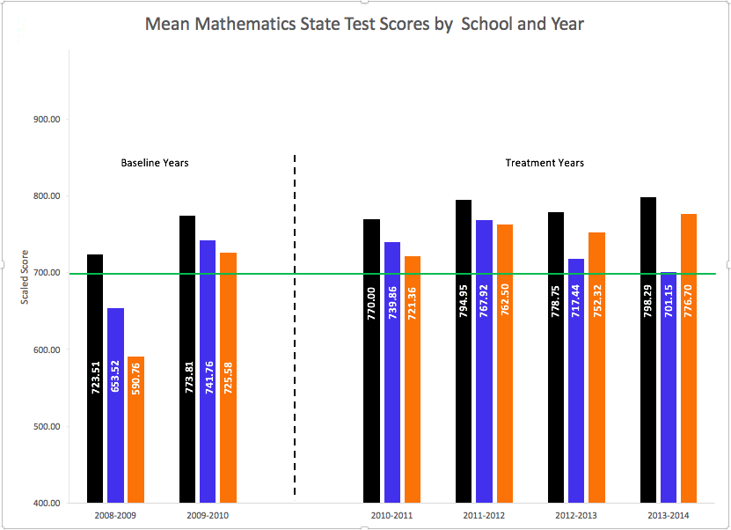
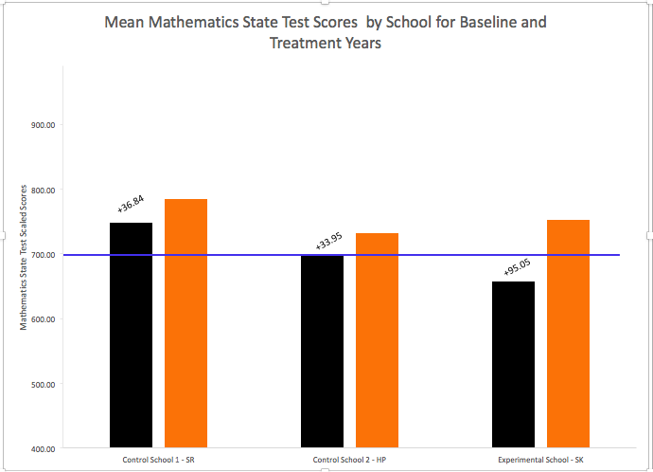
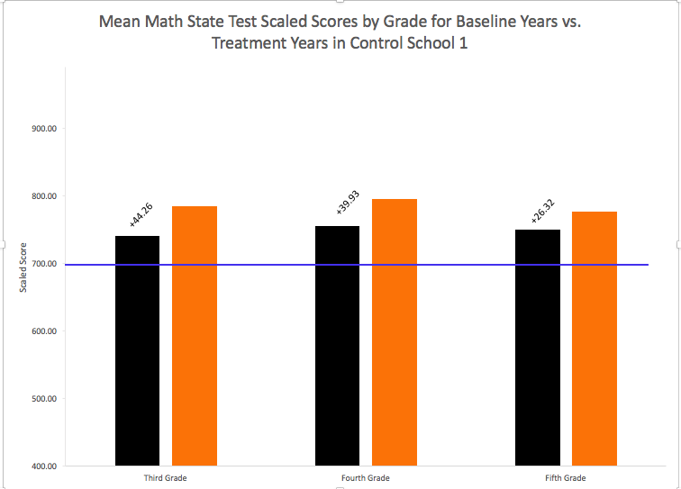
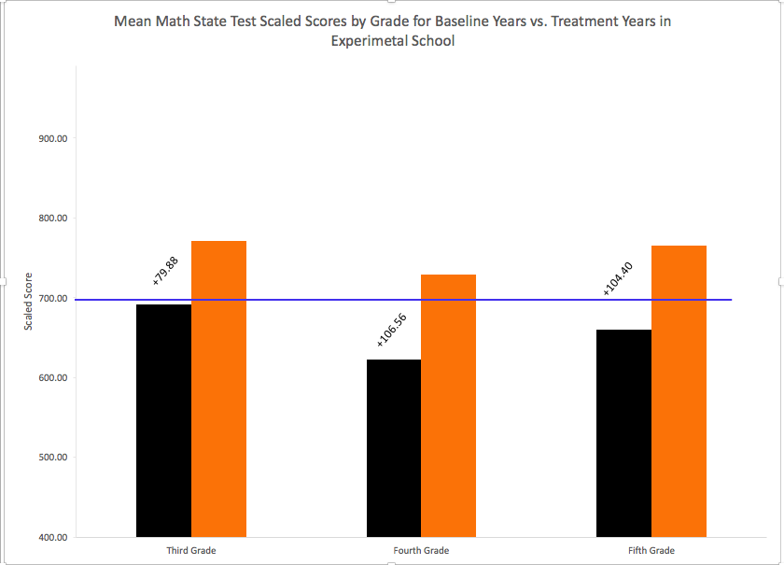
Can Mathematics State Test Scores Improve in Four Minutes a Day?
Justine Celoni, M.S., Carrol Smith, M.S., and Katye Perry, Ph.D.
INTRODUCTION
RESULTS
METHODS
According to National Center for Educational Statistics (2012), 40% of fourth graders and 35% of eighth graders perform at or above proficiency in mathematics on state tests.
Schools are tasked with the challenge of meeting large need with limited resources to remediate mathematics skills.
One method designed to counteract the failures of core curriculum is curricular supports (interventions).
Math-Two-A-Days (MTD) was designed as a curricular support using an evidence-based fluency intervention, Explicit Timing, and the principle of reinforcement schedules by individual feedback and self-graphing (Schutte, et al., 2015).
MTD as an intervention has been conducted within a rural elementary school since the Fall of 2010.
Despite the strong foundation of evidence-based interventions used in MTD, the literature base is sparse for both school-wide mathematics interventions and the evaluation of their effectiveness.
Participants
Three rural elementary schools within the same school district: 1 experimental school, 2 control schools.
Only grades that took state tests were included (3rd-5th).
All schools used the same mathematics curriculum (Math InVisions) and used small group mathematics focus by grade level.
Control School 1 is a non-Title 1 school that required a school-wide intervention time to remediate reading and math skills (no school-wide math intervention implemented)
Control School 2 matched the experimental school as a Title 1 school and in demographics. Control School 2 also implemented a school-wide math fact proficiency intervention called Math Fact Masters.
The Experimental School is a Title 1 school that has implemented Math-Two-A-Days (MTD) for 4 years at the time of the evaluation.
Study Design
3 (school) x 3 (grade) x 6 (time – school year) Longitudinal, quasi-factorial design
Data was obtained from the local school board for the three participating schools.
Archival data included: overall math state test scores and demographics – free/reduced lunch status, ELL status, IEP status
Black = Control School 1
Blue = Control School 2
Black = Baseline Years
Orange = Implementation Years
Orange = Experimental School
Oklahoma State University
RESEARCH QUESTIONS
This study compared the instructional effectiveness of a school-wide mathematics fact fluency intervention, Math-Two-A-Days, that has been implemented for four years in the experimental school to two control schools which did not implement the intervention.
Question 1: Will Math-Two-A-Days be an effective intervention for increasing mathematics state test scores? If so, was there a significant grade level growth?
Question 2: Will principals see Math-Two-A-Days as an effective and efficient school-wide mathematics fact proficiency intervention? If so, would the control school principal consider implementing the intervention at their schools? Does the experimental school principal plan on continuing the intervention in the following school year?
LIMITATIONS AND DISCUSSION
Limitations to the study include a single source of data (state test scores), low number of dependent variables (math state test scores), the different content on the state test by grade level, a change in state test manufacturer creating new ranges for performance levels such that researchers were only able to consider whether the average score was at or above proficient or not.
This study demonstrates that yes, Math-Two-A-Days (MTD) was effective and provided the steepest growth rate to experimental school. Control School 1’s trend showed a slight upward and maintaining trend, while, Control School 2 demonstrated a downward and variable trend. Two principals reported interest in implementing MTD: the experimental school for continued success and Control School 1 if math performance became a larger issue at his school. Future directions include adding reading state test scores, and maintenance data from grades 6th and 8th to see of the growth in math fact fluency generalizes over to high math state test scores.
Black = Baseline Years
Orange = Implementation Years
Black = Baseline Years
Orange = Implementation Years
Effectiveness
Year x School x Grade: 3-way ANOVA found significant results but with a small effect size.
3 Follow-up One-way ANOVAs were conducted to analyze overall treatment year mean to overall baseline years mean by school and found significant differences for Control School 1 and Experimental School with medium effect size, but nonsignificant differences for Control School 2.
Follow-up analysis of mathematics state test scores by grade within the two significantly different schools. The results yielded significant differences in all grades in the Experimental School and significant differences in third and fourth grades in the Control School 1.

