Slide 1
Reciprocity in research: Using a social justice framework to balance evaluator and community needs
American Evaluation Association Conference
November 12, 2015
Giovanni P. Dazzo
U.S. Department of State
Bureau of Democracy, Human Rights and Labor
Notes:
In this demonstration session, I’ll be talking about how to apply a social justice framework to an evaluation, from start—including, evaluation design and co-creating consent forms with participants—to finish—e.g. determining evaluation use and delivering an evaluation product.
This evaluation was conducted in 2014, while I was working as an internal evaluator for a human rights organization funded by the U.S. Department of State’s Bureau of Democracy, Human Rights and Labor (DRL). As of April of this year, I now work with DRL as an internal evaluator.
This evaluation was conducted with former political prisoners in Burma. Through the program being evaluated, these individuals received short-term emergency financial assistance after they were recently released from prison—which they primarily used for temporary housing, and to treat emergency medical procedures due to diseases and disorders they contracted during their imprisonment. This assistance was provided with the intention of helping them reintegrate back into society after years of unjust incarceration due to their political beliefs.

Slide 2
OUTLINE
✔ Demonstrate a few methods
✔ Intersperse a bit of theory
✔ Discuss how to use all of this
Notes:
This afternoon we’ll be breaking up this demonstration session into three parts—1 part for each of the primary methods to be demonstrated.
We can also take some time to discuss as a group—if you have any questions—and it’ll also give us an opportunity to learn from one another if anyone wants to bring up their own experience.
So, in this session, we’ll briefly cover three methods…

Slide 3
3
METHODS
STORY
GROUP
CIRCLES
STORYBOARDS
DATA ANALYSIS
Notes:
… story circles, group data analysis, and storyboards. We’ll also cover a couple of other points, including co-creating consent forms with participants, deciding on evaluation use, and collaborating on evaluation deliverables.

Slide 4
3
RESEARCH
CONCEPTS
TRANSFORMATIVE
PARTICPATORY
RECIPROCAL
ACTION
Notes:
We’ll also cover three concepts within this session, to ground the practice with theory.
These include: the transformative paradigm, participatory action research, and reciprocal research.
Before we start the more hands-on activities within this session, I would like to emphasize that one very important part of the transformative paradigm of evaluation is questioning your role as an evaluator:

Slide 5
?
Let’s
question
our
evaluative
thinking
Notes:
… (1) how you think, and (2) why you think that way. So, we need to question our evaluative thinking. This has an important role in determining the methods you use in working with vulnerable populations, how you use certain methods, and what comes out of an evaluation (for yourself, and for the community).
Often, as evaluators, we come up with evaluation questions or we ask our clients or fellow co-workers to do so—what is it that they actually want evaluated?

Slide 6
evaluation
questions
vs.
questioning
evaluation
Notes:
But, when we form these questions, what we often forget to do prior to conducting or commissioning an evaluation is actually questioning the evaluation exercise itself. If you do choose to incorporate a transformative paradigm to your work, this period of self-reflection is an important step.
Understanding your power and privilege as the evaluation manager or practitioner helps to frame how you might conduct an evaluation—and, it did affect how I undertook this evaluation in Burma. Based on AEA’s Guiding Principles (2004), we’re asked as evaluators to practice ‘respect for people’, and establishing a period before an evaluation where you can question the rationale behind the entire exercise does help you to understand the responsibility you have to (1) yourself—as an evaluation manager or practitioner—and (2) to the communities from whom you’re collecting data.

Slide 7
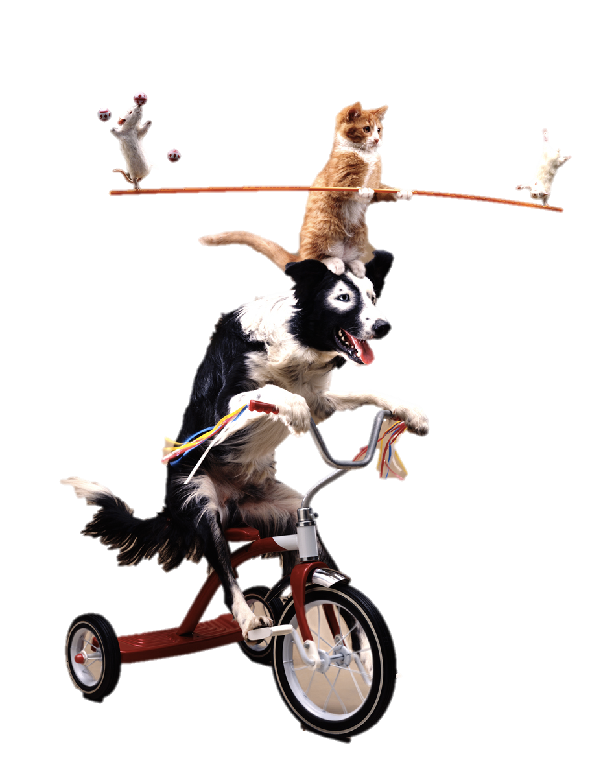
How exactly do we balance evaluator and community needs?
Notes:
In this case, we need to consider the balancing act, we as evaluators, must perform.
That said, I’d like to frame this session around two questions we should often ask when conducting any form of participatory evaluation work: (1) How exactly do we balance evaluator and community needs?
The second question I explored in this process was…
Photograph retrieved from http://www.bigtrends.com/education/forex/the-feds-balancing-act-avoiding-another-1937-1999.

Slide 8
How do we collect data
without feeling guilty?
Notes:
Photograph retrieved from http://i2.wp.com/quietmike.org/wp-content/uploads/2014/05/Culture-of-Fear.jpg?resize=1698%2C1131.

Slide 9
Evaluation Design
Working with community gatekeepers
Co-creating consent forms
Notes:
As mentioned earlier, for this evaluation, I was primarily motivated by Prof. Donna Mertens and her transformative paradigm in evaluation. The reason I wanted to employ this framework to my evaluation work was mainly due to the fact that I would be…

Slide 10
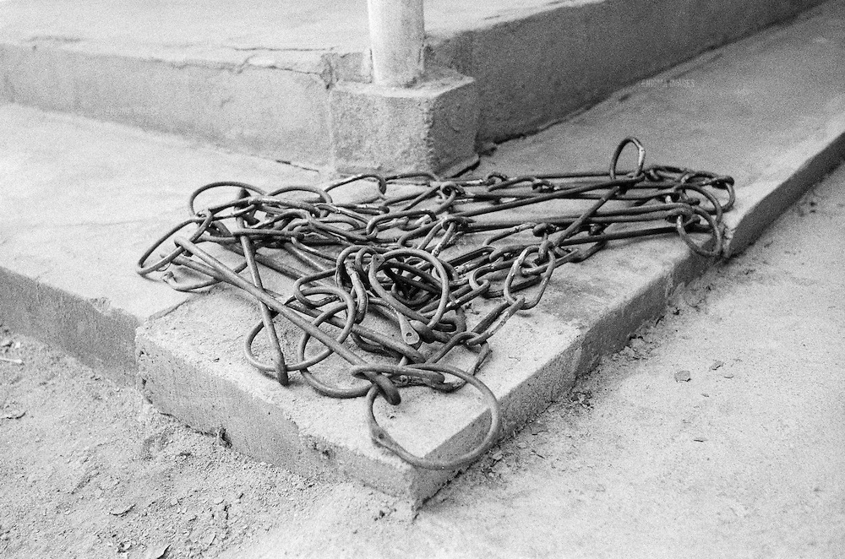
Working with former political prisoners
Notes:
... Working with an extremely vulnerable population—former political prisoners in Burma. These individuals have been observed, studied, interviewed by countless non-profits, international organizations, and media professionals. On a daily basis, many of them relive the horrors of their incarceration due to PTSD, and the physical ailments (Hepatitis, HIV/AIDS, liver disease, chronic heart disease, hypertension) that they contracted while imprisoned anywhere from 3-23 years for their political beliefs. And, sadly, many will have to live with these medical complications for the rest of their lives.
That said, I needed to find a way where they would feel comfortable telling me their stories, so I could evaluate whether the financial assistance they received was actually helpful; and if not, what would be needed in the future and how the donor/non-profit human rights organization could improve through better program options.
This goes back to the idea of balancing my needs as an evaluator (for my client, my employer at the time), with the needs of the population, without feeling guilt about being just one more person collecting data. For that reason, prior to collecting any data, I worked with the participants to co-create the consent forms that would allow me to use their data.
Photo retrieved from http://cdn.c.photoshelter.com/img-get2/I0000Hi0Cq3korGo/fit=1000x750/borderMar10neg002-014.jpg

Slide 11
Co-creating consent forms
Survey session:
Introductions, Q&A
Explained evaluation
Survey
Community consultation:
Co-creating consent forms
Feedback → change forms
Print out new forms and sign on-site
Notes:
As a note—this was a mixed methods evaluation. First, we held three days of surveys with 8 groups. Our partner in the community, which is staffed by former political prisoners, was able to call program beneficiaries, and explain the evaluation work. They also made sure to group them in peer groups (by gender, date / length of imprisonment, affiliation with civil society groups). In a way, it worked a bit like a survey and a focus group; and this established trust from the start—in the way they were planned (through facilitation with the community partner) and a sincere explanation and Q&A session. During the survey session, we (myself, one other staff member from my previous organization, and staff from our community partner) clarified the process. The consent forms for the survey session were a little more straight-forward than those presented in the community consultation; in this case I presented a standard survey consent form and there were was little discussion about these and nothing was changed.
We then invited participants to a two-day community consultation—this is where the story circles, group data analysis, and storyboards come into play. Before we started collecting data through those means, we explained the community consultation process to make it clearer and then went on to co-creating consent forms. This process is a little labor-intensive. In my case, my participants were a little confused at what I was doing at first and needed to be coaxed—it’s really not a trick, I want you to tell me how I can use your data and any content produced (photos, video, stories). After a bit, there was discussion on the consent forms, we made changes in front of the group (they could see it on the projector) and we then printed new forms, which they and all facilitators signed.
I think if you can take one thing away from this session today, it would be this point. The co-creation of consent forms rooted the community consultation—and the evaluation—in the tenets of reciprocal research. After explaining the session and co-creating the forms, the participants knew what they, and the facilitators, would be receiving from the evaluation.
As a note, I will be deleting these photos from this PowerPoint before I post the slides to the AEA eLibrary. Within the consent forms, we agreed that these photos could be used for presentations, but consent would need to be asked every 30 days. So, since I don’t want to ask for consent as long as this content is on the eLibrary, I will be deleting them to hold up my side of the consent form process.
Photographs retrieved from (top-bottom):
http://www.msae.com/associations/1514/files/online-survey.jpg
http://www.generatepr.com.au/images/community_consultation.jpg

Slide 12
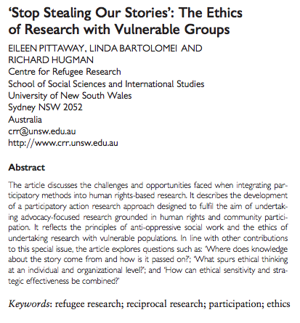
Notes:
This research paper—’Stop Stealing Our Stories’: The Ethics of Research with Vulnerable Groups—helped me to understand how a community consultation could be used to collect data under the guise of participatory action research. The paper brings in a research example—conducted with a group of refugee women in Burma—but I needed to adapt the research for (1) evaluation purposes, and (2) to make it relevant for the population I would be working with.
Photo retrieved from http://jhrp.oxfordjournals.org/content/2/2/229.full.pdf+html (clicking on the photo will also redirect you to the journal article).

Slide 13
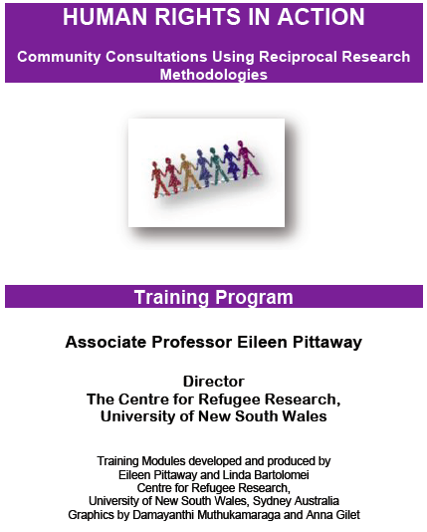
Notes:
The previous research paper also had an accompanying training module called ‘ Human Rights in Action: Community Consultation Using Reciprocal Research Methodologies’. These methods were complimentary to the transformative paradigm. In her book, Donna Mertens talks about reciprocity in research, stating: “People
usually respond positively if they feel they are getting enough in return for what they are giving.” – Mertens (2009). Transformative research and evaluation. New York, NY: Guilford Press
Photograph retrieved from https://www.crr.unsw.edu.au/media/CRRFile/Reciprocal_Training.pdf (clicking on the photo will also redirect you to the journal article).

Slide 14
Community consultation
Story circles
Group data analysis
Storyboards
Notes:
Overall, this community consultation was built on three broad themes: (1) identifying areas of concern; (2) identifying solutions; and (3) determining strategies for dissemination and use. This was done through story circles, group data analysis, storyboards, and the last session included the formation of a group strategy for data use.
First off, I needed to adapt a Pittaway and Bartolomei’s ‘Human Rights in Action’ training module for a different population. Originally, the model was used with refugee women, many of whom were illiterate and did not have much training on their human rights. The population I worked with are all individuals who were imprisoned for their activism—they are formally educated, well-read, and could teach university courses on human rights.
Involving the community partners helped from the onset, especially since the organizations are staffed by former political prisoners themselves, they were able to help me figure out what would work. Earlier on in the evaluation design process, it was mentioned to me by our partners that the former political prisoners were generally interested in training and learning new techniques for their work. Since they had all been recently released from prison, they all wanted to understand how to improve their work on community engagement and advocacy. So, rather than simply collecting their data from them by using story circles and storyboards, we structured the community consultation as a two-day workshop where I included time before each session that showed them the principles behind each technique. Since they are not only human rights defenders, but also survivors of human rights abuses, this provided the opportunity to train the participants on methods they could use to collect data with the vulnerable communities they work with, since they all conduct human rights works themselves—and, at the same time, relate it all to their own experience, which would then provide me with the data I needed to evaluate the program. So, in a sense, we can see it as this social work concept of “meeting people where they are” ideologically, so it resonates with their experience. It also helps when you need them to understand how you—as an evaluator—and they—as the participants—can mutually benefit from the process.

Slide 15
Story circles

Slide 16
Story circles
Process:
Sharing is voluntary
Small groups: identify a problem
Share stories with the larger group
Reciprocity:
Framing: human rights documentation
Showing how to use it in their own work
Story circles provided training and data
Notes:
Story circles provided participants the opportunity to share their stories with their peers. In order to provide the evaluation team with data, we included an evaluation question as the topic of discussion—which related to their current or ongoing problems, if any, that they still faced, even after receiving the short-term emergency assistance. But, we also included questions that allowed them to talk about their lives before prison, in order to not simply focus on negative aspects. Participants were asked to form groups of five to six with their peers, people they would feel comfortable sharing their information. It’s important to note that participants were not forced to share—since we would not want to re-traumatize any of the participants. After participants shared their stories within their small groups (or, story circles), they were then invited to share their stories with the entire group. As a note, I asked one person from each group to share their story to the larger group; however, all of the former political prisoners decided that they wanted to share. In this case, it’s always necessary to leave time for alternative plans—based on the community’s feedback—so you need to be flexible and be able to adapt (always have Plan B, where sessions can be skipped or time decreased, but ensure that this won’t affect the flow of content).
So, how did we make this useful for them. Prior to breaking out into small groups, we reviewed a few basic principles of how to conduct human rights documentation. We framed this session under the guise of human rights documentation, mainly around the topic of recording facts of human rights abuses and violations, by introducing reliable sources on the topic. As previously mentioned, this was done to ensure reciprocity in the process—we were able to obtain insightful qualitative data—and former political prisoners were able to see a new approach in conducting their human rights and advocacy work.
Photograph retrieved from (top-bottom):
https://aaronswankdotcom.files.wordpress.com/2012/11/community-manager.jpg?w=510
http://whoismikehobbs.com/wp-content/uploads/2013/05/Speech-Bubble-And-3d-Character-Meaning-Speaking-Or-Announcement-by-Stuart-Miles.jpg

Slide 17
Demonstration: Story circles
As evaluators, have you had any difficulties conducting collaborative or participatory evaluations?
Notes:
In order to provide a bit of context to our situation, if we were interested in conducting a story circle here, we would present an evaluation question we might want to explore. For example: As evaluators, what difficulties have you had in conducting collaborative, participatory or empowerment evaluations?
Since we’re in conference mode and this is a quick presentation, let’s imagine you all shared this story with your small groups. And now, let’s imagine we’re at the stage of sharing with the larger group. Does anyone want to share the difficulties they’ve experienced; or, the reasons that have held them back from conducting collaborative, participatory, or empowerment evaluations?

Slide 18
Group data analysis
Notes:
Prior to sharing their stories with the larger group, I asked the participants to note the problems or themes they noticed during the stories. Giving them the instructions beforehand, and what to look out for, allowed them to actively listen while others were telling their stories.

Slide 19
Group data analysis
Process:
Note themes during story circle
List (problem) themes
Establish root causes and entry points
Reciprocity:
Framing: canvassing, community outreach
Showing how to use it in their own work
Problem tree provided training and data
Notes:
After each participant’s story was presented, we conducted a problem tree analysis with the group. While participants were listening to stories, they were asked to list problems they identified during the story circle presentations. Then, we grouped these into core issues (or, themes) on a whiteboard. Here, it was important to understand and frame the problem first, without proposing solutions yet; and, to explore why those problems existed, we used the “But Why?” technique.
This method was used to get at some of the root causes of each core problem (Hovland, 2005). After the session, we agreed that the core issues (or, themes) included: employment (more specifically, unemployment or insufficient income), housing, physical health, mental health, discrimination, and surveillance and monitoring by the government.
Some of these core issues could be seen as a cause for another, but the group determined these issues they wanted to address. For example, while discrimination and government surveillance/monitoring could be seen as causes for unemployment, these participants wanted to advocate that these practices cease; rather than advocating for social services they might receive.
Source: Hovland, I. (2005). “Problem Tree Analysis.” In Successful Communication: A Toolkit for Researchers and Civil Society Organisations (pp. 12-13). London: Overseas Development Institute.
Photographs retrieved from http://www.hannelius.com/stick_figure_solving_puzzle_400_clr_4920.png

Slide 20
Demonstration: Group data analysis
Can we group the issues we noted in conducting participatory or collaborative evaluations?
✖ Community buy-in (low opt-in rates)
✖ Drop-out rates (after a promising start)
✖ Disagreement over decisions and roles (infighting)
✖ Negative participation (destructive personalities)
Notes:
To frame the group data analysis exercise of our story circles and make it more relevant to our experience as evaluators, we can group the issues we noted in conducting participatory or collaborative evaluations. Does anyone want to summarize some of the issues that others mentioned?
We may have experienced:
Poor community buy-in (low opt-in rates)
Drop-out rates (after a promising start)
Disagreement over decisions and roles (infighting) – this can occur when disagreements may have already existed within a community, and they, of course, decided to manifest themselves when you were trying to conduct your work. But, we do need to consider that evaluations are political exercises, and certain community members may see this as a chance to exert their power or privilege.
Negative participation (destructive personalities) – we should remember that not all participation is positive. At times, we have people that can derail an entire process.

Slide 21
Storyboards
Notes:
Before we get into practicing a storyboard, a bit of theory…

Slide 22
pedagogy of the oppressed PAULO FREIRE
Notes:
Methods like story circles and storyboards are rooted in the theories of Paulo Freire, and they are compatible with the collaborative, participatory and empowerment approaches many of us are interested in, or use in our work. One of Freire’s big points is treating the learner as a co-creator of knowledge, and this point was applied throughout many of the evaluation processes, from co-creating consent forms to co-writing policy and program recommendations within storyboards.
For this evaluation, there were three reasons behind using storyboards: (1) they would provide an outlet beyond the traditional deficit-model, meaning that our evaluations or needs assessments tend to be far too focused on problems, issues or needs without fully considering the capacities, strengths and knowledge of those we work with; (2) again—reciprocity—the former political prisoners would be able to use these methods with the communities they generally work with—for example: those affected by land rights issues; and (3) framing the evaluation data in a way where we could actually do something with it, rather than simply reporting back to the donor and non-profit.
“Participatory action research is one example of an approach that is compatible with the transformative paradigm when it is applied to the goal of social justice.” — Mertens (2009). Transformative research and evaluation. New York, NY: Guilford Press

Slide 23
Storyboards
Depict a problem
Identify negative impacts
Identify current help
If you were in charge…
Identify potential partners
Identify outcomes
Notes:
Based on the core problems identified during the story circles and problem tree analysis, participants were then asked to plot out recommendations and solutions through storyboards. Using this technique, participants prepared six panels in each storyboard, using any method (e.g. drawing, writing). These panels represent a process of analysis, allowing participants to first document the problem they identified earlier and then outline their own community solutions. The purpose of the storyboard is to move from identifying problems to identifying solutions. The solutions were then discussed in the goal-setting session (determining strategies for dissemination and use).
The six panels we chose included:
Depict a problem or concern experienced by people in your community (here, ‘community’ was defined as the group of political prisoners experiencing a certain issue—e.g. mental health issues).
Identify the impact this problem has on individuals and the community (incl. family, neighbors).
Identify current help available to individuals and its effectiveness.
If you were in charge, explain the services you would provide to the community, to address the identified problem. This is rooted in the tenets of positive psychology.
Recognize the institutions that could provide these services to your community, or those you would want to provide these services.
Identify the best possible outcome for the community if these services were provided.

Slide 24
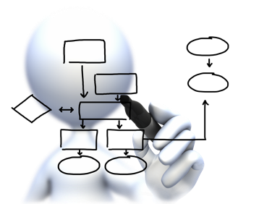
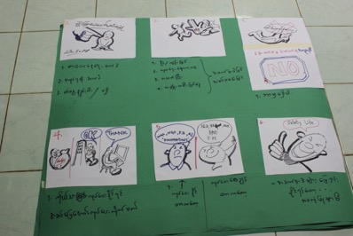
Storyboards
Process:
Form groups by (problem) theme
Discuss and illustrate each plan
Identify solutions and present to group
Reciprocity:
Framing: community asset mapping
Showing how to use it in their own work
Storyboards provided training and data
Notes:
Participants were asked to form small groups based on the problem they considered to be most prevalent in their lives. During this group exercise, participants were able to associate with others that have experienced similar difficulties (e.g. employment, health) after prison release. After discussing their plans, participants plotted out the six panels, from problem to solution. They were then asked to present their storyboards to the entire group.
Photograph retrieved from http://www.starresults.com/wp-content/uploads/2012/02/stick_figure_drawing_flow_chart_1600_clr.png
Storyboard photo was developed by a group of former political prisoners (please do not use this photo without permission).

Slide 25
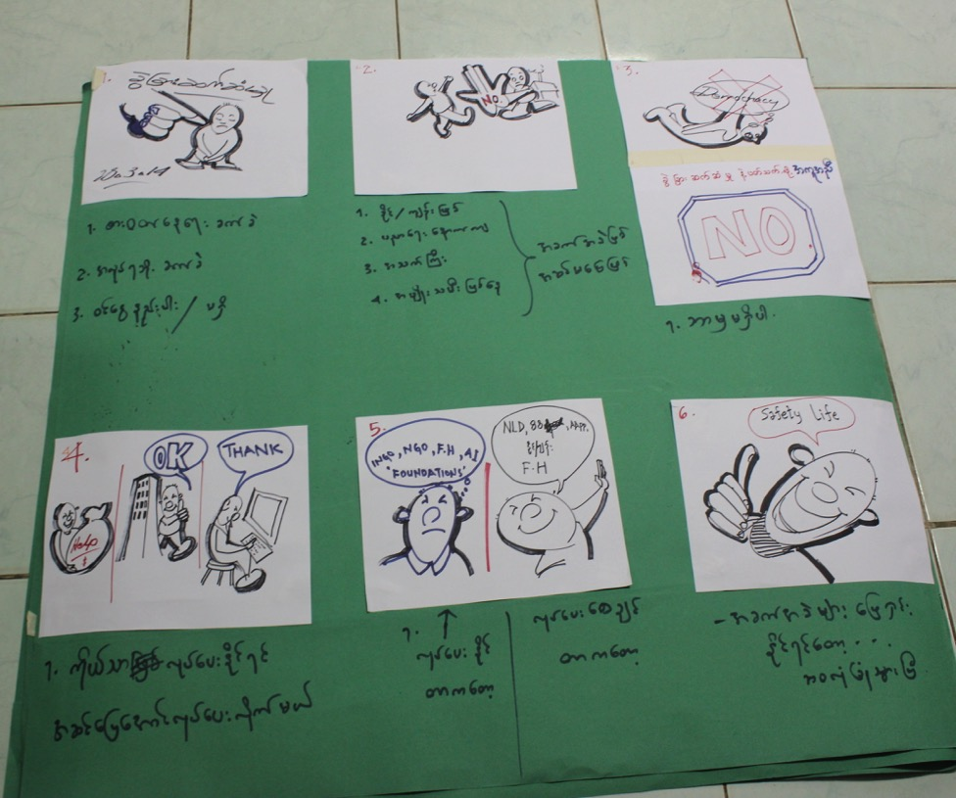
Notes:
Storyboard Example
This storyboard mentions that former political prisoners face discrimination. Participants stated that this causes difficulties finding employment and earning sufficient income. If they were in charge, they would work with businesses to match former political prisoners with opportunities. This would lead them to feel welcome in their own country.
Former political prisoners (FPPs) feel discrimination. “You’re not welcome here,” that is how we feel.
This discrimination leads to a number of issues, such problems with subsistence. We face discrimination in finding good job opportunities, this leads to low income.
There is no current help to address this discrimination.
If we were in charge, we would work with businesses to facilitate employment opportunities.
Our government is responsible, but we don’t want their help nor do we trust them. It is possible that the National League for Democracy (NLD) could help, as well as non-profits [list of non-profits redacted].
After receiving these services, FPPs could feel secure and we would feel welcome in our own country.
Storyboard photo was developed by a group of former political prisoners (please do not use this photo without permission).

Slide 26
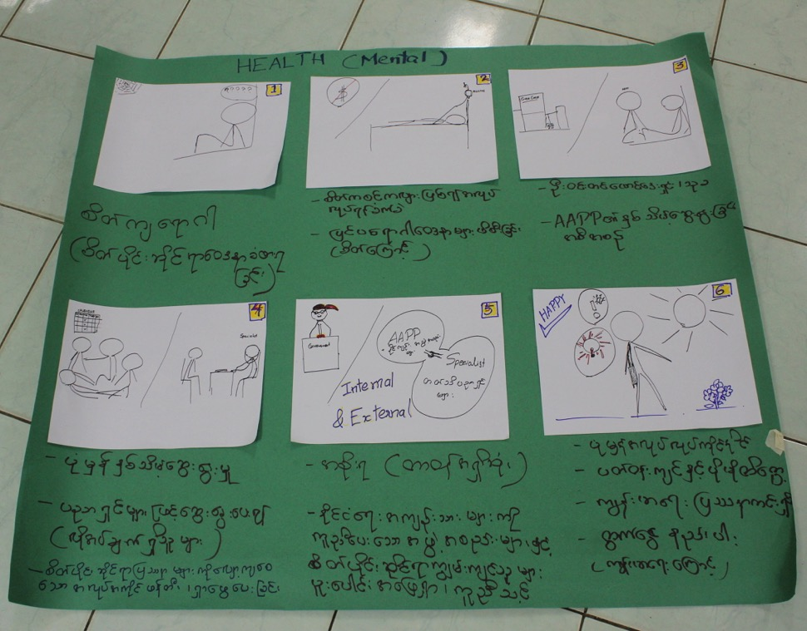
Notes:
Mental health is a problem, especially depression.
Due to mental health issues, FPPs are not sure what to do with their lives. We have trouble finding work, and low incomes lead to other issues.
Non-profits [name of non-profits redacted] have offered support.
If we were in charge, we would offer regular consultations with mental health specialists. Academics and specialists should inform the process.
The government should be responsible.
After receiving regular consultations, we could properly live our lives, and find work.
In this storyboard, panel 4 (“If we were in charge…”) brought up an interesting point during the group discussion. Those in the audience asked what this group meant when they stated that academics and specialist should inform the process of mental health consultations. Through the storyboard and group discussion, it was revealed that these former political prisoners were extremely dissatisfied with the quality of mental health support they were receiving, because they didn’t feel those trying to help them were experts. This raised an important finding on the quality of service provision currently available. Although emergency financial assistance could pay for this mental health support, prisoners weren’t likely to seek it out because it simply didn’t meet their expectations.
Storyboard photo was developed by a group of former political prisoners (please do not use this photo without permission).

Slide 27
Demonstration: Storyboards
Problems you have faced with CPE eval?
How has this affected your work?
Are resources available to you?
What is the best possible outcome?
If I was a community member?
Individuals or groups who could assist you?
Notes:
So, just as a bit of practice—imagine we’re working together to brainstorm ideas on how to address our issues in conducting our participatory and collaborative evaluations. The problems we outlined were:
✖ Community buy-in (low opt-in rates)
✖ Drop-out rates (after a promising start)
✖ Disagreement over decisions and roles (infighting)
Negative participation (destructive personalities)
Option 4, in our case, could be changed from ‘If you were in charge?’ to ‘Can you identify any solutions to help you do your job?’ or ‘If you were in the shoes of the community, why would you participate or who could help you understand that participation could be beneficial?’. In this way, we’re placing ourselves in the shoes of community participants to understand how they would see our evaluation. You can also have your participants establish the questions, but the important part here is making sure the process of thinking goes from problem to solution, and ends with thoughts on the best possible outcome.
So, here’s the storyboard we developed—(although this one is high-tech, these are usually written out by participants, but going high-tech could be an option, depending on your operating environment). This storyboard focuses on drop-out rates.
Panel 1: My evaluation completely lost speed when community members stopped seeing the value in it, and started dropping out along the way.
Panel 2: Participation was so poor that I had to cancel my community consultation.
Panel 3: There are a few resources out there, like AEA’s Coffee Break Seminars, which include experiences that I could learn from to improve my evaluation practice.
Panel 4: If I was a community member, I may have participated if community leaders had been more supportive of the process.
Panel 5: I think several ‘community helpers’ could show the community members that participation may be beneficial, including teachers that can help me invite parents and students to get their perspectives on the issue I want to evaluate (for example, evaluating education).
Panel 6: Hopefully, with community input, evaluation findings can lead to action that changes legislation or the need for community services (or, it improves community services outright).

Slide 28
Evaluation use

Slide 29
Evaluation use
Process:
Share storyboards and prioritize issues
Discuss data use and entry points
Form a plan with the group
Reciprocity:
Framing: advocacy / communications plan
Showing how to use it in their own work
Planning provided training and data
Notes:
Participants were asked to identify how and why they would like to use the information from this community consultation (e.g. writing reports for awareness raising, legislative lobbying for improved service provision). After participants’ responses were listed, the group prioritized each approach.
They then listed who would be responsible for undertaking portions of the action plan (left), individuals or institutions that could help, and their target audience.
The next week, we met with those interested in using information from the community consultation. From the priorities expressed during the collaborative data planning exercise, and during discussions with the group, they decided that they wanted to form an advocacy piece. This booklet would be used to advocate for legislative changes in Burma, informing decision-makers, non-profits, and donors of the difficulties still experienced by former political prisoners.
We highlighted the primary ‘problem themes’ identified during the community consultation, and former political prisoners’ recommendations (from the storyboards) were also included. For each issue, we included the profile of one former prisoner.
Photograph retrieved from http://www.stuartduncan.name/wp-content/uploads/2013/04/megaphone-300px.jpg

Slide 30
Photo deleted
This slide included a photo of a former political prisoner profiled in the advocacy piece using information from the community consultation.
It has been deleted to comply with the confidentiality agreement and consent forms co-created with the former political prisoners.
Notes:
So, the next step was conducting in-depth interviews with 4 former prisoners as we highlighted 4 main themes. I, along with staff from our community partner, interviewed individuals like this who spent 25 years in prison, simply for his political beliefs. Each story was accompanied by a simple photo like this, so the audience could put a face to each theme. The stories included information about their entire live—before, during and after imprisonment—because they didn’t want to focus solely on their problems, but also wanted to show the resiliency and aspirations of each individual as well. For example, when we started this interview, the first words out of his mouth were, “I’m lucky” and he talked about the support he received from family and friends, but he wanted to highlight that reconciliation was necessary during this time of rapid development in the country.

Slide 31
Other applications
Be creative
What can your communities use?
Notes:
Now, to ground all of this in a bit of reality—what were some of the pros and cons of this evaluation? I’ll deviate a bit from this year’s conference theme of exemplary evaluation… because not all of this one was that exemplary.

Slide 32
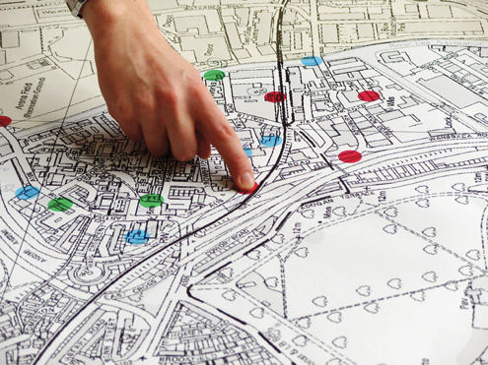
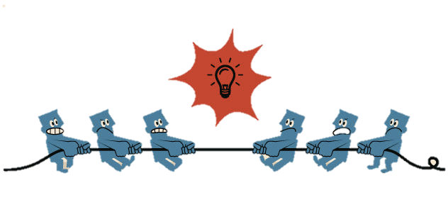
Notes:
Be creative in your approaches.
For example, if a community is interested in photography and documenting change—this is a good entry point to incorporate photovoice methods—teaching them how to take photos, while collecting data you would be able to use. In the end, they’ll have the knowledge to take photos, which can be used for professional or personal reasons, or for community change. Is your community interested in community mapping—this can be useful when working with those exposed to land rights issues, or members of indigenous communities. Or, are you working with a population that needs help with community dialogue and conflict resolution. Community dialogue and conflict resolution work includes methods that can be incorporated into data collection methods.
And, if you’re working with vulnerable populations that may not be community organizers already—you wouldn’t need to adapt Pittaway and Bartolomei’s ‘Human Rights in Action’ modules at all. Learn from your communities and find what would be most useful for them, but realize that you should be comfortable offering them the type of resource they request or need. The process needs to provide mutual benefit.
Photographs retrieved from (top-bottom):
http://floodlightproject.org/media/filer_thumbnails/2012/11/21/photovoice.png__500x0_q85.png
http://www.rudi.net/files/paper/illustrations/map.jpg
http://blog.octanner.com/wp-content/uploads/2012/07/OCT_blog_conflict_resolution.jpg

Slide 33
Pros and cons
Notes:
Now, to ground all of this in a bit of reality—what were some of the pros and cons of this evaluation? I’ll deviate a bit from this year’s conference theme of exemplary evaluation… because not all of this one was exemplary. There were, of course, challenges.

Slide 34
Challenges of CP&E evaluations
Opt-in
Infighting
Drop-out rates
Quality participation
Notes:
Like any evaluation, it’s difficult for everything to go well throughout the entire process. And, there are of course challenges with evaluations that are participatory or collaborative. For one, opt-in may be low. In my case, I surveyed over 70 individuals over a few days, but only half chose to attend the 2-day community consultation. After the consultation, 12 decided that they actually wanted to use the data that was gathered during the consultation and come up with a plan for use.
It’s a humbling experience to conduct collaborative, participatory or empowerment (CP&E) evaluations, and it helps you to understand that participation can’t always be at 100%, nor should it be when it means that participation may be negative and hinder the process for those that want to work with you.
Photograph retrieved (and adapted) from http://www.weberpl.lib.ut.us/sites/default/files/styles/panopoly_image_full/public/general/hand_volunteer_0.png?itok=_zHuVprJ

Slide 35
Benefits of the approach
✚ Grounding the survey findings
✚ Reinforced positive interdependence
✚ Framing the discussion around beneficiary voices
✚ Provided ideas the community could use
Notes:
Grounding the survey findings—through the more qualitative analysis, we were able to note that beneficiaries’ responses were more hopeful of their future situation. The survey used was a standard form developed for more traditional beneficiaries of this emergency assistance program—these traditional beneficiaries include human rights defenders experiencing a very recent threat (in the last few months) because of their human rights work, including physical abuse, intimidation, arbitrary arrest, loss of employment. That said, this evaluation differed from the standard evaluation undertaken with traditional beneficiaries. For our traditional beneficiaries, we set up a rolling feedback system, so each individual received a survey or were interviewed 3-6 months after they received assistance. This allowed us to evaluate short-term outcomes for short-term assistance. In Burma, we weren’t able to do this because we simply didn’t have access to the individuals due to intense surveillance.
So, in effect, the evaluation considered the time we were able to survey these former political prisoners after they had received short-term assistance. In some cases, we surveyed individuals who received assistance over 1.5 year ago, for a form of help that was only supposed to last 3-6 months. I won’t get too much into that, but that’s where more of the quantitative analysis came in, and the qualitative analysis really helped ground participants’ responses to the environment they were living in.
It also provided a way for the community, non-profit, and community partner to work together around a common cause.
Framing the discussion—while, as evaluators, we can form some great recommendations… we chose to include solutions from the storyboards to provide recommendations. On the process side, I was able to tease out certain aspects that could be improved. But, including recommendations directly from the beneficiary group helped to frame the discussion and elevate the voices of those in need of additional program options. After the evaluation, programming was discussed and criteria were modified, using recommendations provided by the beneficiaries themselves. The audience (donor representatives, non-profit, community partners, and service providers) seemed more receptive to the recommendations of the direct beneficiary group.

Slide 36
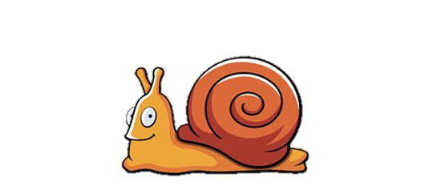
Was it all worth it?
Policy changes are slow, expectations are not.
Losing sleep at night if the process did not go as planned.
Policy
Notes:
You do need to understand your participants’ expectations. If they’re seeking to change policy, evaluation findings can certainly be used
Conducting participatory or collaborative evaluations means we, as evaluators, must hold ourselves accountable.

Slide 37
Final thought
“The most difficult problems with program evaluation are not methodological or political but psychological
… Sometimes, though, what is lacking is the ability to see the point of view of those on the receiving end of the evaluation—the lack of empathic skills—and that is just as important a failing.”
Scriven, M. (1993), Parting perspectives. New Directions for Program Evaluation, 1993: 87–92.
Notes:
An important final thought when designing our evaluations—our work must be methodologically sound, but being “objective” does not mean lacking empathy for those being helped.
Sources:
Freire, P. (1970). Pedagogy of the Oppressed. New York: Continuum.
Mertens, D. M. (2009). Transformative research and evaluation. New York, NY: Guilford Press
Mertens, D. M., Bledsoe, K. L., Sullivan, M., & Wilson, A., (2010). Utilization of mixed methods for transformative purposes. In C. Teddlie and A. Tashakkori (Eds.) Handbook of mixed methods research, 2nd Edition. Thousand Oakes, CA: Sage Publications.
Pittaway, E., Bartolomei, L., & Hugman, R. (2010). 'Stop Stealing Our Stories': The Ethics Of Research With Vulnerable Groups. Journal of Human Rights Practice, 2(2), 229-251. Retrieved Nov. 2013.
Pittaway, Eileen and Linda Bartolomei. (2012). Human Rights in Action: Community Consultation Using Reciprocal Research Methodologies.” University of New South Wales.
Scriven, M. (1993). Parting perspectives. New Directions for Program Evaluation, 1993: 87–92.

