Slide 1
Streamlining Analysis: Blending text mining and manual processes
Ann M. Dozier, RN, PhD, FAAN
Elizabeth Wayman, MS
The University of Rochester Center for Leading Innovation and Collaboration (CLIC) is the coordinating center for the Clinical and Translational Science Awards (CTSA) Program, funded by the National Center for Advancing Translational Sciences (NCATS) at the National Institutes of Health (NIH), Grant U24TR002260.
Notes:
Ann starts at beginning
Betty starts at Method
Ann resumes at Strengths

Slide 2
Acknowledgements
Funding
Center for Leading Innovation and Collaboration (CLIC) is the coordinating center for the Clinical and Translational Science Awards (CTSA) Program, funded by the National Center for Advancing Translational Sciences (NCATS) at the National Institutes of Health (NIH), Grant U24TR002260.
CLIC Team
Raquel Ruiz, Bobbie McCaffery, Robert White, Alicia Tyrell
PIs: Debbie Ossip; Martin Zand

Slide 3
Acknowledgements
Thank you to evaluators from the following institutions who provided feedback on category definitions:
University of Southern California
Medical University of South Carolina
Ohio State University Wexner Medical Center
University of Michigan Medicine
University of Arkansas for Medical Sciences
Wake Forest Baptist Health
University of Pittsburgh Medical Center
University of Washington
UC San Diego
UC Irvine
University of Iowa
Boston University
Indiana University
University of Minnesota
Notes:
Acknowledge 16 evaluators from these institutions

Slide 4
Setting
Notes:
. Official language from NCATS is “more than 50 CTSA Program hubs.” This language prevents the CTSA Program from getting boxed into funding a certain number of institutions (like 62) despite budget changes from on high. They apparently feel like 50 institutions is more manageable.
Also, please do not crop or modify the funding disclaimer at the bottom.

Slide 5
Common Metrics Initiative Turn the Curve Plans
Notes:
Over 50 hubs included data for this.
Also include RBA process overview. Story, Partners , Action, Strategy (can use 2 slides from the informatics kick-off webinars)
Based on Results Based Accountability process
Components:
Story behind the curve
Partners
What works
Strategy

Slide 6
TTC - An Ends to Means Approach

Slide 7
Steps in the TTC Thinking Process
How are we doing?

Slide 8
Steps in the TTC Thinking Process
How are we doing?
What is the story behind the curve?

Slide 9
Steps in the TTC Thinking Process
How are we doing?
What is the story behind the curve?
Who are partners that might have a role to play in turning the curve?

Slide 10
Steps in the TTC Thinking Process
How are we doing?
What is the story behind the curve?
Who are partners that might have a role to play in turning the curve?
What would work to turn the curve?

Slide 11
Steps in the TTC Thinking Process
How are we doing?
What is the story behind the curve?
Who are partners that might have a role to play in turning the curve?
What would work to turn the curve?
What is our strategy to turn the curve?
Notes:
Talk about “Driver Diagrams” for strategies. – These were part of the category development process.

Slide 12
3 Metrics
IRB Duration
Pilot Funding and Publications
Careers in Clinical and Translational Research
Notes:
Over 50 hubs included data for this.
Also include RBA process overview. Story, Partners , Action, Strategy (can use 2 slides from the informatics kick-off webinars)
Based on Results Based Accountability process
Components:
Story behind the curve
Partners
What works
Strategy

Slide 13
How much data is that?
Notes:
Over 50 hubs included data for this.
TTC Plan lengths for 1 metric range from about 100 words to 3000 words
Also include RBA process overview. Story, Partners , Action, Strategy (can use 2 slides from the informatics kick-off webinars)
Based on Results Based Accountability process
Components:
Story behind the curve
Partners
What works
Strategy

Slide 14
Result
IRB Duration
Notes:
Explain that this is result for one of 3 plans . Each of the others have different domains. Part of the value is that it is tailored to each of the metrics.
Has anyone seen the hub report?

Slide 15
Result
Careers in Clinical and Translational Research

Slide 16
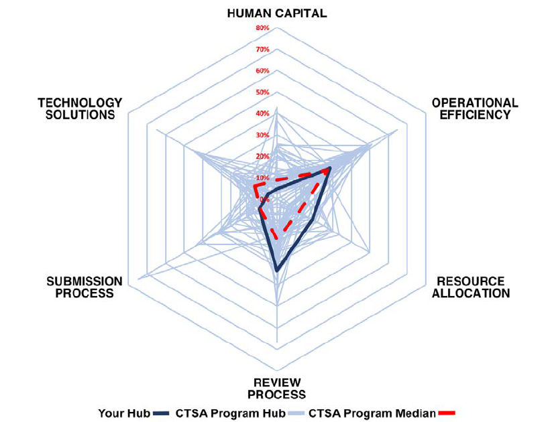
How is this useful?
Notes:
So What? i.e. what is the value?
Question – is there any value to analyszing TTC plans this way? This is a way to compare across hubs in a nonnumeric way. Are there ways to look at the plans to strengthen the TTC plan process itself.
A so what about why we did it and also the larger picture that qual data is underutilized -- daunting process (in Vivo, Atlas.ti) Is this potentially replicable process – machine learning – combined to streamline the process

Slide 17
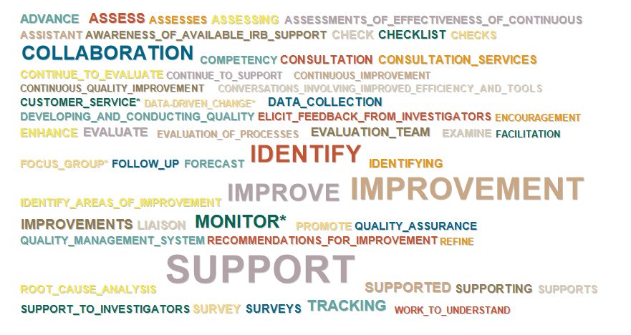
Method
Define Categories
Build Dictionary
Manage Data
Mine Text
Notes:
Betty Starts here
If Ann doesn’t say “this approach can be used with other types of data.” I can say it here.
I’m going to describe the method we followed.
We used this process for each of the 3 metrics, i.e. repeated the process 3 times because we created 3 distinct dictionaries.
I’ll go into detail for each of the steps.

Slide 18
Data Management
Notes:
We start by managing our data

Slide 19
Data Source
De-identified Hub ID
Notes:
The data comes to us as an excel spreadsheet. The original data dump was about 15 Mbytes, with 8,000 rows.
I’ll briefly go through the sections of data we used.
to the left The hub ID allowed us to match the analysis to the hub that wrote the Turn the Curve plan. These IDs were randomly generated 3 letter identifiers.

Slide 20
Data Source
Metric Code
Notes:
A metric code matches the plan to the metric

Slide 21
Data Source
Step in TTC Narrative
Notes:
Next is the label naming the step in the Turn the Curve plan narrative: , Story behind the curve, partners, What works, strategies, and sometimes others that individual hubs created to help them Turn the Curve

Slide 22
Data Source
NoteText
Notes:
The Note text is the narrative text that we analyzed. The length of these notes varied from about 100 words to 3000 words per plan.

Slide 23
Data Source
Record Type
Notes:
Finally, record type identifies the notetext as either current or historical.

Slide 24
Data Management
Inclusion/Exclusion Criteria
Notes:
Data management required attention to detail
We needed to understand what the data included,
what was useful, what was not useful, and the best way to proceed with the analysis.
We became familiar with the data by reading selections from the narratives,
exploring aspects of the data such as number of records per metric or hub.
and using some basic text processing to chart word counts, etc.
After preliminary explorations, we decided to include only records designated as “current notes” which were the most recent version of what was saved in the analysis to avoid duplication of data from the “historical note” records. We included all plans, regardless of length. This was about 2000 rows or
1 to 2 Mbytes of data per dictionary.
-----------------------
IRB 300 rows, ~80 unformatted pages of text, 52,000 words
Pilot 232 rows, ~70 unformatted pages 45,000 words
Careers 300 rows ~80 pages, ~50,000 words

Slide 25
Data Management
Inclusion/Exclusion Criteria
Critical Mass
Notes:
Another aspect of data management is assessing whether there is Critical Mass for the analysis method -- Did we have enough data to perform this type of analysis?
Is anyone here not familiar with the basic concepts of text mining?
*If needed: The term text mining describes a diverse collection of computer analysis techniques using text as input, i.e. social media data, write-in survey responses, political speeches, newspaper articles, etc.
[Text mining/These] techniques include junk email classification, assigning news articles to topic groups.
*
Some of the techniques require a large and diverse data corpus and use sophisticated text transformations based on term frequencies and specific distance measures.
We have a lot of data, but not enough for some of those techniques.
A class of text mining techniques includes categorization using dictionaries of terms, For example, sentiment analysis uses dictionaries of words classified as positive or negative.
Once the dictionary is built, the analysis can be applied to data sets of varying sizes.
This technique is amenable to “smaller” datasets.
We modeled our work after …..
Spinczyk et al. who used a dictionary categorization technique to analyze short “written statements” on an assigned topic by ~70 high school girls.

Slide 26
Data Management
Inclusion/Exclusion Criteria
Critical Mass
Cleaning
Notes:
Data cleaning can be a tedious process, but it is an important step to ensure quality analysis.
We used excel find-and-replace to remove special markup characters.
The tool we used for data analysis, QDA Miner/WordStat, provided an easy-to-use mechanism for finding and correcting misspellings.

Slide 27
Method
Define Categories
Build Dictionary
Manage Data
Mine Text
Notes:
Now that we had clean data, the next step was to define the categories.

Slide 28
Develop working categories
Notes:
We used a structured process to develop the categories.
First I constructed working categories from a randomly chosen subset of 5-10% of the data, or about 4-6 Turn the Curve narratives per metric. I used the qualitative analysis methods of coding and content analysis to group codes into working categories. In addition I used “Driver Diagrams” developed by our Colleagues at Tufts and used by hubs in developing their plans, to augment the category definitions.
I created categories that focused on concepts related to the strategy component of the Turn the Curve plan.

Slide 29
Working Categories
improve IRB submission process
assist researchers
implement IRB submission management and evaluation tools
increase IRB meeting frequency
integrate PI protocol with IRB application and remove redundant sections of application
internal web-based suite of IT modules to facilitate research compliance
provide application templates
revise application so that investigators provide greater detail and clarity about studies
upgrade IRB electronic submission
train IRB members
assess IRB administrator competency and provide training
train IRB members to improve quality of IRB reviewer notes
train IRB members on conditional approvals
train IRB members on IT tools (e.g. RAMS)
train researchers
Resource allocation
Allocate appropriate resources to IRB
increase focus on customer service
proactively reach out to study team members
provide assistance to researchers in submission process
provide online educational guidance for PIs
require regulatory consultation
create specialized IRB committee with particular domain focus
improve IRB meeting process
disseminate identified issues to PI for response prior to IRB meeting
do not constrain studies to stay with original reviewer
establish clear turnaround time performance goals for IRB
establish deadlines for IRB review completion
examine approval process inefficiencies
hold more frequent IRB meetings with consistent chair
identify opportunities for parallel processing
monitor progress on IRB administrative activity deadlines
obtain contact info from PIs prior to IRB meeting
review studies faster at IRB meetings
improve IRB review process
reduce number of full reviews needed
reorganize IRB staff
require initial reviews by senior IRB staff
track IRB submission volumes to assure appropriate balance of resources
update SOPs to increase efficiency and clarity
examine IRB processes for inefficiencies
reduce PI response time
use expedited review where possible
discuss metrics with staff regularly
train researchers in human rights research ethics
train researchers on policies/procedures
improve IRB submission process
Notes:
As an example, These were the working categories for the first metric, IRB Time to Approval.
Each category was labeled and included examples from the data or Drivers Diagrams as a description. One category was improve IRB submission process.

Slide 30
Working Categories
improve IRB submission process
assist researchers
implement IRB submission management and evaluation tools
increase IRB meeting frequency
integrate PI protocol with IRB application and remove redundant sections of application
internal web-based suite of IT modules to facilitate research compliance
provide application templates
revise application so that investigators provide greater detail and clarity about studies
upgrade IRB electronic submission
train IRB members
assess IRB administrator competency and provide training
train IRB members to improve quality of IRB reviewer notes
train IRB members on conditional approvals
train IRB members on IT tools (e.g. RAMS)
train researchers
discuss metrics with staff regularly
train researchers in human rights research ethics
train researchers on policies/procedures
Resource allocation
Allocate appropriate resources to IRB
increase focus on customer service
proactively reach out to study team members
provide assistance to researchers in submission process
provide online educational guidance for PIs
require regulatory consultation
create specialized IRB committee with particular domain focus
improve IRB meeting process
disseminate identified issues to PI for response prior to IRB meeting
do not constrain studies to stay with original reviewer
establish clear turnaround time performance goals for IRB
establish deadlines for IRB review completion
examine approval process inefficiencies
hold more frequent IRB meetings with consistent chair
identify opportunities for parallel processing
monitor progress on IRB administrative activity deadlines
obtain contact info from PIs prior to IRB meeting
review studies faster at IRB meetings
improve IRB review process
reduce number of full reviews needed
reorganize IRB staff
require initial reviews by senior IRB staff
track IRB submission volumes to assure appropriate balance of resources
update SOPs to increase efficiency and clarity
examine IRB processes for inefficiencies
reduce PI response time
use expedited review where possible
train IRB members
Notes:
Other categories were Train IRB Members….

Slide 31
Working Categories
improve IRB submission process
assist researchers
implement IRB submission management and evaluation tools
increase IRB meeting frequency
integrate PI protocol with IRB application and remove redundant sections of application
internal web-based suite of IT modules to facilitate research compliance
provide application templates
revise application so that investigators provide greater detail and clarity about studies
upgrade IRB electronic submission
train IRB members
assess IRB administrator competency and provide training
train IRB members to improve quality of IRB reviewer notes
train IRB members on conditional approvals
train IRB members on IT tools (e.g. RAMS)
train researchers
discuss metrics with staff regularly
train researchers in human rights research ethics
train researchers on policies/procedures
Resource allocation
Allocate appropriate resources to IRB
increase focus on customer service
proactively reach out to study team members
provide assistance to researchers in submission process
provide online educational guidance for PIs
require regulatory consultation
create specialized IRB committee with particular domain focus
improve IRB meeting process
disseminate identified issues to PI for response prior to IRB meeting
do not constrain studies to stay with original reviewer
establish clear turnaround time performance goals for IRB
establish deadlines for IRB review completion
examine approval process inefficiencies
hold more frequent IRB meetings with consistent chair
identify opportunities for parallel processing
monitor progress on IRB administrative activity deadlines
obtain contact info from PIs prior to IRB meeting
review studies faster at IRB meetings
improve IRB review process
reduce number of full reviews needed
reorganize IRB staff
require initial reviews by senior IRB staff
track IRB submission volumes to assure appropriate balance of resources
update SOPs to increase efficiency and clarity
examine IRB processes for inefficiencies
reduce PI response time
use expedited review where possible
train researchers
Notes:
…train researchers….etc
Categories had longer or shorter descriptions depending on what was found in the analysis of the data.

Slide 32
Solicit feedback
Notes:
For each metric we had 6 to 7 hub evaluators who reviewed the categories.
Each volunteer read and provided feedback on 3 de-identified narratives.
Altogether 12-15 narratives were each reviewed by 1 or 2 people, balancing coverage with redundancy. This represented 25 to 30% of the data
The reviewers were given 1 week to provide feedback. The quick turn-around was needed to meet our schedule.

Slide 33
Structured feedback
Category label and description
Notes:
In addition to the 3 de-identified narratives, each reviewer received a form to provide structured feedback.
The form included the category label and description….

Slide 34
Structured feedback
Yes/No questions on category relevance
Notes:
…specific questions about the relevance of the category label or description, based on their reading and analysis of the de-identified narrative.

Slide 35
Structured feedback
Space to provide suggestions for changes to the category
Notes:
…and space to suggest changes to the category, either a more appropriate label, or additional description.

Slide 36
Revised Categories
Technology Solutions
SOPs, workflow, best practices, customer satisfaction, communication/outreach, monitoring and ongoing evaluation activities, discuss metrics with staff regularly;
Use of appropriate technology is optimized and includes strategies such as:
An electronic IRB submission and management system;
Resource Allocation
Allocate appropriate resources to IRB, IRB staff and review committees are sufficient and appropriate wit optimized workloads. Includes strategies such as:
Review Process Improvement
Strategies and activities intended to change the review process in the near term. Changes made primarily affect IRB members. Strategies include:
Submission Process Improvement
Human Capital
Mentoring, training, educating, efforts made to assess and enhance the knowledge based of all who are doing review or submission. Examples include:
Train researchers in human rights research ethics, policies/procedures;
Operational Efficiency
Assessing processes and using quality improvement tools to clearly understand steps in the process and identify potential waste or bottlenecks (Process workflow mapping, Root cause analysis, LEAN / Six Sigma). Examples include:
Reach out proactively to study team members, increase investigator awareness of available hub support services (faculty meetings, symposia/fairs/expo, optimize web site, partner with marketing).
Improving online instructions at the time of data entry;
Programming electronic reminders for outstanding responses to inquiries.
Hire or reorganize staff to provide availability of a wide range of expertise;
Assign a single coordinator to support a study through the entire process;
Increase the number of review panels/committees;
Track IRB submission volumes to assure appropriate balance of resources.
Assign a single coordinator to support a study through the entire process;
Do not constrain studies to stay with original reviewer;
Hold more frequent IRB meetings with consistent chair;
Use expedited review where possible;
Obtain contact info from PIs prior to IRB meeting;
Establish clear turnaround time performance goals for IRB.
Strategies and activities intended to change the submission process in the near term. Changes made primarily affect researchers/study teams/PIs. Examples include:
Integrate PI protocol with IRB application and remove redundant sections of application;
Revise application so that investigators provide greater detail and clarity about studies;
Provide support during application preparation (drop-in clinics, consultation services), pre-screening / pre-review services, feedback on rejected submissions.
Conduct training in the IRB application process for investigators and staff.
Technology Solutions
Notes:
Based on this feedback we revised the categories. For example, for the IRB metric, we regrouped the descriptions from the original 7 categories into 6 revised categories.
Reviewers also suggested clearer or more comprehensive descriptions.
One of the new categories was technology solutions….

Slide 37
Revised Categories
Technology Solutions
SOPs, workflow, best practices, customer satisfaction, communication/outreach, monitoring and ongoing evaluation activities, discuss metrics with staff regularly;
Use of appropriate technology is optimized and includes strategies such as:
An electronic IRB submission and management system;
Resource Allocation
Allocate appropriate resources to IRB, IRB staff and review committees are sufficient and appropriate wit optimized workloads. Includes strategies such as:
Review Process Improvement
Strategies and activities intended to change the review process in the near term. Changes made primarily affect IRB members. Strategies include:
Submission Process Improvement
Human Capital
Mentoring, training, educating, efforts made to assess and enhance the knowledge based of all who are doing review or submission. Examples include:
Train researchers in human rights research ethics, policies/procedures;
Operational Efficiency
Assessing processes and using quality improvement tools to clearly understand steps in the process and identify potential waste or bottlenecks (Process workflow mapping, Root cause analysis, LEAN / Six Sigma). Examples include:
Reach out proactively to study team members, increase investigator awareness of available hub support services (faculty meetings, symposia/fairs/expo, optimize web site, partner with marketing).
Improving online instructions at the time of data entry;
Programming electronic reminders for outstanding responses to inquiries.
Hire or reorganize staff to provide availability of a wide range of expertise;
Assign a single coordinator to support a study through the entire process;
Increase the number of review panels/committees;
Track IRB submission volumes to assure appropriate balance of resources.
Assign a single coordinator to support a study through the entire process;
Do not constrain studies to stay with original reviewer;
Hold more frequent IRB meetings with consistent chair;
Use expedited review where possible;
Obtain contact info from PIs prior to IRB meeting;
Establish clear turnaround time performance goals for IRB.
Strategies and activities intended to change the submission process in the near term. Changes made primarily affect researchers/study teams/PIs. Examples include:
Integrate PI protocol with IRB application and remove redundant sections of application;
Revise application so that investigators provide greater detail and clarity about studies;
Provide support during application preparation (drop-in clinics, consultation services), pre-screening / pre-review services, feedback on rejected submissions.
Conduct training in the IRB application process for investigators and staff.
Resource Allocation
Notes:
another, was resource allocation….etc. You can see how the categories changed because of reviewer feedback

Slide 38
Method
Define Categories
Build Dictionary
Manage Data
Mine Text
Notes:
Now we were ready to build the dictionary

Slide 39
Dictionary Building
Time consuming
Strategies
What works
Notes:
A wall is built brick by brick. A dictionary is built word by word.
This was the most time consuming phase of the project.
These dictionaries contain words and phrases that capture the concepts hubs used in talking about strategies and what works.
I used the text analytics software QDAMiner with the add-on module WordStat.
QDAminer is qualitative analysis software. I used this for the manual coding in the category definition phase.
WordStat has tools for dictionary building, as well as basic text mining and text mining result visualization capabilities.
I used the words in the manually coded text segments from the qualitative analysis phase of category definition to form the foundation of the dictionary.

Slide 40
Add Words to Categories
Notes:
Then I looked for words to add to each category. On the right is a snapshot of the WordStat tool, showing part of the IRB duration metric dictionary.
The tool shows the dictionary as a hierarchically structured list of words, phrases and rules grouped into the categories we defined.
I can add, delete, and edit words here.

Slide 41
Check Leftover Words
List of words from data corpus not yet in dictionary
Notes:
A feature I used extensively was the leftover words list. These are words that are found in the data, but not in the dictionary.
For each word, statistics such as frequency helped me decide which words to consider for inclusion in the dictionary.

Slide 42
Use Keyword in Context
Look at candidate words in context of use
Notes:
Sometimes words needed to be moved to a different category. The keyword in context feature was helpful for making these decisions. Keyword in context highlights the word in its context within the text.

Slide 43
Use Keyword in Context
Occurrences of the word grouped by the following word
Notes:
It also provides a list of all the occurrences of the word in the text and their frequencies.
We can also sort by keyword and the next word or keyword and the previous word.
This is helpful for finding phrases to aid in disambiguating a word. …
…that is, when a word is used with 2 different meanings in the text,
For example Bank could mean a financial institution or
Bank could mean the edge of a river or stream.
In each case different words before or after the word bank could be combined with the word to reliably put it in a category.

Slide 44
Test and Validate
Notes:
Our testing and validation procedure focused on comparing the manually coded results, from the beginning of the analysis
To the computer coded results from the term classification process
Wordstat provided a feature that allowed us to automatically code the sentences with the category names of the words from the sentence that were found in the dictionary.
We compared the results of this feature with the codes from the human coding.
If there were too many disagreements we modified the dictionary and repeated the process.

Slide 45
Method
Define Categories
Build Dictionary
Manage Data
Mine Text
Notes:
Finally, we were ready to classify the text.

Slide 46
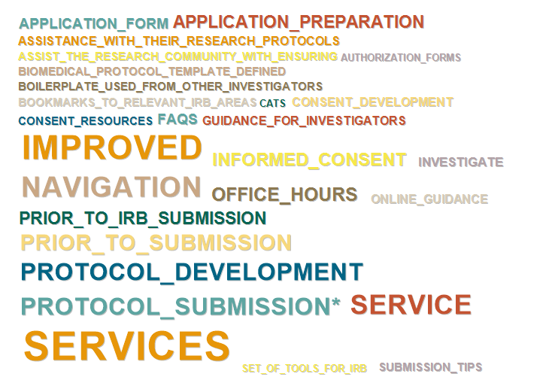
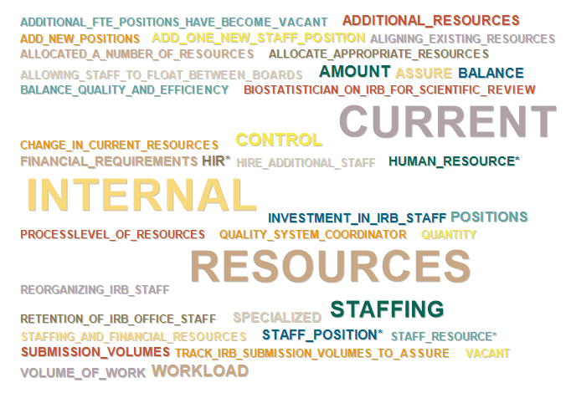
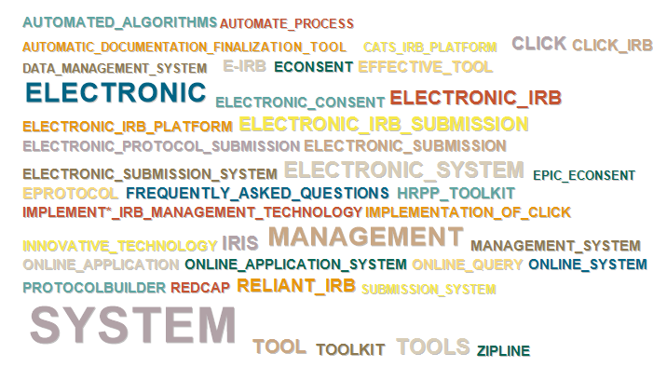
Text Mining
Review Process
Submission Process
Human Capital
Resource Allocation
Operational Efficiency
Technology Solutions
Notes:
This was a simple matter of setting the dictionary categorization level to report the number of words in each category for each narrative.
These results were saved to a csv file to be used to generate the visualizations.

Slide 47
Result
IRB Duration
Notes:
Here again is the final result. Many of you have seen this and we understand that it may have been challenging to interpret, but the idea is to show how different or similar hubs’ TTC plans were to the plans of other hubs. This was our first foray into trying to use the TTC plan data.

Slide 48
How long did this take?
Define Categories
Build dictionary
Manage Data
Run
0.5 week
1.5 weeks
+ ~1.5 hour/reviewer
2 weeks
Seconds
Notes:
Overall the process took about 4 weeks per dictionary. You can see how that breaks down here.
The time to manage data listed here does not include the early explorations of the full dataset. What is counted here is the cleaning and preparation needed specific to each dictionary.
--------------------
This is per dictionary, using Careers, the last dictionary built to give times as the first dictionary involved learning the tool and techniques.
Define categories: 2-3 days prep, 1 week turn-around, 1/2 -1 day to revise.
Building: adding words about 3 days, validating: 2 days.

Slide 49
Lessons Learned
Look at the data!
Notes:
The first lesson is the first step of any data analysis process – we had to look at the data to inform decisions about the appropriate type of analysis.

Slide 50
Lessons Learned
Look at the data!
Involve collaborators
Notes:
We learned the value of asking collaborators to provide feedback.

Slide 51
Lessons Learned
Look at the data!
Involve collaborators
Define categories clearly before building dictionary
Notes:
We learned that it is important to clearly define the categories before building the dictionary. Clear definitions make it easier to decide which words belong in which categories.

Slide 52
Lessons Learned
Look at the data!
Involve collaborators
Define categories clearly before building dictionary
More efficient over time
Notes:
And Since we performed this process 3 times, we learned from each cycle to improve the process for the next dictionary.

Slide 53
Process Improvements
Further reduce false positives
Notes:
There is always room for improvement. I’ll suggest a couple here.
Although the validation process focused on reducing false positives, that is
a word is incorrectly categorized because its use in the text is inconsistent with the category definition, there is still room for improvement in this area. This is a time intensive process.
[These are Improvements about changes to the process whereas gap -- Limitation of the process)

Slide 54
Process Improvements
Further reduce false positives
Increase coverage
Notes:
Another way to improve results is to increase coverage of the dictionary.
Coverage is optimizing number of terms represented in dictionary.
This is analogous to reducing false negatives which are words that should be categorized but are not.
Coverage can also be improved by expanding use of excluded terms, that is terms that are so ubiquitous as to contribute no differntiation.
For example in the IRB Duration metric, the term IRB is used in many contexts. Adding it to a single category would cause many false positives.
Improving coverage will help in keeping the dictionary up to date by making it easier to identify new words that need to be added.

Slide 55
Strengths
Fast (after dictionary is built)
Notes:
Ann resumes
Tailored to the data set. Combination of human with computer analysis provides speedy categorization, once the dictionary is built.

Slide 56
Strengths
Fast (after dictionary is built)
Systematic

Slide 57
Strengths
Fast (after dictionary is built)
Systematic
Extensible
Notes:
As new data comes in, it can be analyzed using the existing dictionary

Slide 58
Strengths
Fast (after dictionary is built)
Systematic
Extensible
Provides meaning with context

Slide 59
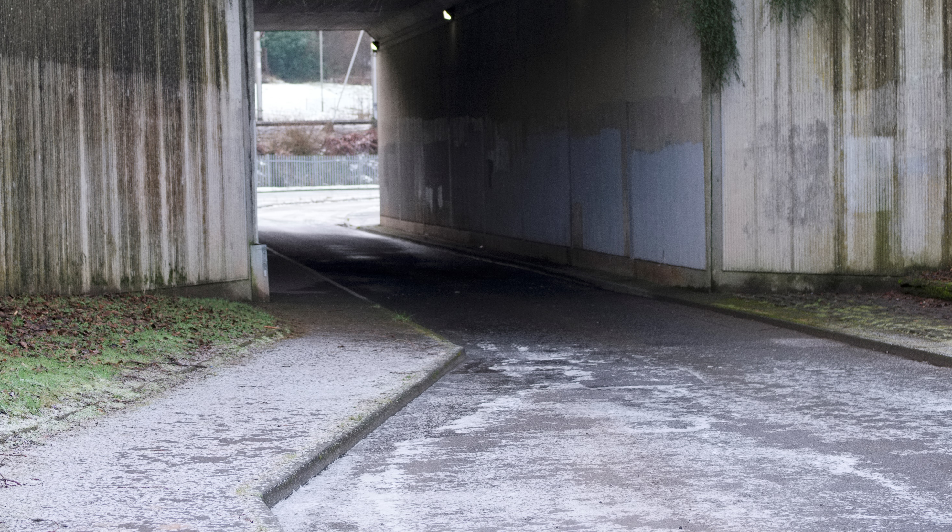
Limitations
Does not account for actual metric performance
Notes:
Nothing inherent in the process to address these. More like limitations, or opportunities for different types of analyses.
Doesn’t distinguish between hubs that are performing well and
Treats all hubs equally regardless of success or challegnes.

Slide 60
Limitations
Does not account for actual metric performance
Diagram may not fully capture the extent of hub activities if the plan was brief
Notes:
Nothing inherent in the process to address these. More like limitations, or opportunities for different types of analyses.
Doesn’t distinguish between hubs that are performing well and
Treats all hubs equally regardless of success or challegnes.

Slide 61
Next Steps
Refine dictionary
Notes:
Add help people use the results.
Comparisons by natural groupings
Hub size
Hub maturity
Dendogram
Opportunities to connect hubs?
Connect spider plot with numerical results?

Slide 62
Next Steps
Refine dictionary
Opportunities to connect hubs
Notes:
Add help people use the results.
Comparisons by natural groupings
Hub size
Hub maturity
Dendogram
Opportunities to connect hubs?
Connect spider plot with numerical results?

Slide 63
Next Steps
Refine dictionary
Opportunities to connect hubs
Comparisons by natural groupings
Notes:
Add help people use the results.
Comparisons by natural groupings
Hub size
Hub maturity
Dendogram
Opportunities to connect hubs?
Connect spider plot with numerical results?

Slide 64
Next Steps
Refine dictionary
Opportunities to connect hubs
Comparisons by natural groupings
Connect plot with metric values
Notes:
Add help people use the results.
Comparisons by natural groupings
Hub size
Hub maturity
Dendogram
Opportunities to connect hubs?
Connect spider plot with numerical results?

Slide 65
Summary/Conclusions
Notes:
We presented a method to provide systematic analysis of textual data that gives results for each hub that can be visualized in the context of all the hubs.

Slide 66
Connect
Ann M. Dozier, RN, PhD, FAAN
Ann_Dozier@urmc.rochester.edu
Elizabeth Wayman, MS
Elizabeth_Wayman@urmc.rochester.edu
Notes:
Put bibliography after this one.

Slide 67
Selected Bibliography
Bengston, D. N., Xu, Z., & North Central Forest Experiment Station (Saint Paul, Minn.). (1995). Changing national forest values: A content analysis.
Duz, M., Marshall, J. F., & Parkin, T. (2017). Validation of an Improved Computer-Assisted Technique for Mining Free-Text Electronic Medical Records. JMIR Med Inform, 5(2), e17.
Elam, C. L., Weaver, A. D., Whittler, E. T., Stratton, T. D., Asher, L. M., Scott, K. L., & Wilson, E. A. (2015). Discerning applicants' interests in rural medicine: a textual analysis of admission essays. Med Educ Online, 20, 27081.
Landmann, J., & Zuell, C. (2008). Identifying Events Using Computer-Assisted Text Analysis. Social Science Computer Review, 26(4), 483-497.
Levy, O. (2005). The influence of top management team attention patterns on global strategic posture of firms. Journal of Organizational Behavior, 26(7), 797-819.
Spinczyk, D., Nabrdalik, K., & Rojewska, K. (2018). Computer aided sentiment analysis of anorexia nervosa patients' vocabulary. Biomed Eng Online, 17(1), 19.
Notes:
Not sure if we need this or what should be included.

