Slide 1
Inclusive methods in the evaluation of outreach education programs: reflective journaling and participant observations
Sondra LoRe, PhD
Evaluation Manager
National Institute for STEM Evaluation and Research (NISER)

Slide 2
Beginning with the end in mind (Condensed to 45min☺)

Slide 3
Agenda
1
Layering Qualitative Data
2
Data informed decisions
3
Reporting

Slide 4
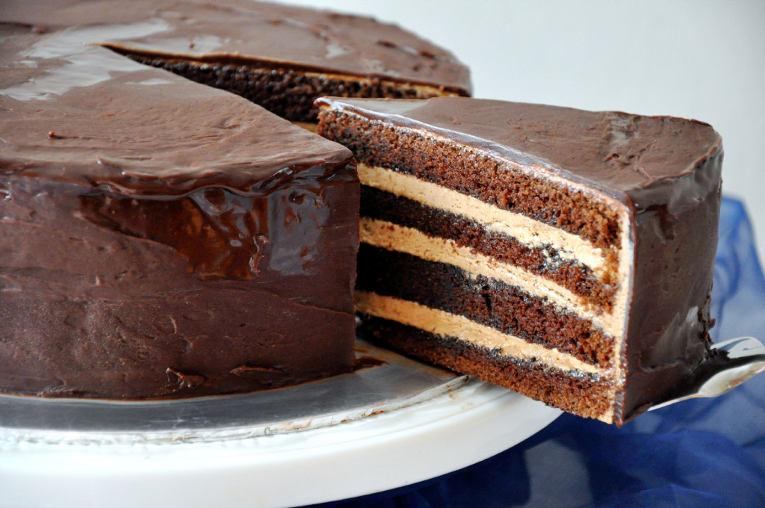
1
Layering Data
Outreach Education
Informal Science Education
Typical Measures:
Surveys
Documents
Artifacts
Focus Groups
Interviews
Observations

Slide 5
1
Data informed decisions
Program Designers
= Principal Investigators (PIs)

Slide 6
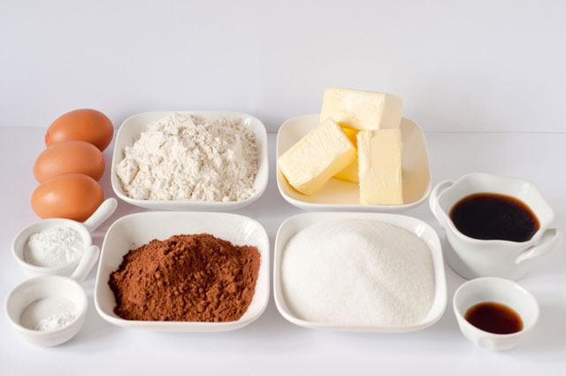
1
Program Ingredients

Slide 7
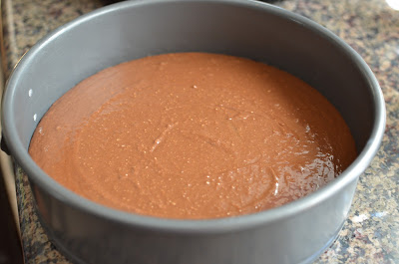
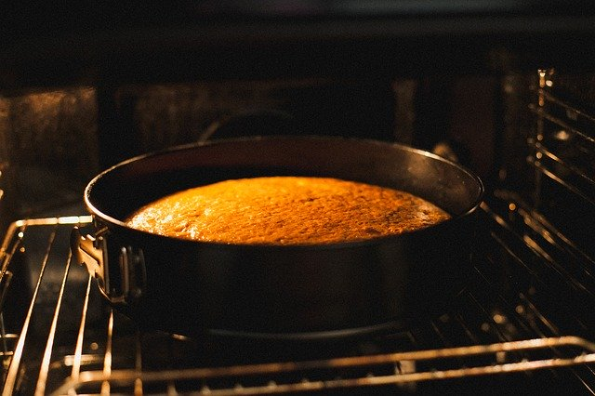
1
Implementers apply the heat
Baking pan is the vessel in which the program will rise
Evaluators keep the window to the oven clear

Slide 8
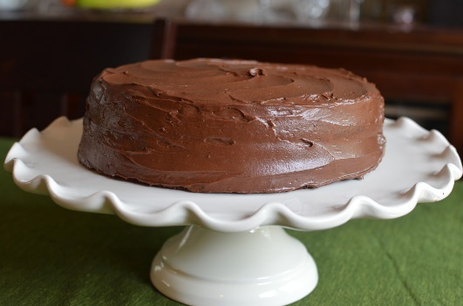
2
Evaluation Questions
What can we learn about the program from implementer’s journals?
What factors impact the experiences of program implementers?
In what ways have the experiences of the program implementers changed over the course of the outreach?
What is the value of reflection data to program designers?

Slide 9
2
Journal reflections of implementors
Codebook
Qualitative
DATA
Observations
Focus groups with implementors
Inductive Coding
Deductive Coding
Constant comparative coding
Inter-rater reliability with 3 coders
Inter-rater reliability with 3 coders
Formative Feedback and Reporting
Notes:
Flow Chart of Data analysis

Slide 10
3
Reflective Journals

Slide 11
3
“Many students also expressed how they hoped to go to college because their parents did not graduate from high school or started college and decided to stop. Overall I think we can make a big impact at School C and I am excited to see what the rest of time there is like.” (Rebecca, School C, Week 1)
“There were also distractions (another group of students) in the Commons (cafeteria) that interfered with class by adding noise and conversations.” (Brittany, School B, Week 2)
“Day 7 at [School 3] once again didn't go according to plan. Our time was cut short about 20 minutes so we only had about 15 minutes to spend with the kids and did not have time to show the video or talk about STEM which was disappointing.” (Cam, School B, Week 7)

Slide 12
3
Observations of Implementer Meetings
Reflective Journals

Slide 13
3
“This one was a little tough. All kids filled this out [hero activity] but there were students who had trouble thinking of people who were their heroes when they were kids. Some kids admitted that they didn’t have any they can think of and it showed that it may have struck a nerve…” (Brittany, School B, Week 2)
“On the drive up we all reviewed and discussed the intervention manual to ensure that we knew exactly what we wanted to see. This helped Elisa and I brainstorm examples for the students in the childhood activities and heroes portion of the day.” (Sam, School C Week 2)

Slide 14
Focus Group with Implementers
Observations of Implementer Meetings
Reflective Journals

Slide 15
3
“He [referring to the school principal] said he and the other teachers at School 2 wholeheartedly support the program and appreciate what we do.” (Nicole, School C Focus Group)
“When we enter the school, students and staff respond kindly to us and give us a good-natured laugh regarding the various ways in which we help and serve their students. We entered into the school and was immediately acknowledged by both front desk staff and other administrators as "Those survey people". Though jarring at first, I realized that it was all endearing and spoken out of their willingness to include us into their school day.” (Eli, School A, Focus Group)
“I think the students really opened up to us, and felt like they could talk to us and ask questions even on the first day. It was really nice to walk around and get to know the students.” (Abby, School A, Focus Group)

Slide 16
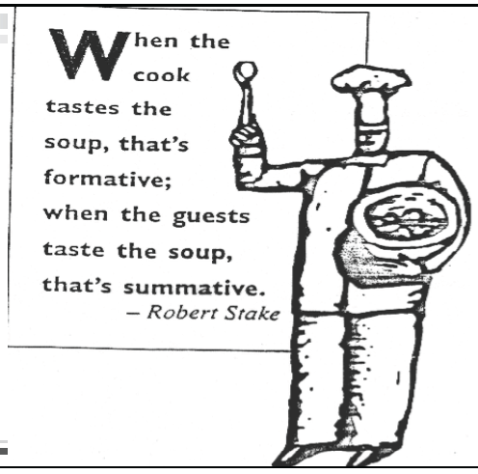
3
Evaluation Questions – Reporting
What can we learn about the program from implementer’s journals?
What factors impact the experiences of program implementers?
In what ways have the experiences of the program implementers changed over the course of the outreach?
What is the value of reflection data to program designers?

Slide 17
3
Reporting

Slide 18
Beginning with the end in mind
Thank you to my co-bakers
co-researchers:
Miranda Chen Musgrove
&
Pamela Bishop
And NISER team bakers members:
Erica Echols &
Meredith York
1
Layering Qualitative Data
2
Data informed decisions
3
Reporting

