Slide 1
DESCRIBE what happened
Irene Guijt, Learning by Design

Slide 2
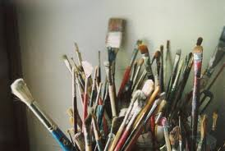

Slide 3
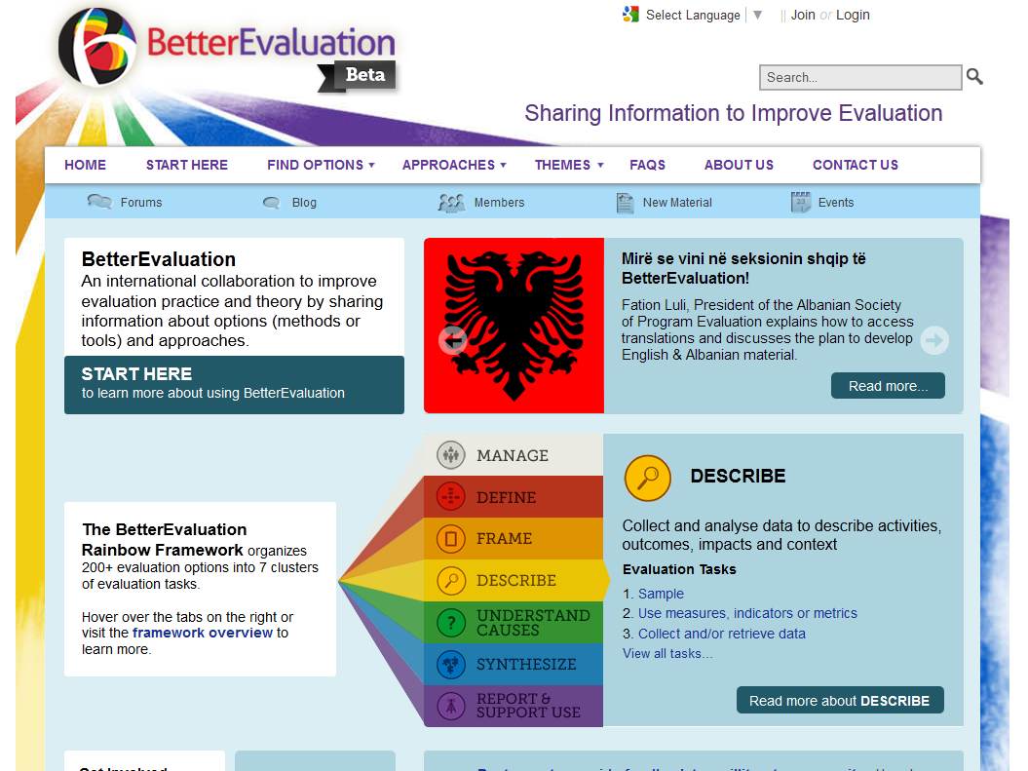
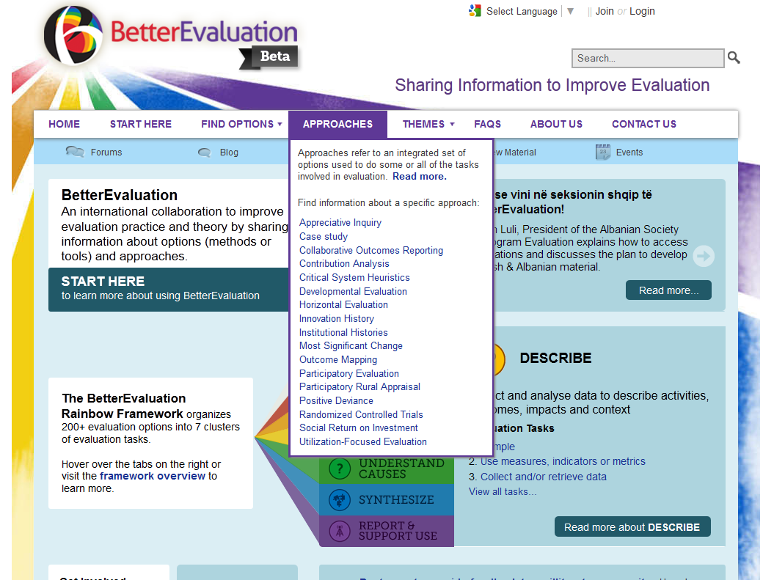

Slide 4
SEVEN evaluation tasks in DESCRIBE
1
Sample
Use measures, indicators or metrics
Collect and/or retrieve data
Manage data
Combine qualitative and quantitative data
Analyze data
Visualize data
2
3
4
5
6
7

Slide 5
1.
Sample
Image source: Wine by rogersmj, on flickr

Slide 6
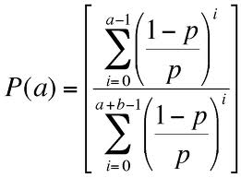
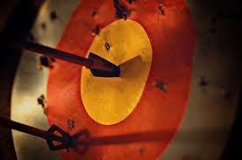
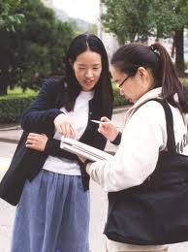
Probability
Multi-stage
Sequential
Simple Random
(more on site)
Purposive
Criterion
Homogenous
Outlier
(more on site)
Convenience
Convenience
Volunteer

Slide 12
2.
Use measures, indicators or metrics
Image source: DoF by papalars, on flickr

Slide 13
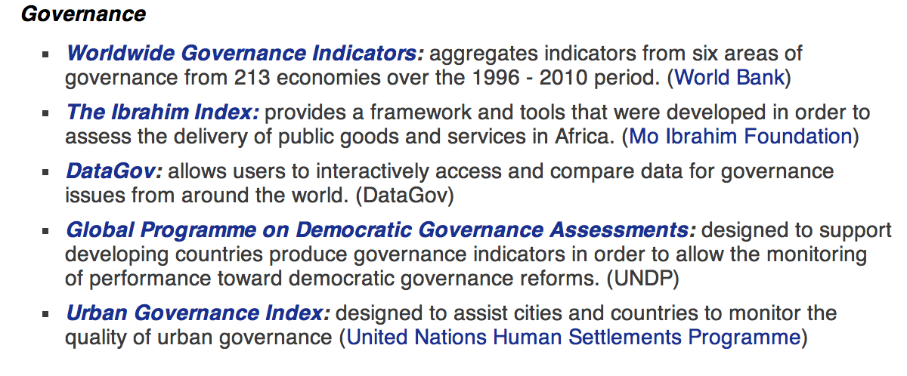
Existing or Tailor-made or Emergent

Slide 14
3.
Collect and /or
retrieve data
Image source: The photographer by Arranging Matches, on flickr

Slide 15
from groups
from individuals
What happened?
Changes for whom?
Context?
existing records
observation
physical measurement

Slide 17
4.
Manage data
Image source: train! by sheeshoo, on flickr

Slide 18
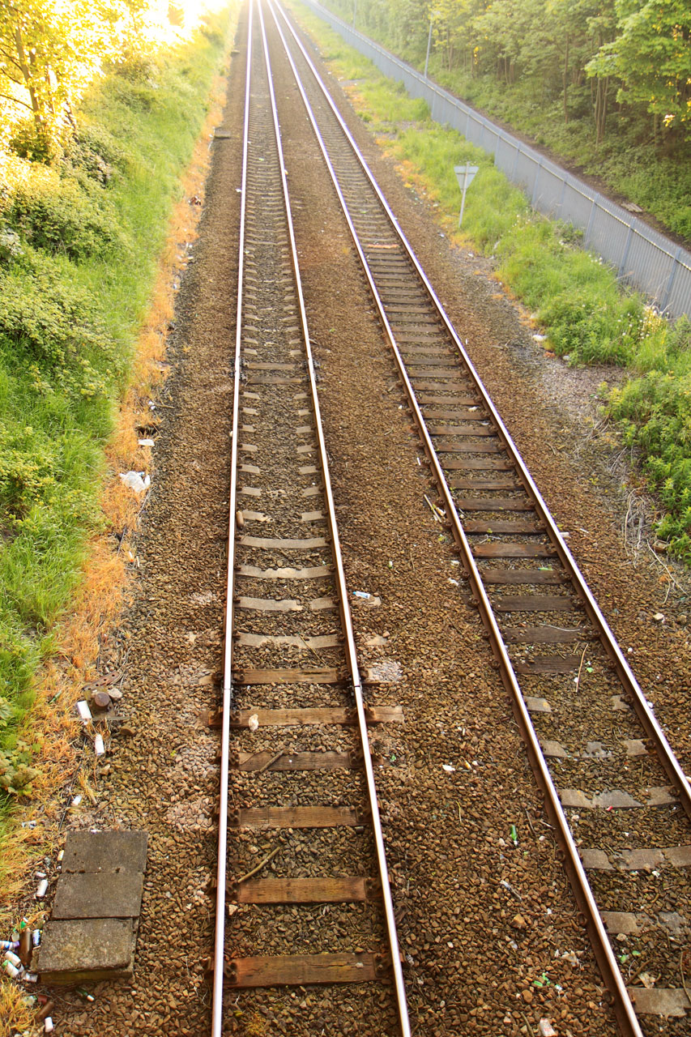
Clean
Record
Modify
Store

Slide 19
Combine qualitative and quantitative data
5.

Slide 20
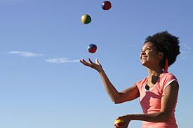
Purpose
Sequence

Slide 21
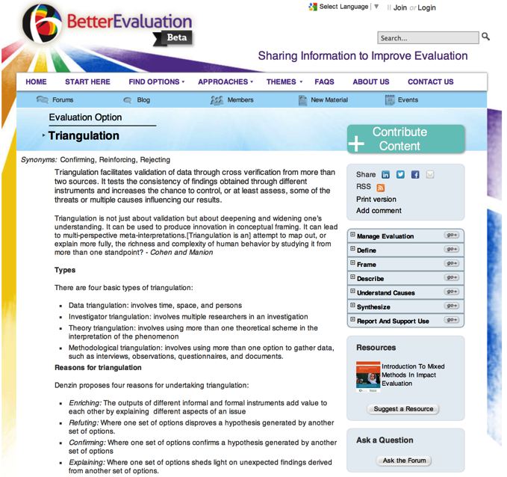
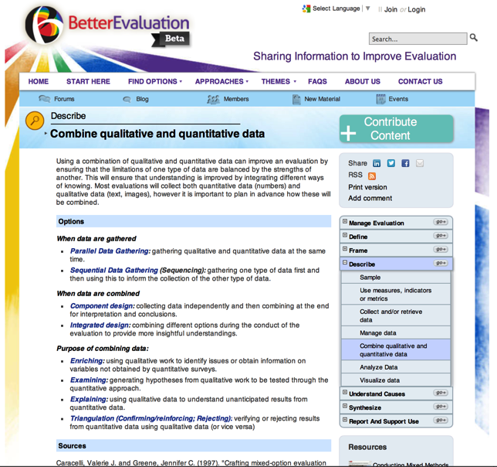
5. Combine qualitative and quantitative data
Triangulation

Slide 22
Analyze data
6.

Slide 23
Graphical
Numeric
Textual
Mapping

Slide 24
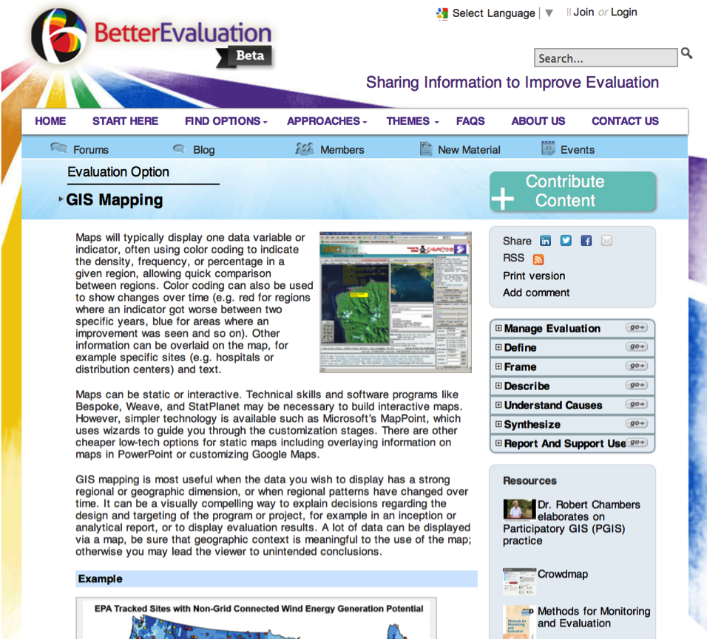
Includes resources (more online):
6. Analyze data
GIS Mapping
Participatory GIS

Slide 25
7.
Visualize data

Slide 26
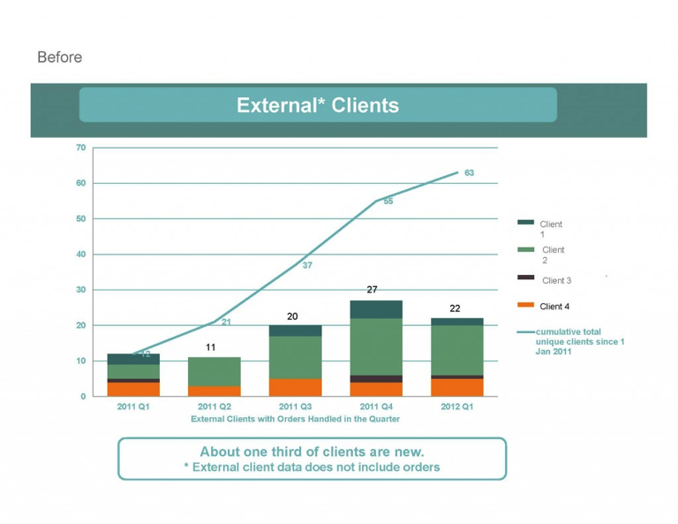
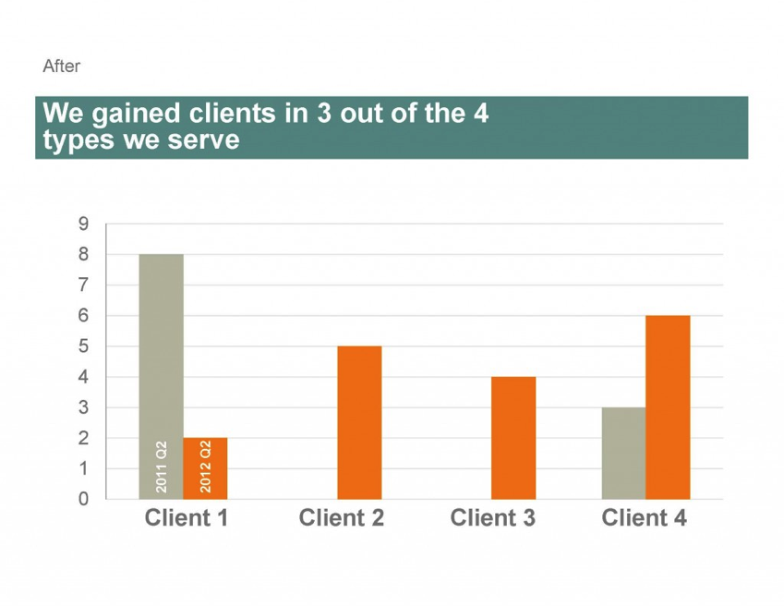
http://stephanieevergreen.com/before-after-slides-stay-on-the-side-of-simplicity-2/

Slide 27
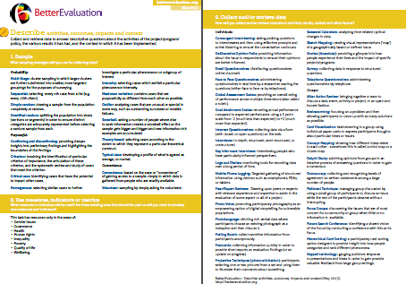
Further resources
http://betterevaluation.org/plan/describe
facebook.com/betterevaluation
@bettereval
Irene Guijt
Learning by Design
iguijt@learningbydesign.org

