Slide 1
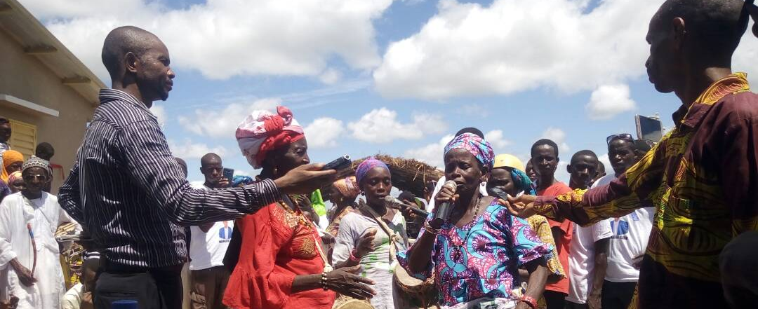
Group work is not a dirty word anymore
How RTI’s MERLA Community of Practice has leveraged expertise to work together in strengthening their MERLA practice
Sarah Miller Frazer
MEL Specialist
AEA Eval 2018
Notes:
15 minutes presentation
30 minutes discussion
I’m Sarah and I’m going to talk about our community of practice at RTI International

Slide 2
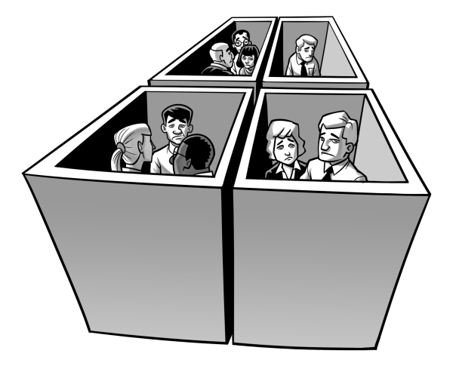
That feeling when
Notes:
By a show of hands – who knows that feeling of working in silos? Wondering if other people are working on what you are working on?
Who Knows the feeling of re-creating the wheel?
That feeling of not learning, not sharing, missing out
When myself and 2 other M&E colleagues realized that we were working on similar problems in different divisions we started meeting for lunch once a month, but still did not have a way to easily share tools and problem solve together.

Slide 3
Connect, Share, Leverage
Notes:
We needed a space to connect with each other, share methods and ideas and leverage each others experience. We wanted to stop duplicating efforts
Wanted a structure to for collaborating, learning from each other and bringing new innovations and successful approaches to our work

Slide 4
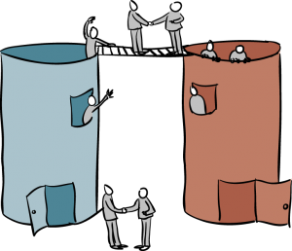
Bridging Silos
Notes:
The goal being, to keep our sectoral expertise but have a structure and a place to share
We wanted a space where staff working in M&E but also, research, capacity development, program management, and could draw from existing expertise and experience to learn from each other.

Slide 5
Community of Practice
Notes:
This is where our MERLA Community of Practice came from – a desire to work more closely with and learn from staff across divisions
We wanted to share tools, ideas, get advice, problem solve talk about the latest developments in the field on all things M&E

Slide 6
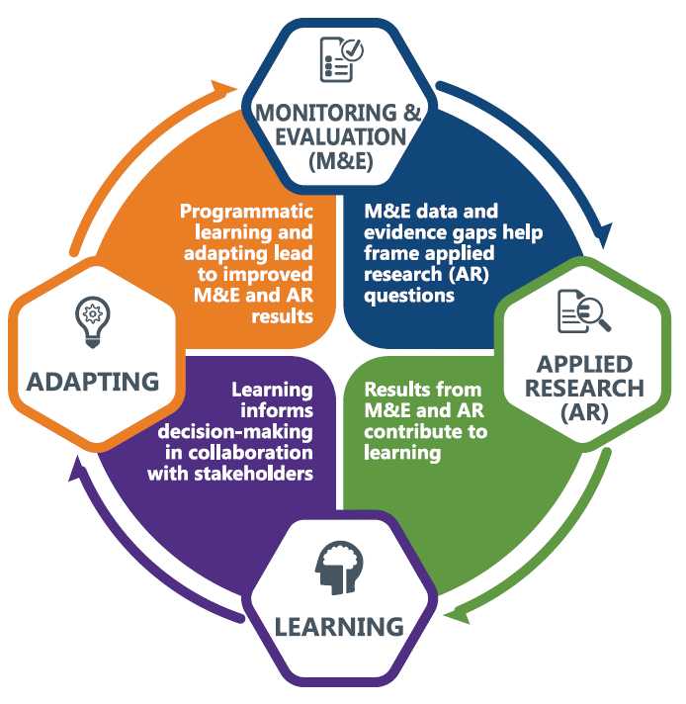
RTI’s MERLA Cycle
Notes:
MERLA Is Monitoring, Evaluation, Research, Learning and Adapting
It is the cycle of applying results-focused M&E and research for continuous learning and adapting to improve program effectiveness

Slide 7
Inaugural year activities
Notes:
At the end of our first year, RTI CoP is roughly 60 members spanning all of our international development sectors who regularly collaborate regularly online and meet monthly. The meetings are open to everyone, regardless of role or location, many members are evaluators, but others are in technical or project management roles who want to be more involved in supporting MERLA initiatives
Our meetings discuss the work of our subcommittees and feature one member sharing "notes from the field“ on a recent success, challenge, or innovation
We have sub committees made up of 15 core members who did much of the work this year

Slide 8
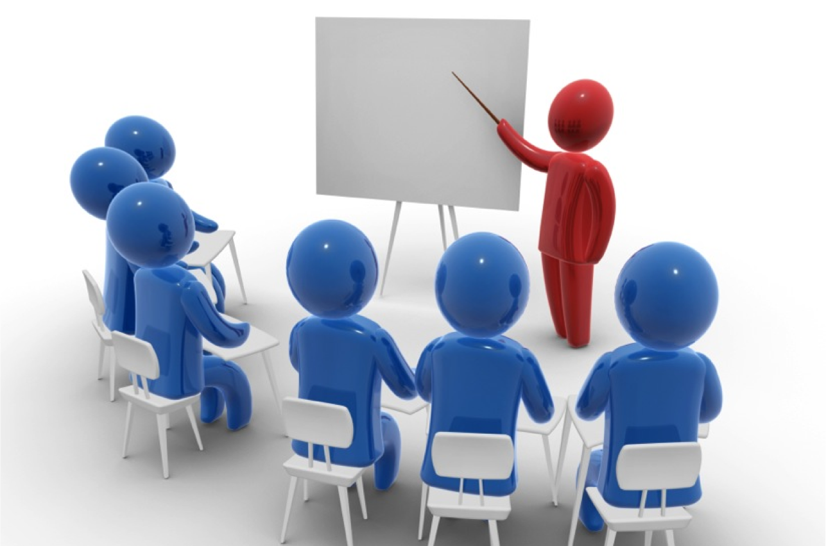
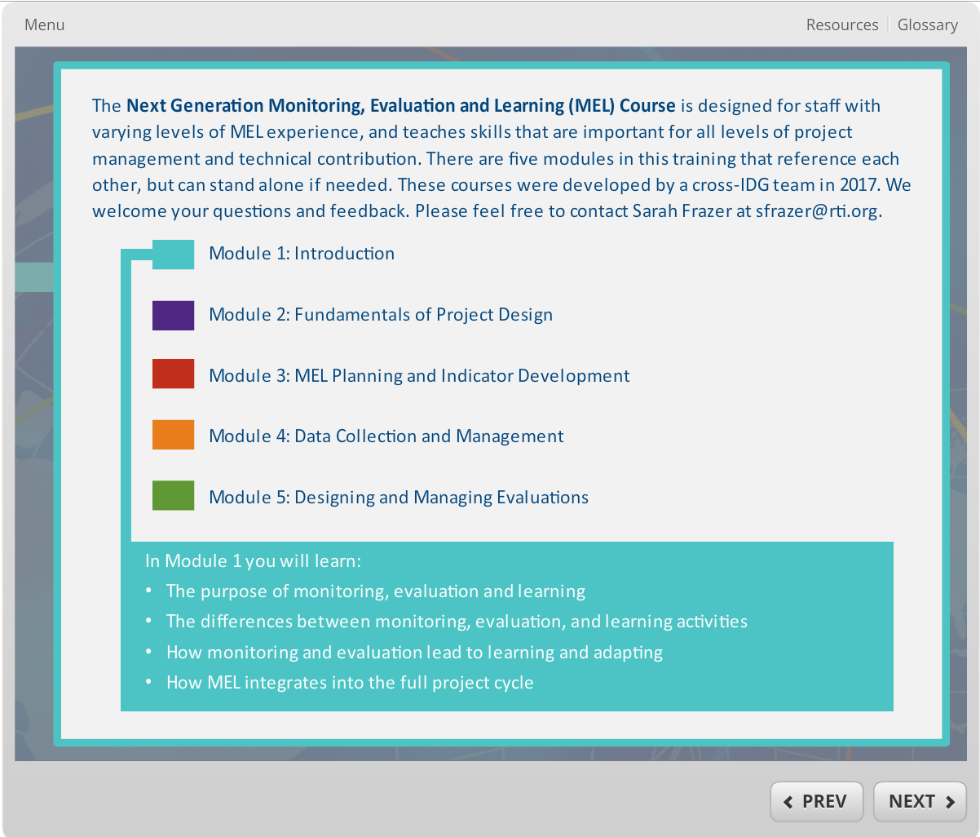
Internal Trainings for RTI Staff
Trainings on MEL, CLA, proposals and projects
Online, self-directed MEL 101 Course
Notes:
Created a training series on MERLA topics related to both projects and proposals. For example a training on how CLA goes beyond your M&E team and how the IRB approval process works
deliver company-wide trainings such as “How to write Monitoring, Evaluation, and Learning (MEL) sections for proposals” and "Operationalizing Collaborating, Learning, and Adapting",
We also launched an online, internal, self-directed MEL 101 course that’s encouraged for all staff, of all levels

Slide 9
Internal Resources for RTI Staff
Directory of staff experience with MERLA tasks
Tools and resources repository
Notes:
We conducted a survey of our international development staff, both home office and field staff, to take stock of our capabilities and tools.
Then we created a directory to better connect people and their skill sets.
And we created a tools and resources repository to provide a central location for sharing for use across projects

Slide 10
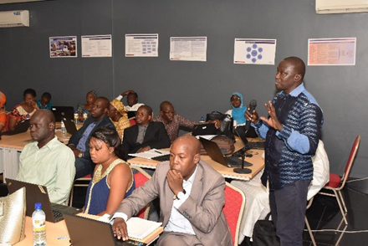
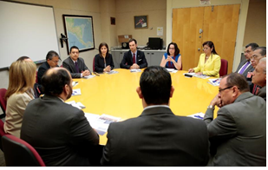
Leverage Experience across Projects
Refine guide for internal reflection session
Learning agenda examples and workplans
Notes:
A few examples of how we leveraged the directory and the tools and resources:
A guide that I developed for internal pause and reflection sessions, shared with a colleague in the global health division to help her plan the session for a health program.
Similarly, we’ve shared example learning agendas, the process for developing them, and the workplans, as more projects develop them.

Slide 11
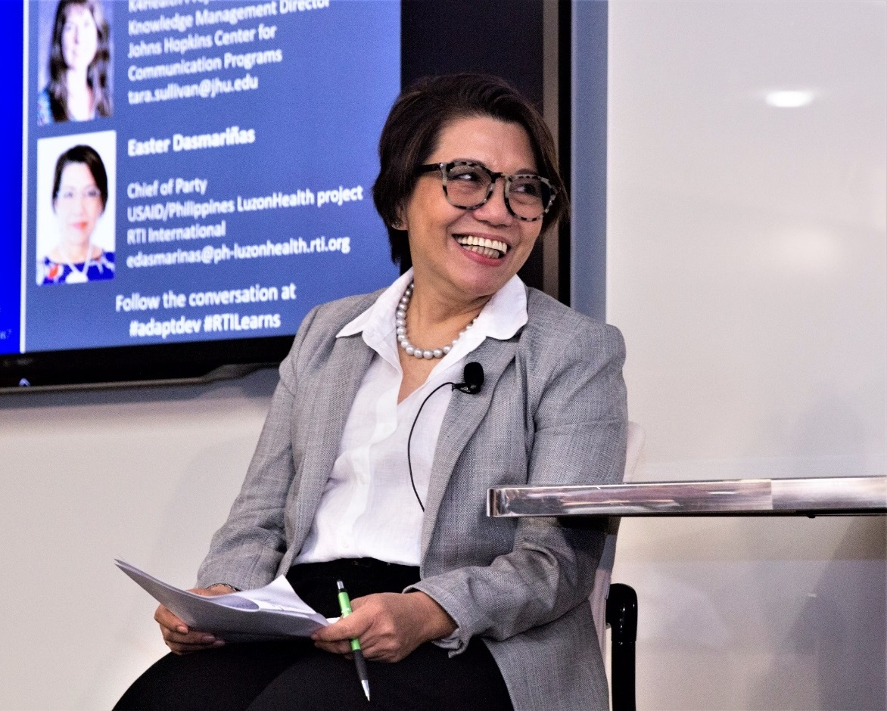
Learning events
Washington, DC Learning Symposium
Philippines Projects Learning Summit
Notes:
We held 2 large events this year, first roughly 250 people from 40 organizations attended our Learning Symposium in DC in May with speakers from USAID PPL, MEASURE Evaluation, and an RTI project Chief of Party.
Then RTI’s 5 projects and USAID’s CLA project in the came together to learn from one another, share their strategies for learning and adapting and discuss ways to collaborate. Philippines learning summit had 160 people in attendance including government and civil society counterparts as well as USAID.

Slide 12
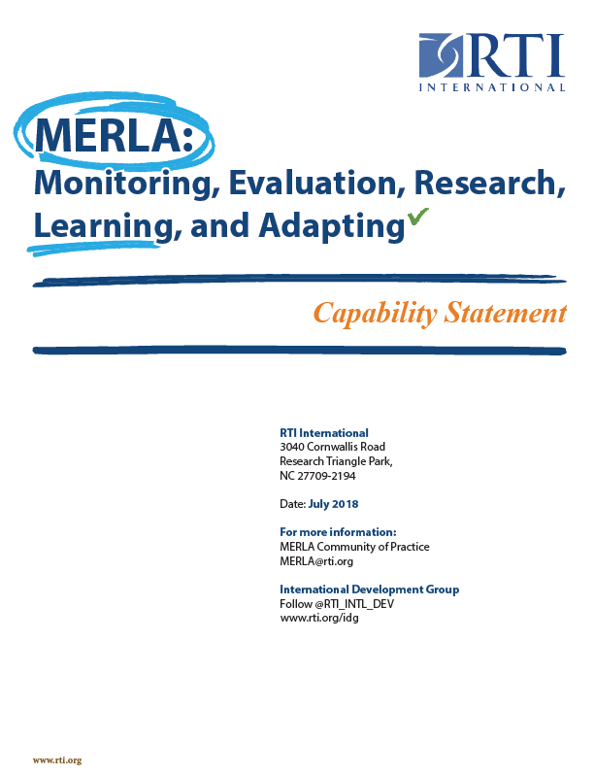
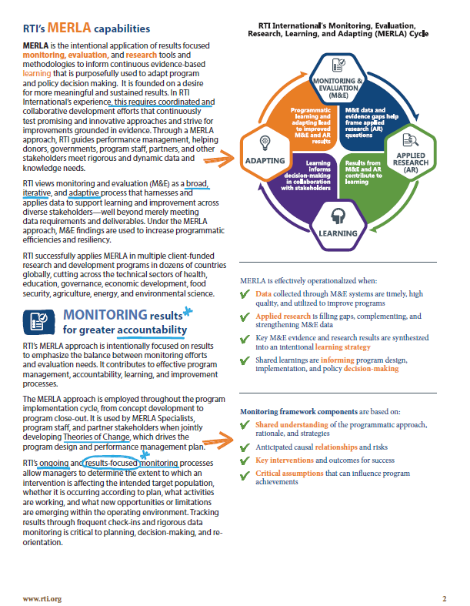
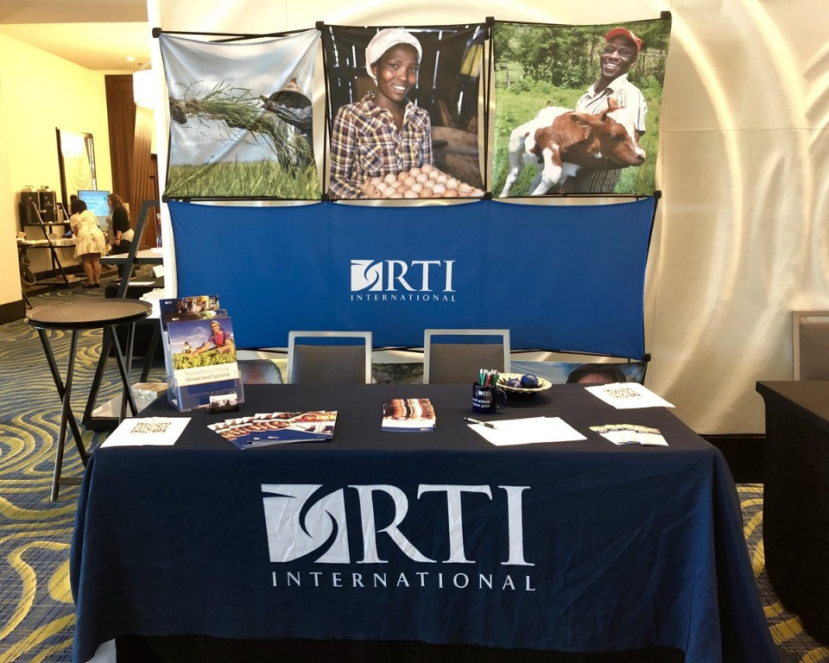
External Communication
MERLA communication materials
Conferences
(come see us at Booth 30)
Notes:
For externally communicating our MERLA strategy, our CoP developed some MERLA communications materials to be shared with partners, collaborators, funders, and the wider community.
participated in the USAID Learning Lab’s Collaborating, Learning, and Adapting (CLA) Challenge Week
And members of our community attended multiple conferences this past year – come see our booth!

Slide 13
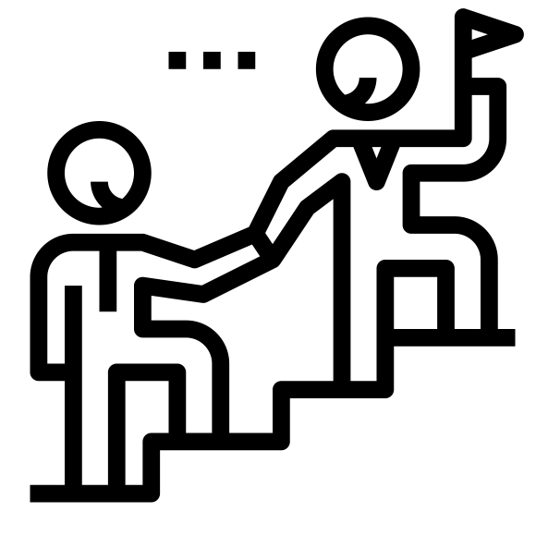
Lessons Learned
Leadership Support
Notes:
I’ll now share several of the most important lessons we learned this year
The turning point in making this CoP a reality was that RTI leadership invested support and internal funding for this effort
This was a lesson learned for us - having leadership’s buy-in and support from the beginning is essential for making something like this successful

Slide 14
Lessons Learned
Core Members
Notes:
We’ve found that an important factor in our success this year has been a core group of 15 or so members, who do the bulk of the work in subcommittees
In any groups, at work, or otherwise, there needs to be a solid community of influencers, of people who are most engaged. These core members take on leadership for planning, organization, getting tasks done, involving other people as needed. They have the support of their supervisors

Slide 15
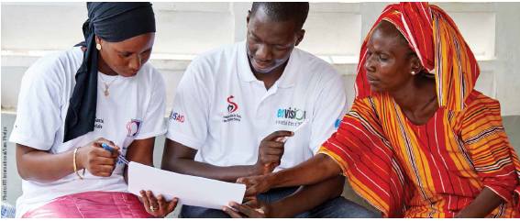
Lessons Learned
Demand for MERLA conversations
Notes:
There is a demand for frank and open conversations about MERLA/CLA both internally and externally.
A desire to continue
Services provided were well attended
People want to connect, share, learn – desire for learning culture

Slide 16
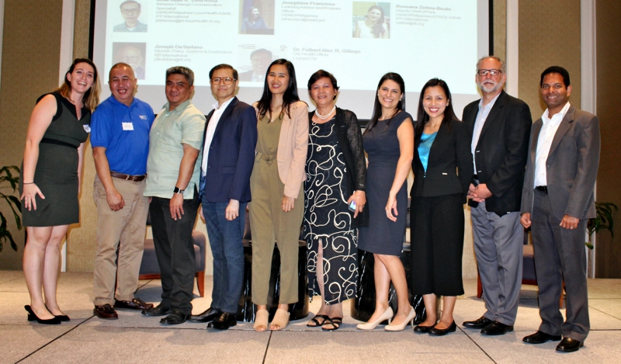
Lessons Learned
Diverse and inclusive representation
Notes:
All divisions and field staff CoP must be engaged to fully represent RTI.
We had varying levels of engagement from different divisions. In order to fully embody a cross-IDG com-munity of practice, we will prioritize bringing in all voices from all IDG divisions and our field staff.

Slide 17
The way forward
Sustainability
Strategic Direction
Notes:
Looking forward we face some big questions and challenges.
In particular, questions about our sustainability and our strategic direction. We need to prove the value add to the organization, and figure out exactly what we work on

Slide 18
Challenges
Field Staff involvement?
Notes:
One question is how we can better incorporate and support field teams, communication can be hard, languages, time zones, technology, systems are different, and we want to encourage meaningful engagement.

Slide 19
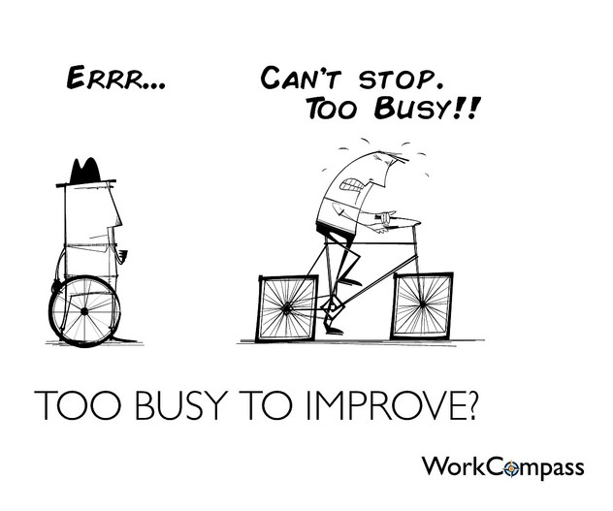
Challenges
Commitment?
Notes:
Our core members produced most of the outputs this year. We need to think about the sustainability, beyond depending on these certain individuals

Slide 20
Challenges
Funding?
Notes:
We are trying to figure out how to continue to support and grow the CoP if there is no longer internal funding for the initiative. Would people participate if there was not a charge code for them to bill their time? How do we produce as many outputs and get participation from as large a number of people and divisions.

Slide 21
What has worked well for you in setting up a community of practice?
Notes:
How did you encourage participation
What lessons did you learn
Membership
Facilitation process
Leadership
Organization

Slide 22
What challenges have you faced?
Notes:
What have you done to address those challenges?
Technology and platforms, communication
How do you learn and adapt?

Slide 23
Goals for your communities of practice this coming year
Notes:
What do you want to focus on this coming year with your CoP?
( operational or technical/task)
What to keep doing? What to change?
Areas for growth?

Slide 24
Thank you!
Sarah Miller Frazer
MEL Specialist
sfrazer@rti.org
Notes:
Here is my email

