Slide 1
Integrating Systems Thinking through a Technology-based Performance Management System for a Consortium TAACCCT Grant
Christa A. Smith, TRAC-7 Research Analyst and Interim Program Manager
Debra E. Mikulka, TRAC-7 Administrator and Office of Sponsored Projects Director
Gillian M. Gabelmann, TRAC-7 Project Director and Associate Dean of Technical Education
Technical Retraining to Achieve Credentials (TRAC-7)
Washburn University
Washburn Institute of Technology
American Evaluation Association Denver, Colorado
October 16, 2014

Slide 2
Technical Retraining to Achieve Credentials
What is TRAC-7?
$19.6M Department of Labor
Round 1 Kansas single-state consortium TAACCCT grant
Washburn University, lead
7 community and technical colleges with 7 signature programs
4th Year ends September 30, 2015

Slide 3
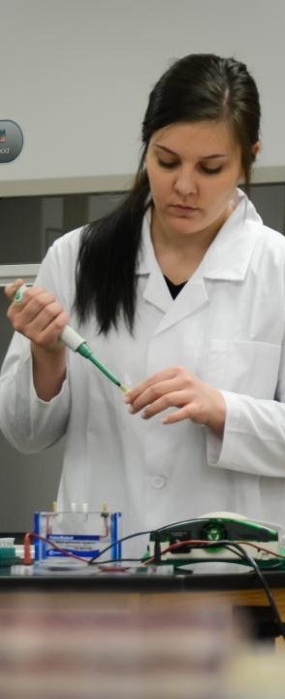
Reporting
Department of Labor TAACCCT Reporting:
Statement of Work Progress and Implementation Performance Outcome Projections
Quarterly Narrative Progress Reports
Annual Performance Reports

Slide 4
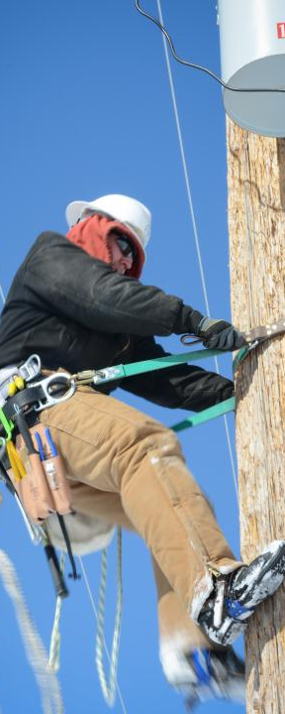
Reporting Challenges
Operationalize terms
Standardize reporting
Compile data from seven diverse institutions
Submit comprehensive quarterly and annual reports as a consortium

Slide 5
Collaborative Process
Collaborative strategic planning sessions conducted
Develop a framework for a performance management system
required metrics
operationally defined terms
indicators of progress
institutions responsible

Slide 6
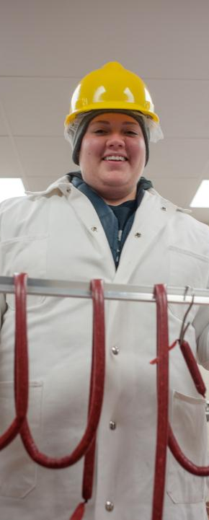
Collaborative Process
build consensus
common understanding of the interrelated components
mindful of the newly forming and existing relationships
respectful of the boundaries and the potential for conflicts

Slide 7
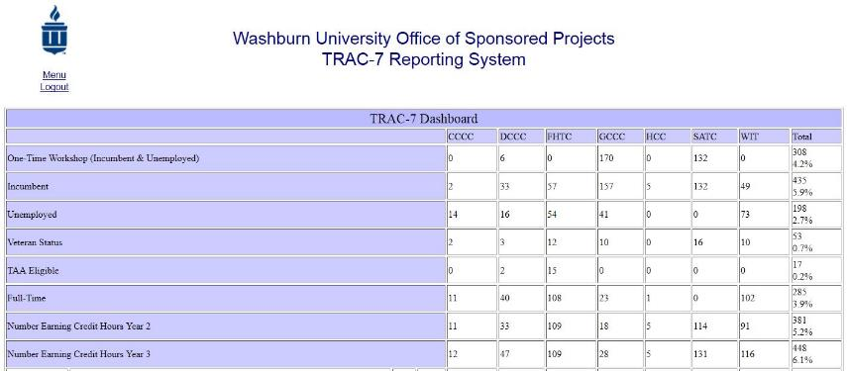
TRAC-7 Reporting System
Notes:
Sites add quarterly quantitative and qualitative data for QNPR into customized online reporting system. The TRAC-7 Reporting System can support multiple users for one consortium institution to allow for asynchronous, remote collaboration within institutions. Users have ability to view and enter data by quarter, and save partial submissions, which allows users to return later to update and/or submit final data. Once data is submitted for a quarter, that quarter is locked for editing by the users. The previous quarter’s qualitative comments are populated into the new quarter to allow users to reflect on the previous entry and update comments if needed to provide richer, contextualized data. The reported data, submission status, and authorized users can be managed by the system administrators. The system archives and sums the quantitative data per quarter. After entry and submission, data can be sorted by three Aggregate Report Types: institution, quarter, and institution and quarter

Slide 8
TRAC-7 Reporting System
Notes:
Sites add quarterly quantitative and qualitative data for QNPR into customized online reporting system. The TRAC-7 Reporting System can support multiple users for one consortium institution to allow for asynchronous, remote collaboration within institutions. Users have ability to view and enter data by quarter, and save partial submissions, which allows users to return later to update and/or submit final data. Once data is submitted for a quarter, that quarter is locked for editing by the users. The previous quarter’s qualitative comments are populated into the new quarter to allow users to reflect on the previous entry and update comments if needed to provide richer, contextualized data. The reported data, submission status, and authorized users can be managed by the system administrators. The system archives and sums the quantitative data per quarter. After entry and submission, data can be sorted by three Aggregate Report Types: institution, quarter, and institution and quarter

Slide 9
TRAC-7 Reporting System Use
Front end: report self-assessment of progress toward outcomes and explanation of progress
Back end: synthesizing and exporting quantitative data and summarizing qualitative comments
Discuss statuses
Identify and areas in need of improvement or gaps
Notes:
More than one user could access it at a time, more efficient, adapt and reduce reporting fields, verification and documentation, quantified measures, helps to measure growth and progress, more transparent and consistent

Slide 10
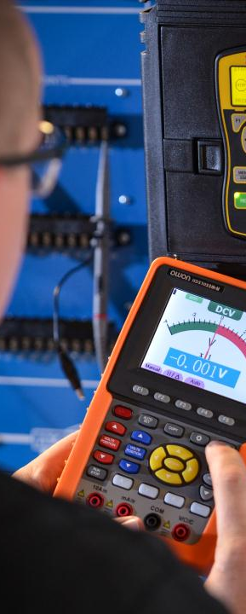
TRAC-7 Model
Recommendations
Advantages:
Tailored to our needs
Provide meaningful findings
Disadvantages:
Uncharted territory
Troubleshooting

Slide 11
Technical Retraining to Achieve Credentials
Washburn University
Washburn Institute of Technology
Topeka, Kansas
Christa A. Smith
Research Analyst
christa.smith@washburn.edu
785-670-2288
Debra Mikulka
Office of Sponsored Projects
debra.mikulka@washburn.edu
785-670-1403
Dr. Gillian M. Gabelmann
Associate Dean for Technical Education gillian.gabelmann@washburn.edu
785-228-6302

