Slide 1
Implementing Standards to Improve Health Development Organizations’ Monitoring and Evaluation Practices
American Evaluation Association, Minneapolis, 2012
Linda Fogarty (lfogarty@jhpiego.net; 410-537-1873)
Eva Bazant (ebazant@jhpiego.net; 410-537-1993)
Jhpiego, 1615 Thames Street, Baltimore MD, 21231

Slide 2
Why do we need M&E standards now?
Growing or decentralizing organization
Ensure quality across programs
Share expectations clearly
Let standards guide our internal work as it guides our external work

Slide 3
What are they?
Program Specific
Adequate M&E human capacity
M&E is integrated into Programs
Each program has a logic model, PMP and M&E work plan
Routine program monitoring systems are in place
Databases are used to facilitate routine M&E
Data quality is assessed routinely
Rigorous evaluations are planned and implemented
Data are used for decision-making
Office Wide
The office has an M&E plan outlining standard operating procedures

Slide 4
How were they developed?
“Organizing Framework for a Functional National M&E System: 12 Components”; UNAIDS 2008
Input from:
M&E Advisors from 27 countries
Program Officers
Piloted: Tanzania, India
Translated to French

Slide 5
See Handout
STANDARDS | VERIFICATION CRITERIA | N/A | OBSERVATION |  |  | SCORE | NOTES
 |  |  | 0 | 1 | 2
1. The office has adequate M&E human capacity | 1. The office has sufficient M&E staffing to meet program needs Staff skills are a good match for M&E program needs |  | There are not enough M&E staff members, and those available do not have the correct skills to meet the needs of current programs. | There are enough M&E staff members but they do not have the correct skills; or current staff members have the correct skills but there are not enough of them to meet the needs of current programs. | There are enough M&E staff members, and they have the correct skills, to meet the needs of current programs.
 | 2. Up-to-date job descriptions (JDs) exist for M&E positions at different levels; a career path is defined for M&E staff |  | JDs for M&E jobs do not exist or are out of date; and there is no provision for promoting M&E staff. | JDs for M&E jobs exist but they are out-of-date; or JDs are current but there is no provision for promoting M&E staff. | Up-to-date JDs for M&E jobs exist and provisions are in place to promote M&E staff.
 | 3. A clear reporting structure is in place for M&E staff |  | M&E staff do not know who they are supposed to report to | Some, but not all, M&E staff members know who they report to; or most have a vague idea of reporting lines. | All M&E staff members know who they report to.
 | 4. Programs provide an appropriate budget and plan for M&E staff capacity building |  | Programs do not budget or plan for M&E staff capacity building | Some programs have plans and budgets for capacity building for some M&E staff | Programs regularly provide budgets to cover M&E staff capacity building

Slide 6
Who is the target audience?
M&E Advisors across the organization
Program staff who perform M&E functions
Country Directors and Chiefs of Party who set the stage for M&E

Slide 7
When do we use them?
Suggested: Annually to identify gaps and strengthen systems
When you train new M&E staff
When you orient new program staff

Slide 8
How do we implement them?
Country-driven
Country Director-sponsored, M&E staff-led assessment
Integrate into annual work planning
Pair with M&E backstop TA visit
Other….?
Quality Improvement-like process
Review the tool, define terms
Plan the approach (who to involve when)
Score all programs
Review findings
Create program-specific Action Plans

Slide 9
Where have we used them?
Indonesia (*facilitated by HQ M&E advisor)
Botswana *
Zambia (country M&E staff)
Tanzania *
Ghana *
Madagascar (program officer)

Slide 10
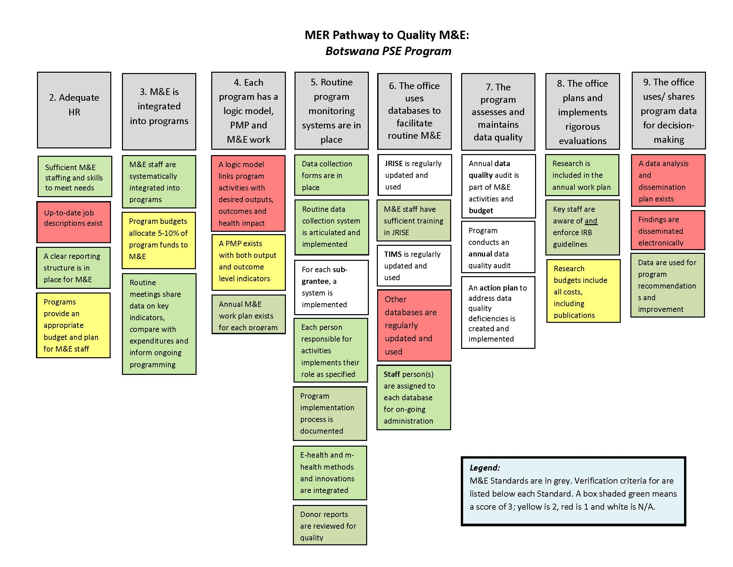

Slide 11
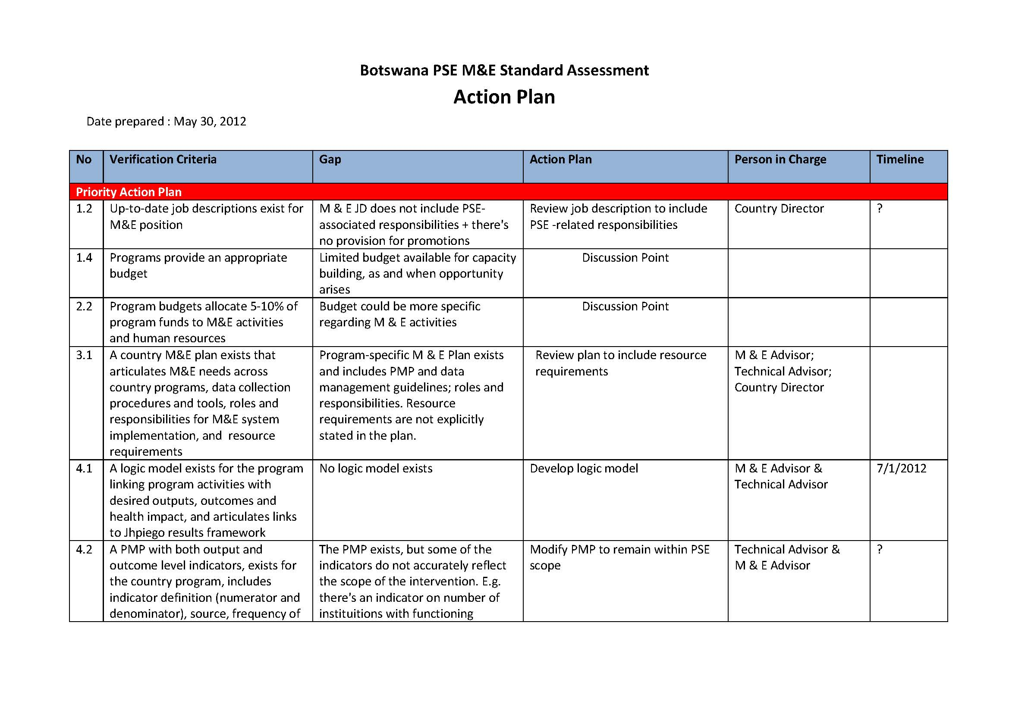

Slide 12
Next Steps
Develop orientation presentations to assist implementation
Complete Process Document
outline suggested implementation process
provide key definitions
Provide example templates for key products (e.g., PMP, logic models)

