Slide 1
Crafting Powerful Reports and Presentations: Strategies for Improving Communication in Evaluation

Slide 2
Presentations
The issue
Q&A
Start
2
End
1
3
4
5
Making it happen
Reports
Notes:
Instructions for how to create this neat slide! This was an agenda inspired by Garr Reynolds.
http://www.ellenfinkelstein.com/pptblog/create-a-timeline-agenda-in-presentationzen-style/

Slide 3
My journey
started with Disappointment.
Notes:
I wanted to start by telling you how I came to be so passionate about communication in evaluation. I have written lots of reports and given a lot of presentations since I started practicing evaluation. But too many times I could tell my audience in my presentation was bored and that my message wasn’t sinking in. I’d send out a report and never hear anything back. I couldn’t understand it. These are programs that people cared about! Yet I felt like too often my audience walked away from my reports and presentations none the wiser, and certainly not motivated to change their beliefs or behavior.
A colleague once argued that this was the stakeholders’ fault – if they couldn’t be bothered to engage with the content, then I couldn’t force them to do it. But I was so disappointed. One of the reasons I became an evaluator is because I thought I would be able to help change my piece of the world. So it broke my heart a little bit every time my evaluation findings didn’t make an impact. I was embarrassed – was I a bad evaluator? I knew other evaluators felt like they were really making a difference, that their work was inspiring action and change – I heard that every year at AEA. So what was I doing wrong? I wondered if there wasn’t more to it – what could I do that would motivate my audience, make the message interesting, resonate with them?

Slide 4
Notes:
Then one year, a colleague brought a book to work that she’d heard about at AEA. I flipped through it and it looked really interesting. I decided to order the book…and it literally changed my life. It sounds cheesy, but for me that book opened up a whole new way of thinking. It made me rethink all the things about communicating information that I’d taken for granted. I started to be very intentional in how I designed my reports and presentations with an eye to helping my stakeholders really learn from them. And it worked! I’m definitely still learning and improving, but today I wanted to share with you some of the things that I’ve learned along the way that have really made a difference.

Slide 5
Communication matters in Utilization.
This is important!
Notes:
What’s most important to all of us as evaluators is actually having our clients use our evaluation findings. How we communicate our results is a critical part of determining whether our evaluations will be used.
Bad communication confuses or bores our clients, doesn’t help them understand what to do with the information, and leaves them feeling no more informed.
Good communication helps us tell clients what we found, why it matters, and inspire them to action.

Slide 6
95% of Reports and Presentations SUCK
Notes:
But the sad fact is that bad presentations and reports are ubiquitous – they are often the rule, not the exception.
How many presentations have you been to lately that made you want to jump out of your seat, or clap your hands, or take action on what you learned?
How many of you read a report lately that didn’t ever seem to answer the evaluation question? Where even after you read the entire 80 pages, you still had to go back and piece things together because the report didn’t make clear what the message was.
As a client of evaluation I have received lots of reports and presentations which were terrible – not because there was anything wrong with the study, but because the reports and presentations did a terrible job communicating what the evaluation had discovered.
Now this might seem like a harsh judgment – so to make sure my experience wasn’t an outlier, I polled fellow evaluators. The consensus was that as a field, we do a pretty poor job of communicating the results of our studies. We spend all this time and energy doing a great evaluation, then fall flat when it comes to actually communicating those results to the clients.
But it doesn’t have to be like that. With a few relatively simple changes we can drastically shift our communication, and make it so much easier for the client to understand and act upon our findings. We all care about utilization – so let’s talk about the role that communication plays in making that happen.
[I wish I’d come up with this idea, but this slide is based on one that Guy Kawasaki used as part of his forward for Presentation Zen. Find it here: http://www.slideshare.net/garr/guy-kawasakis-foreword-for-presentation-zen]

Slide 7
Be intentional
in your communication.
Notes:
So my key message for today is to “be intentional in your communication”. If you take nothing else away from today, I want you to remember this. All communication should be intentionally designed – reports, presentations. By being very intentional about how we present our evaluation findings, we create clarify and meaning for our stakeholders. This helps the findings resonate with them, and increases the likelihood they will use it.

Slide 8
Intentional Design
Meaning
Structure
Visual
Notes:
Intentional design really has two bit parts: we pay attention to structure, we pay attention to visuals – because this is how it will all come together to create meaning. And it’s by creating meaning that we will help our stakeholders gain knowledge about their program, and how we help move them to action.
My goal is to discuss some of the principles you can use to improve both structure and visuals, as well as to provide some concrete examples of what this can look like. However, there isn’t one set thing that will work in every context. If you want a formula, there isn’t one. But if you keep these principles in mind when you’re crafting your deliverables, you will find that your communication is vastly improved.

Slide 9
The issue
Start
2
End
1
Reports
Notes:
Let’s start by talking about reports, and how to apply the principles of design and visuals to this medium.

Slide 10
1
2
Structure matters.
Notes:
Structure of the report creates the backbone of the story. Structure is what will lead your audience through the report, it’s what helps to create meaning and understanding – it’s what will help answer their questions. The importance of structure should not be underestimated. Let’s consider a pretty standard structure for evaluation reports.

Slide 11
Introduction
Question
Method
Findings
Data
Conclusion
Answer
Rehash of data
Notes:
This is a structure that you’ll all recognize – and its the same structure that you use for masters theses, dissertations, and journal articles. Not surprising, since many of us were trained in an academic tradition, this is a structure that persists in evaluation. But let's pause for a moment and consider the value of this structure given what we're trying to do evaluation, which is generally answer a question. How well does this structure serve that purpose? The answer is – not very well.
Questions somewhere up in this section (intro)
Data are somewhere down here (findings)
If we're lucky, the answer is somewhere in here (conclusions)
The question is separate from the data which is separate from the answer. This structure forces clients to wade through a lot of detailed information before they can hope to get to what they’re interested in – the answers to their questions! In our regular conversation we don’t separate questions and answers, yet somehow in reports it suddenly becomes required to do this. This is, in my mind, one of the least useful structures possible for an evaluation report.
And let’s be honest. What happens more often than not is that the report doesn’t actually ever get to answers. We get a rehash of the data. And a call for further study. This doesn’t help our clients understand what was found.

Slide 12
Data dump.
Use structure to create meaning.
Notes:
Reports which relay all the data but don’t ever get to answers are like a big data dump. The data dump entails lengthy descriptions of everything that came out of the evaluation data. I read an evaluation report just the other day that looked like this. The finding section was full of descriptive analyses, and lots of cross-tabs. There were tests of statistical significance. The word “interestingly” appeared a lot, though the authors never told me why those findings were interesting.
At the end of the 50 page report, I had no idea what I should conclude. Was the program helpful? What areas were working well and which areas were weak? The report failed to create any meaning. It was a massive dump of all the data, without leaving me any the wiser.
But here’s the kicker – if we just switch up the structure of our reports and frame them around questions with answers, we avoid this problem. By just changing the structure of our evaluation reports, we can create meaning!

Slide 13
Structure = Meaning
Questions and Answers
Conclusion and Evidence
Meaningful Headings
Notes:
There are three major ways you could consider structuring your reports in order to create meaning. I want to give you examples of each of these so you can see them in action.

Slide 14
Findings*
Question
Data
Interpretation
Answer
*Jane Davidson style!
Notes:
One way to create a more meaningful report structure is to pose the question, then provide the answer. This particular alternative to the traditional structure was suggested by Jane Davidson. You’ll notice that this pulls together the question, the relevant data, and the answer
She suggests also using this structure as the basis of a 2-page executive summary. That way, the client has the answers to their questions whether they choose to read the entire report or not.

Slide 15
Findings
Question
Answer
Evidence
Notes:
Here’s another possible format. I like using this one because it provides the answer right up front, then you can view the evidence through that lens.
These structures don’t exactly sound radical – but think about all the evaluation reports you’ve seen. How many actually made it this easy to understand what was being said? Not many. What’s wonderful about this type of structure is that it doesn’t require any extra work, as such, simply a reorganization of information which should already be in the report.

Slide 16
Overall, SPBP Did Not Improve Student Achievement at Any Grade Level. Analyses of student achievement…
SPBP Did Not Affect Teacher Reported Attitudes, Perceptions, and Behaviors. The survey…
Notes:
Here’s an example of our next principle – conclusion and evidence – which can be really useful when you might have a really important finding that you want to highlight but it doesn’t fit exactly with a question. It’s also great for the conclusion section of a report or for the executive summary – where you want to make the conclusions really stand out. We’ll dawdle over into the visual a little bit here – you’ll notice that the finding is set apart visually by it’s formatting and color, so it would be easy to pick out as you glanced over the report.
One important thing to really notice – the conclusion isn’t a rehash of a statistic or number, it’s actually a holistic interpretation of the data that will follow. Make your conclusions an interpretation rather than a repeat of data (e.g., 75% of teachers really liked the workshop) – this will create meaning.
[This excerpt from: Marsh, J. A., Springer, M. G., McCaffrey, D. F., Yuan, K., Epstein, S., Koppich, J., Kalra, N., et al. (2011). A Big Apple for Educators: New York City’s Experiment with Schoolwide Performance Bonuses (No. ISBN 978-0-8330-5251-3). RAND.
]
[A report that does a nice job of using this format is: Gross, B., & Pochop, K. M. (2008). “How charter schools organize for instruction.” Available from http://www.crpe.org/sites/default/files/pub_hfr08_ch2_dec08_0.pdf]

Slide 17
Changing headings, changes everything.
Notes:
We don’t tend to think too much about the headings in our report – normally because they’re the traditional headings of methods, findings, and because we use them as devices to help orient people to what kind of information will be in a given section (e.g., principal survey results, coaching challenges). They’re just pointers to what people will find if they read that section.
But what if we used them in a different way? What if we used our headings to help communicate what we’d actually learned from the study?

Slide 18
Table of Contents
D. Instructional Coherence and Organizational Health of CMO Schools.
Instructional Coherence
Administrative
Principal Turnover
Notes:
Here’s an example of what you might expect to see in a table of contents. How could we restructure this to make it more useful?

Slide 19
D. Instructional Coherence and Organizational Health of CMO Schools.
Instructional Coherence appears to be high when teachers are observed frequently
CMO Principals Appear To Spend Less Time on Administrative Duties Than Do District Principals
Principal Turnover Is Lower Where CMOs Provide Professional Development and Higher Where CMOS Prescribe the Curriculum
Notes:
This is what the table of contents from the report actually looked like. The authors have used the conclusion or answer to the question as the heading for each section. As the reader, I can tell what the answers are before I even read the report. By using headings that are meaningful – that actually answer the question – you can create a table of contents that will help reinforce your message before people even start reading.
[Example from Mathematica. (2011). The National Study of Charter Management Organization (CMO) Effectiveness. Retrieved from http://www.edweek.org/media/%28cmo_final%20_report%2011%2002%2011.pdf]

Slide 20
Chapter III: The Superiority of Lottery-Based Analysis
• Why is lottery-based evaluation the gold standard?
• What about other evaluation methods, for occasions when lottery-based analysis is not available?
• How do we know which evaluation methods work well?
• How exactly do we use lottery-based data to estimate charter schools’ effects?
• For the technically inclined
Notes:
Here’s a nice example for the table of contents for the method section. As you can see, even the methods in this report have been organized around simple questions, to which the reader can actually expect and answer. This way the reader can tell at a glance what types of methodological issues the authors have considered, and can flip right to any questions they’re interested in. This is a great solution for how to create meaning in a methods section, which can be a challenging proposition!
[Selected pieces of the methods section from Hoxby, C. M., Murarka, S., & Kang, J. (2009). How New York City’s charter schools affect achievement. The New York City Charter Schools Evaluation Project 2009.]

Slide 21
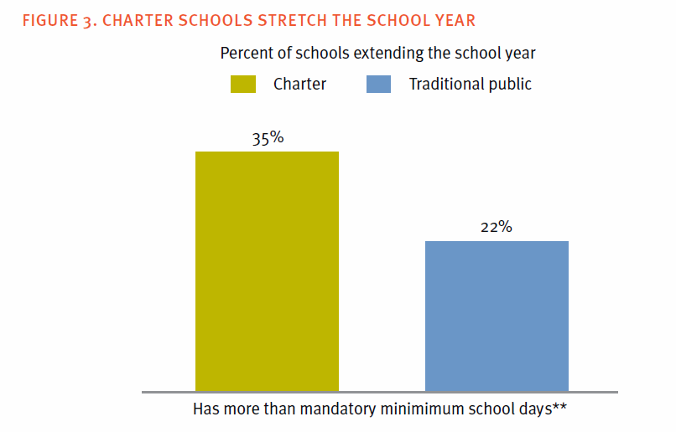
Notes:
The last piece I’d like to highlight is using the headings of charts to reinforce the message. Normally, our chart titles are descriptions of what comparison will be made in the chart. Not very meaningful. But here, the authors have used a title that actually contains the finding from the chart data. How great! Instead of leaving it up to me to decode the data, they provide the interpretation for me right in the title. This is a great way of reinforcing the message from the data.
[Example from: Gross, B., & Pochop, K. M. (2008). “How charter schools organize for instruction.” Available from http://www.crpe.org/sites/default/files/pub_hfr08_ch2_dec08_0.pdf]

Slide 22
Intentional structure reinforces interpretation,
and produces meaning.
Notes:
So the big message here is that, with just some simple reorganization of how you combine the question, answer, and evidence, and how you use answers in headings of sections and charts – you can fundamentally change how well your message is getting across to your audience.

Slide 23
1
2
Visual presentation matters for the written word.
Notes:
It’s tempting to think that it shouldn’t matter how studies look on the page. That the content alone should make us want to read the report and to engage with the content. But let’s be honest. As human beings we are engaged by good visual presentation. Good visualization helps to create meaning and to draw the audience’s attention to important findings and conclusions.
I just want to show you two examples of formatting a written deliverable to help it deliver a bigger punch.

Slide 24
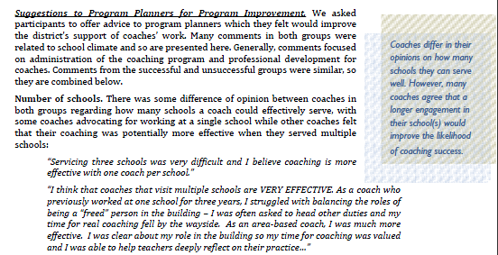
Notes:
Here is an example from a report of another formatting option. You can see that this is a very text heavy report, but that on the edge of some pages there is a pull out box that highlights a critical piece of information. This helps it really jump out and be reinforced – this technique is relatively common for pulling out a key message, or for adding a quote to help add the respondent’s voice. This is very easily done within Microsoft Word.

Slide 25
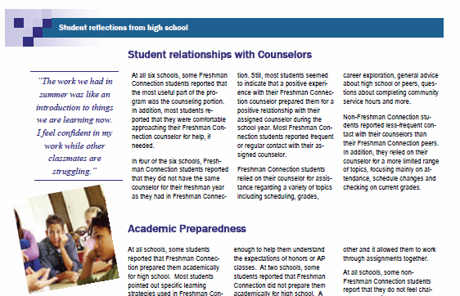
Notes:
Here’s an example of a written deliverable which has been formatted to look less like a regular report, and more like a newspaper or handout format. This was designed to appeal to a non-technical audience – teachers – and the sections which were highlighted were those which we felt would be of most use to teachers. You’ll notice that in addition to breaking up the text across columns, we added pictures and a key quote pulled out on the side to highlight a major finding. It’s important to consider who your audience is when you’re crafting a written deliverable – certain types of visual styles will appeal to and/or be more appropriate to certain types of audiences.

Slide 26
“Words are sacred. They deserve respect.
If you get the right ones in the right order, you can nudge the world a little.”
-Sir Tom Stoppard, playwright

Slide 27
Presentations
The issue
Start
2
End
1
3
Reports

Slide 28
“Death-by-PowerPoint” gets 3,690,000 hits on Google.
Notes:
We’ve all sat through bad presentations. Presentations that are so bad that you count the minutes until it’s over. Presentations that are just so-so, where you walk out not really feeling like you’ve learned anything.

Slide 29
How do we fix this?
Notes:
Clearly, something has gone horribly wrong. How do we fix this? Let’s start by examining some of the things that can go wrong, then we can talk about how to do them right!

Slide 30
1
2
Structure and Storytelling
Notes:
The structure, the arc of the story, is critical in presentations the same way it is in reports. But with presentations you have a bit more opportunity for ‘storytelling’. Nancy Duarte says that “structure is greater than the sum of its parts”. This means that even if ever individual slide is fabulous and informative, your reporting will fall flat without a great structure, the thread of the story that keeps it all together.
There is an art to storytelling. It’s an ancient technique – this is how people remembered and pass down their stories. We don’t have the time today to really delve into the nuances of how to tell a great story – but I would encourage you to read Nancy Duarte’s book “Resonate” for an wonderful exploration of storytelling and great ideas about how to apply it to your presentations.

Slide 31
Tell a
compelling
story.
Notes:
There’s a reason that you can remember the plot of “Back to the Future” but not what you did yesterday. That story engaged you, captured your interest!
Telling a story in the context of evaluation is not the same as making things up. It’s the idea of structuring your presentation so that the facts, the anecdotes, and the conclusions hang together in a meaningful way. Stories have ups and downs – they consider the past and they envision the future. They carry you along through contrasts and changes to cadence – keeping you engaged in what’s coming next.
Presentations offer an array of possible structures which would serve as the basis of good communication. The point is not to use a particular structure, the point is to choose a structure that helps you imbue meaning and engage your audience.
Presentations don’t have to be boring – they can be wonderful stories that help people understand evaluation findings and inspire them to take action.
And remember, the idea is not to add a few stories to your presentation – the idea is to create a presentation that is a story!

Slide 32
Introduction
Methods
Findings
Conclusions
Notes:
That said, I would again suggest not choosing a traditional structure.
The vast majority of presentations we see look like this – again, influenced our academic traditions. This tells one type of story, but it creates those disconnects between the data and what it means. As with reports, you can lead with questions and answers – and layer facts and stories as you present the evidence.

Slide 33
Opening
Conclusion #1 Findings
Stories
Conclusion #2 Findings
Stories
Conclusion #3 Findings
Stories
Call to Action
Notes:
Lead with the conclusion, then back it up with the evidence and some meaningful anecdotes or qualitative data to make it really punchy and memorable. This type of structure also creates a nice cadence as you move from conclusions to interpretation and back. The rhythm helps keep the audience engaged.
We’ll talk about the call to action in just a minute.

Slide 34
The Process
Generating ideas
Determining key message
Ruthless editing
Creating slides
Notes:
So I’ve said many times that structure is the backbone of your presentation – it’s the path that takes your audience to where you want them to go. But creating a good structure isn’t as easy as it sounds. I wanted to take a moment to highlight the four steps you should go through when you’re crafting a structure. And remember – this doesn’t happen in an hour. It does take some time.
The steps:
Generate ideas – think of everything you want your audience to know.
Determine the key message – what is the one thing that you want to communicate in your presentation? For me, this was the concept of using intentional design to enhance communication. This is the message you want people to walk away with, and it’s the driver of what you’ll end up including.
Ruthless editing. You created all those great ideas, now you need to toss most of them out. Remove those pieces that don’t directly support your key message. Edit the heck out of it. I know, it’s traumatic. Have you ever heard someone say – that presentation would have been better if only it were longer? Probably not. Audiences don’t want more info, they want more clarity! Quality depends as much on what you leave out, as what you put in.
Creating slides. You’ll notice this is the absolute last thing you do. Before you go near your slide software, you need to have the structure figured out and all the elements defined. If you use your software from the beginning, you risk creating fragmented pieces of information, rather than a coherent story. So save it for last.

Slide 35
Key Message
Question #1:
Conclusion:
Evidence:
Question #2:
Conclusion:
Evidence:
Question #2:
Conclusion:
Evidence:
Call to Action
Notes:
I really like this tool I came across recently. Once you’ve generated all your ideas, figure out what your key message is. Then figure out the major questions you’re going to answer. Structure your presentation this way – which is essentially the same way we talked about structuring reports earlier – and it will be so much easier.
This is based on a tool by Olivia Mitchell, http://www.speakingaboutpresenting.com/

Slide 36
Key Message
Assertion #1:
Evidence:
Assertion #2:
Evidence:
Assertion #2:
Evidence:
Call to Action
Notes:
If you’re doing a presentation on a topic where it makes sense to leave out the questions, you can use assertions/conclusions as the basis.
This is based on a tool by Olivia Mitchell, http://www.speakingaboutpresenting.com/

Slide 37
End with a
Call to Action.
Notes:
I want to briefly mention the end of a presentation – since presenters have a tendency to say ‘thanks for coming’ or something equally uninspiring. End with a call to action.
[The concept of ‘call to action’ comes from Nancy Duarte’s book “Resonate”]
What is a call to action? It’s the chance for you to call on your audience to take some kind of action based on what they heard today. There are lots of things you might want them to do:
Read the report and think about how this impacts their role
Consider which of their beliefs have been challenged today
Decide on a change they will make to the program based on what they heard – and then make that change
Take what they’ve learned today and discuss the findings with their leadership team
Use the results as part of their strategic planning
Presumably, you want your audience to actually do something with your findings. After all, evaluation findings aren’t much good unless they’re used. So end by telling the audience what action you want them to take - don’t make them guess, prime them for action!

Slide 38
1
2
Visual design matters.

Slide 39
We are visual communicators
Notes:
Let’s be honest. We’re all human beings. We respond to things that we find interesting visually, where the design of the product helps clarify the information, and which inspire us. So as presenters, we have the opportunity to use visual design in a way that will really engage our audience and produce meaning.

Slide 40
Design =
Decoration
Clarity
Notes:
Visual design doesn’t mean prettification. This is not decoration, it’s communication. The purpose of visualization is to help our audience to create meaning – visualization adds insight, not pictures.
By paying attention to some basic principles of design, we can vastly improve the visual way that we support people in understanding our information. PPT and Keynote have led to bad habits in this area. They keep including more and more bells and whistles which let you do crazier things. But just because you can do it, doesn’t mean you should.

Slide 41
Intentional design of text and visuals enhances meaning
Notes:
Sounds good – but what does design that enhances clarity look like?

Slide 42
Meaningful Slides
One idea per slide
Simplicity
Minimize text
Use photos
Notes:
There are four major topics around visuals that I want to talk about today. There are of course many more, and lots of things we can’t cover in our limited time today, but keeping these four principles in mind will get you a long way towards improved communication.

Slide 43
1
2
3
4
One idea per slide
Notes:
People are afraid of using slides. I don’t know why. Maybe it’s because at some point we all heard those silly rules about “one to two minutes per slide”. Forget that. The right number of slides for your presentation is somewhere between 0 and 1000. Your purpose should determine the number of slides.
But when you do make a slide, in general there should only be one idea on it. Don’t crowd a bunch of ideas on a single slide in order to minimize the number of slides in your presentation. There’s no purpose to that, and it just serves to obscure your message. I’m not saying there can’t be more than one thing on a slide – more than one sentence for example – but don’t crowd in multiple ideas. Remember…

Slide 44
Slides

Slide 45
are

Slide 46
free!
Notes:
So use as many as you need.

Slide 47
1
2
3
4
Simplicity
enhances clarity
Notes:
Einstein knew that it was a good idea to “Make everything as simple as possible but no simpler”. But let me clarify – the goal here is not to ignore complexity, but to distill it so that the audience is able to understand the message. This takes time. It’s actually harder to write something that’s short and meaningful than long and meaningful. It is possible to be too simple. You have to think about what’s appropriate for the time, place, and audience.

Slide 48
Notes:
The Japanese concept of Zen is a great metaphor for the type of simplicity we’re striving for with our slides.
We seek visual elegance, and achieve this through elimination of clutter.
There is a lot of planning and attention to detail, but when it all comes together it seems natural.
There is plenty of empty space, and a lack of complication.
Effects like color and texture are used as intentional elements to enhance the message – not as decoration.
This is the original concept of “less is more”.

Slide 49
Background sets the stage
Notes:
One key element of slide visuals is the background. This sets the stage of all the other elements you’ll add. So keep it simple.

Slide 50
Notes:
White is nice.

Slide 51
Notes:
So is black.

Slide 52
Notes:
This type of background is simply distracting. Try to avoid branding which competes with your message. If your organization insists on branding, negotiate with them for branding which is unobtrusive and will not interfere with the simplicity of your slide. When you’re working with multiple partners, you can put their logos on the first and last slide – leave them off the rest.

Slide 53
Color interests us.
It draws our eye.
Notes:
The use of color should be in the service of helping emphasize your message. Again, this isn’t about making things pretty. My advice is to pick three colors. Two of these provide the basis of all your text, and one provides additional emphasis. One color should really pop out from the others (like red or orange or blue).
The reason for keeping it simple is that the goal of using color is to accomplish two things: unity and emphasis. You want your audience to have a sense that the pieces of your presentation go together – they don’t necessarily all have to look identical, but they have to coordinate with each other – the same way that you do with clothes. When you want to emphasize something you use your ‘pop’ color and it really jumps out and grabs their attention.

Slide 54
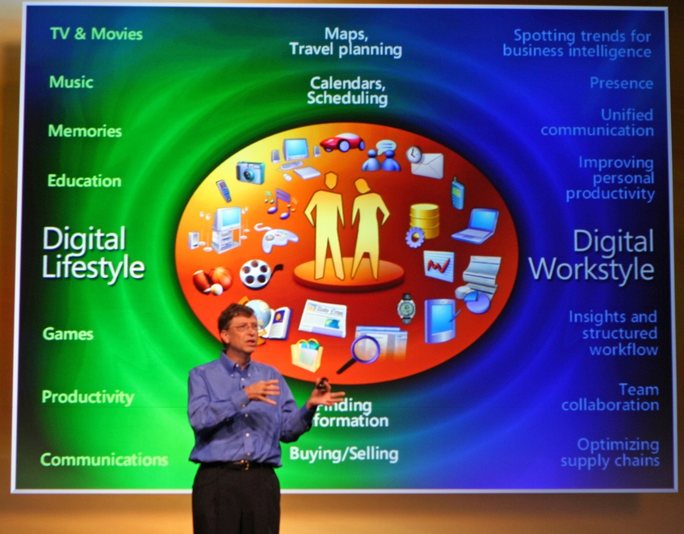
Notes:
This is waaaaay too much color. There’s so much going on that I don’t know where to look. The color here doesn’t serve to enhance the message, it just creates a lot of visual confusion.
From flikr by niallkennedy
http://www.flickr.com/photos/niallkennedy/58614088/sizes/l/in/set-1269791/

Slide 55
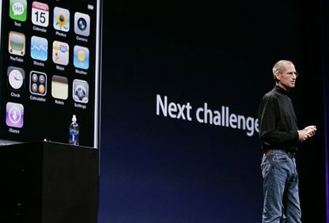
Notes:
Steve Jobs was noted for his presentation style. He knew to keep things simple, including color.

Slide 56
Example #1
Notes:
I want to show you a few examples from powerpoint presentations about how they used color to create unity and emphasis. Don’t worry about the content of the slides – focus on the visuals.

Slide 57
Notes:
In these slides, you can see a light background with a simple color scheme – dark grey and orange.

Slide 58
Notes:
This color scheme creates unity by carrying over onto the next slide, even though this slide has a very different look and format. And here, the orange is used to highlight the key message of this slide.

Slide 59
Example #2

Slide 60
Notes:
This presentation had a similarly simple color scheme, but it’s using three colors – grey, black, and red. Red is used to provide emphasis in the text, while the black creates a bit of emphasis to make the major message bolder.
From a presentation by Garr Reynolds, http://www.slideshare.net/garr/career-advice-08

Slide 61
Notes:
This is from the same presentation, and you can see that the same color scheme helps create unity across the slides, even though the black had been switched to the background while the white has been used for the text.
It’s also worth noting that this kind of reversal of the color scheme can help flag for the audience some kind of shift in the presentation – in this case, it was denoting the end of a section and the beginning of discussion around that section.
From a presentation by Garr Reynolds, http://www.slideshare.net/garr/career-advice-08

Slide 62
Minimize text.
You can say it in less words.
Notes:
Let’s now consider the role of text on our slides. Text is, quite frankly, one of the greatest downfalls of presentations. For some reason, we have come to believe that slides are better if they include as much information as possible. It’s important to remember that slides are not the presentation – they are visual aides to assist you as you give the presentation.
So don’t put a lot of words on them. Your audience can read faster than you can talk. Eliminating words helps keep the focus on what you’re saying and clarifies your message. Your audience will remember your message better because they aren’t trying to process both auditory and visual information at the same time.

Slide 63
Notes:
One of the greatest evils that powerpoint brought to us is that the basic format encourages presenters to write in a certain way, and to add a whole heck of a lot of text to their slides. I’m pretty sure you don’t need a title on every slide so that people know what you’re talking about. And I know that you don’t need 11 lines of text which decrease in size to the point that no one at the back of the room can possibly see them.

Slide 64
Don’t
make a slideument.
Notes:
The key point to remember here is that a presentation is not the same as projecting a document. If someone can read your slides and understand things without you giving the presentation, that was a report. And they don’t need you, and they don’t need a presentation. The opportunity of a presentation is to draw on that human connection.
Don’t project a document. Give a presentation! Slides are your visual aides to help the audience remember your points. They are there to complement, not supplant.

Slide 65
Workshop Results
Session date | Number of responses | Number of possible participants | Estimated Response Rate
8/9/06-8/11/06 | 55 | 81 | 68%
9/28/06 | 50 | 112 | 45%
10/23/06 | 37 | 112 | 33%
11/9/06 | 51 | 116 | 44%
12/13/06 | 35 | 115 | 30%
Leadership
The leadership strand has consistently received among the highest ratings from participants, both in terms of the quality of the presentation, the engagingness of the sessions, and the usefulness of the PD.
Except for the first day, participants have not really provided any comments on the leadership strand, so the data does not provide specific examples of what they find useful or interesting.
Literacy
The literacy strand received fairly low ratings to begin with compared to the math and leadership stands.
Early ratings indicated that participants did not feel that they were increasing their content or pedagogical knowledge around literacy, and seemed unsure about how they would apply concepts from the classes to their work supporting schools.
Some participants commented that the literacy sessions did not provide new information, that the content was too basic given the literacy backgrounds of the participants, or that the sessions should include a variety of learning strategies (i.e., rather than just whole group presentation).
By the third session literacy ratings were beginning to improve slightly, particularly around participants feeling that they could apply what they were learning to their schools. Two participants commented in the fourth session that the day’s session was “excellent”, engaging, and gave them ideas to implement in their schools.
Math
Math sessions have received fairly good ratings from participants.
Ratings indicate that participants generally find the sessions to be engaging, and feel that the knowledge they gain from the workshops is directly applicable to their work with schools.
Comments indicated that a few participants felt that the math sessions were mainly relevant to math coaches and facilitators, but not to other individuals.
Ratings of the math sessions have remained fairly consistent across sessions.
Notes:
This is an example of a slide that’s really a ‘slideument’ from my early days. Now, I would never subject my audience to this kind of slide. I mean seriously, as an audience member you’re going to have no idea what’s going on here.

Slide 66
Use big fonts.
Make a handout.
Notes:
The templates available in powerpoint try to force you to use that horrible hierarchical list. So just start with a blank slide. Use enormous fonts – nothing less than 40 points (and preferably larger). This will help you keep your number of words low.
Don’t use a lot of words. Put up the few key words that will help people grasp your message and then talk about the rest. If you want people to be able to have a copy of your presentation with everything you said then create a handout. Or write in the notes section of the slide and send them the presentation. Don’t put the words on your slide!

Slide 67
Abandon bullets.
Seriously.
Notes:
Here’s a slide which sums up my message, but in a lot less words. See how much better life is without bullet points?

Slide 68
Simplicity of text creates clarity of message.
Notes:
I wanted to provide an example of two slides with very simple text, but a big impact.

Slide 69
Notes:
Here’s a slide that provides a great example. I don’t need lots of words on this slide – instead, I could just talk about it. The words that are on there are punchy, interesting. It evokes emotion. This makes clear how many people are affected, and what the issue is. It draws you in with only 13 words.
From: Charitywater.org

Slide 70
Notes:
And the message becomes so clear in only three words.
www.charitywater.org

Slide 71
Use photos
pictures > words
Notes:
Adding visuals to your slide can help make your message more memorable. You don’t have to use visuals – but if you do, it’s important to identify visuals that will help your message be impactful. To this end, use photos, not clip art. Photos resonate with people – clip art is passé and uninteresting.
The idea with using images is to help visualize your ideas for your audience. Again, it’s not for decoration. Feel free to be creative, but choose an image that is related or representative of your idea. Images don’t have to be exact replications of your idea – e.g., happy doesn’t have to be a picture of people smiling or jumping up and down.
Here are a few examples of images which really engage the audience.

Slide 72
Notes:
This image is jarring because it’s unexpected – filthy water in a baby bottle. But it certainly drives home the point.
From the press kit for charitywater.org

Slide 73
Notes:
This image is happy and inspiring, and I love it because the words are so connected to the key actor here. Remember to keep people inspired and upbeat – don’t just use negative emotions in your presentation, people don’t like to be sad all the time. Contrasting positive/negative emotions keeps your presentation interesting.
http://www.dearworld.me/galleries/message_in_category/popular/8_3/CJ-Black

Slide 74
Slide by Garr Reynolds
Notes:
This is a nice example of an image that helps really drive home the point of the numbers. The statistics which are being presented are much more impactful with this image than they would be alone.
From Garr Reynolds from deck http://www.slideshare.net/garr/sample-slides-by-garr-reynolds

Slide 75
Notes:
Your images can be fun. Use your camera to capture your own images if it’s helpful.
From Dan Roam, based on his book “Back of the Napkin”. http://www.slideshare.net/danroam/healthcare-napkins-all

Slide 76
You Matter!
Notes:
In most cases, your slides should make no sense without you. If people can read your slides and know the whole story, then they don’t need you. Your job is to engage the audience. Think about the value you can bring in a face-to-face situation. Let your personality shine. Don’t be afraid to show people that you’re excited or passionate about what you’re sharing. This will help them value it as well.

Slide 77
“Presentations have the power to change the world.”
-Nancy Duarte, “Resonate”
Notes:
I really believe this. And if you’re not so sure, let’s take a moment to think about some great presentations. Martin Luther King Jr’s “I have a dream” speech still resonates today, Abraham Lincoln and the Gettysburg address (in case you didn’t know, that was 278 words long and took 2 minutes).
This is what could be. This is the power of the presentation.

Slide 78
Presentations
The issue
Start
2
End
1
3
4
Making it happen
Reports
Notes:
So, we’ve talked in some detail about reports and presentations, about the idea that intentional design of our text and our visuals can help clarify our message and make it resonate with the audience. I wanted to finish off by touching on a few big picture ideas related to good communication.

Slide 79
You must “unlearn”
what you
have
learned.
-Master Yoda
Notes:
This is probably the hardest part. Stripping away what we ‘know‘ about reporting. Questioning all those things we take for granted – like the standard academic format. That presentations need to be stuffy and boring in order to be persuasive – or appropriate. That the more we say, the more the audience will understand.
Forget what you’ve been taught. Instead, consider what makes sense for your audience. Consider what will make your message strong, interesting, and unforgettable. Think about how to engage your audience and inspire them to action. Simplify and clarify.

Slide 80
Use what you already have to its potential.
Notes:
Good visual design doesn’t require fancy software. And it doesn’t require experts in programming or graphic design. It might require you learn some new skills though, so become friends with your software. You’ll be together for a long time.

Slide 81
We can’t afford a graphic designer.
I’m not creative.
Notes:
Once you’ve adopted the mindset of being intentional, there are simple techniques you can use to help enhance your visuals. You don’t need experts or a degree in graphic design. It’s an iterative process. Learn something, try something, tweak it for next time. Don’t try to do it all at once! Take baby steps.
Mimic the greats. When I was visiting Europe I went on a tour of one of Picasso’s houses. What amazed me about his early art was that it was all copies of other masters. As he learned to be an artist, he had copied the greats to learn the techniques prior to developing his own style. You can do this too – it’s not cheating! See how others have done it. Find a style that you like and mimic it. On the handout and in the notes for these slides you’ll find lots of links back to the original presenters.

Slide 82
It takes too much time to do all this.
I’m busy.
Notes:
It does take more time to create good communication. But I think that’s a crucial part of our job as evaluators. If we really want to make a difference, if we want our evaluations to be used, then we have to take a bit of extra time to craft good communication. And it’s not all about you either. Your audience is, as Henry M. Boettinger put it – giving you “an irretrievable slice” of their lives to read your report, or attend your presentation. The real issue is whether you’re wasting your audience’s time – have you taken the time needed to make sure that you’ve crated a really meaningful message, that you’ve interpreted the findings for your audience. Does it take time – yes. But the return on investment is worth it – good communication is what will get our evaluations used.

Slide 83
Just ask yourself: How badly do I want my idea
to live?
-Nancy Duarte
Notes:
Change is hard. But when it comes right down to it, communication is how we get our evaluations used. So I’d encourage you to take the time to create intentional communication – whether it’s reports or presentations. Because in the end, we do want our evaluations to live. Good communication is how we make our evaluations matter.

Slide 84
Tomorrow,
take one step.
Notes:
There is so many ways to craft good communication. So when you go back to the work of evaluation, take just one thing that resonated with you today, and change that. Don’t do it all at once. Start small, and it will seem easy.

Slide 85
Presentations
The issue
Q&A
Start
2
End
1
3
4
5
Making it happen
Reports

Slide 86
Kelci M. Price
kprice@ColoradoHealth.org
303.953.7920

