Slide 1
Incorporating Perspectives of Consumers and Frontline Staff:
Understanding the Integration of Physical Health Care Services in Behavioral Health Agencies
Presentation at the American Evaluation Association Conference
Denver, Colorado
October 16, 2014
Angela Gerolamo • Jonathan Brown • Jung Kim
Notes:
Good afternoon. I’m Angela Gerolamo from Mathematica Policy Research and I will be discussing the importance of collecting information from consumers and frontline staff during the development and implementation of physical and behavioral health integration programs.

Slide 2
Presentation Road Map
Discuss the use of qualitative methods to obtain feedback from consumers and frontline staff
Demonstrate the value of having multiple perspectives during program implementation
Describe the advantages of providing formative feedback to program leadership during program implementation
Notes:
Over the next 15 minutes, I will….[read bullets]

Slide 3
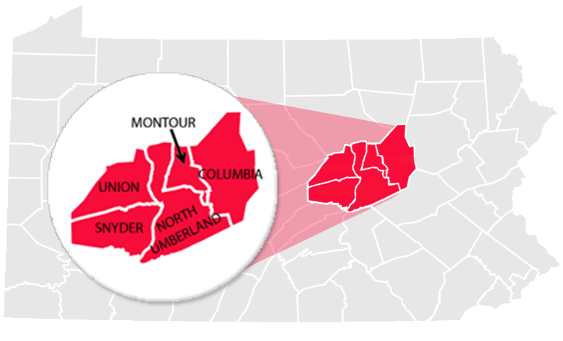
Program Description
Partnership between behavioral health managed care organization and two behavioral health agencies in rural Pennsylvania
Funded a nursing position in each agency
Provided wellness coaching training for nurses and agency staff (case managers and peer specialists)
Implemented a web portal for tracking consumer outcomes
Notes:
The subject of this evaluation is a program that sought to integrate physical health services in two behavioral health agencies in rural PA. Specifically, a BH managed care organization funded and hired a registered nurse to work in each agency and provided all frontline staff (nurses, case managers and peer specialists) with training in Wellness Coaching. Wellness coaching is a recovery-based approach to empowering consumers to take responsibility for their health. Define case managers and peer specialists.
The BH managed care organization implemented a web-based portal that allowed consumers with mental illness to complete health screening tools and track their sleep, weight/body mass index, and tobacco use.
Agencies had not historically hired registered nurses so this was a new endeavor for them.
This pilot program represents a first step towards integration and was not intended to be a fully integrated program.

Slide 4
Methods and Data Sources
Formative program evaluation using qualitative data collection methods
Two rounds of in-person and telephone semi-structured interviews
June 2012 - July 2012: 32 respondents
January 2013 - March 2013: 38 respondents
Focus groups with consumers during each round of data collection
Notes:
Mathematica was contracted by the Assistant Secretary for Planning and Evaluation to conduct an evaluation of the program. The purpose of the evaluation was to provide formative feedback and identify successes and challenges to implementation that could guide others interested in similar initiatives. We conducted two rounds of semi-structured interviews with program developers, agency leaders, frontline staff (nurses, case managers, psychiatrists). Our first round of data collection occurred a few months after the launch of the program, namely, after the staff received training in wellness coaching.

Slide 5
Gather Multiple Perspectives
The implementation picture is not complete without the perspectives of consumers and frontline staff.
Consumers and staff
Notes:
We found that interviews with frontline staff and focus groups with consumers provided valuable information that ultimately shaped program implementation.
Specifically, focus groups with consumers identified that there was discomfort among some consumers in discussing physical health concerns with behavioral health providers and disinterest in using the web-based tool to track health outcomes (for example, sleeping patterns and smoking). These findings signaled to program leadership that consumers needed support and assistance with using the web-portal.
Staff interviews revealed role confusion among staff and discomfort among case managers and peer specialists in identifying and addressing physical health concerns due to their lack of formal training. As a result, in collaboration with the managed care organization, agency leadership clarified staff roles and responsibilities and offered additional training for case managers and peer specialists.

Slide 6
Many Consumers Prefer Paper and Pencil
Consumers with serious mental illness were disinterested in using a computer to monitor health outcomes and faced barriers when using the web portal.
Notes:
About one year after the portal was implemented, fewer than 50 consumers had completed one of the assessment tools and even fewer completed one of the trackers. Some consumers participating in the focus groups verbalized disinterest in using a computer, whereas others reported using the portal but having difficulty remembering their password. Our discussions with staff and consumers showed that many of them were more accustomed to and comfortable with using paper for tracking health information. Further, staff noted that computer and Internet accessibility was a challenge for some consumers, particularly in rural areas.
Program leadership decided to allow consumers to track outcomes using paper and pencil and planned to implement this method in 11 additional behavioral health agencies funded through a PCORI grant. Program leadership also developed a training module on the web portal for staff.

Slide 7
Physical Health Case Managers
Some consumers and case managers were not comfortable with the new role of behavioral case managers in addressing consumers’ physical health concerns.
Notes:
A key goal of this program was to have case managers function as wellness coaches for consumers with mental illness. In this role, case managers would identify physical health goals in collaboration with consumers.
A few consumers noted that they were not comfortable sharing physical health information with their case managers. They cited not wanting to share physical health information because it is personal or because they did not want to burden their case managers with such information. Case managers confirmed this impression, noting that some consumers questioned why they would work on a physical health goal with their case manager because they didn’t view this responsibility as their case manager’s role.
These findings suggested that even consumers need education about the new role of the case manager as discussing physical health problems was not something they were accustomed to or felt comfortable doing. This also points to the fact that consumers’ perspectives should be obtained not only during program development, but also during implementation.
Integrated care is a major paradigm shift for both staff and consumers and this shift will likely take time to be fully embraced.

Slide 8
Agency Steps Towards Culture Change
Trained staffs in wellness coaching
Increased awareness and knowledge of physical health and wellness among staff and consumers
Developed care planning processes that incorporated physical and behavioral health goals

Slide 9
The Value of Timely Formative Feedback
Program leaders developed more specific referral criteria and job descriptions in response to staff members’ desire for more formal procedures and clarity on roles.
Notes:
Timely formative feedback enabled program leaders to refine the program and identify solutions to early implementation challenges.
Our interviews with case managers found that they were uncomfortable identifying consumers with physical health needs because they had very little formal training about physical health conditions. These staff members desired more formal procedures and tools to help them function as wellness coaches. In response to this information, the BH managed care organization and agency leaders developed specific criteria that could be used by case managers and peer specialists to distinguish between consumers who would benefit from working on physical health problems with them and those consumers who should be referred to the nurse.
Again, these BH agencies had not previously had nurses working in the agency. At the outset of the program, case managers did not realize that the goal of the program was for them to function as wellness coaches. The nurses also struggled with defining their roles since they were new to the agency. As a result, there was a lot of role confusion among staff. To address this, the BH organization and agency staff developed written job descriptions for both the nurses and case managers to provide clarity on responsibilities and expectations. Also, a high-risk care manager from the BH managed care organization initiated meetings with nurses on a weekly basis to assist with role clarification and serve as a resource for information.
These important perspectives of staff and consumers allowed for mid-course corrections that moved the program closer to its goals.

Slide 10
Why Integrate Physical Health and Behavioral Health Care?
The mind and body are inextricably connected.
Notes:
Why is integrated care significant and why is it important to understand implementation?
We know that individuals with serious mental illnesses (SMI) have a shorter lifespan that they general population. They have high rates of chronic physical health conditions, including metabolic disorders and cardiovascular disease (De Hert et al. 2011; Newcomer 2007; Newcomer and Hennekens 2007; McEvoy et al. 2005).
Also, individuals with SMI and comorbid diabetes or cardiovascular disease receive suboptimal care (Mitchell et al. 2012; Clark et al. 2009; Nasrallah et al. 2006; Frayne et al. 2005; Desai et al. 2003).
There is a critical need to treat the mind and the body together. It is the right way to provide care.

Slide 11
Opportunities for Physical Health and Behavioral Health Care Integration
The Affordable Care Act and several other federal initiatives promote and financially support the integration of physical health care services within behavioral health care settings.
Notes:
Physical and behavioral health care services have historically been financed and delivered separately. The Affordable Care Act and several other federal initiatives promote and financially support the integration of physical health care services within behavioral health care settings. As Medicaid expansions and other health care reforms are expected to increase coverage for people with mental health problems, many of whom will require care for comorbid physical and mental health conditions—there is a need to understand how integration programs are implemented, particularly in rural and underserved communities where behavioral health providers will likely face increased pressure to address both physical and mental health needs. While some of these efforts have demonstrated promising outcomes, few evaluations have thoroughly examined the implementation of these efforts to inform their replication. There is a critical need to understand these efforts from multiple levels of the system – including health plan administrators, agency leadership, front-line staff, and consumers. There is particular value in gathering information directly from nurses, care managers, and other providers implementing these efforts as well as consumers who receive care.

Slide 12
Input from End Users Should Guide Integration Efforts
A comprehensive evaluation of an integrated physical and behavioral health care program should gather the perspectives of consumers and frontline staff.
Notes:
A comprehensive evaluation of an integrated care program should gather the perspective of consumers and frontline staff. That is, those who are receiving the services and those who are delivering them. This information can be used to refine the program and ensure that it is implemented as it was intended. Perspectives of consumers and frontline staff are a critical piece of the puzzle when it comes to understanding implementation of an integrated care program.

Slide 13
For More Information
Angela Gerolamo
AGerolamo@mathematica-mpr.com
(609) 945-3345
Jonathan Brown
JBrown@mathematica-mpr.com
(609) 264-3446

