Slide 1
Follow Me, Friend Me, Tweet Me:
A Demonstration of Social Media’s Evaluation Power
Robin Kipke, Tobacco Control Evaluation Center
Amelia Silbert-Geiger, California Youth Advocacy Network
Notes:
Welcome to this session on ways to evaluate use of social media. I’m Robin Kipke
Intro self & what here to talk about here today

Slide 2
Tobacco Control Evaluation Center
We are the statewide technical assistance center for evaluation
We provide consultation, training, resource materials, and research on evaluation
http://programeval.ucdavis.edu
www.facebook.com/TCEC.pg
rakipke@ucdavis.edu
530.752.9951
Notes:
I am an evaluation associate at the TCEC at UC Davis. We provide evaluation assistance to all of the projects working on tobacco control in CA. We conduct trainings, produce resource materials and publications, as well as carry out evaluation research.

Slide 3
California Youth Advocacy Network
Statewide technical assistance center for social media and mobilizing youth, young adult, and military service members
Provides training, technical assistance and resource materials
www.cyanonline.org
www.facebook.com/CYANfan
amelia@cyanonline.org
916-339-3424 x23
Notes:
We’re partnering with the CA Youth Advocacy Network to develop a how-to guide on Social Media –what it can do for orgs engaged in advocacy, how to use it, ways to evaluate its use. And in this session we hope to share some of what we learned and perhaps talk over some the struggles we are still grappling with.
Before we begin talking about how to evaluate SM, want to give a little background context about our audience for this manual, as that impacts how we think about the evaluation.
Talk about how Amelia and I are from two diff orgs w diff focuses, and 2 diff generations—one that embraces SM and one that needs to be convinced of its utility. She brings SM expertise, I bring evaluation.
We’re sorry that she could not be here today.

Slide 4
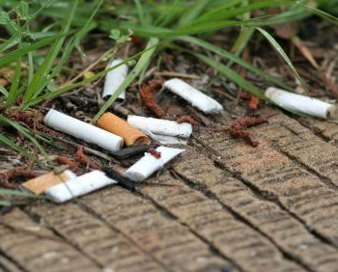
Tobacco Control in California
Notes:
We serve approximately 100 county health departments and community-based organizations working on tobacco control issues throughout CA. Funded by the state’s Dept. of Public Health, the projects attempt to change community norms in order to get policies passed which reduce the reach and health impacts of the tobacco industry – policies for example that restrict smoking in apartment complexes, or shared public spaces, or require a license to sell tobacco products.

Slide 5
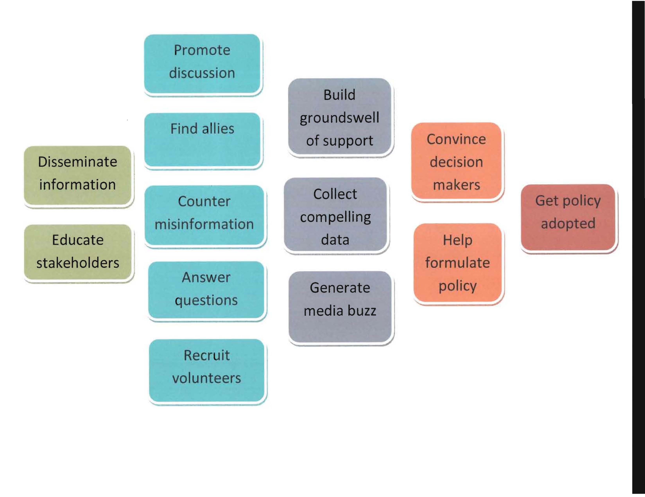
The Path to Policy
Notes:
This norm change process requires each project to build allies within the community, educate stakeholders and the public, build a groundswell of support, collect compelling data to convince decisionmakers, and then work with them to draft policy language for adoption.
So projects need to be good communicators and have effective avenues for reaching and listening to the public. Sounds like a job for social media, doesn’t it? That’s what we’ve been thinking.

Slide 6
Notes:
In order to talk about how advocacy orgs can assess their social media campaigns, we’re going to take a look at one of the projects we serve -- the tobacco project of the Shasta County Health Dept. Like many of our client orgs, they are sort of new to the world of SM. (in fact about half of our projects are not using SM yet) and most of those that are don’t feel like they know enough to get the full benefit of it yet

Slide 7
Shasta’s Social Media Goals
More efficient communication with coalition
Maintain continual dialogue
Increase coalition engagement
Recruit more diverse partners & members
Educate the public about tobacco control issues
Build support for policy efforts
Notes:
Initially the project launched both a Twitter and FB account as a way to more efficiently communicate with the members of its tobacco education coalition, get them more actively engaged. Quickly found 2 things. 1 Twitter was too confusing so dropped it. 2. Although members wouldn’t engage in conversation on FB, they really liked all the info the project was posting on the issues so they could stay informed. SO the project decided to make their FB pg open to the community = info hub. Problem was, did not have a clearly defined media plan, or measurable obj. As a result they aren’t sure how they could improve its utility or how they should be evaluating their campaign. Which makes it a lot harder to know what measures to look at.

Slide 8
Shasta County Facebook Campaign
Notes:
They do use the built-in metrics of FB Insights to get a sense of what is happening as a result of their online presence. But aren’t really sure what to do with the info. So here’s a screenshot of the overview page. What we see is that the page has 75 people who are fans and with all of there friends, potentially 19,148 people could see Shasta’s posts. However, when we look at the trends, the weekly total reach declined over time and the weekly number of people talking about the page or its posts is consistently low. One reason is probably because there was only 1 post in the last 30 days and no one actually looked at it. Even so, the # of likes increased in this timeframe, so that tells us that people are liking this page not for its content, but because of who the project is. So this data should prompt some different strategies right off the bat to make Shasta’s SM presence worthwhile. First try posting with more frequency so that followers start paying attention to when you post. May also need to look at why no one read last post. Go back to it and see what it was about and try to understand why no one opened it. See what day and time it was posted, the topic, if a link or a photo, etc.
[reach=# people who saw post; engaged users=unique people who clicked on post; Talking about=# unique people who liked, commented or shared post, answered ? Or responded to event; virality=# people who created a story from your post as % of # who’ve seen it

Slide 9
Shasta County Facebook Campaign
Notes:
In order to know how they might want to tailor their messaging, they need to know who a little about their fans. This page can tell them the age groups, gender and language of who follow their page. And for this coalition what may also be useful is to know where people live (actually=where their internet access is). So for example if you want to recruit college age volunteers from Redding, you could word your posts that would be most meaningful to those followers.

Slide 10
Shasta County Facebook Campaign
Notes:
This page shows how many people are liking your page each day. So you could go back to your posts and see what content people were moved to like – this can give you some indication that you might want to include more posts of a similar topic. Look too at The Like Sources – where are they coming from? A good strategy is to learn what you have in common with people who may share your interests. Here we see that 2 people were liking something on your page or your news feed and 1 liked your page as a recommended pages\ source.

Slide 11
Shasta County Facebook Campaign
Notes:
This page is useful because it shows you how many unique people were reached by Shasta’s posts. Here there is no difference between those who saw content about the page in their newsfeed, ticker or on your page and those who saw it as a post from a friend. So that means that no one reposted. What is interesting is the frequency data. It shows that in the last 7 days, about 16 people saw content about the page 1-2 times a day. Your goal is to reach unique people as often as possible.

Slide 12
Shasta County Facebook Campaign
Notes:
When looking at this page you want to try to account for the peaks and valleys – what might be driving people to your different tabs on your site on particular days. Looking at what content people are looking at can help you ID the kind of content that gets people to open (and perhaps like). Direction= do more of that type
From external referrers, you can get a sense of how people are finding your page outside of FB. Google analytics can give you a better idea of that.

Slide 13
Correlate Data Sources
Google analytics
Influence scores (e.g., Klout)
Surveys
Organizational records
Call-ins
Requests for information
Membership/volunteerism sign-ups
Subscription rates (e.g., newsletter)
Participation in program activities

Slide 14
Shasta County Google Analytics
Notes:
Another source of data that you can access for free is Google analytics. To set it up, you add a line of code onto ea pg you want included in the analysis and then you’ll be able to see all sorts of things about who is visiting your website, what pages they go to, for how long, what content they download, etc. What’s interesting here is the source of the web traffic. Facebook is the #1 source. Important to pay attn to who is driving traffic to your site. Depending on type of content, it may be problematic that they are only spending 10 sec on the pg

Slide 15
ThinkUp: Content Analysis
Notes:
One helpful open source analytical software = ThinkUp. Pulls together data from multiple SM platforms and presents it in a variety of formats
CAVEAT: ThinkUp is for organizations and personalities who have more than 1,000 friends or followers, and need deeper analysis tools to derive meaning from those interactions.
http://thinkupapp.com/
You can use it to do content analysis. You can search by person or by topic or key word. This slide shows a compilation of all posts and tweets containing the word “design”.

Slide 16
ThinkUp: Word Trends
Notes:
You can also look at trends across conversations by pulling up the 20 most commonly mentioned words. It compiles the list but then also shows each mention so you can examine the context within a conversation.

Slide 17
ThinkUp: Geo-locators
Notes:
You can also map posts and responses geographically to see if there is a trend by area – do people in one community feel differently about the topic than those in another?

Slide 18
Measuring Outreach
Who is talking?
Metrics
Demographics
Who is listening vs. talking?
Who takes action?
Who are potential allies?
Who are likely opponents?
Who drives traffic to you?
Who are the influencers on this issue?
#, % increase unique visitors
Engaged users, talking about
Posts, sign-ups, volunteers
Like sources, referrals, mentions
Mentions, posts
Google analytics
Content analysis
Notes:
Metrics are determined by objectives
-- Reach
-- Engagement
-- Content
So as we began to think about what evaluation measures to look at, we had to keep in mind the realities of our client organizations. Many are facing shrinking budgets and staff; they are looking for ways to do more with less. Expensive software or conduct time-intensive research is out of the question. They are looking for quick, easy snapshots of what their use of SM is doing for their program. They want to know whether SM can increase their reach, relevance and engagement so that they can understand community needs and priorities, improve their messaging, build wider support and mobilize people to take action.
The for-profit sector took the lead early on to devel metrics that measure # views, friends, retweets, etc. but less able to measure engagement – community-building, that outreach is actually making a difference with advocacy orgs like ours. We are not trying to sell a product but trying to change community norms and promote policies. Social media is about building connections. Using social media for advocacy efforts seems more about process than outcomes.

Slide 19
Investigating Opportunity
Where are they talking?
metrics
What platforms are they using?
How are they finding you?
When do they access your posts/site?
What news/events lead people to your posts/site?
What other news/events draw people away from your posts/site
Built-in analytics, Hoot Suite
External referrers, source
Time of day, day of week, frequency
Correlate page views with posts, RSS feeds, content mentions
Notes:
Engagement – where, when, how best to engage your audience

Slide 20
Listening to Content
What are they saying?
Using Content analysis
What do they say about you?
How do they frame the issue?
What wording do they use ?
What misperceptions exist?
What do they care about?
What are their priorities ?
What are their concerns around the issue?
How much do they know about the issue?
Vanity search, content % +/-
+/-, ID need for reframing
Key words
Identify and correct
Use as tie-in’s
ID potential partners
Address concerns , reframe messaging
Use to target educational outreach, messaging
Notes:
Content – what is being said, perceived about you/your issue?

Slide 21
Fine-tuning the Message
Reading between the lines
Measures
Where do they get their info on this issue?
What content do they download most ?
How useful do they find your posts/site?
What information works best with this audience?
How are they using info on this issue?
Mentions, influencers
# of downloads by type
# likes, shares, feedback
Correlate posts w responses, # likes, reposts
Mentions
Notes:
Using the data to shape your messaging, methods of outreach (your use of Social Media)

Slide 22
What Difference Is SM Making?
On social media presence
On the PRogram
Increased # unique visitors to page/site
Increased # different tabs/pages viewed
% sessions > 2+ minutes long
% recommending brand to others
Increased # info requests
Increased # TA calls
Increased # subscribers
Increased participation in program activities
% who express satisfaction with materials, interactions
Notes:
How is social media benefitting your program/organization? Is it worth the investment of time/resources?

Slide 23
Social Media Is SOCIAL
Use is different than engagement
Engagement happens with individuals
Drill down to the conversation level to build relationships with people
Base sentiment analysis on conversation-level data rather than individual comments
Notes:
Engagement is not so much a metric but a method. There are multiple levels of engagement
Focus on conversation-based rather than comment-based sentiment analysis = a better read on the aggregate sentiment (mashable.com? Making Data Relevant 1/1/11)

Slide 24
Some Useful Resources
Guides:
CDC Health Communicator’s Social Media Toolkit
Community Anti-Drug Coalitions of America (CADCA) Wiki: Social Media Digital Primer
Public Media Social Media Handbook
Blogs:
Social Media news source (www.mashable.com)
Nonprofit Technology Network (www.nten.org)
Avinash Kaushik’s blog (www.kaushik.net)
Notes:
And currently in development for release in 2012, a comprehensive guide on using and evaluating social media from the California Youth Advocacy Network and the Center for Evaluation and Research (Tobacco Control Evaluation Center). So stay tuned!

