Slide 1
Developing Data Utilization Training Materials for Mental Health Service Providers
Diana Seybolt, Ph.D.
Stacy Rudin, L.C.S.W.
Firoozeh Taherpoor, Ph.D.
Sarah Krassenbaum, M.S.
University of Maryland School of Medicine

Slide 2
Acknowledgements
Maryland Behavioral Health Administration
ValueOptions®
OMS Participants:
Adults, Children/Adolescents/Caregivers
Providers

Slide 3
Outcomes Measurement System (OMS)
OMS tracks how well people served in outpatient services in Maryland’s public mental health system (PMHS) are doing over time
Information is collected by clinicians through a collaborative interview with the consumer and/or caregiver (youth)
Interviews are done at intake and every six months
There are adult and a child/adolescent questionnaire versions
Questionnaires and interview methods designed with input from providers and consumers
The OMS began in September 2006, questionnaires revised in 2009, currently undergoing another revision.

Slide 4
OMS Life Domains
Living Situation
Psychiatric Symptoms
Functioning
Employment/School Performance
Recovery/Resilience
Alcohol and Substance Use
Legal Involvement
General Health (including smoking)
Social Connectedness of Caregiver (youth only)

Slide 5
OMS Datamart
Technology to address provider requests for results
Available to the general public through the Maryland Mental Hygiene Administration website (http://maryland.valueoptions.com/services/OMS_Welcome.html)
Data available at state and county levels; providers able to access their own agency data
Design approach: simple graphic and tabular presentations – “some people like pictures and some people like numbers”
Analytic approaches:
Most recent interview (cross sectional)
Change from initial interview to most recent interview

Slide 6
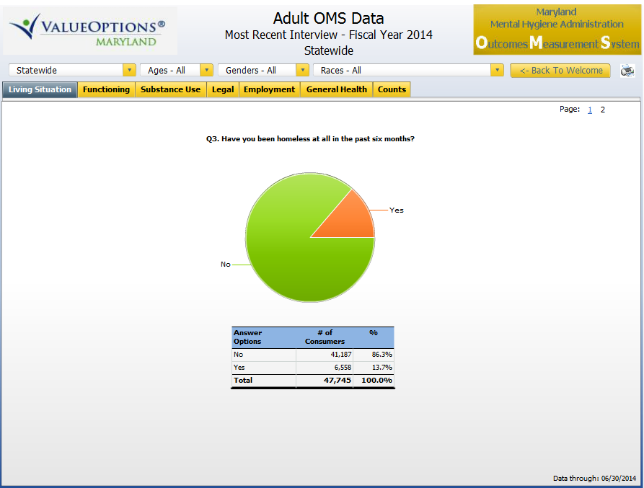

Slide 7
Initial OMS Training Materials
How to Administer the Questionnaire
Interview Guide
Reference Sheet (2 pages)
Power Point Presentation
Datamart Navigation
In-person demonstrations for state administrators and Core Service Agencies
Webinars for the provider community.

Slide 8
“If you build it, they will come” (or maybe not)
Once the Datamart was available, there was far less use than anticipated
State government leadership questions how data is being used
Diversity of knowledge/understanding re: data and evaluation become apparent in meetings with provider and system administrator communities
The “aha” moment…

Slide 9
The Basic Questions
What does the data mean?
How do I know if my results are statistically different from another group?
How do I interpret the data and use it?

Slide 10
Training Materials to Address the Basic Questions
What does the data mean?
Introduction to Data and Data Analysis
How OMS Items are Analyzed
How do I know if my results are statistically different from another group?
Excel spreadsheets (4) that can be used to compare two groups and determine statistically significant differences
Determining Statistical Significance for OMS Data Step-by-Step Guide
How do I interpret the data and use it?
Using Your OMS Data

Slide 11
What Does the Data Mean? Introduction to Data and Data Analysis
Basic primer with simple language and examples
Concepts limited to those that would be encountered when viewing and or using OMS data
Information included:
Data types: quantitative, qualitative, categorical, continuous
Basic data analysis: frequency tables, measures of central tendency, standard deviations
Statistics for comparison: statistical significance, probability levels, Chi squares , effect sizes

Slide 12
What Does the Data Mean? How OMS Items are Analyzed
Considered not essential for most Datamart users
Provided in response to request from most sophisticated users
In-depth, detailed information on how each OMS item is analyzed

Slide 13
How Do I Know if My Results are Statistically Different from Another Group? Workbooks for Determining Statistical Significance
Requested by more sophisticated users
Excel workbooks (4) using Chi-Square
Users enter data for a specific item (one tab per item)
Workbook indicates significance (or not)
Step-by-Step guide for using workbooks provided, includes caveats about sample sizes, interpretation, etc.

Slide 14
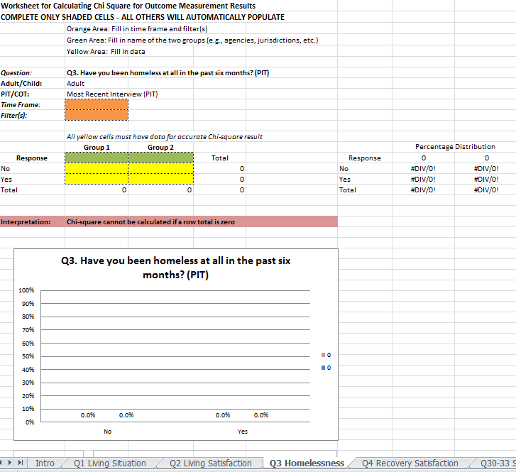
OMS Statistical Significance Workbook

Slide 15
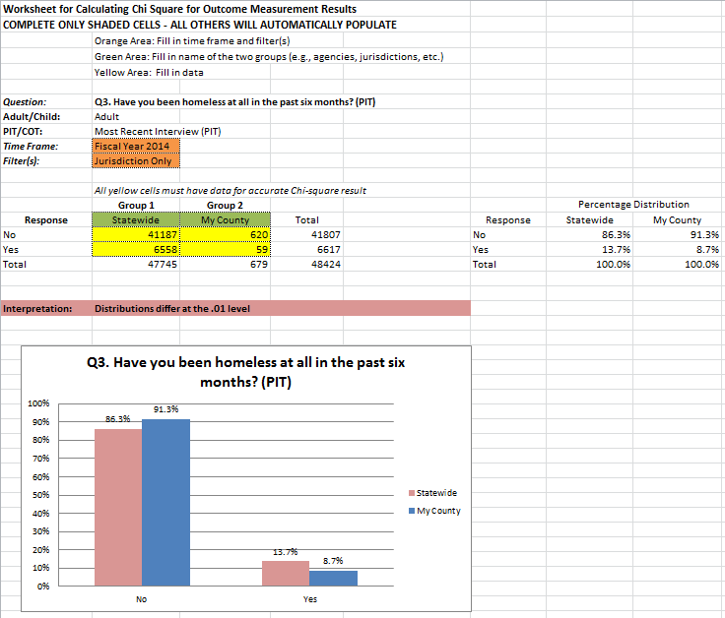
OMS Statistical Significance Workbook

Slide 16
How Do I Interpret Data and Use It? Using Your OMS Data
Outline potential uses of OMS Data
Describe guidelines for choosing Datamart elements based on user’s needs
Suggest questions for use with interpreting data
Identify other data sources for context
Summarize possible next steps
Propose different considerations and formats when presenting and distributing OMS data
Case example provided in an appendix

Slide 17
How Do I Interpret Data and Use It? Using Your OMS Data
Comparing a program/jurisdiction to others
Providing data for required accreditation activities
Planning and implementing Quality Improvement (QI) and program evaluation projects
Responding to requests for information

Slide 18
How Do I Interpret Data and Use It? Using Your OMS Data
Suggested Questions to Aid in Stimulating Discussion and Interpreting Data
Are these the expected results? Why or why not?
Were the data affected by policies, procedures, or characteristics at the community, county or state level?
Were the data affected by contextual or programmatic factors?
Were the data affected by characteristics of individual staff members or the consumers being served?
If you are comparing two sets of data for program evaluation, you may also want to ask:
Did the data change after the intervention? If so, how?
If there is a change, is it meaningful?
Was implementation of the intervention a factor? What were some of the challenges encountered and how might they have affected the results?

Slide 19
Challenges
Diverse Target Audience
Writing for data novices while not “talking down” to more sophisticated users
Helping users with little data experience recognize that their own expertise forms the foundation for data interpretation
Did not anticipate volume of training need (one document led to another…)
Time and effort needed to use easy to understand language
Workbook creation took on life of its own as we worked to make it fool-proof
Lost Time
Tendency to “overinclude”, then eventually cut non-OMS relevant information
Nature of the documents created an iterative review process, delaying distribution until almost all were finalized
Staff turnover and competing priorities
Getting distracted by “decision by exception”

Slide 20
Facilitators
Staff turnover – fresh eyes
Diversity of team working on all phases of OMS development
Differing levels of understanding of data and evaluation allowed for successful interpretation of often complex material for the masses
Continuing stakeholder input/feedback in development of materials
“Perfect is the enemy of the good”

Slide 21
Data Training Materials (14)
How to Administer the Questionnaire
Interview Guide
Reference Sheet (2 pages)
Power Point Presentation
How to Access the Data
OMS Datamart Demonstration – Webinar and Slides
OMS Dashboards – User Guide for Providers
OMS Dashboards – User Guide for CSAs
How to Understand and Interpret the Data – The Basic Questions
Introduction to Data and Data Analysis
How OMS Items are Analyzed
Determining Statistical Significance for OMS Data – Step-by-Step Guide & Workbooks
Adult PIT - OMS Statistical Significance Workbook
Adult COT - OMS Statistical Significance Workbook
Child-Adolescent PIT - OMS Statistical Significance Workbook
Child-Adolescent COT - OMS Statistical Significance Workbook
Using Your OMS Data

Slide 22
Contact Information
Diana C. Seybolt, Ph.D.
dseybolt@psych.umaryland.edu
410-646-1756

