Slide 1
Peer-teacher instructional coaching in K-6 rural schools
Bruna Irene Grimberg, Ph.D.
AEA 2013 Annual Conference
Washington, D.C.

Slide 2
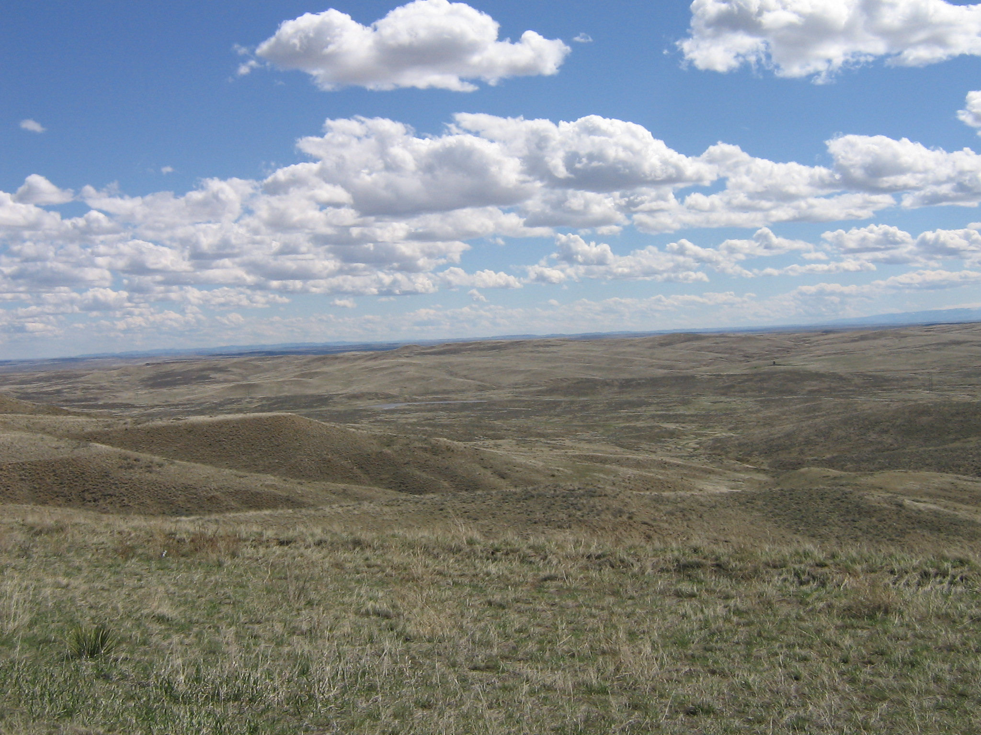
In remote rural areas …
Need of improvement of teacher’s skills and competences
Preparation in their teaching subject
Classroom management
Pedagogical content knowledge in their area
Understanding of the school culture
Cultural differences between teachers and community

Slide 3
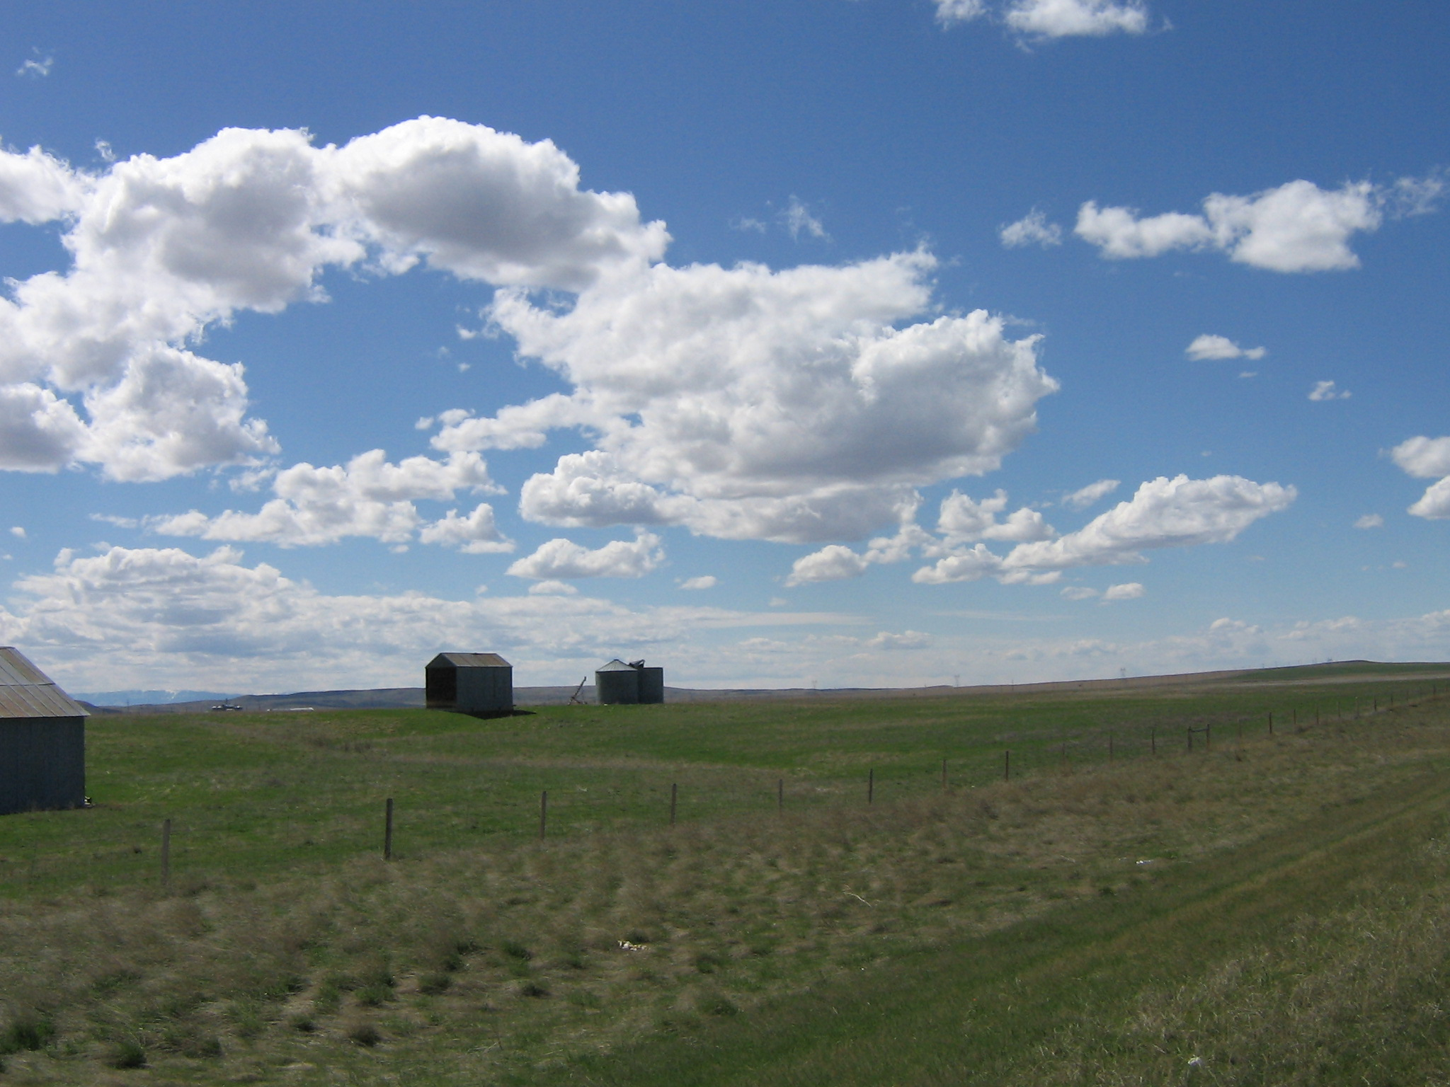
In rural remote Areas…
Very general teacher professional development programs geared toward educational reforms.
Few opportunities for teacher professional learning communities.

Slide 4
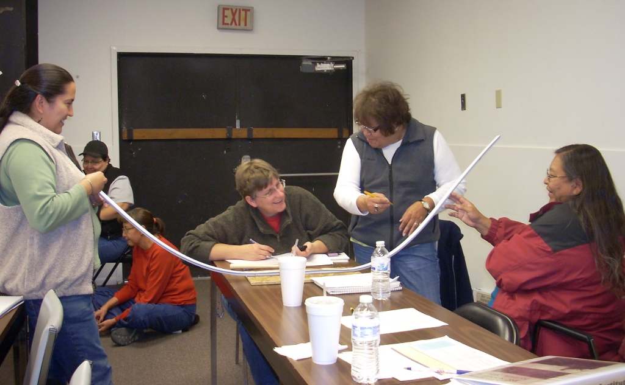
Project
This intervention is a component of a long-term MSP-NSF project for G2-8 science teachers, BSSP.
BSSP was structured in two periods of three years, delivered to two cohorts of teachers.
Teachers received professional development (PD) on three areas: Earth Science; Astronomy, Wheatear and Climate; and Physics.
The foci of the PD were: content knowledge, inquiry-based instruction, and integration of science and American Indian culture.

Slide 5
The Intervention
The intervention was a component of the project
Teacher professional development focused on science instructional coaching
Period: 8 months
Participants: sub-group of teachers that completed the project (BSSP)
Goal: facilitate teacher leadership and support K-6 science teaching.

Slide 6
Intervention Context: Place
Mean household income of the school communities for 2006-2010 ranges between 35% - 23% less than the mean household income in Montana (World Media Group).
The location of the schools is about 100 miles away from an urban area.
Schools are located in desert-food areas with increasing public health problems related to water quality and scarcity.

Slide 7
Intervention Context: Schools
Six schools located in two American Indian reservations in Montana
In 2012 none of these schools made AYP for the last 5-11 years (OPI)
Free and Reduced Lunch enrollment in 2012 ranges from 80.2%-98.1% (OPI)
88.6% of students are American Indians (OPI)
About 20% of teachers are American Indians

Slide 8
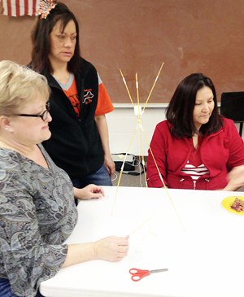
Intervention Participants
Seven teacher leaders were identified
Criteria: resourceful, experienced, knowledgeable of the tribal culture, eager learners, and dedicated

Slide 9
Participant’s Characteristics
Teacher leaders: three American Indian and four Caucasians, with one male teacher.
One science curriculum director, all others G3-6 teachers. One teacher run and after-school science program.
All teachers live either on the reservations or in towns adjacent to the them.

Slide 10
Intervention Overview
Professional development on science instructional coaching.
Three components: workshops, real-life coaching experience, and mentoring for coaches.
Workshops on: steps of coaching, coaching by modeling, classroom observations, communication with coached teachers, sustainability of a coach-coached relationship.

Slide 11
Intervention Overview (Con’t)
Real-life experience: Teacher leaders coached a colleague of their school during two months.
Mentoring: Monthly consultations with a mentor during the coaching experience period.
Assignment of the coached teacher varied.
School principals supported teacher leader’s instructional coaching.

Slide 12
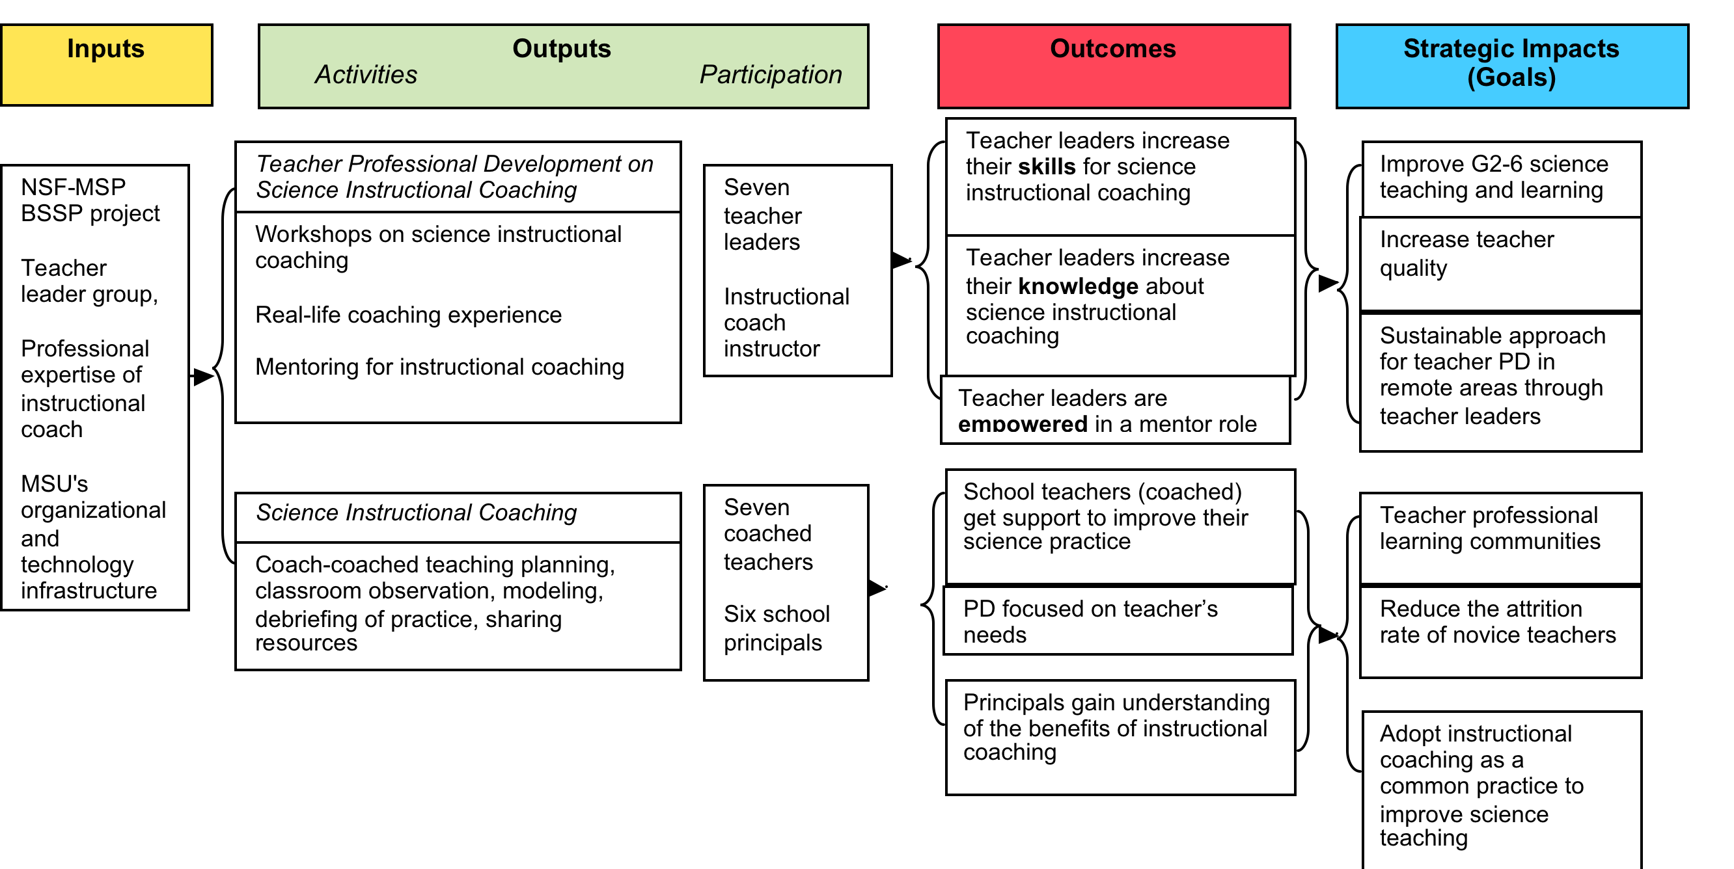
Intervention Logic Model

Slide 13
Evaluation
Design: naturalistic inquiry design “observ[ing] the program as its unfolds naturally including the emergent and diverse effects on participants” (Patton, 2012)
Theory of change: Teacher Instructional Coaching is transformative.

Slide 14
Evaluation
Evaluation themes
Practice-embedded PD model
Instructional coaching and coaches
Instructional coaching and teacher peers and school culture
Evaluation questions focused on effectiveness, implementation, and impact for each theme
Leaders increase their skills for science instructional coaching
Leaders increase their knowledge about instructional coaching
Leaders are empowered
Outcomes
Teachers get support for science teaching
PD focused on teacher’s needs
Principals understand the benefits of coaching

Slide 15
Data Collection
Evaluation Theme | Data Collection Source
Effectiveness of a practice-embedded PD model | Coaches follow up interviews Monthly conference calls
Impact of instructional coaching PD on coaches | Workshop’s field notes Coach’s log Coaches follow up interviews
Impact of instructional coaching on coached teachers and school | Coach and principal follow up interviews Coached-teacher questions

Slide 16
Coach Log

Slide 17
Findings (preliminary)
Conditions for coach-coached partnerships
a) Existing relation between teachers (trust)
b) Coached teacher identifies a problem
c) Coaching presents mutual benefits to the teachers
d) Mandate from school administration
Identifiers of coach role
a) Idea for the cause of a problem
b) Coach self-confidence of having a solution
c) Facilitation of coached-teacher’s self-reflection

Slide 18
Findings (con’t)
Coaching styles
Collaborative/co-teach
Didactic
Modeling
Reaffirmation of coach role happens when:
a) Coach's perception is re-assured
b) Noticeable change in coached-teacher practice
c) Coach is recognized

Slide 19
Conclusion
Use grounded theory to identify emerging themes in social interactions of teacher instructional coaching
Use of emerging themes as "measurable" dimensions of the intervention
Evaluation as knowledge construction or theory-building provides descriptive and explanatory narratives for decision-making.

Slide 20
Thank you!
grimberg@montana.edu

