Slide 1
Human systems dynamics & developmental evaluation: Exploring the Intersection of Two Approaches to Evaluating the Creative CityMaking Project
Katie Fritz Fogel & Beki Saito, RAINBOW RESEARCH
Gulgun Kayim, Arts, Culture, & the Creative Economy, CITY OF MINNEAPOLIS
Wendy Morris, INTERMEDIA ARTS

Slide 2
GOAL:
What is DE and HSD
Why did we choose these approaches
What is Creative CityMaking (CCM)
How did we utilize DE and HSD
Challenges and Opportunities
Notes:
Walk away with an understanding of how Developmental Evaluation (DE) and Human Systems Dynamics (HSD) approaches were utilized in the evaluation of Creative CityMaking, an arts-based community development initiative in Minneapolis

Slide 3
Introductions
Notes:
Who is here and What do you want to learn from this session
Name, Org, Learn
Who we are and Why we’re here

Slide 4
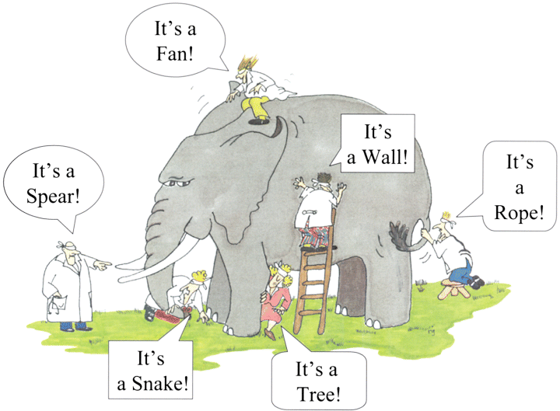
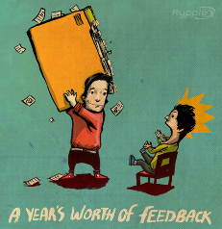
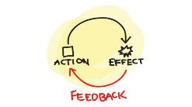
developmental evaluation?*
Supports the PROCESS of INNOVATION in which the PATH and the DESTINATION are EVOLVING
Introduces REALITY TESTING into the process of innovation
“Rapid” or ongoing feedback is supported by data to help innovators fine-tune the process
* A Developmental Evaluation Primer, Jamie A.A. Gamble, The J.W. McConnell Family Foundation, 2008
Notes:
When something is innovative it implies that we do not already know how to do something, that it is pioneering, breaking new ground.
Initiatives that are said to be innovative are often in a state of continuous development and adaption—they are not “tried and true” rather they are learning and growing and changing—thus, this type of evaluation approach is best used when the process or product or program in question is not fully known from the start, and, like the spiral on the slide, in fact the end point or destination may be a notion, rather than a fixed, crisp image, and thus the evaluation, in order to be useful, must be able to be an integral part of the ongoing learning, and growing and changing—the DEVELOPMENTAL PROCESS—in which innovation drives the change.
“Developmental evaluation applies to an ongoing process of innovation in which both the PATH and the DESTINATION are evolving. Adaptions to the program or initiative are driven by new learning, new insights, new perspectives that are CAPTURED BY THE EVALUATION AND REFLECTED BACK
DE introduces reality testing into the process of innovation. Thus, when we began our evaluation, we started with, “what will success look like to you” and “how will we get there?” Unlike traditional evaluations we did not do this in order to measure how closely they follow their path or closely their final result matched their anticipated picture of success. Rather, we did this to discover the multiple starting points, pathways and end points that key actors in this initiative had in mind.
And, like the inspectors inspecting different parts of the elephant, different plays saw the elephant—the initiative—in many different ways.
And finally, a key feature of DE is the notion of rapid or ongoing feedback. The evaluators constantly reflect back what they are seeing so that staff can make adjustment as necessary. Unlike, more traditional evaluations where you wait til the end to share findings, DE is part and parcel of the innovation cycle or process.
Wendy Morris, Director of Creative Leadership, at Intermedia Arts will explain and demonstrate some of the constructs of Human Systems Dynamics or HSD.

Slide 6
Complex Adaptive System Self-organizing system
A collection of individual agents who have the freedom to act in unpredictable ways, and whose actions are interconnected so that they produce system-wide patterns.
Agents interact

Slide 7
Complex Adaptive System Self-organizing system
Those system-wide patterns, in turn, influence the behaviors of the agents
System-wide patterns emerge
Agents interact

Slide 8
An illustration….

Slide 9
Milling
What did you notice about agents in the system?
What did you notice about the whole system?
What were the connections?
What differences made a difference?
What patterns emerged?

Slide 10
Adaptive Action Model
What?
Now what will we do?
Adaptive Action
So what does it mean?
What?
Notes:
Milling – you were making choices - quickly picking up..
What’s going on? So what does it mean? Now what will I do?
When you stayed fixed on your destination, what happened?
Adaptive action is iterative cycles of noticing, making meaning form what we observe, and choosing action, which brings us to a new situation or a new “what?”

Slide 11
Background
Short List of Simple Rules
Why?
Support coherent action among diverse agents
Use?
Scaling up from 1 to 5 departments
If everyone follows the same short list of simple rules, then the group behaves in a coherent way as a whole
Notes:
Milling – a few simple rules established a coherent action in the group as a whole…
Creative CityMaking is a collaboration between Intermedia Arts and the City of Minneapolis that places highly skilled community-engaged artists in City departments to work on City issues around equity related to transportation, housing, community engagement, and beyond. As the program expanded from one department in 2013 to five departments in 2015, we wanted to create a unified whole across an increasingly broad and complex system. With the perspective of 2013’s demonstration year, we defined a few seed behaviors to guide decisions and actions for everyone working on Creative CityMaking. These six guidelines frame a shared understanding of how we function together to best serve our shared work. Individuals across the programs, including artists, administrators, City staff and apprentices, are free to interpret and apply the seed behaviors in any interaction. As they do so, a coherent and purposeful culture emerges.

Slide 12
Creative CityMaking Simple Rules
Artfully engage underrepresented communities
Test big ideas
Act with tact
Leverage conflict as a resource
Run with what works
Demonstrate value
Notes:
Used these simple rules in many ways – from reporting out about what was happening in projects, to navigating tension to move the City towards preferred patterns of engagement.

Slide 13
What Do We Mean by “Pattern?”
Similarities, differences, and connections that have meaning across space and/or time.
Notes:
What’s a similarity you see? A difference? And a connection? The blue circle looks like it’s laid on top of the striped form.
This pattern is a fractal -- A fractal is a structure that repeats a similar pattern at many levels of scale - from the smallest to largest imaginable.
Fractals occur...
in mathematically-generated art — when a formula produces a geometric image that repeats the same patterns at small and large scales
in nature — when the branching pattern in a leaf echoes the branching pattern of a tree trunk
in human culture — when a social pattern, like competition or empathy, shows up in individuals, in teams, in an organization and/or a community
Our work has been about shifting patterns in how our City government engages communities, and how communities engage with City government.

Slide 14
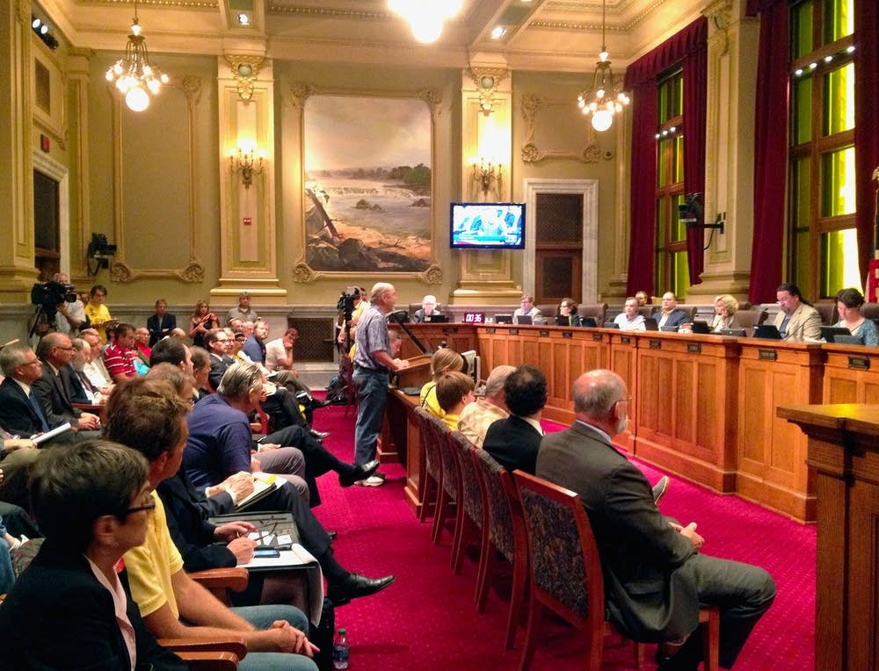
What do we mean by “patterns”?
similarities, differences, and connections
Notes:
Patterns in organizations (and other human systems) are made up of
similarities, differences, & connections that have meaning across space and/or time.
What are the similarities that are key? What are the differences? What are relationships?
These are the Minneapolis City Council Chambers…

Slide 15
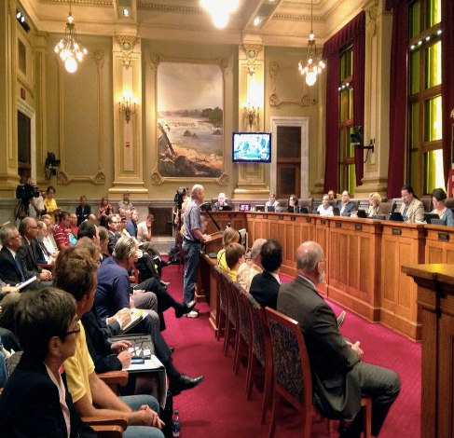
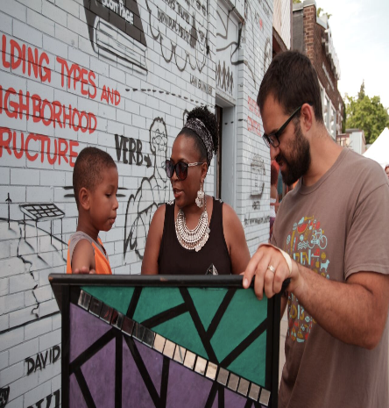
Patterns
Notes:
Two different patterns ---
Similiarities – both have a pulpit.
Differences -
Connections – not obvious, but they are both means for collecting community input about City policy and plans.

Slide 16
Keep your options open Containers, Differences, Exchanges
Notes:
Last and perhaps the most fundamental concept from HSD that informs our work is the understanding of three conditions that are always present in complex adaptive systems.
These are the containers – that bound, define and hold the system together,
The differences that distinguish one part of the system from another,
And the exchanges – the flow between different the different parts of the system.
These three conditions are present in every CAS at all times. Their interactions with each other influence how quickly the system self-organizes, what direction that self-organization will take or even the path by which the system will move..
We can influence the systems by shifting one or more of these conditions. The conditions are massively entangled, meaning that, even
though they can be separately seen and described, their influences on each other cannot be separated. A shift in one condition can signifi-
cantly influence either one or both of the other conditions.
MILLING: when we made the container smaller, how did that influence the exchanges?
When we understand and pay attention to these conditions, we are better able to use what we perceive to influence outcomes within the
system.

Slide 17
Keep your options open Containers, Differences, Exchanges
Notes:
Artists may not have the language for any of this, but the activity and practices of making art are a brilliant training ground, for seeing and playing with these conditions.

Slide 18
Why HSD & Development Evaluation?
Notes:
About the RFP --

Slide 20
CCM 2015-16
An arts-based community development initiative in which experienced community artists build the capacity of City of Minneapolis departments to more respectfully, effectively and authentically engage traditionally under-represented communities
https://vimeo.com/176471192

Slide 21
Notes:
Cities are used to thinking about the role art plays in creating urban environments through its contribution in capital investment and infrastructure, civic buildings, districts, economics through art objects and products, sculptures that populate our public spaces. These monuments & spaces play the role of telling stories about ourselves, about our civic aspirations, our conquests & national identities. But what about art processes? What have these got to contribute to the story of the City?

Slide 22
The City's 2005 Plan for Arts and Culture, established by the Minneapolis Arts Commission and the Minneapolis City Council recommended the establishment of an artist-in-residence program within City Departments.
Notes:
CCM began with looking at the value of artistic processes as they relate to the work of the City. Our idea of artist residences is to place artists in close relationship to the work of City departments and city staff

Slide 23
In-ter-sec-tion-al-i-ty
noun: intersectionality; the interconnected nature of social categorizations such as race, class, and gender as they apply to a given individual or group, regarded as creating overlapping and interdependent systems of discrimination or disadvantage. “Though an awareness of intersectionality, we can better acknowledge and ground the differences among us.”
Notes:
As you have seen in the video the Creative CityMaking model is based on intersections – at many levels. Inter-section-ality is at the heart of our work
CCM intentionally cultivates intersections where City staff and artists can address issues of disparity among people who live and work in Minneapolis. These intersections / are between diverse fields, sectors , cultures perspectives = the birthplace of new thinking, which is the source of new behavior. The new behavior we are seeking is to allow diverse voices to be heard, residents to influence decision-making, and government to be more responsive in creating a city that works for all, without exception…

Slide 24
FOUR INTERSECTIONS
Notes:
CCM is an intersection/ collaboration btwn City Depts, the City’s Arts, Culture & the Creative Economy Program, and Intermedia Arts. Btwn community based artists and City staff, City departments and the communities they serve.

Slide 25
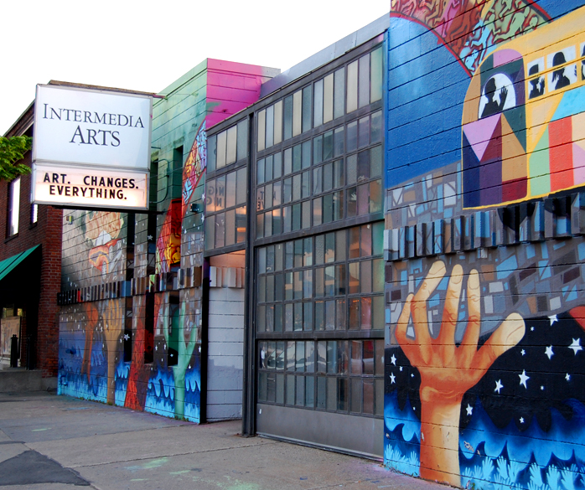
Notes:
Intermedia Arts, is a small multi-cultural, multi- disciplinary arts center that for decades years had been leveraging the power of arts and culture to transform communities. For the last 10 years, it has offered Creative Leadership and cross sector training to artists and non-artists.

Slide 26
City Goal: One Minneapolis
Disparities are eliminated so that all Minneapolis residents
can participate and prosper.
Racial inequities (including housing, education, income and health) are addressed and eliminated.
All people, regardless of circumstance, have opportunities for success at every stage of life.
Equitable systems and policies lead to a high quality of life for all.
All people have access to quality essentials, such as housing, education, food, child care and transportation
Residents are informed, see themselves represented in City government and have the opportunity to influence decision-making.
Notes:
The CCM collaborations are aimed at eliminating the racial disparities of our City. In support of a goal within government which we call ‘One Minneapolis’ and this goal area is…

Slide 27
Racial Equity
“The development of policies, practices and strategic investments to reverse disparity trends, eliminate institutional racism and ensure that opportunities for all peple are no longer predictable by race”
Minneapolis City Ordinance, 2014
Notes:
Is in turn supported by the City council’s definition of Racial Equity. We crafted this program to address these issues not only because of new leadership within the City but also because even though MPLS is a prosperous community in many ways – it also struggles with some of the worst racial disparities in the nation in every significant marker of well-being – housing, health, jobs, education, and identity.

Slide 28
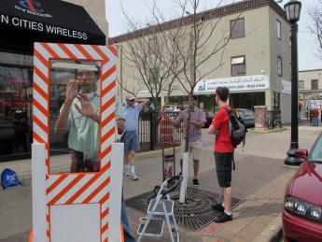
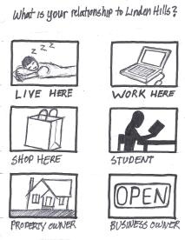
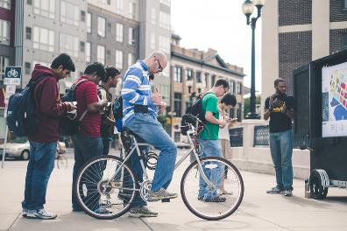
MOBILE, FRIENDLY & APPROACHABLE
Notes:
Since 2013 we have worked with 5 city departments, placed 9 teams of artists within 10 projects. Here are some example engagements from just 2 projects…

Slide 30
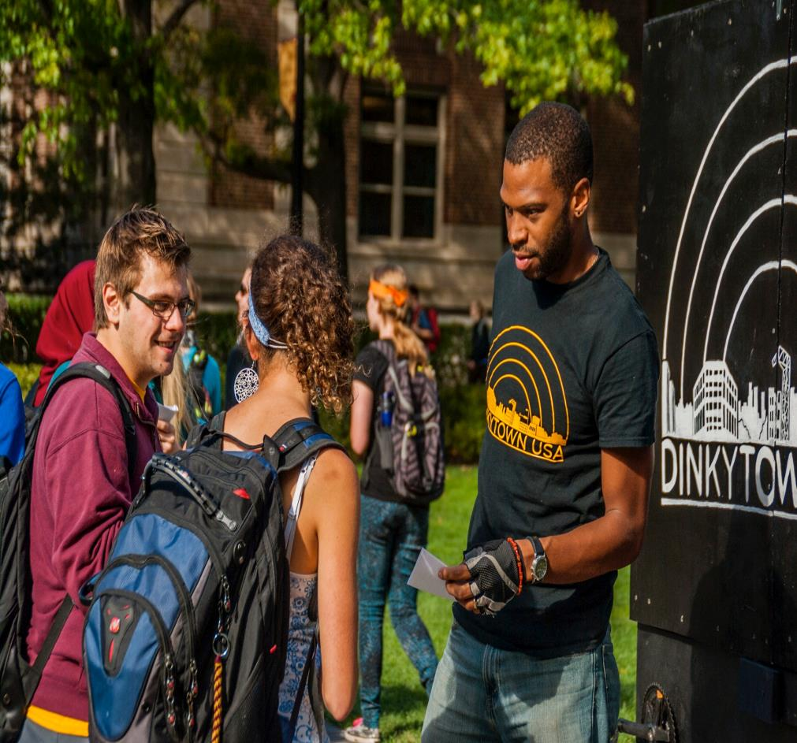
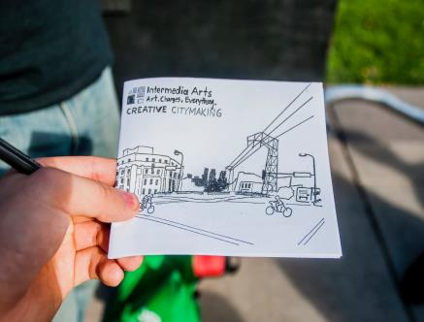
Notes:
Another example is a 2013 project with the Long Range Planning Dept in the Dinky Town Small area planning process to increase input on a plan in a neighborhood experiencing tremendous growth as developers buy up properties to capitalize on a student housing gap, a team of artists biked through the area with a “mobile engagement theater” and a hand drawn-zine that converted a standard survey into a whimsical invitation to provide input- this method gathered 840 responses. The artists captured the attention and voices of a young and diverse population, individuals who typically are not part of the conversation. The input represented 40% of the community survey and brought hundreds of new, younger voices to the planning process.

Slide 31
DE & HSD

Slide 33
Evaluative questions
Articulating the Model: Discovery
What is the context of the department and the priority issue? What is the pattern of collaboration between the artist(s) and the City staff? What is the pattern of community engagement around the priority issue? What patterns of community engagement would the team like to see? What does success look like from each stakeholders’ perspective?
What are we learning? Sense-making
What does the project mean to the Artist Engagement Team? The City Staff? The Community? What changes in the patterns identified in the Discovery Phase are you seeing? What opportunities are there for deepening or strengthening those changes? What has surprised the teams (regarding assumptions or expectations)?
What can we do? Action Cycles
What can the Team act on next? Has this changed from the original plan? Why? What additional information should be collected? What don’t we know? How will the Team know if the action selected was useful or successful? How will we know if it “worked?”

Slide 35
reflections
Notes:
Partnering, trust-building
Examples of adaptive action
Could not make structural changes in one year timeline
Role of evaluator in HSD and DE: DRAMATURG
Power to effect change when they are your client/customer
Evaluator in from the start; co-creating

Slide 36
Thank you!
Gülgün Kayim
Director, Arts, Culture and the Creative Economy
City of Minneapolis
Office of the City Coordinator
350 South Fifth Street –M301│ Minneapolis, MN 55415
p: (612) 673-2488 │c: 612-710-2232
gulgun.Kayim@minneapolismn.gov
www.minneapolismn.gov
Wendy Morris
Director of Creative Leadership
Intermedia Arts 2822 Lyndale Avenue South
Minneapolis, MN 55408 p: 612.874.2810
C: 612.280.1949
wendy@intermediaarts.org
www.intermediaarts.org
Katie Fritz Fogel
Research Associate
Rainbow Research
621 West Lake Street, Suite 300
Minneapolis, MN 55408
(612) 824-0724
kfogel@rainbowresearch.org
www.rainbowresearch.org
Rebecca (Beki) Saito
Senior Research Associate
Rainbow Research
621 West Lake Street, Suite 300
Minneapolis, MN 55408
(612) 824-0724
bsaito@rainbowresearch.org
www.rainbowresearch.org

