Slide 1
On-going learning informing program design
Insights from a South African financial literacy program
Evaluation 2016
29 October 2016

Slide 2
evaluation + design
Notes:
INTRODUCTION
In line with the theme of this conference, this presentation will provide some insights into the interplay between evaluation and design in practice through the example of a South African financial literacy programme.
The initial programme design informed our evaluation design (“evaluation ready”) , and the evaluation of the programme in turn informed the design of new programmes.

Slide 3
Setting the scene: Consumer Financial Education (CFE) in South Africa
Financial education
Financial literacy
Financial capability
Financial inclusion
Notes:
Financial inclusion seeks “to ensure that all households and businesses, regardless of income level, have access to and can effectively use the appropriate financial services they need to improve their lives.”¹
Why is this important?
Day to day transactions made easier and safer
Safeguard savings that help smooth consumption
Insurance and savings reduce the vulnerability of poor households to economic downturns or unexpected events
Access to credit helps spur small enterprise activity
New businesses have broader impact on the economy as a whole contributing to economic growth and development
Financial inclusion is emerging as a priority issue on political agendas around the world.
Financial capability is both the external and “internal capacity to act in one’s best financial interest, given socioeconomic and environmental conditions.” ²
Internal capacity refers to financial knowledge and skills, decision-making ability, personal preferences, attitudes, confidence and self-awareness with respect to understanding, selecting and applying financial concepts and tools, and the ability to access financial services that fit their needs.
External capacity refers to societal and environmental constraints and personal income
Financial literacy is “the ability to understand how to use financial products and services and how to manage personal, household, or micro-enterprise finances over time” ³
Financial education is the process through which people’s financial literacy and capability is built and improved.
2012: The South African Financial Services Board (FSB) commissioned a national baseline survey to determine the levels of financial literacy in the country. The findings indicate that overall financial literacy levels in South Africa are low, shown by a national score of 54/100.
In response, the South African National Treasury implemented the National Consumer Financial Education Strategy (2013) which aims to increase the financial capability and financial well-being of all South Africans. This strategy incorporated CFE into the Financial Sector Charter, which guides the operation of the Financial Services industry.
Financial institutions encouraged to implement CFE and are incentivized through the South African affirmative action policy
Target audience: Living standard measure (LSM) 1 – 8 (individuals earning less than R180,000.00 p/a).
Funding: 0.4% of NPAT
All initiatives should be subject to M&E by independent service providers
¹ Consultative Group to Assist the Poor (2016) What is Financial Inclusion and Why is it Important? [http://www.cgap.org/about/faq/what-financial-inclusion-and-why-it-important]
² World Bank (2013) Why Financial Capability is important and how surveys can help 6
³ World Bank, Financial Literacy & Education Russia Trust Fund (2013) A toolkit for the evaluation of financial capability programs in low and middle-income countries

Slide 4
Setting the scene: Consumer Financial Education (CFE) in South Africa
54
100
Notes:
The South African National Treasury implemented the National Consumer Financial Education Strategy (2013) which aims to increase the financial capability and financial well-being of all South Africans.

Slide 5
Notes:
The ASISA Foundation was established by the Association for Savings and Investment South Africa (ASISA) to implement meaningful CFE initiatives on behalf of the industry.

Slide 6
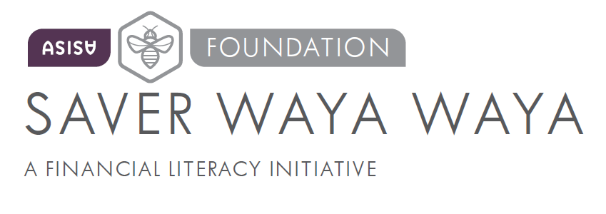
Saver Waya Waya 2014: Objectives
PILOT
Short term: to achieve knowledge transfer
Long term: to achieve a positive change in financial behavior
To assess the effectiveness of the implementation methods
Notes:
Saver Waya Waya – meaning “to save all the time” – was the ASISA Foundation’s pilot financial literacy program implemented in 2014.
By providing appropriate and accessible financial education, the ASISA Foundation strove to inform, educate and empower consumers to better manage their financial affairs, with the ultimate short term and long term objectives:
Short term: achieving knowledge transfer that would be relevant to the day-to-day lives of the target audience, and
Long term: achieving a positive change in financial behaviour and improving the quality of the interactions between the target audience and the savings and investment industry.
Furthermore, since this was a pilot, the Foundation explicitly wanted to learn and understand what worked and what didn’t work from an implementation perspective, so as to improve the programme and make it ready for scale-up.
M&E was embedded into the design of the programme.
In this way, the design of the program informed the way in which we approached and designed our evaluation.
As the M&E partner were were involved right from the beginning and were able to collect data at various different stages through a variety of methods. These will be explained further after I have explained the program implementation.

Slide 7
Saver Waya Waya 2014: Implementation
✓
✓
Budgeting
Saving
✓
Planning
✓
Interest
✓
Credit
18-29
30-44
45-60
Life-stage approach
Three/four-hour
face-to-face workshop
Three/four-hour
face-to-face workshop with industrial theatre
Radio drama campaign
on Moretele FM
SMS radio competition
on Moretele FM
Opt in SMS financial
tips campaign
Notes:
Saver Waya Waya was designed to cover the basics of financial literacy (Needs and wants; Planning; Budgeting) as well as the three Cs of wealth management:
Wealth creation (Golden rules of saving; Saving as a habit; Interest)
Wealth conservation (Protecting your money; Growing your money with investments)
Wealth consumption (Addictive spending; Calculating the cost of different purchase options; Saving for emergencies)
The target audience for the program was low income individuals between the ages 18 to 60.
To ensure that the messaging was relevant, the target audience was segmented into three different life stages and targeted separately:
Young adults, targeted through places of study
Middle aged adults/young families/employed adults, targeted through worksites
Mature adults, targeted through community volunteer organisations
This “Life-stage approach” was to allow for better tailoring and contextualising of the messages
The overall program employed a story-based approach to help contextualise the messaging and make it more enjoyable. This story followed the Phala family and their neighbour. The Phala family consisted of three members representing the three target audience segments or life-stages, while their neighbour represented
someone who makes bad financial decisions.
The programme adopted a multi-method approach to communicating its messages. These included:
Face-to-face approaches
Three/four-hour face-to-face workshops: all messages were covered and stitched together by the story to contextualise
Three/four-hour face-to-face workshops including 20 minutes of industrial theatre: same format as above but also included a 20 minute edutainment skit to energise the audience, stimulate awareness and support the transfer of knowledge
Mass reach approaches
4 episode radio drama broadcast, which followed the story of the Phala family and contained embedded financial education messages. This was played on a local community radio station and also included an SMS competition to improve the concentration of the listeners and to test the ability of radio dramas to impart knowledge
An opt-in SMS financial tips campaign to reinforce the messaging.
The evaluation was particularly interested in assessing the effectiveness of the life-stage approach as well as the addition of the industrial theatre component.
The evaluation methods included:
Workshop surveys (including a control workshop focused on HIV education)
Session observations
Informal discussions with participants and trainers
Focus group discussions with participants and trainers
Key informant interviews with the implementation team
SMS data and registers
Passive involvement in the project team

Slide 8
Saver Waya Waya 2014: Key recommendations
The target groups respond differently to financial education and should be targeted separately
Embed the financial education within a broader program that tries to improve the other pillars of financial wellbeing..
Industrial theatre was found to be effective at enhancing the learning experience but it is difficult to scale up. Explore an alternative edutainment type approach.
Repeat messaging is one of the more vital components of an education strategy.
Notes:
1. The life stage approach is appropriate, but the target groups respond differently to financial education and should be targeted separately. This is because each life stage has slightly different needs and are exposed to different contexts, so the messaging should be tailored for each group to make the content relevant.
Young adults are positive and are only just entering the world of work. They are hopeful about their future, believe they will soon have an income to save, but are exposed to substance abuse/sugar daddies etc.
Middle-aged adults are perhaps trying to buy a home or pay off debt. Many of them have insecure income and families to support.
Mature adults were slightly more jaded as they reported having little to no income. Many of them are thinking about retirement and accessing their pension.
2. Embed the financial education within a broader program that tries to improve the other pillars of financial wellbeing, such as people’s incomes or reliability of income.
Financial capability consists of both internal and external factors. While the financial literacy programme deals with internal capability, it does not address constraints to external capability.
Embedding the financial education within a broader programme that tries to improve the other pillars of financial wellbeing, such as people’s incomes or reliability of income might account for this.
3. Industrial theatre was found to be effective at enhancing the learning experience but it is difficult to scale up. Explore an alternative edutainment type approach that is easier to include in all sessions at a lower cost.
Industrial theatre requires hiring professional actors who, if the programme was scaled up, would need to available at multiple sites on multiple occasions, or many different actor would have to be hired in each region. This is expensive and difficult to implement.
Alternative approach: e.g. a video recording
4. Repeat messaging is one of the more vital components of an education strategy.
Sessions should not be longer than 2 hours as the audience’s ability to learn beyond this is limited. It is therefore better to have multiple sessions a opposed to trying to cover everything in one long session.
Repeat messaging through multiple sessions also allows for follow up and reinforcement of the content.
Repeat messaging through auxiliary methods (such as SMS and radio) also help reinforce the content.

Slide 9
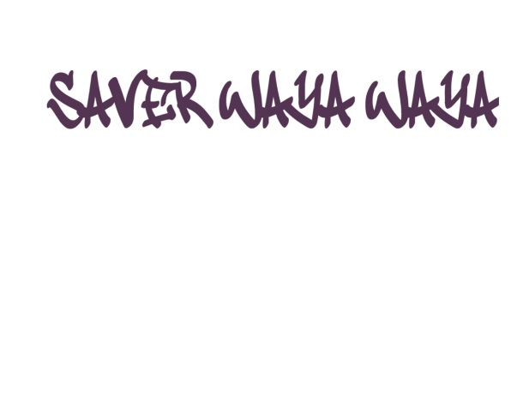
Lessons informing design
Notes:
The ASISA Foundation took the recommendations on board and responded by designing three new programmes, each one geared towards a different life stage.
Saver Waya Waya TVET – Young adults
FLAME (Financial literacy and Micro Enterprise) – Mature adults
Project Qaphela – Middle-aged adults/employees

Slide 10
Lessons informing design
Lessons from Saver Waya Waya 2014
Saver Waya Waya TVET 2016
The youth (18-29) were the most positive about financial education and are easily reached through institutions of learning and training.
Targeted young adults attending Technical Vocation Education and Training (TVET) colleges and incorporated soft skills around the world of work and the job search
f
The youth are easily reached through social media and mobile devices.
The program made use of Facebook and WhatsApp to reinforce messaging.
Edutainment is effective and should be continued.
Edutainment based on industrial theatre was a core component.
To achieve behaviour change repeat messaging is necessary.
x6
Repeat messaging instilled through a 6-week program
Notes:
Saver Waya Waya TVET
Evaluation lessons: wanted to get more depth of information - diaries, observation, evaluator participation, baseline and endline

Slide 11
Lessons informing design
Lessons from Saver Waya Waya 2014
FLAME 2016
This cohort were the least positive about financial education as they reported little to no income, despite having social grants.
Addition of soft skills component focused on building confidence about income generating activities
Mature adults can be reached through community structures such as savings and lending groups.
Targeting mature adults through savings co-operatives
The program should leverage other programs aimed at improving participants’ ability to make money.
Shop
Program contains a Micro Enterprise “bootcamp” and incubation component
To achieve behaviour change repeat messaging is necessary.
x4
Repeat messaging instilled through a 4-week program
Notes:
Financial literacy and Micro Enterprise (FLAME)

Slide 12
Lessons informing design
Lessons from Saver Waya Waya 2014
Project Qaphela 2016
Middle-aged, income-earning adults are the most vulnerable because they can access credit in the formal system, but may not have the necessary skills to manage it.
%
Messages tailored to include issues around debt and interest rates.
Find a credible way to mobilise workers and coordinate them to attend workshops.
Use labor unions to generate impetus for the program.
To achieve behavior change repeat messaging is necessary.
6 hour workshop complemented by industrial theatre and regular smses.
Notes:
Project Qaphela

Slide 13
Saver Waya Waya TVET: Evaluation findings validate design
“We can save by taking lunch boxes instead of buying take aways #saverwayawaya #Tembacampus”
f
“2day I have opened my new account 4 my savings thanks to #saverwayawaya 4 the love and education. #RustenburgCampus”
The drama component was an “innovative learning experience” - Trainer
“It is important to know what to wear to an interview and to be well-groomed. #SAVERWAYAWAYA #BRITS_CAMPUS”
Single life-stage targeting was appropriate
Working through TVET colleges proved successful and enabled repeat messaging
Notes:
The evaluation of Saver Waya Waya TVET, which took place this year, yielded some interesting findings that validated the recommended design.
The single life-stage approach worked well as participants and trainers could interact using colloquial language and slang, relevant to their context, and the trainers could contextualise the messages appropriately.
Using social media complemented the workshops well and helped reinforce the messaging. Facebook displays some anecdotal evidence of behaviour change.
TVET colleges facilitated repeated interactions with the same students
The messaging was appropriate to the target audience
Incorporating edutainment complemented the students’ learning experience and reinforced the messaging. The students were very positive about the drama component.
Add in a graph

Slide 14
research and development
noun
noun: research and development
(in industry) work directed towards the innovation, introduction, and improvement of products and processes.

Slide 15
Research and Development
Private sector invests in R&D to improve product lines so as to generate greater profits in the long term.
It is not expected to yield immediate profit and often entails failure
What about the development world?
Notes:
R&D refers to the investigative activities a business conducts to improve existing products and procedures or to lead the development of new products and procedures.
But why is this limited to the commercial sphere?
The interplay between evaluation and design speaks to an R&D attitude toward development programs, where failure is allowed because we are always trying to learn, adapt and improve our programs so that they are the most effective and impactful they can be.

Slide 16
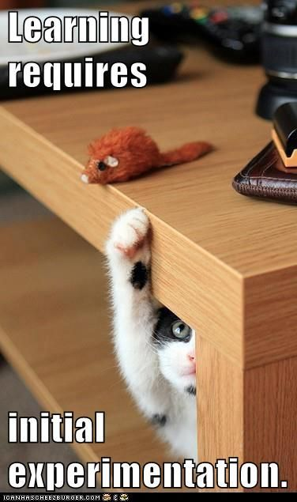
“
it is often through the process of experimenting, failing, and learning from those failures that effective, evidence-based diagnoses and intervention strategies emerge¹
”
¹ World Bank (2015) World Development Report: Adaptive Design, Adaptive Interventions.

