Slide 1
Building the Evaluation Field Through Strengthening Voluntary Organisation of Professional Evaluators (VOPE) in Indonesia
Presentation by
Benedictus Dwiagus Stepantoro
InDEC (Indonesian Development Evaluation Community)
2013 AEA Conference, Washington DC

Slide 2
CONTENT
The CONTEXT
WHAT WE WANT TO IMPROVE? HOW?
ADDRESSING INSTITUTIONAL CAPACITY
ADDRESSING INDIVIDUAL CAPACITY
INFLUENCING THE CONTEXT (ENABLING ENVIRONMENT)
LESSONS LEARNED & CONCLUSION

Slide 3
THE CONTEXT

Slide 4
INDONESIA CONTEXTS
Post-Reform Democracy (post-1998)→
Public demand for government’s performance and development results →
Policy/legal framework established for evaluation & performance management (more like a ‘reporting system’)→
→ but still no evaluative culture, yet – mostly driven by international agency

Slide 5
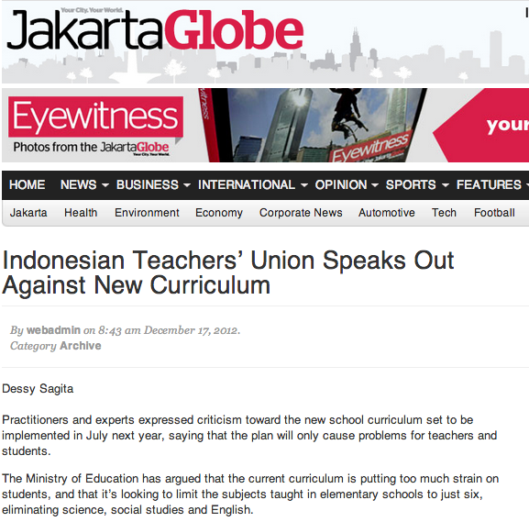
Public Pressure …

Slide 6
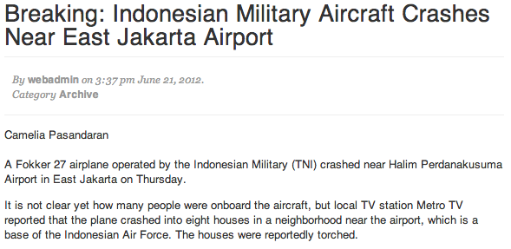
ACCIDENT…

Slide 7
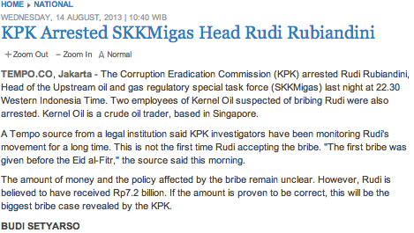
CORRUPTION…

Slide 8
THE CONTEXT: Current Evolution
Evaluation as choice
Evaluation as compliance
Evaluation as culture
Audit Finansial
Performance
Audit
Impact Evaluation
Learning Focused
Evaluator as
Accountant / Auditor
Evaluator as
Researcher
Evaluator as
Facilitator
Indonesia

Slide 9
ON THE OTHER SIDE…
Paris Declaration, Accra Agenda, Bushan Partnership → Jakarta Commitment → public demand for Aid Effectiveness
Growing number of evaluation and/or M&E related works in Indonesia
Growing numbers of Local Indonesian professionals entering the field of Evaluation/M&E
Very few ‘center of excellence’ for evaluation.

Slide 10
WHAT WE WANT TO IMPROVE? HOW?
Why InDEC?

Slide 11
GOAL - VISION
EVALUATION/
M&E PROFESSION
IS MORE ACKNOWLEDGED/ APPRECIATED
MORE LOCAL EVALUATOR/ M&E PRACTIONERS GAIN MORE SKILLS/KNOWLEDGE/ MOTIVATION
MORE QUALITY PRACTICES IN EVALUATION/ M&E
MORE THEORETICAL/ PRACTICAL DISCOURSES ON EVALUATION/M&E

Slide 12
WHAT CAN a VOPE (InDEC) DO?
Advocacy for promoting evaluation/M&E practice and its use by development actors
Promoting awareness and demands of evaluation/M&E
Enhancing competency and credibility of Evaluation/M&E Professionals
Creating standards/code of conduct for evaluation practice/products
Sumber:

Slide 13
FRAMEWORK FOR CHANGES:
Culture/Motivation
Capacity
Enabling Context
New
Behaviour
Source: IDRC, IADB, Universalia

Slide 14
ADDRESSING INSTITUTIONAL CAPACITY

Slide 15
InDEC: HISTORY
Started with an email listserv in 2007-2008
Declared as an informal entity in June 2009
Established as a formal organization in January 2012

Slide 16
InDEC: WHAT WE HAVE
Registered Member of InDEC: 41
Unofficial Member (subscribed in Indo-MONEV email listserv): ± 563 (as of to-date)
Members from:
International Development Organisation (Bilateral, Multilateral, INGOs.)
Government officials
Individual/Independent Practitioners
CSOs – Local NGOs
Academia & Research Centre
Journalist

Slide 17
WORKING AREAS:
Internal Management
Networking & Advocacy
Capacity Building
Study/Research

Slide 18
ADDRESSING THE KEY ISSUES ON INSTITUTIONAL CAPACITY
Organising Capacity
Resources
Promoting sustained leadership
finding key influencing people supporting InDEC
$ - fund mobilisation
- build Incentive mechanism
Organisation’s Credibility
Learning from other organisations
Establishing management system
delivering product/service

Slide 19
ADDRESSING INDIVIDUAL CAPACITY

Slide 20
INDIVIDUAL CAPACITY OUTCOMEs
Confidence
Competence
Credibility
Evaluators/M&E-ers is more confident with the profession
Evaluators/M&E-ers is getting more knowledge and skills
Evaluators/M&E-ers is getting more trusted
… no study yet to show the overall picture!
… progress has not been adequate!
… not yet reach a critical mass!

Slide 21
Bottlenecks/Challenges
External Environment
Knowledge Sharing & Learning Culture
“What’s in me to share?” – individual capacity to share/learn
Expat (international) vs. Local – quality, quantity, credibility
“What’s in it for me?” – individual gain expectation
Evaluation as traumatic experience → non-use /misuse
Evaluation perceived as a marginalised profession
“Why me and not others?” – confidence/self-worthiness

Slide 22
What InDEC have done?
Gathering and Supporting
Capacity Building Sessions
Listserv, Website, SocMedia, Newsletter (upcoming)
Thematic discussions, mini-seminars, journal club…
Informal gathering,… peer support,…
Knowledge Sharing

Slide 23
Examples of Activities
Mini-Seminars or Mini-trainings
Sharing of IPDET Training experience
Discussion (face-to-face and on-line)
How to check the Quality of M&E System
Journal Club – not yet able to attract many
Sharing of learning around thematic M&E issues/approach (social program, post-disaster program)
How to manage evaluation and assess evaluation plan
How to address ethical issues in evaluation
Internal Evaluation vs. External Evaluation

Slide 24
Enabling Factors
External
Shared vision
Internal
Passion & commitment
Expanding networks
Shared language
Shared feeling
Organisation set-up

Slide 25
INFLUENCING THE CONTEXT (ENABLING ENVIRONMENT)

Slide 26
Key Actors
Adapted from:
Quesnel, J.S.
at
VOPE/
Evaluation Association
EVALUATORS/
M&E PRACTIONERS
Teaching Institutions/ Academia
Clients
Evaluation Users
Commissioners
CSOs
Gov’t
Int’l Dev’t Agencies
Mass Media
Parliament

Slide 27
INFLUENCING THE CONTEXT
NETWORKING
IDENTIFYING KEY ACTOR
ADVOCACY
COLLABORATION
DIFFUSION
KEY ACTOR
CHANGE
MINDSET
POLICY

Slide 28
Lessons Learned & CONCLUSION

Slide 29
Lessons Learned
build networks of allies with different stakeholders for advocacy and creating opportunity
capacity building should be diverse and based on needs, but structured
passion and commitment of enthusiastic people is key, plus credibility to have more impact

Slide 30
CONCLUSION:

Slide 31
InDEC
Web:
www.indec.or.id
Email:
info.indec@gmail.com

