Slide 1
Representing Stakeholder Values Through Effective Communication of Findings
Ms. Danielle Martin
Program Evaluator
Army Institute of Public Health, Public Health Assessment Program
American Evaluation Association Annual Conference
5 November 2011
UNCLASSIFIED

Slide 2
Briefing Outline
PURPOSE: To provide best practices for effectively communicating evaluation findings to stakeholders.
Attendees will gain experience:
Identifying various stakeholder values
Selecting evaluation findings to address stakeholder values
Documenting findings to address stakeholder values
Disseminating findings to address stakeholder values
Email: HPW-PHAP@amedd.army.mil
UNCLASSIFIED

Slide 3
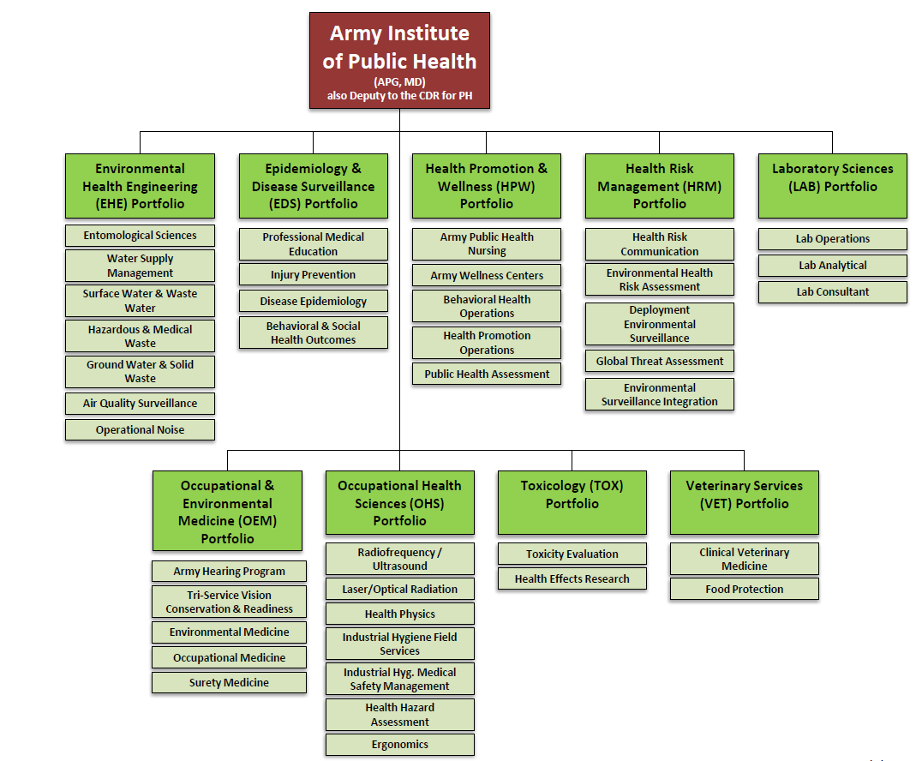
Army Institute of Public Health Organizational Structure
Email: HPW-PHAP@amedd.army.mil
UNCLASSIFIED
3

Slide 4
Public Health Assessment Program
Vision: Improve the health of the Army Family through maximally effective health promotion practice
Mission: Advocate for evidence based health promotion practice within the US Army public health system through systematic assessment
Our activities to accomplish this mission include:
Program evaluation planning, consultation, and review
Qualitative and quantitative data consultation
Identification of evidence-based public health practices and benchmarks
Conducting comprehensive program evaluations
Monitoring and improving standardized systems approaches to public health program implementation and evaluation
Email: HPW-PHAP@amedd.army.mil
UNCLASSIFIED
4
Notes:
We are a multi-disciplinary team that offers a varied but integrative approach to program evaluation.
Focus areas
Conduct systematic program evaluation
Advocate for scientific process in health promotion
Build programs’ internal capacity for program evaluation
Develop metrics
Collect, analyze, report and disseminate data
Monitor impact of health promotion initiatives
Other info – We:
Identify behaviors that are both protective and destructive to optimal health by using the public health process as a standard
Systematically review literature
Identify, catalog, prioritize and promote evidence-based prevention and wellness strategies and best practices and provide subject matter expertise
Where gaps in the evidence exist, collaborate with HPW, other PHC directorates, and external partners to develop, implement, monitor and evaluate interventions to optimize personal and social health and wellness of the Army family.

Slide 5
Public Health Assessment Program
Public Health Assessment Program is a relatively new program which has engaged in a great deal of groundwork in order to identify potential stakeholders and their values
Evaluations are often initiated by leadership, funders, and staff
In order to obtain quality data, it became evident that framing the purpose of the evaluation differently for each stakeholder is a necessity
It also became imperative to frame the findings in a meaningful way for each stakeholder in order to produce stakeholder action
Email: HPW-PHAP@amedd.army.mil
UNCLASSIFIED
5

Slide 6
Overarching Concepts of Communication
Identify the stakeholders and their expectations for reporting
Develop a reporting strategy along with the evaluation strategy
Allocate time, talent, and treasure to effective communication
Revisit communication strategy throughout evaluation and revise
Email: HPW-PHAP@amedd.army.mil
UNCLASSIFIED
6
Notes:
How do your stakeholders prefer to communicate? Email? phone? Face-to-face? How would they like the information delivered? Comprehensive report? Presentation? Round table discussion?
What are your stakeholders most interested in? there are often times things that are interesting to us as scientists and evaluators, but have no bearing on the stakeholders involved. Can anyone think of an example of this? (funders are interested in cost effectiveness, not necessarily customer satisfaction)
If you don’t spend the time to develop these things, effective communication will not occur
Be flexible; things will change. Stakeholders may change. Their opinions may change. Adapt to this in order to ensure your recommendations are still well received

Slide 7
General Communication Tips
Create a mental map of the individual with whom you are communicating
Understand their personality and communication style
Be attentive to body language, both yours and theirs
Maintain cultural competence
Email: HPW-PHAP@amedd.army.mil
UNCLASSIFIED
7
Notes:
There are 4 main things that can help you be a better communicator
Mental map: obtain a 360 view of the person; visual cues (eye contact, body language), auditory clues (voice pitch, speed), and kinesthetics (pauses in conversation, touching people/things)
How are they motivated? Are they an introvert or an extrovert? (concealing feelings/exposing feelings, reflect/interact)
What do they pay attention to? Intuiter or sensor? (future/present, learning new skills/utilizing established skills)
How do they make decisions? Feeler/thinker? (values and subjective judgment/reason and logic)
How do they function? Perceiver/judger? (spontaneous, open/ planning, organizing, decisive)
“Open body language” uncrossed arms/legs, eye contact, smiling, leaning forward, relaxed aura. If possible synchronize your body language to theirs-signifies you are on the same page. Unconsciously, we respond best to those who look, feel, sound, and act like us. Synchronizing body language will help to build rapport
Culture is the “lens through which you view the world”. This does not apply only to ethnicity (although highly important), but it also applies to occupational cultures. Be aware if your stakeholder has a preconception of evaluation, the program, or your organization. Attempt to manage this from the first encounter.

Slide 8
Why is effective communication with stakeholders important?
Helps to maintain good working relationships between stakeholders and evaluators
Ensures stakeholders are engaged during the evaluation
Increases the credibility of the evaluation
Ensures the quality of evaluation data
Ensures stakeholders are able to interpret evaluation findings appropriately
Increases the likelihood that the evaluation findings will be accepted and utilized
Email: HPW-PHAP@amedd.army.mil
UNCLASSIFIED
8
Notes:
What could happen if you don’t engage with your stakeholders in a way they expect and understand?
-might lose interest in the evaluation
-unrealistic expectations of findings/recommendations
-quality data
-ensures actionable recommendations
-Helps to keep everybody happy and on the same page.

Slide 9
Who are potential stakeholders and what are their values?
Who are potential Stakeholders?
Program operators (program staff)
Program management (program leadership)
Program finances (program funders)
Individuals with similar objectives (professionals in a similar field)
What are their values?
Obtaining funding
Developing the program
Promoting the program
Improving the program
Developing the community
Email: HPW-PHAP@amedd.army.mil
UNCLASSIFIED
9
Notes:
Program promotion: ensure program is properly understood, use evaluation data in brochures, flyers, annual reports, explain the benefits of your program
Development and CI: Identify strengths and weaknesses, comparing your performance against what you hope for
Community development: source of renewed commitment to community goals, track progress, develop appropriate service

Slide 10
What are the evaluation questions based on stakeholder values?
Stakeholder | Evaluation Questions?
Program Staff | What is the quality of the program? What can be done to improve the quality of the program? Are end users satisfied with the program’s current status and outcomes?
Program Leadership | What is the quality of the program? What can be done to improve the quality of the program? What is the program’s relationship with staff members? Do current staff approve of the implementation process? Are end users satisfied with the program’s current status and outcomes? What is the program’s relationship with community? How does the community view the purpose/intent/execution of the program?
Program Funders | What is the cost of program? Do the benefits outweigh the costs?
Professionals in a similar field | What is the program’s relationship with staff members? Do current staff approve of the implementation process? Are end users satisfied with the program’s current status and outcomes? What is the program’s relationship with community? How does the community view the purpose/intent/execution of the program?
Email: HPW-PHAP@amedd.army.mil
UNCLASSIFIED
10
Notes:
If you are program staff, what do you care about?
If you are program management, what do you care about?

Slide 11
Exercise 1: Matching Stakeholder Values
Based on your scenario, discuss with your group the possible values held by your target stakeholder.
Stakeholders: Values:
Program Staff Obtaining funding
Program Leadership Developing the program
Program Funders Promoting the program
Professionals in a similar field Improving the program
Developing the community
Email: HPW-PHAP@amedd.army.mil
UNCLASSIFIED
11

Slide 12
Selecting Findings to Present to Stakeholders
All evaluation findings are not relevant to all stakeholders
Utilization-focused: select the findings that are most useful to your stakeholders
Exercise 2: Based on your scenario, identify which findings are appropriate for your target stakeholder and why.
Program staff
Program leadership
Program funders
Professionals in a similar field
Email: HPW-PHAP@amedd.army.mil
UNCLASSIFIED
12
Notes:
So you’ve engaged with your stakeholders, you know what their values are, you’ve conducted the evaluation. Your next step is to determine what findings to present to your stakeholders.
What we’ve been talking about is Utilization focused evaluation: evaluations should be judged by their utility and actual use. This is highly personal, and situational.
Things to consider: how does this finding contribute to program improvement?
how does this finding contribute to major decision making within the program?
how does this finding contribute to decisions regarding funding?
how does this finding contribute to individuals who want to initiate a similar program or fill a similar need?

Slide 13
Importance of Framing Findings
Presentation
Articulate methodology and statistics at the appropriate level of complexity
Context
Mistaking correlation with causality- causation should only be put forth if there is reasonable evidence for it and no compelling evidence against it
Perspective
Statistical significance versus practical significance- results should be considered with a healthy helping of common sense
Spurious correlations- two visible variables are not really linked to each other but are linked to a third, hidden variable
Email: HPW-PHAP@amedd.army.mil
UNCLASSIFIED
13
Notes:
You have now selected the important/relevant findings. How do you frame them appropriately for your stakeholders?
Presentation: you want your stakeholders to understand what the data will and will not tell them. Explain your methods in a way they will understand the limitations and gain appreciation for the importance behind the finding.
Context: while a positive finding is good, be sure your stakeholder knows what it really means. How strong is this finding? Will they be able to utilize it in the way they want? Ensure your stakeholders are aware of the difference between associations and predictions
Perspective: You have a positive statistic, Great!----What does this mean for your stakeholder? How can this be utilized? Think about actionability. Remember to consider all integrated pieces of the puzzle. Be upfront about this.

Slide 14
How do you present findings?
Prioritize findings based on importance to stakeholder
Present findings in unbiased fashion
Clearly explain what the results are and what they mean
Explain why you think the results occurred (support with data)
Develop a plan to correct any issues with evaluation procedures
Report program challenges and what can be done to remediate the problem
Clarify the next course of action
Carefully design follow-up studies
Email: HPW-PHAP@amedd.army.mil
UNCLASSIFIED
14
Notes:
Positive/negative/mixed: present them in the same fashion. Explain the context; for example you did not see an association in your outcomes, but you found that the process was not being implemented as it was intended (as per evidence, policy, etc). The outcome result may have occurred because of this, and therefore a recommendation is to adjust the process by which the program is implemented. Provide them with the tools necessary to do this. What needs to be changed? How? When? Continue monitoring to ensure you are on the right track.
Inconclusive: did something go wrong? Quality of data? Poor evaluation question? Poor method of collecting the data? Be upfront. Attempt to correct problems and re-engage.

Slide 15
Articulating Findings: The Elevator Speech
Concise, planned, punchy description of the findings
Purpose: Effectively communicate the most important results of the evaluation to anyone, anywhere
Keys to development
What are the significant findings? → What does it mean for the stakeholder?
What findings are important to the stakeholder? → Are these findings significant?
Exercise 3: Based on your scenario, target stakeholder, and selected findings, create a 30 second elevator speech framing your evaluation findings.
Email: HPW-PHAP@amedd.army.mil
UNCLASSIFIED
15
Notes:
You’ve selected and framed your findings for your stakeholder. You need to be able to speak to this in a non-lengthy, non complicated way.

Slide 16
Documentation
Evaluation Report:
Introduction
Develop the problem and response
Purpose of the evaluation
Research design and evaluation methodology
Findings
Recommendations
Lessons learned
Email: HPW-PHAP@amedd.army.mil
UNCLASSIFIED
16
Notes:
How do you permeate your findings to others? How do you share with others the effects of the program? The lessons learned? Recommendations? By documenting in a formal evaluation report to proliferate the scientific literature. How do we structure this?
Introduce the program
Discuss the need from which the program arose (situational context)
Why the evaluation was initiated; main evaluation questions
How you conducted the evaluation
What you found
What the findings mean, what does the program do/go from here?
Geared toward evaluation lessons learned, can include things from the program lessons learned. Things that weren’t originally part of the evaluation questions

Slide 17
The Evaluation Report
Do include:
Program description, theory and literature review
Evaluation questions, purpose, and methodology
Summary of key findings (remember to consider your stakeholder and their values)
Discussion of importance of key findings (be sure to frame the findings to parallel your stakeholders’ values)
Recommendations/Action Steps Don’t include:
Limitations with data as part of your findings
Excessive precision of findings
All of the information collected
Recommendations not supported by the data
Additional analyses
Email: HPW-PHAP@amedd.army.mil
UNCLASSIFIED
17
Notes:
Do: information on the program/development
Evaluation questions (explain how this developed out of the stakeholders goals),
What you found, what it means to your stakeholder
Actionable next steps
Don’t: poor quality data,
Every finding; focus on what’s important to your stakeholder
Recommendations not supported by the data (where you can utilize lessons learned if appropriate). This may come out in the motives of the stakeholder, if there’s something they wanted to the evaluation to state and it didn’t/couldn’t. be aware of these biases.
Additional analyses may be included as appendices

Slide 18
Documentation: Graphs
http://www.visual-literacy.org/periodic_table/periodic_table.html
Graphs and tables are typically included in documentations of evaluation findings
Convenient for displaying findings
Not all findings are conducive to graphical displays
Not all graphs are created equal
Most effective graphical displays will easily articulate the findings most important to your stakeholder
Frequencies, means, and percentages are helpful for communicating data to most stakeholders; some stakeholders will want more information
Email: HPW-PHAP@amedd.army.mil
UNCLASSIFIED
18
Notes:
How do you display your findings? In a graph! Be aware, don’t overuse. Make sure its appropriate, and easily understood by your stakeholder. Don’t use it to demonstrate every finding.
Differences in stakeholders; some are satisfied with means and percentages. Some want more. Be sure to provide your stakeholders with the information they are expecting (something you discussed at the onset of the evaluation)

Slide 19
Visuals: Pretty versus Clarity
Email: HPW-PHAP@amedd.army.mil
UNCLASSIFIED
19
Notes:
Which program yielded a higher percent return on investment in year 1? Year 3?

Slide 20
Visuals: Pretty versus Clarity
Email: HPW-PHAP@amedd.army.mil
UNCLASSIFIED
20

Slide 21
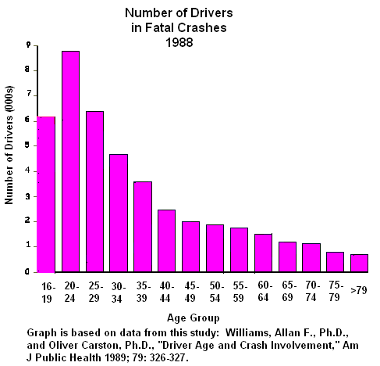
Visuals: Presenting Numbers
Email: HPW-PHAP@amedd.army.mil
UNCLASSIFIED
21
Notes:
This graph shows us the number of drivers in fatal crashes. Based on this graph, it is easy to assume that drivers aged 20-24 were involved in the highest number of fatal crashes in 1988. Is this an accurate representation? Why or why not? (not relevant to how many miles are driven)

Slide 22
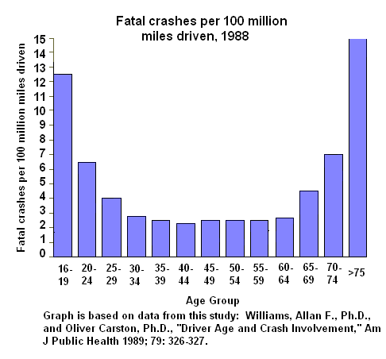
Visuals: Presenting Numbers
Email: HPW-PHAP@amedd.army.mil
UNCLASSIFIED
22
Notes:
In perspective of how many miles are driven by each age group, drivers 75 and older are involved in the highest number of fatal crashes per 100 million miles driven.

Slide 23
Table Version 1
Table 1: Parenting Factor From Parent Survey by Measurement Wave and Condition (Only cases with 3 or 4 waves of data, including baseline)
Condition | Measurement Wave
 | Baseline |  | Post test |  | Booster 1 |  | Booster 2
 | Mean | SD | Mean | SD | Mean | SD | Mean | SD
Family | 2.70 | 0.71 | 2.43 | 0.64 | 2.43 | 0.69 | 2.36 | 0.65
Child | 2.69 | 0.86 | 2.49 | 0.77 | 2.47 | 0.77 | 2.53 | 0.57
Parent | 2.65 | 0.76 | 2.30 | 0.60 | 2.29 | 0.65 | 2.43 | 0.83
Minimal | 2.46 | 0.65 | 2.31 | 0.61 | 2.19 | 0.54 | 2.31 | 0.68
Notes: Parenting factor ranges from 1.00 to 5.68
Email: HPW-PHAP@amedd.army.mil
UNCLASSIFIED
23

Slide 24
Table Version 2
Table 1: Parenting Factor From Parent Survey by Measurement Wave and Condition (Only cases with 3 or 4 waves of data, including baseline)
Condition | Measurement Wave
 | Baseline |  | Post test |  | Booster 1 |  | Booster 2
 | Mean | SD | Mean | SD | Mean | SD | Mean | SD
Family | 2.70 | 0.71 | 2.43 | 0.64 | 2.43 | 0.69 | 2.36 | 0.65
Child | 2.69 | 0.86 | 2.49 | 0.77 | 2.47 | 0.77 | 2.53 | 0.57
Parent | 2.65 | 0.76 | 2.30 | 0.60 | 2.29 | 0.65 | 2.43 | 0.83
Minimal | 2.46 | 0.65 | 2.31 | 0.61 | 2.19 | 0.54 | 2.31 | 0.68
Notes: Parenting factor ranges from 1.00 to 5.68
Email: HPW-PHAP@amedd.army.mil
UNCLASSIFIED
24

Slide 25
Table Version 3
Table 1: Parenting Factor From Parent Survey by Measurement Wave and Condition (Only cases with 3 or 4 waves of data, including baseline)
Statistic | Condition | Measurement Wave
 |  | Baseline | Post-test | Booster 1 | Booster 2
Mean | Family | 2.7 | 2.4 | 2.4 | 2.4
 | Child | 2.7 | 2.5 | 2.5 | 2.5
 | Parent | 2.7 | 2.3 | 2.3 | 2.3
 | Minimal | 2.5 | 2.3 | 2.2 | 2.3
SD | Family | 0.71 | 0.64 | 0.69 | 0.65
 | Child | 0.86 | 0.77 | 0.77 | 0.57
 | Parent | 0.76 | 0.60 | 0.65 | 0.83
 | Minimal | 0.65 | 0.61 | 0.54 | 0.68
N | Family | 104 | 100 | 102 | 54
 | Child | 91 | 91 | 90 | 14
 | Parent | 87 | 84 | 87 | 12
 | Minimal | 106 | 99 | 103 | 57
Note: Parenting factor ranges from 1.00 to 5.68
Email: HPW-PHAP@amedd.army.mil
UNCLASSIFIED
25

Slide 26
Exercise 4: Documentation
Based on your scenario, target stakeholder, and selected findings, determine which type of visual presentation is most appropriate and why.
Email: HPW-PHAP@amedd.army.mil
UNCLASSIFIED
26
Notes:
So lets think about what other kinds of visuals could be used?
Diagrams
Flowcharts
Bar graphs
Line graphs
Pie charts
tables

Slide 27
Dissemination
Evaluation reports are not ideal for all stakeholders
In order to ensure evaluation findings are understood and recommendations are utilized, evaluators must move beyond providing an evaluation report to stakeholders
Involve your stakeholder from the beginning; discuss in what format they would prefer to receive evaluation results in order to meet their needs
Interactive approaches often yield higher utilization of evaluation recommendations
Email: HPW-PHAP@amedd.army.mil
UNCLASSIFIED
27
Notes:
How do you effectively share the findings with your stakeholders? Must take additional steps once you have provided them with the evaluation report in order to ensure that your recommendations are undertaken.
At this point, you should already know your stakeholders wish to receive the information, what they understand, and what their values are.
Be sure to get feedback throughout the dissemination process to ensure they understand.

Slide 28
Common Avenues of Dissemination
Seminars: requires stakeholder attendance/attention to evaluators.
Workshops: requires interaction between stakeholder and evaluators.
Websites: allows stakeholders who may have busy schedules to view findings in an easy format at their own pace; requires conscientious stakeholders.
Conference presentations: requires technical level of understanding of evaluation techniques and ability for stakeholders to be present at conference.
Scientific publications: requires high technical level of understanding of evaluation techniques and stakeholder access to scientific literature.
Email: HPW-PHAP@amedd.army.mil
UNCLASSIFIED
28
Notes:
How can we disseminate evaluation findings to stakeholders? The way you choose will depend on your stakeholder and what their relationship is to the program.
Example: professionals in a similar field: conferences and publications would be appropriate. But would it be for program staff as well?

Slide 29
Exercise 5: Dissemination
Based on your scenario and target stakeholder, determine which avenue of dissemination is most appropriate for your selected findings and why.
Email: HPW-PHAP@amedd.army.mil
UNCLASSIFIED
29

Slide 30
Review
Identify your stakeholders, know their values and expectations
Select the evaluation findings that are most useful for your stakeholders
Frame the findings in a way your stakeholder will understand and be able to utilize
Document the findings in an evaluation report, creating logical graphs and tables for findings most relevant to your stakeholders’ values
Disseminate information based on stakeholders’ abilities and needs
Email: HPW-PHAP@amedd.army.mil
UNCLASSIFIED
30
Notes:
What is the first step to effective communication? Know who you are communicating with
Know what your stakeholder wants out of the evaluation. Select the findings they can use.
Frame the findings so they can understand them
Use logical graphs and tables that will help articulate your findings to your stakeholders
Share the information with your stakeholders in a way that is accommodating to them to ensure action on recommendations.

