Slide 1
Seeking and incorporating youth voice in a residential program setting: The use of a personal rights Check-in tool
Presenter:
Edgar Estrada, B.A.
Additional Authors:
Erin Sullivan, B.A.
Natalie Gallardo, B.A.
Elisa Hernandez, B.A.
Mollie Sternberg, MPH
Cynthia G. Williams M.A.
Janine Quintero Psy. D.
Gina Peck-Sobolewski MA, LMFT
Joe Ford M.A.
Cameo Stanick, Ph. D
Debbie Manners, LCSW

Slide 2
Learning Objective
After this presentation, participants will be able to:
Identify and describe importance of youth insight in evaluation strategy

Slide 3
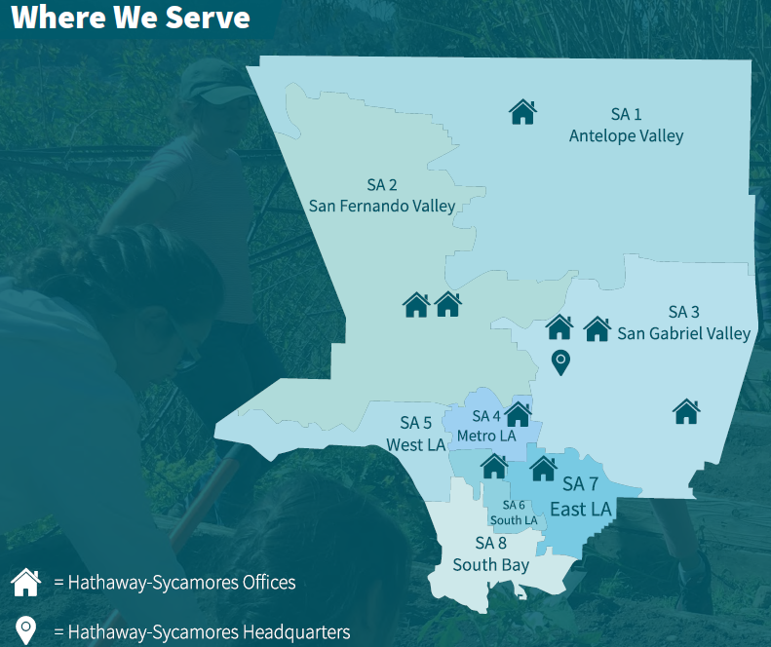
About Hathaway-Sycamores
Largest non-profit community mental health agency in Los Angeles County
4,756 served in 2018-19
2 residential program services
Los Angeles, CA

Slide 4
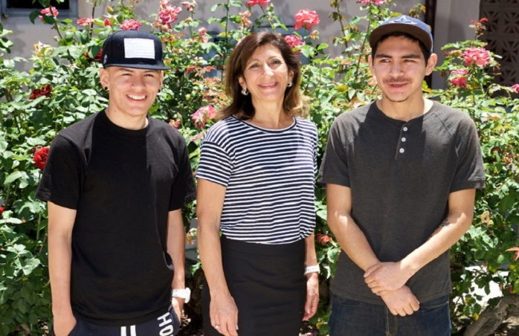
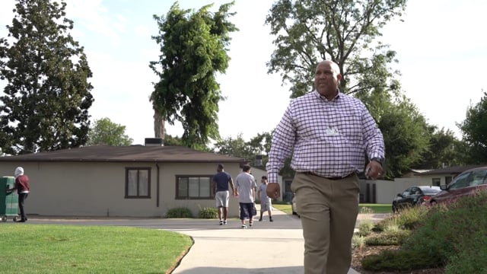
Short-term Residential Therapeutic Program
Residential intervention provides mental health and housing supports
34 Beds
3 Buildings
High Behavioral Intensity Youth
11-18 years old
Predominantly marginalized youth
Intensive Mental Health Services and Support
Clinicians
6 Month Length of Stay target
Facilitators
Parent Partners
Generally male
Youth Advocates
4
Notes:
Large MediCal contract with LACDMH (~50 million/year)

Slide 5
Residential Program Philosophy
Youth-guided
Permanency focused
Family-driven
Emphasis on reconnecting with family and relatives
Inclusion of youth perspective
Services aim for successful return to live with family

Slide 6
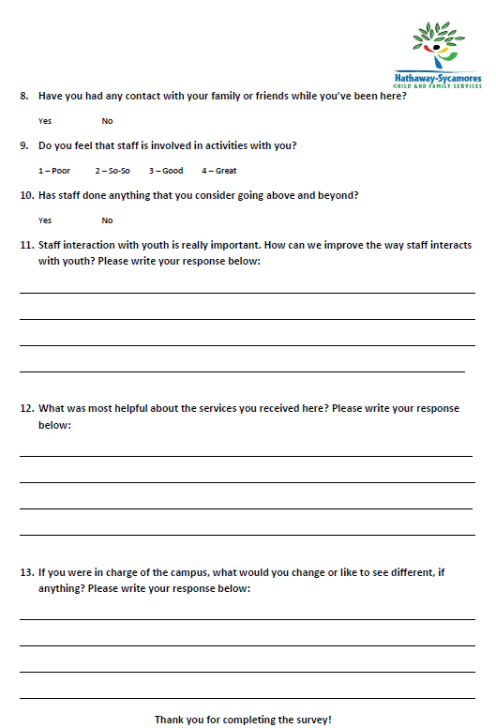
Development of Survey Tool: Personal Rights Check- in
Resources used
Collaboration
Leadership
Survey best practices
Program statement
Research manager
Program staff

Slide 7
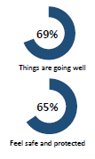
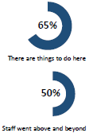
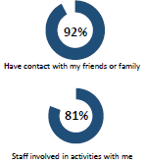
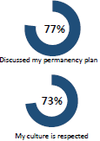
Survey as Evaluation Method
Format
Administration
Community Wellness Specialists
Items
13-15 questions
4-point Likert scale
3 Open-ended
iPad (online)
Paper
Peer Advocates
Notes:
Relevant Stakeholders:
Program Leadership
R&E Team (Analyst/Assistants)
Youth Specialists and Youth voices
About the survey:
5-Point Likert Scale
Open-Ended questions
About 15 survey items
Takes about 3-5 minutes

Slide 8
Survey areas and question examples
Relationships with Family
Have you had any contact with your family or friends while you’ve been here?
Quality of Services
If you were in charge of the campus, what would you change or like to see different, if anything?
Paths to Housing Placement
Have you discussed your permanency plan (where you will go when you leave residential) with a County Social Worker?

Slide 9
Cycle of Improvement: Focus groups
Deep Dives into Specific Survey Items
Establish Data-Driven Initiatives
Responds to specific needs
In-depth assessments
More detailed questions
Informs leadership and staff of target areas for growth

Slide 10
Supporting decision-making
Leverages Insights
Adapt to changing needs and demands
Mobilizes the right resources
Foster a responsive and agile environment
Promotes youth engagement

Slide 11
Take Away Message
Gain valuable insight
Captures authentic youth voice and choice
Catalyst for changes in program service
Improved Decision-making
Provides leaders with a better understanding
Implement changes that target areas of growth

Slide 12
Thank you!
Have questions? Reach out!
CommunityResearch@hscfs.org

Slide 13
References
Bassuk, E. L., DeCandia C. J., Beach, C. A., & Berman (2014). America’s Youngest Outcasts: A Report Card on Child Homelessness. National Center on Family Homelessness. Retrieved from American Institutes for Research website: https://www.air.org/resource/americas-youngest-outcasts- report-card-child-homelessness
Freisen, J. B., Koroloff, N. M., Walker, J. S., & Briggs, H. E. (2011). Family and youth voice in systems of care: The evolution of influence. Best Practices in Mental Health 7(1), 1-25.
House, E. R. (2017). Evaluation and the Framing Race. American Journal of Evaluation, 38(2), 167-189. Doi: 10.1177/1098214017694963
Hilton, L. & Libretto, S. (2017). Evaluation Capacity Building in the Context of Military Psychological Health: Utilizing Preskill and Boyle’s Multidisciplinary Model. American Journal of Evaluation, 38(3), 393-404. Doi: 10.1177/1098214016664584
Li, D., Chng. G. S., & Chu C. M. (2017). Comparing Long-Term Placement Outcomes of Residential and Family Foster Care: A Meta-Analysis. Trauma, Violence, & Abuse, 1-12. Doi: 10.1177/1524838017726427
Patton, M. Q. (2017). Empowerment evaluation: Exemplary is its openness to dialogue, reflective practice, and process use. El Servier: Evaluation and Program Planning, 63, 139-140. http://dx.doi.org/10.1016/j.evalprogplan.2016.10.003
The Joint United Nations Programme on HIV/AIDS (UNAIDS), the United Nations Children’s Fund (UNICEF), and the US Agency for International Development (USAID). (2004). Children on the Brink: A joint report of new orphan estimates and a framework for action. Retrieved from UNICEF website https://www.unicef.org/publications/cob_layout6-013.pdf
Thomas, V. G. & Parsons B. A. (2017). Culturally Responsive Evaluation Meets Systems-Oriented Evaluation. American Journal of Evaluation, 38(1), 7-28. Doi: 10.1177/1098214016644069
13

