Slide 1
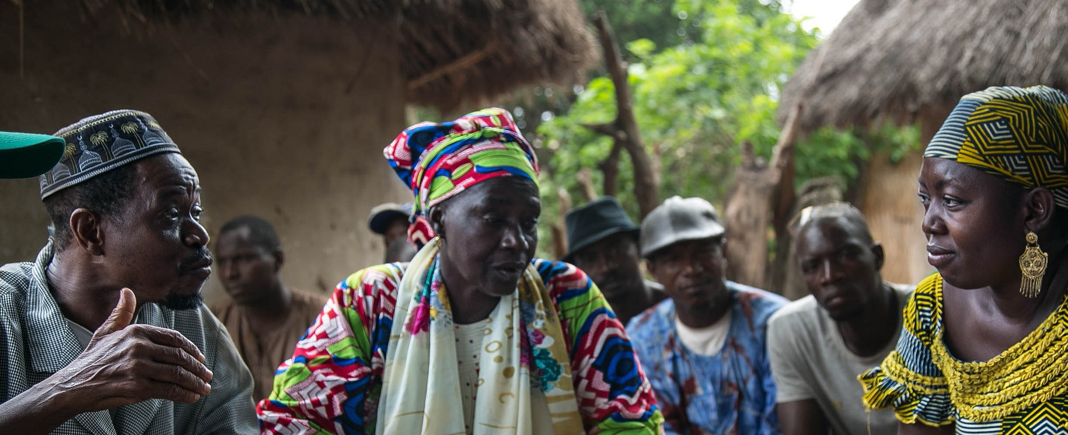
Learning loves company
How RTI’s MERLA Community of Practice has convened experts from across the company for knowledge sharing and collaboration
Sarah Miller Frazer
MEL Specialist
AEA Eval 2018
Notes:
By a show of hands – who knows that feeling of working in silos? Wondering if other people are working on what you are working on?
Who Knows the feeling of re-creating the wheel?

Slide 2
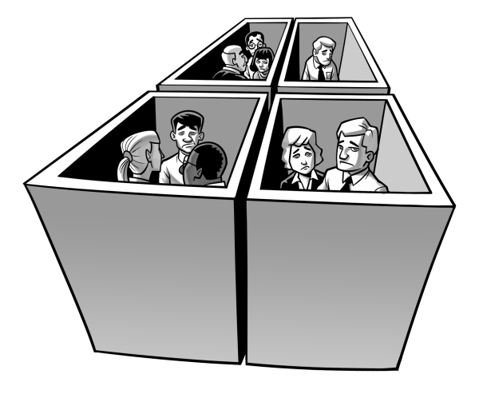
That feeling when
Notes:
That feeling of not learning, not sharing, missing out
When myself and 2 other evaluator colleagues in other divisions realized that we were working on similar problems, we started meeting for lunch once a month, but still did not have a way to easily share tools and problem solve together,

Slide 3
Connect, Share, Leverage
Notes:
We needed a space to connect with each other, share methods and ideas and leverage each others experience
Wanted a structure to for collaborating, learning from each other and bringing new innovations and successful approaches to our work

Slide 4
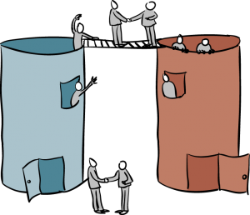
Bridging Silos
Notes:
The goal being, to keep our sectoral expertise but have a structure and a place to share
We wanted a space where staff working in evaluation but also, research, capacity development, program management, and could draw from existing expertise and experience to learn from each other.

Slide 5
Community of Practice
Notes:
This is where our MERLA Community of Practice came from – a desire to work more closely with and learn from staff across divisions
We wanted to share tools, ideas, get advice, problem solve talk about the latest developments in the field on all things Evaluation

Slide 6
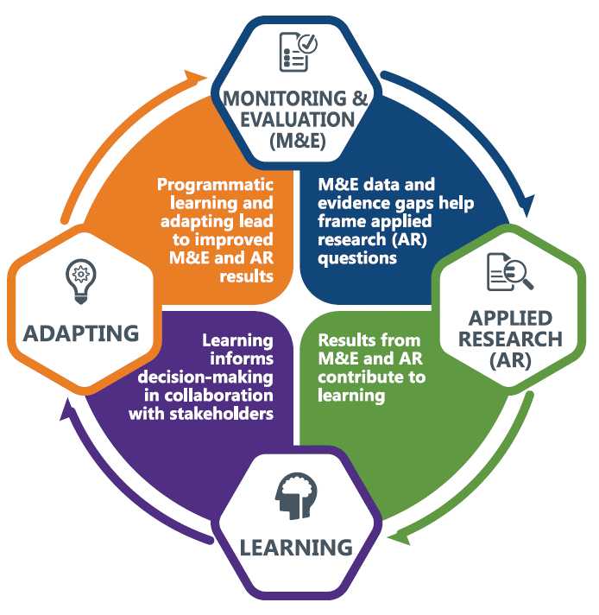
RTI’s MERLA Cycle
Notes:
Our community of practice works on MERLA Monitoring, Evaluation, Research, Learning and Adapting
It is the cycle of applying results-focused M&E and research for continuous learning and adapting to improve program effectiveness

Slide 7
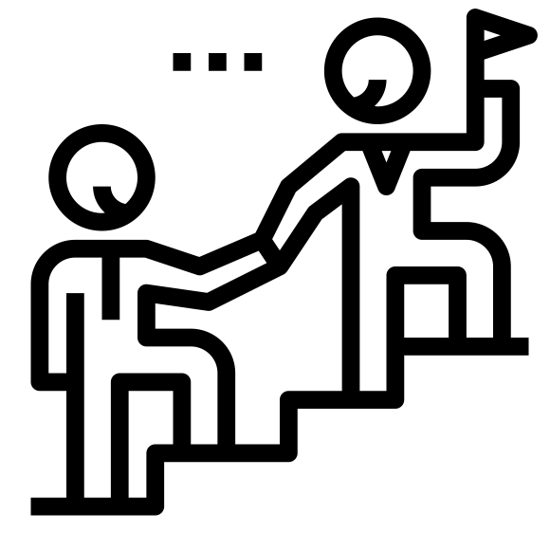
Leadership Support
Notes:
The turning point in making this CoP a reality was that RTI leadership invested support and internal funding for this effort
This was a lesson learned for us - having leadership’s buy-in and support from the beginning is essential for making something like this successful

Slide 8
Inaugural year activities
Notes:
At the end of our first year, we have 60 members across sectors who regularly collaborate online and meet monthly
Our meetings discuss subcommittee work and feature one member sharing "notes from the field“ on a recent success, challenge, or innovation

Slide 9
Core members across divisions
Notes:
While all of our activities are open to our general members, whether evaluation staff or other roles
We’ve found that an important factor in our success has been a core group of 15 or so members, who do the bulk of the work in subcommittees
Here is some of the work we focused on this year

Slide 10
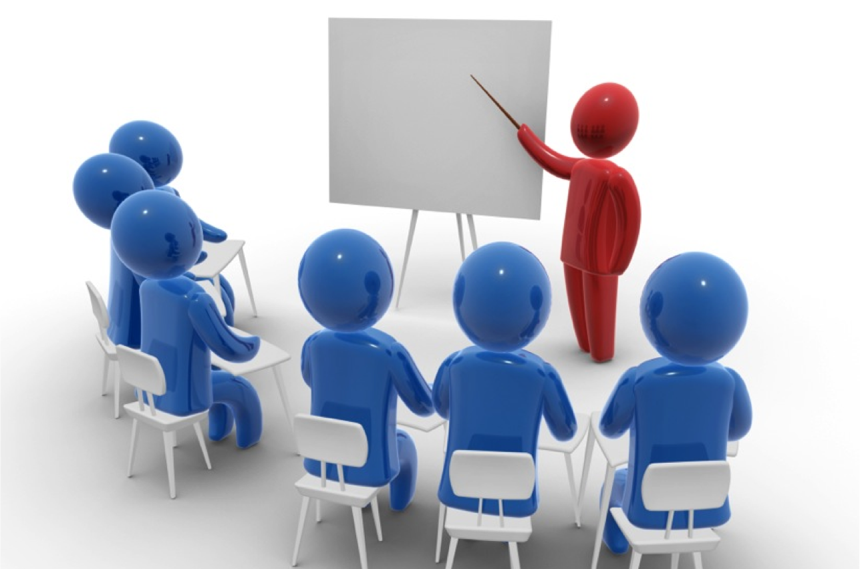
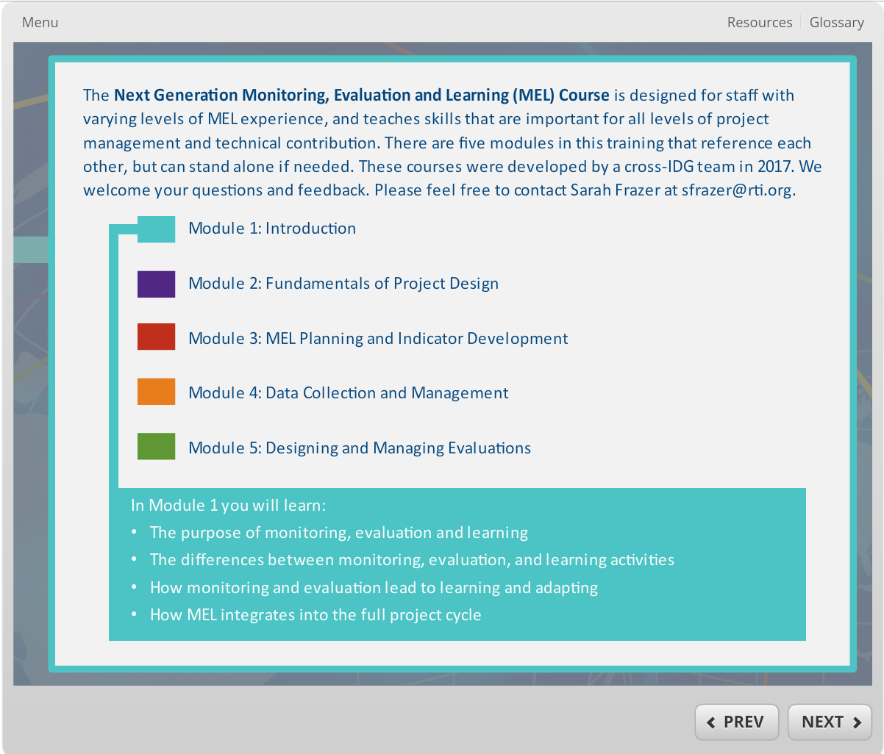
Internal Trainings for RTI Staff
Trainings on MEL, CLA, proposals and projects
Online, self-directed MEL 101 Course
Notes:
Created a training series on MERLA topics related to both projects and proposals. For example a training on how CLA goes beyond your M&E team and how the IRB approval process works
We also launched an online, internal, self-directed MEL 101 course that’s encouraged for all staff, of all levels

Slide 11
Internal Resources for RTI Staff
Directory of staff experience with MERLA tasks
Tools and resources repository
Notes:
After conducting a survey of our staff capabilities we created a directory to better connect people and their skill sets.
And we created a tools and resources repository to provide a central location for sharing for use across projects

Slide 12
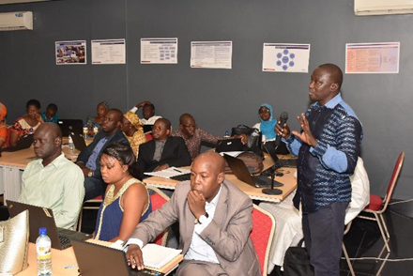
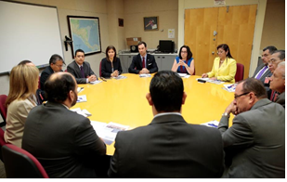
Leverage Experience across Projects
Refine guide for internal reflection session
Learning agenda examples and workplans
Notes:
A few examples of how we leveraged the directory and the tools and resources:
I shared the guide I had developed for internal pause and reflection sessions, with a colleague in the global health division to help her plan a similar session
Similarly, we’ve shared example learning agendas, the process for developing them, and the workplans, as more projects develop them.

Slide 13
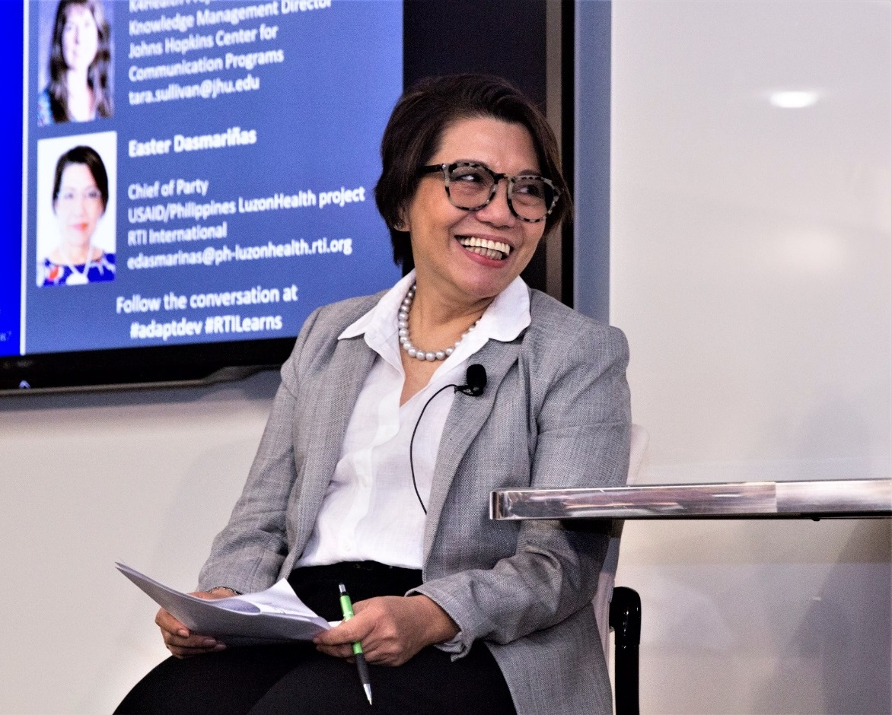
Learning events
Washington, DC Learning Symposium
Philippines Projects Learning Summit
Notes:
We held 2 large events this year,
first roughly 250 people from 40 organizations attended our Learning Symposium panel in DC
Then RTI’s 5 projects and USAID’s CLA project in the Philippines the came together to share their strategies for learning and adapting and discuss ways to collaborate

Slide 14
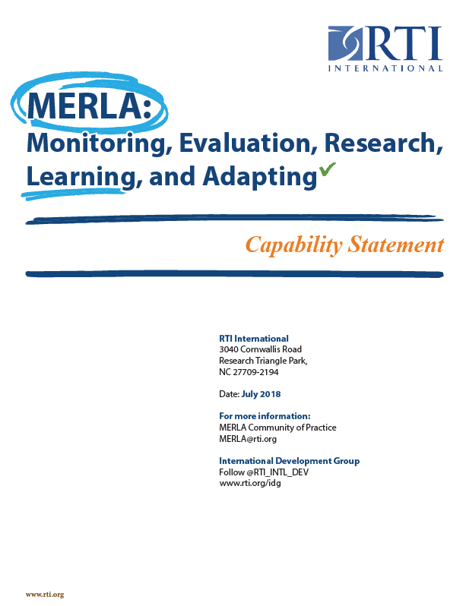
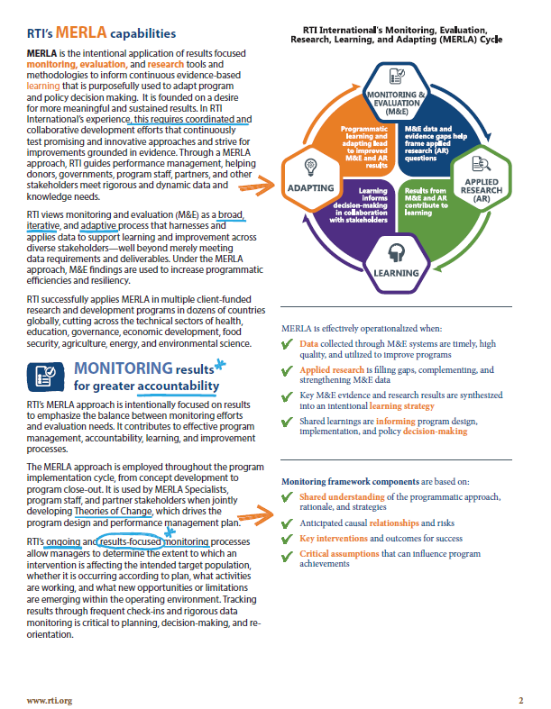
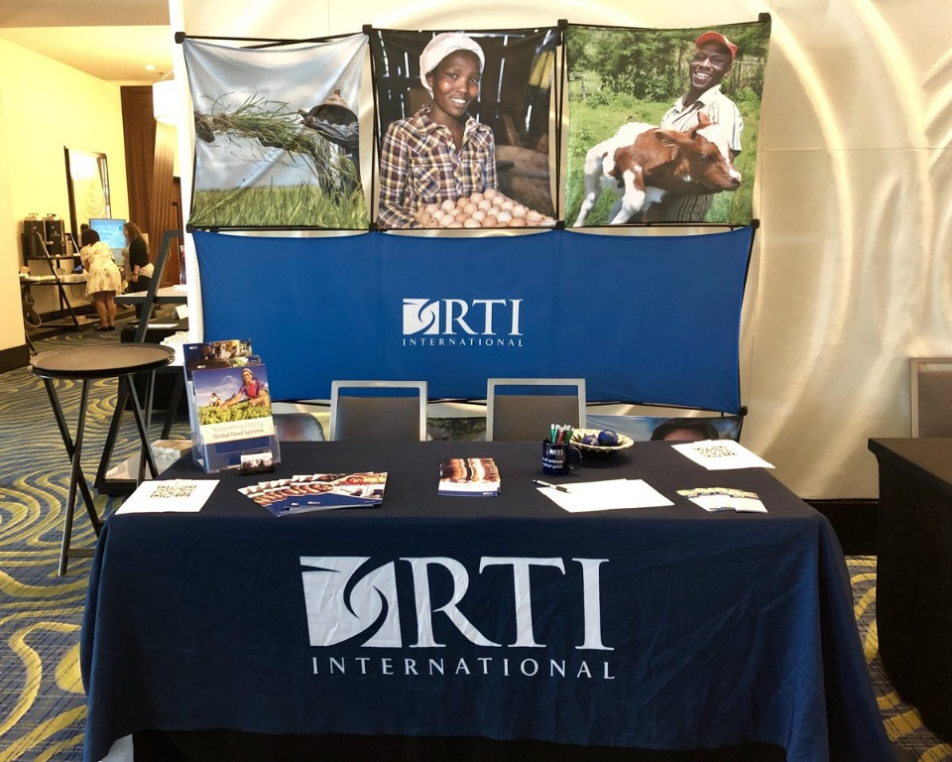
External Communication
MERLA communication materials
Conferences
(come see us at Booth 30)
Notes:
We developed some MERLA communications materials to be shared with partners, collaborators, funders, and the wider community.
And members of our community attended multiple conferences this past year – come see our booth!

Slide 15
The way forward
Sustainability
Strategic Direction
Notes:
Looking forward we face some big questions and challenges.
In particular, questions about our sustainability and our strategic direction. We need to prove the value add to the organization, and figure out exactly what we work on

Slide 16
Challenges
Field Staff involvement?
Notes:
One question is how we can better incorporate and support field teams, communication can be hard, languages, time zones, technology, systems are different, and we want to encourage meaningful engagement.

Slide 17
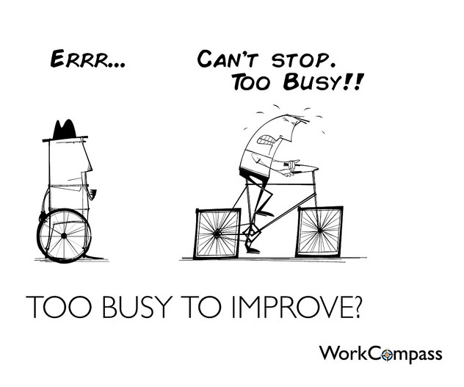
Challenges
Commitment?
Notes:
Our core members produced most of the outputs this year. We need to think about the sustainability, beyond depending on these certain individuals

Slide 18
Challenges
Funding?
Notes:
We are trying to figure out how to continue to support and grow the CoP if there is no longer internal funding for the initiative. Would people participate if there was not a charge code for them to bill their time? How do we produce as many outputs and get participation from as large a number of people and divisions.

Slide 19
Do you have a community of practice?
Notes:
So now that I’ve shared about what we set up and the challenges we faced, I want to put out an offer to connect.
I’d love to hear about your communities of practice, lessons you’ve learned, how you’ve overcome your challenges, and I’m happy to share more about what we’ve done and what we learned

Slide 20
Thank you!
Sarah Miller Frazer
MEL Specialist
sfrazer@rti.org
Notes:
Here is my email
I’m also doing a birds of a feather session over lunch today at 12:30 – so come find me there and we can talk more
It’s an idea exchange, networking table, informal discussion on CoPs and fostering organizational learning and sharing

