Slide 1
Evaluation with Law Enforcement Agencies in Tanzania, Lessons Learned
2013 American Evaluation Association Annual Conference
Washington DC, 17th October 2013
Authors: Daisy Kisyombe, Todd Malone, Anthony Binamungu, Frida Chilimo

Slide 2
Pact - building local promise
Health
Livelihoods
Natural
Resources
Impact
Capacity
Development
Good
Governance
Access to
Markets
Results and Measurement
Pact implements over 70 projects in 26 countries
Notes:
Talking points:
Pact is an international non-profit organization based in Washington, DC.
Our main impact areas of work include: Health, Natural Resource Management, Livelihoods.
Our core competencies are: Capacity Development, Governance, Engaging Markets.

Slide 3
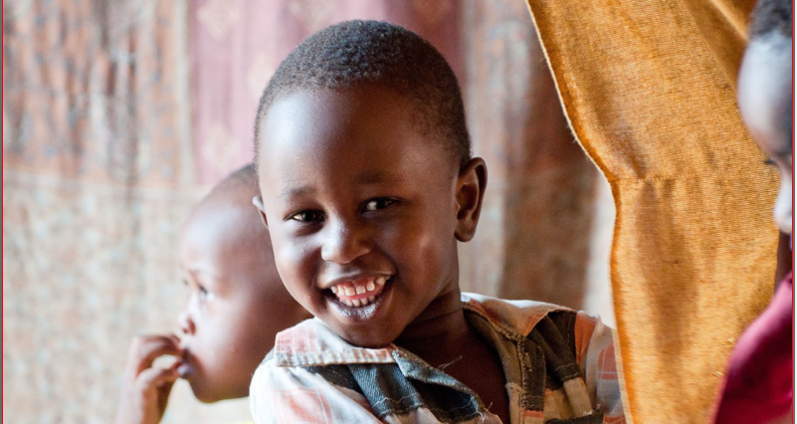
Background
The Project
Pact established Child Protection Units and trained Police to protect children who need support and children in contact/conflict with the law. A one year Pilot in two sites in Tanzania.
The Evaluation
6 focus groups discussions
11 most significant change stories
Notes:
Child protection with law enforcement agencies
District Child protection systems strengthening

Slide 4
Evaluation questions
To what extent has Child Protection activities been implemented?
How has the implementation of Child protection systems strengthening model contributed towards child protection?
What are the strengths and weaknesses of using the systems strengthening model especially District Child Protection Teams?
What are the lessons learned in the implementation of Child protection systems strengthening model?
How relevant were the mechanisms and tools used to implement this program in line with the objectives of the program?

Slide 5
Findings- Program contribution to child protection
Awareness of Law of a Child Act, 2009 for prisons officers resulting in children getting fair treatment and children being separated from adults in prisons
Improved working conditions
Computers and furniture
Privacy in the gender and children desk office
Strengthened referral network and increased collaboration between implementers in the Child Protection units

Slide 6
Findings- Strengths & weaknesses of the system
 | STRENGTH | WEAKNESS
1 | Multisectoral structure of DCPT enhancing collaboration and coordination | The structure relies on specific members of the team and limited people
2 | Identification and reunification of children victims of forced labour and domestic trafficking | Referral points depending entirely on the trained personnel members of the team
3 | Referral of children in need of temporary shelter to the nearby children homes or orphanages. | Children homes have limited resources, are not part of the DCPT and mostly unaware of the child protection work.

Slide 7
Findings- systems strengthening
Reporting of child abuse cases
108 incidences were reported at the police gender and children desk (Mar - Nov 2011) no data prior
Operationalization of the Child Protection Information management system
Support led to improving the draft of Police Standard Operating procedures for Child protection and gender based violence

Slide 8
Findings -Areas for improvements
The structure relies on limited members of the team who have acquired skills and knowledge on child protection
Heavy demands for urgent responses and action towards reported cases
Inefficiency or poor support services for victims of abuse e.g. unavailability of temporary shelters, demand for service fees at health facilities
Community willingness to testify to cases of abuse is poor

Slide 9
Lessons learned
Qualitative evaluation methods are feasible to evaluate sensitive subjects with law enforcement agencies
Child Protection System Strengthening Program brought a positive shift in understanding the concept of child rights and protection
Addressing household vulnerability is avenue to facilitating family reunification

Slide 10
How the evaluation findings are being used
Pact
Support establishment of Child Protection program in 3 more districts
Continue supporting pilot districts for improved performance
Government
Roll out the Police Standard operating procedures for Child Protection and Gender Based Violence

Slide 11
Thank you for your time Daisy Nathan Kisyombe dkisyombe@pactworld.org
We acknowledge
Our Donor : USAID through Pharm Access International
Our partners:
Musoma Municipal Council, Bukoba District Council,
Tanzania Police Force, Local NGOs and
Communities where project was implemented

