Slide 1
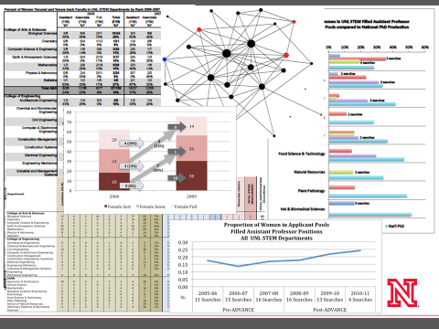
Using Evaluation Data to Inform Programmatic and Institutional Change
ADVANCE-Nebraska
Advancing Women, Advancing STEM
Mindy Anderson-Knott, Trish Wonch Hill and Jenn Rutt
Benefits:
Improved rigor over traditional evaluation designs
Sampling
Measures
Response Rate
Expanded research questions and methods
Different analytic tools
More diverse data
Reach broader audience
Different data speaks to different people
Contributing to disciplinary knowledge
Barriers:
Communication
Time and patience required to translate across disciplines
Cost
Funding both evaluation and research is costly
Time
Research requires analysis that takes more time
The peer review process takes additional time
EVALUATION
PROGRAMMING DECISIONS
DATA
SCIENTIFIC
KNOWLEDGE
RESEARCH

