Slide 1
Assessing Program Fidelity Across Multiple Contexts: The Fidelity Index, Part II Session # 814 Joel Philp, Krista Collins, and Karyl Askew The Evaluation Group
American Evaluation Association Annual Conference
October 13-18 2014
Denver, CO

Slide 2
For Today
Introductions – Joel, Krista, and Karyl
Review – Steps in Creating a Fidelity Index (Joel - 15 minutes)
Applications and lessons learned in different education contexts across different phases of fidelity assessment:
Designing (Karyl –i3 STEM - 15 minutes)
Monitoring and Adaptation (Krista – RTT-D Blended Learning - 15 minutes)
Reporting (Joel – i3 College prep - 15 minutes)
Answer questions and hear your comments (20-30 minutes)

Slide 3
Background
TEG has evaluated over 150 education-based programs over the last 20 years
Most are multi-year, multi-component programs
Most have some type of fidelity assessment, but little guidance exists
Ex., What Works Clearinghouse is explicit on impact evaluation, silent on implementation evaluation

Slide 4
Review: What is a Fidelity Index?
Fidelity Index:
“A quantitative assessment of the extent to which a multi-component intervention has been implemented as intended across the program.”
Computing a Fidelity Index requires us to “roll-up” scores:
Program-Level
Component-Level
Individual-Level
(see handout)

Slide 5
Review: 8 Key Criteria for Assessing the Implementation of any One Program Component (Durlak and DuPre, 2008)
Individual Level | Program Level
Adherence | Reach
Dosage | Differentiation
Quality | Contrast
Responsiveness | Adaptation

Slide 6
Review: A Simple Example
School-based program for 100 at-risk students
Mentoring
Case Management
Higher grades, motivation
Enroll in college
College Prep Workshops

Slide 7
Review: Steps in Creating a Fidelity Index
Step #1: Identify Key Components
Decide what are the Key Components of your Multi-Component Program.
Everything can’t be a key component.
More key components you identify, the more complex the implementation assessment.
Tip: Stick to direct services as key components (not preparation or planning services)

Slide 8
Review: Steps in Creating a Fidelity Index
More from Karyl
Step #2: Determine your criteria
Select 1 key component and decide the criteria you will use to assess its implementation
Some criteria are more difficult to measure than others (ex., Quality)
You don’t need to use all criteria!
In the example, we will use the first 4 criteria with MENTORING, all of which can be measured at the individual-level
Criteria
Adherence
Dosage
Quality
Responsiveness

Slide 9
Review: Steps in Creating a Fidelity Index
Step #3: Operationalize your criteria
Define the criteria and plan for data collection
Criteria | MENTORING Operationalized Criteria
Adherence | 3 Core ingredients: Mentor must be: an Adult; received training; and be the same gender as his/her mentee. Method: Student survey
Dosage | Weekly 1-1 meetings, minimum of 45 minutes each: Method: School Sign-in/out sheets
Quality | Three standards of quality Mentoring: Mentor is on-time; reviews previous meeting; listens/ask questions: Method: student survey
Responsiveness | Students rate their satisfaction with mentoring on a 1-5 scale. Method: student survey

Slide 10
Review: Steps in Creating a Fidelity Index
Step #4: Determine Levels and Thresholds
Define the # of levels of implementation
Can have any number of levels, but 2-3
seems best. For example:
Adequate/not adequate
Poor/satisfactory/exemplary
Below expectations/meets expectations/exceeds expectations

Slide 11
Review: Steps in Creating a Fidelity Index
Step #4: Determine Levels and Thresholds
Define the thresholds (i.e., targets) for each level
Thresholds and criteria are set a priori from:
Discussions with program staff
Review of program model or grant narrative
Known best practices cited in the literature
Historical program evidence

Slide 12
Review: Steps in Creating a Fidelity Index
Levels (3)
Mentoring Component
Criteria | Poor | Adequate | Exemplary
Adherence | 1 of 3 core ingredients | 2 of 3 core ingredients | 3 of 3 core ingredients
Dosage | 1/month or less | 2-3 month | 4+ per month
Quality | Meets 1 of 3 mentoring standards | Meets 2 of 3 mentoring standards | Meets all 3 mentoring standards
Responsiveness | Rating of 1-2 | Rating of 3-4 | Rating of 5
Thresholds

Slide 13
Review: Steps in Creating a Fidelity Index
Step #5: Assign scores to each level; compute the range
Here, scores range from 4 (all criteria scored ‘1’) to 12 (all criteria scored a ‘3’)
Criteria | Poor (1) | Adequate (2) | Exemplary (3)
Adherence | 1 of 3 core ingredients | 2 of 3 core ingredients | 3 core ingredients
Dosage | 1/month or less | 2-3 month | 4+ per month
Quality | Meets 1 of 3 mentoring standards | Meets 2 of 3 mentoring standards | Meets all 3 mentoring standards
Responsiveness | Rating of 1-2 | Rating of 3-4 | Rating of 5

Slide 14
Review: Steps in Creating a Fidelity Index
Step #6: Define implementation at the Individual level
Determine the range of summed scores that will define poor, adequate, and exemplary implementation
For example:
4-6 = poor implementation
7-9 = adequate implementation
10-12 = exemplary implementation

Slide 15
Review: Steps in Creating a Fidelity Index
Step #7: Define implementation at the Component level
Determine a priori the range of summed scores that will define poor, adequate, and exemplary implementation at the component level, and assign a score to that level:
If 50% or fewer score between 10-12 = Poor implementation = score of 1
If 51-74% score between 10-12 = Adequate implementation = score of 2
If 75% or more score between 10-12 = Exemplary implementation = score of 3

Slide 16
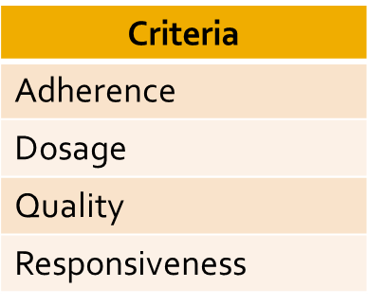
Review: Steps in Creating a Fidelity Index
Step #8: Repeat steps 2-7 for each of your identified key components
Mentoring
Case Management
College Prep Workshops

Slide 17
Review: Steps in Creating a Fidelity Index
Step #9: Define Implementation at the program level
Determine a priori the range of summed scores that will define poor, adequate, and exemplary implementation for ALL component at the PROGRAM level, and assign a score to that level:
Ex.: With 3 components, each with same scoring = range of 3-9:
Poor implementation = Combined score of 4 out of 9 (44% or less) or less summed across all components
Adequate Implementation = Combined score of 5-7 out of 9 (55 -77%) summed across all components
Exemplary implementation = Combined score of 8-9 out of 9 summed across all components (78% or higher)

Slide 18
Review: Steps in Creating a Fidelity Index
Step #10 : Score each component at the predetermined time.
Mentoring Component
Criteria | Poor (1) | Adequate (2) | Exemplary (3)
Adherence | 1 of 3 core ingredients Score =1 | 2 of 3 core ingredients | 3 core ingredients
Dosage | Ave 1/month or less | Ave 2-3 month Score = 2 | Ave 4+ per month
Quality | Meets 1 of 3 mentoring standards | Meets 2 of 3 mentoring standards Score = 2 | Meets all 3 mentoring standards
Responsiveness | Rating of 1-2 | Rating of 3-4 | Rating of 5 Score = 3
Summed Score = 8 (adequate)

Slide 19
Review: Steps in Creating a Fidelity Index
Step #11: Roll–up across components and entire program
Score | N | %
4-6 | 15 | 15%
7-9 | 20 | 20%
10-12 | 65 | 65%
Mentoring
Score
2/3
Score | N | %
4-6 | 10 | 10%
7-9 | 12 | 12%
10-12 | 78 | 78%
Fidelity Index
6/9, 66% or Adequate Implementation
Score
3/3
Case Management
Score | N | %
4-6 | 25 | 25%
7-9 | 45 | 45%
10-12 | 30 | 30%
Score
1/3
College Prep Workshops

Slide 20
Design: INSPIRE – An US DOE i3 Grant
K-12 STEM pipeline approach for STEM course content and instructional design.
Year 1 of a four-year i3 grant that mandated studies of impact and fidelity of implementation.
Target Sample
1 School District
4 Schools (2 Elementary , 1 Middle, 1 High)
2085 K – 12 Students
95 K – 12 Teachers

Slide 21
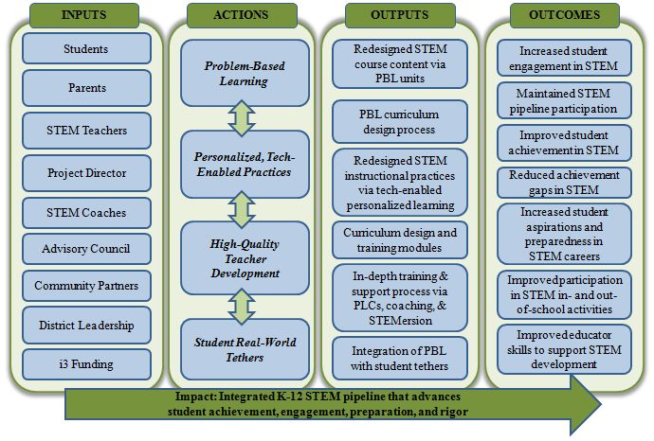
Design: INSPIRE Logic Model - Components

Slide 22
Design: INSPIRE Fidelity Index - Components
1. STEM problem-based and project-based learning (PBL) INSTRUCTION |  | 2. PERSONALIZED, TECH-ENABLED INSTRUCTION
3. TEACHER PROFESSIONAL DEVELOPMENT AND SUPPORT |  | 4. STUDENT REAL-WORLD STEM TETHERS

Slide 23
Design: INSPIRE Fidelity Index – Criteria Identified
1. STEM problem-based and project-based learning (PBL) INSTRUCTION # of PBL lessons developed (A) % of PBL lessons that are interdisciplinary (A) % of PBL lessons meeting quality criteria (Q) % of teachers implementing PBL lessons (A/D) % of students reporting favorable opinions (Rs) % of teachers reporting favorable opinions (Rs) |  | 2. PERSONALIZED, TECH-ENABLED INSTRUCTION % of PBL lessons incorporating technology (A) % of STEM teachers rating experiences as “good” or “excellent” (Rs) % of STEM students reporting weekly use of technology with adaptive content (R/D) % of STEM students rating experiences as “good” or “excellent” (Rs)
3. TEACHER PROFESSIONAL DEVELOPMENT AND SUPPORT # of INSPIRE trainings and institutes offered (A) % STEM teachers completing 10 hours of STEM PD per year (R/D) % of teachers utilizing on-site STEM coaches per month (D) #, % of teachers participating in STEM Professional Learning Communities (PLCs) per month (D) % STEM teachers demonstrating increased PBL proficiency (Q) |  | 4. STUDENT REAL-WORLD STEM TETHERS % of STEM students participating in school-sponsored STEM events by level per year (D) % of STEM students who participate in NASA summer camps per year (R) % of STEM students who report STEM-related career aspirations (Q) % of STEM students rating experiences as “good” or “excellent” (Rs)
Legend
A=Adherence; D=Dosage; R=Reach; Q=Quality; Rs=Responsiveness

Slide 24
Design: INSPIRE Fidelity Index – Criteria Defined
A_{ES}. % of K-5 STEM students who participate in at least 2 school-sponsored STEM events (D). Measure: School administrative records and permission slips.
B. % of NASA summer camp slots filled (R). Measure: NASA Camp daily attendance records.
C. % of STEM events achieving an average effectiveness rating of 3.0. Measure: STEM Event Teacher Survey quality subscale.
D. % of STEM students rating experiences as “good” or “excellent” (Rs). Measure: INSPIRE Year-End Student Survey.
4. STUDENT REAL-WORLD STEM TETHERS % of STEM students participating in school-sponsored STEM events by level per year (D) % of STEM students who participate in NASA summer camps per year (R) % of STEM students who report STEM-related career aspirations (Q) % of STEM students rating experiences as “good” or “excellent” (Rs)
Legend
A=Adherence; D=Dosage; R=Reach; Q=Quality; Rs=Responsiveness

Slide 25
Design: INSPIRE Fidelity Index – Thresholds
Criteria & Measure | Year 1 Threshold
A_{ES}. % of K-5 STEM students who participate in at least 2 school-sponsored STEM events (D; PM 4.4). Measure: School administrative records and permission slips. | 733 of 1466 (50%) STEM elementary school students
B. % of NASA summer camp slots filled (R). Measure: NASA Camp daily attendance records. | 240 of 300 (85%) NASA camp slots
C. % of STEM events achieving an average effectiveness rating of 3.0. Measure: STEM Event Teacher Survey quality subscale. | 60% of STEM Events
D. % of STEM students rating experiences as “good” or “excellent” (Rs). Measure: INSPIRE Year-End Student Survey. | 1563 of 2085 (75%) Targeted STEM students

Slide 26
Design: Tips and Takehomes
Begin with a logic model to identify key components.
Engage stakeholders in an iterative process to determine the appropriate criteria and thresholds.
Collaboration and communication can help to ease/calm stakeholders’ anxiety and increase commitment to data collection.

Slide 27
Monitoring: IMPACT – An US DOE Race to the Top District (RTT-D) Grant
1 School District
9,526 students
616 teachers
-9 middle schools
-4 high schools
-2 alternative schools
Individualized Student Learning
Student Transition Activities
Blended Learning Implementation
Student College and Career Readiness
Professional Development
Data Driven Decision Making
Teacher Effectiveness
Sustainability

Slide 28
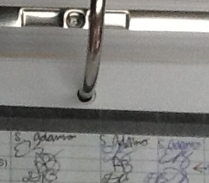
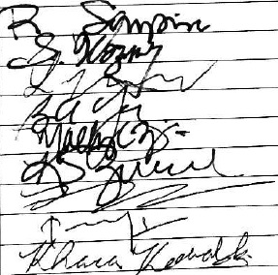
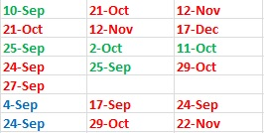
Monitoring: Oversee Data for Fidelity Index
Is the necessary data available?
How is the data being collected?
Are the targets set being met?

Slide 29
Adaptation: Initial Fidelity Index
Individualized Student Learning
Blended Learning
Demonstration Classrooms
Student Transition Activities
Summer Transition Camp
College Readiness Institute
Professional Development
Teacher PD
Self-Assessment
Data Driven Decision Making
Personalized Learning Communities
Individualized Coaching

Slide 30
Adaptation: Adapt FI to Align with Current Program Focus: End of Year 1
Individualized Student Learning
Blended Learning
Demonstration Classrooms
Student Transition Activities
Summer Transition Camp
College Readiness Institute
Professional Development
Teacher PD
Self-Assessment
Data Driven Decision Making
Personalized Learning Communities
Technology
Individualized Coaching
Admin PD

Slide 31
Adaptation: Adapt FI to Align with Current Program Focus: Thinking Ahead
Individualized Student Learning
Blended Learning
Demonstration Classrooms
Student Transition Activities
Summer Transition Camp
College Readiness Institute
Professional Development
Teacher PD
Self-Assessment
Data Driven Decision Making
Personalized Learning Communities
Technology
Individualized Coaching
Admin PD
Sustainability

Slide 32
Adaptation: Revise Targets Annually
Summer Transition Camp
Measure | Year 1: 2013-2014 |  |  |  | Year 2: 2014-2015
 | Target | Actual | Weight | Total | Target | Weight
Dosage: % of participating students attending all days | 60% | 87.1% | .40 | .58 | 70% | .50
Reach: % of targeted students attending | 30% | 17.9% | .20 | .12 | 30% | .20
Responsiveness: % of students who rated the STC as “useful” to “very useful” | 60% | 95.7% | .40 | .64 | 70% | .20
Quality: % of best practices implemented | N/A | N/A | N/A | N/A | 60% | .10
INDIVIDUAL ACTIVITY FIDELITY: |  |  |  | 1.34 | Fidelity in Place

Slide 33
Monitoring and Adaptation: Tips and Takehomes
Monitor the data for the fidelity index
Establish the format for all data collection tools
Developing a fidelity index is an iterative process
Adapt fidelity index to align with current program goals and performance levels
Reconfirm that fidelity index will address longitudinal interests

Slide 34
Reporting
What are some ways of reporting fidelity?
Roll-up across key components to get a final program -wide score
Report implementation of each key component separately (# adequately implemented)

Slide 35
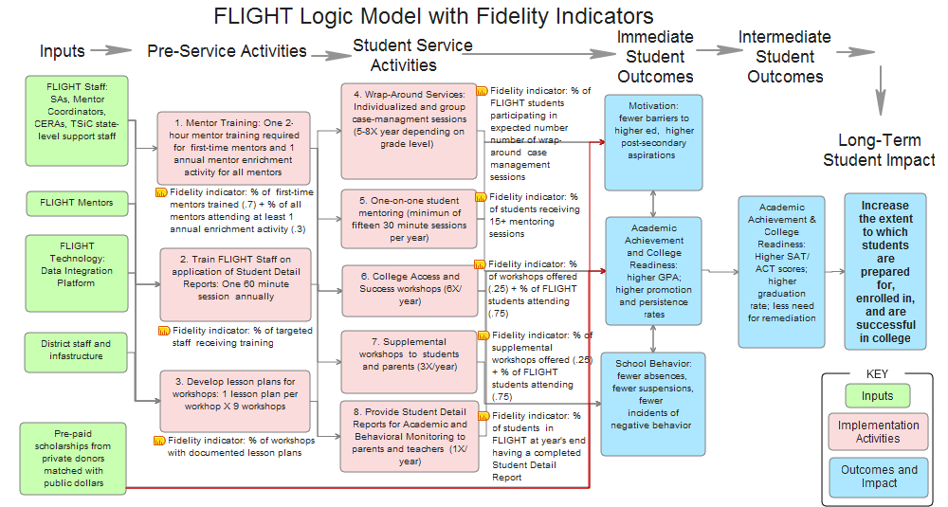
Reporting: Program Wide Fidelity Score

Slide 36
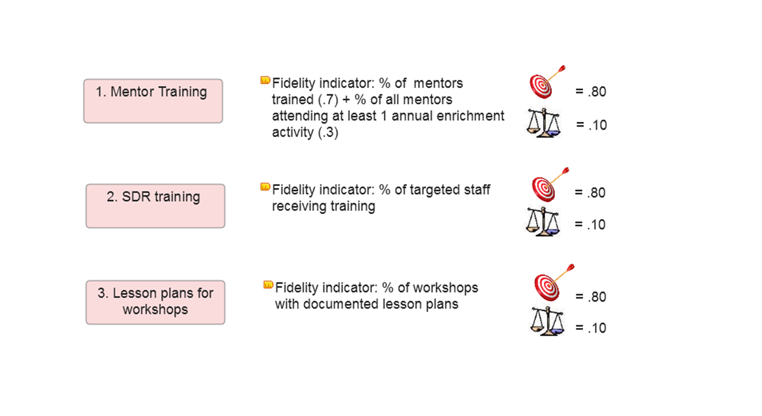
Reporting: Program Wide Fidelity Score

Slide 37
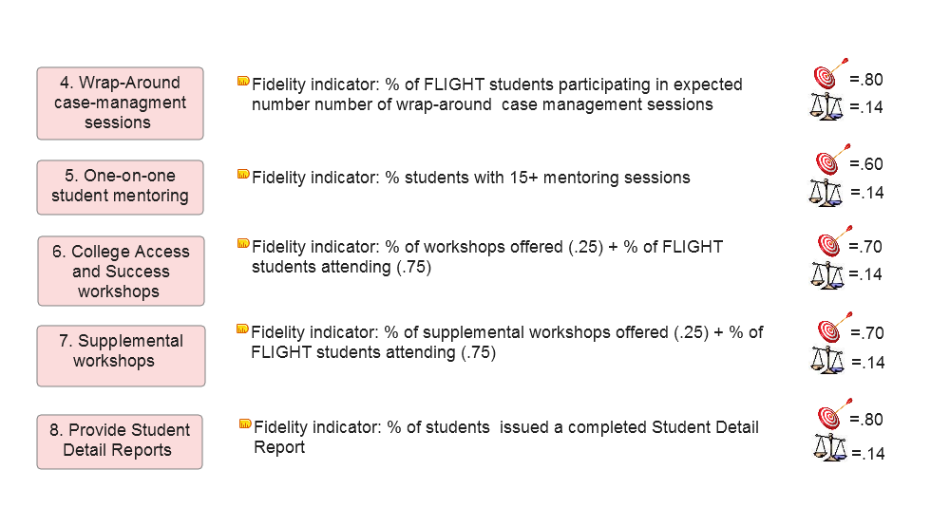
Reporting: Program Wide Fidelity Score

Slide 38
Reporting: Program Wide Fidelity Score
A program component score is the ratio between what was expected (the target) and what actually occurred
A score of 1.0 = perfect fidelity between what was expected and what was observed.
A rubric qualifies the range of fidelity scores
Weighting the scores and summing across all activities yields an overall weighted score for the entire project, aka the Fidelity Index

Slide 39
Reporting: Program Wide Fidelity Score
Fidelity Scores - 3 Level of Implementation
Fidelity Score | Level of Implementation | Descriptor
.80< | Below expectations | Actual implementation fell well below the expected level. Implementation of this core component needs to be improved upon.
Between .81-1.20 | Meets expectations | There is congruence between the actual level and expected level of implementation. The implementation of this core component is satisfactory.
1.21 > | Exceeds expectations | The actual level of implementation far exceeds the expected level of implementation. The implementation of this core component is outstanding.

Slide 40
Reporting: Program Wide Fidelity Score
Summary Table of Weighted Fidelity Scores Across All Services
Activity Description/Indicators | Target | Actual | Actual/ Target Ratio | Assigned Weight | Weighted Fidelity Score
Pre-Service Activities
Train mentors | 80 | 86 | 1.07 | .10 |  | .107
Train staff on Student Detail Reports | 80 | 100 | 1.25 | .10 |  | .125
Create instructional plans for workshops | 80 | 100 | 1.25 | .10 |  | .125
Pre-service activities |  |  |  |  |  | .362
Student Centered Activities
Case Management Meetings | 80 | 61 | .76 | .14 |  | .106
mentoring sessions | 60 | 57 | .95 | .14 |  | .133
College Access and Success Workshops | 70 | 64 | .91 | .14 |  | .127
Supplemental Student Workshops | 70 | .92 | 1.31 | .14 |  | .183
Issue Student Detail Report | 80 | 100 | 1.25 | .14 |  | .175
Student Centered Services |  |  |  |  |  | .724
Fidelity Index |  |  |  |  |  | 1.09

Slide 41
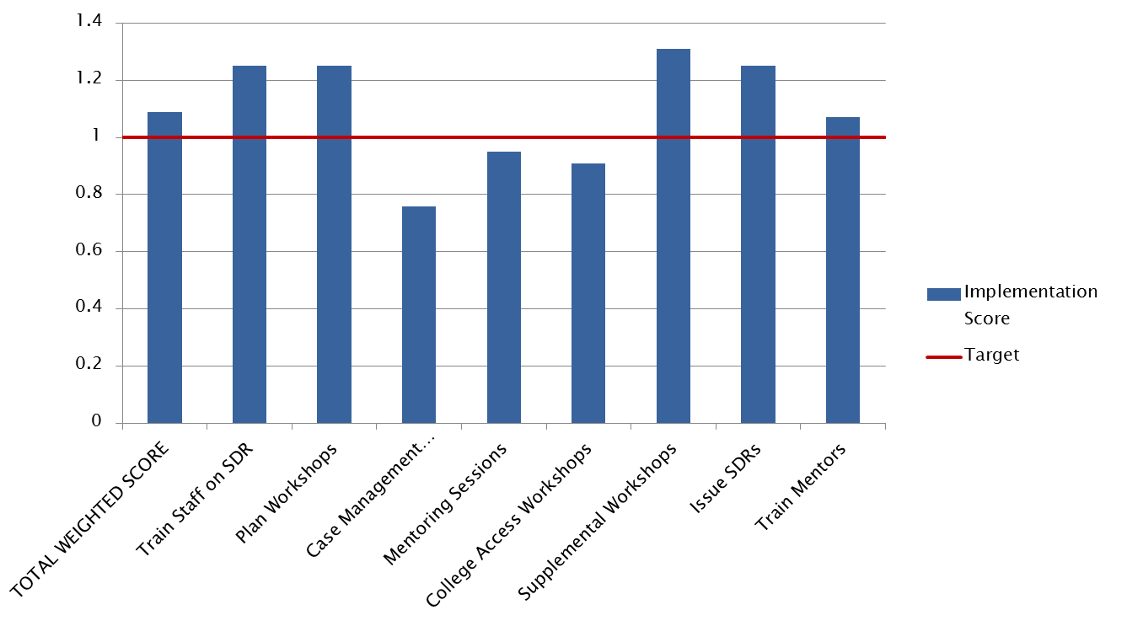
Reporting: Program Wide Fidelity Score

Slide 42
Reporting: # of Key Components Adequately Implemented
Just two levels - adequate and inadequate implementation
Defined a priori for each key component
If you report by components, you can always roll-up to the program level in the future (assuming performance levels were set a priori)

Slide 43
Reporting: # of Key Components Adequately Implemented
Key Component: College Prep Workshops (CPWs) Implementation of component = sum of implementation scores for 2 indicators (Range 0-4). 0 - Inadequate = score of 0-2 1 - Adequate = score of 3 -4
Indicator | Criteria | Operational Definition for Indicator | Data Source(s) for Measuring Indicator | Raw Scoring and Scoring Criteria for Fidelity
 |  |  |  | Implementation Criteria | Results (B=Broward; H=Highlands) | Impl. Score | Fidelity Rating
1 | Adherence: Students have an opportunity to participate in CPWSs | Number of CPWSs offered each year | Student workshop sign –in sheets; STAR database | 0 (low) = 1-3 CPWSs offered per year 1 (moderate) = 4-5 CPWSs offered per year students 2 (high) = 6 CPWSs offered per year | Broward Co. offered 5 CPWSs to 11th grade students ; H offered 2 CPWSs to 11th grade students ; The required number of CPWSs is 2 for 11th graders. | 2-High | Adequate
2 | Dosage: Students participate in CPWSs | % of targeted students participating in the required # of CPWSs offered each year | Student workshop sign –in sheet; STAR database | 0 (low) = 60% or fewer students attended the required number of CMMs 1 (moderate) = 61% – 74% of students attended the required number of CMMs 2 (high) = 75% or more of students attended he required number of CMMs | Of the 58 11th grade students, 36 (62%) attended at least 2 CPWSs. (B=32/46, 69%; H=4/12, 33%) | 1 - Moderate

Slide 44
Reporting: # of Key Components Adequately Implemented
Summary of Fidelity Ratings for Each Key Component.
Key Component | Rating | Comment
Train Mentors | Adequate | All (100%) of the 95 mentors working with FLIGHT students received the mentor training.
SDRTraining | Adequate | All 14 staff in Broward and Highlands were trained on the creation of the SDR.
Workshop Plans | Adequate | Plans were submitted for 10 student workshops plus one parent orientation workshop.
Case Management Meetings (CMMs): | Adequate | Ninety-eight percent of all active FLGHT students received the requisite number of case management meetings.
Mentoring | Inadequate | FLIGHT fell just short (14.6) of the target threshold of an average of 15 mentoring sessions per student, per year.
College Prep Workshops (CPWs) | Adequate | FLIGHT consistently offered CASWs to students; 62% of the 11th grade students attended the requisite two or more sessions.
Supplemental Student Workshops | Adequate | Most (89%) of the FLIGHT students participated in the requisite number of supplemental workshops.
Student Detail Report | Adequate | All study students in FLIGHT received a SDR.

Slide 45
Reporting: Tips and Takehomes
Reporting using a program-wide index may be appropriate:
With a stable, proven program
Important to monitor implementation across time
Want to differentially weight certain components
Reporting by key component may be appropriate when:
Key components are expected to change across time
Important to monitor implementation within time.

Slide 46
Discussion/Questions – 25 minutes

Slide 47
Contact Information
Joel Philp : Joel@evaluationgroup.com
Krista Collins: Krista@evaluationgroup.com
Karyl Askew: Karyl@evaluationgroup.com

