Slide 1
A Human rights based approach for evaluating disability issues: Evaluation of an action plan for the inclusion of persons with disabilities in German development cooperation
AEA Washington DC, November 9th, 2017
Lena Ahrens, Heike Steckhan, Dr Thomas Schwedersky, Dr Martin Bruder
www.deval.org

Slide 2
The German Institute for development Evaluation (DEval) within the system of Germany´s development cooperation
Ministry of Economic Cooperation and Development
BMZ
Takes political and programmatic decisions
GIZ
Implements and evaluates technical cooperation programmes. Provides sector expertise for BMZ.
KfW
Implements and evaluates financial cooperation programmes.
DEval
Since 2012 provides strategic evaluations that inform BMZ policies and political decisions: evaluates strategies, polices, programmatic approaches,...
Civil Society Implements development programmes

Slide 3
The API as part of the German CRPD architecture
2009: Germany ratifies the UN Convention on the Rights of Persons with Disabilities (CRPD). It includes provisions regarding the international cooperation between states.
2013: The BMZ-Action Plan for the Inclusion of Persons with Disabilities is published. It includes programmes implemented by KfW and GIZ, but mainly activities related to BMZ itself.
2016-2017: Both, civil society organisations and BMZ, suggest that DEval should evaluate the results of the implementation of the action plan to inform further measures to be taken in 2018.

Slide 4
The BMZ Action Plan: Goal and Strategic Objectives
Systematic mainstreaming of the inclusion of persons with disabilities in German development policy
Strategic Objective (SO) 1:
Set a good example in our own organisation
Strategic Objective (SO) 3:
Cooperate with others
(civil society, private sector, international organizations)
Strategic Objective (SO) 2:
Strengthen the inclusion of people with disabilities in partner countries

Slide 5
Evaluation Functions
Summative evaluation:
Compatibility of German development cooperation with provisions of the CRPD → Does BMZ adhere to its related duties?
Status quo of mainstreaming of the inclusion of persons with disabilities in German development cooperation.
Formative evaluation:
Inform the formulation of future strategies regarding disability inclusion in German development cooperation.
Generate learning outcomes regarding what works in mainstreaming inclusion and human rights of persons with disability in development cooperation on the strategic and operative level.
Notes:
3 FTE for 1.5 years plus external support

Slide 6
Methods and methodology
Mixed Methods:
Workshops/focus group discussions,
Interviews,
Five case studies of development programmes in Bangladesh, Guatemala, Indonesia, Malawi, and Togo
Online survey in BMZ
Document analysis (evaluation reports, program documents, sector strategies,...)
Methodology: Theory based evaluation and human-rights based evaluation
Notes:
3 FTE for 1.5 years plus external support

Slide 7
Validation criteria based on CRPD articles (selection)
Art. 4 (3) General obligations Art. 32 → International Cooperation | Organizations of persons with disabilities participate during the concept, planning, implementation and evaluation phase of development programs.
Art. 8 →Awareness-Raising | Programs contribute to awareness-raising regarding the rights of persons with disabilities. Awareness-raising interventions are based on the human rights based model of disability (“rights” instead of “needs”).
Art. 31 → Statistics and data collection | Programs contributes to the availability of data on the situation of persons with disabilities disaggregated data. Programs strengthen capacities in partner countries to collect and process disaggregated data.
Notes:
3 FTE for 1.5 years plus external support

Slide 8
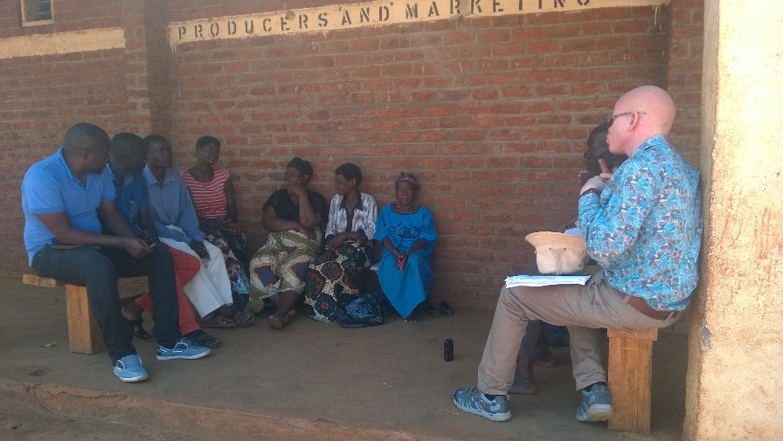
CRPD-based evaluation process
Including consultants with disabilities in the evaluation team (e.g. Malawi)
Challenges:
Lack of consultants that work at the intersection of development and disability in Germany due to other priorities.
Proximity of activism and disability studies can be challenging, especially for an evaluation institute.
Consultants in partner countries are generally hard to identify, social exclusion of persons with disabilities makes it even harder.
Notes:
3 FTE for 1.5 years plus external support

Slide 9
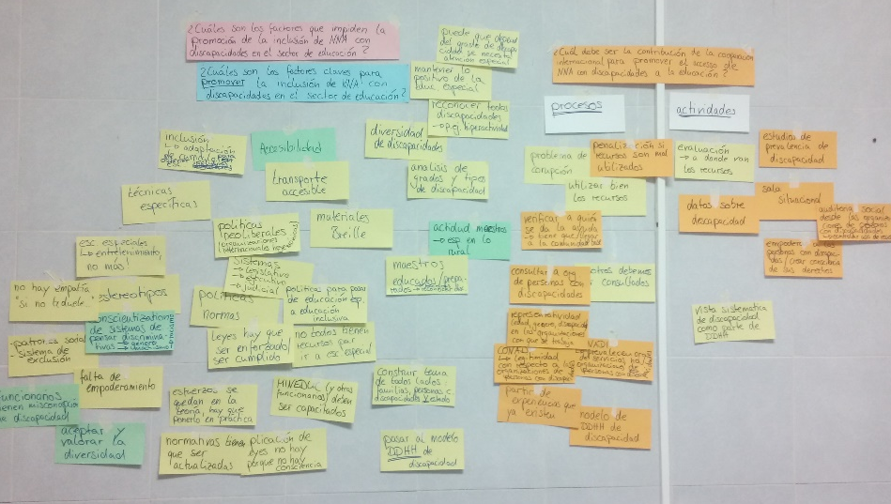
CRPD-based evaluation process
Include DPO in the case studies.
Challenges:
Social exclusion affects capacities to engage in discussions on international development issues.
Ethical questions of data extraction versus participation (similar to other situations of civil society engagement – what´s in there for them?).
Notes:
3 FTE for 1.5 years plus external support

Slide 10
Thank you for your attention!
Lena Ahrens Lena.Ahrens@DEval.org | Heike Steckhan Heike.Steckhan@DEval.org
Thomas Schwedersky Thomas.Schwedersky@DEval.org | Martin Bruder Martin.Bruder@DEval.org

Slide 11
Task for working groups
Evaluating disability issues:
From your experience, what are specific challenges in following a human rights based approach and how can these be addressed?
Please come up with at least three major challenges and respective recommendations for addressing these challenges

