Slide 1
What Can Valuing Methods Tell Us About Valuing Theory? A Review of Two Story-based Valuing Methods Used in Evaluation In Progress
Emily Gates, Assistant Professor, Boston College
Eric Williamson, Sebastian Moncaleano, and Larry Kaplan
Measurement, Evaluation, Statistics, & Assessment (MESA) Department
November 14, 2019 | American Evaluation Association Conference

Slide 2
Overview
Background
Research purpose & questions
Two story-based evaluation-specific methods
Most significant change
Success case method
Study methods
Analytic framework
Preliminary results
Next steps

Slide 3
What is evaluation?
Applied inquiry process for collecting and synthesizing evidence that culminates in conclusions about the state of affairs, value, merit, worth, significance or quality of a program, product, person, policy, proposal, or plan…It is the value features that distinguishes evaluation from other types of research... (Fournier, 2005, p. 139-140).

Slide 4
Logic of Evaluation
Valuing as a four-step process:
1) Establishing the criteria of merit;
2) Constructing standards;
3) Measuring performance and comparing with standards;
4) Synthesizing data into a judgment of merit or worth
(From Scriven & Fournier as cited in Julnes, 2012, p. 6)

Slide 5
“The methodologies distinctive to evaluation are the ones that go directly after values.” (Davidson, 2013)
Examples:
Needs and values assessment
Merit determination methodologies (blending values with evidence about performance, e.g. with evaluative rubrics)
importance weighting methodologies (both qualitative and quantitative)
Evaluative synthesis methodologies (combining evaluative ratings on multiple dimensions or components to come to overall conclusions)
Value-for-money analysis

Slide 6
“…we now find that a knowledge of the logic of evaluation and of some of its specialized methodologies are increasingly crucial for much investigation in applied social science.” (Scriven, 1999)
Between 2005 and 2014, “very few Research on Evaluation investigations in the published literature explicitly address values or valuing in evaluation (3.50%)” (Coryn et. al, p. 11)

Slide 7
Quality-as-Measured | Quality-as-Experienced
Quality is measurable
Comparison of evaluand to a set of standards
E.g., Scriven’s logic of evaluation
“experience-distant”
Quality is a personal phenomenon
Evidence = narrative account
E.g., social phenomenology and practical knowledge
Quality in terms as close as possible to the experience of the participant
(Stake & Schwandt, 2006)
Notes:
“experience-distant” – quality rendered in language, values of evaluator/scientist
QAE
Quality is a personal phenomenon, technical later if need be
Narrative account contains reflection of quality

Slide 8
Study Purpose & Questions
Purpose: critically review two story-based methods used for valuing in evaluations
Study Questions:
How are the methods used to carry out valuing in the evaluations?
To what extent do the valuing methods mis/align with Scriven’s four-step logic?

Slide 9
Selection of Story-based Methods
Story-based
Most Significant Change
Success Case Method
Economic
Cost Benefit Analysis
Rubrics
Public
Social Return on Investment
Geographical Information Systems
Crowdsourcing

Slide 10
Study Methods
Search procedure
Evaluat* + valu* + method
Evaluat* + method name
Selection procedure
Case applications using the method in evaluations
Both peer-reviewed and gray literature
Analysis Procedure
2 researchers read and coded each selected article; 3rd researcher read each article
Group mtgs to resolve discrepancies between generated codes
3rd researcher synthesized across articles

Slide 11
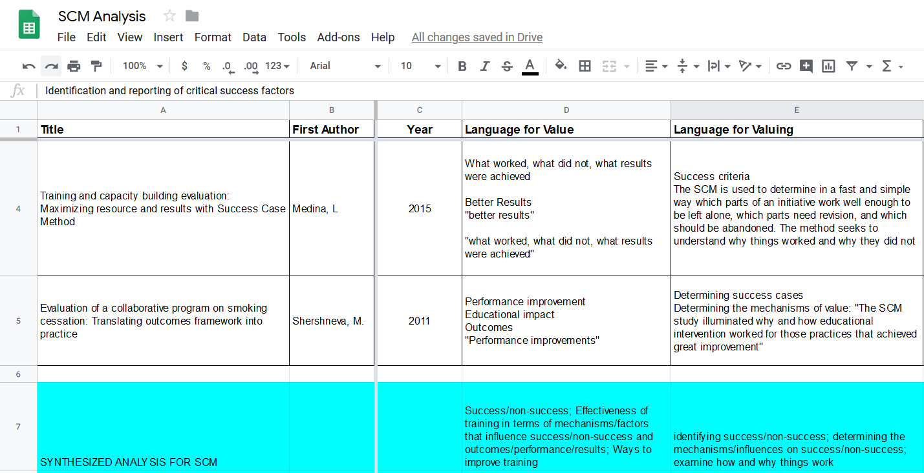
Screenshot of Process

Slide 12
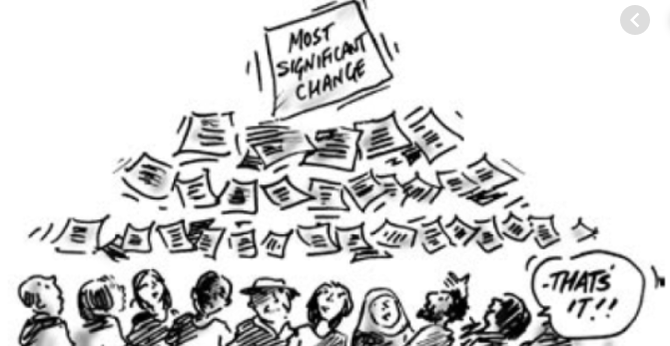
Most Significant Change (Dart & Davies, 2003)
Identify types of stories to collect
Collect stories
Determine which stories are the most significant
Share the stories & facilitate learning about what is valued

Slide 13
Success Case Method (Brinkerhoff, 2003)
Focus and plan the SCM study
Create an impact model that defines what success should look like
Design and implement a survey to search for success cases
Interview and document success cases
Communicate findings, conclusions, and recommendations

Slide 14
Analytic Framework
Category | Meaning
Language for value | Words used in place of value
Language of valuing | What words are used in place of valuing to indicate an evaluative judgement
How value is operationalized | How value or value-based criteria are defined
Assumptions about values | Philosophical, ontological, epistemological, theoretical statements about what values are
Purpose of method | Broad statement providing reasons, aims, justification for using the method within context of their study
Evaluative questions | Purpose and/or questions the method is used to answer within the evaluation
Evaluative claims/conclusions | Conclusions drawn from using the method to evaluate something
Methodology | Steps, procedures, logic, etc. of how the method is used by researchers
Evaluation design | Overall design and methods used in addition to our valuing method of interest
Application context | Context around the application of the valuing method
Utility of the method | What authors say about utility and/or consequences of using the method
Strengths | What authors say or we think are the benefits/pros/advantages of the method or its application
Limitations | What authors say or we think are the weaknesses of the method or its application

Slide 15
Literature: Most Significant Change
Most Significant Change
Author | Year | Peer-reviewed (P) v. Gray (G) | International v. US | Field
Choy, S. | 2013 | P | International | Education
Finger, G. | 2015 | P | International | Education
Trudell, J. | 2017 | P | International | Education
Limato, R. | 2018 | P | International | Healthcare
McIver, S. | 2018 | P | International | Healthcare
Le Cornu, R. | 2006 | G | International | Education
Velarde, G. L. M. | 2007 | G | International | Geology/Agriculture
Coyle, S. | 2016 | G | International | International Development

Slide 16
Literature: Success Case Method
Success Case Method
Author | Year | Peer-reviewed (P) v. Gray (G) | International v. US | Field
Shershneva, M. | 2011 | P | US | Healthcare
Kennedy, P. | 2014 | P | US | Multiple
Medina, L. | 2015 | P | US | Healthcare
Lee, C. | 2017 | P | International | Government
Bell, C. | 2006 | G | International | Government
Olson, C. A. | 2011 | G | US | Healthcare
Mbada, N. A. | 2013 | G | International | Healthcare/Education

Slide 17
Study Question #1 Preliminary Results
How are the methods used to carry out valuing in the evaluations?
SCM/MSC
Surfacing value through participant narratives (Quality-As-Experienced)
Standards and criteria (Quality-As-Measured)
Mostly negotiated by the organization
MSC: Organization decides from submitted stories/interviews which represent significant changed
SCM: “Success” as pre-determined and measured by survey (usually)
But…
With MSC, feedback mechanism to stakeholders
With SCM, orgs. can leave room for other definitions of success ($)

Slide 18
Study Question #2 Preliminary Results
To what extent do the valuing methods mis/align with Scriven’s four-step logic?
Criteria of merit + standards
Negotiation: What does success/significant change look like?
Measuring performance + synthesizing data
SCM: “Success” measured through survey (quant. indicators of success)
MSC: Sig. change client stories moving up hierarchy of org. (negotiated value)
Overall
Not perfectly criterion-oriented, especially with MSC
Valuing as a four-step process:
1) Establishing the criteria of merit;
2) Constructing standards;
3) Measuring performance and comparing with standards;
4) Synthesizing data into a judgment of merit or worth

Slide 19
Next Steps
Finalize results & write up study
Expand review to additional valuing methods
In the future…
Conduct method and cross-method analyses (expanded)

Slide 20
References
https://www.betterevaluation.org/en/plan/approach/most_significant_change
https://www.betterevaluation.org/en/plan/approach/success-case-method
Brinkerhoff, R. O. (2003). The success case method: find out quickly what’s working and what’s not. San Francisco: Berrett-Koehler
Coryn, C. L. S., Wilson, L. N., Westine, C. D., Hobson, K. A., Ozeki, S., Fiekowsky, E. L., Greenman, G. D., & Shroeter, D. C. (2017). A decade of research on evaluation: A systematic review of research on evaluation published between 2005 and 2014. American Journal of Evaluation, 38(3), 329-347.
Dart and Davies (2003). A Dialogical, Story-based Evaluation Tool: the Most Significant Change Technique. American Journal of Evaluation, 24(2).
Davidson, J. (2013). Evaluation-specific methodology: The methodologies that are distinctive to evaluation. Retrieved from: http://genuineevaluation.com/evaluation-specific-methodology-the-methodologies-that-are-distinctive-to-evaluation/
Fournier, D. M. (2005). Evaluation. In S. Mathison (Ed.), Encyclopedia of Evaluation (pp. 139-140). Thousand Oaks, CA: Sage.
Scriven, M. (1999). The nature of evaluation part I: Relation to psychology. Practical Assessment, Research, and Evaluation, 6(11).
Stake, R. E., & Schwandt, T. A. (2006). On Discerning Quality in Evaluation. In The Sage handbook of evaluation: policies, progrms and practices (pp. 404–418).

Slide 21
Extra Slides…

Slide 22
Results Language of Valuing
MSC
Participants’ stories of perceived changes in context
Most significant changes
SCM
Success cases – trainees who realize desired outcomes of a training
Factors that led to successful use of training by trainees back in their work environments

Slide 23
Results Questions
MSC
What stories do participants tell about meaningful changes, outcomes, or impacts from participating in this initiative?
Of these, which do program leaders, staff, etc. view as most significant and why?
SCM
How is success/non-success defined?
Which participants are successful/non-successful in implementing changes following training?
What are the factors/mechanisms that influence whether or not those participating in trainings are successful?
What changes can be made to the training or practice contexts to support training transfer/better outcomes?

Slide 24
Results Design & Methodology
MSC
Used as primary method
Used with interviews, focus groups, and/or survey elements to verify stories
SCM
Used as primary method
Combined with others within overall design
Combinations included:
a pre-existing model to define impact, outcomes, indicators
formative components to help improve the training
Impact components (e.g. time series analysis)

Slide 25
Results Utility of the Methodology
MSC
Starts with and centers participants’ perspectives
Does not require pre-determined outcomes
Incorporates emerging outcomes
Feasible
SCM
Pairs training outcome data with contextual data regarding training transfer
Works with more and less structured meanings of success
Feasible

Slide 26
Results Strengths & Limitations
MSC
Rich narratives of change
Gives voice to participants.
Data provided can enhance institutional learning and encourage participant self-reflection.
Lack of inclusion of negative stories.
Attribution made by participants.
SCM
Rich narratives about success or non-success and contextual influences.
Focused on learning from the extremes.
Provides useful information for decision-making.
Focuses on extreme ends of success/non-success; therefore, not generalizable to whole group of attendees or transferable to other training implementations.

