Slide 1
Organizational culture eats strategy for breakfast
Holta Trandafili (World Vision US)
Wendi Bevins (Lutheran World Relief)
Ramu Bishwakarma (Lutheran World Relief)
Notes:
Who we are –1 min
Ramu as chair will intro each of us; Ramu, Lutheran World Relief-IMA, Senior Technical Advisor for MEL
Holta, World Vision US, Research, Learning, and Analytics Manager
Wendi, Lutheran World Relief-IMA, Technical Advisor for Resilience & MEL

Slide 2
Our time together will be spent…
Discussing conducting ex-posts evaluations in the backdrop of our organizational culture.
Sharing our (rookie) mistakes and wins, when packaging and communicating findings by stakeholders –from field-level community actors to fundraising or marketing teams, leadership, and donors.
Sharing how we learned to sophisticate our ex-post measurements overtime and succeed to influence programming strategies in the long-run.
Handouts will be distributed at the end for those (still here) with more technical questions about study designs, tools that we used, etc.
Notes:
Agenda -1.5 min
Ramu

Slide 3
Raise your hand if…
 | Your organization has conducted at least one ex-post evaluation in the last 5 years.
 | Your organization has shared externally (at a conference, on a website, or in a paper) some of the findings from its last ex-post evaluation.
 | Your organization has shared publicly (at a conference, on a website, or in a paper) a comprehensive set of the findings from its last ex-post evaluation.
 | Your organization has applied learning from ex-posts internally.
 | Your organization plans to conduct at least one ex-post within the next two years.
Notes:
Get to know the audience -2.5 min (only read statement –ask people to observe the room and move to next statement)
Wendi

Slide 4
Value of ex-posts
The value of the global humanitarian and development industry is being questioned
For far too long we have relied on end-of-program evaluations to make statements of impact and assume its link to sustainability
Genuine interest among all stakeholders to learn about what works, for whom, for how long (moral imperative, as well as an issue of accountability)
Notes:
Background -1 min
Wendi

Slide 5
11 ex-post evaluations in 8 countries from 2015 - 2019
Most were cross-sectional studies. All used mixed methods approach.
Overall programs had no sustainment definition or pre-set benchmarks of “success” post-closure (for the community groups or the participants); there were issues with untested sustainability assumptions and availability and quality of M&E records.
All but one of the World Vision programs were privately funded (child sponsorship). One of Lutheran World Relief’s programs was privately funded and the other was funded by Foods Resource Bank.
Notes:
Overview of studies -3 min
RAMU
Broad geographic representation with 11 ex-post evaluations in 8 countries (Nicaragua, Bolivia, Kenya, Uganda, Tanzania, India, Myanmar, Sri Lanka)
Mixed methods approach (where qualitative data was used to complement, triangulate or shape information from quantitative data)

Slide 6
Sample of research questions
Lutheran World Relief
What are the key impacts of the project for the targeted organizations and farmers?
Did men, women, boys, and girls experience the effects differently?
Does the cooperative continue to employ the policies and practices developed under the project?
World Vision
What are the long-term outcomes and contribution of programs’ work among those who participated in our programs?
What is being sustained? I.e. outcomes, processes, practices, activities, community groups left-behind, other?
(How) have our programs enabled communities to sustain improvements in child well-being?
Notes:
Continued overview -1.5 min
RAMU
Pick one question from each org to read out loud and invite the audience to all of them read to themselves.
Sustainability
i. Access to resources from financial institutions was an important aspect of the project but had minimal results by the project’s end. Were partners able to leverage the project’s training and support in this area afterward? Has access to financial institutions improved, decreased, or ended since the end of the project?
ii. Access to markets for grapes improved during the project. What value chain relationships endured? Have any new relationships evolved?
a. Impact
i. What are the key impacts of the project for the targeted organizations and farmers? Did men, women, boys, and girls experience the effects differently?
1. Some impacts that were mentioned during the final evaluation were the extension services models used, such as Training the Trainer and Farmer Field Schools. Have these models continued or evolved? Have extension services continued on the same trend as during the project?
2. Household income based from grape sales increased according to the project's final evaluation. Has this trend been maintained or improved since the end of the project?
3. The percentage of household incomes spent on food generally decreased during the project. Has this trend been maintained?
4. What other impacts from the project are considered important by the targeted organizations and farmers?
ii. What recommendations from the project’s final evaluation and subsequent studies were implemented? What were the results? Did men, women, boys, and girls experience the results differently?
What are the perspectives of implementing partners on the project’s long-term effects? Did men and women experience the effects differently?
LWR/Nicaragua Gender/food security (before/after political crisis):
Are there households making decisions in a gender-equitable manner? To what extent?
Does the cooperative continue to employ the policies and practices developed under the project aimed at improving transparency and better engaging women and youth?
What is the status of food security for men, women, boys and girls who belong to households that have a cooperative member?
What is the yield of coffee/cocoa for men and women
Has the number of women engaged in coffee or cocoa production changed since endline? Since the crisis began?
Have members lost, retained or further improved their knowledge of crop management and approaches to increasing coffee and cocoa yields?
How does the variety of crops farmed compare to endline data?
What are the major unintended outcomes (positive or negative), if any, that resulted after the project ended?
World Vision: Two rounds of ex-post studies of our sponsorship funded programs in collaboration with Tulane… + two other stand alone studies (mandated by donors Gates, USAID)
Round 1 (2014-2016) -three sites (Sri Lanka, Uganda, Kenya). Questions driven by organizational identity:
CHILD FOCUSED: What are the long-term outcomes and contribution of programs’ work in the current education, health, and employment status of individuals who participated in the program as children?
COMMUNITY-EMPOWERING: (How) have our programs enabled communities to sustain improvements in child well-being?
LONG-TERM PRESENCE: To what extent have the outputs and/or immediate results of our interventions been sustained in the program area?
CHRISTIAN: What has been the value, meaning, and effects for those participating in the program? (explored aspects of psychosocial wellbeing, effects of relationships with sponsors, meaning of faith in the life of participants)
Round # 2 (2017-2018) -six sites (India, Myanmar, Bolivia) simplified questions driven by WV’s key sustainability plan (outcomes to be sustained by empowered community groups left behind).
What does sustainability look like in WV Area Programs (sponsorship funded)?
o What is being sustained (outcomes, processes, practices, activities, groups, other)?
o To what extent does evidence of sustainability align with WV’s expectations or available definitions about sustainability?

Slide 7
Expectations
Leadership teams
Fundraising and Marketing teams
Sustainability champions among staff
Notes:
HOLTA
Organizational culture rooted in who we are and positions we have: 2 min
Ex-post evaluations, especially when new in an organization are exciting. Everyone sees so much potential in them. A common reason for supporting ex-posts esp. funded internally is the belief that good results, sustained achievements are there… We just haven’t measured them. Depending on who you are (your role, experience, and sometimes worldviews) also shapes how you view or what you may expect ex-posts to bring home.
Looking at these pictures we can see how perceptions can differ from one person to another. How far is really the child from the father? I am a mother, when my husband does this with our 20 month old, you know where I stand…
Let’s bring this back to ex-posts though. Our different stakeholders had different hopes of how much sustained achievement was going on and what we could do with the learning and results… If you were to guess from this list of stakeholders (leadership, fundraisers, program staff (including M&E), who do you think had the highest hope of what we could do with results?
[five second silence and if none has jumped in with a thought] you don’t have to answer, we will tell you soon…

Slide 8
Who wanted to know what from the ex-posts?
At onset
Leadership teams: organizational understanding of how both programming strategies and exit strategies worked; claims of long-term impact;
Fundraising and Marketing teams: expectations to showcase good results
Sustainability champions among staff: inquiries around does it really work; what does it look like to measure sustainability; etc.
Academic audiences: advancing what we know about sustainability drivers (factors) and how to measure it; looking at sustainability through sector lens.
At the end
Who do you think got the answers that they wanted?
Notes:
Intended audience for our work: 2 min
HOLTA
LWR: internal leadership team; region where eval took place; deepen understanding for development of org-wide ag strategy on capacity building for farmers’ orgs in value chains; expectations about using externally for fundraising purposes based on expectations that the results would be good/showcase sustainability. The second one focused on gender + resilience so slightly more academic audience externally.

Slide 9
Spoiler Alert!!!!
Mixed Results!!!
Notes:
Results: 1 min
WENDI
Let me help you with that… what if I told you that we came back with Mixed Results! Shocking, right?!
What can marketers do with mixed results?
What can leadership do with mixed results?
Well, the audiences that had no problem with that were the academic partners and surprise/surprise M&E and program staff (those sustainability champions).
Wendi’s funny anecdote: This ‘politics’ issue was when I really knew that M&E was my tribe. Evaluation types tend to want to talk about the ‘dirty laundry’ in a way that makes leadership and fundraisers nervous. Everyone in this room knows that their biggest competitor probably also fails at the same thing their org fails at….but we usually aren’t allowed to talk about it, or at least not to the level of depth necessary to find a way to fix it.
But each of stakeholder does not operate in vacuum or isolated from one another. Getting to what is our take-away and how to communicate that meaningfully was our challenge. The two audiences that felt they did not get out of ex-posts what they needed, are also often those that make decisions and drive organizations…

Slide 10
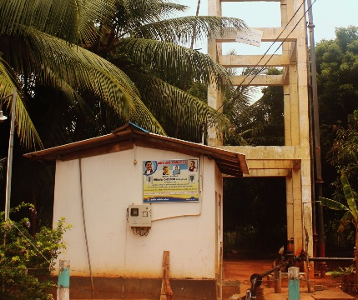
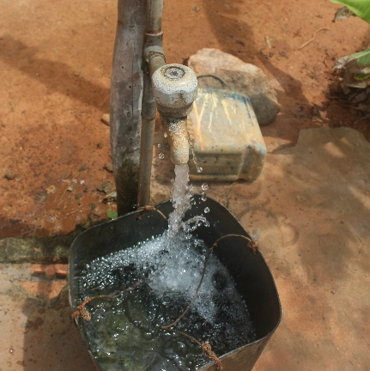
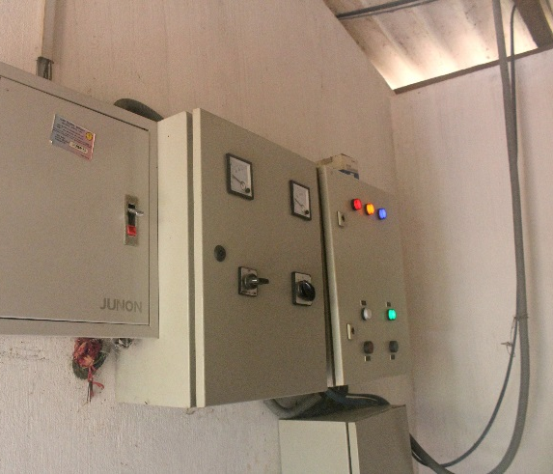
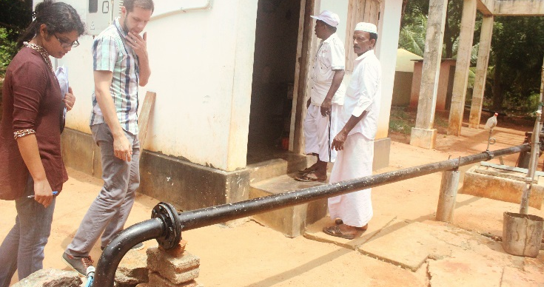
Success in the eye of the beholder (Illustrations)
Zam-Zam Water Society,
Putalam, Sri Lanka
Notes:
Examples of results to anchor what was controversial: 6 min (2-3 min per story 2-3 stories)
HOLTA
Zam -Zam water project serves three communities (Karathieuv South, Mahalawilluwa, Karathieuv North, Serakkuliya, and part of Mangalapura).
It started with WV building the central tall structure in 2007 and then two years later the Asian Development Bank built on the investment and provided pumps, pipes, and a tank. In 2013 the Water Consumer Society dug a 400 feet deep pump. In collaboration with the local government the WCS now has also an office building which is also used to operate the water station. In 2014 the government provided a third water tank.
This plant serves 1,700 families. The caretaker lives on the premises. The expenses are covered by each family paying for units of water used. If the families use more than 15 units, they have to pay five rupees per unit. The total cost comes to 400-1,200 rupees per family per month. The operating costs are around 100,000 rupees per month.
When constructed the water was used for a number of years for all purposes. Currently, after analysis on the quality of water, it has been agreed that the water is not the best choice for drinking. The water is used mostly for washing, cooking, and cleaning. Families buy drinking water.
Was this a successful water project or not? Our purpose was to provide drinkable water to the population. From that aspect, we did not succeed. But looking at how these communities have come together, and been able to maintain and grow and benefit from the project since WV left in 2012… From that aspect, one can consider this a success story… When we talk about mixed results this is one of those stories that we brought back… Not BLACK and WHITE

Slide 11
Success is in the eye of the beholder
Grape Value Chain project in Dodoma, Tanzania
Notes:
WENDI: 1 min
In an ex post of LWR’s Grape Value Chain project in Dodoma Tanzania:
-Two-thirds of farmers interviewed in the evaluation reported their incomes have continued to increase from grape farming since the end of the project, leading to improvements in quality of life.
-One-third of farmers interviewed in the evaluation reported that their incomes have not increased or sustained at the level they were during the project, which the report cited as tied to poor capacity of the cooperatives after the project. The cooperatives functioned poorly after the project as a result of not carrying out the capacity training topics that were provided to the cooperatives during project implementation, thus resulting in poor outcomes for their farmers.
So was this project successful? The leadership and marketing teams were thrilled about the 2/3 of farmers who continue to see profits. But the programming staff, especially the MEL people, were really unhappy to see that 1/3 of farmers didn’t get what they needed from a farmers’ cooperative that got a lot of support to improve its business functions.

Slide 12
What followed the finalization of the ex-post…
Mistakes we made
Wins we scored
Lengthy technical reports
Lacking evidence translation
Over-emphasizing what did not work
Alienating rather than garnering support
More internal teams learned/vested on sustainability
Welcomed by a large external support network
Pushed our boundaries about sustainability (theories, implementation pre-requisites, measurement, etc.)
(some) Institutional, program and measurement improvement
Aided by uptick on sustainability discussion among big funders (e.g. USAID)
Notes:
Learning from the experience: 3 min
HOLTA
Any marvel fan here? Can you tell which movie this Is from? Yes, right –Civil War. Kind of joking was not like that… or maybe the part that there’s good reason why can end up in either camp…
Examples on mistakes (anecdotes to illustrate).
Lengthy technical reports (60-70 pages), and executive summaries that passed four pages (how dare we)? Head of Sponsorship Marketing: “I read it, Holta but what does it say… What is the conclusion are our programs sustainable or not?” We relied on coms people and the documents look pretty and we thought we used lay-person language, yet somehow the message was not simple enough (black or white) or meeting the need for these folks and yes the findings did not match the expectation.
Missing evidence translation to stakeholder’s language
Over-emphasizing what did not work (bottle half full or empty type of discussion) –did not aid our fundraisers. We look at our silo as M&E and researcher –we speak our language and argue p-values, sampling and power. We rely on comms people to do some miracle and translate it and then the fundraiser is expected to do their job. I hand over the baton. But if you care about the topic, then we soon discovered that the M&E and evaluator needs to gain some other skills that are not normally part of the suite. That also includes coming up with ideas on what can be communicated for fund-raising even if that is not your job. The person to first advice me on this was Plan USA (Justin Fuggle). Sitting on his office, he told me his approach to work with marketers, then offered to have his folks talk to ours. That didn’t happened, but I learned. I could make it happen.
The way we shared made it more difficult in some respect to fund and support ex-posts internally
WINS
Exposed more internal teams to the intricacies of sustainability to speak about our ex-posts to more teams than we knew when we started the journey
Found a large external support network for ex-posts and all issues related to sustainability (talk to us and plug in if new in this space)
Know so much more about sustainability (fallacy of theories, implementation hick-ups, measurement roadblocks and a lot more on solutions, prepping better measurements, implementing better programs)
Revised core program documents and introduced new measurements (Transition Guidance for responsible program exits; new programming standards demand more in-depth thinking about sustainability upfront etc.)
Not in the wrong side of history (aided by uptick on sustainability discussion among funders –e.g. USAID’s Journey to Self-reliance, and peers)

Slide 13
Uptake a few years down the road…
Notes:
We only have 1 to 1.5 min left here…
WENDI
We’d always considered ourselves good at ‘capacity building,’ but we struggled to define what it meant or how to measure it. Upon learning the local organizations whose capacity we thought we’d built actually were not capable of functioning without us, we took a hard look at what that meant. We extrapolated to what that might mean also for other organizations we had taken a similar ‘capacity building’ approach to, and if their results would also be less impressive than we hoped. We wove into the sector-wide strategy that was being developed at the same time as the ex post findings became available that genuine, measurable capacity building of these organizations was foundational to our ability to achieve any other objectives, and began to develop tools to measure capacity, develop it accordingly, and

Slide 14
High-level learning beyond just hunting for good results…
Context changes affect results, making it difficult to speak about attribution or contribution. Sustainability is dynamic not static.
If we don’t plan for sustainability upfront it is difficult to measure it after closure.
The best use of ex-posts is for learning and designing better programs; however they often provide cause for celebration.
Notes:
High level learning (target broadening mindset): 1 min
RAMU
Coming in later to this process, seeing some of these with ‘new eyes’; give perspective

Slide 15
Our (not-so) secret tips
What to anticipate
Good findings
Bad findings
Unclear findings
Natural champions
Natural detractors
What to avoid
Hiding bad findings
Recommendations that aren’t future-oriented
What to mitigate
Bring the project team into design and analysis
Identify ‘bigger picture’ opportunities to feed in findings beforehand
Bring comms colleagues in early
Notes:
Wrapping up: 2 min
RAMU

Slide 16
What’s your experience? What are your tips?
Notes:
Open up to audience: 15 min
RAMU

