Slide 1
Using Social Network Analysis to Understand and Improve Collaboration Among Michigan’s Integrated Improvement Initiatives and Center for Educational Networking
David Merves, Evergreen Evaluation And Consulting
Jan Vanslyke, Jan Vanslyke Evaluation Inc.

Slide 2
Evaluation Context
Michigan’s Integrated Improvement Initiatives and Center for Educational Networking
Evaluation approach and goals
Decision to use Social Network Analysis (SNA)

Slide 3
Collaborative Relationships
A Balancing Act
EEC
SNA Mentors
JVS
MI3
OSE-EIS
CEN
Initiatives

Slide 5
Inherent Tensions
Divergent goals and values
Priority setting (and scheduling)
Contextual pressures

Slide 6
Advantages of SNA
Participatory process gives a voice to all stakeholders
SNA mentors guide the process and help frame results
Network maps promote insight and discussion
Visual representation of findings can validate participant experiences

Slide 7
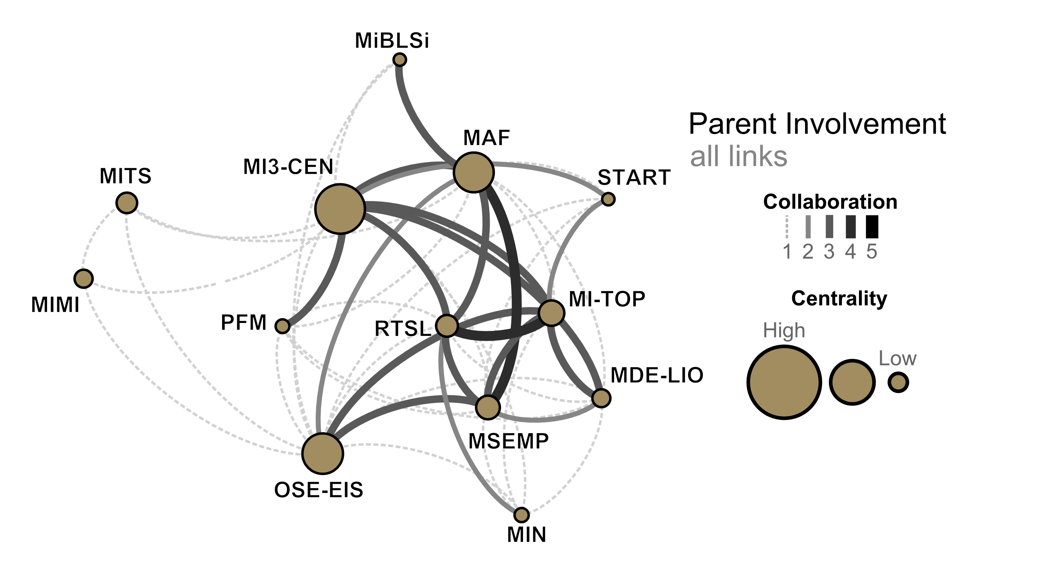
Parent Involvement Example

Slide 8
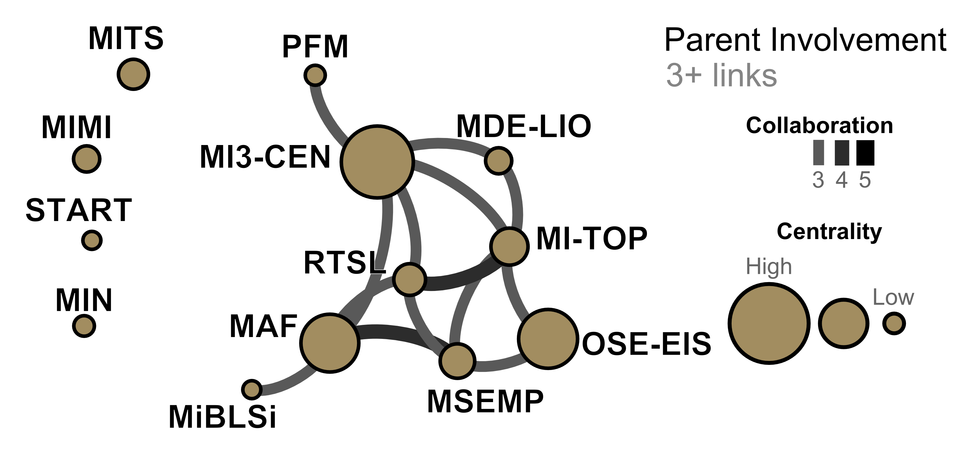
Parent Involvement Example

Slide 9
Challenges with SNA
Can be time consuming and resource intensive
SNA is a complicated method – Need to balance time devoted to technical detail with resources
Choosing a data collection tool and method

Slide 10
Hogue et. al. Adapted Measure of Collaboration

Slide 11
Lessons Learned
Determine a feasible level of participatory work
Investing time to reach consensus on measurement is a double edged sword
Use mentors to add value to your process and products

Slide 12
THANK YOU
David Merves, Evergreen Evaluation And Consulting david@evergreenevaluation.net
Jan Vanslyke, Jan Vanslyke Evaluation Inc. jan@jvseval.com

