Slide 1
Evaluating Training and Career Development Grants in the Biomedical Sciences: Methods, Measures, Benchmarks, & Best Practices

Slide 2
Evaluating Training & Career Development Grants:
Lessons Learned & Recommendations from the ICRP Research Outcomes Committee
Stephanie Birkey Reffey, Ph.D.
Managing Director, Evaluation & Outcomes
Susan G. Komen
AEA Evaluation 2013

Slide 3
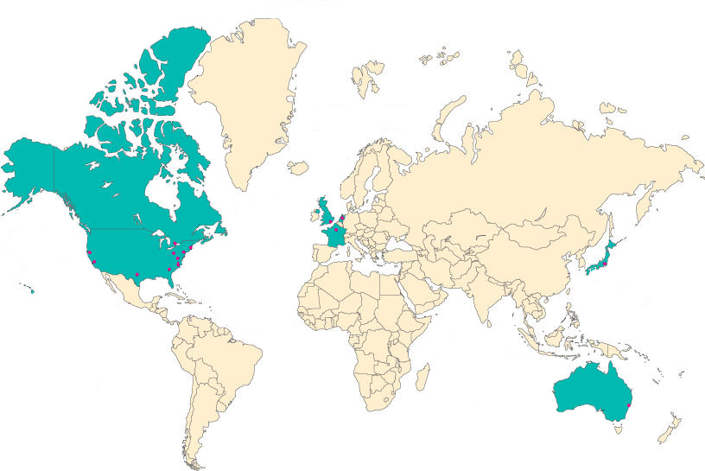
Canadian Cancer Research Alliance
National Pancreas Foundation
Oncology Nursing Society Foundation
National Cancer Research Institute
KWF Kankerbestrijding (Dutch Cancer Society)
California Breast Cancer
Research Program
French National Cancer Institute (INCa)
Pancreatic Cancer
Action Network
Avon Fondation for Women
National Cancer Center
US Army Medical Research and Medical Command
Susan G. Komen
for the cure
National Institute of Health
American Cancer Society
American Institute for Cancer Research
National Breast Cancer Foundation (NBCF)
Notes:
ICRP initiated in 2000 with 10 cancer funding agencies – now 54 cancer funders represented from the US, Canada, Europe, Australia, and Japan
Mission: Enhance the impact of research to benefit all individuals affected by cancer through global collaboration and strategic coordination of research.
The outcomes subcommittee was initiated in 2006 with the goal of identifying and/or developing best practices for capturing, reflecting, and evaluating research outcomes – surveyed partners for ways to measure outcomes.
Challenges cited = lack of models, metrics, benchmarks, use of proxy indicators, insufficient staffing resources, and length of time required for adequate follow-up.
Outcomes library developed – recommending using resources in the library to develop benchmarks and best practices
Training/Career Development Awards chosen for first project since most partners offered such mechanisms

Slide 4
Objectives
Synthesize what has been done to evaluate training and career development awards
Identify common methods and measures
Identify preliminary benchmarks
Develop recommendations for best practices
Notes:
Project initiated to…

Slide 5
Approach
Data Collection
Partners submitted relevant surveys/reports
Committee performed web-based search
Document Review
17 analyses included
Compile Results
Created matrix of methods, measures
Identified commonalities/differences between and among grant types
Notes:
Each Partner submitted surveys and reports pertaining to their training and career development awards. In addittion, the Outcome Subcommittee searched the internet for additional studies that could supplement Partner reports.
Studies more than 10 years old or that were not publicly available were excluded. 17 studies included in this report: 7 predoc; 6 postdoc (4 new investigator/career development)
Document review with follow up, as needed. – organized by award type and then matrix of methods and measures used; findings compiled; median value ranges from most common measures were calculated
Predoctoral Awards
NCRI/Wellcome Trust (3)
NIH (1)
NCRI/CRUK (2)
CBCRP (1)
Postdoctoral Awards
CBCRP (2)
Komen (1)
NIH (1)
Damon Runyon (1)
NCI (1)

Slide 6
Methods Utilized
Literature Search
Funding Search
Control Group???
Notes:
Grantee Surveys
All predoctoral analyses used grantee surveys
All but one postdoc analysis used grantee surveys (NCI Postdoctoral Award analysis)
Some also conducted phone interviews, while others used email or web-based surveys
Literature searches and funding searches used to validate PI-reported data (for some – not all)
Control groups
Most did not use a control group
Those who did, used top ranked unfunded applicants (NIH Predoctoral – NRSA Analysis)

Slide 7
Predoctoral Training Grants
Notes:
First- Evaluation of our postdoctoral Fellowship Grant
- Grants include those grants intended to support graduate students in pursuit of a doctoral degree – includes mentorship as a component

Slide 8
Common Measures: Predoctoral Grants
Common Outcome Measures:
Publishing
Staying in research
Leveraging additional funding
Self-reported Career Gains:
Transferable skills
Enhanced job prospects
Satisfaction with research and experience
Notes:
These studies focused more heavily on the experience of the trainee than others
Common Measures…

Slide 9
Findings: Predoctoral Grants
At least one
publication
Stay in research
Leveraged funding
Notes:
Publication output and the ability to leverage additional funding is generally viewed as less important at this stage, but it is still a valid indicator of success and predictive of continuation in the field.
Publications are often the only tangible outcome of these grants for the funding agency, so they are the most commonly tracked – retention in the field is also common
One paper published within 10 years of award receipt = 82% median
Staying in the field had more variation = 70% median
Additional funding = just under 50% with a range of 38% to 67%

Slide 10
Findings: Predoctoral Grants
Organizational
Skills
Presenting
Skills
Enable Scientific
Career
Improve Job
Opportunities
Notes:
While these measures are more subjective, categories using more concrete skills such as presentation are not as variable as others like “improved job opportunities”

Slide 11
Proposed Benchmarks: Predoctoral Grants
Publish at least one paper 85%
Stay in research (funded field or related field) 70%
Leverage additional funding (self or mentor) 50%
Satisfaction with graduate school 70%
Satisfaction with research experience 95%
Perceived career gains (enhanced job prospects, acquiring transferable skills) 70%
Notes:
Benchmark = % of grantees who fulfill the criteria (range) # of studies / grantees incl in each benchmark
Publication of at least one paper 85% (80-95%);3 studies (5 groups), n= 43628
Stayed in research: 70% (56-86%); 4 studies (6 groups), n= 43759
Obtain additional funding: 50% (35-65%); 2 studies (4 groups), n=43492
Satisfaction with overall experience: 70% (65-98%); 3 studies (4 groups), n=572
Satisfaction with research experience: 95% (87-98%); 3 studies (4 groups), n=572
Career Gains (Enhanced job prospects and transferable skills): 70% (25-85%) 3 studies (4 groups), n=572

Slide 12
Postdoctoral Fellowship Grants
Notes:
First- Evaluation of our postdoctoral Fellowship Grant – Productivity is of utmost importance
Postdoctoral traineeships prepare individuals for careers as independent investigators – therefore, measures of productivity and career-related outputs as well as the importance of mentorship

Slide 13
Common Measures: Predoctoral Grants
Common Outcome Measures:
Publishing
Staying in research
Leveraging additional funding
Self-reported Career Gains:
Self-Confidence
Independence
Career progression (e.g. faculty position)
Notes:
Common measures = measures of productivity and career-related outputs as well as the importance of mentorship
Publish at least 1 paper
Stay in research/field
Leverage funding - Self or mentor
Self-reported Career Gains
Self confidence
Independence
Faculty position

Slide 14
Findings: Postdoctoral Grants
At least one
publication
Stay in research
Leveraged funding
Notes:
Productivity is measured by publications in the field and ability to leverage additional funding.
Postdoctoral work lays the foundation for future work, so common for postdocs to stay in that field or a closely related field
91% mean – published at least one paper (82%-100%)
81% mean – remained in the field or a closely related field (71%-83%)
59% mean – leveraged additional funds (46% - 90%)

Slide 15
Findings: Postdoctoral Grants
Self-confidence
Independence
Faculty Position
Notes:
Among these studies, more than 60% of grantees cited attainment of important career gains

Slide 16
Proposed Benchmarks: Postdoctoral Grants
Publish at least one paper 80%
Remain in the field 70%
Leverage additional funds based on the funded project 50%
Positive career gains 60%
Notes:
Benchmark% of grantees who fulfill the criteria (range)# of studies / grantees included in each benchmark
Publication of at least one paper 80% (82-100%) 2 studies, n=80
Retention in field 70% (71-83%) 3 studies, n=308
Obtained additional funding 50% (46-90%) 3 studies, n=308
Career Gains: 60%
Increased self confidence (61-74%) 3 studies, n=308
Increased independence (52-69%) 3 studies, n=308
Award helped obtain faculty position (32-74%) 3 studies, n=308

Slide 17
Benchmarks
Notes:
Comparison of median responses between grant types – points out the similarities and differences

Slide 18
Recommendations: Best Practices
Funders of Training/Career Development Grants should:
Perform systematic, on-going review of grants
Keep detailed records of grants and grantees
Define goals of the evaluation study & tailor to appropriate grant type
Assess resources - effort should be proportional to the overall value of the evaluation study
Use appropriate measures for the stage of training/career

Slide 19
Recommendations: Best Practices
Don’t forget…
When performing bibliometric analyses, primary research articles must be reviewed and verified to determine specific contributions and funding sources
Plan studies so that the results can be operationalized & improve granting program--not just an intellectual exercise
Collect a variety of data
Notes:
Collect a variety of data – process and outcomes, quantitative and qualitative, short- and long-term… enables a variety of uses and on-going value for time spent

Slide 20
Future Plans: ICRP
Build on benchmarks: iterative process as more studies done and/or made available
Expand best practices: create a manual with detailed recommendations for study design and analysis
Create “template” survey instrument questions for each training grant award type
Encourage Partners to replicate part or all of an evaluation study conducted by another Partner

