Slide 1
Training Program Evaluation: Creating a Composite Indicator to Measure Career Outcomes
National Institutes of Health / National Cancer Institute & Thomson Reuters
October 27, 2012
Presenter: leo.dijoseph@thomsonreuters.com
Session Chair: joshua.schnell@thomsonreuters.com

Slide 2
Acknowledgements
National Cancer Institute (NCI) / Center for Cancer Training (CCT)
Jonathan Wiest
Julie Mason
Ming Lei
Jessica Faupel-Badger
Erika Ginsburg
Discovery Logic / Thomson Reuters
Yvette Seger
Leo DiJoseph
Joshua Schnell
Laure Haak

Slide 3
What did we evaluate? – the NCI K program
NCI/CCT administers grant mechanisms (K Awards) intended to stimulate career development of biomedical researchers. (cf. session by presenter Julie Mason).
Cohort summary:
Fiscal Years 1970 to 2008
7 grant mechanisms
2,889 principal investigators,
1,204 awardees (35%)
1,685 non-awardees

Slide 4
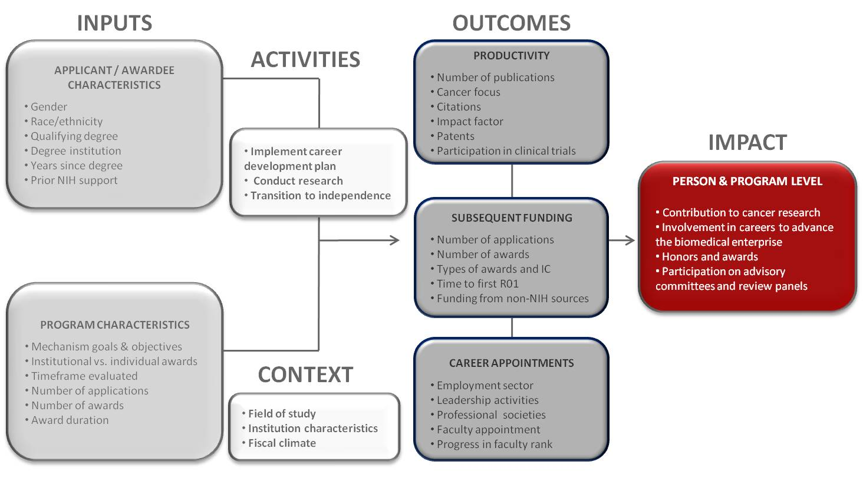
What was the “view through the Logiscope”?
NCI K Award program evaluation logic model

Slide 5
What data did we collect?
Defined full cohort with selection rules, and a “bubble” cohort with propensity score matching having p(Award=Yes) ~ 0.5.
Independent Variables
Individual Demographics
Prior Training
Sponsoring Institution
Application Timeline
Primary Mechanism
Funding Status of K Award
Dependent Variables
grant activity
publications (productivity and quality)
clinical trials
professional society memberships
committee service, health care practice, and NIH employment.

Slide 6
.What happened as we studied the data?
Phase I – tabular and graphical descriptive summaries
Phase II – linear & logit regression modeling and hypothesis testing of specific analysis questions
Phase III – interpretation and revision
Leading to…a problem
Missing data problem: high recall for NIH grants, but lower for grants from other sources, and other outcomes (publications, patents, etc.)
Each outcome analyzed separately larger fraction of cohort affected by at least one recall issue

Slide 7
What was a typical missing data pattern ?
Grants | Committees | Publications
1 | 1 | 1
1 | 1 | 0
1 | 1 | 1
0 | 0 | 0
0 | 0 | 0
1 | 1 | 0
1 | 1 | 1
1 | 1 | 0
0 | 1 | 1
1 | 1 | 1
0 | 0 | 0
0 | 0 | 0
0 | 0 | 0
1 | 1 | 1
0 | 0 | 0
1 | 1 | 1
1 | 1 | 0
0 | 0 | 0
0 | 0 | 0
1 | 1 | 0
1 | 1 | 1
1 | 0 | 1
1 | 1 | 1
0 | 0 | 0
1 | 1 | 0
0 | 0 | 0
0 | 0 | 0
 | data missing
 | data available
Missing at least one
60%
Missing all
41%

Slide 8
What did we add to the model to compensate for missing outcome data ?
“Is (a) Researcher”
combines all sources of information about subsequent funded research activity
“Is Engaged”
captures any available indication of continued participation in the field, even if there is no evidence of funded research
Definition restricted to {Is Researcher = No} cases, giving a scale: not engaged, engaged, researcher.

Slide 9
Using the indicators, what did our cohort look like ?
Indicator Group | Individuals | % of Cohort
Is Researcher = Yes | 1,555 | 54%
Is Engaged = Yes | 1,044 | 36%
Is Engaged = No | 290 | 10%
For comparison the “not found” count for publications, as a single outcome, is 819 individuals.

Slide 10
How did we determine the indicator values ?
Group 1: {Is Researcher = Yes}
Subsequent research activity with:
NIH
Department of Energy
International Cancer Research Partnership (ICRP)
Listed as Key Personnel on Registered Clinical Trials

Slide 11
How did we determine the indicator values ?
Group 2: {Is Engaged= Yes}
Subsequent research engagement, including:
Participation on NIH review panels (non-grant outcomes)
Membership in the Federation of American Societies for Experimental Biology (FASEB), the American Association for Cancer Research (AACR) or the American Society of Clinical Oncology (ASCO)
Inclusion in Healthlink physicians database
Service on a Federal Advisory Committee (FACA), as reported through FIDO.gov

Slide 12
How did we determine the indicator values ?
Group 3: {Is Engaged= Yes}
Individuals found as authors of articles in MEDLINE.

Slide 13
Did NCI K promote engagement ?
Tested as a 2x2 contingency table using the Fischer exact test
 |  | Is Engaged
 |  | Yes | No
Awardee | Yes | Awardee engaged | Awardee not engaged
 | No | Non-Awardee engaged | Non-Awardee not engaged
Total N | Odds Ratio (95% CI) | p value
1,334 | 5.33 (3.52, 8.34) | 8.2E-21

Slide 14
How well did specific grant programs do ?
some uncertainty for smaller mechanisms, but generally odds of engagement significantly higher for awardees
Grant | Total N | Odds Ratio (95% CI) | p value
K01 | 246 | 5.02 (2.00, 15.08) | 0.0001
K07 | 239 | 8.15 (2.44, 42.81) | 3.3E-05
K08 | 525 | 5.66 (2.75, 13.17) | 2.2E-08
K11 | 82 | 4.73 (1.16, 28.06) | 0.0155
K22 | 110 | 3.30 (0.87, 18.76) | 0.0718
K23 | 90 | 1.89 (0.37, 18.92) | 0.7291
K25 | 42 | 5.66 (0.97, 61.53) | 0.0414

Slide 15
Was the same effect present for the Bubble ?
The results for the propensity-score-matched subset were not conclusive, except for the K08 mechanism.
Grant | Total N | Odds Ratio (95% CI) | p value
K01 | 45 | 1.99 (0.28, 23.42) | 0.6808
K07 | 30 | ∞ (0.62, ∞) | 0.1029
K08 | 116 | 5.60 (1.47, 31.89) | 0.005
K11 | 0 | N/A | N/A
K22 | 23 | 2.59 (0.17, 157.06) | 0.6036
K23 | 22 | 1.63 (0.12, 98.21) | 1
K25 | 6 | 0.32 (0.002, 14.84) | 1

Slide 16
Conclusions
Composite indicator of engagement was effective in compensating for recall issues in matching to career outcome data.
The composite indicator established a clear level of success for the K Award program, even for individuals for whom direct evidence of subsequent funded research was not easy to obtain.

Slide 17
Contact Information
Title: Training Program Evaluation: Creating a Composite Indicator to Measure Career Outcomes
Presenter: Leo DiJoseph, leo.dijoseph@thomsonreuters.com
Chair: Joshua Schnell, joshua.schnell@thomsonreuters.com

