Slide 1
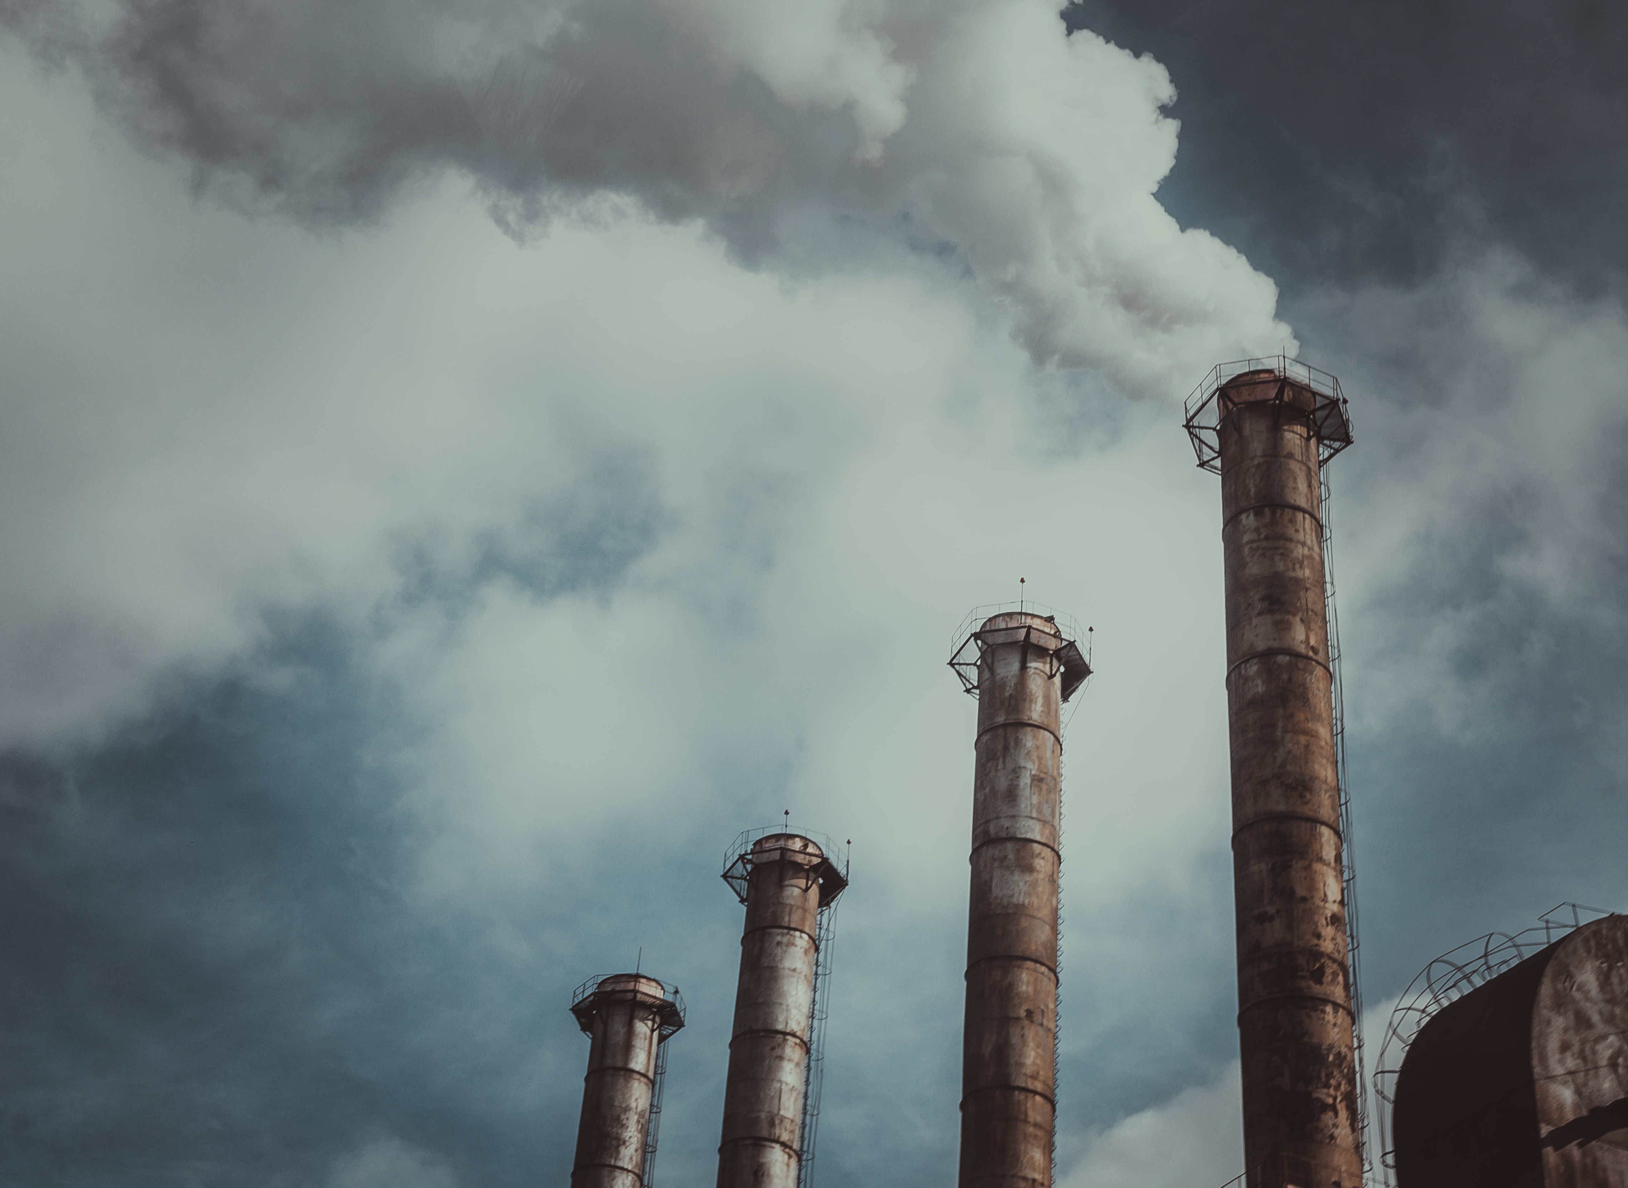
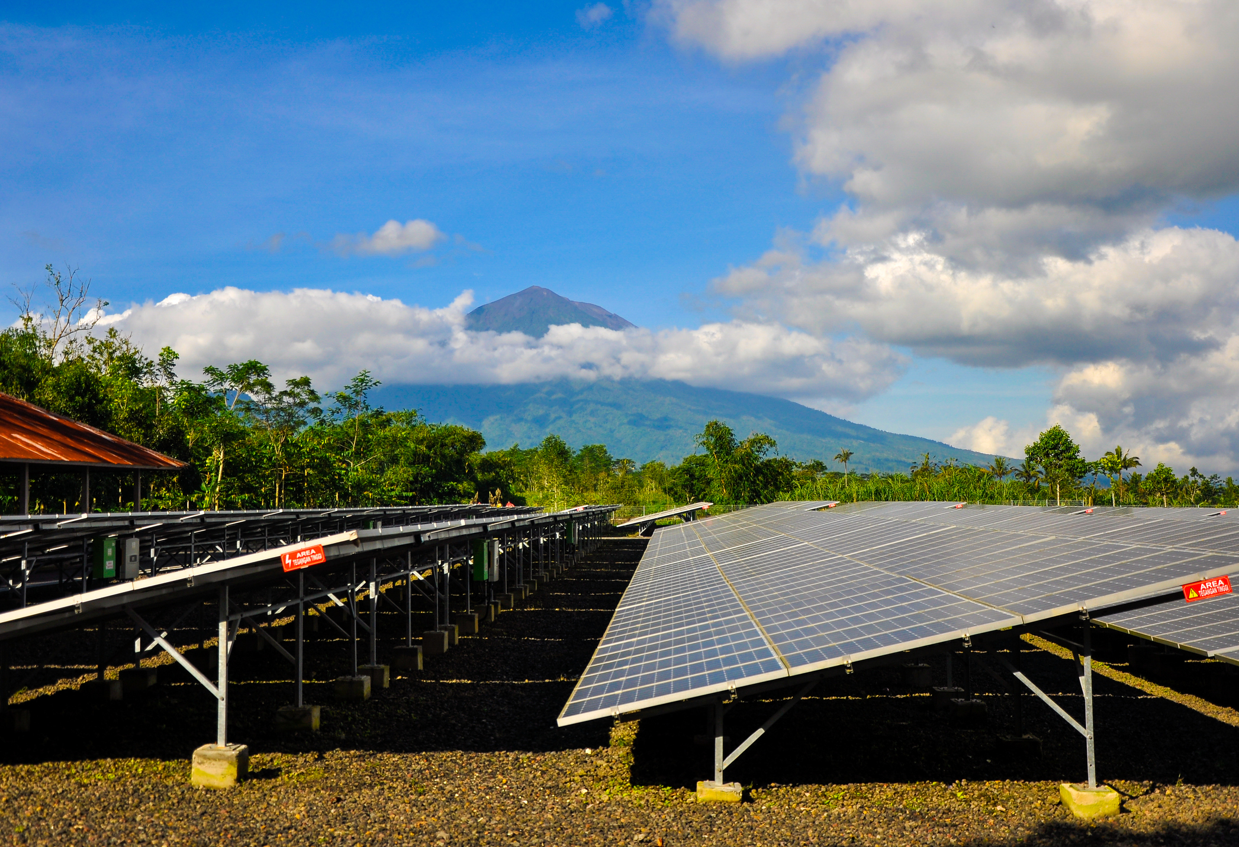
Evaluation, Truth and Accountability the Case of Climate Change Mitigation
Presidential Strand – American Evaluation Association Conference – Nov 1, 2018 – Cleveland
Chair – Scott Chaplowe, Director of Evidence Measurement and Evaluation, Children’s Investment Fund Foundation, Schaplowe@CIFF.org
Presenter – Craig Thornton, Senior Fellow at Mathematica Policy Research, CThornton@Mathematica-Mpr.com
Presenter – Nandini Chaturvedula, Associate at Ross Strategic, Nandini@RossEtrategic.com
Presenter - Hari M. Osofsky, Dean of Penn State Law and the Penn State School of International Affairs and Distinguished Professor of Law, Professor of International Affairs, and Professor of Geography, hmo8@psu.edu
Discussant – Rees Warne, Director of Evaluation and Learning, ClimateWorks Foundation, Rees.Warne@Climateworks.org

Slide 2
CIFF Climate Mitigation
- Renewable Energy
- Greener Cities - Eliminate Fluorinated Gases - Improved Air Quality - Sustainable Land Use
- Strategic Litigation

Slide 3
Session Agenda
“Holding Cities Accountable for Meeting Greenhouse Gas Emission Reduction Targets” – Craig Thornton, Mathematica
“Accountability and Learning in Dynamic Contexts: The Case of a Low-Carbon Urban Mobility Initiative in Brazil“ – Nandini Chaturvedula, Ross Strategic
“Evaluating Litigation as a Tool for Climate Change Mitigation” – Hari M. Osofsky, Penn State Law and the School of International Affairs
Audience questions and comments
Discussant summary and reflections – Rees Warne, ClimateWorks Foundation

Slide 4
Holding Cities Accountable for Meeting Greenhouse Gas Emission Reduction Targets
American Evaluation Association Meeting
Cleveland, Ohio
November 1, 2018
Craig Thornton, Eva Ward, Matthew Ribar

Slide 5
For global warming, cities are …
Causes: Cities produce 70 percent of greenhouse gas emissions
Victims: Cities face dire consequences of global warming
Part of the solution: Cities’ decisions can mitigate or exacerbate global warming

Slide 6
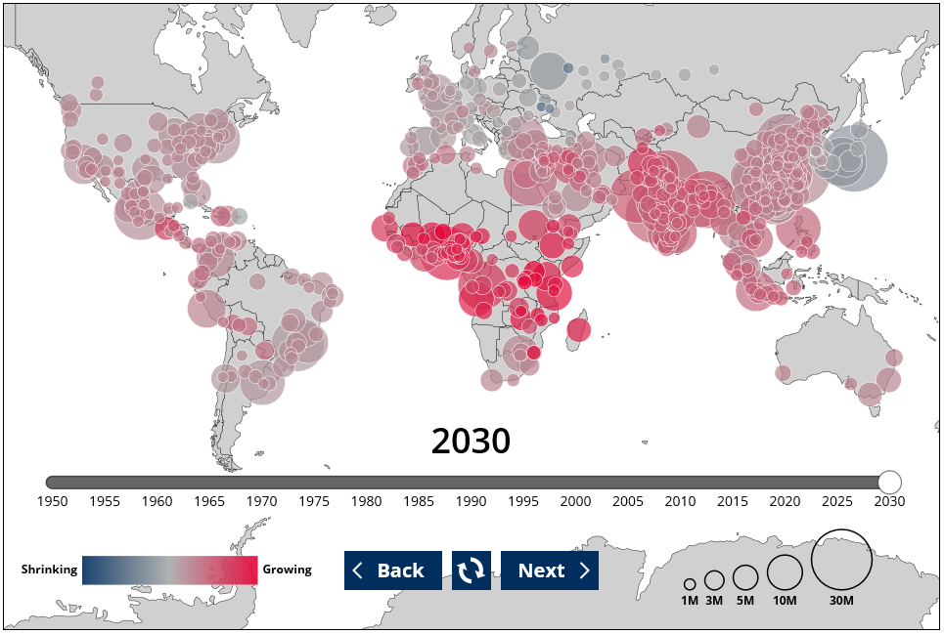
Continued Urbanization
Source: https://www.mathematicampr.com/dataviz/urbanization

Slide 7
City-Level Emissions Data Becoming Available

Slide 8
Most Cities Have Not Reported Their Emissions
Note: Aggregation of data reported to CDP and carbonn through 2017.

Slide 9
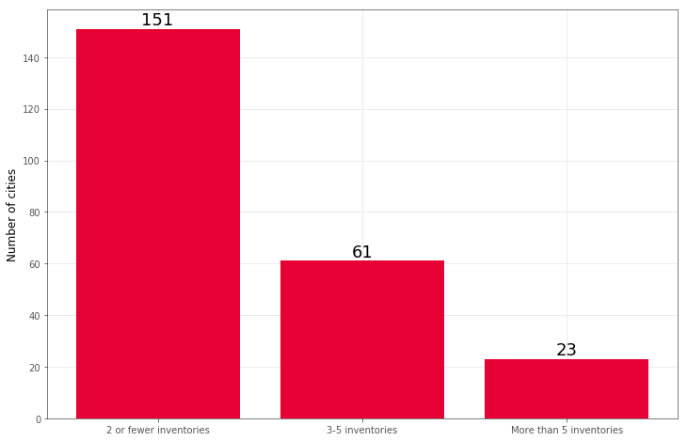
Few Cities Have Longitudinal Data
2 or fewer inventories
3 to 5 inventories
More than 5 inventories
Note: Aggregation of data reported to CDP and carbonn through 2017.

Slide 10
Targets Reported to CDP by the Largest Cities
Note: Aggregation of data reported to CDP 2011-2017.

Slide 11
Target Data Needed to Assess Ambition
Base year
Emissions in the base year
Target year
Target reduction percentage
Population projections
From Cities
From the UN

Slide 12
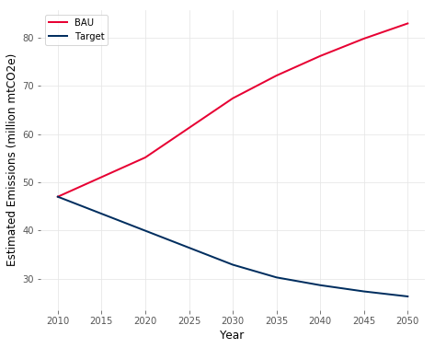
Ambition Based on Targeted Reduction
BAU = Business as usual
Targeted reduction
Note: Analysis based on World Resources Institute Compact of Mayors Emissions Scenario Model ) https://www.wri.org/publication/compact-mayors-emissions-scenario-model)

Slide 13
Target-Reporting Cities in CDP with Adequate Data
Note: Aggregation of data reported to CDP 2011-2017.

Slide 14
Target-Reporting Cities in CDP with Adequate Data
Note: Aggregation of data reported to CDP 2011-2017.

Slide 15
Truth to Power
Despite a lot of bold statements and many great stories
Most of the 1,700 largest cities cannot be held accountable using existing data

Slide 16
There Is Still Hope
Progress is being made
City reporting in increasing rapidly
Greater use of standard protocol
Cities are getting involved
Continued search for data
Satellite imaging
Imputations and small area estimation
Process and other qualitative analysis methods

Slide 17
Thank You!
This presentation is based on an evaluation that Mathematica Policy Research is conducting for the Children’s Investment Fund Foundation.
For more information:
Craig Thornton: CThornton@mathematica-mpr.com
Eva Ward: EWard@mathematica-mpr.com
Matthew Ribar: MRibar@mathematica-mpr.com

Slide 18
Useful references about city emissions
CDP: https://www.cdp.net/en
cCR: https://carbonn.org/
Global Covenant of Mayors: https://www.globalcovenantofmayors.org/
C40: https://www.c40.org/
World Bank: http://www.worldbank.org/en/topic/urbandevelopment/brief/global-platform-for-sustainable-cities
ICLEI: https://iclei.org/
GPC: http://ghgprotocol.org/GPC_development_process
World Resources Institute (WRI): https://www.wri.org/
CIFF: https://ciff.org/impact/cities-frontline/

Slide 19
Evaluation of CIFF’s Support to Curbing Brazil’s Transport Emissions Trajectory by Transforming City Mobility
Nandini Chaturvedula November 1, 2018

Slide 20
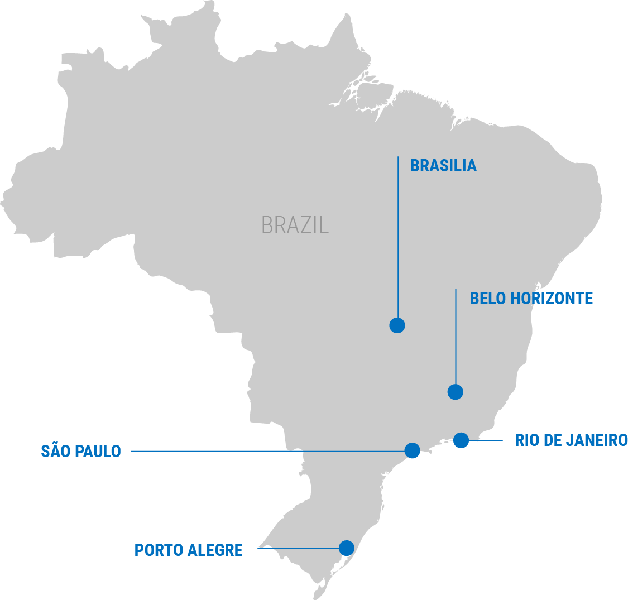
Evaluation Background
5 Brazilian Cities 2015-2017

Slide 21
Evaluation Context
CIFF Grant Period
2015-2017
Dilma Rousseff Impeached/ Michel Temer Took Power
August 2016
Municipal Elections
October 2016
General Elections
October 2018
2013
2014
2015
2016
2017
2018
2019
World Cup
June/July 2014
Brazil’s Worst Economic Crisis Ever
2015-2016
Former President Lula Convicted of Corruption
July 2017
Rio Olympics
August 2016

Slide 22
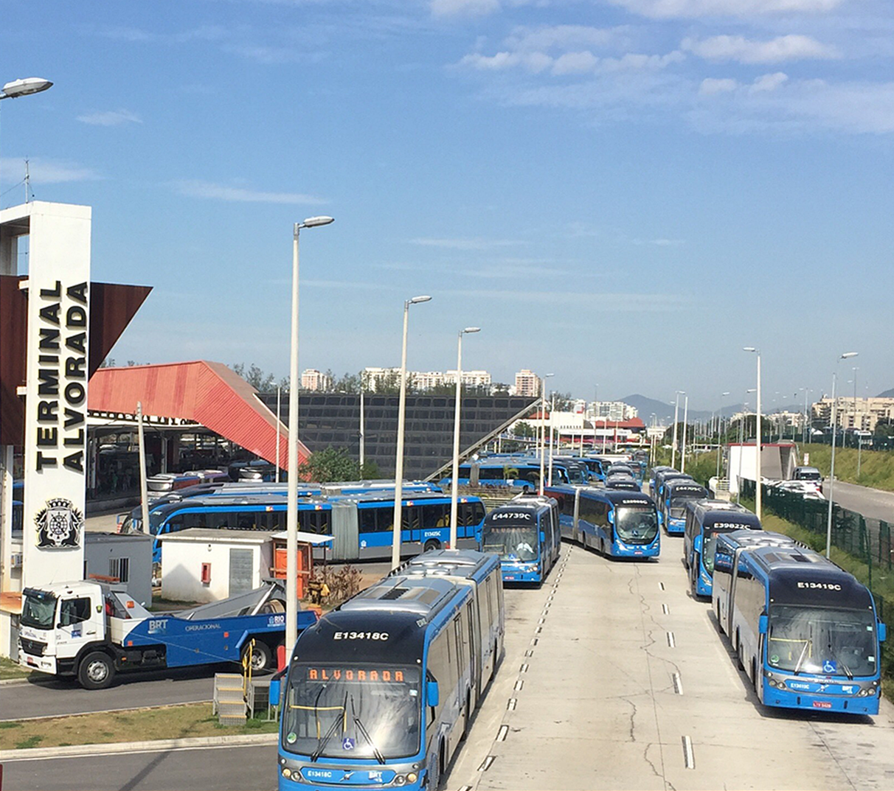
Evaluation Findings
Mid-line evaluation revealed grantees weren’t on track to deliver envisioned results
Importance of evolving theory of change and strategy given challenging context
Grantees needed inside and outside game strategies

Slide 23
Key Grantee Shifts during Work Program
After the Mid-Line Evaluation and Annual Progress Review, and in light of the Brazilian political and economic context, grantees made the following changes in their work plan:
Focus changed from national financing mechanisms to other funding sources
Shift from work at the national level to municipal & local level and from large infrastructure projects to small-scale interventions
Moved beyond urban mobility planning to implementation and dissemination of concepts

Slide 24
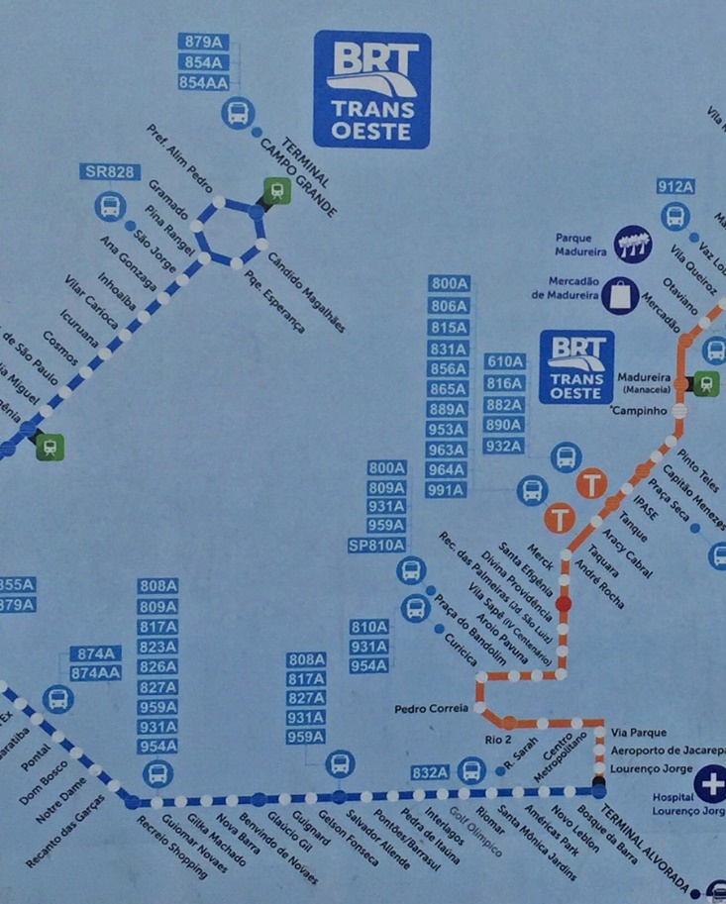
Insights for Evaluation
Value of Mid-Line Evaluation coupled with opportunity for grantee-funder-evaluator learning
Elevate contextual factors to help funders & grantees make sense of findings
Importance of having a country expert on the evaluation team to provide context and credibility

Slide 25
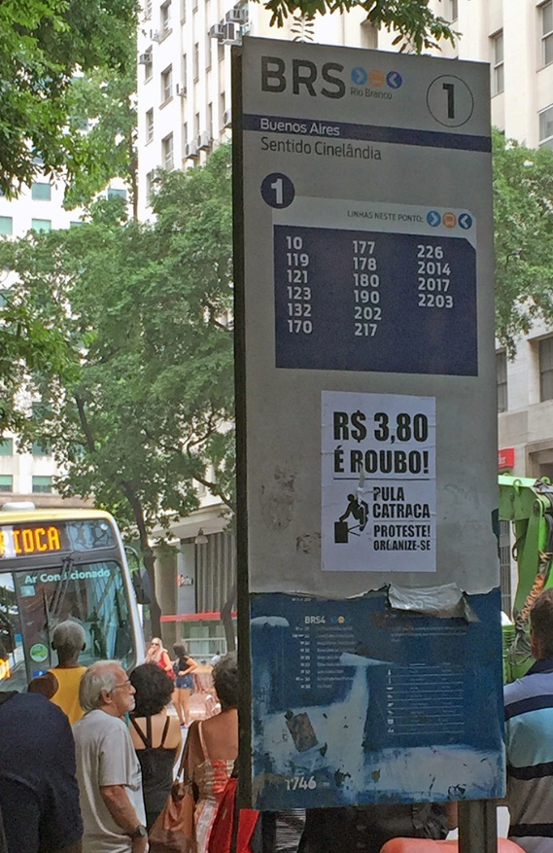
Speaking Truth to Power
Multiple Power Dynamics:
Evaluator ➔ Grantee & Funder
Grantee ➔ Funder
Grantee ➔ Policymakers
Evaluator ➔ Policymakers

Slide 26
Evaluating Strategic Litigation as a Tool for Climate Change Mitigation
Dean Hari Osofsky, Penn State Law and School of International Affairs on behalf of University of Melbourne Evaluation Team
Presentation to American Evaluation Association, Evaluation 2018
November 1, 2018

Slide 27
Strategic Climate Litigation Speaking Truth to--and Changing--Power
Strategic litigation: regulatory and social impact focus
Aims to influence government, corporate, or broader social behavior
Direct and indirect impacts
Notes:
Litigation often seen as forum for interpretation and enforcement of law.
Traditions, particularly in common law countries, of using litigation in strategic fashion to advance given policy outcomes. Can be brought specifically with goal of advancing (or blocking) regulatory action to address emissions or in effort to drive behavioural change by other actors eg corporations

Slide 28
CIFF Climate Program Phase I, 2014-2017
LITIGATION
3-year grant to ClientEarth for program of strategic climate litigation in Europe
3 workstreams:
Air Quality - To drive cities and countries to improve air quality by complying with European air quality regulations, as a means to achieve co-benefits for climate change mitigation
Company and Financial - To motivate behavioural change by companies, investors, and other financial actors to disclose and manage climate-related business risks
European Energy and Coal - To accelerate the phase out of coal power in Europe and put the continent on track for the transition to a clean, flexible, and competitive energy system
POLICY
ECF grant for promoting European climate leadership and pathway to 80-95% emissions reduction
Focused on improving existing regulation and advocating for new, more stringent standards
ENGAGEMENT
CDP grant to drive corporate emissions reductions
Focused on compiling evidence base to strengthen investor engagement with companies
Accelerate low carbon transition to keep global warming <1.5°C

Slide 29
Approach to Evaluation for Project Aimed at Speaking Truth to Power
Long timeframe of litigation impacts
OECD DAC criteria as organizing frame:
relevance, efficiency, effectiveness, impact, sustainability
Strategic questions around value of litigation as tool
https://www.greenbiz.com/article/are-countries-legally-required-protect-citizens-climate-change
Notes:
Note OECD criteria were used at request of funder but some were difficult to assess e.g. efficiency (especially across different workstreams) and sustainability with such a slow-burn type of intervention

Slide 30
Evaluation Challenges
Establishing causal links
Accounting for breadth of activities & relationships between them
What is success?
Winning cases? Establishing precedent?
Transformational vs incremental change
Notes:
difficulty of assessing causal links: indirect effects, intervening causal factors, use of qualitative approach, long timeframes to impact
differences in understanding of ‘strategy’ between a legal and evaluation context: wins vs policy influence, different strategic considerations eg bad precedent vs bringing losing cases for their learnings, utility of case selection methodology vs ensuring nimbleness and flexibility to take advantage of opportunities and short litigation windows, value of theory of change for lawyers to think more systematically about how produce change
how to conceive of ‘success’ in a program of strategic climate litigation: showpony vs workhorse issue, linking up individual wins to see broader picture

Slide 31
Insights for Evaluation of Strategic Litigation’s Impact
Program design
Value of Theory of Change
Combine showpony and workhorse cases
Funding to support foundational work
Flexibility to adapt strategy
Longer-term funding commitment
Evaluation Approach
Quantification difficult, often inappropriate
Holistic evaluation useful
Longer-term evaluation for clearer assessment of impact
Value of iterative and adaptive approaches

Slide 32
Implications for Speaking Truth to Power in Next Evaluation Phase
Consolidation and expansion of legal interventions and geographies
Capture long-term impacts through longitudinal approach building on Phase 1
More adaptive, iterative method + strategic input
Regular strategy testing sessions

Slide 33
Q&A
Prof. Jacqueline Peel (team leader), Melbourne Law School, j.peel@unimelb.edu.au
Dean Hari Osofsky (co-team leader), Penn State Law and School of International Affairs, hmo8@psu.edu
Dr Anita Foerster (researcher), Melbourne Law School, anitacf@unimelb.edu.au

