Slide 1
Tools for
Theory of Change Analysis
of Environmental Programs
Svetlana Kozlova, MPS, AIMS
Mikhail Paltsyn, PhD Candidate, SUNY-ESF
John Mathiason, PhD, AIMS
Evaluation 2016, October 24-29, Atlanta, GA
Notes:
Может быть, анкеты или плакат на стену??? Who are you? Why does this topic matters to you 1 sentence?
Welcome. We’re here today to talk about how to [CLICK] craft your presentation message. We’re aiming specifically for the conference presentations so that you all have fantastic experiences as presenters and audience members, but we’re also hoping you’ll carry these ideas over into the presenting you do as part of your regular evaluation dissemination. I’m going to lead you through what research says about structuring a great presentation, what our top AEA presenters do, and what you said you needed as an audience.
ll

Slide 2
Introduction
Svetlana
Mikhail
John
Notes:
Может быть, анкеты или плакат на стену??? Who are you? Why does this topic matters to you 1 sentence?
Welcome. We’re here today to talk about how to [CLICK] craft your presentation message. We’re aiming specifically for the conference presentations so that you all have fantastic experiences as presenters and audience members, but we’re also hoping you’ll carry these ideas over into the presenting you do as part of your regular evaluation dissemination. I’m going to lead you through what research says about structuring a great presentation, what our top AEA presenters do, and what you said you needed as an audience.

Slide 3
Agenda: 11.00-11.45 am
Introduction
Explanation
So what?
4. Questions
Notes:
Introduction – 1 min.
Background - 5% (3 min)
Bottom Line (Findings and Conclusions) - 20% (7 min)
Explanation (discussion) - 50% (23 min)
Literature Review (So What) – 15% (7 min)
Call to Action - 10% (5 min.)

Slide 4
Background
Why this content matters to you?
What is TOC Analysis?
3. What organizations use TOC Analysis?
4. Why TOC Analysis?
5. Tools for TOC analysis?
6. Outputs, Outcomes, Impacts?
7. Why Miradi?

Slide 5
1. Why this content matters to you?
SMART Theory of Change
Lessons from
international
development
Notes:
(1 min)
This talk is actually going to be relevant to your needs if you:
Have issues in assessing SMART-ness of formulation Outputs, Outcomes, and Impacts.
If you want to learn how to review a Logframe easily and restore the Program Theory of Change according to the Global Environmental Facility standards.
If you want to know how to use Program planning and conservation software Miradi in your evaluation work.
If you want to ask questions about the Results-Based Evaluation to the UN expert with 20 years working experience.

Slide 6
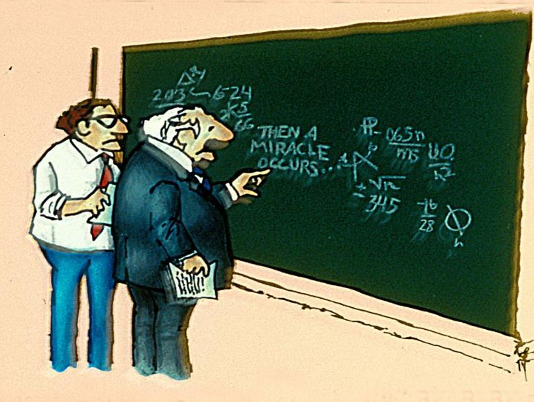
2. What is TOC Analysis?
Notes:
1. Background – 3 min.
А) the parts you have to state at the start of your presentation:
UNEP guidance on creating a reconstructed Theory of Change basically says we can use Theory of change to assess the achievement of the project’s outcomes and impacts through review of project progress along the pathways from outcome to impact as a graphical representation of causal linkages and factors.
B) and the part of your topic you’ll include in the Background to set the stage:
It’s overspread that the evaluation consultants miss the opportunity to reconstruct the project logic using Theory of Change. They tend to think that the project Logframe could be used for the purpose of the evaluation and take it for granted.

Slide 7
3. What organizations use TOC Analysis?
Notes:
1. Background – 3 min.
А) the parts you have to state at the start of your presentation:
UNEP guidance on creating a reconstructed Theory of Change basically says we can use Theory of change to assess the achievement of the project’s outcomes and impacts through review of project progress along the pathways from outcome to impact as a graphical representation of causal linkages and factors.
B) and the part of your topic you’ll include in the Background to set the stage:
It’s overspread that the evaluation consultants miss the opportunity to reconstruct the project logic using Theory of Change. They tend to think that the project Logframe could be used for the purpose of the evaluation and take it for granted.

Slide 8
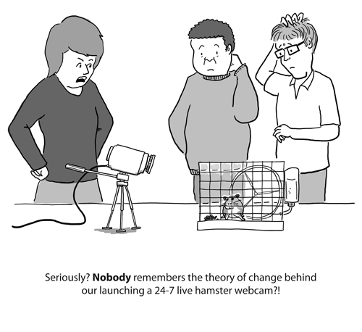
4. Why TOC Analysis?
Some Evaluations
are confusing
because of
poor TOC Analysis
Notes:
“We’ve completed more than 50 meta-evaluations during the last 3 years for UN agencies and we found out that most of the evaluation reports missed comprehensive Theory of Change analysis.” Also, we performed evaluations for UNEP, Oxfam, and the World Wild Fund where we developed tactics how to implement effective Theory of Change analysis in case of poor program design.

Slide 9
Verification and Reconstruction of the project logic:
Strategies?
Results?
Likelihood?

Slide 10
5. Tools for TOC Analysis?
Process Tracing
ROtI Method
Notes:
In this presentation we will speak about how to prepare rigorous, scientific, and credible Theory of Change by using Miradi software.
In addition, we will discuss how to use such scientific tool as Process Tracing to design hypotheses to assess the contribution of the project’s outputs to the outcomes and impacts along with other international and national initiatives.

Slide 11
6. Outputs, Outcomes, Impacts? Result-Based Management
Understanding of Impacts, Outcomes, and Outputs by International Donors is different
Confusing use of Outcomes and Outputs

Slide 12
Result-Based Management
ROtI

Slide 13
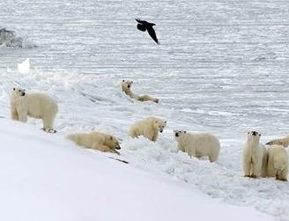
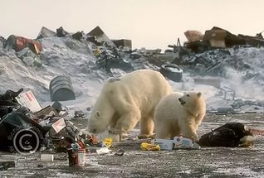
We will use WWF definitions:
Output
Impact
developed
THEORY
OF
CHANGE
Intermediate Outcome
ria.ru
Population
Is
Stable
Approved
&
Implemented
Outcome
Human-Bear
Conflicts
Reduced

Slide 14
7. Why Miradi?
C L A R I T Y
Notes:
Miradi is a user-friendly program that allows nature conservation practitioners to design, manage, monitor, and learn from their projects to more effectively meet their conservation goals, following a process laid out in the Open Standards for the Practice of Conservation. Open standards adapt the Results-Based Management Approach to the conservation field.

Slide 15
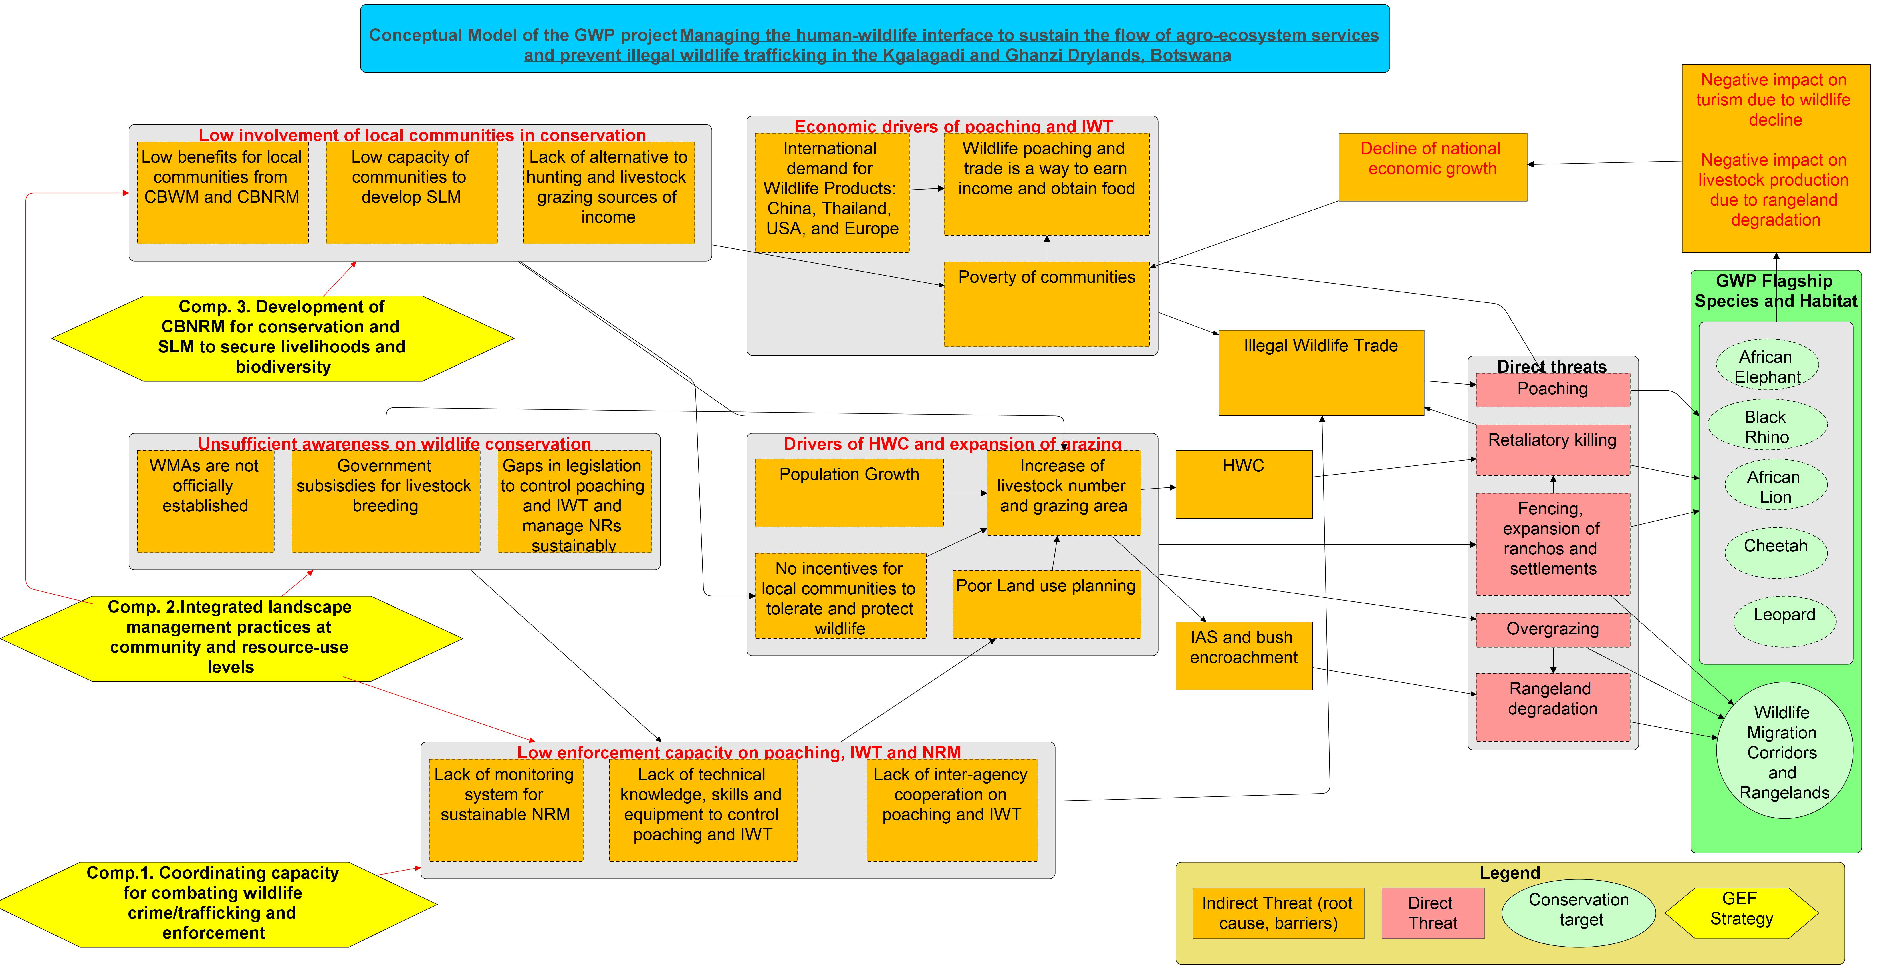
Conceptual Model = Situation Analysis
Notes:
(2 min)
You will learn from this Demonstration why Miradi is appropriate tool to review the project logic through designing:
Project Conceptual Model
Results Chain (Outputs, Outcomes, Impacts, Assumptions/Impact drivers)

Slide 16
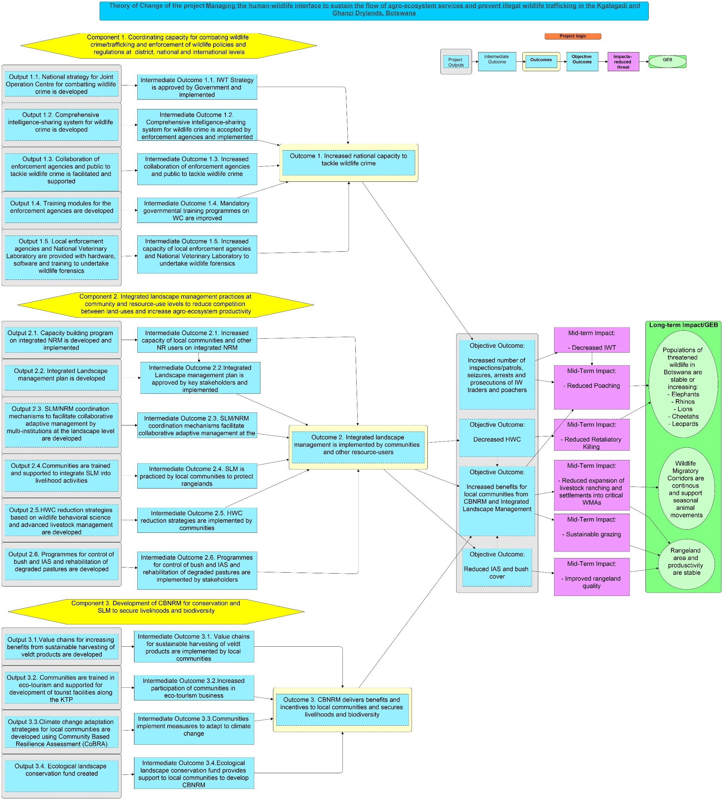
Results Chain = Theory of Change
Notes:
(2 min)
You will learn from this Demonstration why Miradi is appropriate tool to review the project logic through designing:
Project Conceptual Model
Results Chain (Outputs, Outcomes, Impacts, Assumptions/Impact drivers)

Slide 17
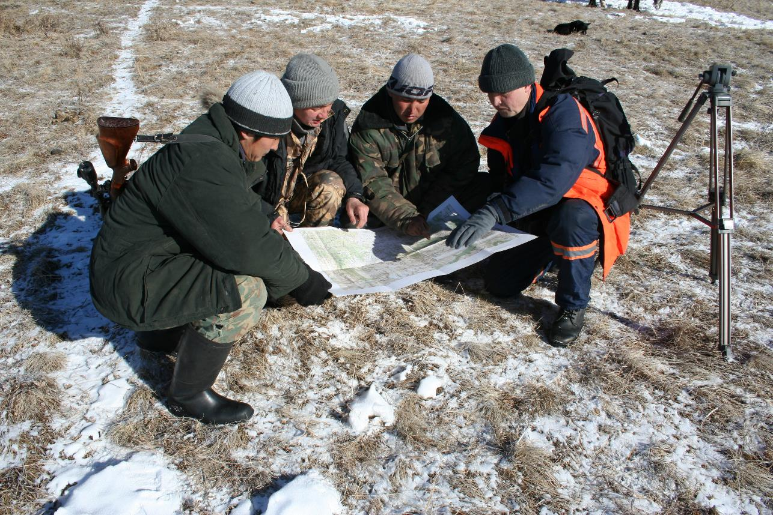
Participatory Approach!
http://www.rbc.ru/
Notes:
From the very beginning in all our planning and evaluation work we involved stakeholders. We called on skype and discussed with key managers and program partners all chains. We checked with them targets, threats and cause-effect links. This is a very interesting exercise for which all our clients gratitude us. They said it cleared up their mind and helped to understand the logic of the program.

Slide 18
Explanation:
1. Re-construction of Conceptual Model
Re-construction of Theory of Change
3. Re-construction of Logical Framework
Notes:
23 min.
In this presentation we will speak about how to prepare rigorous, scientific, and credible Theory of Change by using Miradi software and use it to re-construct the project logic and conduct the evaluation.

Slide 19
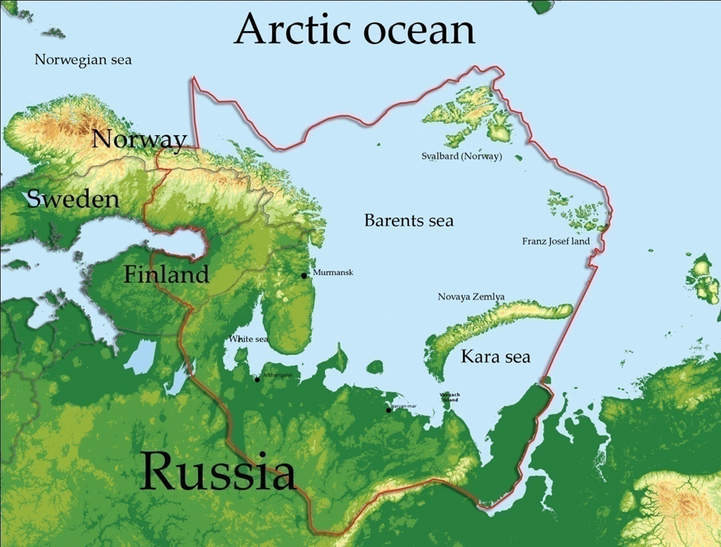
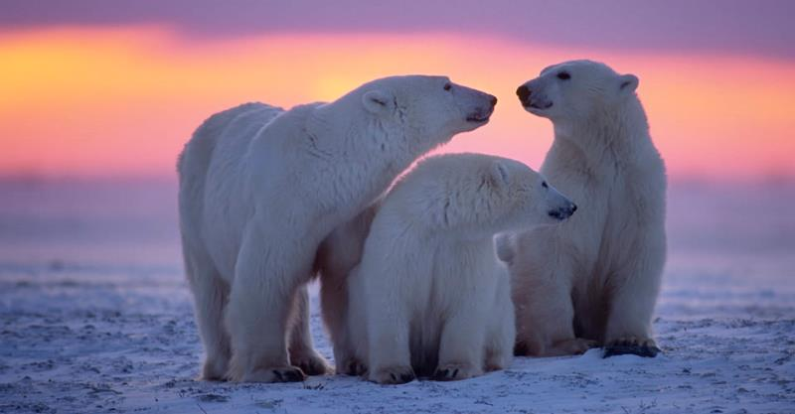
1. Re-construction of Conceptual Model
WWF Barents Sea Ecoregional Strategy
Polar Bear
Notes:
(3 min)
I’m going to tell you the 3 key things we learned about Theory of Change analysis in evaluation of environmental programs:
“This year we were conducting evaluation of the WWF-Russia Barents Sea Ecoregion Programme. The program had 2 strategies: Barents Sea Ecoregion Action Plan with focus on the marine biodiversity and endangered species and Barents Region Boreal Zone Strategy with a focus on conservation of the Intact Forest Landscapes. The problem was too many conservation targets (12) and objectives (14). So, we wondered if we needed to construct 12 Conceptual Models and 14 Results Chains?
First lesson that we learned was that one Ecoregion should has 1 strategy with conservation 3-5 conservation targets and objectives.
Second lesson was that goals for both strategies had confused formulations and were outcome oriented instead of being impact oriented (consider reduced environmental threats and improved status of a conservation targets).
And third lesson was there was no baseline data for the conservation targets and threats as well as monitoring indicators.
So, the main outcome of this Demonstration is that you learn lessons on how to perform a Theory of Change analysis for multiple objectives with poorly formulated and misplaced outputs, outcomes, and impacts.

Slide 20
Impact is not defined!
Original Goal = Intended Impact for Polar Bear: By 2020, threats for Polar Bear reduced by 60% (What is 100% threats level?)
Impact should be a population status, not threat reduction (Outcome)
Notes:
This is the Conceptual Model for THE BARENTS SEA ECOREGION STRATEGIC ACTION PLAN. The Conceptual model has 6 species targets and 4 ecosystems targets.
Conceptual Model is very basic and do not provide necessary details for planning, because________________________ (Please, write it down, Mishel).
Direct and Indirect Threats for selected conservation targets were identified, but their Formulations are too broad that could be relevant for any Program, basic levels for threats and targets (BASELINE DATA) were not assessed, so it was impossible to monitor and assess the Impact which was the condition of the Conservation targets and Environmental Threats.
Let’s discuss another example.

Slide 21
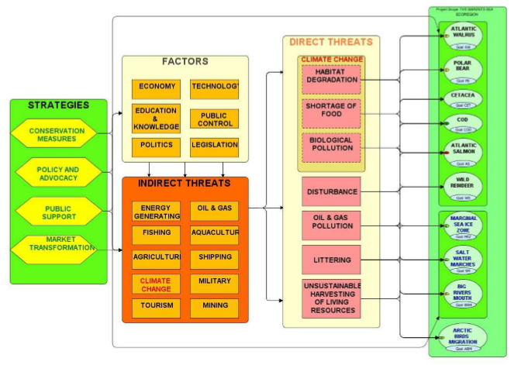
Threats and Strategies are unclear
Threats for Bear?
Strategy for Bear?

Slide 22
Threats are unclear from Threats Ranking
?
?
?
?
Notes:
This is the brainstorming question to interact with the audience. Also, Misha, think about how to address and comment on this question by yourself.

Slide 23
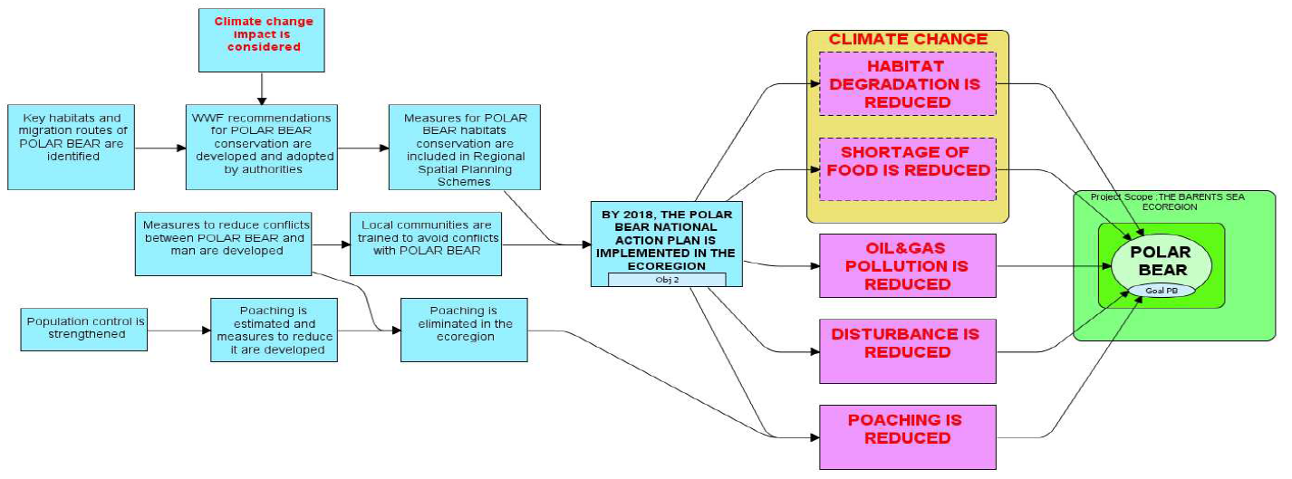
No clear Strategies in the TOC:
Spatial Planning?
Adaptation?
Or Action Plan?
Anti-poaching?
Do we have adequate strategies?
Notes:
Ищу угрозы, есть ли они?
А есть ли стратегии? А стратегий нету.
А логичны ли цепочки, нет.
Вывод – делаем конц. Модель.

Slide 24
Conclusion: Reconstruction of Conceptual Model!
1. Intended Impact
2. Threats
3. Strategies
4. Relevance of strategies to mitigate threats
Unclear
Notes:
we look at the Conceptual Model.
Original Conceptual Model – неполная модель: 1. не определены четко угрозы, которые влияют на медведя. 2. Не понятно, какие стратегии были использованы и на сколько они релевант, чтобы снизить угрозы для медведя.
Мы строим кон. Модель, чтобы
понять, какие угрозы ключевые для медведя. Когда мы строим на оргинальную модель,у грозы неопнятные, что они значат.
А какие непрямые угрозы ведут к угрозам медведя?
А правильно ли выбраны стратегии, чтобы снизить угрозы.
А охватывают ли эти стратегии все ключевые угрозы для меведя?

Slide 25
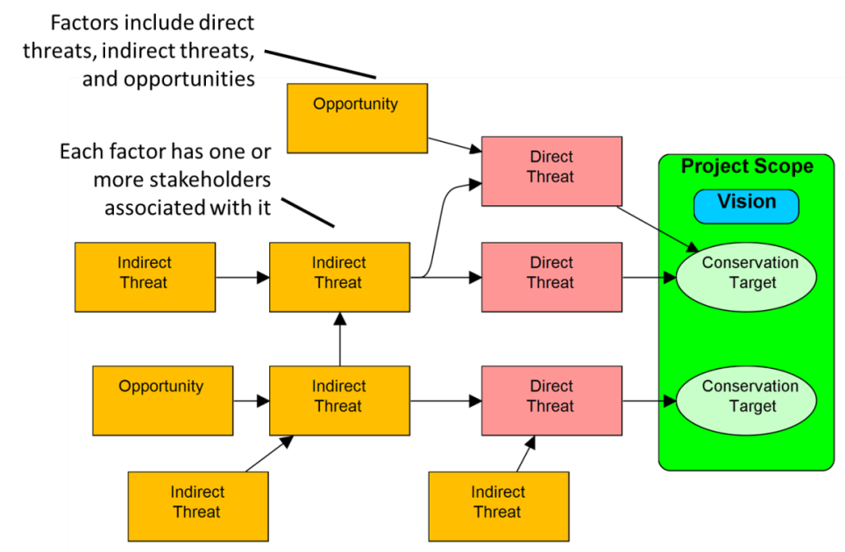
Re-constructing Conceptual model
4 steps
3
step
2
step
4
step
1 step
www.ConservationMeasures.org
Notes:
Miradi includes

Slide 26
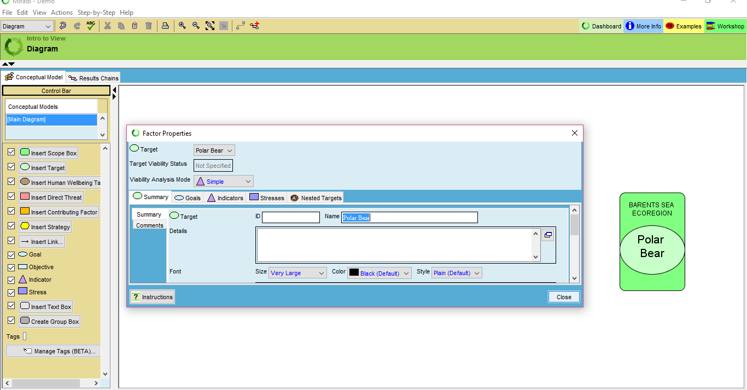
Step 1. Scope and Conservation targets
Baseline population: 5,800 individuals (95%CI: 4,600 – 7,100)
Notes:
Targets - A limited suite of species, communities, and ecological systems that are chosen to represent and encompass the full array of biodiversity found in a project area. They are the basis for setting goals, carrying out conservation actions, and measuring conservation effectiveness. In theory - and hopefully in practice - conservation of the focal targets will ensure the conservation of all native biodiversity within functional landscapes. In Miradi, a target is represented by a large green oval. Conservation targets could be Species, Ecosystems, and Human Wellbeing Targets.

Slide 27
Step 2. Direct Threats
Baseline level of Direct Threats:
Notes:
Direct threat - A proximate agent or factor that directly degrades one or more conservation targets.
In Miradi, a direct threat is represented by a pink rectangle.

Slide 28
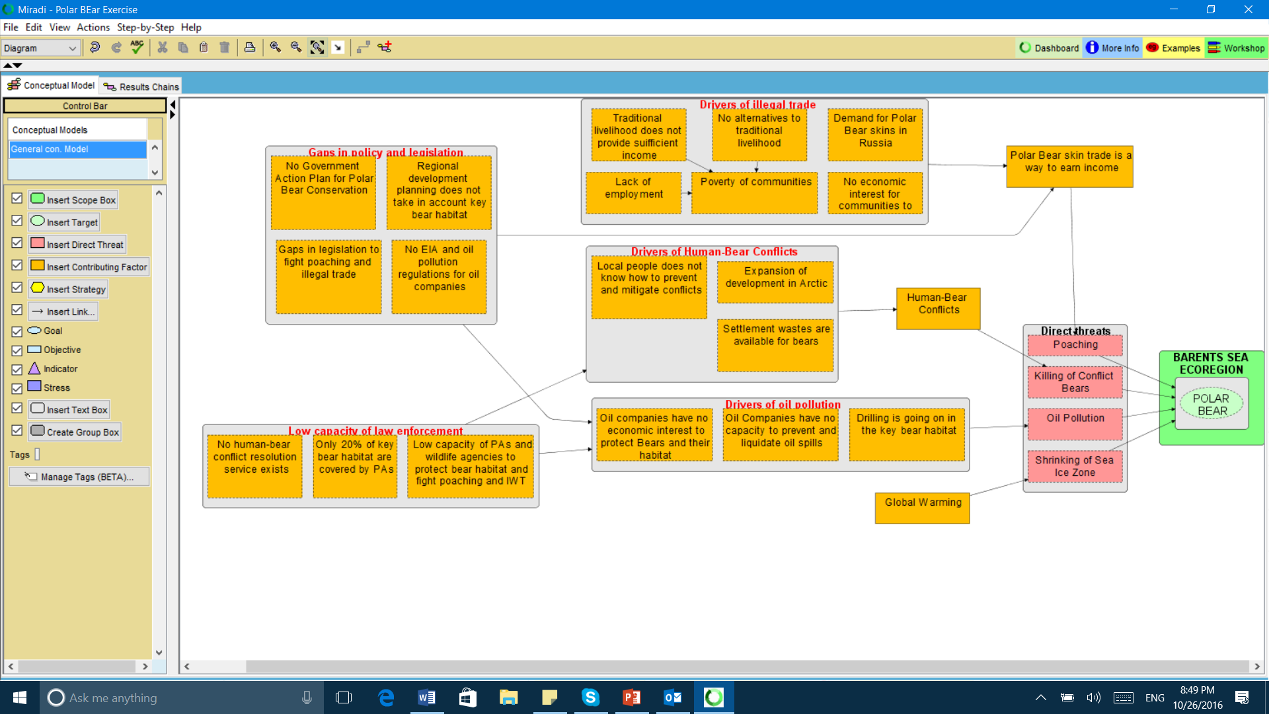
Step 3. Indirect Threats & Opportunities
Notes:
Contributing factor (Indirect threats and Opportunities) - A human-induced action or event that underlies or leads to one or more direct threats. In Miradi, a contributing factor is represented by an orange rectangle.

Slide 29
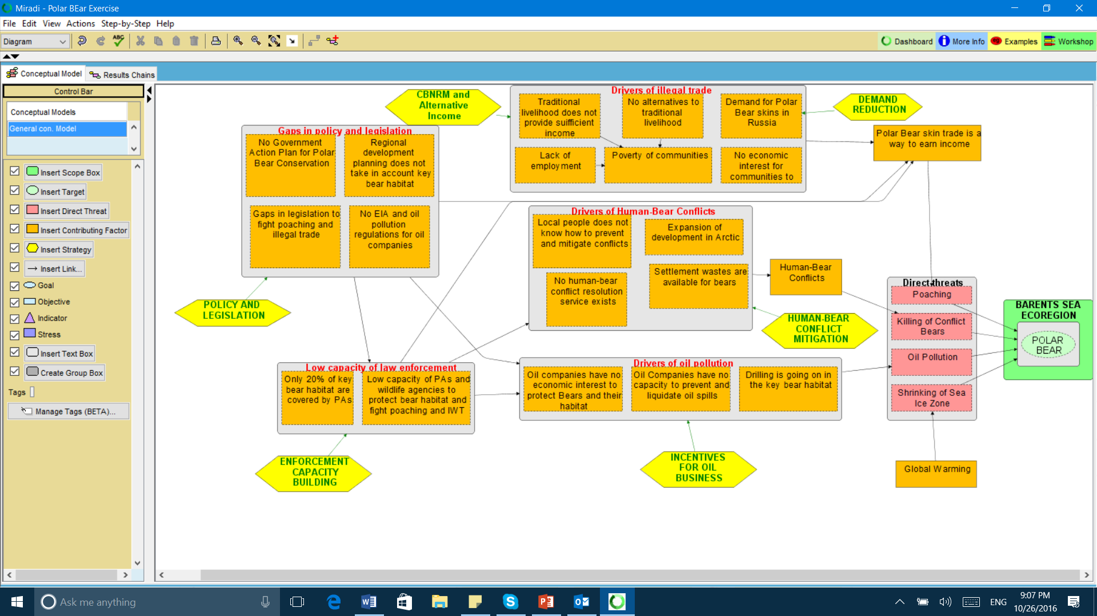
Step 4. Strategies
Notes:
Contributing factor (Indirect threats and Opportunities) - A human-induced action or event that underlies or leads to one or more direct threats. In Miradi, a contributing factor is represented by an orange rectangle.

Slide 30
Sum up! Re-constructed Conceptual Model
Clarified threats
2. Clarified strategies
3. Basis for reviewing TOC
Notes:
We can conclude that Conceptual Model is a useful tool to check if the Program describes the Project Impacts correctly (Conservation targets and level of Environmental Threats). Also, we can assess if the program assumptions about contributing factors are correct or not. I mean casual links between indirect and direct threats and targets.

Slide 31
2. Re-construction of Theory of Change
WWF Barents Sea Ecoregional Strategy
Hypothesis 1
Casual links
Assumptions
Hypothesis 2
Other
Programs’
outputs
Other Programs’
outcomes
Notes:
UN Environment evaluations are structured around a project or programme’s Theory of Change to assess the causal logic of the intervention and determine whether all external factors affecting outcomes, impact, sustainability and up-scaling have been carefully considered.

Slide 32
Original Theory of Change: WWF Barents Sea Ecoregional Strategy
Unclear Logic…
Notes:
This is the Conceptual Model for THE BARENTS SEA ECOREGION STRATEGIC ACTION PLAN. The Conceptual model has 6 species targets and 4 ecosystems targets.
Conceptual Model is very basic and do not provide necessary details for planning, because________________________ (Please, write it down, Mishel).
Direct and Indirect Threats for selected conservation targets were identified, but their Formulations are too broad that could be relevant for any Program, basic levels for threats and targets (BASELINE DATA) were not assessed, so it was impossible to monitor and assess the Impact which was the condition of the Conservation targets and Environmental Threats.
Let’s discuss another example.

Slide 33
Activity
Outcomes
No assumptions
No link
No link
Outcome
Outputs
Unrealistic Outcome
Are Outputs - products & services?
Are Outcomes – linked to Outputs?
Casual links
are checked!
Notes:
1. If the Objective really represent the Outcome with lead to direct threats reduction?

Slide 34
Theory of Change reconstruction
Step 1. Convert Conceptual Model
to the Results Chain
Step 2. Re-constructing the Results Chain
Step 3. Checking alternative hypotheses (Process Tracing)

Slide 35
Step 1. Convert Conceptual Model
to the Results Chain (automatically)
Notes:
We FORMULATE:
Goals for conservation targets (one goal)
Objectives for key Outcomes – decreased Direct or Indirect Threats (maximum 1-3)
Outcomes – fulfilled opportunity or decreased Indirect threat (not under the Program control)
Outputs for the products and services which will lead to the Outcomes happen (Outputs are under the Program control)

Slide 36
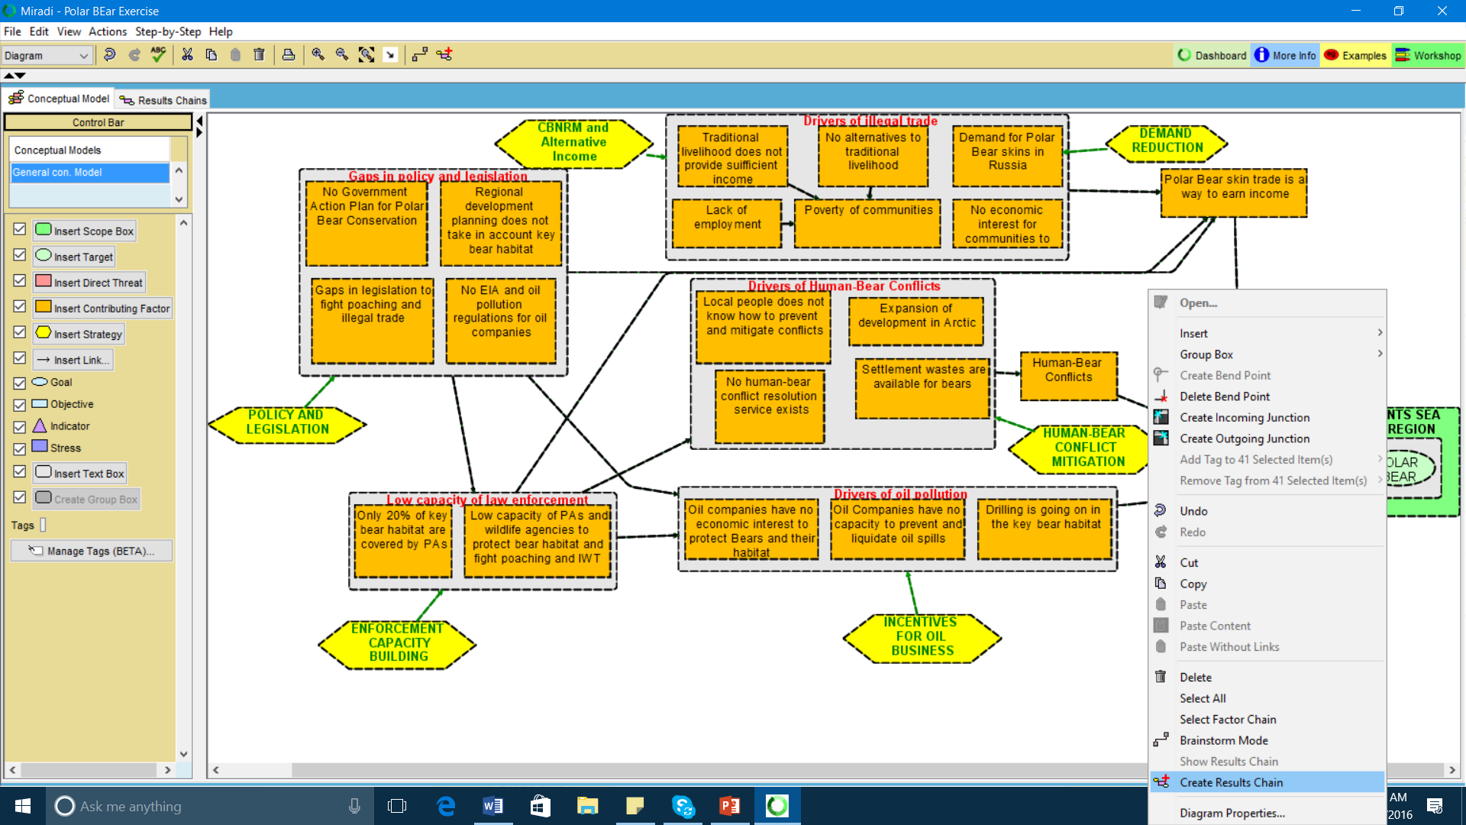
Notes:
1. If these are true direct threats directly degrades a conservation target? If no, change them with the program managers
2.

Slide 37
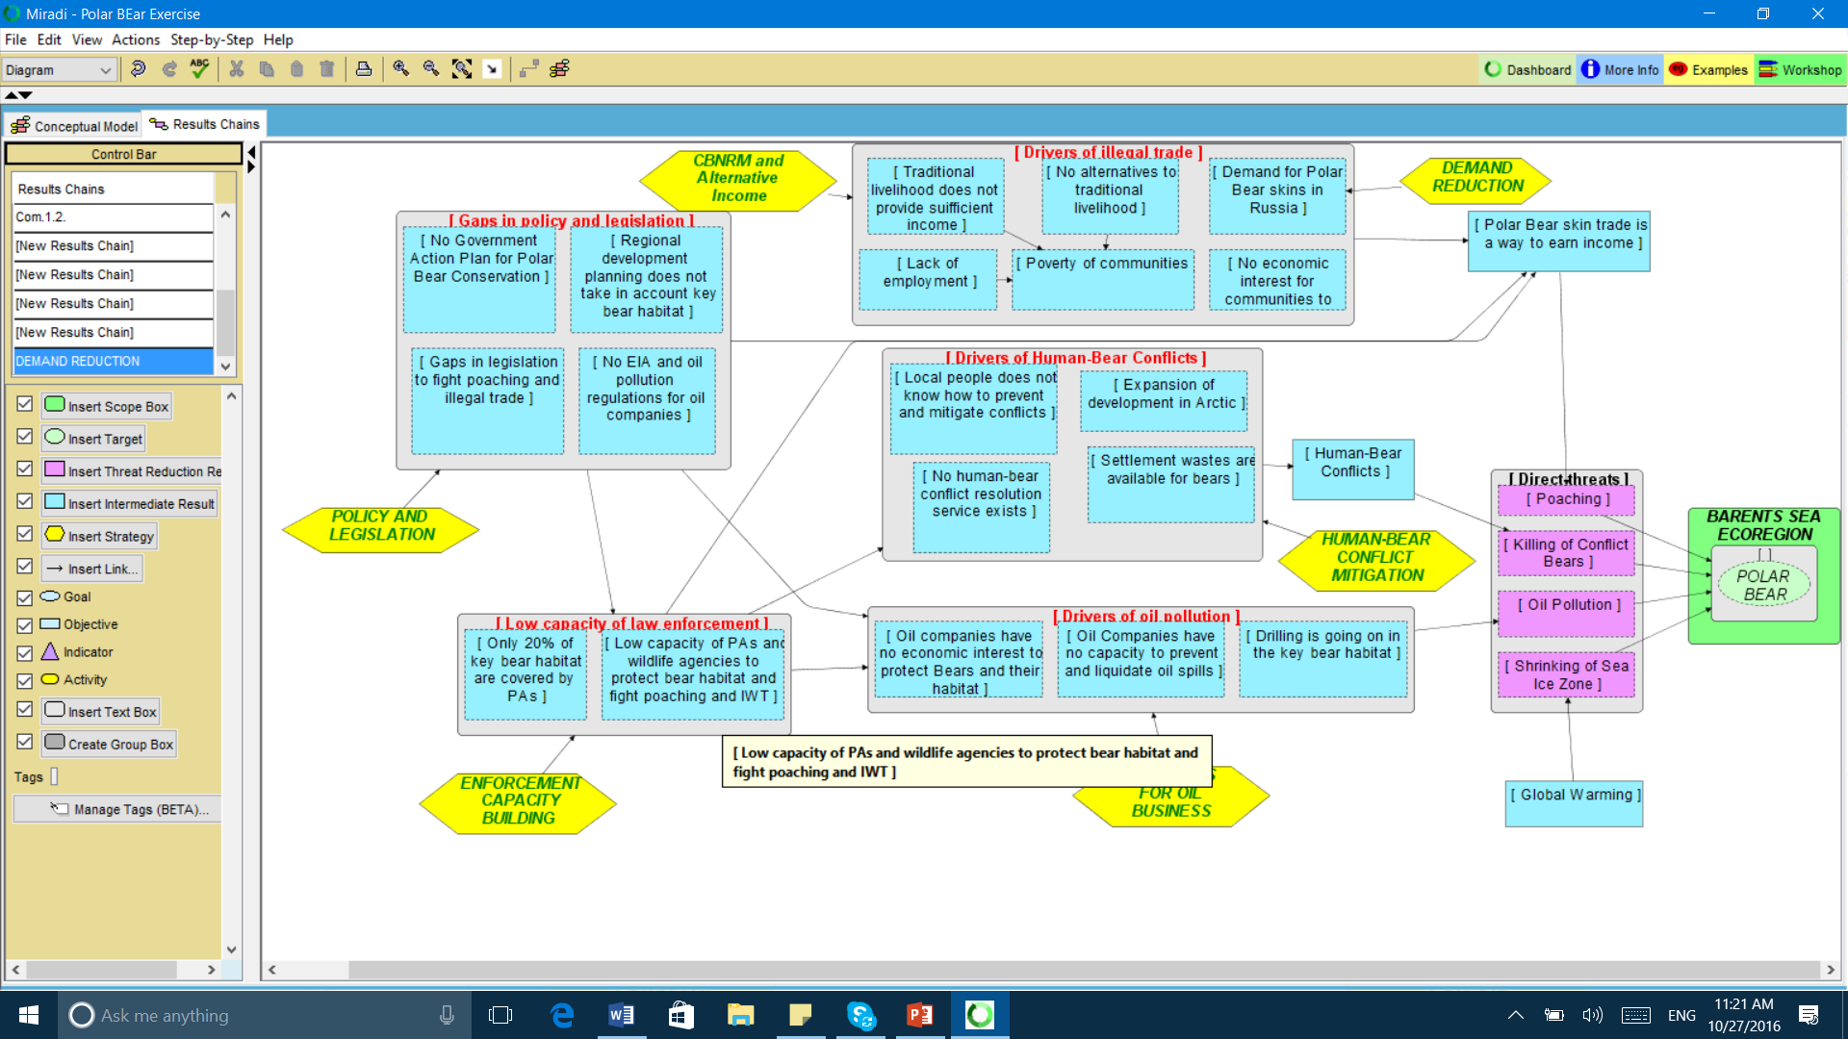
Notes:
1. If these are true direct threats directly degrades a conservation target? If no, change them with the program managers
2.

Slide 38
Step 2. Re-constructing the Results Chain
Intended Impact?
Expected Outcomes?
Realistic level of direct threat reduction?
Probably, we cannot do anything with shrinking Sea Ice…
Notes:
1. If these are true direct threats directly degrades a conservation target? If no, change them with the program managers
2.

Slide 39
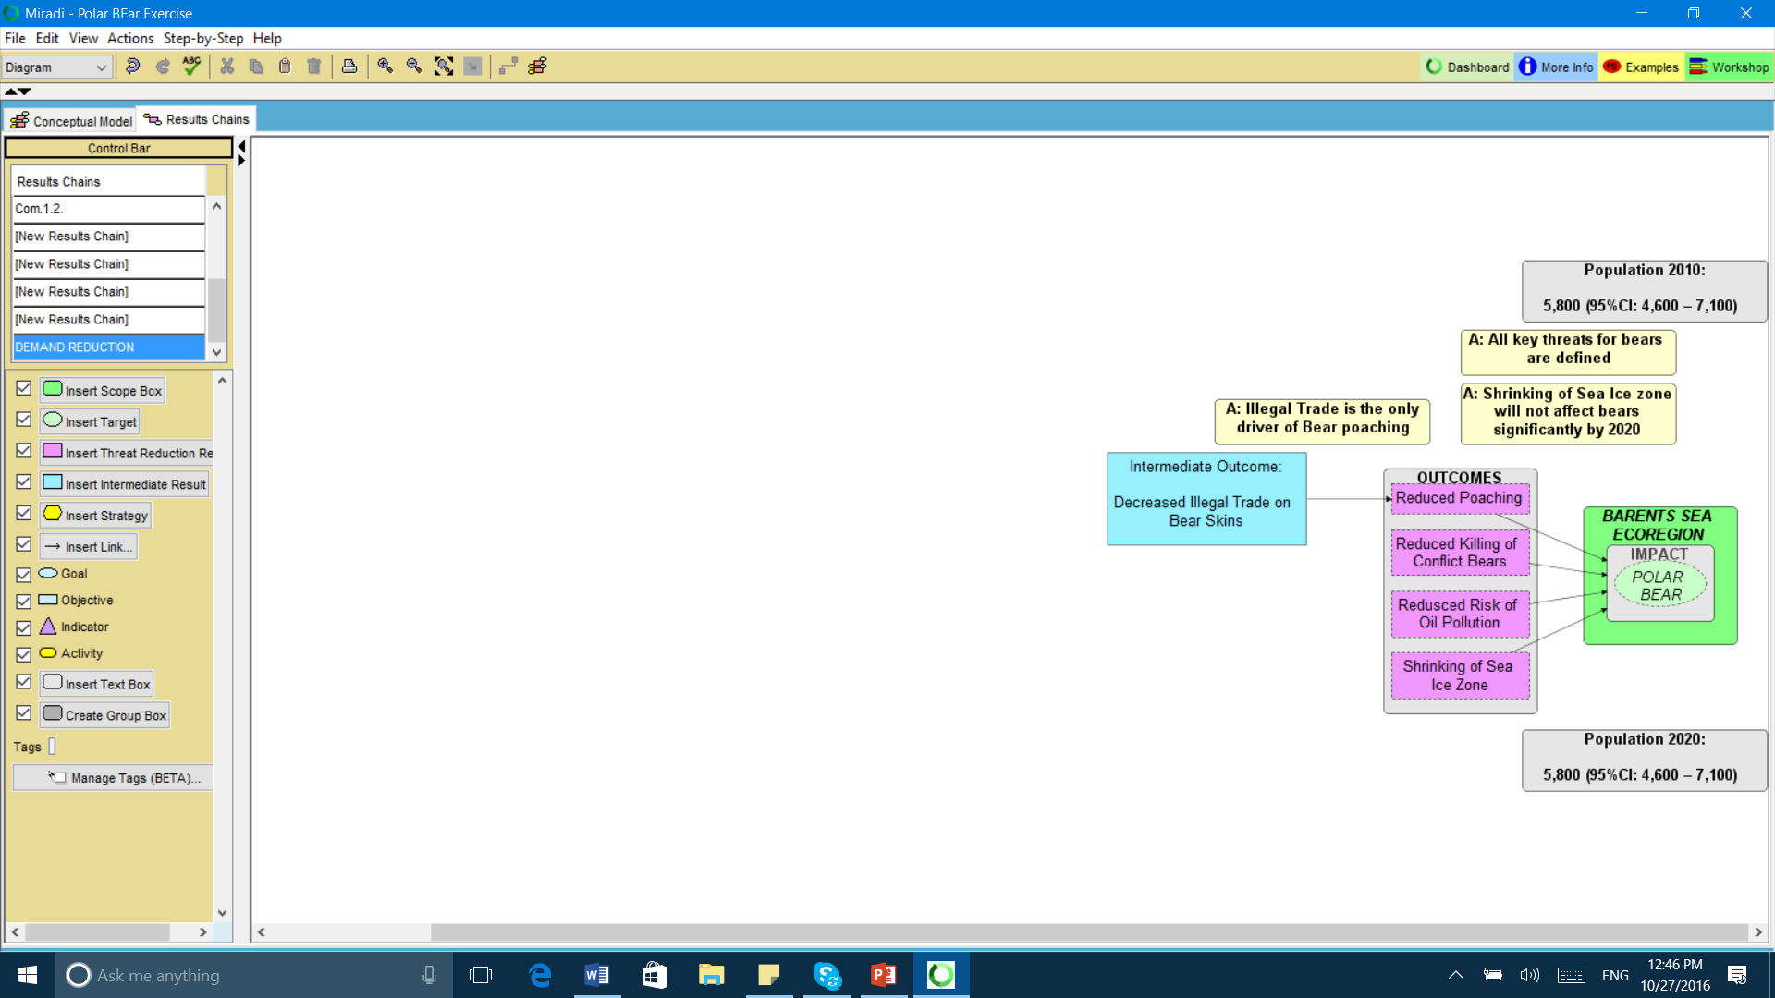
Notes:
1. If the Objective really represent the Outcome with lead to direct threats reduction?

Slide 40
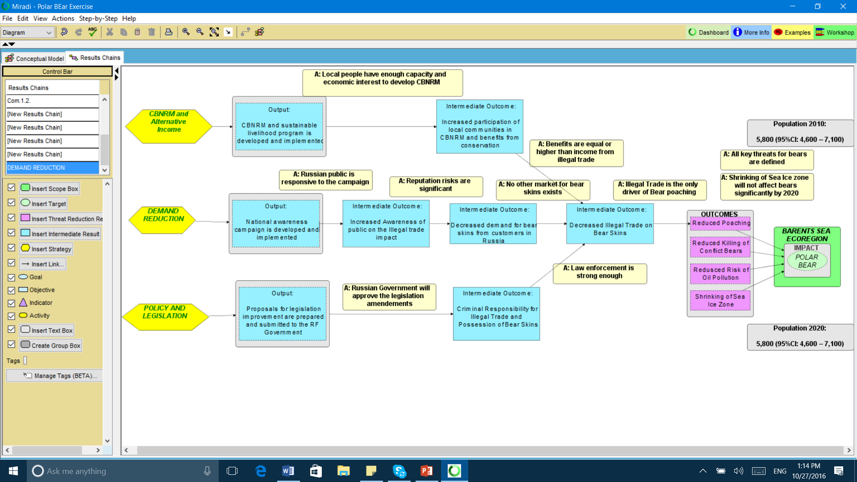
Notes:
1. If the Objective really represent the Outcome with lead to direct threats reduction?

Slide 41
Step 3. Checking alternative hypotheses (Process Tracing)
Actor 1: WWF
Actor 2: UNEP
Actor 3: UNDP
Actor 4: Government

Slide 42
Sum up! Re-constructed Results Chain
1. Clear Outputs, Outcomes, and Impacts
2. Fixed casual links between Outputs - Impacts
3. Clarified Assumptions
4. Clarified contributions of different actors

Slide 43
2. Re-construction of Logical Framework
 | Indicator | Baseline 2010 | Target 2020 | Assumptions
Impact: | Polar Bear population | 5,800 | 5,800 | Assumption 1
Outcome 1: | Reduced Poaching (bears killed annually) | 1,000 | < 100 | Assumption 2
Intermediate Outcome: | Decreased trade (number of ads in the Internet) | 200 | <10 | Assumption 3
Outputs: | Output 1.1. CBNRM and sustainable livelihood program is developed and implemented Output 1.2. National awareness campaign is developed and implemented Output 1.3. Proposals for legislation improvement are prepared and submitted to the RF Government
Activities:
 | Means of verification
Notes:
UN Environment evaluations are structured around a project or programme’s Theory of Change to assess the causal logic of the intervention and determine whether all external factors affecting outcomes, impact, sustainability and up-scaling have been carefully considered.

Slide 44
Another example of Logical Framework
[Program or Project Name} Logical Framework: [years covered]
Outputs | Outcomes | Performance Indicator of Outcome | Baseline | Data Source | Data Collection Strategy
Specific Objective 1:
 | 1.1
 | 1.2
 | 1.3
Assumptions:
Specific Objective 2:
 | 2.1
 | 2.2
 | 2.3
Assumptions:
Notes:
UN Environment evaluations are structured around a project or programme’s Theory of Change to assess the causal logic of the intervention and determine whether all external factors affecting outcomes, impact, sustainability and up-scaling have been carefully considered.

Slide 45
Recommendations for Logframe analysis
Have a reasonable and factual time-horizon
Determine the Impact as something to be seen to solve a problem by that time horizon
Clearly indicate the Outcomes that will need to happen to achieve the Impact
Show the Output of the project that can reasonably be expected to make the Outcomes happen
Then design the evaluation of whether this has happened (or not) and why (or why not)
Notes:
John, could you please prepare these 3 slides for your part of the presentation?

Slide 46
Sum up! Logical framework is reviewed
Impacts, Outcomes, and Outputs, Assumptions are in the clear table
2. Indicators of different levels are identified
3. Means of verification are set
Notes:
We can conclude that Conceptual Model is a useful tool to check if the Program describes the Project Impacts correctly (Conservation targets and level of Environmental Threats). Also, we can assess if the program assumptions about contributing factors are correct or not. I mean casual links between indirect and direct threats and targets.

Slide 47
4. So what?
Benefits for the Evaluation field:
almost every 2d report does not meet RBM standards
TOC analysis may help: 1.Conceptual Model, 2.Results Chains, 3.Logframe review
Notes:
Meta-evaluation shows almost every 2d report does not meet RBM standards

Slide 48
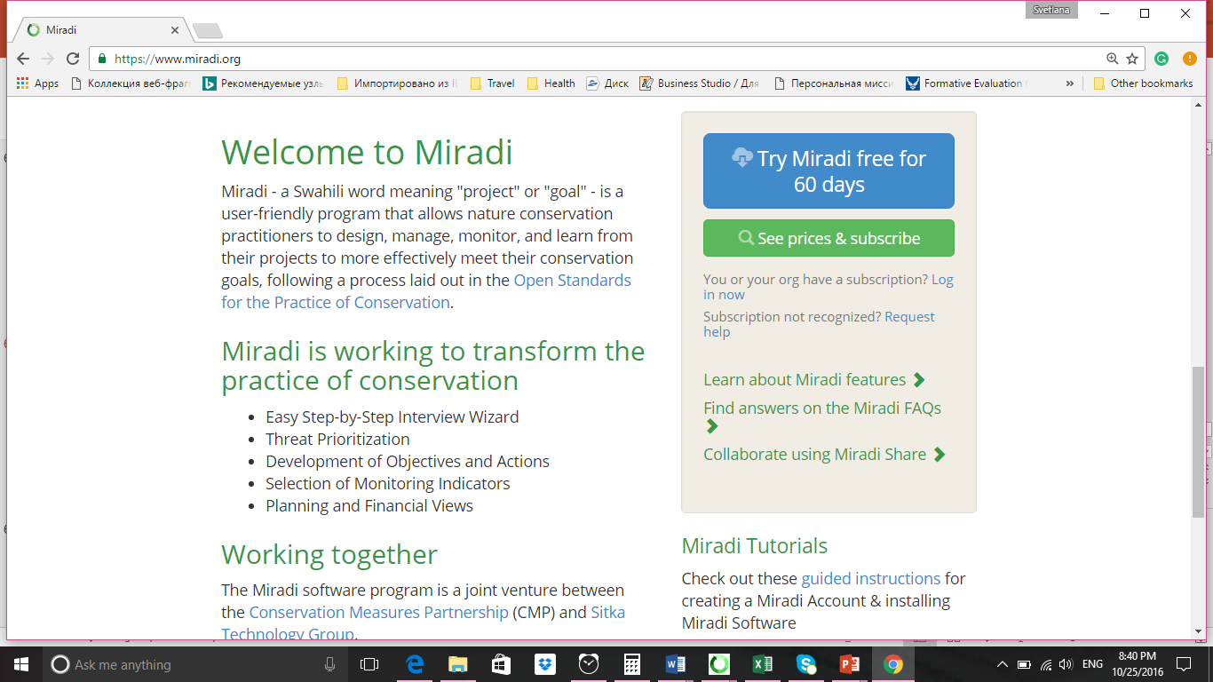
Learn more about Miradi
www.miradi.org

Slide 49
Email: mypaltsy@syr.edu
Phone: (315) 560-5477
(USA)
Notes:
You’ll also probably want to encourage people to connect afterward.
“Contact me in all of these ways Look for our forthcoming journal article in Evaluation and Program Planning…”
The main idea here is that we hope to have poked at our audience’s brain and heart to stir them up a bit about this topic. Let’s give them methods to extend that energy.
Take a moment to jot down the next steps you want your audience to take after they hear from you.

Slide 50
John Mathiason
Email: jrm@intlmgt.com Mobile: (315)-558-1119
Svetlana Kozlova
Email:sveta2404@gmail.com Mobile: +79137688280 (Russia)
Mobile: (315)-4402786 (USA)

Slide 51
Thank you for your attention! Questions?
Notes:
We’ll take a break here to answer some of your questions.

