Slide 1
After School Programs and ISAT Scores
Ximena D. Burgin, Ed.D.
Alexis E. Ball, M.S.Ed.
Brent E. Wholeben, Ph.D.
Office of Research, Evaluation and Policy Studies
Northern Illinois University
American Evaluation Association
Minneapolis, MN
October 24, 2012

Slide 2
Background
After school programs are supposed to impact learning and achievement by providing:
structured,
supervised, and
meaningful activities
Common focus in afterschool programs is:
literacy,
math,
science,
the arts,
homework assistance,
sports activities.
Claim of after school programs: effectively address low reading and math ISATs.

Slide 3
Background
Research indicates that the most successful after school programs provide:
services to students that are relevant and interesting to them,
motivation, engagement, and connection to communities,
tutoring/homework help, differentiated instruction and integrated technology,
engagement across the curriculum, leading to a variety of enhanced skills in and out of school.

Slide 4
Purpose
The objective was to see whether math and reading grades and after school program attendance were predictive of ISAT achievement scores in a meaningful way.

Slide 5
Data Analyses – Descriptive
ISAT (Math and Reading) scores

Slide 6
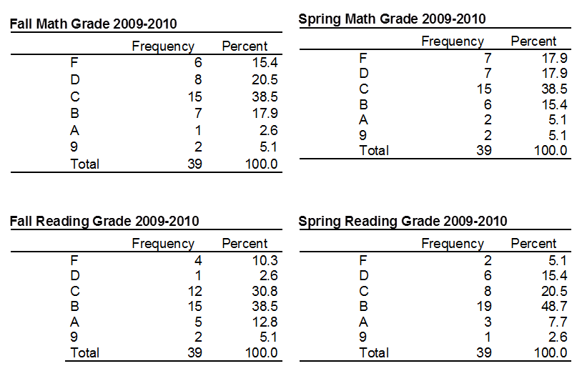
Data Analyses – Descriptive
semester Math and Reading grades

Slide 7
Data Analyses
Mann Whitney U test
Test Statistics^{b}
 | Fall Reading Grade 2009-2010 | Fall Math Grade 2009-2010 | Spring Reading Grade 2009-2010 | Spring Math Grade 2009-2010
Mann-Whitney U | 144.000 | 130.500 | 153.000 | 123.000
Wilcoxon W | 297.000 | 283.500 | 306.000 | 276.000
Z | -1.276 | -1.663 | -1.031 | -1.881
Asymp. Sig. (2-tailed) | .202 | .096 | .302 | .060
Exact Sig. [2*(1-tailed Sig.)] | .232ª | .110ª | .347ª | .072ª
a. Not corrected for ties.
b. Grouping Variable: Gender

Slide 8
Data Analyses
Discriminant Analysis
Press’s Q statistic is a statistical test for the discriminatory power of the classification matrix.
The Q statistic is calculated by the following formula:
Press’s Q = [N – (nK)]2
N(K – 1)
where N = total sample size
n = number of observations correctly classified
K = number of groups
Ha: The model hit ratio is not better that the change. Accepted.

Slide 9
Results
The analysis did not find statistical significance for reading, math, and attendance.
The results of the comparison indicated that the null hypothesis: “Students’ math grades, reading grades, and after school program attendance can predict ISAT student performance levels and the model hit ratio can be used as a measure to determine accuracy of classification” was rejected.
The model hit ratio is not better than chance for math and reading.

Slide 10
Conclusions
There are a number of issues that this data analysis brings to light.
The data analysis indicated that ISAT scores and grades are not strongly correlated and the results are only due to chance.
No improvements in grades from Fall to Spring were seen.
Program attendance is not correlated with any variable except school attendance.
The correlation between program and school attendance is logical since no student is allowed to attend the program unless she/he has attended school for that day.

