Slide 1
The Formative Evaluation Toolkit
Demonstration of a New Resource for Evaluating Program Implementation and Early Outcomes
Heidi Melz, Ph.D.
Elliott Graham, Ph.D.
Anne Fromknecht, M.P.H.
Evaluation 2019
American Evaluation Association
November 15, 2019

Slide 2
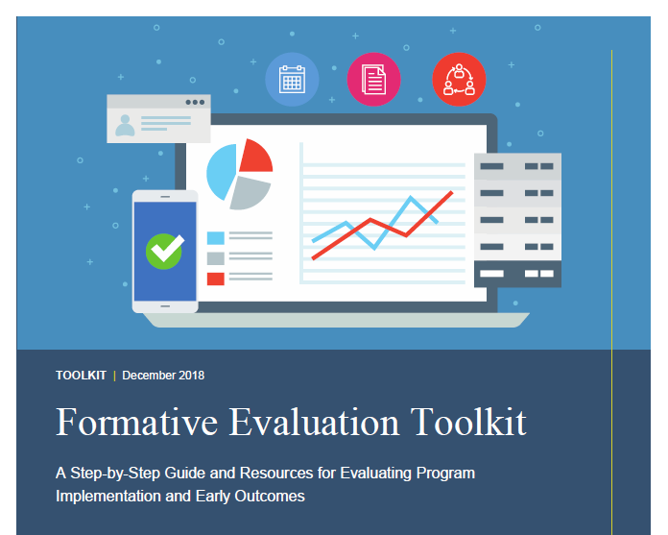
Download at www.jbassoc.com

Slide 3
Lesson 1
Understanding Formative Evaluation

Slide 4
What is Formative Evaluation?

Slide 5
Key Differences Between Formative and Summative Evaluation
Question | Formative evaluation | Summative evaluation
What is it? | An evaluation of whether a program is producing expected outputs and short-term outcomes; it may also provide information about unintended outcomes | A rigorous evaluation of short-, medium-, and long-term outcomes
When is it conducted? | During initial implementation, while a program is still being developed | During full implementation, once a program is fully functioning and no additional changes are expected
Who conducts it? | Program staff or an external evaluator | Usually an external evaluator

Slide 6
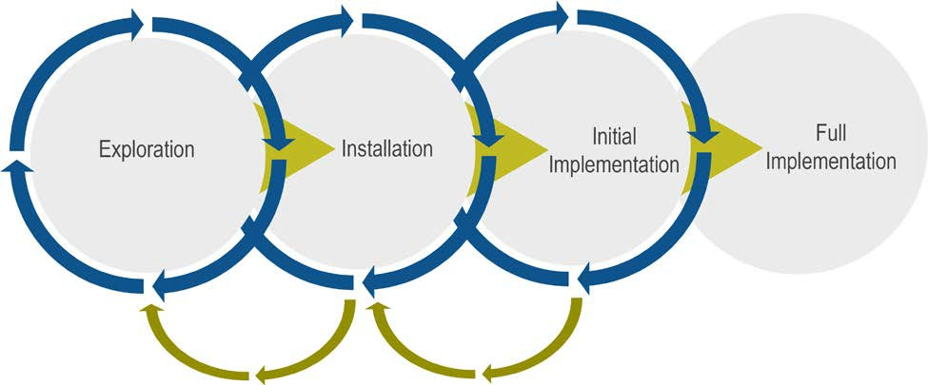
Stages of Program Implementation
Formative Evaluation
Summative Evaluation

Slide 7
Exploration
Determine needs, goals, and readiness
Identify target population
Articulate theory of change and develop logic model
Explore the fit of potential programs
Form an implementation team
Develop implementation plan
May be the most important stage because it sets a
program on its trajectory

Slide 8
Installation
Refine teaming structures
Operationalize the program
Evidence-based programs versus Innovations

Slide 9
Initial Implementation
Begins when clients begin receiving services
Usability testing
Assess program functioning and make quick improvements
Decide if the program is ready for FORMATIVE EVALUATION

Slide 10
Full Implementation
Monitor program once services, structures, and processes are stable
May be ready for a summative evaluation

Slide 11
Lesson 2
Meeting Preconditions of Formative Evaluation

Slide 12
1: Have an implementation team in place
This team oversees the implementation and formative evaluation of the program
2: Set realistic timelines
Steps leading to formative evaluation typically take a long time to complete
Possibly 2+ years

Slide 13
3: Have a clear theory of change
Articulate clear theory about the root cause of the problem
Theory of change uses root cause analysis to identify causal linkages
This is what drives selection of your program
4: Select a program that aligns with your theory of change
Implementation team reviews array of possible programs before selecting
Program may require adaptation

Slide 14
5: Develop a logic model and evaluate it for plausibility and gaps
A logic model:
Visually depicts how the program should operate
Expresses goals from the theory of change in terms of outputs and outcomes
Give clues about what data will need to be collected
Review the logic model to identify gaps in logic, false assumptions, and unrealistic expectations.
Undetected flaws in program logic can cause problems later

Slide 15
6: Operationalize program, install supports
Develop a program manual or practice profile
This may already be available for evidence-based programs
Install key implementation supports, for example:
Leadership and stakeholder engagement
Staff recruitment and retention
Training and coaching

Slide 16
7: Identify needed data elements and install data system
Implementation team needs data across implementation to
Ask/answer key questions related to target population, desired outcomes
Monitor implementation and inform improvements
Test and document outcomes in formative and summative evaluation

Slide 17
8: Conduct usability testing
Usability test during initial implementation
Testing program components under real-world conditions reveals whether they function as intended
Program enrollment process
Client assessment process
Data system operations
Define questions and set targets for success, make improvements between cycles
Continue the cycle of feedback and improvement until you meet your targets

Slide 18
Usability Testing
Area | Questions | Targets
Referral and enrollment | Are referral criteria well operationalized and understood by staff? | Percentage of referred families that met eligibility criteria: 80%
Implementation of core program components | Do staff conduct baseline assessments on time? | Percentage of baseline assessments completed within 14 days: 70%
Data collection | Are protocols for data collection processes feasible? Are data entry and reporting occurring as intended? | Percentage of assessments correctly entered into data system within 7 days: 68%

Slide 19
Lesson 3
Conducting a Formative Evaluation

Slide 20
Conducting a Formative Evaluation
Identify key formative evaluation questions
Select indicators of program functioning
Choose evaluation methods
Collect data
Analyze and report data
Decide what comes next (Are you ready for summative evaluation?)

Slide 21
Step 1. Identify Key Formative Evaluation Questions
Is the program reaching the intended number of participants?
How are inputs contributing to program functioning?
Is the program being delivered as intended?
Are short-term outcomes promising?

Slide 22
Step 5. Analyze and Report Data
Use the key formative evaluation questions in Step 1 to organize analyses and reporting
Compare the data on program indicators to the benchmarks set in Step 2
Summarize whether each indicator exceeded, met, or fell short of the benchmark
Statistical significance is not particularly important in formative evaluation
In reports and presentations, describe what is working and not working regarding implementation and short-term outcomes
Document lessons learned and modifications made to the program

Slide 23
Example: Indicators of Program Functioning
Outputs | Formative Evaluation Questions | Indicators/Benchmarks
# and % of parents participating in home visits | How many in-home visits are scheduled per week per family? | At least 2 in-home visits are scheduled per week per family
 | What percentage of families completed scheduled in-home visits? | 75 percent of scheduled in-home visits are successfully held
Short-Term Outcomes
Parents demonstrate improved parenting skills, including active listening and problem solving | What percent of parents demonstrate improved parenting skills at program completion? | 90 percent of parents demonstrate improved parenting skills at program completion

Slide 24
Short-Term Outcome Tracking Template
Example: Short-Term Outcomes Tracking Template
Short-Term Outcomes | Is it intended to increase or decrease? | Formative Evaluation Questions Has it increased or decreased so far? (is it better or worse?)
Decrease in risk assessment ratings at program completion | Decrease | To what degree have participants’ risk assessment ratings changed between program enrollment and completion?
Parents demonstrate improved parenting skills including active listening and problem solving | Increase | What percent of parents demonstrate improved parenting skills at program completion?

Slide 25
6. Decide What Comes Next –
Are You Ready for Summative Evaluation?
Moving too quickly to summative evaluation may explain in part low program success rates
Summative evaluation is costly both financially and in terms of personnel time and effort

Slide 26
Evaluation Tollgate
The process of deciding whether and when to proceed to summative evaluation is sometimes called an evaluation “tollgate”
The “toll” that must be paid is evidence that:
The program’s logic model is plausible
Core program components are functioning as intended
Participants are interested and responsive
The program is being delivered with increasing fidelity
Short-term outcomes are trending in the right direction
Melz, H., Ingoldsby, E., Killian, C., Fromknecht, A., & Graham, E. (2018). Formative evaluation toolkit: A step-by-step guide and resources for evaluating program implementation and early outcomes. Washington, DC: Children’s Bureau, Administration for Children and Families, U.S. Department of Health and Human Services.

