Slide 1
MANAGE your evaluation
Kerry Bruce - Pact
Notes:
Good afternoon to those of you in North America. I am Kerry Bruce and I am the Director of Results and Measurement for Pact. I am presenting this webinar to you from Madagascar.
I’ve been working with Better Evaluation for over a year now to help get the platform off the ground and I am very pleased to be presenting the last presentation in this webinar series on the important topic of managing evaluations. As a manager of evaluations myself and a coach and mentor for field staff who manage evaluations, this is a topic that is important and also important to do well.

Slide 2
The Rainbow Framework
Notes:
Manage is the last presentation in the coffee break webinar series for Better Evaluation, because it refers to the cross-cutting function that you will need to do throughout the process of an evaluation.
By now you may have listened to the other webinars on each of the pieces of the rainbow framework and if not you can find them on the AEA coffee break webinar site.
Today I am going to talk about Better Evaluation’s resources around managing evaluations (or a series of evaluations), including deciding who will conduct the evaluation and and how to document your evaluation. I will discuss the key tasks for managing an evaluation and provide an example from my own experience.

Slide 3
Why do we need to manage our evaluations?
Notes:
For me, there are three key reasons why managing evaluations (from start to finish!) are important.
Like the person in this photo, there are a lot of tasks in managing an evaluation and seeing it from beginning to end. While it does not need to be treacherous, not managing the process will not lead to a good end.
My observation is that many people stop managing once they’ve written the TOR and selected the consultants for the evaluation. We will use the better evaluation framework to illuminate why there is more to managing an evaluation than simply drafting a TOR and hiring a consultant.
And finally, when we are intentional about managing our evaluations, their quality is improved. At Pact, one of our internal business metrics is on the outcomes of our external evaluations (positive or negative). This has had the effect of shining a spotlight on the management of our evaluations and the Better Evaluation Framework can really help to ensure that we are addressing all of the key tasks.

Slide 4
Nine evaluation tasks in MANAGING
1.Understand and engage with stakeholders
2.Establish decision making processes
3.Decide who will conduct the evaluation
4.Determine and Secure Resources
5.Define ethical and quality evaluation standards
6.Document management processes and agreements
7.Develop Evaluation Plan, Framework or Policy
8.Review Evaluation (do meta-evaluation)
9. Build Evaluation Capacity
Notes:
Better Evaluation breaks the management of an evaluation into 9 key tasks. Beginning from the upper left the manager of an evaluation needs to understand and engage with stakeholders, establish decision making processes, decide on the contributors to the evaluation, determine and secure resources, define the ethical and quality evaluation standards to be employed in the evaluation, document the process and ensure there is a clear evaluation plan or framework within which the evaluation rests. The last two tasks are the hallmark of well managed and quality evaluations are evaluations that evaluate themselves against these tasks and that serve to also build evaluation capacity.

Slide 5
Understand and Engage with Stakeholders
1.
Photo credit: Ilwad M. Ali, activist – Somalia, Oxfam East Africa
Notes:
The first task is around engaging the stakeholders and understanding who needs to be involved in the evaluation? How can they be identified and engaged?

Slide 6
Notes:
Here is an example of how the resources are organized on the site. When you go to the Manage button and click, the nine task will appear. Let’s say you are just starting out on your evaluation (although this is not a linear process) and you want to consider resources on understanind and engaging with stakeholders. You would click on this option…

Slide 7
Notes:
And the site’s resources for this option would appear. You can read a little about this topic in the top section and under Options you’ll see several links to further resources.

Slide 8
Notes:
In the Options section you can choose from the one that is relevant to your evaluation.
For me, last year Pact held a Community of Practice meeting for our monitoring and evaluation officers last year in Namibia. The entire meeting was devoted to conducting an evaluation on one of our programs. As we started to meet to plan the evaluation, we wanted to consider who would need information from this evaluation. Here’s where the Stakeholder mapping and analysis option is very handy. So if we click on that…

Slide 9
Notes:
We see resources that can help us to identify and organize the stakeholders by role and their interests. There are further resources and posted in the right hand frame. So that’s an example of how you can use the site to help with your management needs around evaluation and specifically around understanding and engaging with stakeholders.

Slide 10
2.
Establish Decision Making Processes
Photo credit: Solutions that empower
Notes:
Who will have the authority to make what type of decisions about the evaluation?
Who will provide advice or make recommendations about the evaluation?
What processes will be used for making decisions?

Slide 11
Notes:
Making decisions (whether it be on the method, the consultant, the timing) transparent will aid communication and improve understanding among all stakeholders in an evaluation. Deciding on the type of structure for decision making and who it will involve is as important as clearly understanding how decisions will be made (of course several methods may be used and methods may change depending on changing needs in the evaluation).
The website offers guidance on advisory committees, steering groups and community groups also known as citizen juries. The website also offers guidance on considering your group’s way of operating – will you be consensus decision makers, follow a formal meeting process, use a round robin method and there is even guidance on the 6 hats method of operating.
In the case of our evaluation in Namibia, we followed a weekly meeting process that was somewhere between the formal and informal options. The Community of Practice was split into two groups, one focussed on preparing for the evaluation and collecting the data and second focussed on the analysis and presentation of the data to stakeholders.

Slide 12
3.
Decide who will conduct the Evaluation
Photo credit: Balazs Gardi
Notes:
Who will actually undertake the evaluation?

Slide 13
Community
Expert Review
External Consultant
Learning Alliance
Hybrid
Internal Staff
Peer Review
Notes:
There are lots of choices on who should conduct an evaluation. Different management tasks will arise depending on who will be conducting the evaluation.
The website offers guidance on how to select who should do an evaluation for some of these options.
In the Namibia context we decided that while the focus of our evaluation was internal, that we would use a peer review method, where other monitoring and evaluation officers from Pact projects in other countries would come and conduct the evaluation. The benefit of this was that it allowed the learning to remain internal to Pact, it built skill in our own staff and yet it allowed for some impartiality in the data collection and analysis.

Slide 14
4.
Determine and Secure Resources
Notes:
What resources (time, money, and expertise) will be needed for the evaluation and how can they be obtained? Consider both internal (e.g. staff time) and external (e.g. previous participants’ time).

Slide 15
Many budgeting templates and tools
Suggestions for what to include in your evaluation budget
Handy 6 point list on ways you can consider for reducing your evaluation budget.
Notes:
Obviously an evaluation will not proceed without resources to support it, and as a manager of evaluation I am often asked questions like –”How much do I need to budget for an evaluation” and “Can I evaluate my 5 year $10 million program with $50,000?”
The BetterEvaluation Website has some useful resources to provide guidance on this and also has a handy 6 point list that you can turn to when you need to consider reducing your budget.
In the case of Namibia, we were able to leverage some donor resources for the evaluation and couple these with institutional funds for training and capacity development.

Slide 16
5.
Define Ethical Quality Evaluation Standards
Photo credit: Victoria Wood visits MAG Lao IMG_0672 by MAG
Notes:
What will be considered a high quality and ethical evaluation?
How should ethical issues be addressed?

Slide 17
Notes:
The Website has great resources on cultural competency, including AEA’s guide on cultural competency in evaluation launched in 2011 and their assessment tool and can point you towards the basic ethical guidelines in evaluation and towards well respected evaluation standards. The site could use more resources about the role of Institutional Review Boards in evaluation and ethical guidelines in evaluation and we encourage you to become members and contribute resources to the site to share with evaluators around the world.
In the case of Namibia, we had an internal technical review of the terms of reference and the instruments developed for data collection and abstraction, but we did not have a full IRB review. Whether or not to have an IRB review is a difficult issue for non-profits, especially those working outside the health sector where IRBs can be difficult to find, especially in developing country contexts. We did however consider evaluation standards to ensure that our evaluation would meet minimum standards.

Slide 18
6.
Document Management Processes and Agreements
Photo credit: Human Rights by Hugo
Notes:
How will you document the evaluation’s management processes and agreements made?

Slide 19
Document what is needed in an evaluation:
1. Request For Proposals
2. Terms Of Reference
Document how different organizations will work together:
3. Contractual Agreement
4. Memorandum Of Understanding
Notes:
On this page of the site you will find some of the most heavily downloaded resources on the site, especially the resources around developing a terms of reference. An explicit terms of reference that makes it clear what will be evaluated, the methods, the processes and the expected product will make a manager’s job much easier.
There are also handy resources on the contractual pieces of evaluation which are critical to ensuring that our evaluation delivers what the client is expecting and what the evaluator is planning to deliver.
For our Namibia evaluation we developed a Terms of Reference as a group activity and a skill building activity for participants. Participants learned for example the importance of making the data collected during the evaluation a deliverable from the group performing the evaluation so they could consider future evaluations that might yield results over time.

Slide 20
7.
Develop Evaluation Plan or Framework
Photo credit: Architecture: Realtime Physics for Space Planning on Vimeo by Marc Syp
Notes:
What is the overall plan for the evaluation?
Is there a larger evaluation framework across several related evaluations?

Slide 21
Evaluation plan-set out the proposed details of an evaluation including what, how and when an evaluation will take place.
Gantt chart- a bar chart showing the start and finish dates of various tasks within a project
Notes:
Having an overall plan for your evaluation is critical to ensure that it proceeds in a timely and logical order and that there is transparency in the process. The Better Evaluation website has some useful tools for helping you to plan your tasks.
For the Namibia Community of Practice evaluation, we used a Google Site created by one of our country M&E officers to house and document all of our plans, agreements, drafts and timelines, which proved to be a handy repository for the group because many of them were participating virtually before (and after) the actual event. Additionally, before we even arrived in Windhoek we developed dummy tables for our analysis to make sure that we would capture all of the outcomes that we intended to capture.

Slide 22
8. Evaluate your Evaluation 9. Develop Evaluation Capacity
8+9.
Notes:
And finally tasks 8&9 which are exemplary of good evaluations. Task 8 - How will the evaluation itself be evaluated – including the plan, the process and the report?
And Task 9 – How can the ability of individuals, group and organization to conduct and use evaluations be strengthened?

Slide 23
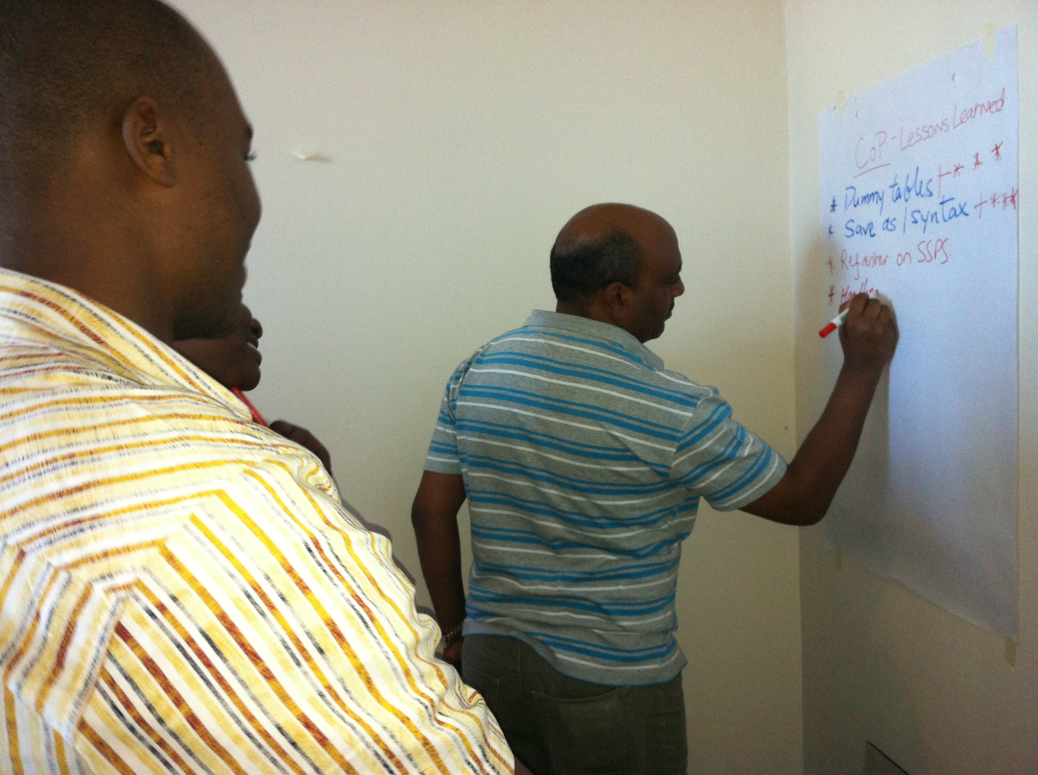
Notes:
On the task of evaluating your evaluation, the site has useful resources on
1. Beneficiary Exchange
2. Expert Review
3. External Review
4. Group Critical Reflection
5. Individual Critical Reflection
6. Peer Review
How can the ability of individuals, groups and organizations to conduct and use evaluations be strengthened?
1.Conferences
2. Learning Circle
3. Mentoring
4. Organizational Policies And Procedures
5. Peer coaching
6. Peer Review
7. Reflective Practice
8. Training and Formal Education
Pact is the process of developing a training module on building capacity of civil society organizations to prepare for and manage evaluation, which we will share with this site when it is ready which will be an additional resource on building capacity in evaluation.
As described above, Pact’s community of practice evaluation activity was an exercise in building evaluation capacity through conducting evaluation. During the on-site portion of the evaluation we also took time with each group to learn lessons and evaluate our evaluation.

Slide 24
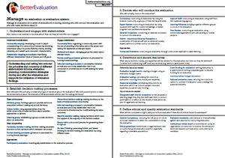
http://betterevaluation.org/plan/manage_evaluation
facebook.com/betterevaluation
@bettereval
Kerry Bruce
Director, Pact
kbruce@pactworld.org
Notes:
In summary – I feel that Management and Managing of Evaluations is a critical function that is cross-cutting to an evaluation. While the methods and the evaluation questions are also important, ensuring you have a solid process behind your evaluation, guided by the nice key tasks outlined on the BetterEvaluation website, will help you to become better prepared and informed managers of evaluations.
We would very much appreciate your experiences and resources around managing evaluations and we hope that you’ll find us through the site, through Facebook or on Twitter and join the discussion.

